Slide 1
Food Preservation Basics
Pressure Canning
Master Food Preservers of Amador/Calaveras Counties
Welcome!
Enjoy the music while you wait, we start at 6:00 p.m.
Notes:
Welcome Guests (promptly at 6:00 p.m.)
Welcome! Quick housekeeping
You have been muted upon entry, please keep yourself muted unless I ask for audience participation. If you have a question at any time during the presentation, please put it in the chat pod and Robin will let me know.
Although, I would love to see all your faces, please keep your video off to ensure we have enough bandwidth to provide a quality presentation. The bathrooms are down the hall. Good luck and don’t get lost.
Food Preservation Basics Pressure Canning
Today you will learn about Food Safety in canning, the tools and equipment needed, and the step-by-steps process on how to can in a pressure canner. Along the way you will learning the safest practices in canning and why canning preserves food.
This is brought to you today by the University of California Agriculture and Natural Resources, through the Master Food Preservers of Amador/Calaveras Counties. The UC Master Food Preserver Program is purpose is to teach research-based home food preservation to the residents of California. We are a volunteer organization within University of California Cooperative Extension, trained and certified by the University of California, guided by a statewide UC Master Food Preserver Program.
We mention various products and brands throughout the class as examples, none of these are endorsements
My name is Vera M. Bullard, and I have been a Master Food Preserver since 2014 and I am your hostess with the most-est for the night.
With me is the extraordinary Robin Cleveland, who will be funneling your questions for us tonight. Also with us is the illustrious Sue Mosbacher who will be demoing pickled garlic for us, and showing a quick video on canning pickles.
Make sure everyone has current handouts (Core Canning Techniques, Copy of the powerpoint, which is copyrighted, and the processes handout) and towards the end of the of our presentation we will be giving you a link to a class evaluation in the chat pod, and it will be included in a follow-up email.

Slide 2
Agenda
Basic Food Safety
How Canning Preserves
USDA Recommended Canning Methods
Basic Ingredients
Equipment & Tools
Basic Information
Processes

Slide 3
Basic Food Safety
Core Canning Techniques, Pages 2-3

Slide 4
Factors that Affect Growth of Microorganisms
Temperature
Temperature
Acidity or Alkalinity (pH)
Moisture
Acidity or Alkalinity (pH)
Moisture
Oxygen
Time
Food
Oxygen
Time
Food
Inhibitors
Inhibitors
Notes:
Read them all then go through them

Slide 5
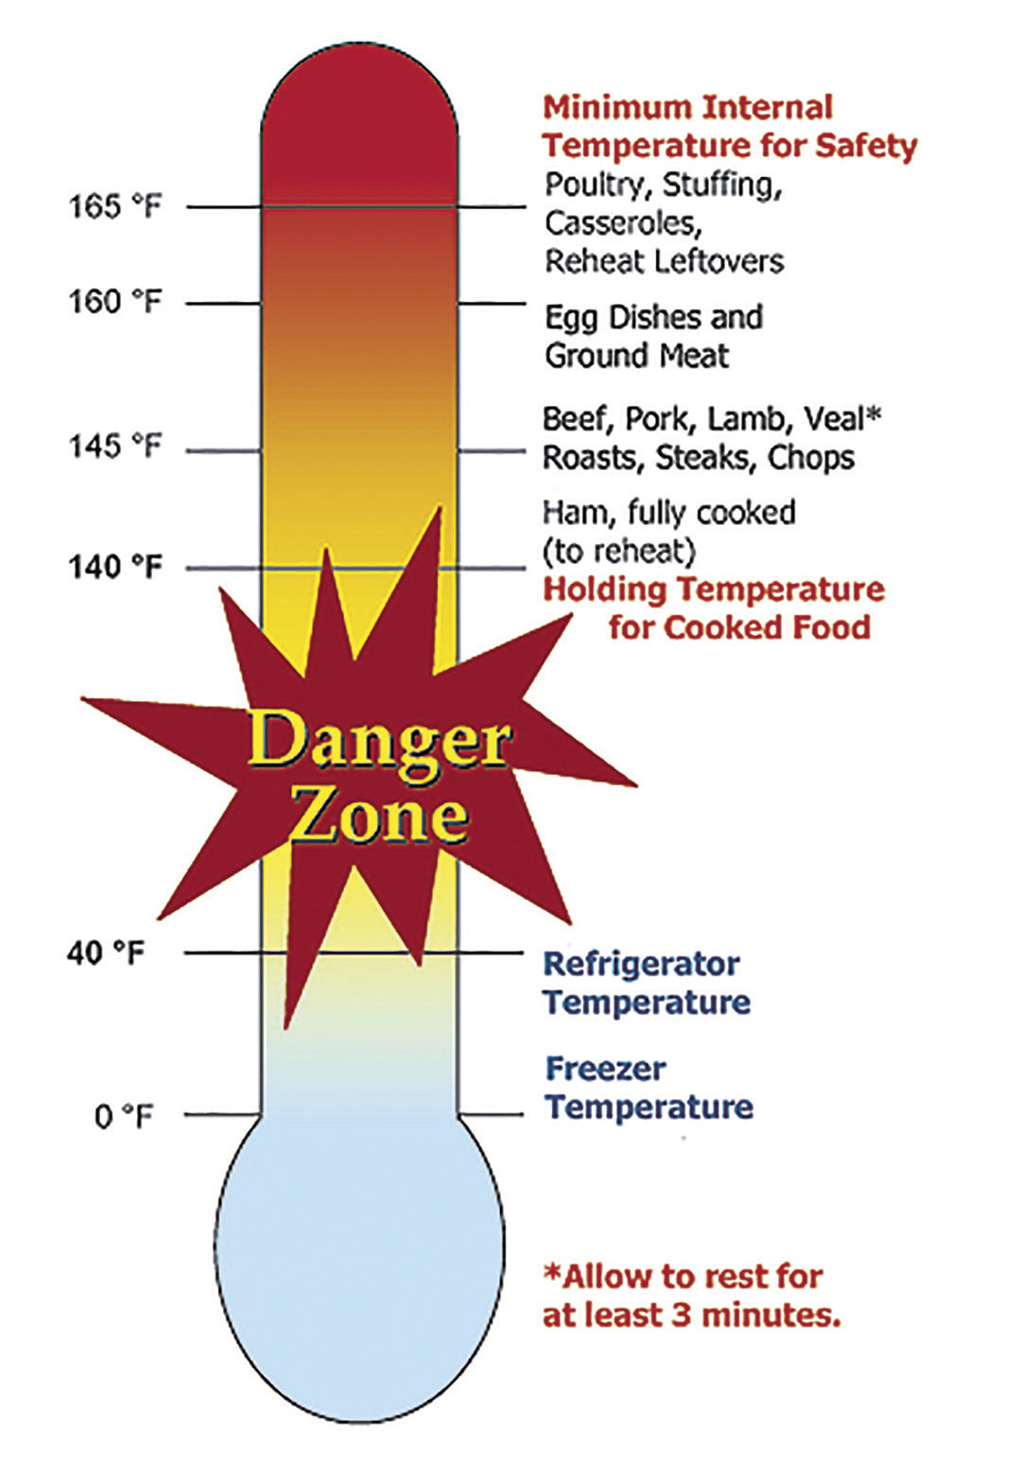

Notes:
Foodborne pathogens grow best under the same conditions that allow people to thrive.
Most foodborne bacteria grow fastest at temperatures from 90° to 110° F.
However, foodborne bacteria will grow in the temperature range known as…… dun dun dun… the Danger Zone, 40° to 140°F; some grow at temperatures below this range.

Slide 6
Factors that Affect Growth of Microorganisms
Temperature
Temperature
Acidity or Alkalinity (pH)
Moisture
Acidity or Alkalinity (pH)
Moisture
Oxygen
Time
Food
Oxygen
Time
Food
Inhibitors
Inhibitors
Notes:
Acidity or alkalinity (pH):
Most organisms grow best under conditions that are not highly acid or alkaline; that is, a neutral pH. (Very few foods are highly alkaline.)
High acid foods generally do not support bacterial growth.
Moisture:
Microorganisms require moisture for growth. Dehydration preserves foods by removing moisture.
Oxygen:
Most microorganisms require oxygen to grow; a few pathogens do not, or may require limited oxygen.
However, controlling oxygen content is not useful for controlling bacterial growth for home food preservers.
Time:
It takes time for microorganisms to grow or multiply in foods.
The time required is affected by temperature, acidity, moisture and oxygen levels.
Under ideal conditions bacteria can double in number every 10 to 20 minutes.
Food:
Bacteria require nutrients to reproduce.
Foods provide proteins and carbohydrates for growth.
Inhibitors:
Some natural compounds/food additives are bacterial inhibitors (sugar, acid).
Now that you know more about what affects growth of Microorganisms, lets look at how we can prevent foodborne illnesses.

Slide 7

Preventing Foodborne Illness

Slide 8

Preventing Foodborne Illness: Clean
Wash Hands Frequently
20-seconds
Bandage/Gloves
Wash Cleaning Items
Use Disposable Towels
Use Disinfectant
Notes:
Personal hygiene
Wash hands frequently with soap
Clean clothing (apron)
Bandage any cuts or burns on hands before handling food
Secure hair
Keep kitchen clean
Wash with soapy water and/or sanitize counters and food preparation areas
Rinse all fresh fruits and vegetables well under running water before preparing or eating

Slide 9

Preventing Foodborne Illness: Separate
Avoid Cross Contamination
Separate Cutting Boards
Rinse Fruits and Vegetables
Clean Plates for Cooked Meat
Avoid Ice Contamination
Raw Meat Storage
Notes:
Avoid cross-contamination
Wash knives and utensils in hot soapy water
Sanitize cutting boards/mats
Use paper towels or clean kitchen towels

Slide 10
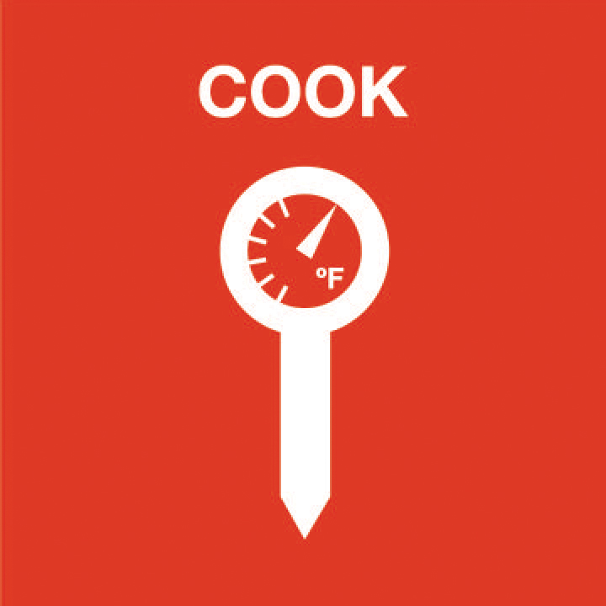
Preventing Foodborne Illness: Cook
Internal Temperature
Use Thermometer
Use Reputable Recipe

Slide 11

Preventing Foodborne Illness: Chill
Refrigerator 40°F or below
Refrigerate Perishable Foods
Thaw in Refrigerator/Microwave
or under running COLD water
Refrigerator After 2-Hours
Divide Leftovers
Temperature Affect Spoilage

Slide 12
Food Safety Golden Rule
When In Doubt - Throw It Out!
Never taste food that looks or smells strange.
Just discard it.
Foods containing bacteria will look, smell, and taste normal.
Most bacteria that cause foodborne illness are
odorless, colorless and tasteless.
Notes:
Please refer to the resources on page 3 of Core Canning Techniques for more information.

Slide 13
How Canning Preserves
Core Canning Techniques, Page 4

Slide 14
How Canning Preserves: Vacuum Seal
Vacuum Seal:
Air is driven from the jar during heating. As the jar cools, a vacuum seal is formed.
Holds the lid on the jar.
Prevents recontamination of the food.
Prevents air from drying out the food.
A vacuum seal doesn't guarantee safe food.
Core Canning Techniques, page 4

Slide 15
How Canning Preserves: Heat
Heat:
Heat destroys most heat-resistant microorganisms capable of growing in food stored at room temperature.

Slide 16
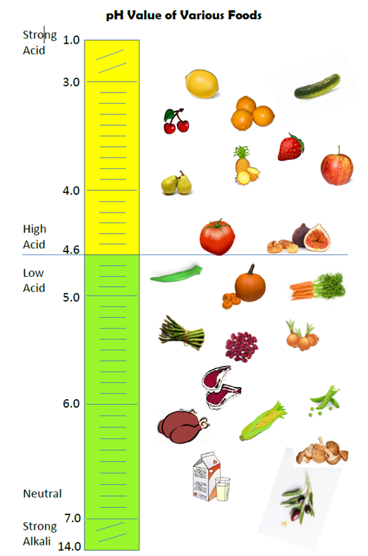
How Canning Preserves: Acid
Food is divided into two main categories:
High Acid Foods
(contain acid)
Low Acid Foods
(contain little or no acid)
pH: The measure of acidity/alkalinity

Slide 18

How Canning Preserves: High Acid Foods (pH <4.6)
Generally all fruits
Tomatoes and figs are borderline
  specific amounts of citric acid or lemon juice must be added to acidy for canning.
Sauerkraut
Foods with large amount of added acid (pickles)

Slide 19
How Canning Preserves: Low Acid Foods: pH >4.6
Generally all vegetables
Meats (including poultry)
Seafood
Fish
Soup
Mixtures of acid and low acid foods (spaghetti sauce – meat, vegetables, tomatoes)

Slide 20
USDA Recommended
Home Canning Methods
Core Canning Techniques, Pages 4-5

Slide 21
USDA Recommended Home Canning Methods
High Acid Canning:
Boiling Water Canning
Atmospheric Steam Canning
212˚F at sea level
Used for: fruits, pickles, fermented products, and jams and jellies.
Low Acid Canning:
Pressure Canning
240˚F at sea level
Used for: meats, vegetables, and mixtures of high and low acid foods.

Slide 22
USDA Recommended Home Canning Methods: Why?
Clostridium Botulinum!!!
C. Botulinum forms protective spores that are heat-resistant.
C. Botulinum Spores:
  Won’t germinate in acid environments.
  Are destroyed at 240˚F or above at sea level.
    Boiling water & steam canners reach no higher than 212F˚.
    Pressure canners reaches 240˚F and higher.
Notes:
Baa-chuh-lai-nuhm

Slide 23

What CAN Happen!
When low acid foods are not pressure canned conditions become favorable for C. Botulinum Spores.
40˚F-140˚F
High moisture
No/very little air
Low acid environment
C. Botulinum Spores germinate and form toxin producing cells.
Botulism

Slide 24
What CAN Happen: Botulism
Food can contain toxin without showing signs.
Symptoms usually appear within 12-72 hours:
  Digestive upset (in some cases)
  Blurred, double vision
  Difficulty swallowing, speaking, and breathing
  Death
USE and FOLLOW the PROPER PROCEDURE!!!

Slide 25







UC Master Food Perservers
How Does it

Slide 26

Are you
ready?!

Slide 27


Round 1
Meats

Slide 28
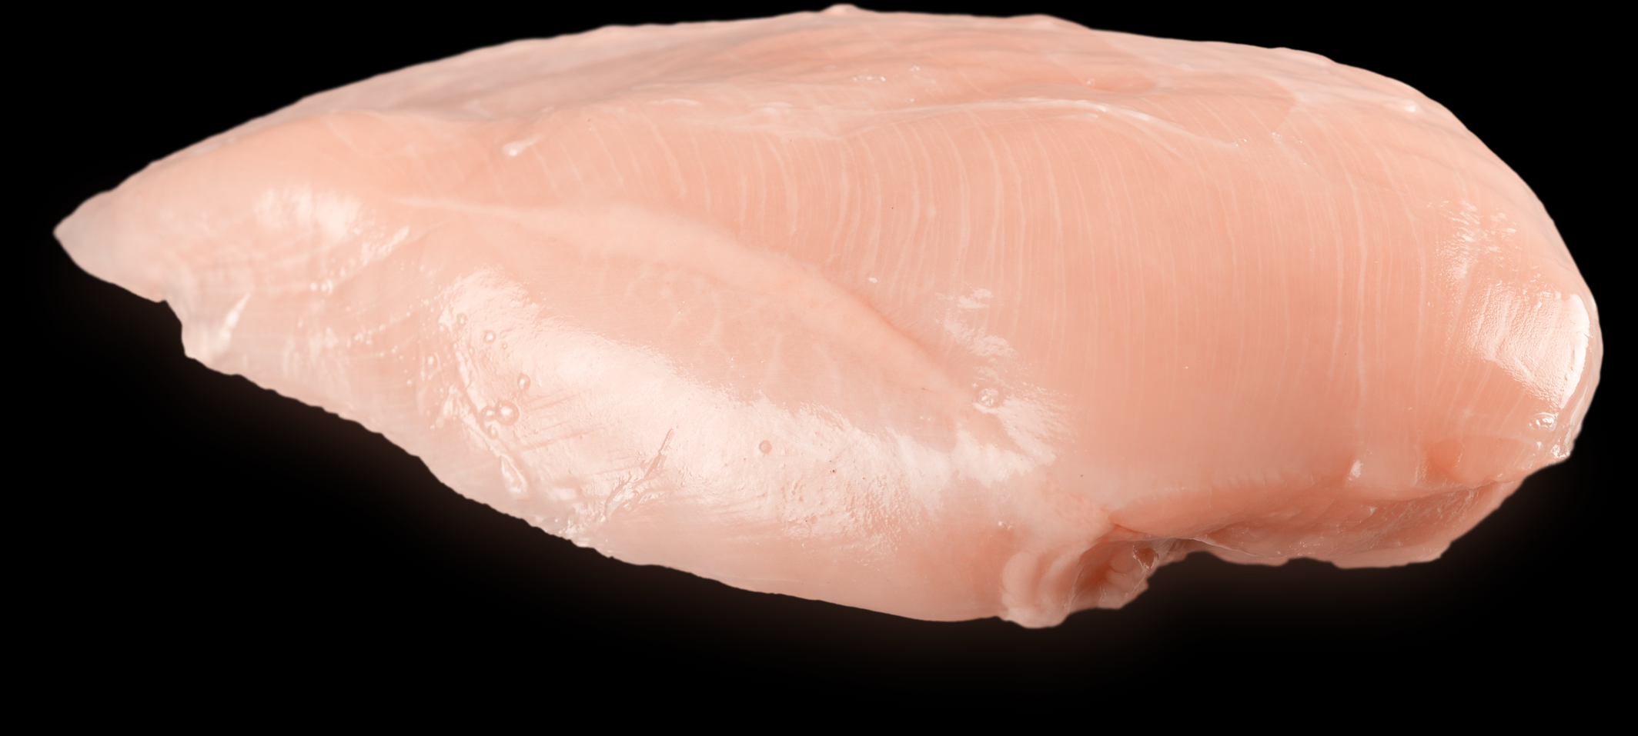
Notes:
Pressure Canner
Poultry
Chicken or Rabbit
Chicken or Turkey Stock

Slide 29
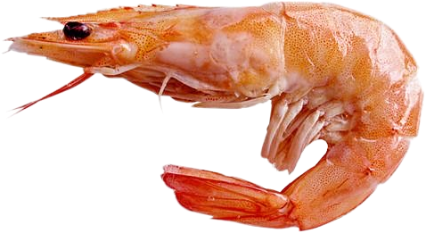
Notes:
Pressure Canner
Seafoods
Clams
Crab Meat, King and Dungeness
Fish (pint jars, USDA)
Fish (quart jars, University of Alaska Cooperative Extension Service)
Fish, Smoked
Oysters
Tuna

Slide 30
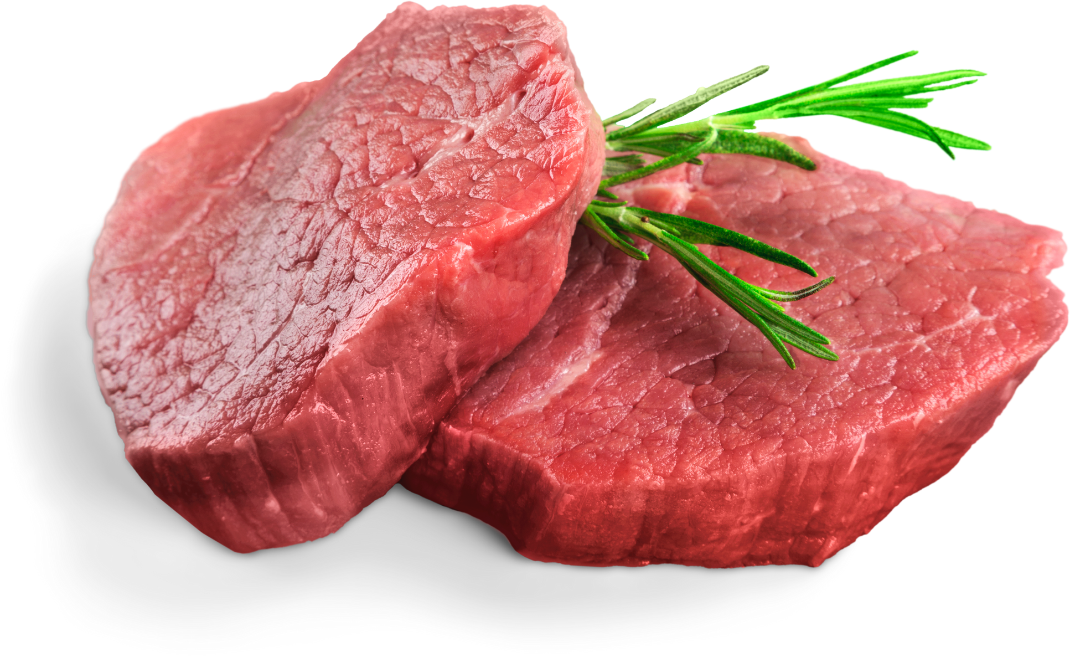
Notes:
Pressure Canner
Meat Products
Chili Con Carne
Meat, Ground or Chopped
Meat, Strips, Cubes or Chunks
Meat Stock
Meat and Vegetable Soup
Mincemeat Pie Filling

Slide 31


Round 2
Fruits and Veggies

Slide 32

Notes:
Boiling water/atmospheric steam canner

Slide 33
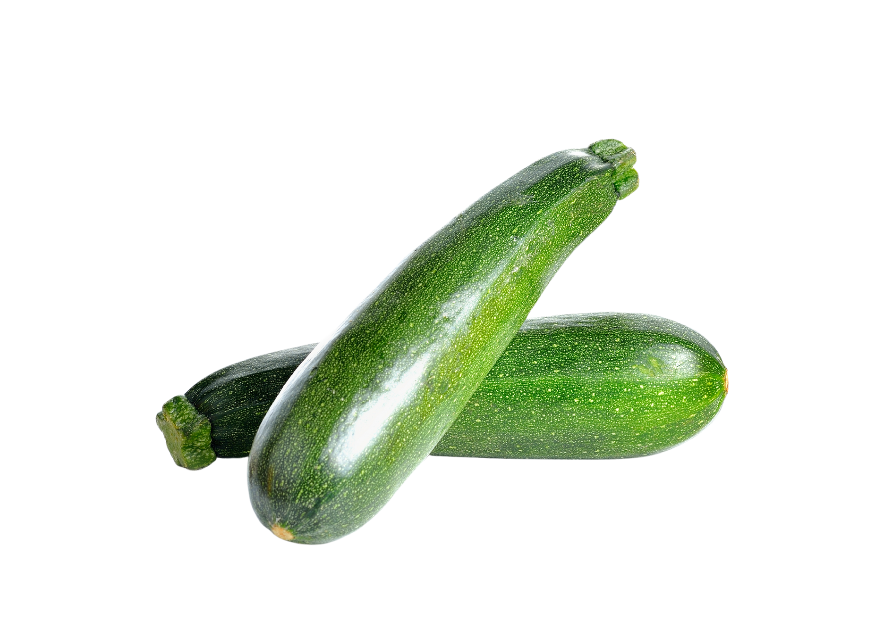
Notes:
Pressure Canner
UNLESS: Pickled, then Boiling water/atmospheric steam canner

Slide 34
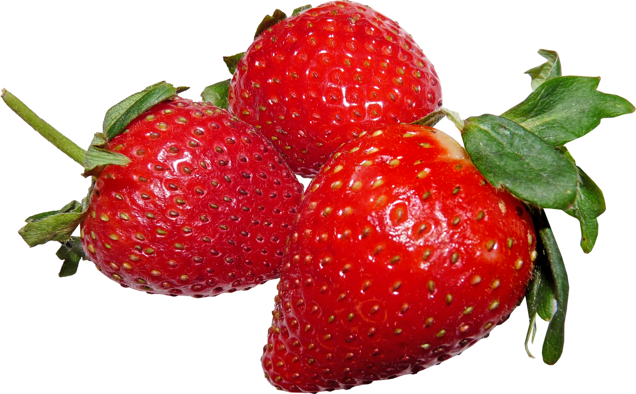

Slide 35
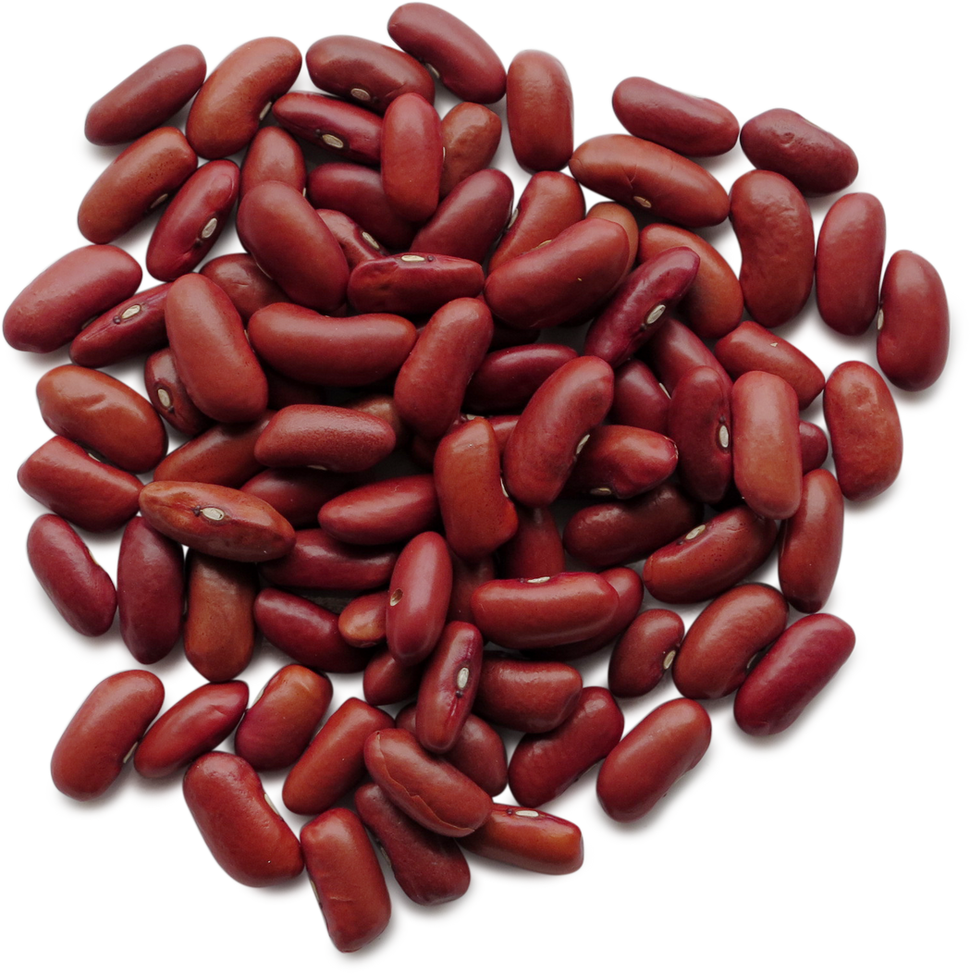
Notes:
Pressure Canner
UNLESS: Pickled, then Boiling water/atmospheric steam canner

Slide 36
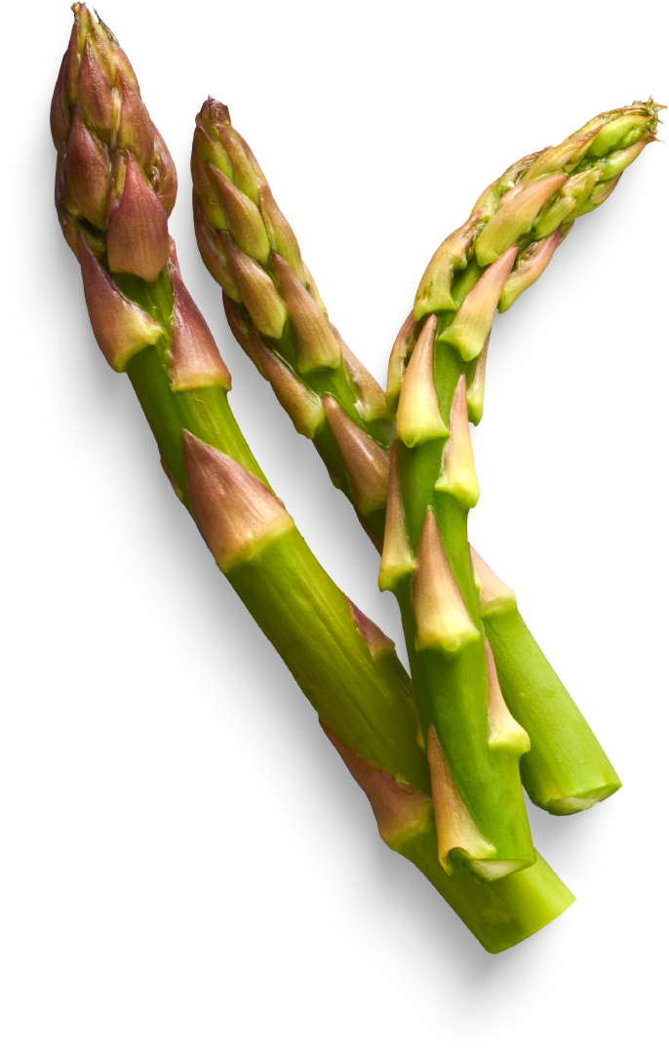
Notes:
Pressure Canner
UNLESS: Pickled, then Boiling water/atmospheric steam canner

Slide 37


Slide 38
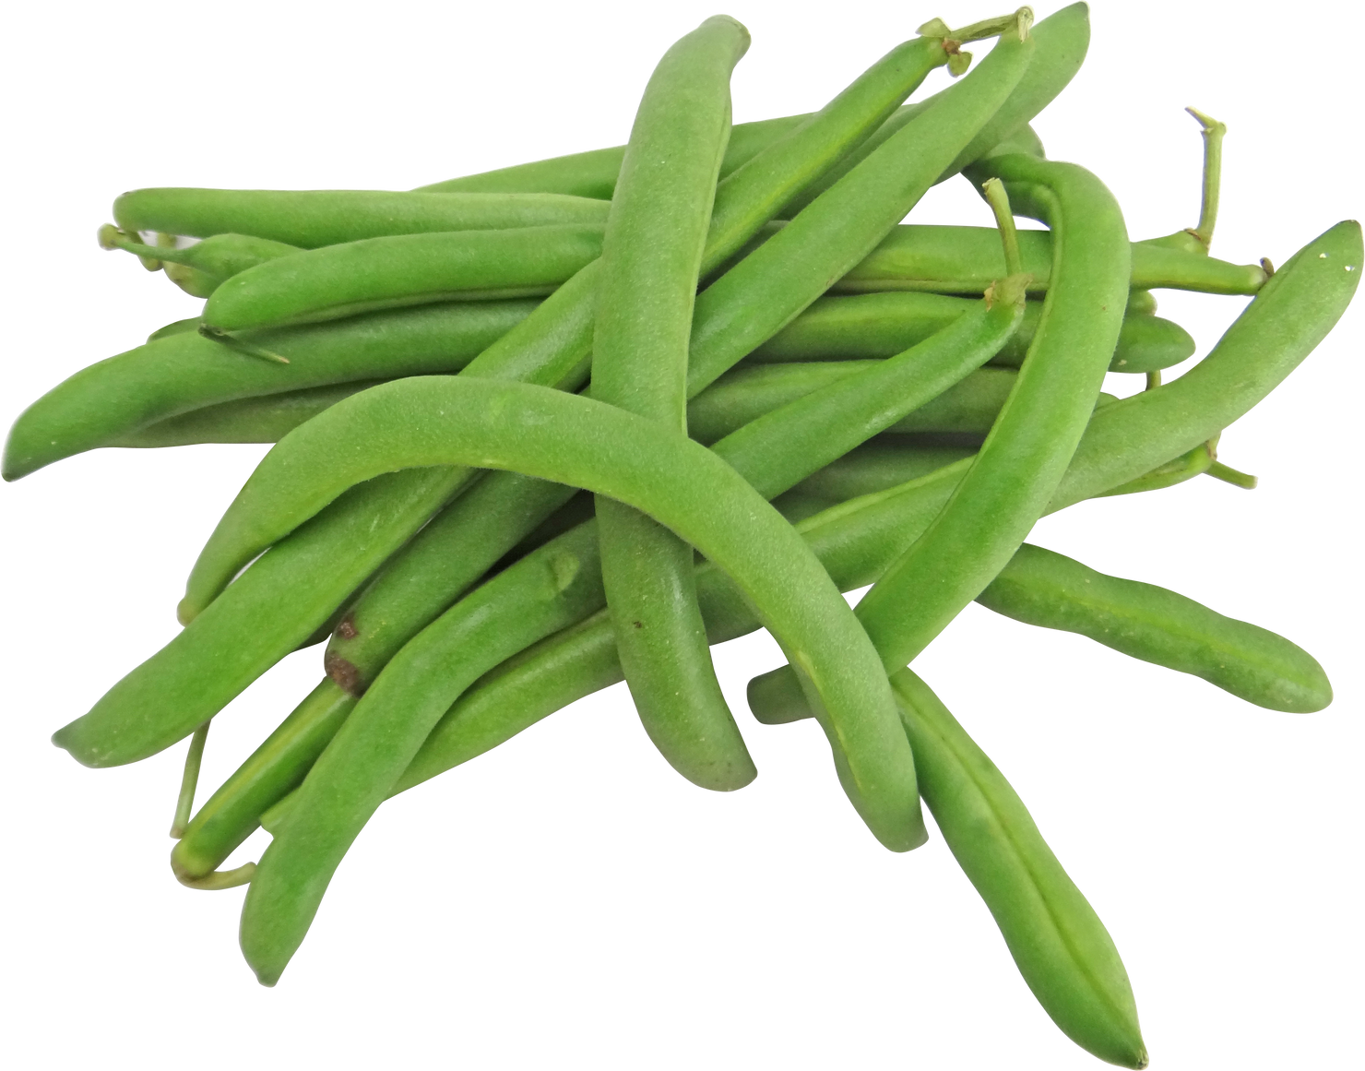
Notes:
Pressure Canner
UNLESS: Pickled, then Boiling water/atmospheric steam canner

Slide 39
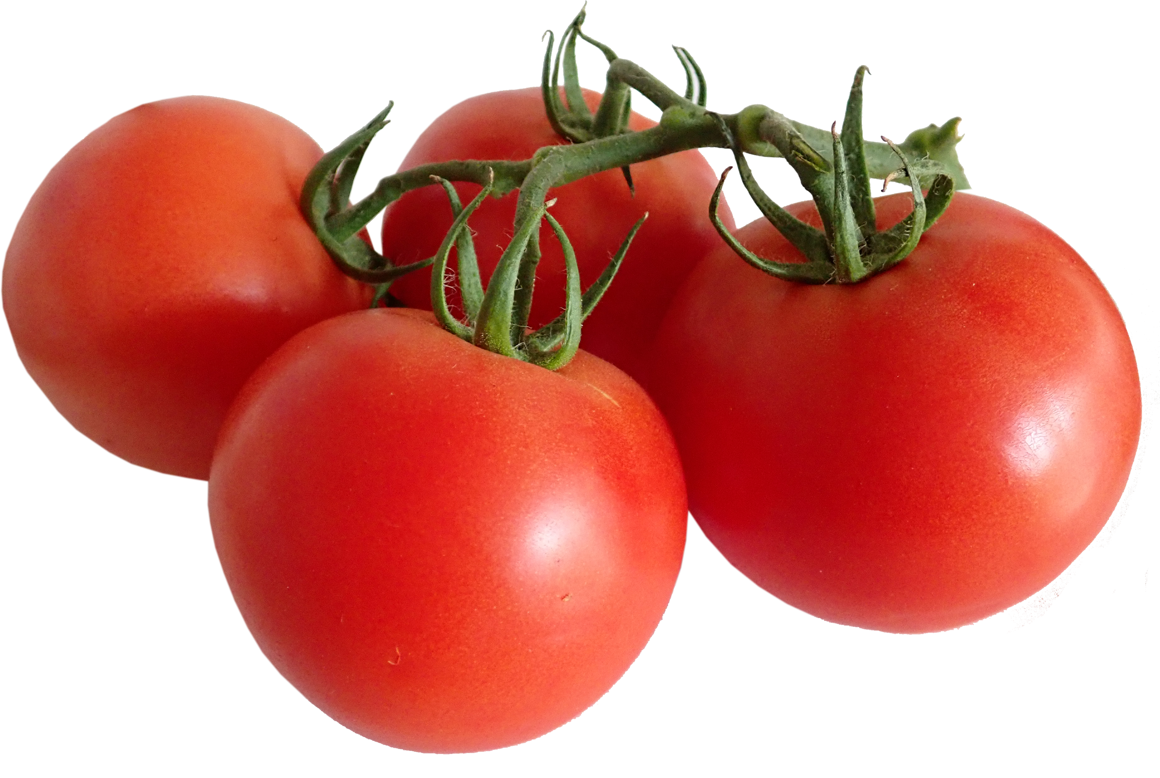
Notes:
Pressure Canner or ACIDIFIED, then Boiling water/atmospheric steam canner
Tomato Juice
Tomato and Vegetable Juice Blend
Crushed Tomatoes (with no added liquid)
Standard Tomato Sauce
Whole or Halved Tomatoes (packed in water)
Whole or Halved Tomatoes (packed in tomato juice)
Whole or Halved Tomatoes (packed raw without added liquid)
Tomatoes with Okra or Zucchini
Spaghetti Sauce without Meat
Spaghetti Sauce with Meat
Tomato Ketchup
Tomato Paste
Country Western Ketchup
Blender Ketchup
Easy Hot Sauce
Barbecue Sauce

Slide 40
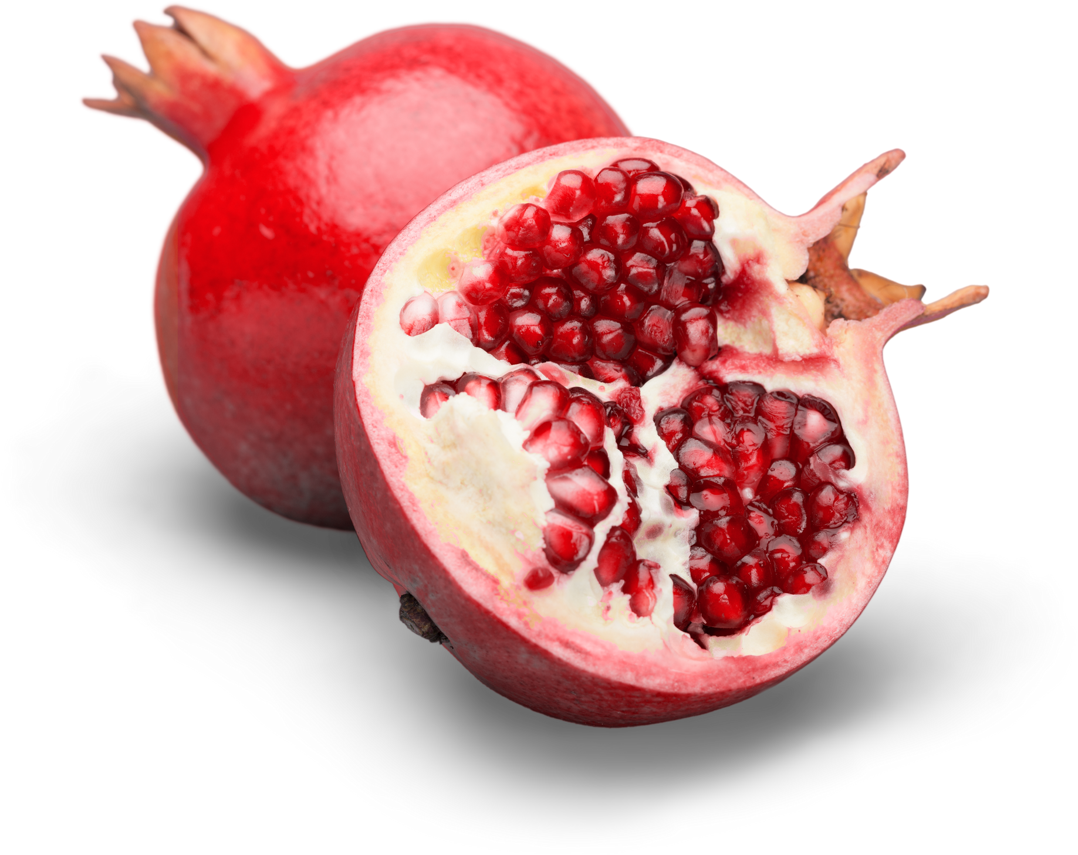
Notes:
Boiling water/atmospheric steam canner

Slide 41
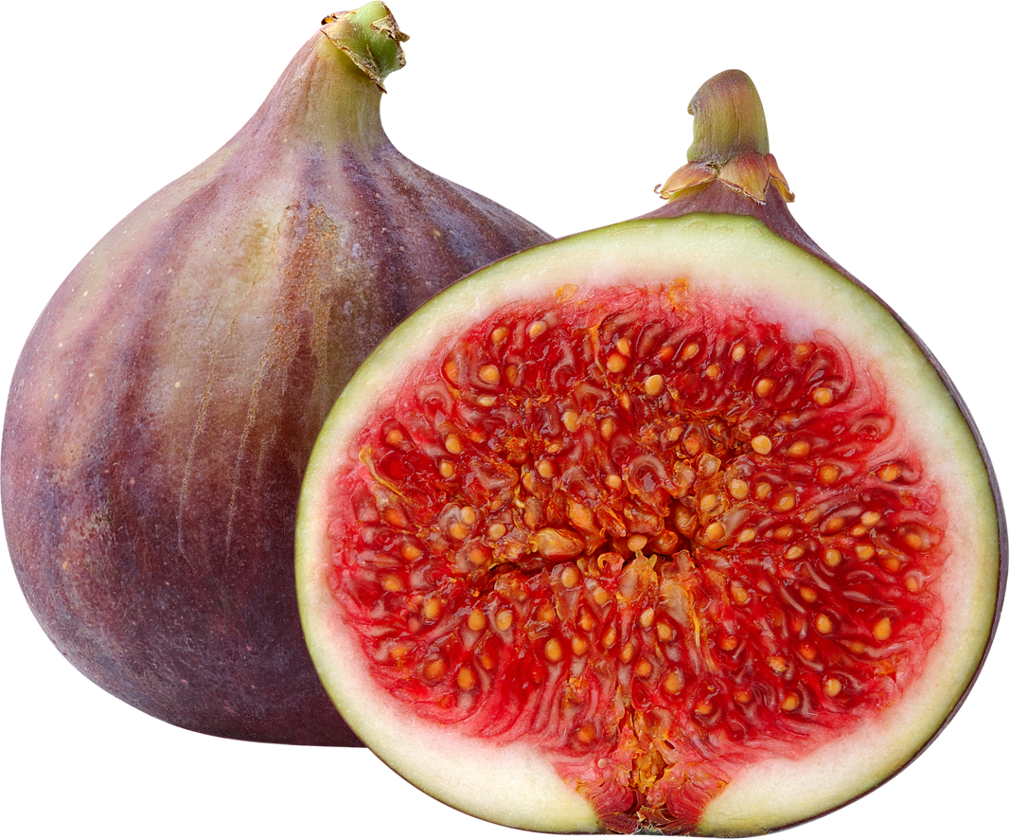
Notes:
MUST be ACIDIFIED, then Boiling water/atmospheric steam canner

Slide 42

Notes:
Boiling water/atmospheric steam canner

Slide 43
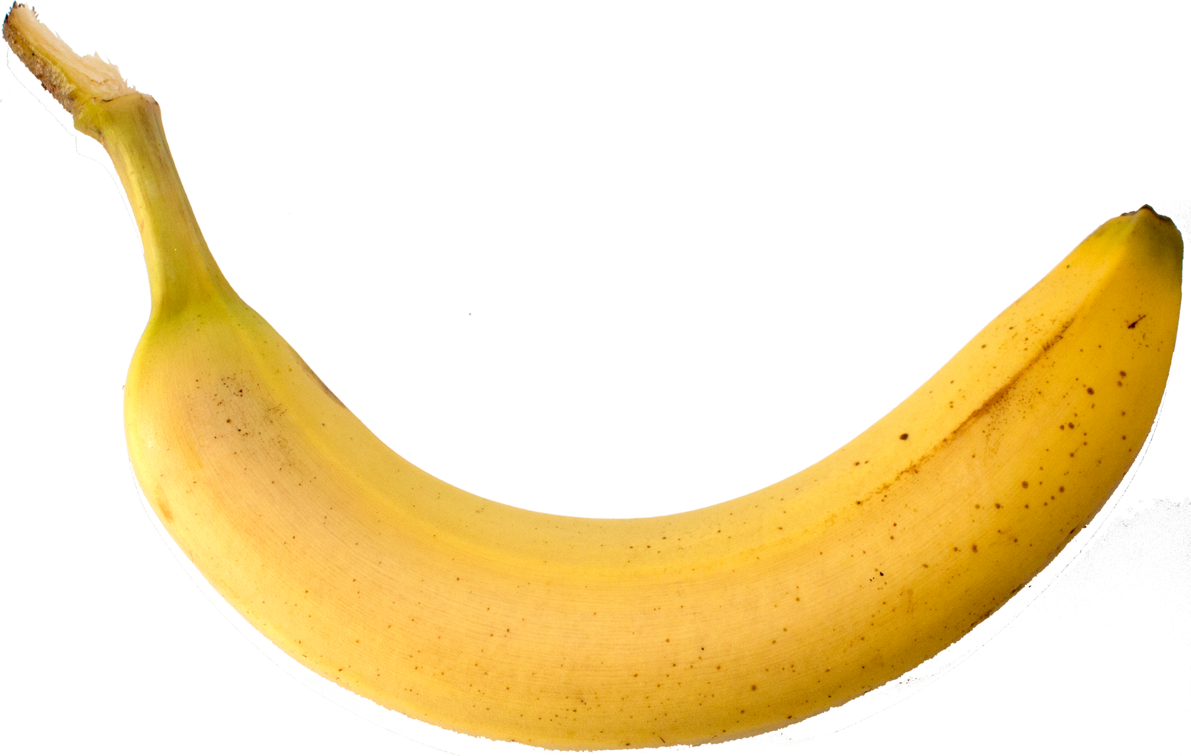
Notes:
NO!

Slide 44






Hope you had fun!
Notes:
Other
Green Peanuts in the Shell
Salsa/Taco Sauce - Salsas typically are mixtures of acid and low-acid ingredients; they are an example of an acidified food and appropriate for boiling water canning if the final pH of all components is less than 4.6. If the mixture has less acidity, it would need to be treated as a low-acid canned food and require sufficient research to eliminate a botulism risk as a canned food.

Slide 45
Basic Ingredients
Core Canning Techniques, Page 5

Slide 46
Basic Ingredients: Food
Notes:
Select produce that is fresh and of high quality. Discard any produce that is moldy or shows signs of decay or insect damage. Cut away bruises and blemishes from fruits and vegetables.
Young and tender vegetables, processed within several hours of harvesting, produce the best results when canned.
Fruit should be firm and ripe; Do not can overripe fruit as an unsafe product may result.
It does NOT allow you to include noodles or other pasta, rice, flour, cream, milk or other thickening or dairy ingredients. We will talk a little more about that later.

Slide 47
Equipment & Tools
Core Canning Techniques, Page 9 &13-14

Slide 48
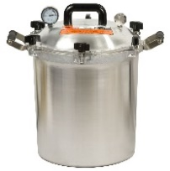
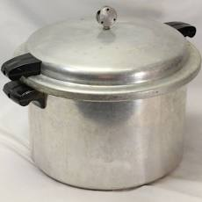
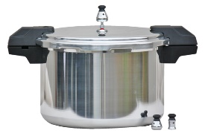
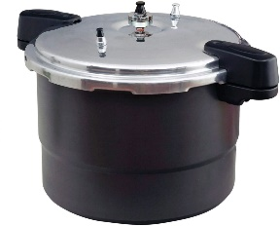
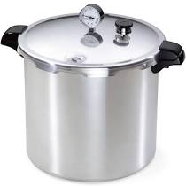
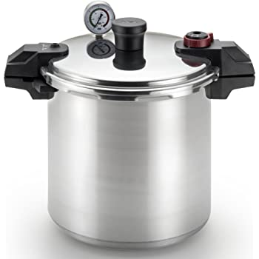
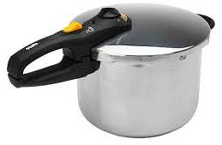
Equipment & Tools: Pressure Canners
Notes:
One of the confusing things about pressure canners is there are a lot of options out there!
While they all look different, they have the same functionality. The analogy I use is
<click> comparing rental cars. <give analogy>

Slide 49
Equipment & Tools: Pressure Canners
All American
Mirro
Granite Ware
T-Fal
Old style
Current style
Presto
Fagor / Zavor
(induction compatible model available)
Notes:
So let’s put a brand name to each of the canners shown earlier.
<click> to bring up each brand name.
Granite ware has a non-stick interior and comes with a steaming rack for cooking.
T-fal’s over pressure plug is in the top handle; less mess if it is forced out.
Note that Fagor isn’t sold or supported in the US anymore and can only be canned at the highest pressure setting. More on that in another module. There’s a similar model available called a Zavor. Both can work on induction burners. And both have a spring loaded pressure adjuster, so you need to be careful with storage so you don’t bang it around and impact the accuracy.
Remember, these canners look different from each other, but they have the same core components, they’re just different models.

Slide 50
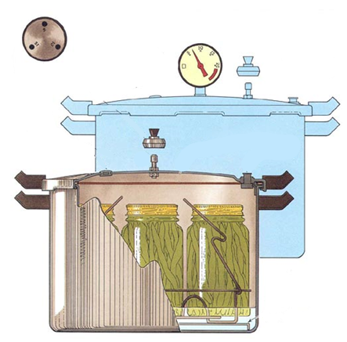
Equipment & Tools: Pressure Canner Features
Rack
Lid gasket (on most)
Vent port
Pressure regulator
Pressure indicator
Safety locks when pressurized
Overpressure plug

Slide 51
Equipment & Tools: Pressure Canners
All American
Mirro
Granite Ware
T-Fal
Old style
Current style
Presto
Fagor / Zavor
(induction compatible model available)
Notes:
We’ve seen this collection before. Which canners are dial gauge canners?
<click> only the Presto.

Slide 52
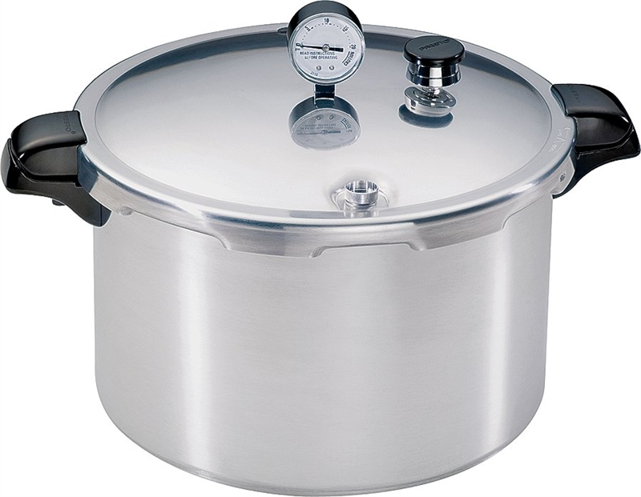
Equipment & Tools: Presto Canner
Just because it has a dial doesn’t mean it’s a dial-gauge pressure canner
Only 1 true dial-gauge
pressure canner: Presto
  Others are considered
  weighted-gauge canners
  with a dial-gauge for
  reference
  Per manuals

Slide 53
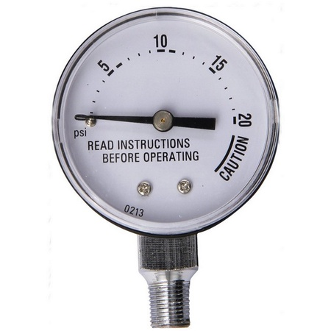
Equipment & Tools: Presto Dial-Gauge
Indicates pressure inside the canner.
More flexibility in altitude adjustments.
  Small psi increments
Increase / decrease pressure by adjusting heat.
Check annually for accuracy.
Notes:
Gives you signs of where it’s going but it’s up to you to control it by adjusting the heat.
Recommendation: when the gauge is getting close to the desired pressure, start to turn the heat down a little so you don’t swing far above the desired psi, then drop below, and continue back and forth. It doesn’t take a high temperature setting on your stove to maintain the pressure once you reach it.

Slide 54
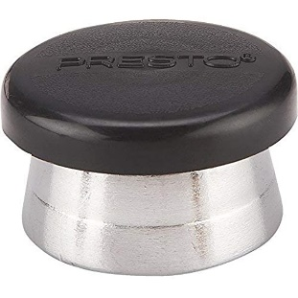
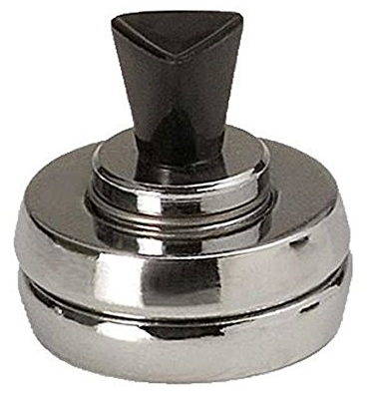
Equipment & Tools: Presto Dial-Gauge Weight
Standard model comes with a 15 psi weight
  Can’t get dial gauge tested?
  Treat as a weighted gauge canner and can at 15 psi
Optional 3-piece weighted gauge
  Converts to a full weighted gauge canner
  with 5, 10, 15 psi weight
Notes:
During the pandemic we had people calling the office concerned about not being able to test their dial gauge. What could they do? They were responsible canners and knew they needed to verify the accuracy of their dial gauge.
There were a couple of easy solutions.
<click> <click> The first is the easiest and cheapest. Just use the one piece 15 psi weight and can your food at a higher pressure. The weight will rock gently when it reaches 15 psi and will release pressure to keep the internal pressure at 15psi.
You may worry that you’re over cooking your food at this higher pressure, but the incremental temperature of each 1 lb. of pressure is only 2°F. So, the temperature difference of canning at 11 psi to 15 psi is only 8°F. So you’d be cooking the food at 248°F instead of 240°F, which isn’t going to make a difference in the food quality.
<click> If you normally can at a lower pressure, you can buy a three-piece weighted gauge designed specifically for Presto and just treat the canner like a weighted gauge canner instead of a dial gauge canner.

Slide 55
Equipment & Tools: Pressure Canners
All American
Mirro
Granite Ware
T-Fal
Old style
Current style
Presto
Fagor / Zavor
(induction compatible model available)
Notes:
We’ve seen this collection before. Which canners are weighted gauge canners?
<click>ALL but the Presto.

Slide 56
Dial-Gauge vs Weighted-Gauge
Just because it has a dial doesn’t mean it’s a dial-gauge pressure canner
  Weighted-gauge canners have a dial-gauge
  for reference only
  Per manuals

Slide 57
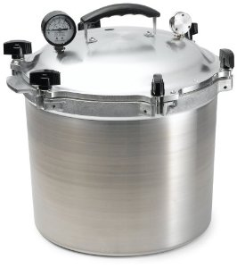
Pressure Canners: Weighted
All American: Dial & Weighted Gauge on top
  Use as a weighted gauge canner (per manual)
  Lube metal-to-metal contact
Gauge
  Accurate +/- 2 lbs
  Use to tell when to remove lid;
  no pressure lock indicator

Slide 58
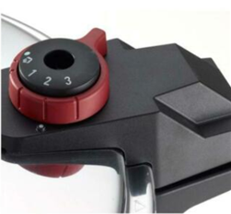
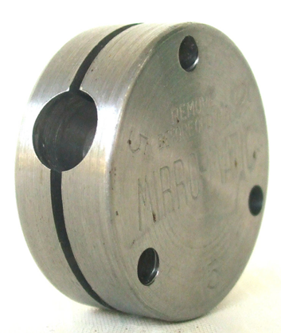
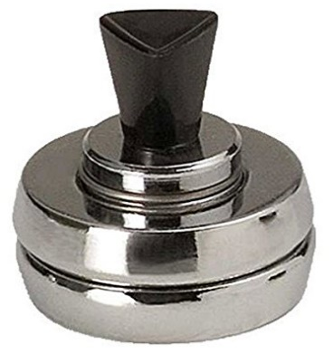
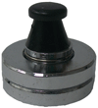
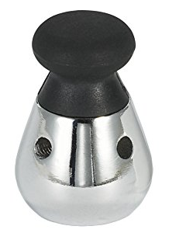
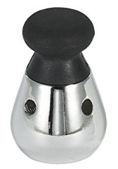
Pressure Canners: Weighted Gauge
Weighted Gauge
  Regulates pressure inside the canner
  Releases pressure from canner during processing to maintain correct setting
  Altitude adjustment requires increase of 5 psi pressure
Notes:
The regulator is what keeps the pressure at the correct setting
Wide variety; will look at each style.

Slide 59
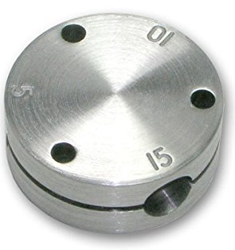
Pressure Canners: Weighted Gauge
Selective: One piece
  Fitting for 5, 10 or 15 psi
  Movement at correct pressure:
    Read the manual
    AA & old Mirro: “jiggles” 1 to 4 times per minute
  Increase/decrease pressure by adjusting heat.
Notes:
Click on pictures to bring up videos that show the rocking
Pre-load video to skip the ads: https://www.youtube.com/watch?v=xUIdWvtiVrc

Slide 60
Pressure Canners: Weighted Gauge
Adjustable 3-piece
  Fitting for 5, 10 or 15 psi
  Do not use 1-piece weight from dial gauge canner
  or pressure cooker
  Movement at correct pressure: Read the manual
    Presto & Graniteware: rocks gently throughout entire process
  Increase / decrease pressure by adjusting heat
Presto
Granite ware
Notes:
Click on pictures to bring up videos that show the rocking
Pre-load granite ware video to skip the ads

Slide 61
Pressure Canners: Weighted Gauge
Singular: Three piece set
  Which piece used determines 5, 10 or 15 psi
  New Mirro: spins and steams
  Increase / decrease pressure by adjusting burner heat
Notes:
Click on pictures to bring up videos that show the rocking (on this slide the images are grouped so there’s a clear box over them to click on)
- Pre-load and skip ad: Mirro 22 qt Pressure Canner weight jiggling - YouTube

Slide 62
Pressure Canners: Weighted Gauge
Built-in adjustments
  Open vent port
  Setting 1 = 5 psi
  Setting 2 = 10 psi
  Setting 3 = 15 psi
Steady gently release of steam and
soft hissing: it’s at pressure
Gauge is a reference only
Notes:
This is the T-fal canner.
Increase / decrease pressure by adjusting burner heat
Click on picture to bring up videos that show the rocking (start at 47 seconds)

Slide 63
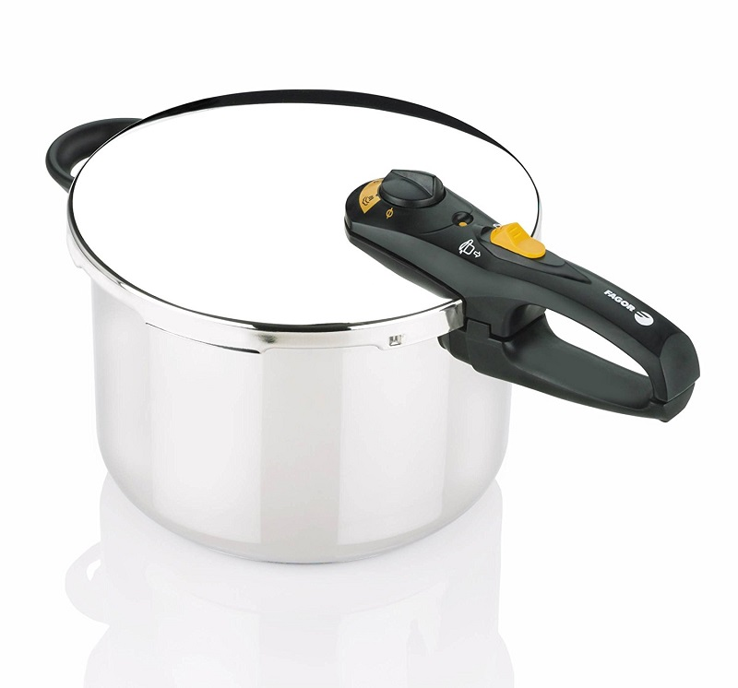
Pressure Canners: Weighted Gauge
Zavor (& Fagor, not sold or supported in US anymore)
Holds 4 quart jars
Only can at 15 psi
  Setting 2 = 15 psi
  Setting 1 = 8 psi (cooking only)

Slide 64
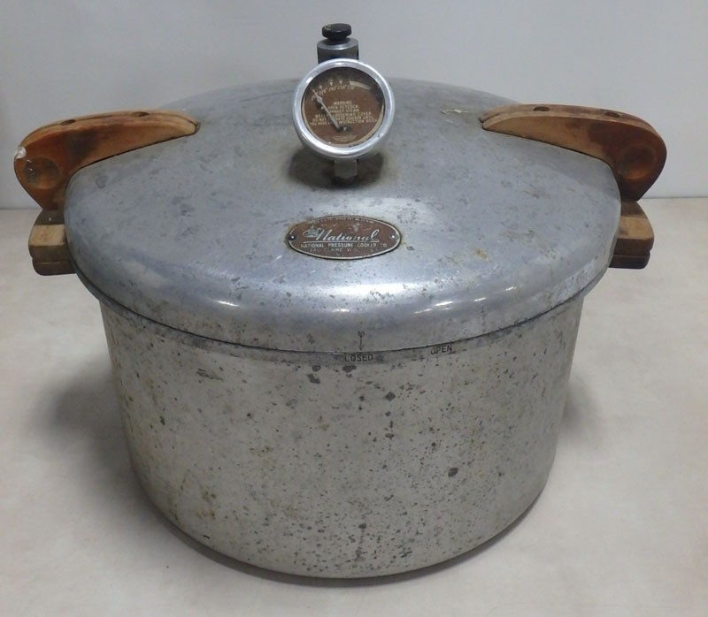
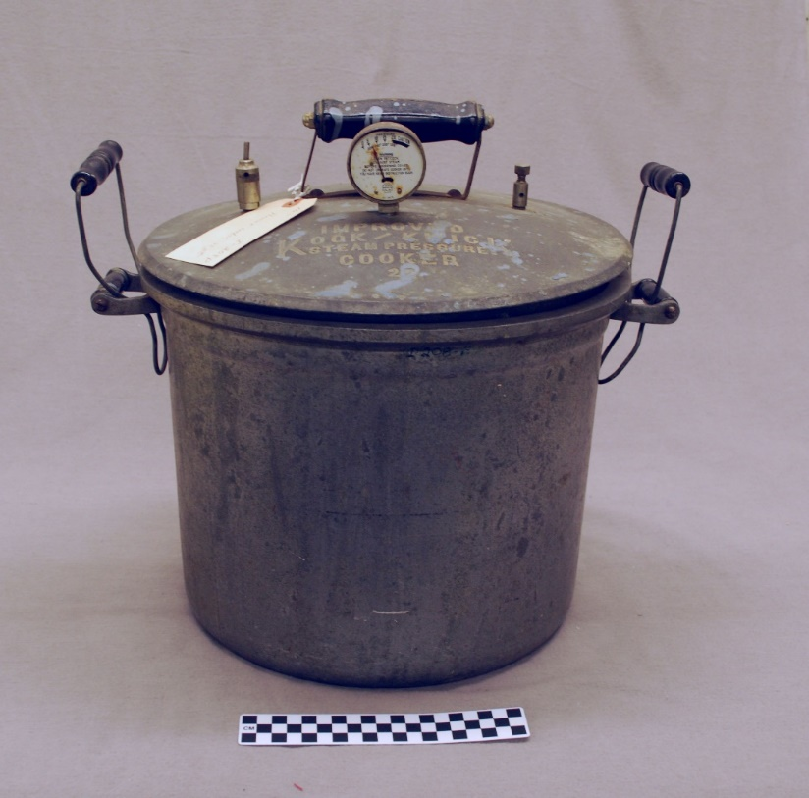
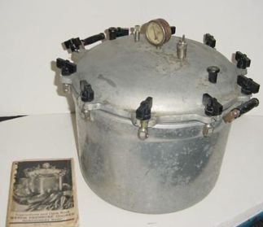
Equipment & Tools: Pressure Canner Keep it Current
Notes:
Now you can find a lot of pressure canners at thrift stores and yard sales, however, make sure it is in good working order.
Pitted canners – decoration. Make a great flower planter or garden art.

Slide 65
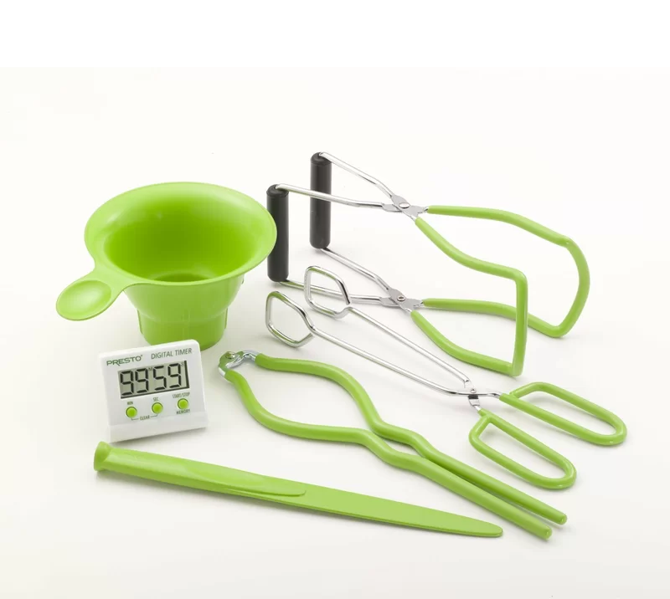
Equipment & Tools: Specific
Specific Canning Tools
  Rack (for canner bottom)
  Jar lifter
  Headspace measurer/de-bubbler
  Canning ladle
  Canning funnel
  Canning jars
  Rings and NEW lids
Core Canning Techniques, Page 9

Slide 66
Equipment & Tools: Basics
General
  Measuring cups and spoons
  Bowls
  Tray(s)
  Hand towels
  Ladle
  Paper towels
  Marker
  Blue tape

Slide 67
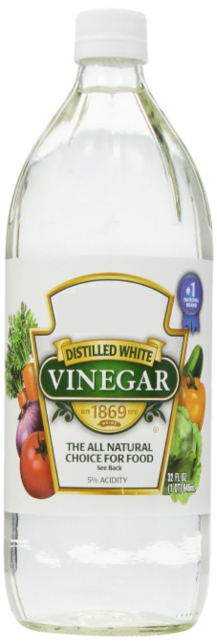
Equipment & Tools: Pro-tip
Using vinegar to wipe rims…

Slide 68
Equipment & Tools: Recipe
A reputable recipe that follows the USDA recommended canning procedures.
Core Canning Techniques, Page 4

Slide 69
Canning Basic Information
Boiling Water and Steam Canning Basics, Page 6-7

Slide 70
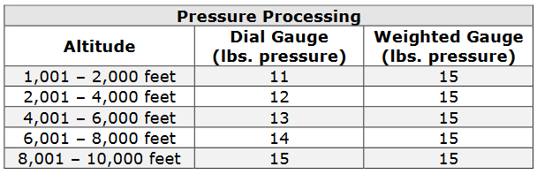
Canning Basic Information: Altitude Adjustment
Sea Level: 212˚F water boils
  All recipes use sea level as the criteria for process times.
  Higher altitude equals a lower boiling temperature.
  Adjust processing time above 1000 ft.
Core Canning Techniques, Pg. 7

Slide 71
Canning Basic Information: Raw Pack
For foods that lose shape when cooked.
Place raw food directly in jars.
  Boiling hot liquid is then poured over the food.
Pack firmly, don’t crush.
Core Canning Techniques, Pg. 7

Slide 72
Canning Basic Information: Hot Pack
Preferred method for most foods.
Food is cooked in liquid before packing.
  Cooking liquid poured over food in jar.
Fewer jars needed.
Less floating.
Better color and flavor.
Easier to pack, foods pliable.
Core Canning Techniques, Pg. 7
Notes:
What is floating

Slide 73
Canning Basic Information: Non-Standard Jars
Do NOT use re-use Atlas-Mason jars used to package Classico Sauces or any other jar used in commercial canning.
A coating is applied at the glass plant to reduce scratching and scuffing, this weakens the jar, causing it to break more easily.
Also the lighter weight of the jar could make it unsafe for home canning.

Slide 74
Canning Basic Information: Canning Jars
Preparing Jars
Check jars for nicks, scratches, bubbles, or other imperfections.
Wash jars and lids on hot, soapy water.
Keep jars hot until ready for use.
If the process time is under ten (10) minutes sterilize jars.
  Sterilize by boiling in water for 10 minutes, adding 1 minute per 1,000 ft. above sea level.
Core Canning Techniques, Pg. 10

Slide 75
Canning Basic Information: Canning Lids
Preparing Lids
Use two-piece lids.
Follow instructions on package.
Use single use lids.
  Do not re-use lids!
Check bands for rust.
Core Canning Techniques, Pg. 10

Slide 76
Canning Basic Information: Headspace
Space between inside lid and top of food.
Always follow the directions for correct headspace.
Too little:
Food may bubble out during processing, which may prevent proper seal.
Too much:
Food may discolor on top.
Jar may not seal properly
  Air may not be all forced out during processing.
Core Canning Techniques, Pg. 8

Slide 77
Canning Basic Information: Process Time
Each food has its own processing time.
  Follow directions carefully.
Time differs with size of the jar.
Adjust for altitude.
Too little time will possibly lead to spoilage.

Slide 78
Canning Basic Information: Heat Penetration
Heat penetration is slowed by:
Adding extra sugar or fat.
Having food piece larger than called for in directions.
Adding thickeners, like flour or corn starch.
FOLLOW THE RECIPE!

Slide 79
Five-Minute Break

Slide 80
Processing
Core Canning Techniques, Pages 17-18

Slide 81
Processing: Pressure Canner
Prep food & jars, ensure canner is clean
Heat water (not boiling)
  Hot pack: 180˚F
  Raw pack: 140˚F
Place jars in canner
Cover fastening securely
  Leave vent/petcock open
Steady column of steam
  Vent for 10 min
Place counterweight/weighted gauge or close petcock
Process
Remove from heat and wait until cool (0 pressure)
Remove lid
Remove jars
Notes:
Pressure Canner Processing
1. Clean lid gaskets and other parts according to the manufacturer’s directions. Make sure all vent pipes are clear.
2. Add 2-3 inches of water to the canner (follow the manufacturer’s specific recommendations).
3. Heat water in canner to 140F for raw pack or 180F for hot pack.
4. Placed filled jars on the canner rack.
5. Place lid on the canner and fasten securely. Leave the weight off the vent pipe or open the petcock.
6. Turn heat to high until steam flows in a steady stream from the open vent pipe or petcock.
7. Allow the canner to vent for 10 minutes. Always vent for 10 minutes, regardless of the manufacturer’s instructions.
8. Place the counterweight or weighted gauge on the vent pipe, or close the petcock.
9. Begin to count processing time when the pressure on the dial gauge indicates that the recommended pressure has been reached, or for canners without dial gauges, when the weighted gauge begins to jiggle or rock as the manufacturer describes.
10. Regulate the heat to maintain a steady pressure at or slightly above the correct gauge pressure or weighted gauge rocking motion.
➢ If at any time during processing the pressure goes below the recommended amount, bring the canner back to pressure and restart the timing process from the beginning.
11. When the time is up, turn off the heat, remove the canner from the heat element (electric burner) if possible, and allow the canner to cool down naturally and the pressure to drop to 0. Do not force cool the canner.
12. After the canner has completely depressurized, remove the weight from the vent pipe or open the petcock. Wait 10 minutes, then unfasten the lid and remove it, carefully lifting it away from you.
13. Carefully remove the jars to a cooling rack or heavy cloth towel.
➢ Straight up – Straight Over – Straight Down
➢ Do not invert jars!
14. Dry the canner, lid and gasket. Take off removable petcocks and safety valves and wash and dry them thoroughly. Follow the maintenance and storage instructions that come from your canner manufacturer.
15. Allow jars to cool in still, ambient air away from drafts for 12-24 hours.
16. Test jars for seals.
➢ If a jar did not seal, refrigerate it and use within a few days, or reprocess it within 24 hours using a new lid.
17. Clean and dry jars and screw bands.
18. Label jars and store in a cool, dry, dark place.

Slide 82
Processing: Prep Food
Reputable recipe – be very selective
Prep work area
Check jars & canner integrity
Notes:
<click> Pretty much anything you’re going to pressure can has a tested recipe on the NCHFP or Ball. I had someone in a public class tell me they just canned all of their leftovers using the same time. Please don’t take chances. We want people to be aware of the safety of pressure canned food made using reputable, tested recipes– while still respecting the risks if done improperly.
<click> Clean and sanitize your work area. Remember, Your work area includes you.
<click> Pay extra attention to jars, checking for cracks and bubbles. These imperfections can cause jars to break under pressure. The most common place I’ve seen jars break is at the bottom, where we plop jars on the counter.
<click> headspace is usually 1 inch –
<click> tomatoes is ½ inch. Read the recipe!
<click> If using a product with oil or natural fat,
<click> wipe the rim with white vinegar to cut the grease. If unlike me, you are capable of filling jars and adjusting headspace without making a mess, water is fine.

Slide 83
Processing: Filling Jars
Check headspace.
Remove air bubbles.
Check headspace again.
Wipe rims, with wet paper towel.
  Meat recipes: wipe with vinegar
Adjust 2-piece lids.
  Tighten finger-tight.
    Allows air to escape during processing.

Slide 84
Processing: Placing Jars in the Pressure Canner
Canner should be filled with hot water.
  Simmering, not boiling
Use jar lifter to place jars in canner.
  Keep jars straight up.
2” to 3” of water in canner
  Longer processing time = more water; see owner’s manual
Place lid on canner
Vent 10 Minutes
Weight on
Pressurize
Core Canning Techniques, Pg. 15-16

Slide 85
Processing: Venting
Process times intended for pure steam environment
  Canner’s empty space: mixture of steam & air
  Lower temperature than pure steam
  Venting eliminates air; creates pure steam environment
USDA: vent ALL pressure canners for 10 minutes.
  Without proper venting, up to 30% of the sterilizing value of a 20-minute process may be lost at 10 psig
Notes:
Venting kind of looks like the steam that comes from a steam canner, but on the top of the canner instead of the side.
When teaching a class, it’s sometimes hard to see the steam. If you hold up something dark behind the canner it’s easier to see. Or shine a flashlight into the steam to make it more visible.

Slide 86

Processing: Cooling Down
Heat off, walk away
Time to cool down
  Pints:
  Quarts:
Pressure at 0?
  Weight off
  Wait 10 more minutes
Lid off, jars out
30 minutes
45 minutes
Notes:
When the timer goes off after the canner being at pressure for the entire processing time, just turn the heat off and walk away.
How long it takes the pressure to drop to 0 depends on the size of the jars in the canner.
<click> pints
<click> quarts
<click> (next steps)
<Click> Dennis’ canner story

Slide 87
After Processing
Cool jars away from drafts
DO NOT DISTURB or move jars.
  12-24 hours
The USDA and University of California DO NOT recommend inverting jars.

Slide 88
Testing for Seal
Listen for “pop”
Lid curved inward
Lid won’t move when pressed.
Clear ringing sound when tapped.

Slide 89
Storage
Check Seal.
  Store unsealed jars in the refrigerator.
  OR reprocess.
Remove bands; clean
Gently wash lid and jar thread, and dry
Label
Store in a cool, dark place.
Avoid temperature extremes.
Use within one (1) year for best quality.

Slide 90


Fluctuating Pressure
Large and/or quick variations in pressure during processing may cause loss of liquid from jars.
Tip to find your stove’s “sweet spot”
  Practice canning jars of water
Pressure drops?
  Return to pressure; restart timing
Notes:
Pay attention to your canner so the pressure doesn’t drop
Tip:
As the pressure gets closer to where you want it, start to turn the heat down a little bit. Pressure will still build but you can keep it from going too high, and then dropping too low. Control the pressure.
<click> How can you tell if your jars siphoned, which is when liquid from the jar squirts out under the lid and into the canner?
<click> you can smell it. Don’t panic, wait to see if the jars sealed. If it’s just liquid it will probably still seal
<click> finding the sweet spot. My stove’s sweet spot is around 2.
<click> practice canning water
<click> what happens if pressure drops too low?
<click> return to pressure, restart

Slide 91

Processing: Prevent Botulism with Timing
Follow recipe exactly.
Timing is everything
  Heat-up and cool-down times count toward sterilizing value of the process
  Don’t rush it; entire time needed
Heat to vent
Vent
Pressurize
Process
Cool-down / depressurize
Notes:
Total processing time includes more than just the time listed in the recipe. It also includes the time spent heating up the canner, venting, pressurizing, and depressurizing.

Slide 92
Resources
National Center for Home Food Preservation (www.nchfp.uga.edu)
So Easy to Preserve

Slide 93

Questions?
Don’t forget to fill out the survey after the class!
Notes:
https://ucanr.edu/pcb

