Slide 1
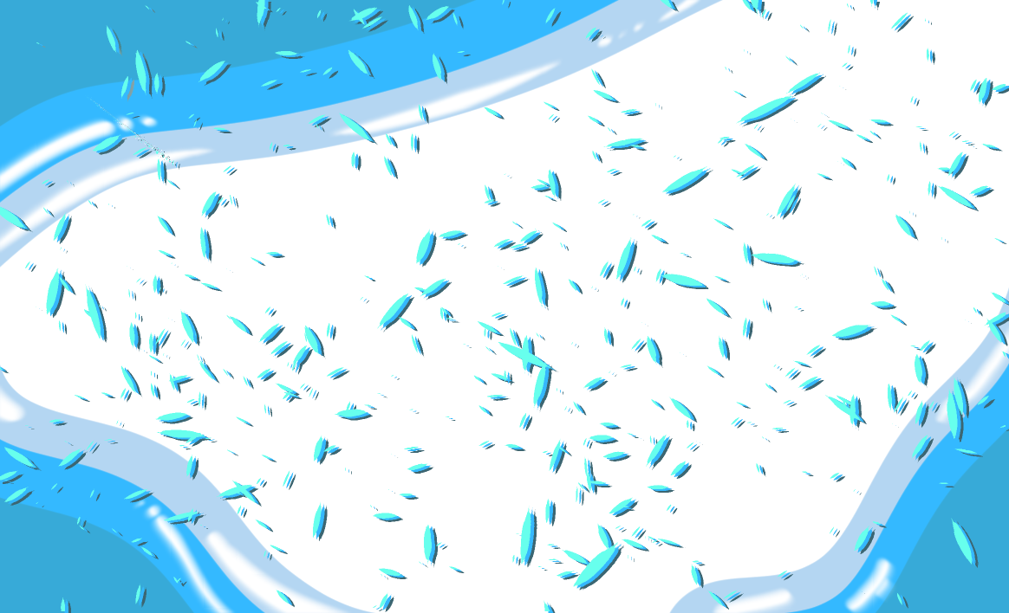
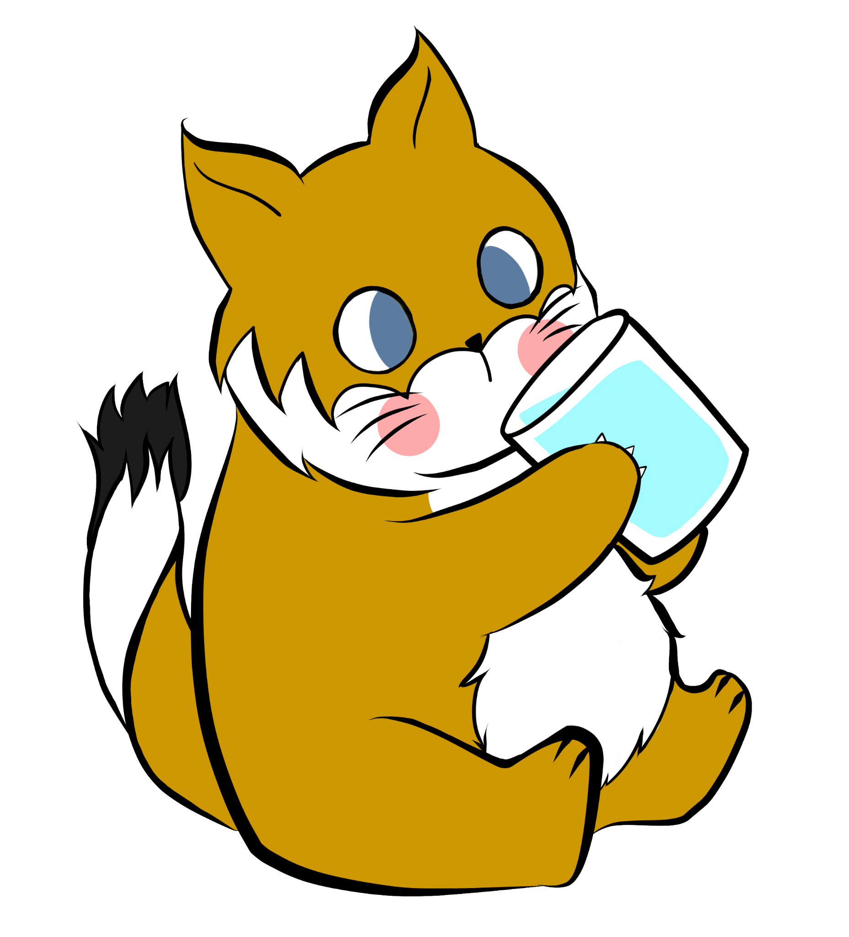
Welcome to the
Drinking Water Quality Workshop!
Welcome to the
Drinking Water Quality Workshop!

Slide 2

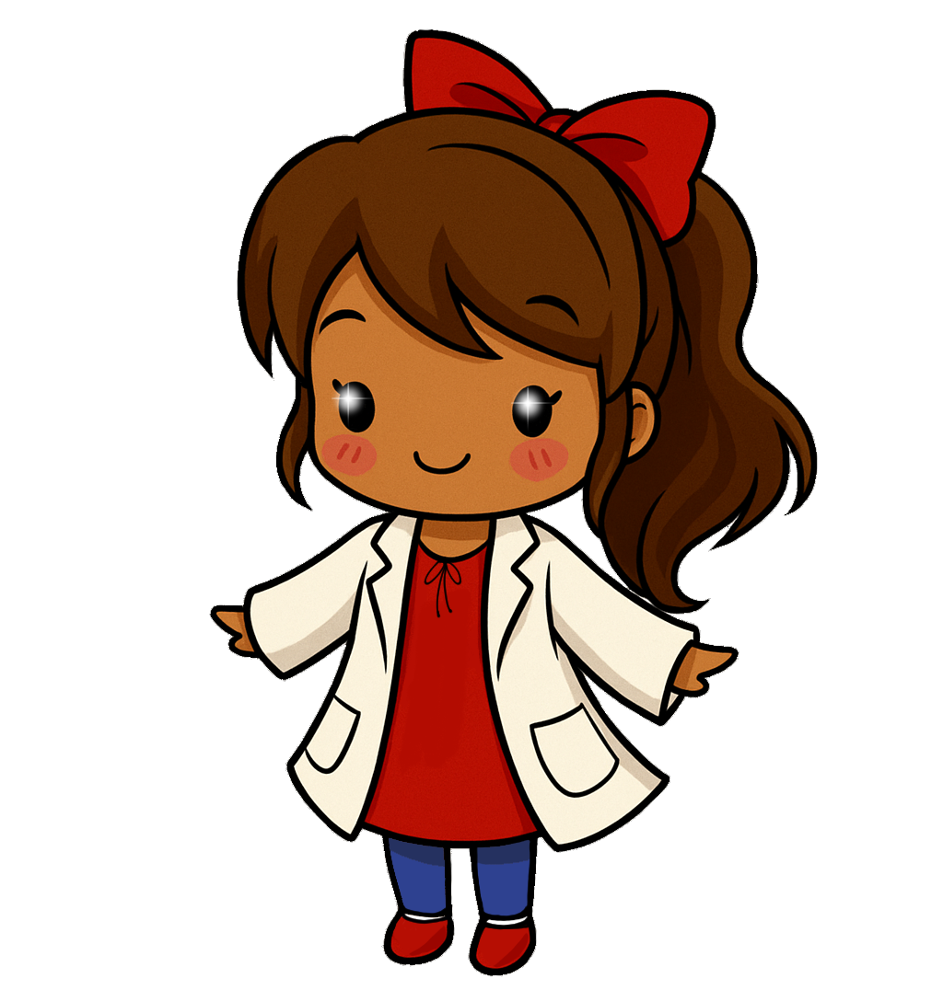





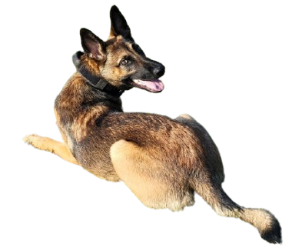





About me -
Ms. Navi
C.Navarrete

Slide 3








Special thanks
https://ciwr.ucanr.edu/index.cfm
https://fews-us.org/
https://www.grizzlycorps.org/
https://www.americorps.gov/

Slide 4

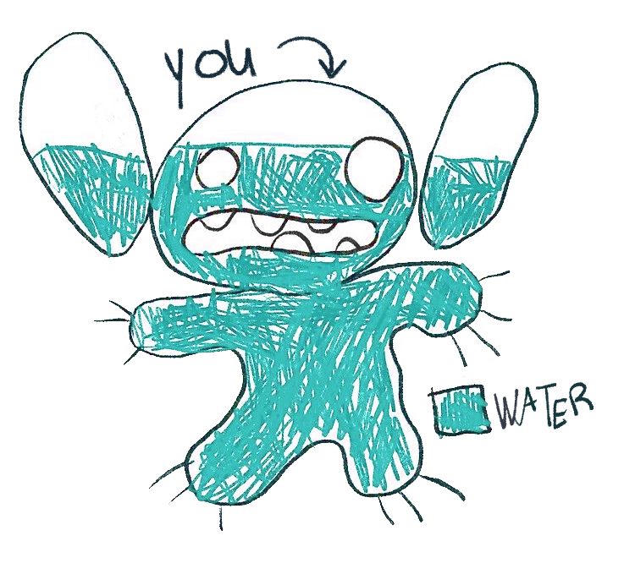
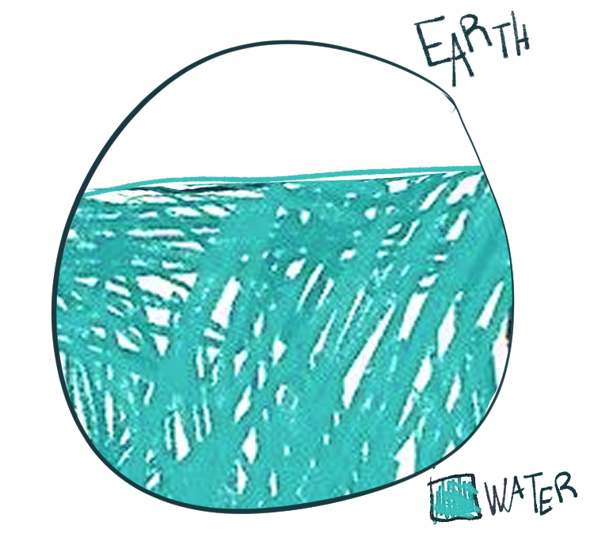
Why Care About Water?
Water = Life
Cali. AB 685 = Your Right to Safe Drinking Water
Your body is ~70% Water
Earth is ~70% Water

Slide 5
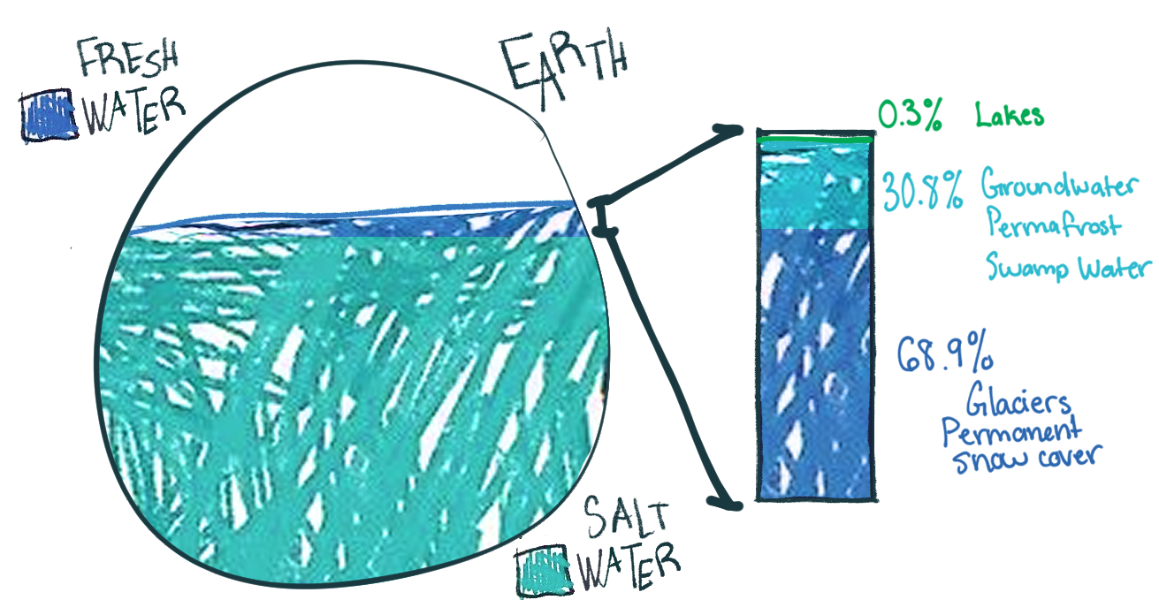
Water Availability

Slide 6
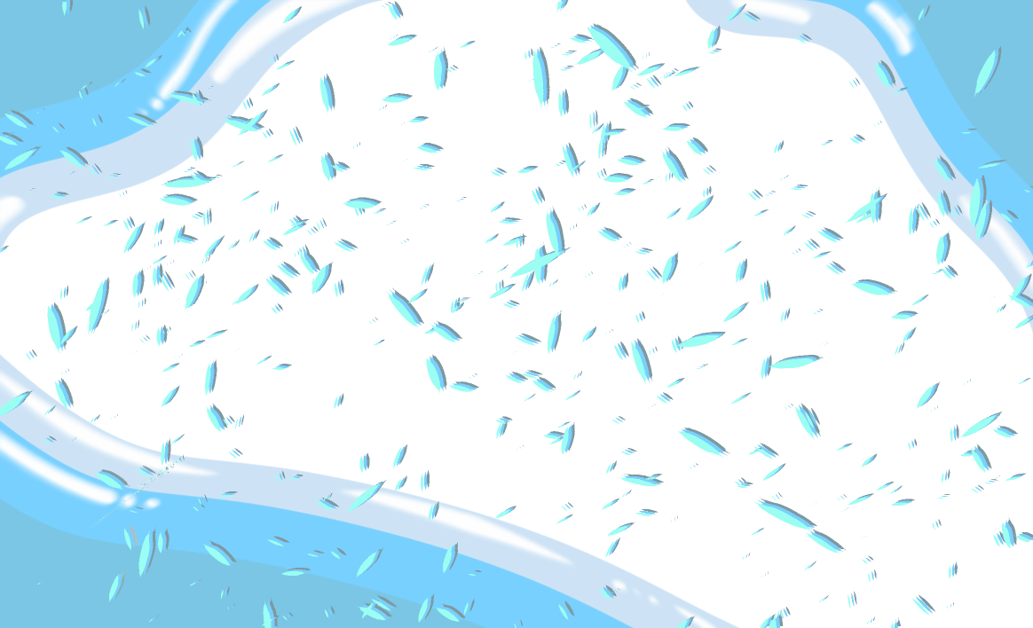
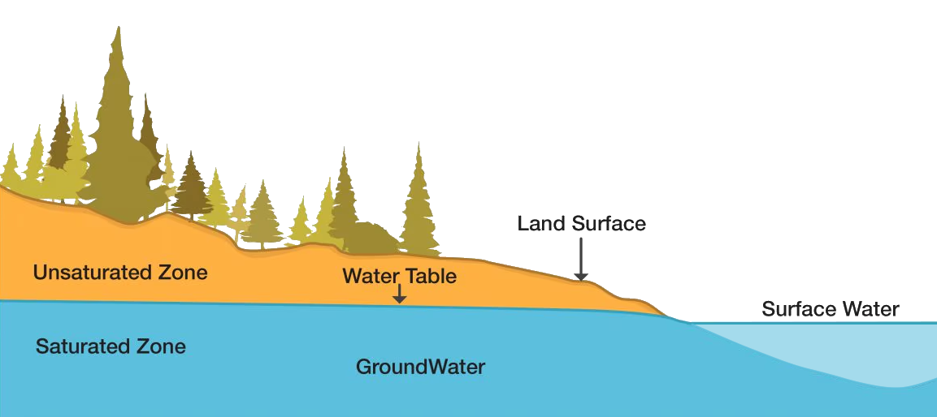
Water Sources
Groundwater
Notes:
Most communities in the U.S. get their drinking water from surface water and groundwater. There is a 3rd less popular option; recycled water. Since it can take a relatively long time to set up small recycled water schemes, due to extensive planning and approval processes, it isn't worth mentioning. Anyways, surface water sources includes lakes, reservoirs, and rivers. Where groundwater is located below the ground and accumulates as runoff flows through soil and rock.

Slide 7
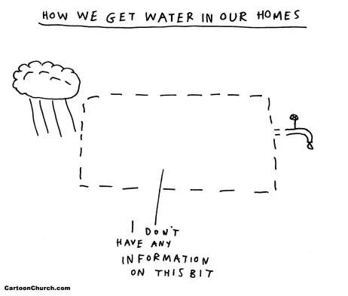
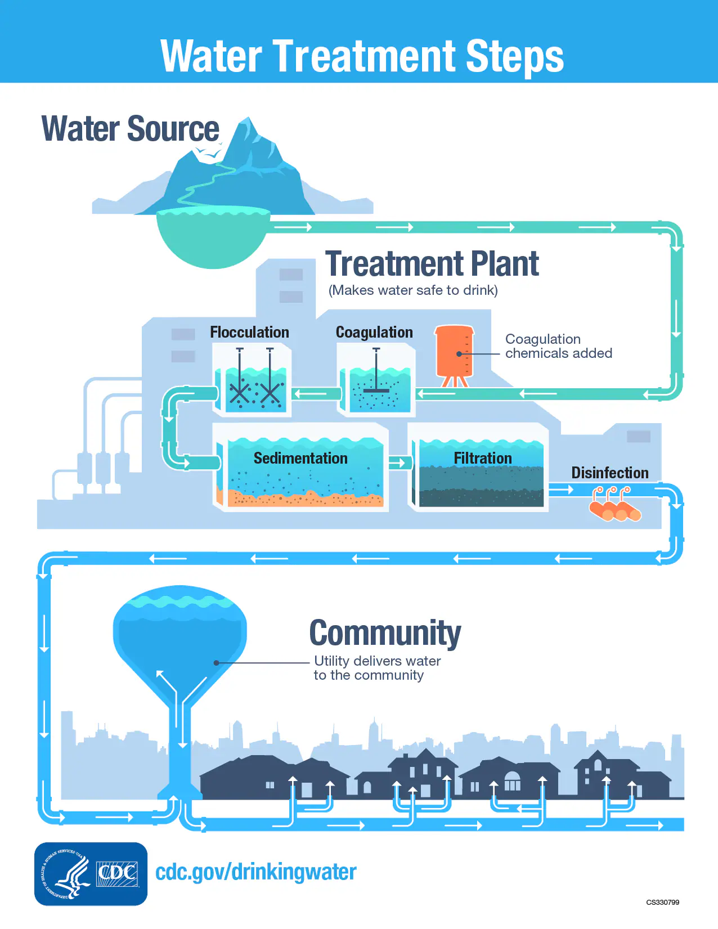
Notes:
Coagulation: The first step in removing solids from the water. In this process, water is treated with positively charged chemicals to neutralize the negative charge of solids in the water.
Flocculation: The second step in removing solids from the water. In this process, a chemical (called a flocculant) is added to encourages solids in the water to stick together.
Sedimentation: The third step in removing solids from the water. In this process, the groups of solids that stuck together during flocculation (called a floc) settle at the bottom, leaving the cleaner water at the top.
Filtration: The fourth, and final step in removing solids from the water. In this process, the cleaner water resulting from sedimentation passes through filters with different size holes and materials to catch whatever solids are left.
Disinfection: After solids are removed, chemical disinfectants are added to the water to kill any remaining parasites, bacteria, or viruses. This helps keep the water safe as it travels from the water treatment plant to your tap.

Slide 8
Notes:
Coagulation: The first step in removing solids from the water. In this process, water is treated with positively charged chemicals to neutralize the negative charge of solids in the water.
Flocculation: The second step in removing solids from the water. In this process, a chemical (called a flocculant) is added to encourages solids in the water to stick together.
Sedimentation: The third step in removing solids from the water. In this process, the groups of solids that stuck together during flocculation (called a floc) settle at the bottom, leaving the cleaner water at the top.
Filtration: The fourth, and final step in removing solids from the water. In this process, the cleaner water resulting from sedimentation passes through filters with different size holes and materials to catch whatever solids are left.
Disinfection: After solids are removed, chemical disinfectants are added to the water to kill any remaining parasites, bacteria, or viruses. This helps keep the water safe as it travels from the water treatment plant to your tap.

Slide 9
Notes:
Coagulation: The first step in removing solids from the water. In this process, water is treated with positively charged chemicals to neutralize the negative charge of solids in the water.
Flocculation: The second step in removing solids from the water. In this process, a chemical (called a flocculant) is added to encourages solids in the water to stick together.
Sedimentation: The third step in removing solids from the water. In this process, the groups of solids that stuck together during flocculation (called a floc) settle at the bottom, leaving the cleaner water at the top.
Filtration: The fourth, and final step in removing solids from the water. In this process, the cleaner water resulting from sedimentation passes through filters with different size holes and materials to catch whatever solids are left.
Disinfection: After solids are removed, chemical disinfectants are added to the water to kill any remaining parasites, bacteria, or viruses. This helps keep the water safe as it travels from the water treatment plant to your tap.

Slide 10

What Is a CCR
PRIMARY WATER STANDARDS: Things we check to make sure the water is safe to drink!
Substance | Units | Detected | Range | Typical Source
Chlorine | (mg/L) | x | 0.23 – 0.97 | Disinfectant added for treatment
Nitrate (as N) | (mg/L) | x | 1.3 – 5.8 | Runoff from fertilizer/sewage, erosion of deposits
?
Consumer Confidence Report
Think of it as a Water Quality Report Card
A CCR tells you what’s in your water
SECONDARY WATER STANDARDS: The Look, Smell, and Taste Test!
Substance | Units | Detected | Range | Typical Source
Water Hardness | (mg/L) | x | 4.0 – 15 | Groundwater that has passed through mineral-rich rocks
Color | Visually | x | Visually | Naturally occurring organic materials
pH | 0-14 | x | 7.8 – 8.2 | Aesthetic (taste/feel/corrosiveness)
Total Dissolved Solids | Visually | x | Visually | Runoff/leaching from natural deposits

Slide 11



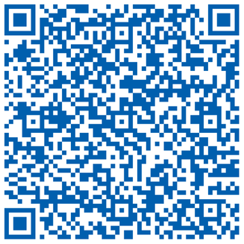

Your utility
https://www.cityofmerced.org/home/showpublisheddocument/20827/638550081365030000
Your Local CCR
City of Merced
https://www.google.com/url?q=https://www.atwater.org/wp-content/uploads/2024/04/2023-CCR.docx&sa=D&source=docs&ust=1752301626205049&usg=AOvVaw2EiCtbWIBPwKsUgGzPT1YP
City of Atwater
https://www.google.com/url?q=https://github.com/caccr/caccr.github.io/raw/master/word/2410007.docx&sa=D&source=docs&ust=1752301806949039&usg=AOvVaw3UyGyf5RCq-X9KTAJXqcyg
Planada Community Services District
https://ordspub.epa.gov/ords/safewater/f?p=136:102
https://ordspub.epa.gov/ords/safewater/f?p=136:102

Slide 12
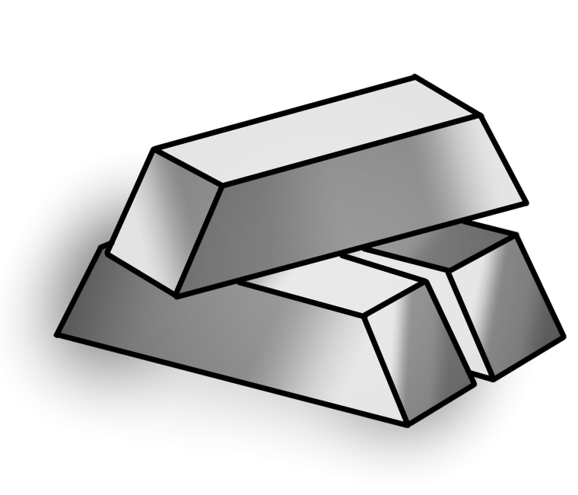
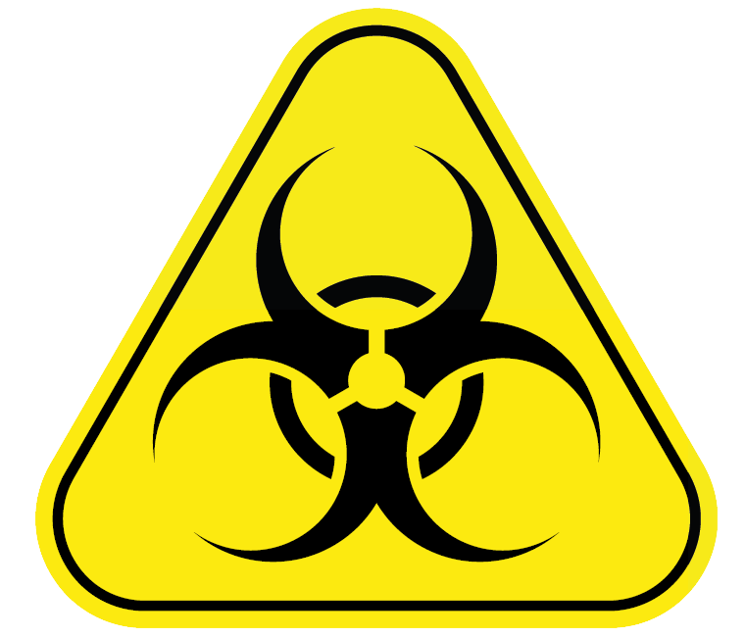
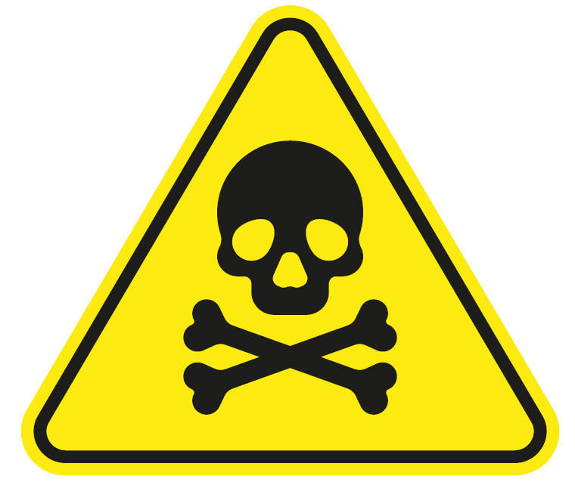
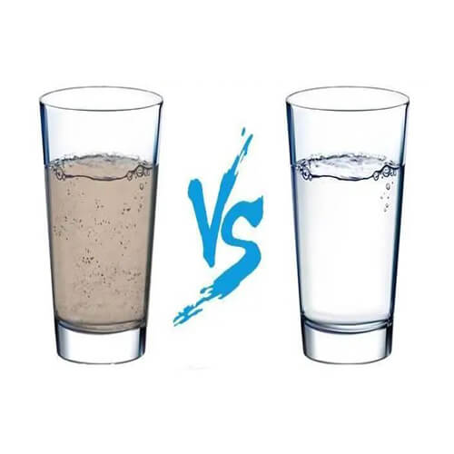
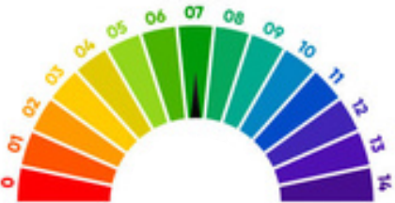
Contaminants and Indicators
Biological
Chemical
Metals
A byproduct of industrial activity (agriculture or manufacturing).
Bacteria, parasites, and viruses like E.coli and Giardia
pH
Turbidity
The measure of water clarity; high turbidity appears cloudy.
Short for potential of Hydrogen, which measures how acidic a liquid is.
Naturally present in all water bodies, but commonly a result of human pollution

Slide 13
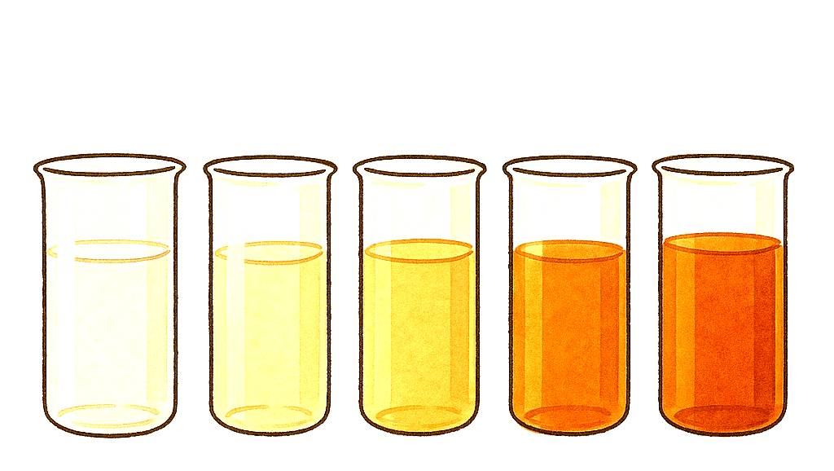
Turbidity
Turbidity
Turbidity
?
?
?
?
Turbidity means how cloudy or dirty the water looks because of tiny pieces floating in it.
The more stuff floating in the water, the higher the turbidity.
This stuff can include soil, tiny organisms, debris, minerals and even soap!

Slide 14
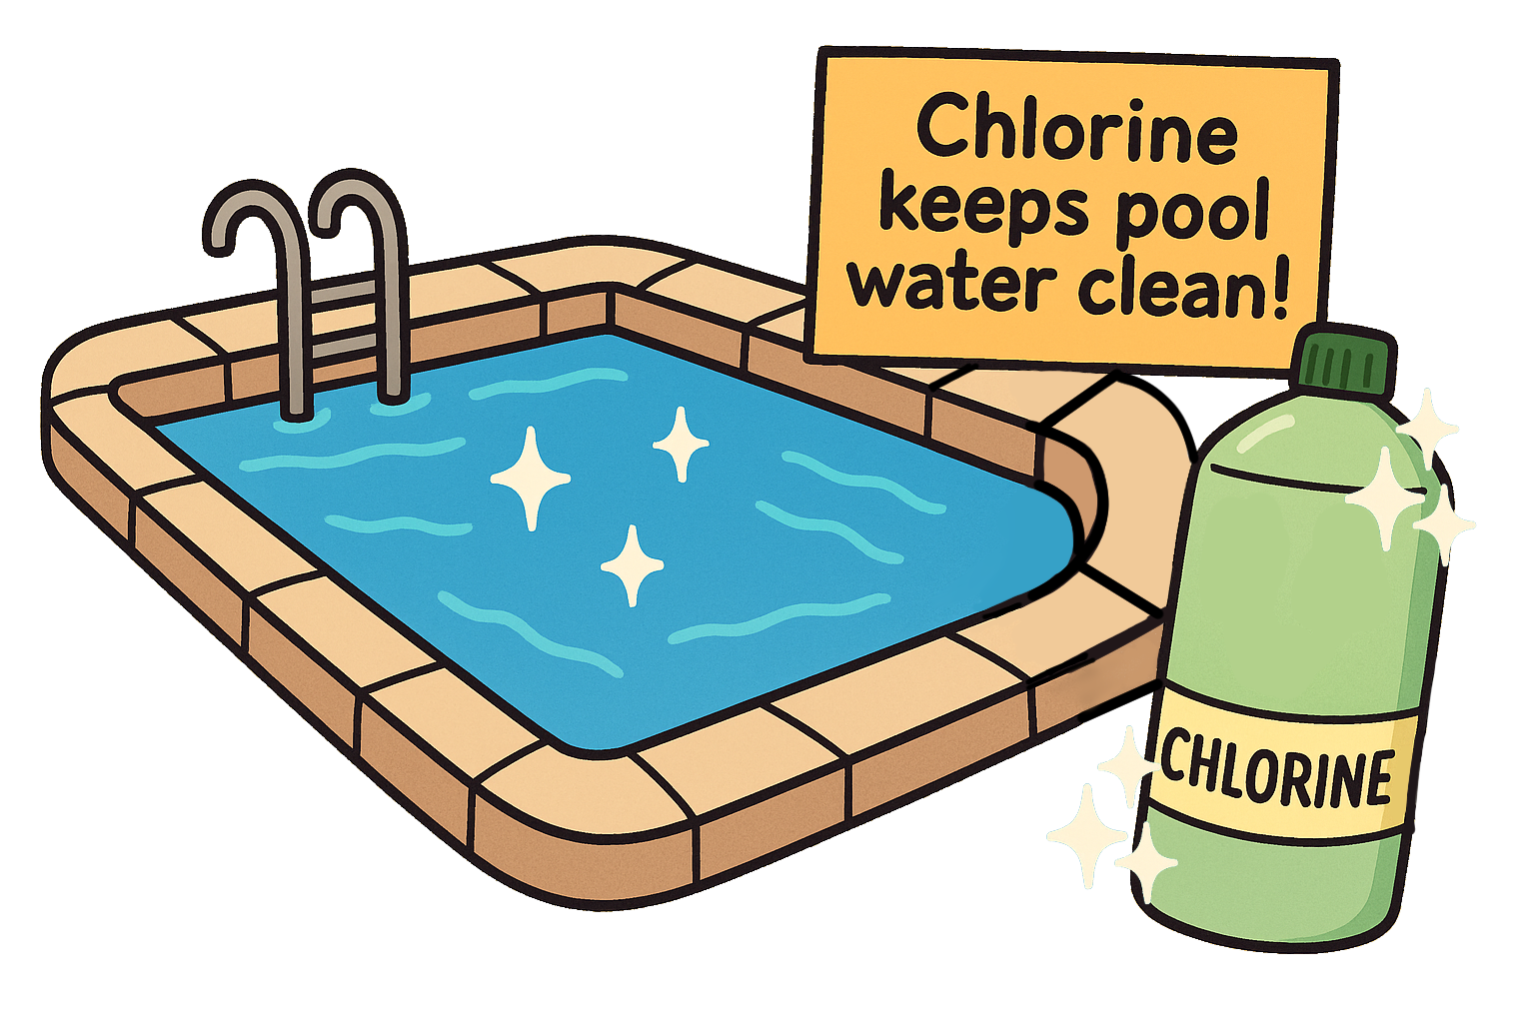
Chlorine
Chemical
Chlorine is a chemical that people add to drinking water to kill germs and bacteria.
It helps make water safer by disinfecting it — just like how bleach cleans surfaces.
However, too much chlorine can give water a strong smell or taste, kind of like a swimming pool.

Slide 15
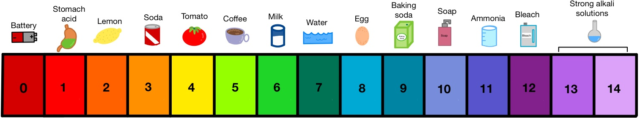
H
pH
p
pH stands for "potential of Hydrogen". It tells us how acidic or basic (aka alkaline) a water sample is.The pH scale goes from 0 to 14,
where
and
lower numbers are acidic,
7 is neutral,
higher numbers are basic

Slide 16



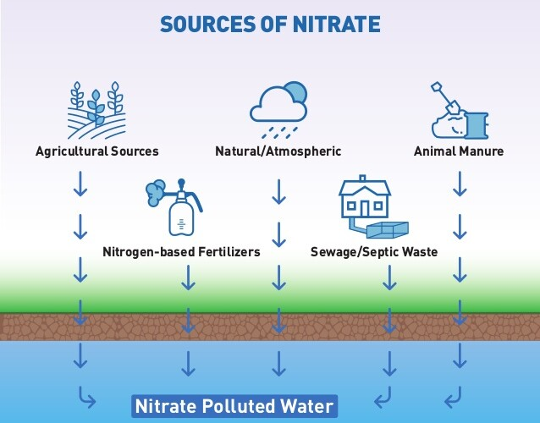
&
Nitrates Nitrites
Biological
Chemical
Nitrates & Nitrites are naturally occurring and found from man-made sources.
You can’t see it, smell it, or taste it, and too much in your drinking water can be harmful to your health.

Slide 17
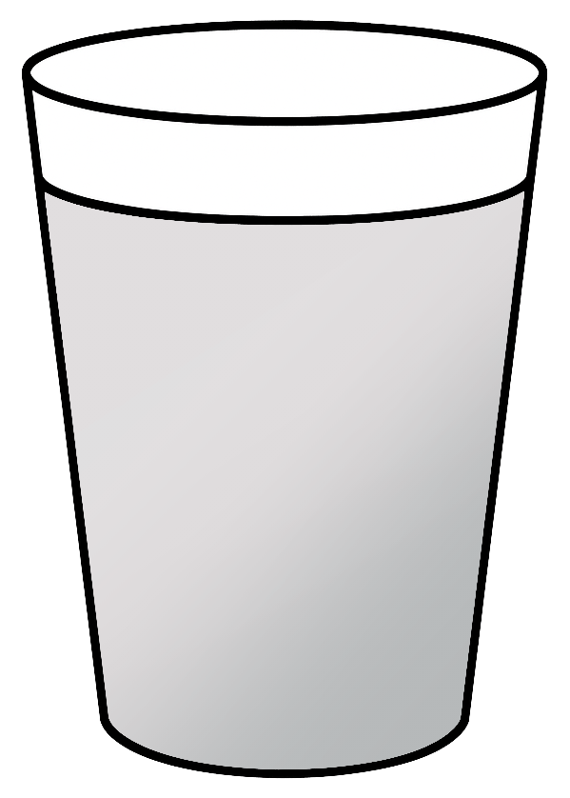

Make your Prediction!!
Color? Smell? Cloudy or Clear?
Draw on the cup in your activity sheet!

Slide 18
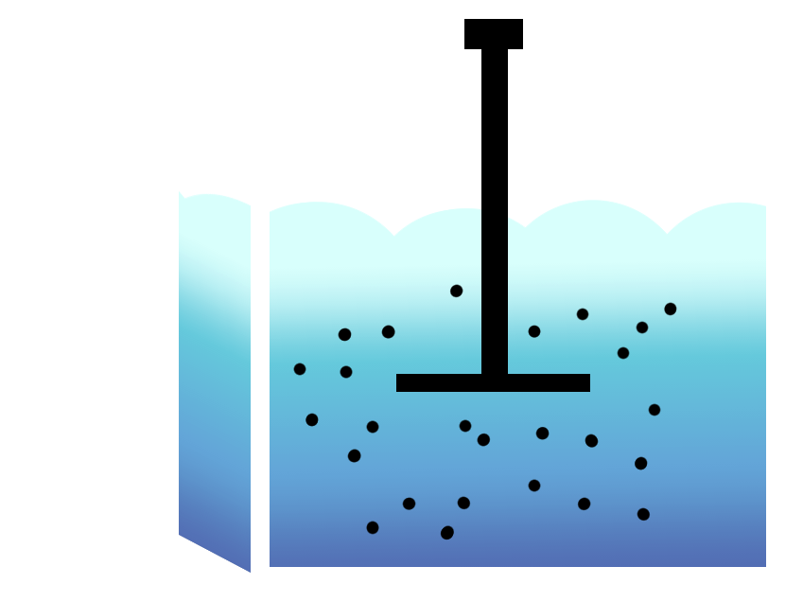

Testing Round 1
One student per table will bring their first empty cup to the front of the class.
Fill it with the contaminated water from the container.
Return to their desk and begin testing the sample
Dip and gently swirl each strip in the sample water for 10 seconds.
  DO NOT shake off the excess water.
  Lay the strip flat on a paper towel.
  Read and record results.
Record findings on the Activity Sheet.

Slide 19
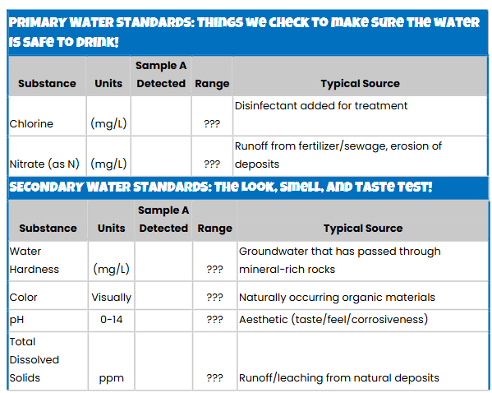
Testing Round 1
                This table!
It depends on what we are testing for!
Chlorine, pH, TDS, etc.

Slide 20
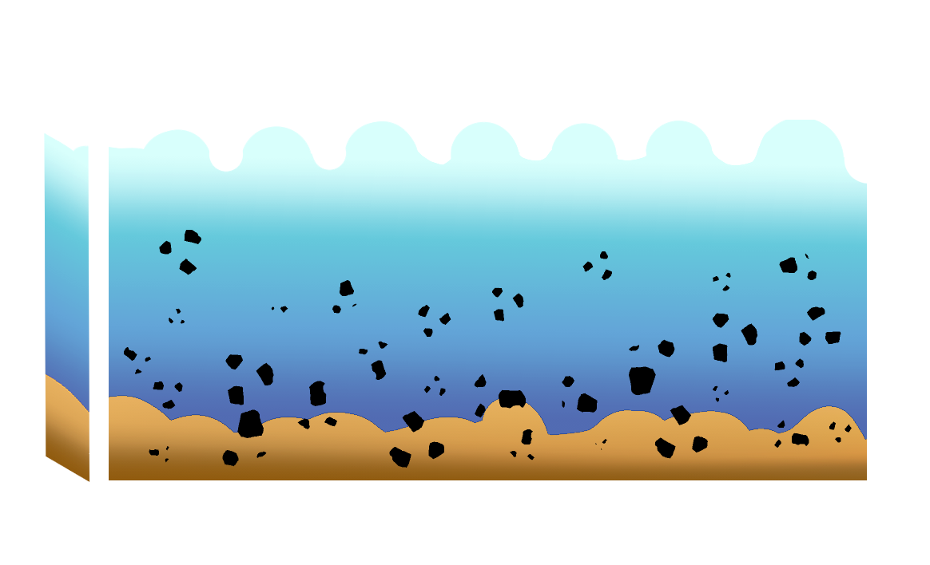
Live Demo: Water Purifier in Action!
The instructor will add a water purifier solvent into the contaminated water container.
Students will observe coagulation and flocculation in real time
  Coagulation = particles clump
  Flocculation = clumps settle

Slide 21

Testing Round 2
One student per table will bring their second empty cup to the front of the class.
Fill it with the treated water from the container.
  Return to their desk and begin testing the sample
Dip and gently swirl each strip in the sample water for 10 seconds.
  DO NOT shake off the excess water.
  Lay the strip flat on a paper towel.
  Read and record results.
Record findings on the Activity Sheet and compare results.

Slide 22
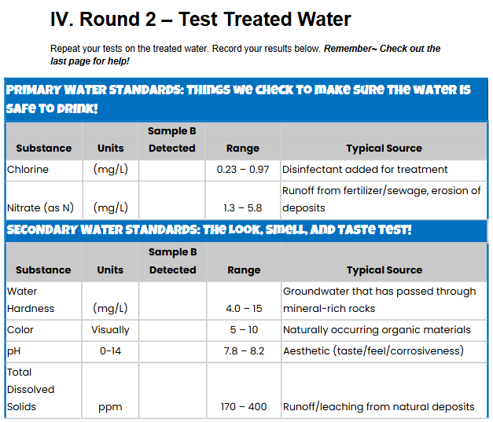
Testing Round 2
It depends on what we are testing for!
Chlorine, pH, TDS, etc.

Slide 23
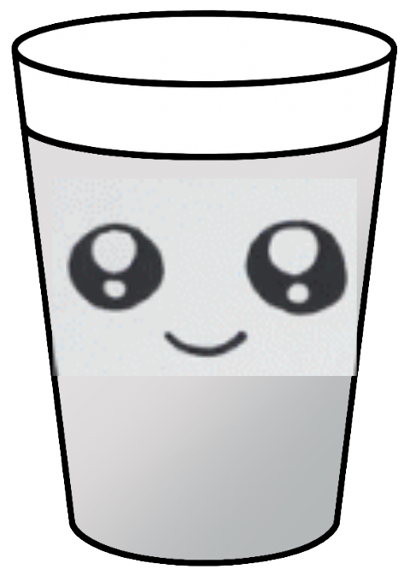
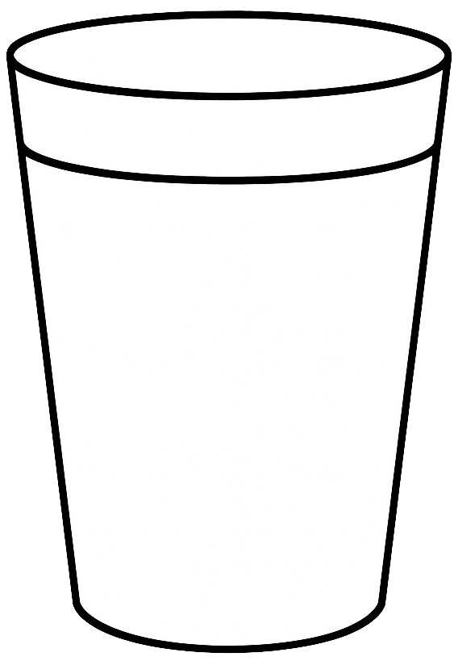
What changed?
Is your water sample clearer?
After comparing the values, did they improve?
Are your results within the range provided?
What about your predictions?
?

Slide 24
Why does this matter?
Discussion Prompts:
What surprised you?
Why do we test our drinking water?
What would you tell your families or other friends?
This is how real scientist track this!

Slide 25
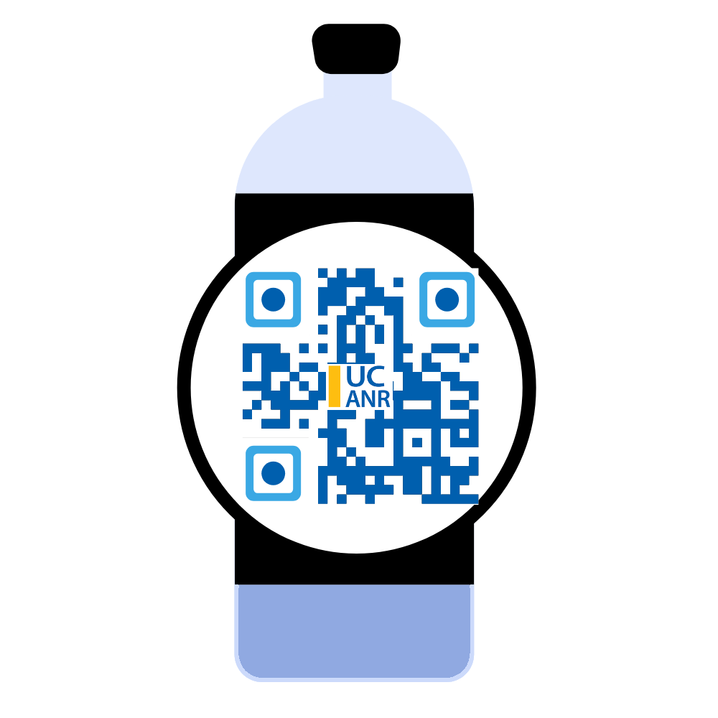

Thank you, young scientist!

Slide 26

Ask your family where their water comes from 💧🏠
Check your city’s CCR!
Don’t forget to grab stickers! Especially of me!

Slide 27



Again, Special thanks
Colleen C. Naughton
Assistant Professor
Civil & Environmental Engineering
University of California Merced
Erik Porse, PhD
Director, Cooperative
Extension Specialist
and YOU!!
Celeste Navarrete
UC Berkeley GrizzlyCorps Fellow
2024-2025
Based at UC Merced

