Slide 1
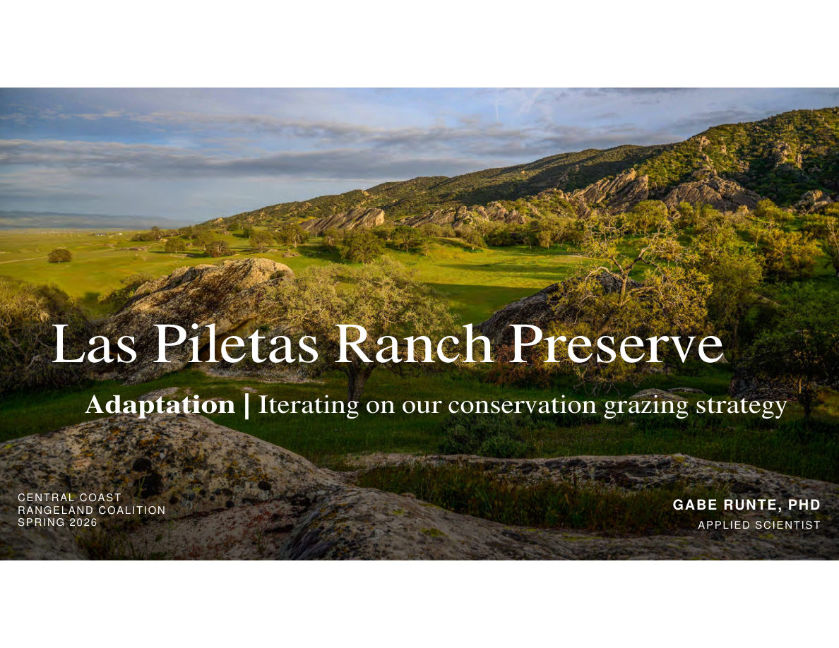
Notes:
SLIDE 48 of 71: Adaptation – Section Title
SECTION TITLE SLIDE: Las Piletas Ranch Preserve – Adaptation: Iterating on Our Conservation Grazing Strategy
Presenter: Gabe Runte, PhD – Applied Scientist
Organization: The Nature Conservancy
Event: Central Coast Rangeland Coalition Spring 2026
IMAGE DESCRIPTION: Wide landscape photograph of Las Piletas Ranch Preserve (San Juan Unit) in winter/spring. Foreground shows green grasses, scattered oak trees, and colorful wildflowers. The distinctive white/gray volcanic rock outcroppings of the Caliente Range form a dramatic jagged ridgeline in the background. Blue sky with scattered fair-weather cumulus clouds. The landscape is lush and green from recent rains. Cattle visible in the oak woodland in the middle distance.

Slide 2
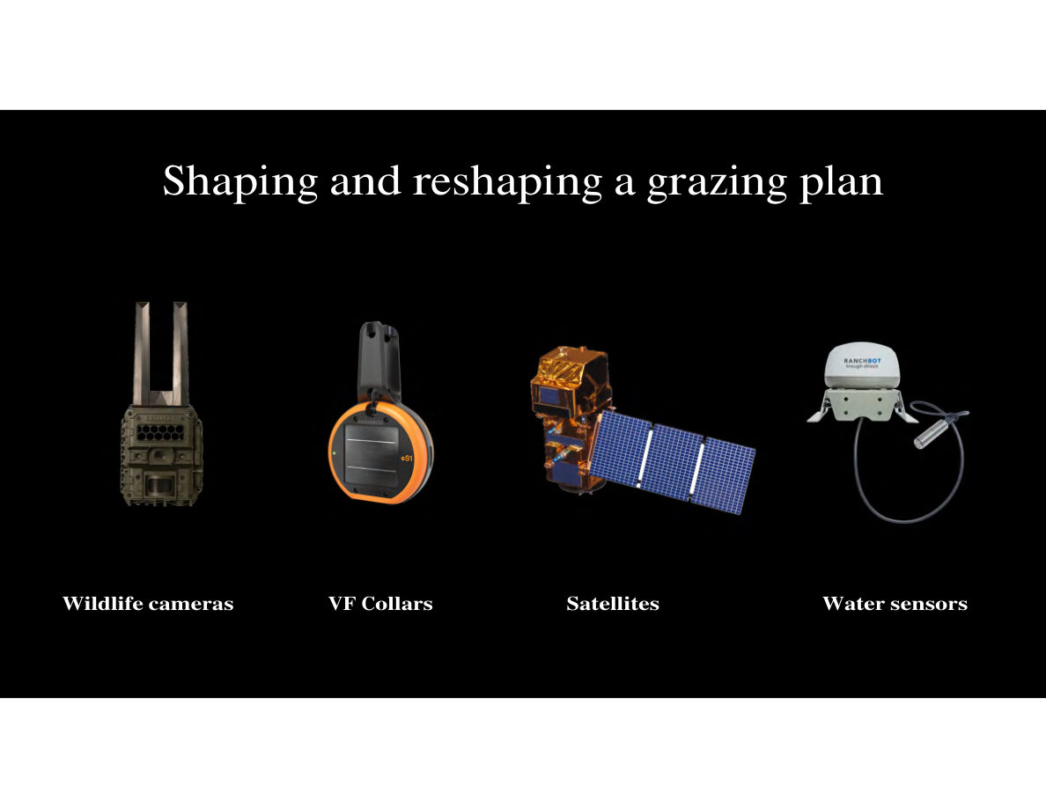
Notes:
SLIDE 49 of 71: Shaping the Grazing Plan – Technology Stack (with Water Sensors)
SLIDE: Shaping and Reshaping a Grazing Plan
Four monitoring technologies on black background:
1. WILDLIFE CAMERAS – Reconyx trail camera (olive/tan colored, rectangular body with upward antenna). Role: Monitor wildlife species use of water sources and vegetation; document pronghorn and Tule Elk distribution.
2. VF COLLARS – Gallagher eShepherd GPS virtual fence collar (round, orange disc-shaped device with black solar charging panel and mounting hardware). Role: Track cattle locations in real time; enforce virtual paddock boundaries; record grazing distribution data.
3. SATELLITES – Communications/Earth observation satellite (gold/copper body with two large blue solar panels extended). Role: Provide vegetation index data (NDVI, NDTI) to assess forage quantity and residual dry matter.
4. WATER SENSORS – Ranchbot IoT water monitoring device (white dome sensor with gray probe/float attached by cable). Role: Remote monitoring of tank levels, well pump status, and rainfall.

Slide 3
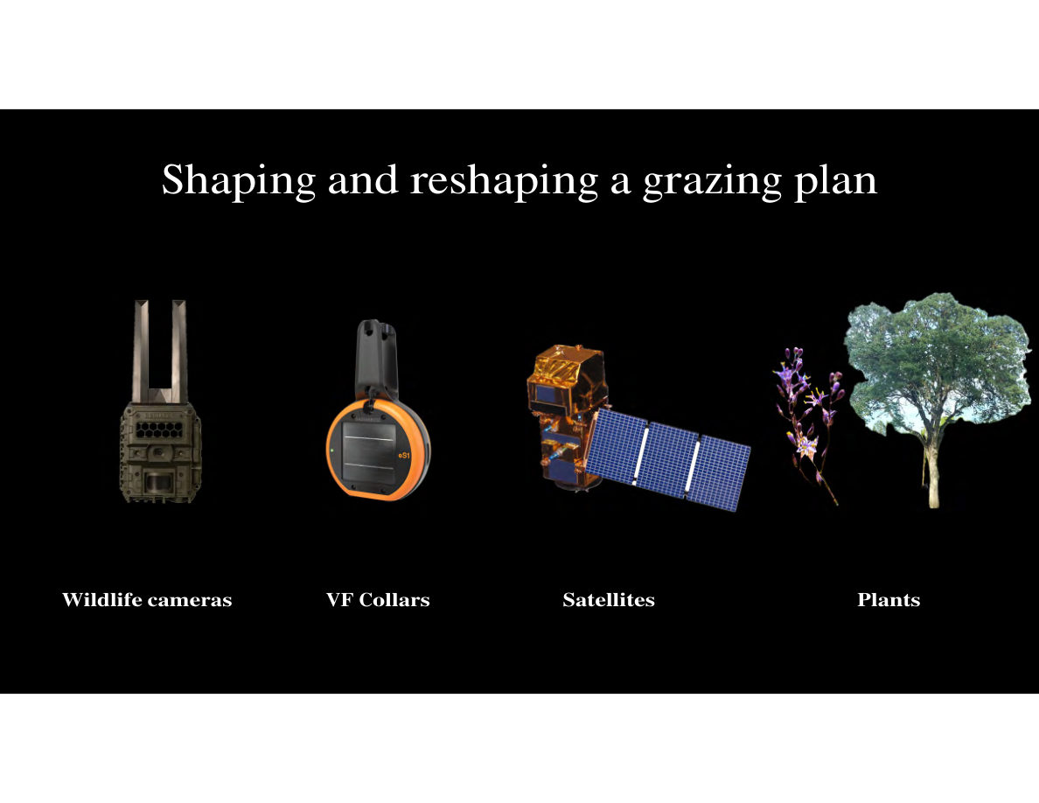
Notes:
SLIDE 50 of 71: Shaping the Grazing Plan – Technology Stack (with Plants)
SLIDE: Shaping and Reshaping a Grazing Plan (updated version)
Same four technology icons, but the fourth category changes from "Water sensors" to "Plants":
1. WILDLIFE CAMERAS (same as previous)
2. VF COLLARS (same as previous)
3. SATELLITES (same as previous)
4. PLANTS – Two plant specimens shown:
• Left: Dichelostemma (brodiaea family) wildflower — slender stem with cluster of small purple-blue star-shaped flowers with yellow stamens. A California native bulb plant.
• Right: A large deciduous tree (valley oak or similar) in full leaf — broad rounded canopy, dark trunk.
Role: Sensitive and indicator plant species phenology (growth timing) drives grazing exclusion timing and location; plant community mapping guides where and when cattle should or should not graze.
This version of the slide emphasizes that plants themselves are data inputs to adaptive management decisions.

Slide 4
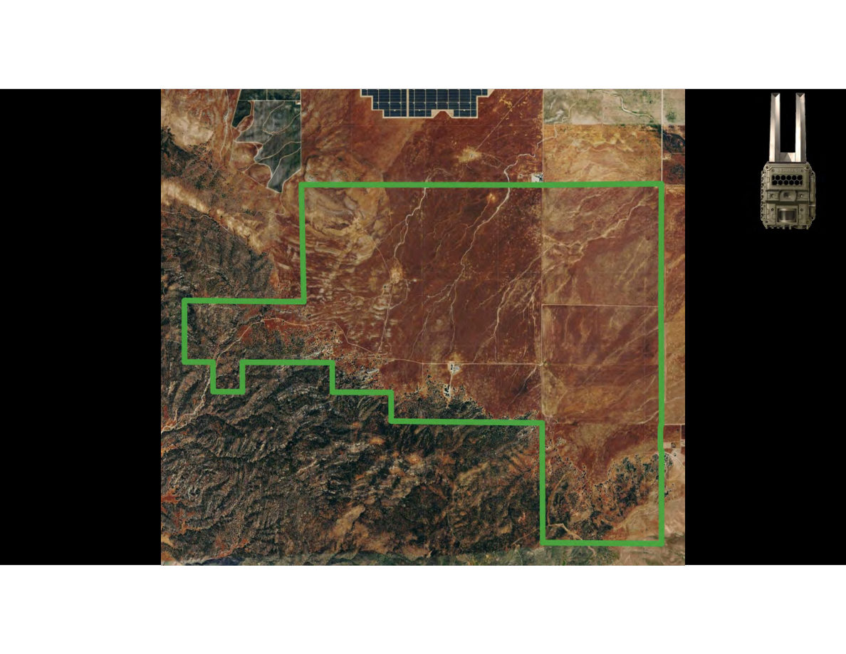
Notes:
SLIDE 51 of 71: Pronghorn Use – Baseline Aerial Map
SLIDE: Pronghorn Spatial Use – Baseline
IMAGE (AERIAL MAP): Satellite aerial photograph of the North Carrizo Unit (flat Carrizo Plain portion of the preserve). The property boundary is outlined in bright green. Terrain is reddish-brown/tan arid plain with some scrub vegetation. Solar panel arrays visible on adjacent private land to the north.
No data points are shown in this slide — this is the baseline view before camera-detected pronghorn locations are overlaid. A small Reconyx camera icon appears in the upper right corner.
Unit orientation: North is approximately toward top. The property is roughly rectangular with some irregular southern boundary. Flat terrain throughout.

Slide 5
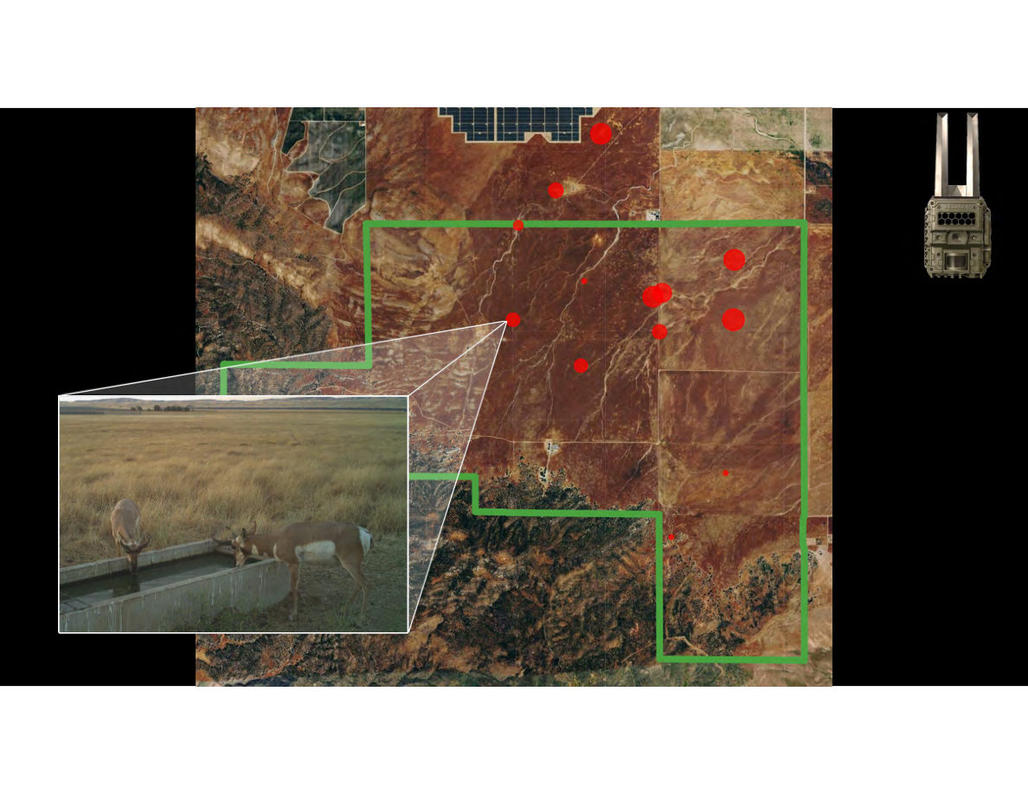
Notes:
SLIDE 52 of 71: Pronghorn Use – Camera Detection Locations
SLIDE: Pronghorn Spatial Use – Camera Detection Data
IMAGE (AERIAL MAP): Same North Carrizo Unit aerial photograph, now with red dots overlaid showing pronghorn detection frequency at each camera location. Dot size is proportional to number of detections (larger dot = more pronghorn photos at that location).
DOT DISTRIBUTION:
• Largest dots (highest use): Central-northern area near water troughs
• Medium dots: Scattered across northern and eastern portions
• Small dots: A few in the southern/central area
• Southern canyon edge: Very little pronghorn camera activity
Overall pattern: Pronghorn concentrate in the flat northern sections, particularly near water sources. The rugged southern canyon terrain has minimal pronghorn use.
INSET PHOTO: Trail camera image showing a pronghorn doe and spotted fawn drinking from a concrete water trough. Both animals are at the trough simultaneously. The fawn is notably small, suggesting recent birth.

Slide 6
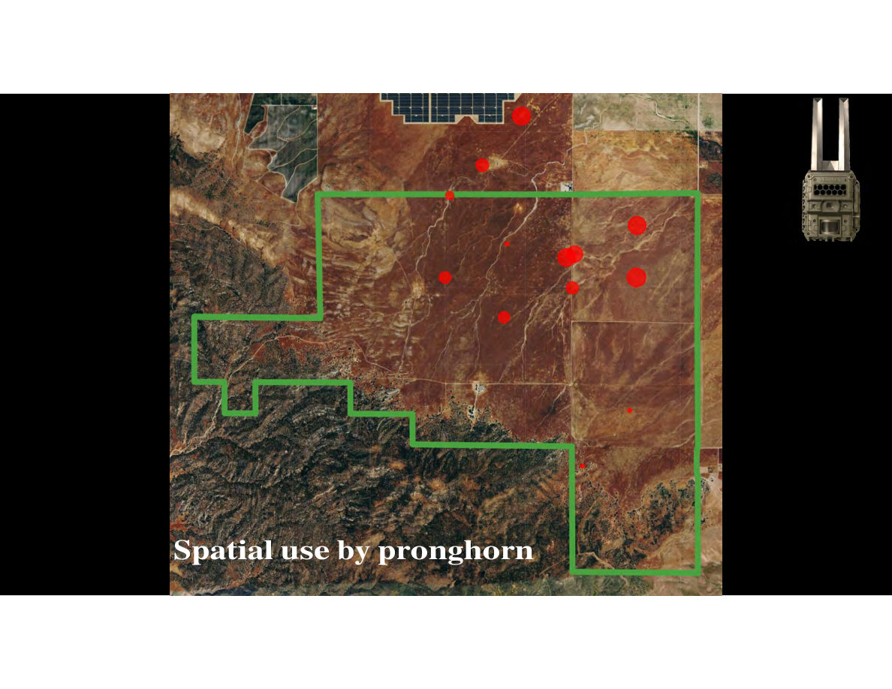
Notes:
SLIDE 53 of 71: Pronghorn Spatial Use – Annotated
SLIDE: Spatial Use by Pronghorn
IMAGE: Same aerial map with red dot data, now with "Spatial use by pronghorn" text label added in white at the bottom.
The spatial pattern shows pronghorn concentrating in the flat arid northern plain sections of the North Carrizo Unit, with highest activity near water sources. Camera icon in upper right corner.
Reconyx wildlife camera icon in upper right.

Slide 7
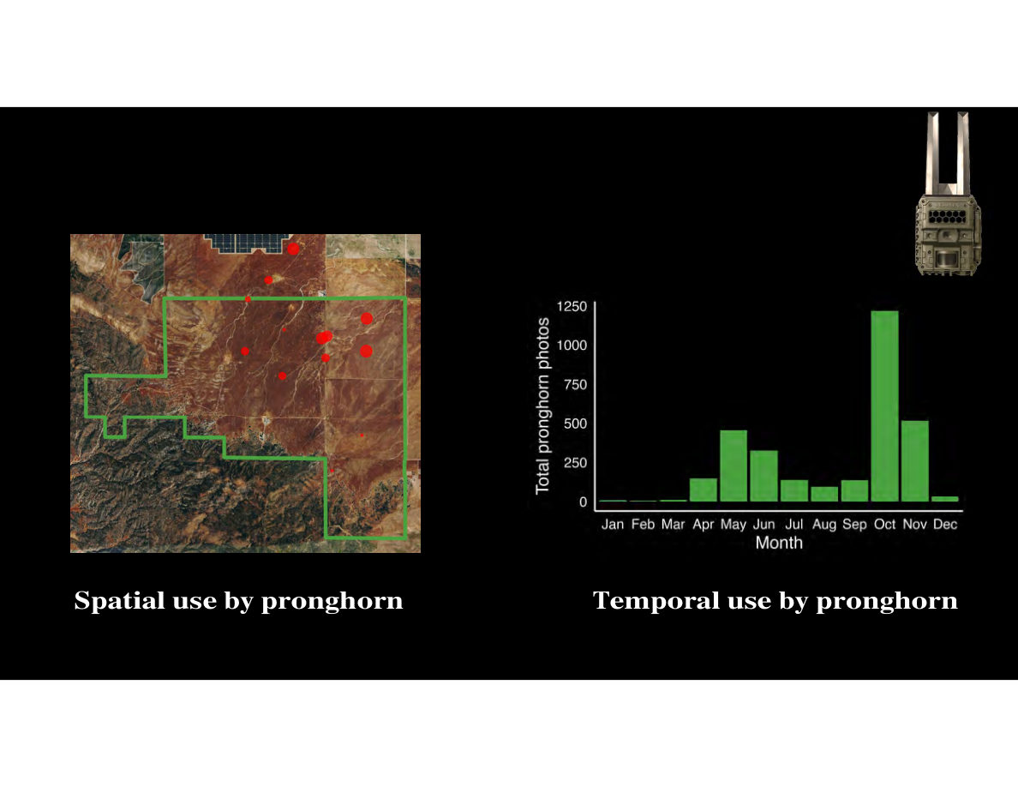
Notes:
SLIDE 54 of 71: Pronghorn Spatial and Temporal Use
SLIDE: Spatial and Temporal Use by Pronghorn
TWO-PANEL SLIDE:
LEFT (SPATIAL MAP): North Carrizo Unit aerial with red dot pronghorn detections — same as previous slides.
RIGHT (BAR CHART – "Temporal use by pronghorn"):
• Y-axis: Total pronghorn photos (0–1,250)
• X-axis: Months (Jan–Dec)
Monthly detection counts (approximate):
Jan: ~5 photos
Feb: ~10 photos
Mar: ~120 photos
Apr: ~450 photos (first major peak – spring)
May: ~300 photos
Jun: ~175 photos
Jul: ~100 photos
Aug: ~100 photos
Sep: ~100 photos
Oct: ~150 photos
Nov: ~1,200 photos (largest peak – fall)
Dec: ~500 photos
INTERPRETATION: Two peaks in pronghorn activity:
1. Spring peak (April–May): possibly related to water needs during dry season onset
2. Fall/rut peak (October–November): pronghorn breeding season increases movement and water use
Lowest activity in winter (Jan–Feb) when rainfall provides alternative water sources.

Slide 8
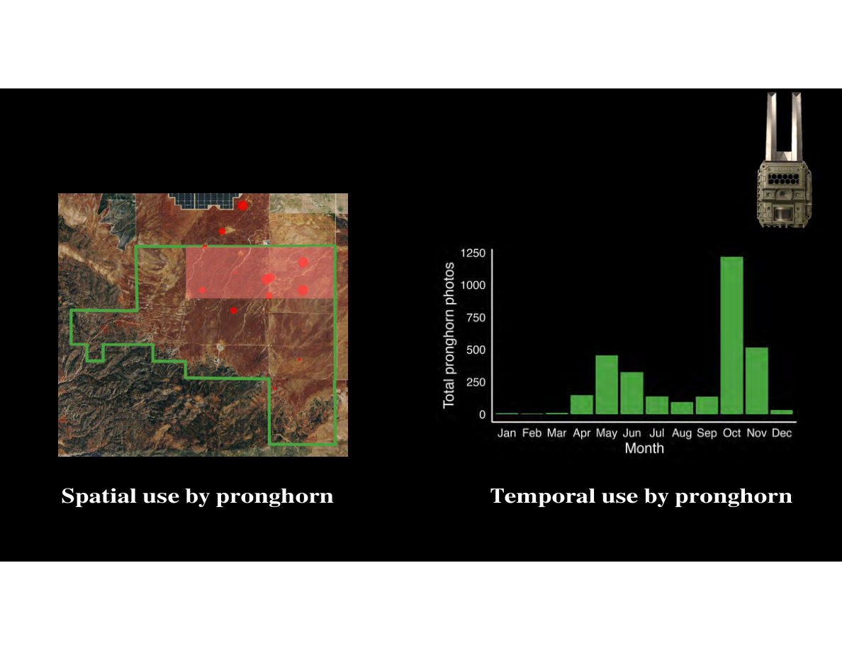
Notes:
SLIDE 55 of 71: Pronghorn Use – Spatial Hotspot Highlighted
SLIDE: Pronghorn Use – Spatial Hotspot Analysis
Same two-panel layout with spatial map and temporal bar chart.
NEW FEATURE: A pink/salmon transparent rectangle has been overlaid on the spatial map, highlighting the area of concentrated pronghorn activity in the northern portion of the North Carrizo Unit. The highlighted zone covers approximately the north-central area where the largest red dots are clustered — this is the primary pronghorn use zone.
Interpretation: Pronghorn are not uniformly distributed across the unit — they concentrate in a specific zone in the northern flat terrain, presumably due to proximity to water, forage quality, and terrain preference (pronghorn prefer flat open areas with long sight lines for predator detection).
The temporal bar chart remains the same.

Slide 9
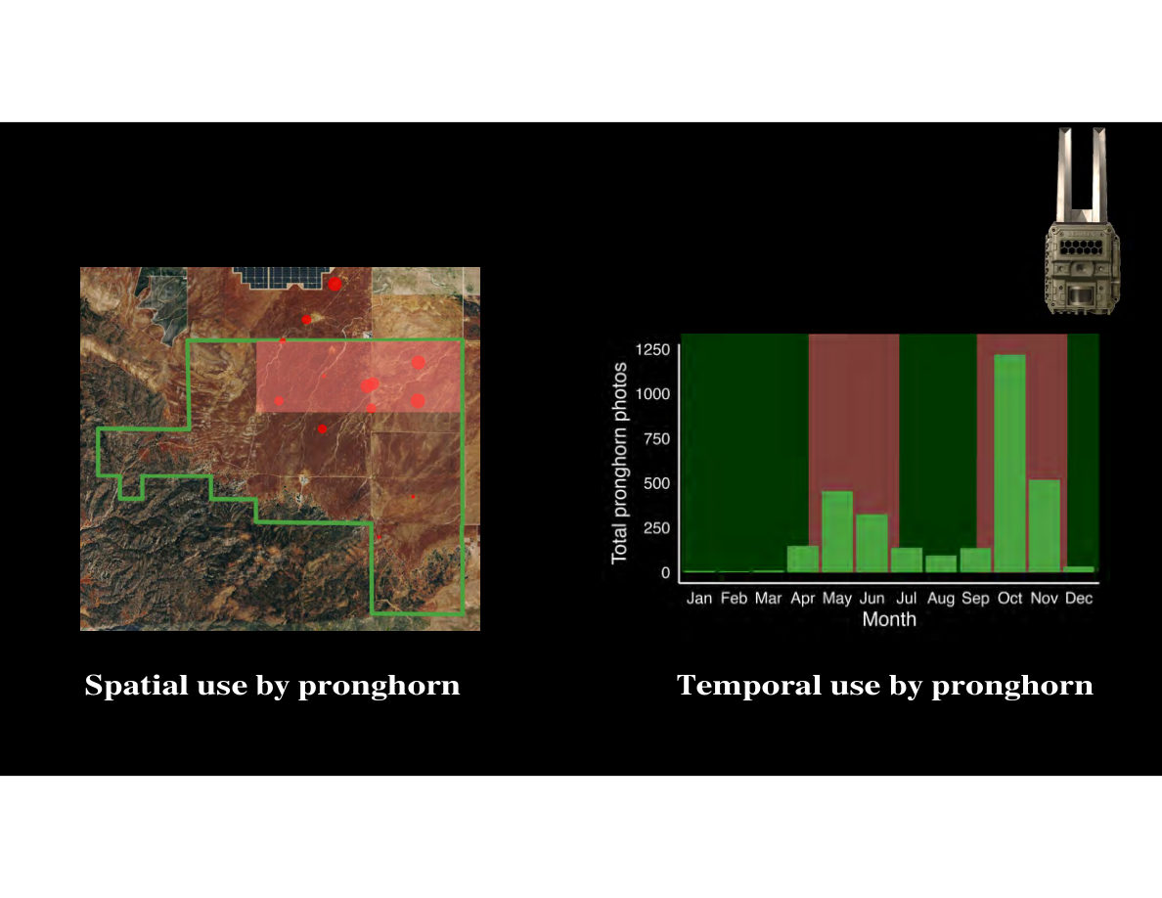
Notes:
SLIDE 56 of 71: Pronghorn Use – Temporal Hotspot Highlighted
SLIDE: Pronghorn Use – Temporal Hotspot Analysis
Same two-panel layout.
NEW FEATURE: The bar chart now has an olive/dark green overlay highlighting the months of PEAK pronghorn activity while low-activity months remain as bright green bars against the dark background.
Highlighted (peak) months: April–May (spring peak) and October–November (fall/rut peak)
Lower-activity months: January–February, June–August (minimal use)
COMBINED INTERPRETATION:
WHERE: Northern flat terrain, near water sources (spatial hotspot)
WHEN: April–May and October–November (temporal hotspot)
This informs grazing scheduling: if cattle grazing in the pronghorn hotspot zone is planned during peak pronghorn months (April–May, October–November), managers need to consider potential competition for water and forage, and may need to adjust virtual paddock locations accordingly.

Slide 10
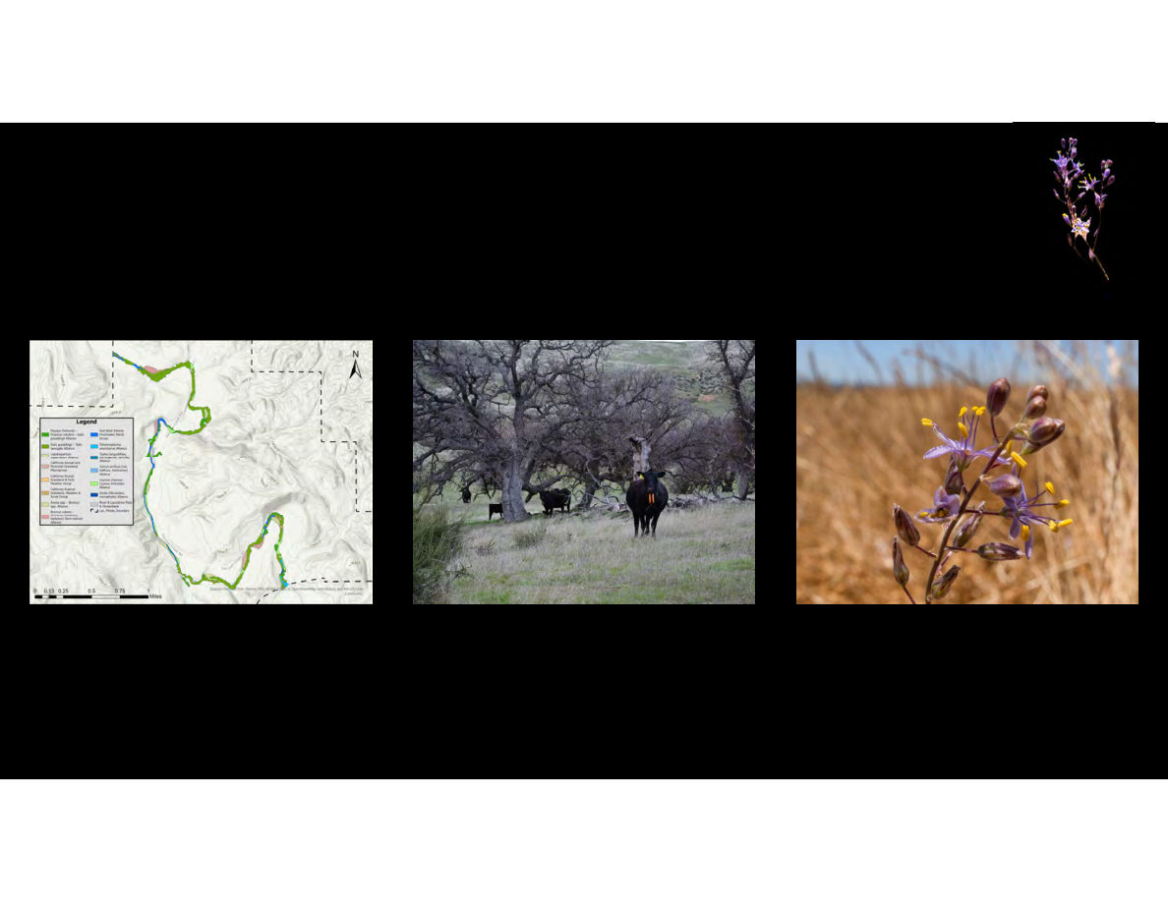
Notes:
SLIDE 57 of 71: Sensitive Plants – San Juan Unit Overview
SLIDE: Sensitive Plant Communities – San Juan Unit
THREE-PANEL IMAGE:
LEFT: Vegetation map thumbnail (San Juan Unit riparian corridor — see Slide 58 for full detail).
CENTER PHOTO: Cattle wearing eShepherd virtual fence collars grazing in oak woodland. Cattle are black Angus, wearing orange VF collars. Green grass understory. Bare-limbed oak trees in winter/early spring condition. Rolling grassy hills visible in background.
RIGHT PHOTO: Close-up of a Dichelostemma (brodiaea family) wildflower in bloom. The flower cluster shows: purple-blue star-shaped petals, 6 petals per flower, bright yellow anthers. Multiple flowers open at different stages on the stem, with brown ovary/seed capsules below. Background is soft-focus golden dry grass. This sensitive native bulb species is a key driver of grazing exclusion timing.
Plant icon (small purple Dichelostemma illustration) in upper right corner.

Slide 11
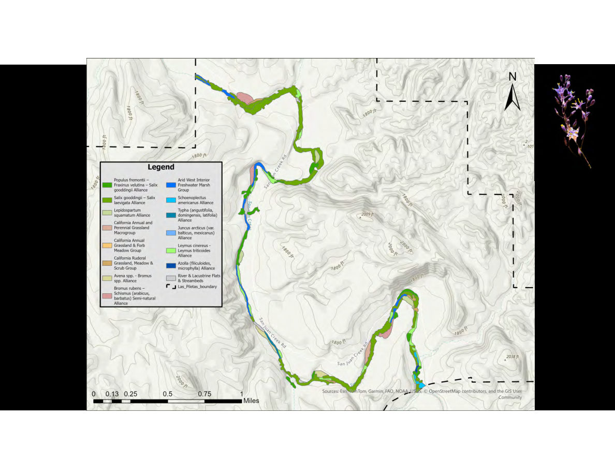
Notes:
SLIDE 58 of 71: San Juan Unit Vegetation Map
SLIDE: San Juan Unit Riparian Vegetation Map
IMAGE (DETAILED VEGETATION MAP): Botanical vegetation alliance map of the San Juan Creek riparian corridor within the San Juan Unit of Las Piletas Ranch Preserve.
Map features:
• Background: Gray topographic hillshade
• Topographic contours at 1-foot intervals
• San Juan Creek Road labeled (north and south sections)
• Property boundary: Black dashed line (Las_Piletas_boundary)
• North arrow and scale bar (0–1 mile)
VEGETATION ALLIANCES (color-coded, full legend):
Dark green: Populus fremontii–Fremont Cottonwood/Velvet Ash/Goodding's Willow Alliance (riparian woodland)
Medium green: Salix gooddingii–Salix laevigata Alliance (willow woodland)
Tan/pale: Lepidospartum squamatum Alliance (scale-broom scrub)
Light tan: California Annual and Perennial Grassland Macrogroup
Orange: California Annual Grassland & Forb Meadow Group
Dark brown/tan: California Ruderal Grassland, Meadow & Scrub Group
Yellow: Avena spp.–Bromus spp. Alliance (oat-brome annual grassland)
Pink/salmon: Bromus rubens–Schismus (arabicus, barbatus) Semi-natural Alliance (invasive annual grasses)
Blue: Arid West Interior Freshwater Marsh Group
Cyan: Schoenoplectus americanus Alliance (bulrush marsh)
Teal: Typha (angustifolia, domingensis, latifolia) Alliance (cattail marsh)
Blue-green: Juncus arcticus var. balticus/mexicanus Alliance (rush)
Dark blue: Leymus cinereus–Leymus triticoides Alliance (wild rye)
Deep blue dot: Azolla (filiculoides, microphylla) Alliance (water fern)
White/outline: River & Lacustrine Flats & Streambeds
PATTERN: Vegetation alliances form linear strips following the creek corridor. Diversity of wetland/riparian types reflects the complexity of water availability and flow regime along San Juan Creek.

Slide 12
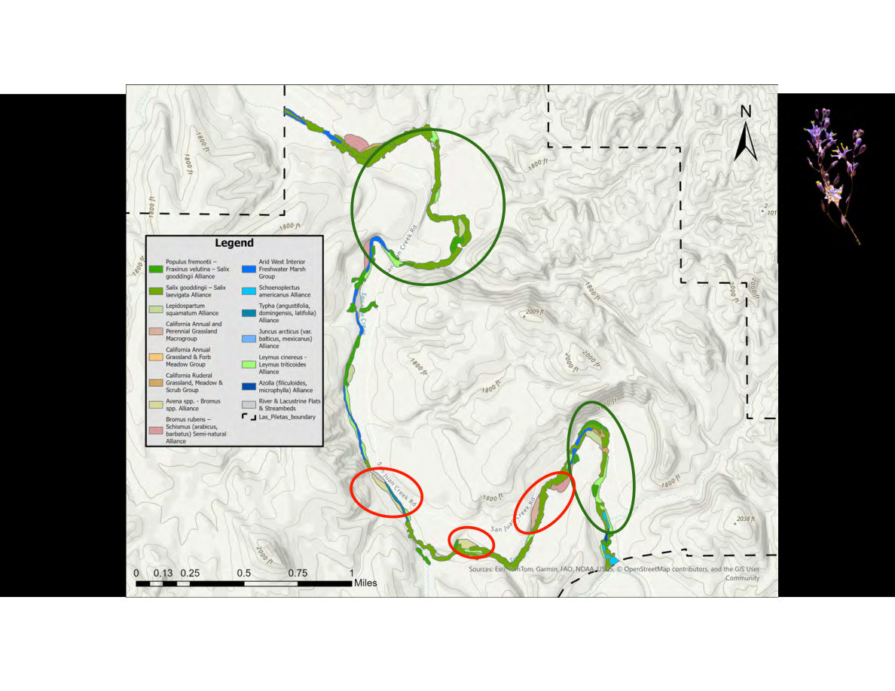
Notes:
SLIDE 59 of 71: San Juan Unit Vegetation Map – Areas Highlighted
SLIDE: San Juan Unit Vegetation Map with Priority Areas Annotated
Same detailed vegetation map as previous slide, with three annotation circles:
GREEN CIRCLE (large, north section): Highlights the northern portion of the riparian corridor where San Juan Creek meanders create a complex of diverse riparian habitat types. Multiple vegetation alliances present in close proximity. This is a HIGH-CONSERVATION VALUE area — likely priority for grazing exclusion or careful management.
RED CIRCLES (two, middle and south sections):
1. Middle section: Highlights an area with pink/salmon coloring (Bromus rubens–Schismus Alliance) — invasive annual grasses indicating degraded or disturbed riparian conditions.
2. South section: Highlights another area of concern, possibly additional invasive grass or disturbed habitat.
Interpretation: Green circle = protect/maintain. Red circles = areas of concern requiring management intervention (possible weed control, restoration, or careful grazing management to prevent further degradation).

Slide 13
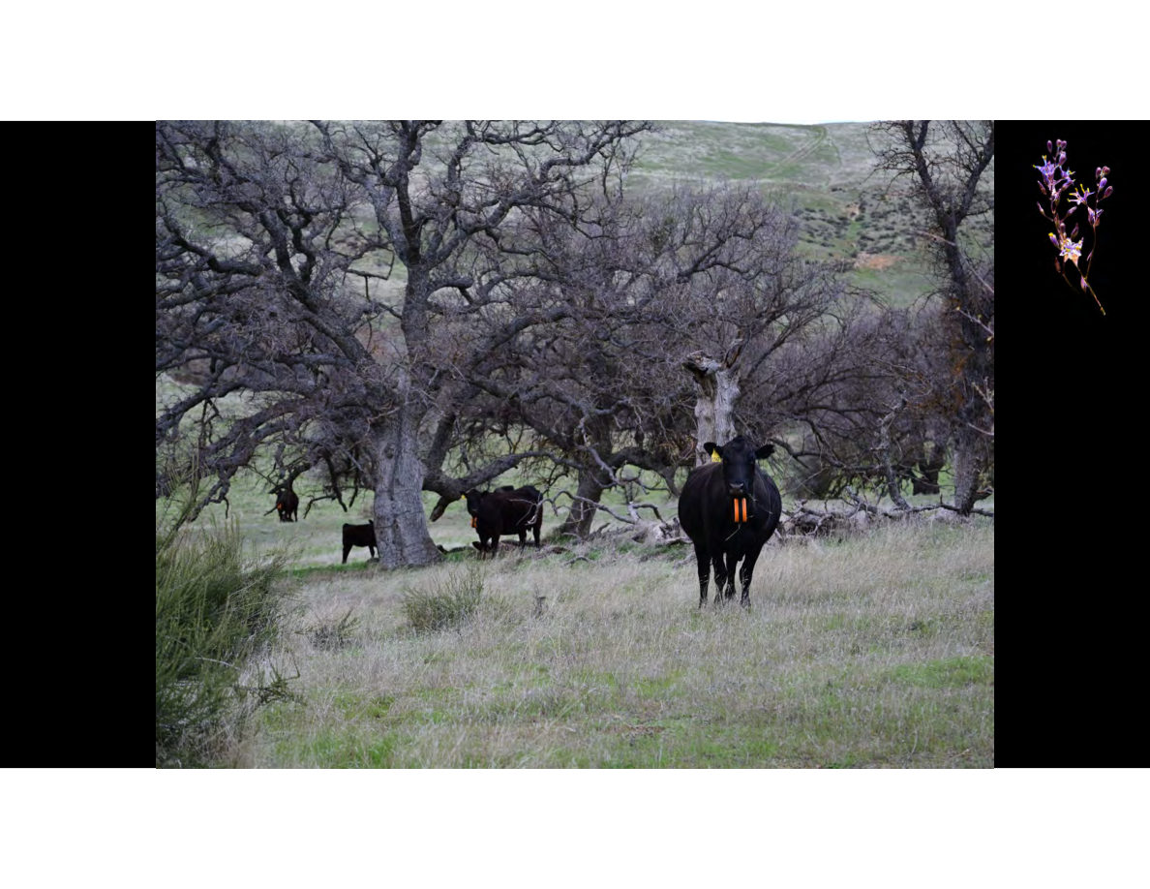
Notes:
SLIDE 60 of 71: Cattle in Oak Woodland – No Exclusion
SLIDE: Cattle in Oak Woodland (baseline grazing)
IMAGE DESCRIPTION: Photograph of several black Angus cattle grazing in open oak woodland with green grass understory. Trees are large, gnarled valley oaks or blue oaks with bare limbs (late winter/early spring). The cattle are wearing orange eShepherd virtual fence collars. Rolling grassy hills visible in background. A small orange VF collar is clearly visible on the nearest animal. The image shows cattle actively using the San Juan Unit riparian/woodland habitat.
This is the "before exclusion" reference state — cattle present in the woodland area.

Slide 14
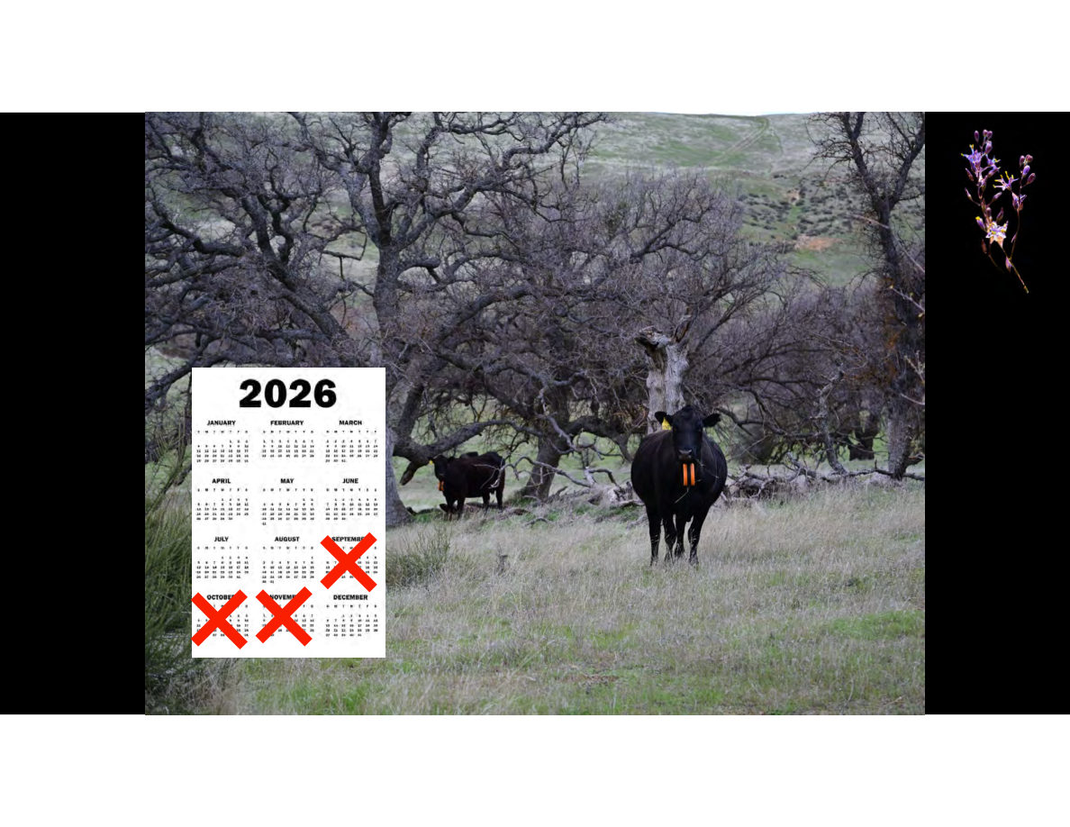
Notes:
SLIDE 61 of 71: Cattle in Oak Woodland – With Exclusion Calendar
SLIDE: Grazing Exclusion Calendar for Sensitive Species
IMAGE: Same cattle-in-oak-woodland photograph as previous slide.
OVERLAY: A 2026 calendar is shown in the lower-left portion of the image. Red X marks are stamped over three months:
✗ September 2026 (crossed out)
✗ October 2026 (crossed out)
✗ November 2026 (crossed out)
INTERPRETATION: Cattle will be excluded from the sensitive San Juan Unit riparian and woodland areas during September, October, and November 2026. This timing is driven by the phenology (growth and reproduction cycle) of sensitive plant species — particularly the Dichelostemma wildflower shown on adjacent slides — which requires protection during its late-summer/fall bulb development and seed set period.
Virtual fencing makes this exclusion easy to implement: managers simply redraw paddock boundaries in the eShepherd app to move cattle away from sensitive areas during the exclusion months, without installing physical temporary fences.

Slide 15
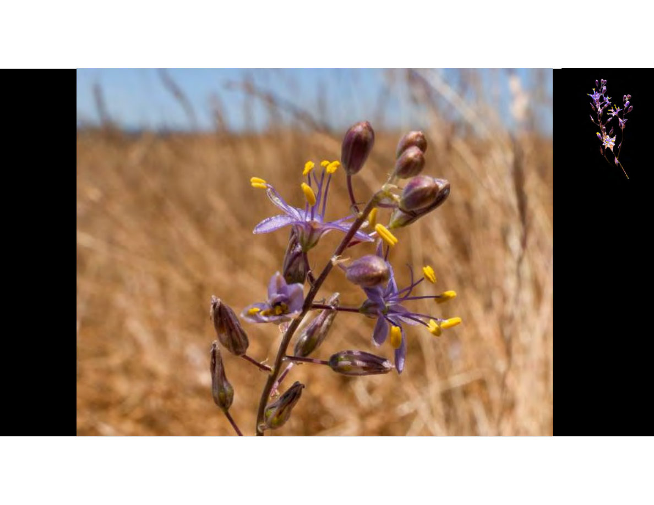
Notes:
SLIDE 62 of 71: Dichelostemma Wildflower – Full Frame
SLIDE: Dichelostemma Wildflower (sensitive species)
IMAGE DESCRIPTION: Full-frame close-up photograph of a Dichelostemma multiflorum or similar species (blue-dicks or brodiaea family) wildflower in bloom.
Botanical details visible:
• Stem: Slender, slightly reddish-brown
• Flowers: Purple-blue petals, 6 per flower, arranged in star/lily shape
• Stamens: Bright yellow, prominent, extending beyond petals
• Buds: Multiple brown oblong buds at various stages — some opening, some still closed
• Several fully open flowers and several tight buds on the same stem
• Background: Soft-focus golden/tan dry grass — typical Carrizo Plain summer grassland
• Blue sky visible at top edge
Dichelostemma is a California native bulb plant (family Themidaceae/Asparagaceae). It blooms in late spring to early summer after annual grasses have dried. Bulbs are sensitive to trampling and soil compaction, making cattle exclusion during bulb development and seed set (late summer/fall) critical for population maintenance.

Slide 16
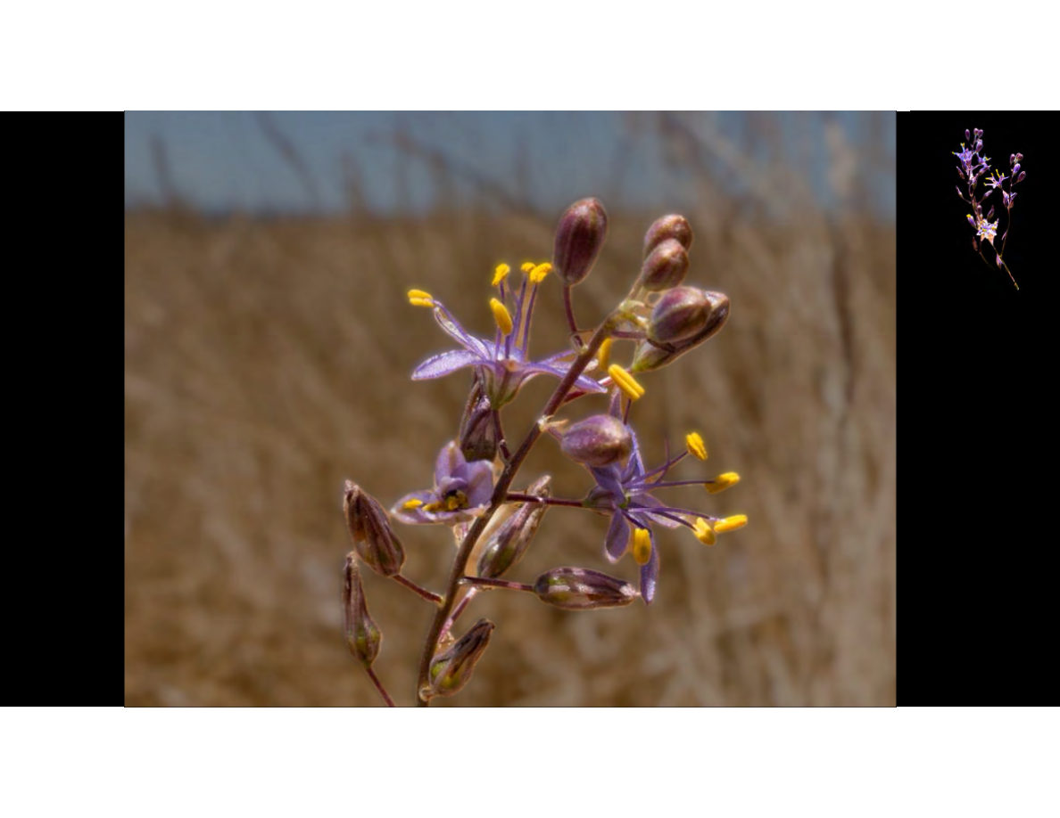
Notes:
SLIDE 63 of 71: Dichelostemma Wildflower – Variation
SLIDE: Dichelostemma Wildflower (second photograph)
IMAGE DESCRIPTION: Another close-up photograph of the same or similar Dichelostemma species. Slightly different angle/framing from the previous slide.
Similar botanical details:
• Purple-blue star-shaped flowers with bright yellow stamens
• Mix of open flowers and brown seed capsules/unopened buds
• Slender reddish stem
• Background: Blurred golden grass and tan/brown grassland
This slide reinforces the visual identification of this sensitive species and its importance to the adaptive grazing strategy. The presence of Dichelostemma populations in the San Juan Unit riparian areas drives the September–November grazing exclusion timing shown on the previous calendar slide.

Slide 17
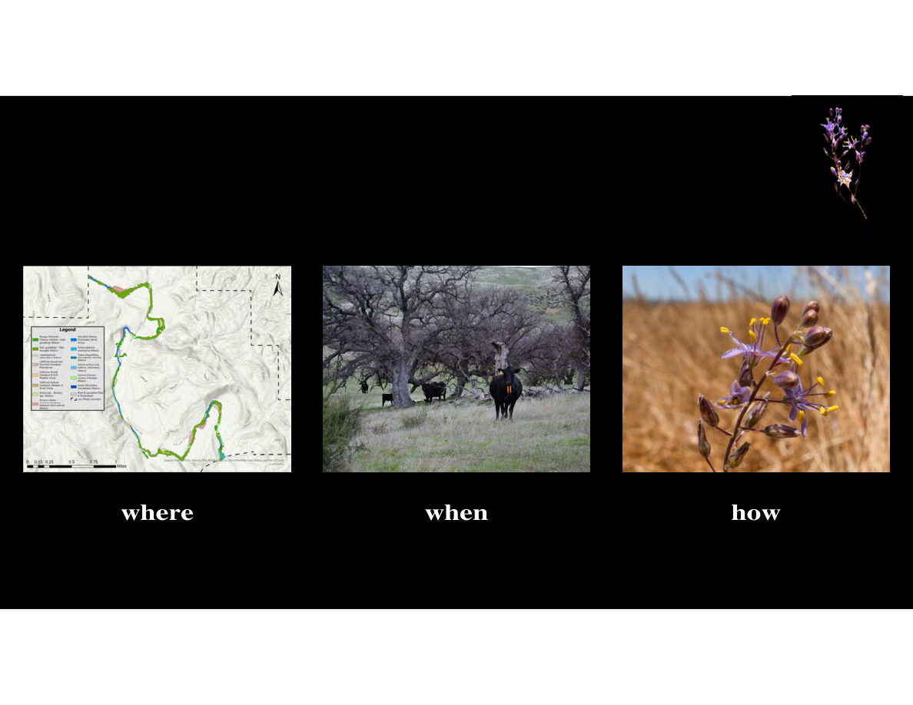
Notes:
SLIDE 64 of 71: Adaptive Grazing – Where, When, How
SLIDE: Adaptive Grazing Framework – Where, When, How
Three-panel graphic on black background:
LEFT PANEL – "where":
Image: San Juan Unit vegetation map (thumbnail) showing riparian plant alliances in color
Label: "where"
Meaning: Vegetation mapping tells managers WHERE sensitive species are located and WHERE specific habitat types need protection or careful management.
CENTER PANEL – "when":
Image: Cattle with VF collars grazing in oak woodland (green understory)
Label: "when"
Meaning: Phenology of sensitive plants (like Dichelostemma's fall bulb development period) and pronghorn activity peaks tell managers WHEN to exclude or rotate cattle.
RIGHT PANEL – "how":
Image: Close-up of Dichelostemma wildflower in bloom
Label: "how"
Meaning: Understanding which species are present and their growth requirements informs HOW cattle should be managed (intensity, duration, season) to protect and promote sensitive plant communities.
Dichelostemma icon in upper right.
SUMMARY: The adaptive grazing strategy integrates spatial (where), temporal (when), and ecological (how) data from multiple technology sources to continuously refine management.

Slide 18
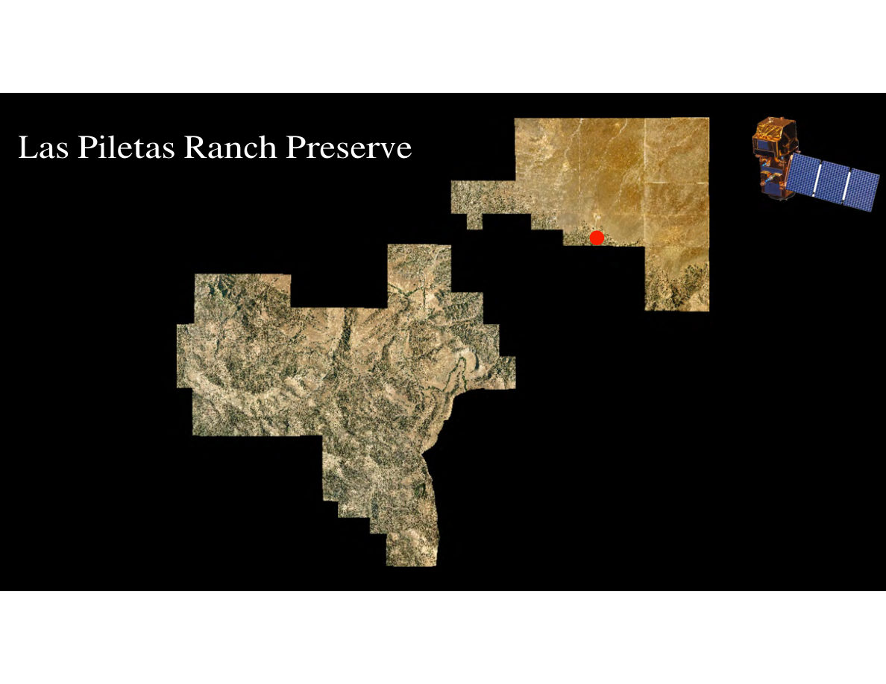
Notes:
SLIDE 65 of 71: Satellite Integration – Las Piletas Ranch Full Preserve
SLIDE: Las Piletas Ranch Preserve – Satellite Overview
IMAGE: Aerial satellite view of the full Las Piletas Ranch Preserve showing both management units. Two distinct landscape types visible:
NORTH CARRIZO UNIT (upper right, larger):
• Flat, arid, reddish-brown terrain typical of Carrizo Plain
• Rectangular property boundary
• A small red dot indicates a specific location (camera or water point)
• Adjacent solar panels visible to north
SAN JUAN UNIT (lower left, larger, more complex):
• Rugged canyon terrain with dark rock outcroppings and mixed vegetation
• Irregular boundary following terrain features
• Much more topographic relief than the Carrizo unit
Satellite icon (gold communications satellite with solar panels) in upper right corner.
The two units are geographically separate parcels that together make up the full Las Piletas Ranch Preserve.

Slide 19
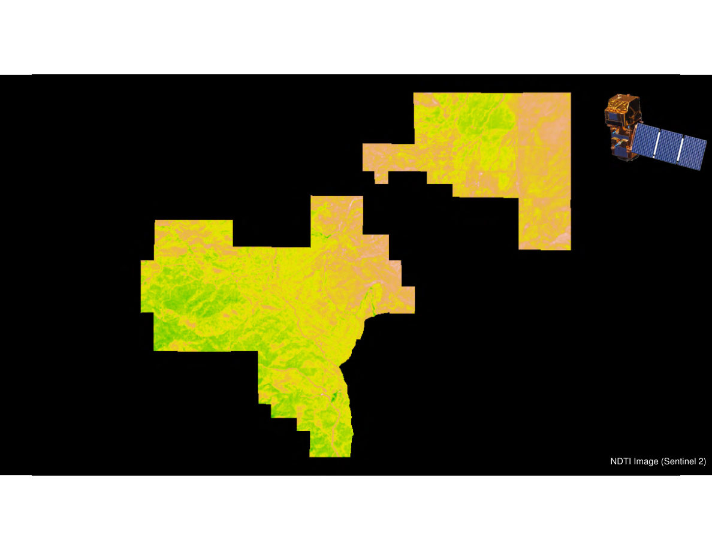
Notes:
SLIDE 66 of 71: Satellite – NDTI Residual Dry Matter Map
SLIDE: NDTI Residual Dry Matter Map – Full Preserve
IMAGE (FALSE-COLOR NDTI MAP): Sentinel-2 satellite-derived NDTI map covering both units of Las Piletas Ranch Preserve (broken into image tiles due to cloud cover or acquisition dates).
Color interpretation (NDTI scale):
• Bright yellow-green: Highest NDTI = highest residual dry matter (most standing grass)
• Yellow/lime: Moderate-high NDTI
• Orange/tan: Low-moderate NDTI
• Pink/light orange: Low NDTI = low residual dry matter (grazed out or bare)
Spatial patterns:
NORTH CARRIZO UNIT: Northern section shows moderate-high NDTI (yellow-green patches in northeast). Southern flat section shows lower NDTI (orange), suggesting more grazing impact or lower grass density.
SAN JUAN UNIT: The canyon unit shows predominantly high NDTI values (bright yellow-green throughout), indicating dense standing grass cover in the canyons.
Label: "NDTI Image (Sentinel 2)" — bottom right.
Satellite icon in upper right.

Slide 20
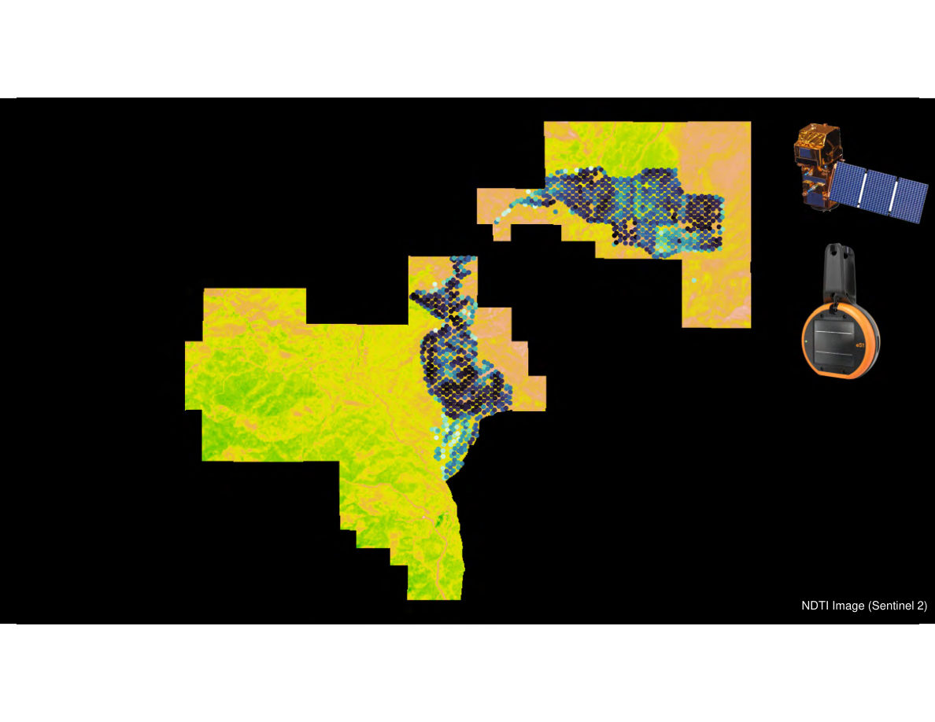
Notes:
SLIDE 67 of 71: Satellite + Virtual Fence – Combined Data View
SLIDE: Integrating Satellite NDTI with Virtual Fence GPS Data
IMAGE (COMBINED MAP): Same NDTI false-color map overlaid with GPS collar location data.
GPS LOCATIONS (dark blue/navy dots): Individual cattle GPS collar positions showing the herd's current or recent location on the NDTI map.
Cattle location patterns:
NORTH CARRIZO UNIT: A linear band of dense GPS points runs roughly east-west across the center of the unit, following what appears to be a drainage corridor or access road. The concentration suggests cattle are preferentially using this corridor.
SAN JUAN UNIT (upper right section): Cattle GPS points cluster in the eastern portion of that unit.
COMBINED INTERPRETATION:
• The cattle in the North Carrizo Unit are concentrated in an area of moderate-to-low NDTI, suggesting they may be grazing down available forage in that corridor while adjacent areas with higher NDTI remain less grazed
• This spatial mismatch between where cattle are (GPS) and where forage is available (NDTI) would prompt a management response: move the virtual paddock to redirect cattle to ungrazed high-NDTI areas
Icons: Satellite (upper right) and eShepherd VF collar (orange, right side).

Slide 21
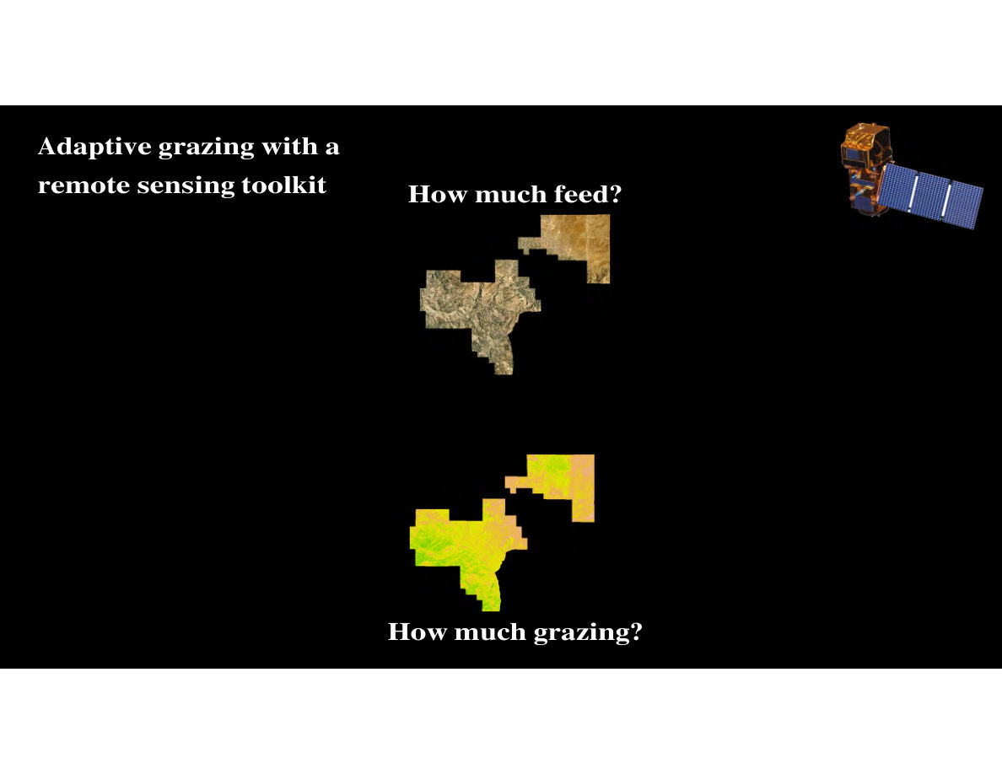
Notes:
SLIDE 68 of 71: Adaptive Grazing Framework – Questions
SLIDE: Adaptive Grazing with a Remote Sensing Toolkit
TWO KEY QUESTIONS:
1. "How much feed?" — Answered by satellite imagery (current forage production)
2. "How much grazing?" — Answered by GPS collar data (where cattle have grazed and what RDM remains)
IMAGE: Two small satellite map images of Las Piletas Ranch Preserve:
TOP: Natural color aerial view (tan/brown terrain) — represents "How much feed?" — what forage exists before grazing
BOTTOM: NDTI false-color view (yellow-green-orange) — represents "How much grazing has occurred?" — what remains after grazing
The juxtaposition of pre- and post-grazing satellite imagery enables quantitative assessment of forage consumption.

Slide 22
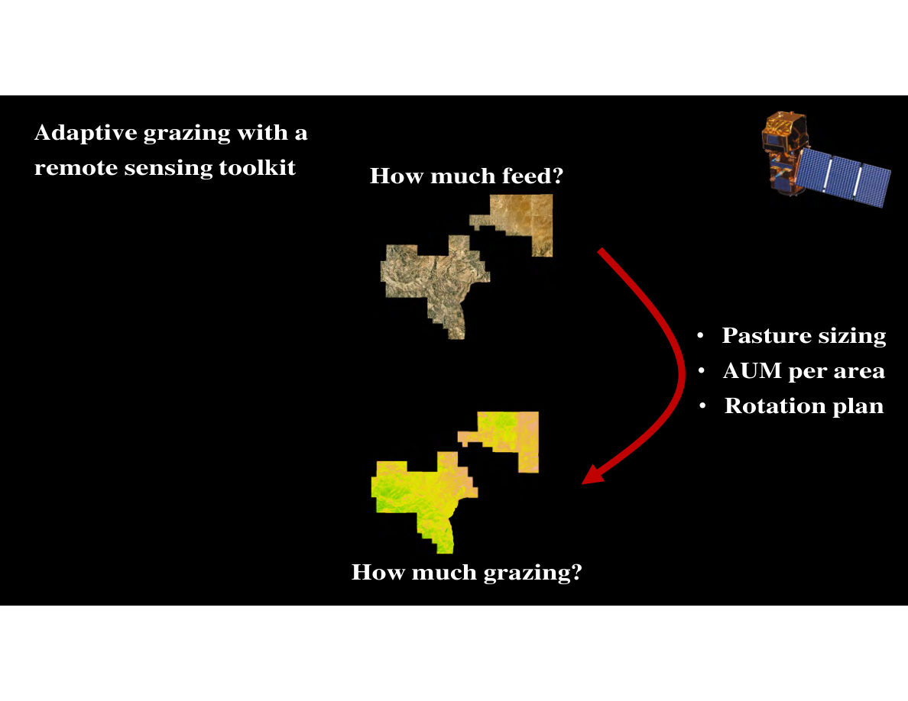
Notes:
SLIDE 69 of 71: Adaptive Grazing Framework – Decision Loop (Pasture Sizing)
SLIDE: Adaptive Grazing with Remote Sensing Toolkit – Decision Framework
IMAGE (DIAGRAM): Flow diagram on black background.
INPUTS:
• "How much feed?" (top, with natural-color satellite map)
• "How much grazing?" (bottom, with NDTI satellite map)
PROCESS ARROW: Large red curved arrow from "How much feed?" curves right to three bullet points:
• Pasture sizing — how large should each virtual paddock be?
• AUM per area — how many Animal Unit Months of forage are in each area?
• Rotation plan — how long should cattle graze each paddock before moving?
These three decisions translate satellite forage data into actionable grazing management.
Satellite icon in upper right.

Slide 23
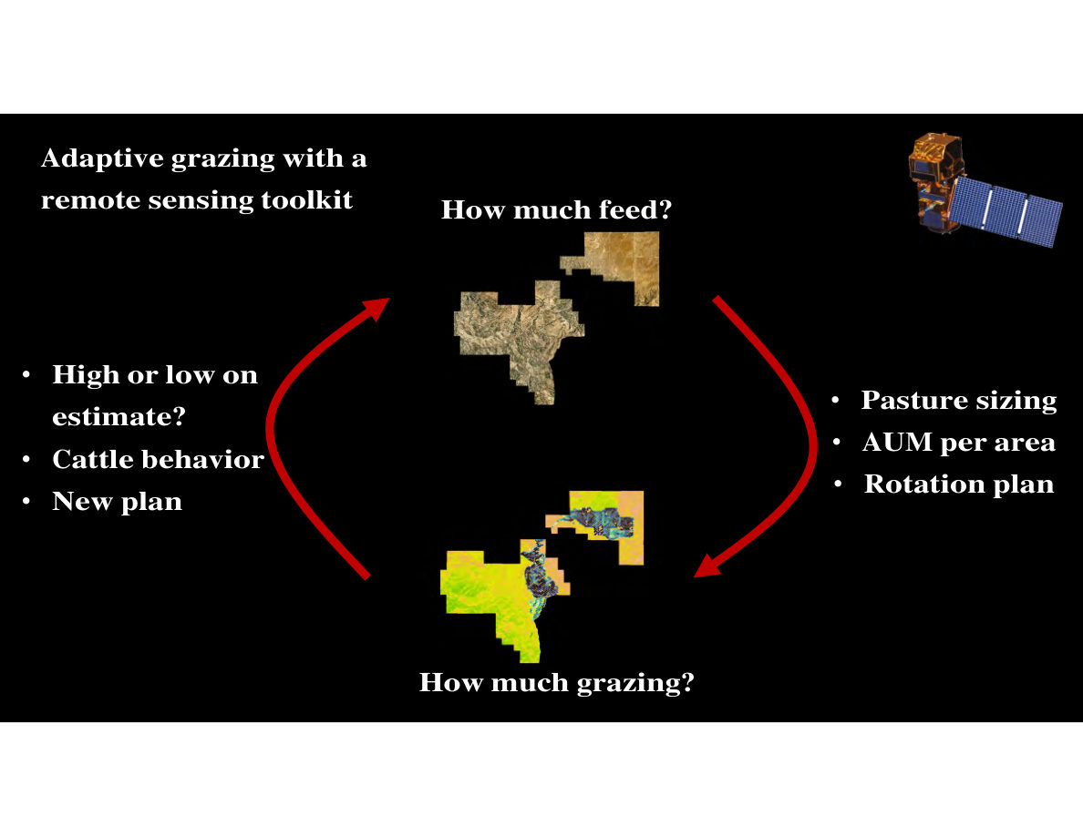
Notes:
SLIDE 70 of 71: Adaptive Grazing Framework – Full Feedback Loop
SLIDE: Adaptive Grazing with Remote Sensing Toolkit – Complete Feedback Loop
IMAGE (DIAGRAM): Full adaptive management feedback loop on black background.
COMPLETE CYCLE:
RIGHT SIDE (planning):
• "How much feed?" (satellite imagery showing pre-grazing forage)
→ Large red arrow curves right to:
• Pasture sizing
• AUM per area
• Rotation plan
→ Arrow continues down to:
BOTTOM (monitoring):
• "How much grazing?" (NDTI map now WITH GPS collar dots showing actual cattle distribution)
LEFT SIDE (adaptation):
→ Large red arrow curves left and up back to "How much feed?" with these adaptation triggers:
• High or low on estimate? — was the forage estimate accurate?
• Cattle behavior — are cattle using the paddock as expected?
• New plan — update the grazing strategy based on what was observed
SUMMARY: The loop continuously cycles: estimate forage → set stocking plan → monitor actual grazing → adjust estimate and plan → repeat. Virtual fencing enables rapid plan adjustments at any point in the cycle.
Satellite icon upper right.

Slide 24
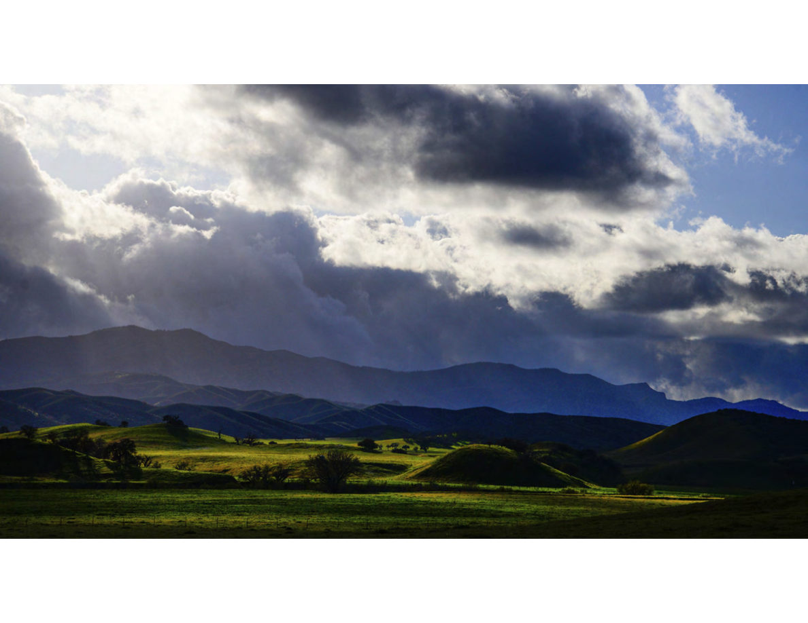
Notes:
SLIDE 71 of 71: Closing Landscape
CLOSING SLIDE – Las Piletas Ranch Preserve
IMAGE DESCRIPTION: Wide panoramic landscape photograph in late afternoon light. Rolling green grassland hills in the foreground and middle ground lit by warm golden sunlight. The grasses are lush green (winter/spring conditions). Several small rounded volcanic plug hills are visible in the middle distance. A fence line runs along the lower edge of the frame. Dark, dramatic storm clouds dominate the upper sky — deep purple-gray and nearly black in places. Blue sky and bright light break through in the upper right corner, creating a dramatic chiaroscuro effect. The landscape conveys both the beauty and the challenging climate conditions of California's rangelands.
---
PRESENTATION SUMMARY:
Central Coast Rangeland Coalition – Spring 2026
"Forage, Water and Fence: Technologies Benefitting Ranchers and Rangeland Managers"
Las Piletas Ranch Preserve (purchased by TNC June 2022)
Presented by:
• Ethan Inlander – Preserve Director, Stewardship Lead
• Dillon Brook – Stewardship Associate
• Gabe Runte, PhD – Applied Scientist
Organization: The Nature Conservancy
Key technologies demonstrated:
Water: Ranchbot IoT monitoring, solar pumps, distributed troughs
Cameras: Reconyx wildlife cameras + Animl AI classification (1.25M+ images)
Fence: 7.5 miles modified, 5 miles removed; pronghorn documented crossing immediately
Virtual Fencing: Gallagher eShepherd with GPS collars
Remote Sensing: Upstream Tech Lens, Rangeland Analysis Platform, Sentinel-2 NDTI
LiDAR: Sub-meter DEM, geomorphic classification, erosion mapping
Adaptive Management: Spatial + temporal pronghorn data, plant phenology, grazing feedback loops

