Slide 1
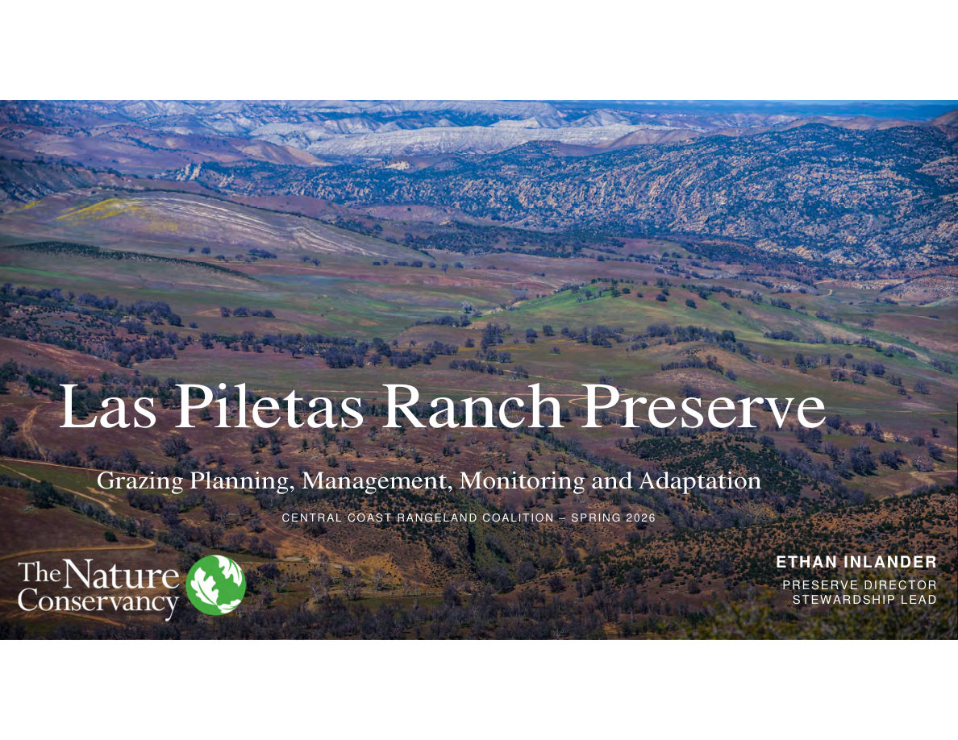
Notes:
SLIDE 26 of 71: Grazing Planning – Section Title SECTION TITLE SLIDE: Las Piletas Ranch Preserve – Grazing Planning, Management, Monitoring and Adaptation Presenter: Ethan Inlander, Preserve Director / Stewardship Lead Organization: The Nature Conservancy Event: Central Coast Rangeland Coalition – Spring 2026 IMAGE DESCRIPTION: Wide aerial landscape view of Las Piletas Ranch Preserve in winter/spring. Green grasses cover rolling hills. Distinctive white chalky/volcanic rock outcroppings and ridgeline of the Caliente Range form a dramatic backdrop. Oak woodland in valleys. A fence line and dirt road visible in foreground. Soft winter light. The landscape shows the complexity and beauty of the preserve — grassland, woodland, and rugged mountain terrain in close proximity.

Slide 2
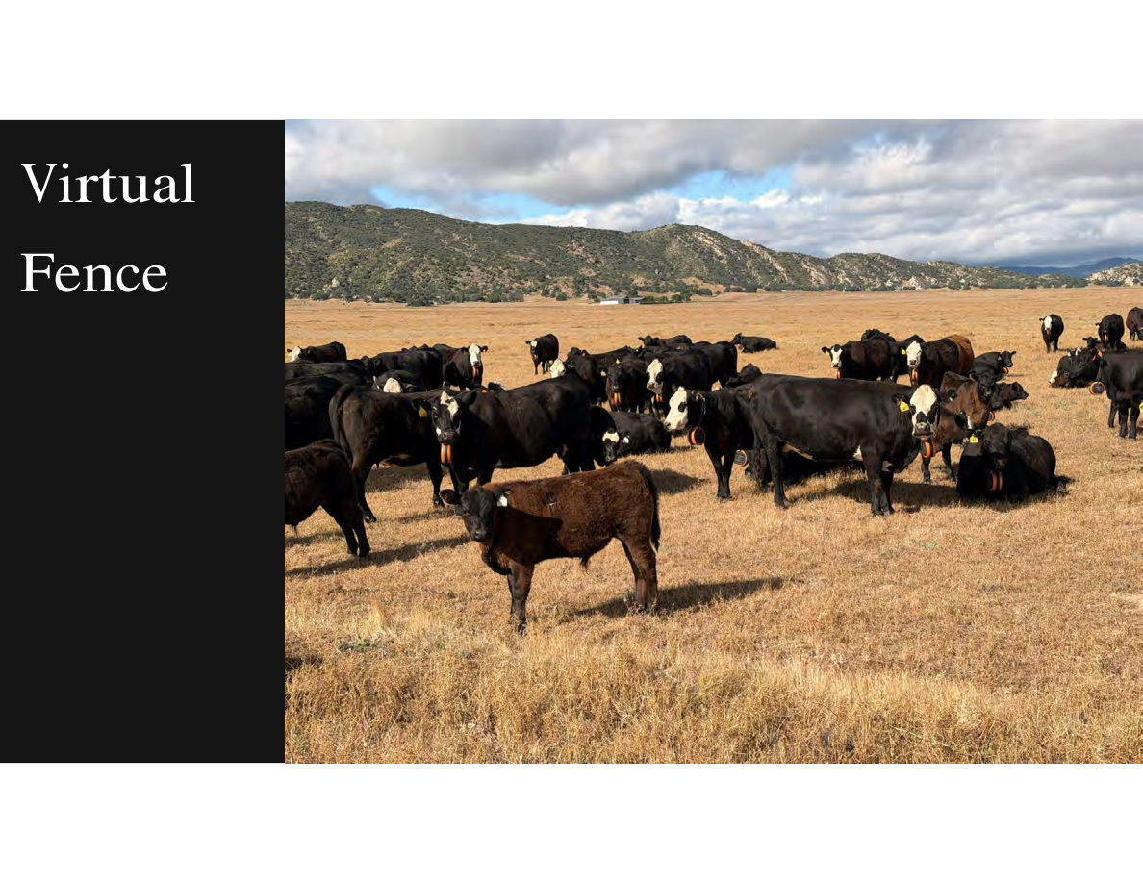
Notes:
SLIDE 27 of 71: Virtual Fence – Introduction SLIDE: Virtual Fence IMAGE DESCRIPTION: Photograph of a herd of approximately 40 black and black-and-white cattle standing in dry golden grassland. Rolling hills and mountains visible in background under partly cloudy sky. Most cattle are wearing bright orange Gallagher eShepherd virtual fence GPS collar devices around their necks — the collars are clearly visible as orange circles at the base of each animal's neck. A brown/red calf stands in the foreground without a collar. Virtual fencing technology overview: • GPS collar technology defines grazing areas without physical fence infrastructure • When animal approaches boundary: auditory warning (tone) given first • If animal continues: mild electrical stimulus redirects movement • Boundaries can be redrawn from any computer or smartphone • Enables rapid, flexible rotation without manual fence moving

Slide 3
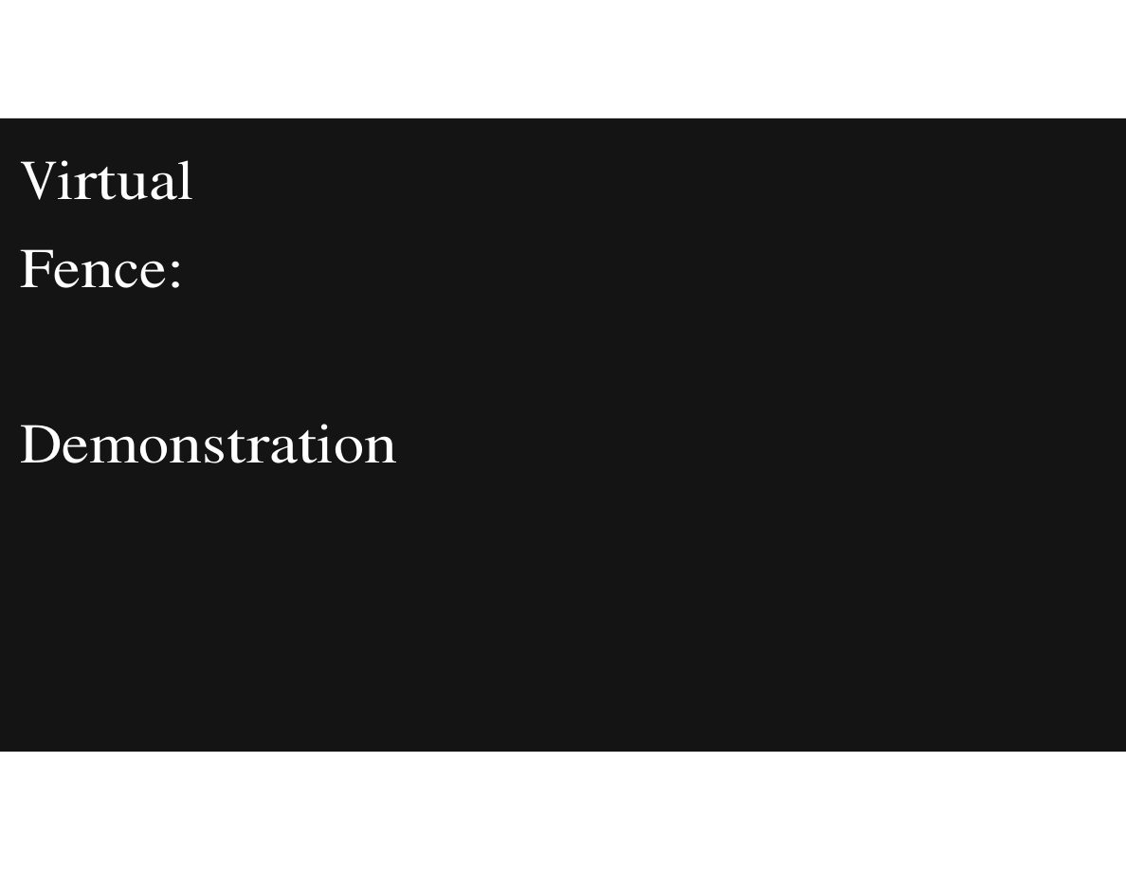
Notes:
SLIDE 28 of 71: Virtual Fence – Demonstration SLIDE: Virtual Fence: Demonstration [This slide contained a live demonstration of the eShepherd virtual fence system. The demonstration showed how virtual paddock boundaries are drawn and managed in the software.] Key demonstration elements: • Drawing virtual paddock boundaries on a satellite map • Assigning animals/herds to virtual paddocks • Setting schedules for automatic paddock transitions • Monitoring real-time animal locations via GPS • Adjusting paddock size and location remotely

Slide 4
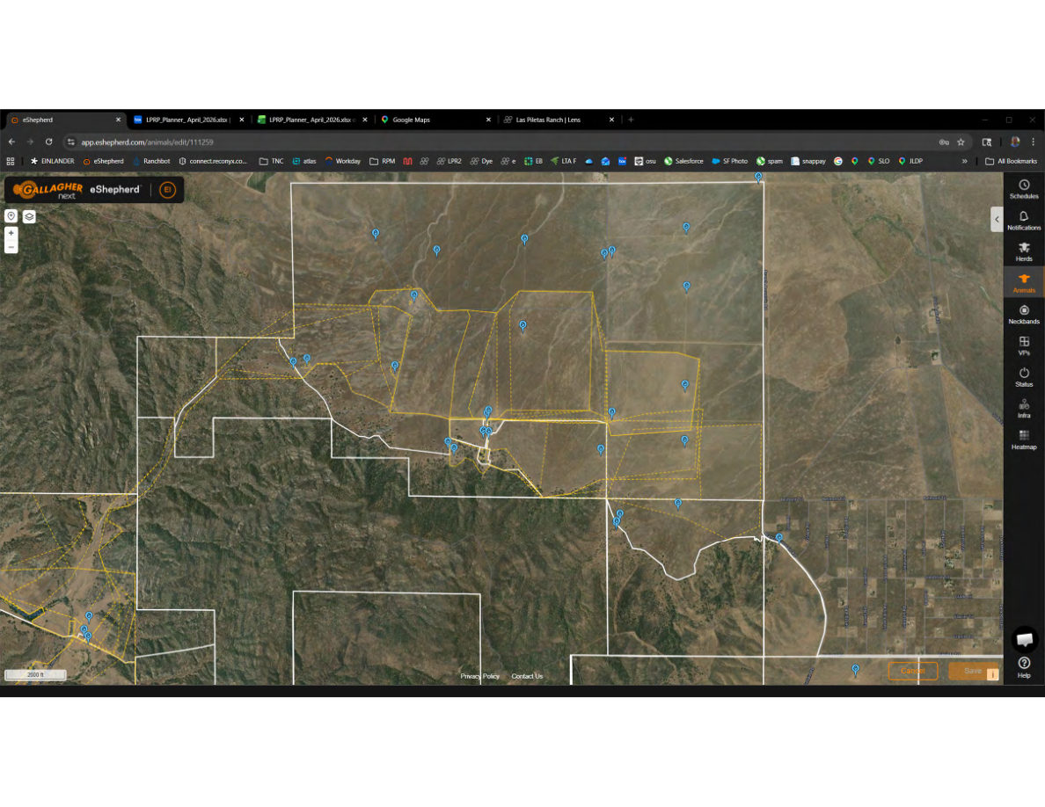
Notes:
SLIDE 29 of 71: Virtual Fence – eShepherd Map with Paddocks SLIDE: Virtual Fence – eShepherd Software Interface IMAGE (SCREENSHOT): Gallagher eShepherd web application (app.eshepherd.com/animals/edit/111259) Browser tabs visible: eShepherd | LPRP_Planner_April_2026.xlsx (x2) | Google Maps | Las Piletas Ranch | Lens MAP VIEW: Satellite aerial base map (HERE Maps provider) showing: • White solid lines: Property/pasture boundaries for Las Piletas Ranch Preserve • Yellow dashed lines: Active virtual paddock boundaries drawn on the property • Blue pin icons: Individual animal GPS locations — clustered in the central corridor and scattered across the north Carrizo unit • Multiple animals visible in north Carrizo unit and south San Juan unit areas RIGHT PANEL icons: Schedules | Notifications | Herds | Animals (highlighted/orange) | Neckbands | VPs (Virtual Paddocks) | Status | Infra | Heatmap Note: Browser bookmarks visible include: TNC, atlas, Workday, RPM, LPR2, Dye, EB, LTA F, osu, Salesforce, SF Photo, spam, snappay, SLO, JLDP — indicating the presenter's typical workflow tools.

Slide 5
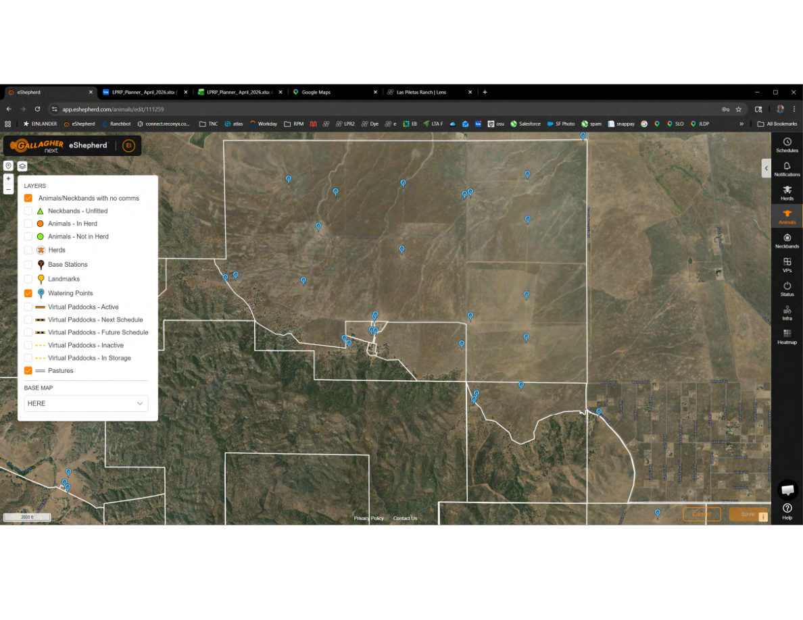
Notes:
SLIDE 30 of 71: Virtual Fence – eShepherd Layer Controls SLIDE: Virtual Fence – eShepherd Layer Controls IMAGE (SCREENSHOT): Same eShepherd map with layer control panel open on the left side. LAYERS PANEL (available toggles): ✓ Animals/Neckbands with no comms (checked – blue) □ Neckbands – Unfitted □ Animals – In Herd (orange dot indicator) □ Animals – Not in Herd (green dot indicator) □ Herds □ Base Stations □ Landmarks ✓ Watering Points (checked – blue water drop icon) □ Virtual Paddocks – Active (solid line) □ Virtual Paddocks – Next Schedule (dashed) □ Virtual Paddocks – Future Schedule (dotted) □ Virtual Paddocks – Inactive (yellow dashed) □ Virtual Paddocks – In Storage (yellow dotted) ✓ Pastures (checked – orange) BASE MAP: "HERE" (dropdown selector) MAP STATE: Animal pins removed from view; only white pasture boundaries and blue watering point icons visible, showing full water infrastructure network across the preserve.

Slide 6
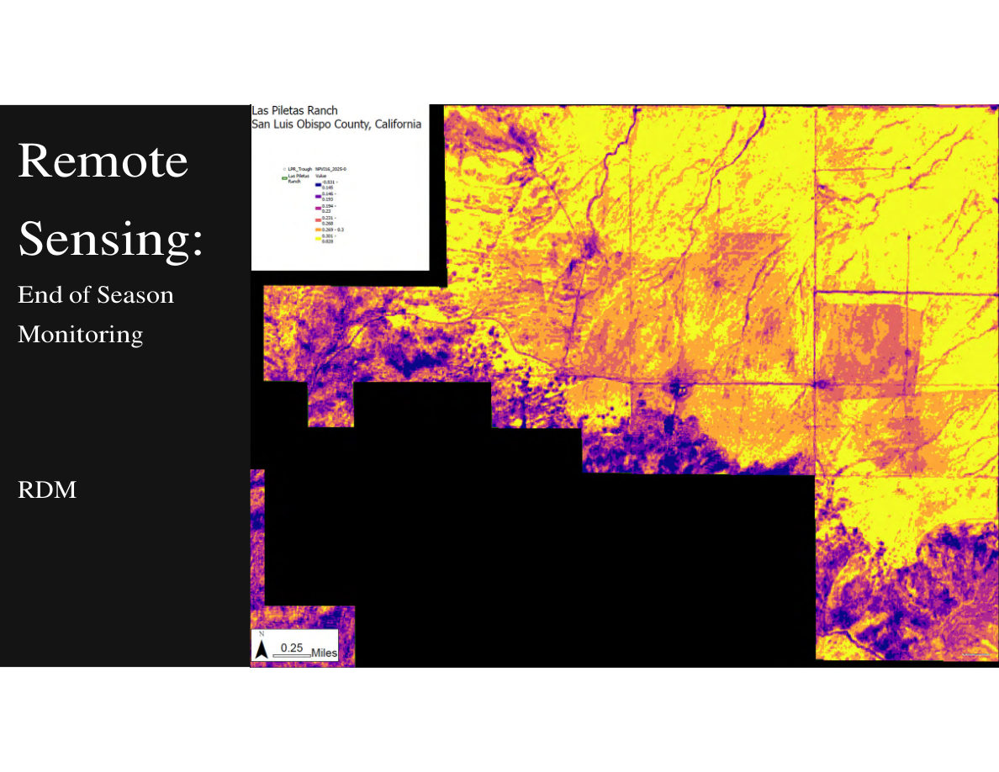
Notes:
SLIDE 31 of 71: Remote Sensing – End of Season Monitoring (RDM) SLIDE: Remote Sensing – End of Season Monitoring: RDM IMAGE (NDTI MAP): Satellite-derived NDTI (Normalized Difference Tillage Index) raster map of Las Piletas Ranch Preserve, San Luis Obispo County, California. Color scale (from legend): • Purple/dark blue = lowest NDTI values (~0.031–0.145) • Blue-purple = low NDTI (~0.146–0.193) • Pink-red = moderate NDTI (~0.194–0.230) • Orange = moderate-high NDTI (~0.231–0.300) • Yellow = highest NDTI (>0.300–0.028 max shown) Spatial interpretation: • Yellow/orange areas (flat Carrizo Plain sections, north) = higher residual dry matter; more ungrazed standing grass • Purple/dark areas (canyon terrain, south) = lower residual dry matter; more bare soil or intensively grazed Map features: Water trough locations overlaid (small symbols). Property boundary visible. Drainage channels appear as dark lines. Scale bar: 0.25 miles. RDM = Residual Dry Matter: the standing dry grass remaining at end of growing season, used to evaluate whether areas were over- or under-grazed.

Slide 7
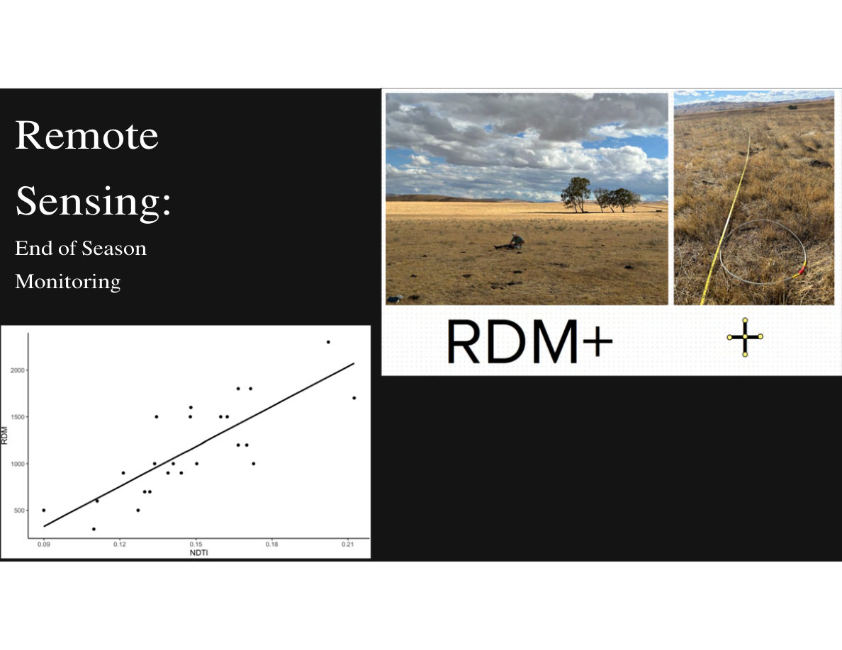
Notes:
SLIDE 32 of 71: Remote Sensing – RDM+ Field Validation SLIDE: Remote Sensing – End of Season Monitoring (RDM+ field validation) IMAGE LEFT (SCATTER PLOT): Correlation between field-measured RDM (y-axis, 0–2,500 lbs/acre) and NDTI satellite values (x-axis, 0.09–0.21). Approximately 20–25 data points scattered with a positive linear trend line. R-squared approximately 0.60–0.70. Shows positive but imperfect correlation — satellite NDTI is a useful proxy for ground-measured RDM but has natural variation. IMAGE TOP RIGHT: Field photograph of a researcher/technician crouching to take measurements in dry golden grassland. Open flat landscape, a tree visible in middle distance, mountains on the horizon. Demonstrates RDM+ measurement protocol. IMAGE BOTTOM RIGHT: Close-up photograph of an RDM+ measurement frame — a circular metal hoop placed on the ground in sparse dry grass. A yellow measuring tape extends from the frame. The vegetation is sparse dry golden grass on bare earth. This is a standardized rangeland monitoring method. RDM+ = enhanced Residual Dry Matter protocol that uses a circular frame and counts standing dead grass biomass at fixed sample points across a pasture.

Slide 8
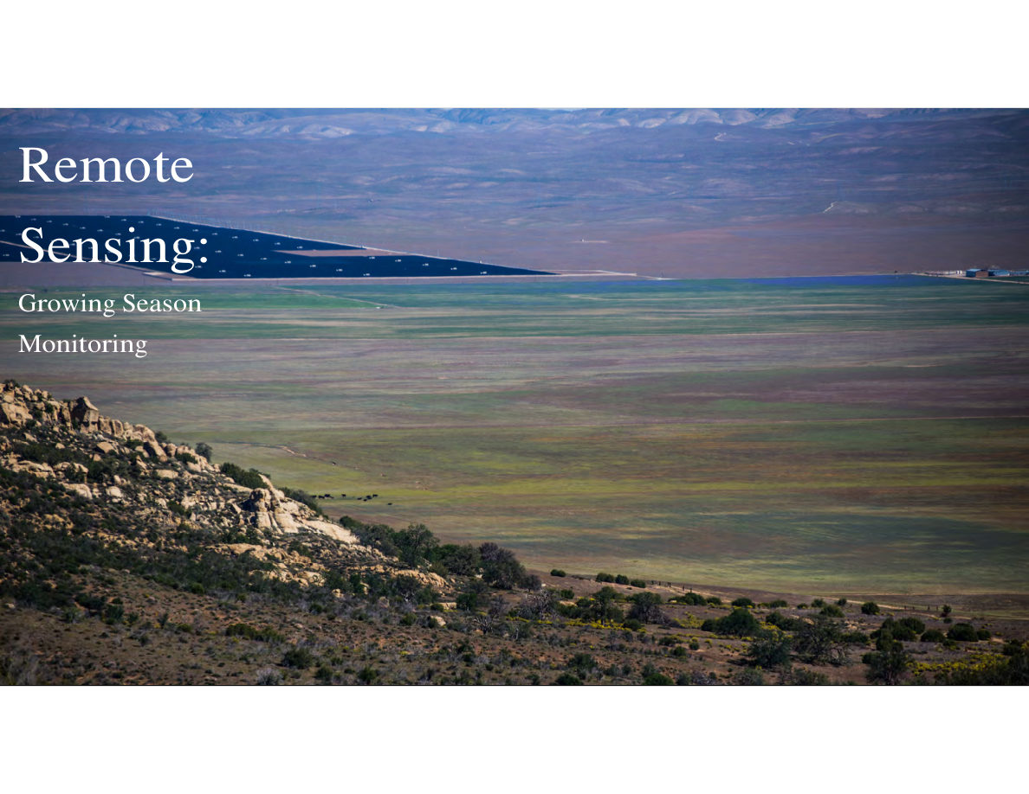
Notes:
SLIDE 33 of 71: Remote Sensing – Growing Season Monitoring SLIDE: Remote Sensing – Growing Season Monitoring IMAGE DESCRIPTION: Wide landscape photograph of Las Piletas Ranch Preserve during early spring green-up. The flat Carrizo Plain portion of the property is covered in bright green annual grasses extending to the horizon. The Caliente Range mountains are visible in the background as blue-gray silhouettes. Solar panel arrays are visible on adjacent private lands to the north (dark geometric shapes). Cattle are visible as small black dots in the green plain. A dramatic fog bank or low clouds caps the mountain range in the upper portion of the image. This image illustrates the dramatic seasonal transformation from the dry brown conditions of summer/fall to the lush green of winter/spring on California annual grasslands.

Slide 9
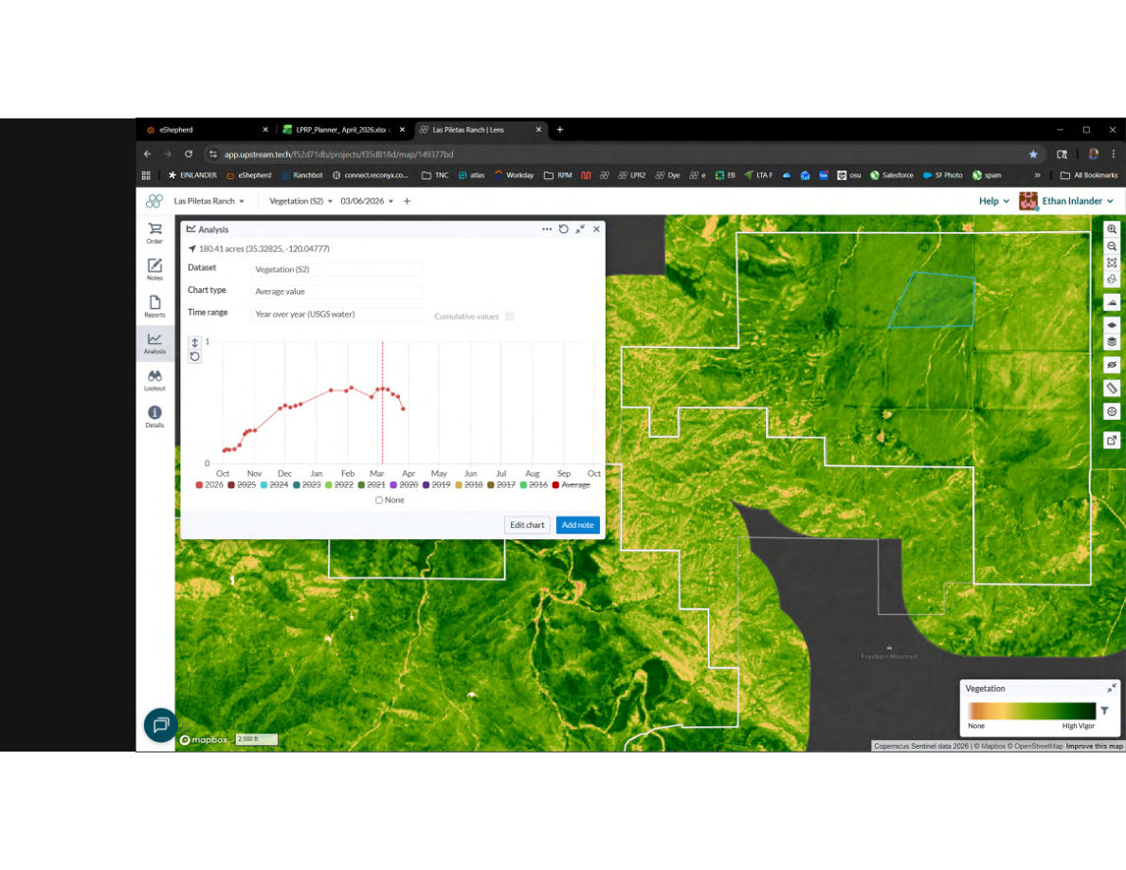
Notes:
SLIDE 34 of 71: Upstream Tech Lens – Vegetation Time Series (Single Year) SLIDE: Upstream Tech Lens – Vegetation Monitoring (March 6, 2026) IMAGE (SCREENSHOT): Upstream Tech Lens platform (app.upstream.tech). Las Piletas Ranch project, Vegetation (S2) dataset, March 6, 2026 date. MAP: Satellite vegetation index map showing preserve in false color. High vegetation vigor = bright green. Low = orange/yellow/tan. Northern flat Carrizo unit is mostly bright green. A selected paddock (180.41 acres at 35.33°N, 120.05°W) is outlined in blue in the upper right portion of the map. ANALYSIS PANEL (open): • 180.41 acres (35.32825, -120.04777) • Dataset: Vegetation (S2) [Sentinel-2 satellite] • Chart type: Average value • Time range: Year over year (USGS water year) • Cumulative values toggle: off CHART (single year – 2026 only, red line): X-axis: months Oct through Oct (water year). Y-axis: 0 to 1 (vegetation index). The 2026 line starts near 0 in October, rises steadily through November–January, peaks around 0.38–0.40 in late February/early March, then begins declining in March–April. Current date marker (red dashed vertical line) at March 6.

Slide 10
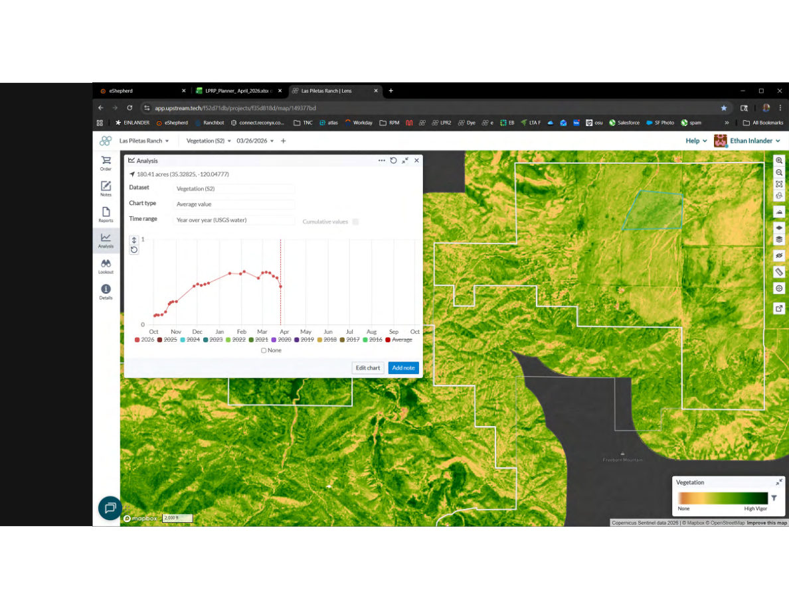
Notes:
SLIDE 35 of 71: Upstream Tech Lens – Adding 2025 Season SLIDE: Upstream Tech Lens – Vegetation Monitoring (2025 + 2026) Same Lens platform view as previous slide, date advanced to March 26, 2026. MAP: Same vegetation map; the selected paddock outline is visible. The map now shows slightly less green than the March 6 view, indicating vegetation has peaked and is beginning to dry down. CHART changes: Second year line added (2025, different color). • 2026 (red): peaks around 0.40 in late February, currently declining • 2025: similar peak timing, slightly lower peak (~0.35–0.38) Comparing the two lines allows managers to assess whether the current season is above or below the previous year at the same point in the season.

Slide 11
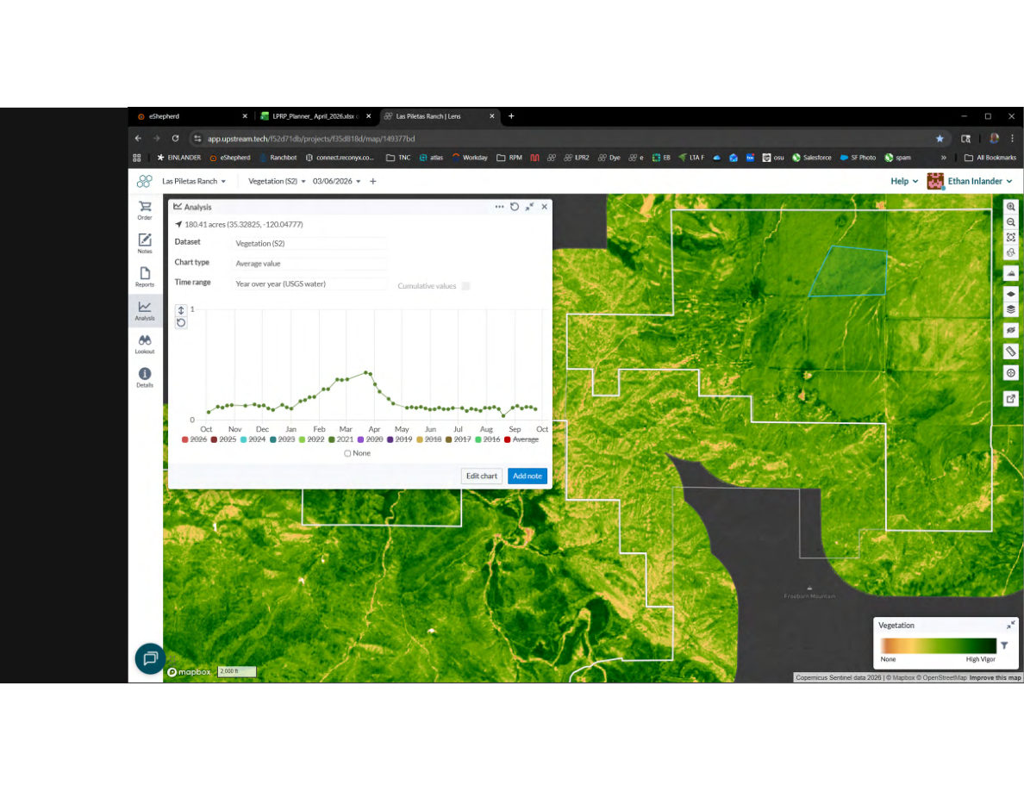
Notes:
SLIDE 36 of 71: Upstream Tech Lens – Adding 2021 Season SLIDE: Upstream Tech Lens – Adding 2021 High-Production Year CHART changes: 2021 season line added (bright green). • 2026: peaks ~0.40 in late Feb • 2025: peaks ~0.35–0.38 in late Feb • 2021 (bright green): peaks higher (~0.45–0.50) and slightly earlier (mid-February). This was likely a high-rainfall/above-average production year. Interpretation: 2026 is tracking similar to or slightly above 2025, and below the high-water mark of 2021. The three-year comparison begins to reveal the range of interannual variability.

Slide 12

Notes:
SLIDE 37 of 71: Upstream Tech Lens – Adding 2020 Season SLIDE: Upstream Tech Lens – Adding 2020 Season CHART changes: 2020 season line added (blue/teal). • 2026 (red): peaks ~0.40 Feb • 2025: peaks ~0.36–0.38 Feb • 2021 (green): peaks ~0.47 Feb (highest) • 2020 (blue): peaks around 0.44–0.46 in April — later timing than 2021 but similar height. Shows 2020 was also a high production year but with a delayed green-up. Interpretation: Both 2020 and 2021 were above-average production years. 2025 and 2026 are tracking lower but still within normal range.

Slide 13

Notes:
SLIDE 38 of 71: Upstream Tech Lens – Multiple Years Added SLIDE: Upstream Tech Lens – Multiple Years 2016–2026 CHART changes: Multiple additional years added creating a multi-line "spaghetti" chart. • All years from 2016–2026 visible (11 lines in various colors) • Each line follows the same seasonal arc: low in Oct, rise in Nov–Jan, peak Feb–Apr, decline May–Sep • Variation between years clearly visible in peak height and timing • High years (2017, 2019, 2021, 2023?) show peaks >0.40 • Low/drought years show peaks <0.25–0.30 • Average pattern begins to emerge from the cluster of lines Purpose: Building up the full multi-year context to establish the long-term average baseline.

Slide 14
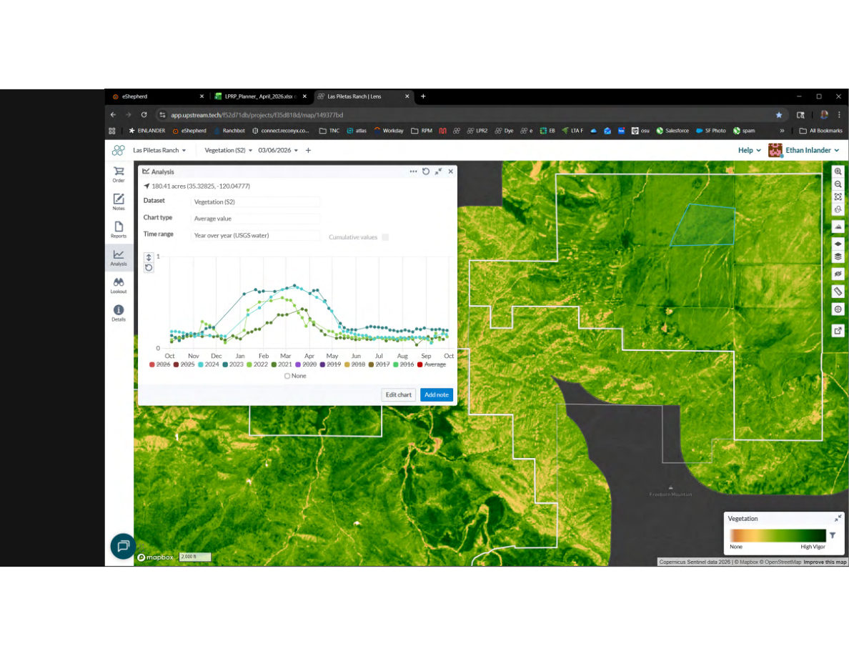
Notes:
SLIDE 39 of 71: Upstream Tech Lens – With Long-Term Average SLIDE: Upstream Tech Lens – Full Time Series with Average (2016–2026) CHART: Same multi-year view, now with long-term average line added (bold darker line distinct from the individual year lines). • Individual year lines: 2016–2026 in varied colors (green, teal, dark green, etc.) • Long-term average: Bold line showing the mean seasonal trajectory across all years • 2026 (red): Currently tracking slightly above the long-term average at this point in the season Interpretation: The long-term average provides the key reference line. Managers can see at a glance whether the current season is running above average (more forage available) or below average (reduced stocking needed). This directly informs adaptive management decisions.

Slide 15
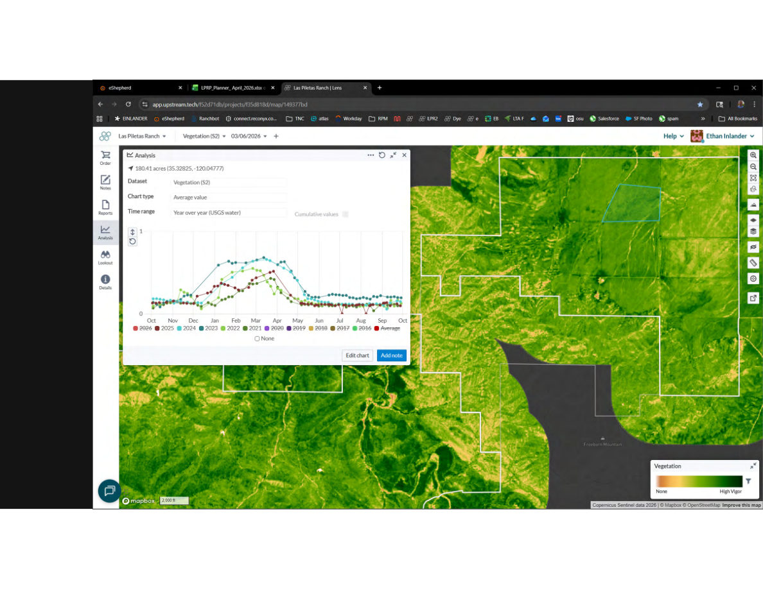
Notes:
SLIDE 40 of 71: Upstream Tech Lens – Current Season Tracking SLIDE: Upstream Tech Lens – Current Season Tracking Against Historical Average CHART: Final view with vertical dashed line indicating the current monitoring date (March 6, 2026) and all historical years plus average visible. • Current date marker: vertical dashed line at approximately March 6 • 2026 line (red): At the current date, vegetation index is approximately 0.38–0.40, which is above the long-term average (~0.32–0.35) at the same point in the year • Years with below-average production (possible drought years) visible as lower flat curves Key finding: As of spring 2026, Las Piletas Ranch is experiencing an above-average forage production year, supporting potentially higher stocking rates or earlier turnout of cattle. This feeds directly into the adaptive grazing framework: "How much feed?" → "How much grazing?"

Slide 16

Notes:
SLIDE 41 of 71: Upstream Tech Lens – All Years Comparison SLIDE: Upstream Tech Lens – Complete Multi-Year Vegetation Comparison CHART: Full multi-year comparison with all lines visible and clearly differentiated. • 2026 (red, current year): Peaks in late February–early March around 0.38–0.42 • Multiple historical years visible in blues, greens, and other colors • Long-term average (bold): Provides central reference • Vertical dashed line: Current date marker MAP: Same Lens platform view showing the 180-acre paddock in the northern Carrizo Plain unit. Vegetation is still strongly green in late March, confirming above-average conditions. This slide completes the growing season monitoring demonstration, showing how satellite data informs adaptive grazing decisions at Las Piletas Ranch.

Slide 17
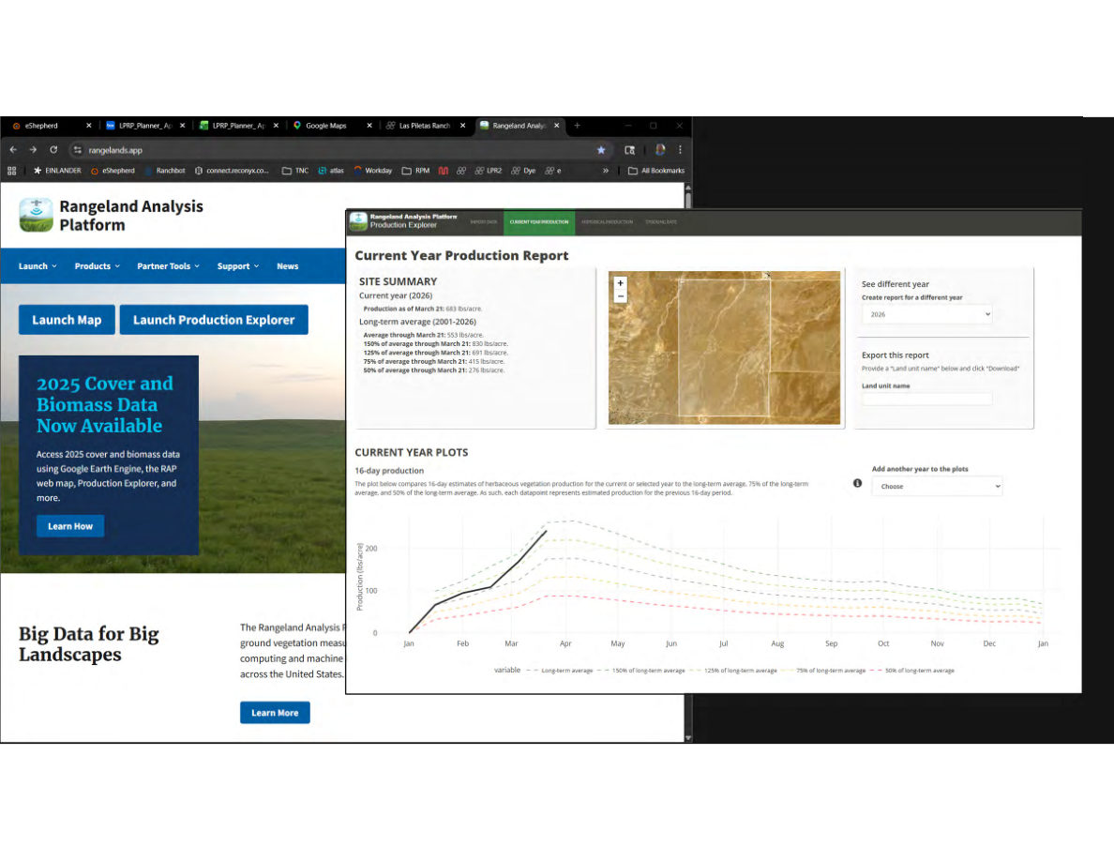
Notes:
SLIDE 42 of 71: Rangeland Analysis Platform (RAP) SLIDE: Rangeland Analysis Platform (RAP) – Current Year Production Two screenshots displayed side by side: LEFT SCREENSHOT – RAP Homepage (rangelands.app): Header: "Rangeland Analysis Platform" Tagline visible: "Big Data for Big Landscapes" Buttons: "Launch Map" | "Launch Production Explorer" Featured content: "2025 Cover and Biomass Data Now Available – Access 2025 cover and biomass data using Google Earth Engine, the RAP web map, Production Explorer, and more." Description: "The Rangeland Analysis Platform uses ground vegetation measurements and remote sensing data processed via Google Earth Engine computing and machine learning across the United States." RIGHT SCREENSHOT – RAP Production Explorer: Current Year Production Report SITE SUMMARY – Current year (2026): • Production as of March 21: 683 lbs/acre • Long-term average (2001–2026) through March 21: 553 lbs/acre • 150% of average through March 21: 830 lbs/acre • 125% of average through March 21: 691 lbs/acre • 75% of average through March 21: 415 lbs/acre • 50% of average through March 21: 276 lbs/acre CURRENT YEAR PLOTS: Line graph comparing 16-day production estimates Oct–Jan: • X-axis: Jan through Jan (full water year) • Y-axis: Production lbs/acre (0–225 shown) • Solid black line (2026): Rises steeply from October, reaches ~220 lbs/acre by March 21 — above long-term average • Dashed black line (long-term average): Lower curve, peaks around 160–180 lbs/acre • Dashed lines: 75% and 50% of average shown as lower reference lines KEY FINDING: 2026 production is running 23% above the long-term average as of March 21, 2026.

Slide 18
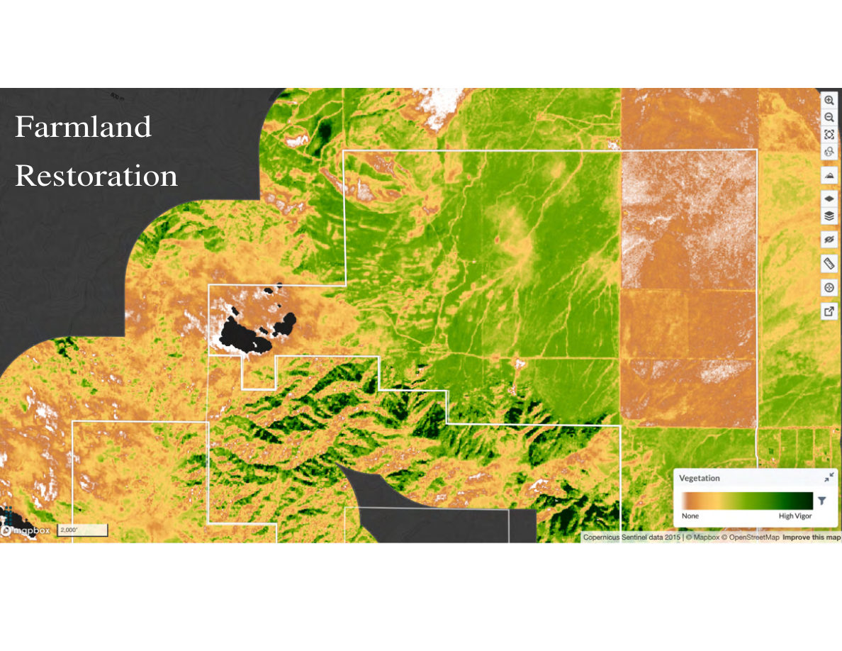
Notes:
SLIDE 43 of 71: Farmland Restoration Monitoring SLIDE: Farmland Restoration IMAGE (VEGETATION MAP – Upstream Tech Lens): High-resolution Sentinel-2 vegetation index map of the northern portion of Las Piletas Ranch Preserve (flat Carrizo Plain unit). Map interpretation: • Bright green areas: High vegetation vigor — restored native/annual grassland with good ground cover • Orange/tan areas: Low vegetation — areas dominated by bare soil, sparse vegetation, or land still recovering from prior agricultural use • The northern flat unit shows highly variable vegetation: some paddocks are bright green while large patches are still orange/brown • Clear rectangular/geometric boundaries between vegetation types reveal former cultivated field boundaries — evidence of prior row crop or dryland farming • Southern canyon terrain (lower left): Consistently high vegetation vigor (all green) • Property boundary in white Context: Portions of Las Piletas Ranch were previously cultivated farmland. This vegetation map tracks restoration progress — bright green areas show successful transition back to grassland cover.

Slide 19
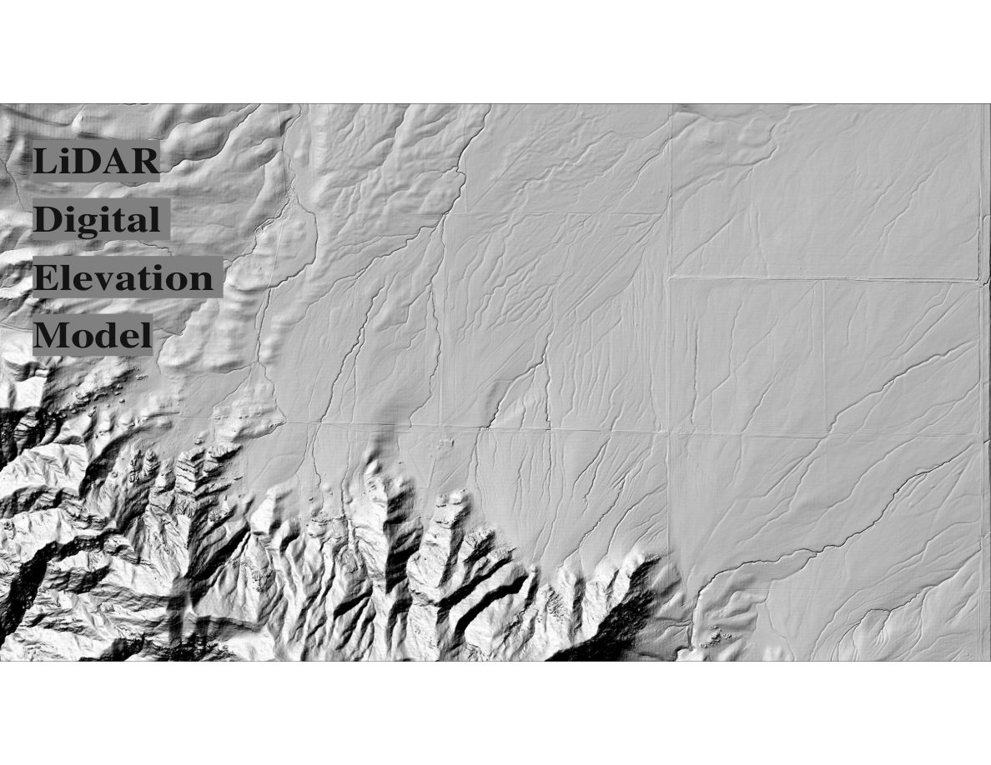
Notes:
SLIDE 44 of 71: LiDAR – Digital Elevation Model SLIDE: LiDAR Digital Elevation Model IMAGE (HILLSHADE MAP): High-resolution hillshade relief visualization derived from LiDAR (Light Detection and Ranging) aerial survey data. Map features: NORTH (flat Carrizo Plain unit, right/upper portion): • Appears nearly flat in hillshade • Subtle features visible: faint linear drainage channels, slight topographic depressions, terracing from former agricultural use (very faint parallel lines) • Property boundaries appear as straight lines cutting across the terrain SOUTH (canyon unit, left/lower portion): • Dramatic terrain with deep canyon walls and complex ridge-valley topography • Multiple parallel ridgelines with steep slopes • Deep, incised canyon bottoms with dendritic drainage patterns • Rock outcroppings visible as irregular shapes LiDAR advantage over standard DEM: Sub-meter resolution captures fine-scale features including erosion rills, small channels, and terrain position that affect water flow, grazing patterns, and vegetation distribution.

Slide 20
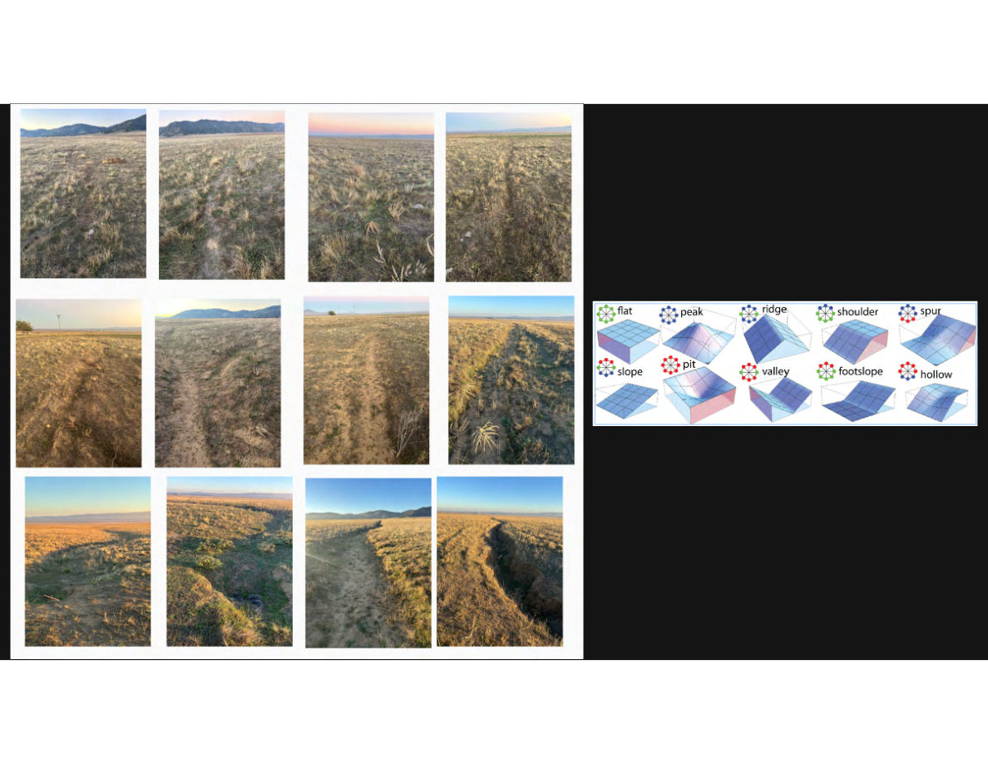
Notes:
SLIDE 45 of 71: LiDAR – Erosion Features and Geomorphic Classification SLIDE: LiDAR – Erosion Documentation and Geomorphic Landforms LEFT PANEL – 12 field photographs in a 4x3 grid documenting erosion features: Row 1: Shallow surface rills — faint tracks in dry grass, early-stage linear erosion. Golden grasses with mountains in background. Row 2: Established rills and small channels — deeper, more defined erosion tracks. Some with bare soil margins. Row 3: Significant gully erosion — headcuts visible, deeply incised channels, one to two feet deep. Some with standing water or wet soil indicating active erosion. All photos taken in dry golden grassland, typical Carrizo Plain appearance. RIGHT PANEL – Geomorphic landform classification diagram: Ten landform types derived from LiDAR analysis: 1. Flat (uniform gray surface) 2. Peak (convex top) 3. Ridge (elongated crest) 4. Shoulder (convex slope break) 5. Spur (lateral ridge) 6. Slope (uniform incline) 7. Pit (concave depression) 8. Valley (concave bottom) 9. Footslope (base of slope) 10. Hollow (concave hillside depression) Each is shown as a 3D blue wireframe surface with red/blue coloring indicating convex/concave curvature.

Slide 21
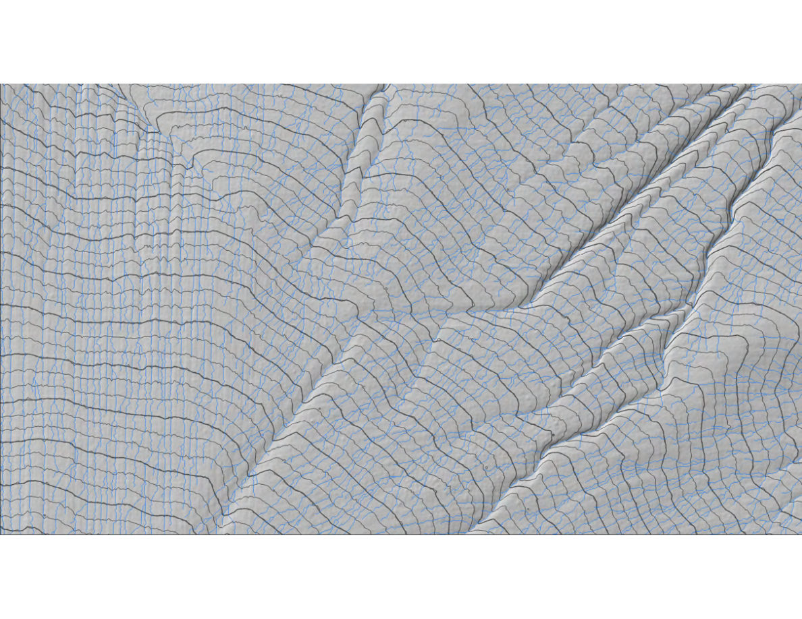
Notes:
SLIDE 46 of 71: LiDAR – Contour Map with Stream Network SLIDE: LiDAR Contour Map with Derived Stream Network IMAGE (TOPOGRAPHIC MAP): Detailed hillshade relief map of the southern canyon unit of Las Piletas Ranch Preserve. Features: • Gray hillshade base: Shows terrain relief (light = sunny slopes, dark = shaded) • Dark gray contour lines: Topographic contours at 1-foot vertical intervals — extraordinarily fine resolution showing every small ridge and valley • Blue lines: Derived stream/drainage network calculated from the LiDAR DEM using flow accumulation analysis - Blue lines concentrate in valley bottoms and follow dendritic branching patterns - Finer blue lines = smaller upstream drainages - The network shows dozens of small drainages feeding into major canyon systems The canyon terrain shows: multiple parallel north-facing ridgelines; deep V-shaped valley bottoms; complex drainage networks; prominent fault-related linear features. This data enables precise location of erosion repair opportunities, water harvesting sites, and riparian restoration areas.

Slide 22
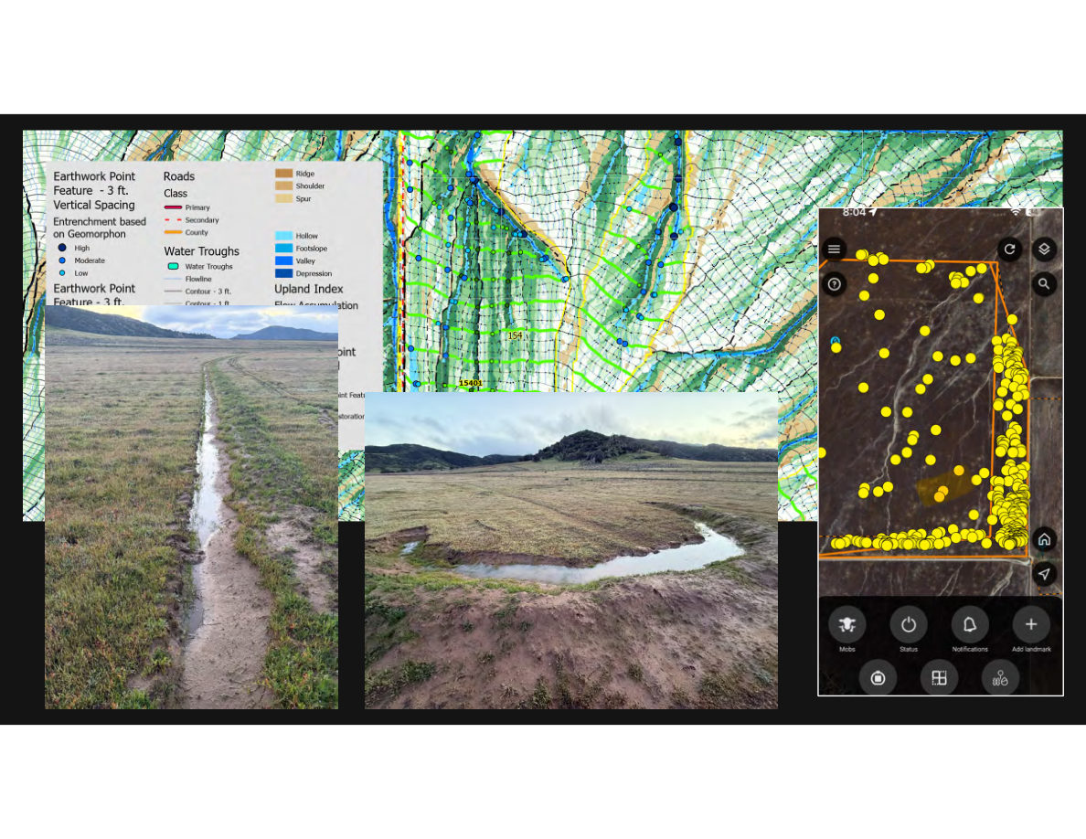
Notes:
SLIDE 47 of 71: LiDAR – Integrated Analysis and Applications SLIDE: LiDAR Integrated Analysis and Applications Three-panel composite image: LEFT PANEL (MAP): Complex multi-layer analysis map showing: • LiDAR topographic contours (1-ft and 3-ft intervals) • Geomorphic landform classification (color-coded by type: ridge/tan, shoulder/orange, spur/yellow, slope/green, footslope/blue, valley/dark blue, hollow/purple, depression/gray) • Roads by class (primary/secondary/county — red/dashed/orange) • Water trough locations (blue dots) • Flowlines/drainages (blue lines) • Flow accumulation zones • Earthwork Point Features coded by entrenchment severity: - High (dark blue dots) = deeply entrenched, significant erosion repair needed - Moderate (medium blue) - Low (light blue) = minor erosion Legend fully labeled. CENTER PANEL: Field photograph of a muddy dirt road/track with vehicle ruts filled with standing water. Golden grass on both sides. Shows the kind of linear erosion feature visible in LiDAR data. CENTER-RIGHT PANEL: Field photograph of a restored/functioning wetland area in the flat Carrizo Plain. A sinuous stream channel winds through bright green grasses in foreground. Flat plain and dark hills in background. Shows restoration potential. RIGHT PANEL (MOBILE APP): Smartphone screen showing eShepherd virtual fence app with a satellite base map. A dense cluster of approximately 80–100 yellow dots (individual GPS collar positions) shows the cattle herd concentrated in the corner of an orange virtual paddock boundary. Navigation icons visible.

