Slide 1
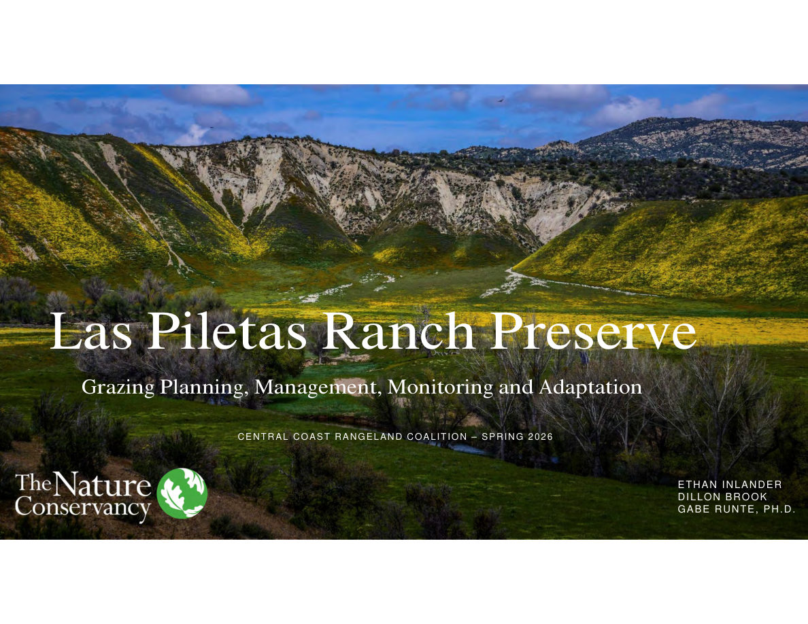
Notes:
SLIDE 9 of 71: Las Piletas Ranch Preserve – Grazing Planning, Management, Monitoring and Adaptation
SECTION TITLE SLIDE: Las Piletas Ranch Preserve – Grazing Planning, Management, Monitoring and Adaptation
Presenters:
• Ethan Inlander
• Dillon Brook
• Gabe Runte, Ph.D.
Organization: The Nature Conservancy
Event: Central Coast Rangeland Coalition – Spring 2026
IMAGE DESCRIPTION: Stunning aerial landscape of Las Piletas Ranch Preserve canyon country in full spring bloom. Yellow wildflowers (mustard family) carpet the hillsides. A riparian corridor with leafless cottonwood or willow trees winds through the canyon bottom. White chalky rock outcroppings on canyon walls. Deep blue sky with scattered clouds. Dramatic scale of the canyon landscape visible.

Slide 2
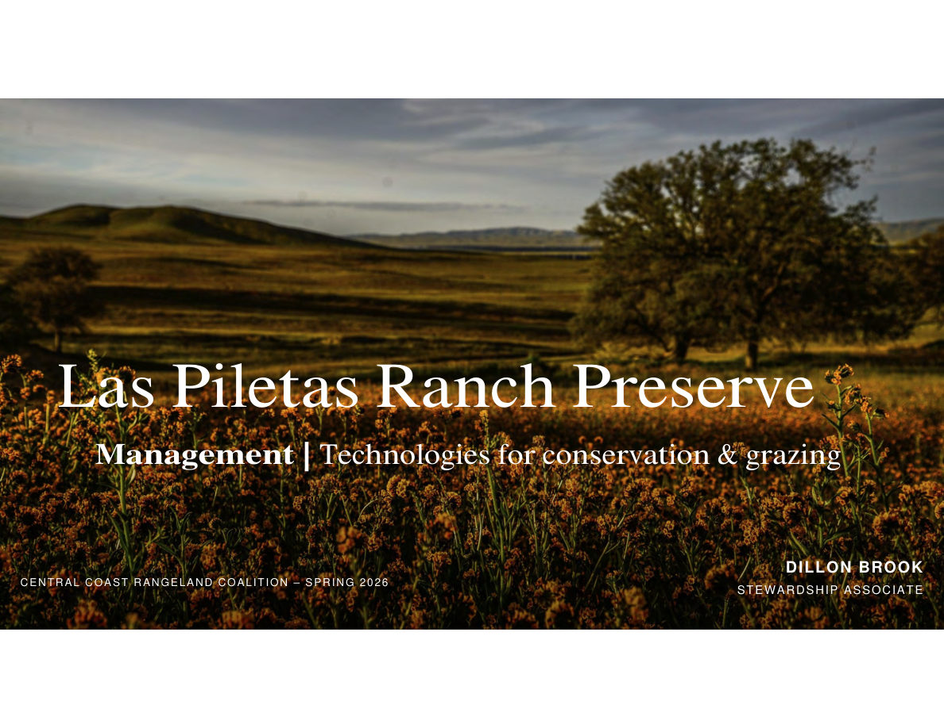
Notes:
SLIDE 10 of 71: Las Piletas Ranch Preserve – Management: Technologies for Conservation and Grazing
SECTION TITLE SLIDE: Las Piletas Ranch Preserve – Management: Technologies for Conservation & Grazing
Presenter: Dillon Brook, Stewardship Associate
Organization: The Nature Conservancy
Event: Central Coast Rangeland Coalition – Spring 2026
IMAGE DESCRIPTION: Golden-hour landscape of Las Piletas Ranch Preserve. Dry golden grasses and late-season wildflowers in foreground. A large solitary valley oak tree stands in the middle ground, silhouetted against warm light. Flat Carrizo Plain terrain extends to the distance. Sky is hazy/smoky with warm amber tones.

Slide 3
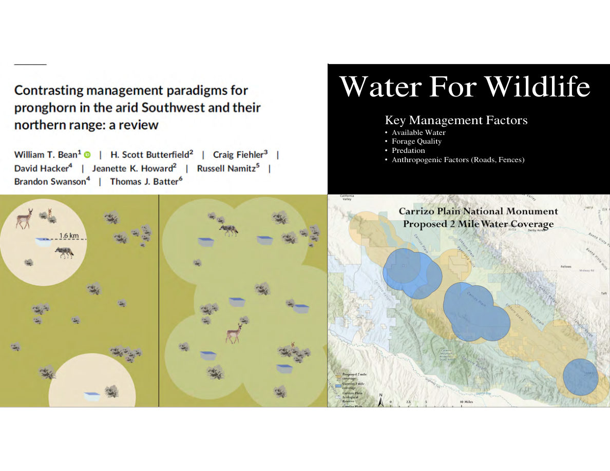
Notes:
SLIDE 11 of 71: Water for Wildlife – Key Management Factors
SLIDE: Water for Wildlife
Research reference: "Contrasting management paradigms for pronghorn in the arid Southwest and their northern range: a review" by William T. Bean, H. Scott Butterfield, Craig Fiehler, David Hacker, Jeanette K. Howard, Russell Namitz, Brandon Swanson, Thomas J. Batter.
KEY MANAGEMENT FACTORS FOR PRONGHORN:
• Available Water
• Forage Quality
• Predation
• Anthropogenic Factors (Roads, Fences)
IMAGE LEFT (DIAGRAM – two panels):
Left panel: Single water source (blue oval) in center of tan landscape with pronghorn clustered within a 1.6 km radius circle. Large areas of the landscape are empty/unused.
Right panel: Multiple distributed water sources (several blue ovals) across the same landscape. Pronghorn are distributed throughout, with overlapping range circles showing full landscape utilization.
IMAGE RIGHT (MAP): "Carrizo Plain National Monument Proposed 2-Mile Water Coverage." Blue circles = current 3-mile water coverage zones. Tan circles = proposed 2-mile coverage zones. Shows Carrizo Plain Ecological Reserve and surrounding area. Expanding water point density from 3-mile to 2-mile coverage radius would allow pronghorn to utilize significantly more of the landscape.

Slide 4
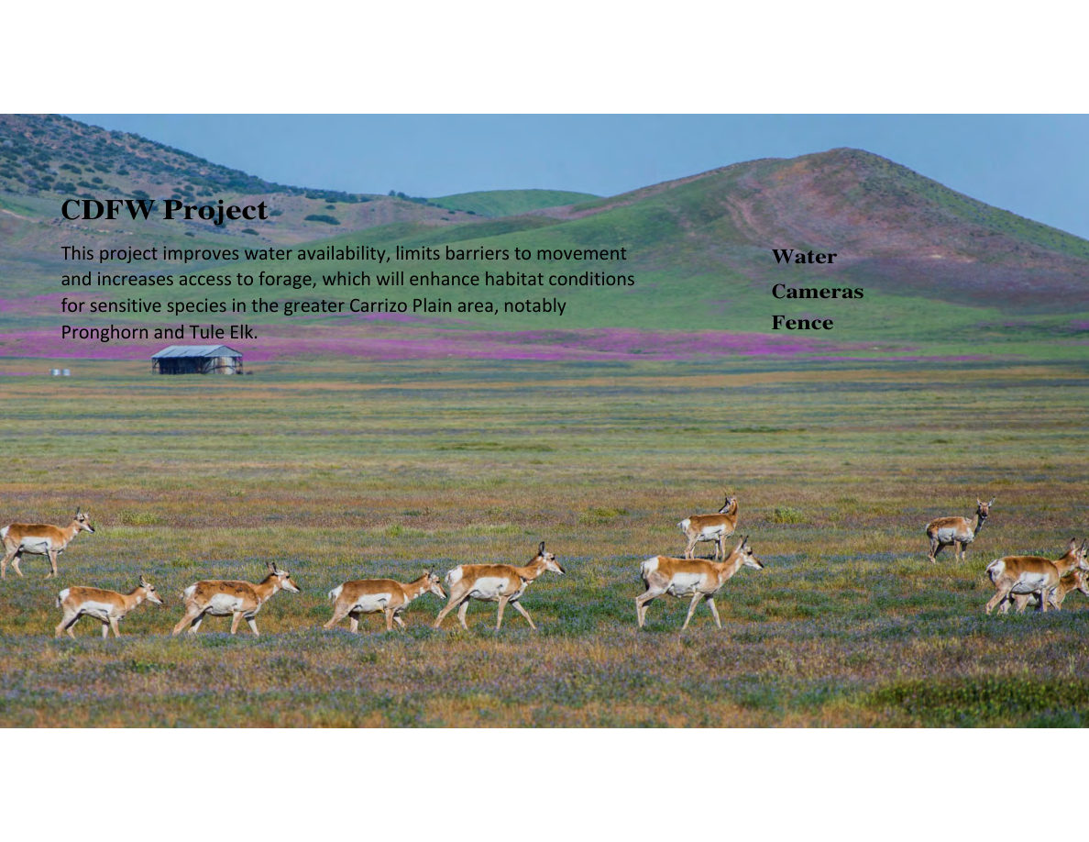
Notes:
SLIDE 12 of 71: CDFW Project – Water, Cameras, Fence
SLIDE: CDFW Project
Project goal: Improve water availability, limit barriers to movement, and increase access to forage — enhancing habitat conditions for sensitive species in the greater Carrizo Plain area, notably Pronghorn and Tule Elk.
Three project components: Water | Cameras | Fence
IMAGE DESCRIPTION: Wide landscape photograph of a large herd of pronghorn (American antelope) walking across a vast flat wildflower meadow at Carrizo Plain. Purple phacelia and yellow goldfields wildflowers cover the plain in full bloom. Approximately 30–40 pronghorn visible, moving left to right. A small historic ranch building visible in background. Mountains rise at the rear. Bright blue sky with light clouds.

Slide 5
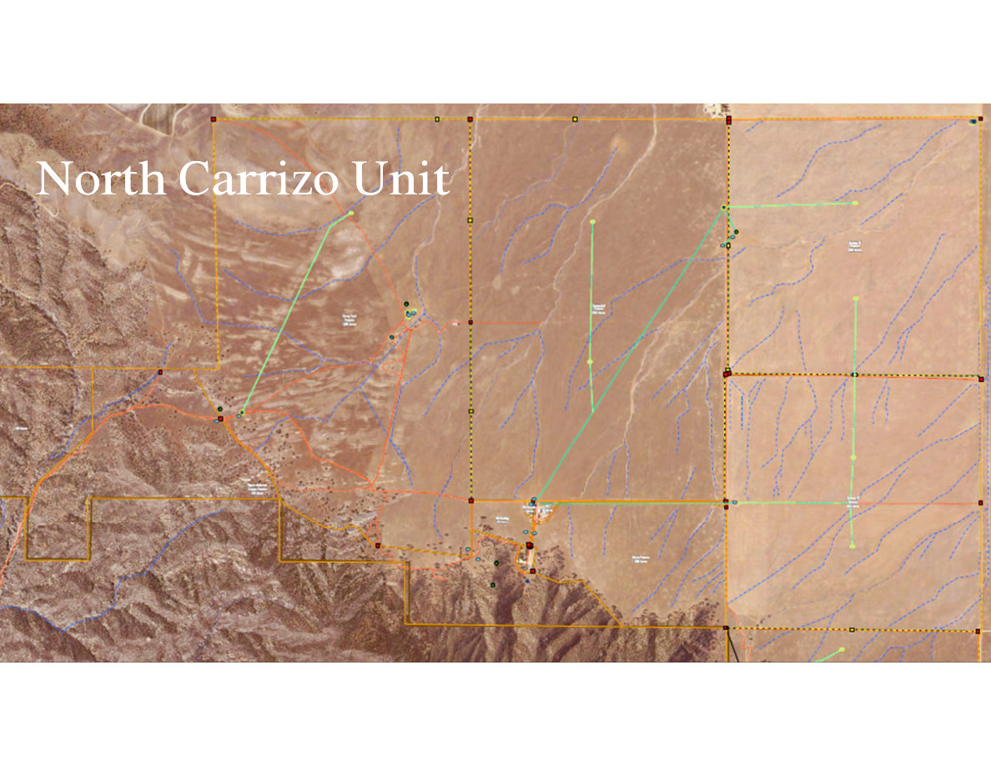
Notes:
SLIDE 13 of 71: North Carrizo Unit – Infrastructure Map
SLIDE: North Carrizo Unit Infrastructure Map
IMAGE (AERIAL MAP): Satellite aerial map of the North Carrizo Unit at Las Piletas Ranch Preserve.
Map features:
• Orange dashed boundary lines: Property boundary for the North Carrizo Unit
• Green lines: New pipeline routes connecting wells to distribution points
• Red lines: Existing infrastructure/roads
• Blue dotted lines: Seasonal streams/drainages
• Colored dots: Water point locations
- Green dots = new or modified water troughs
- Red squares = existing water points/wells
- Cyan circles = water tanks
Terrain: North and east portions are flat arid plains. Southwest portion transitions to rugged foothills and canyon terrain where the Caliente Range begins.
The map shows the complete water distribution network connecting wells to an array of distributed troughs across the unit.

Slide 6
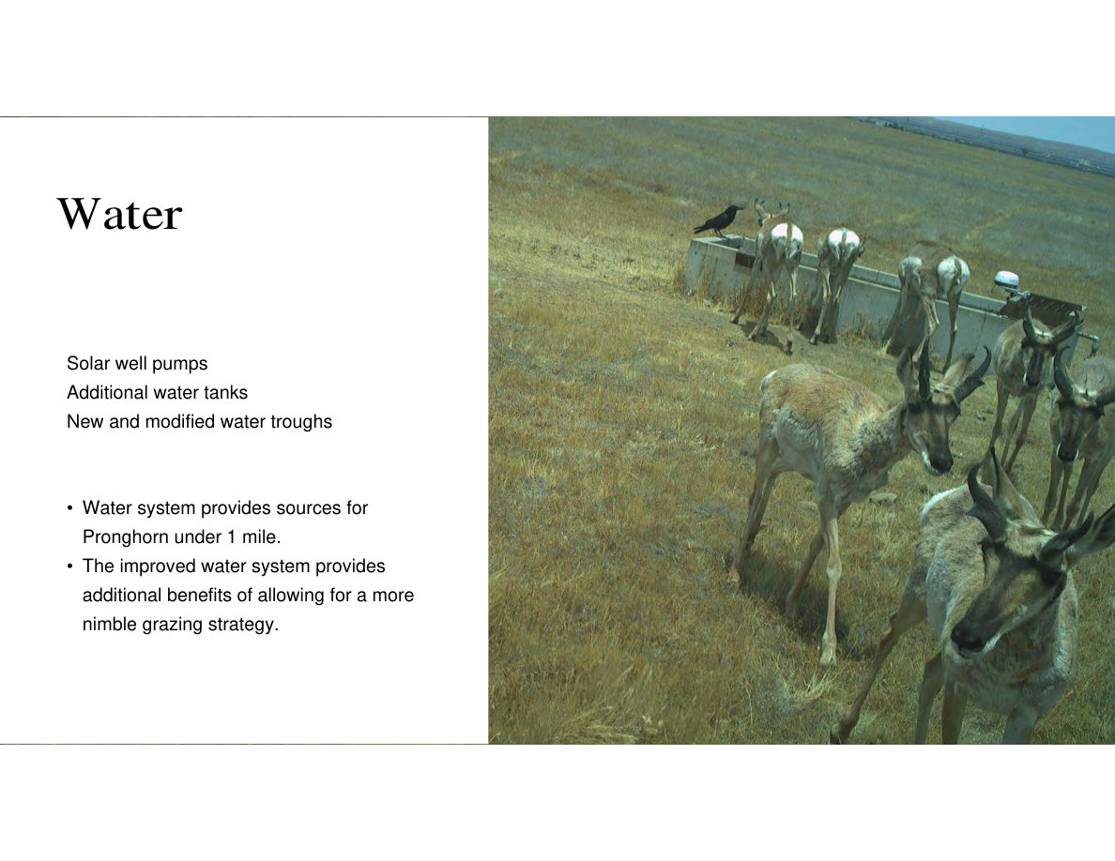
Notes:
SLIDE 14 of 71: Water Infrastructure Details
SLIDE: Water Infrastructure
Water system components installed:
• Solar well pumps – off-grid power to extract groundwater
• Additional water tanks – expanded storage capacity
• New and modified water troughs – positioned for pronghorn access
Key outcomes:
• Water system provides sources for Pronghorn within under 1 mile of any location
• The improved water system provides additional benefits of allowing for a more nimble grazing strategy
IMAGE DESCRIPTION: Trail camera photograph of a group of 8–10 pronghorn using a concrete water trough. The animals are drinking and milling around the trough in dry golden grassland. A raven perches on the trough edge in the upper left. Wide open flat prairie extends to a distant horizon.

Slide 7
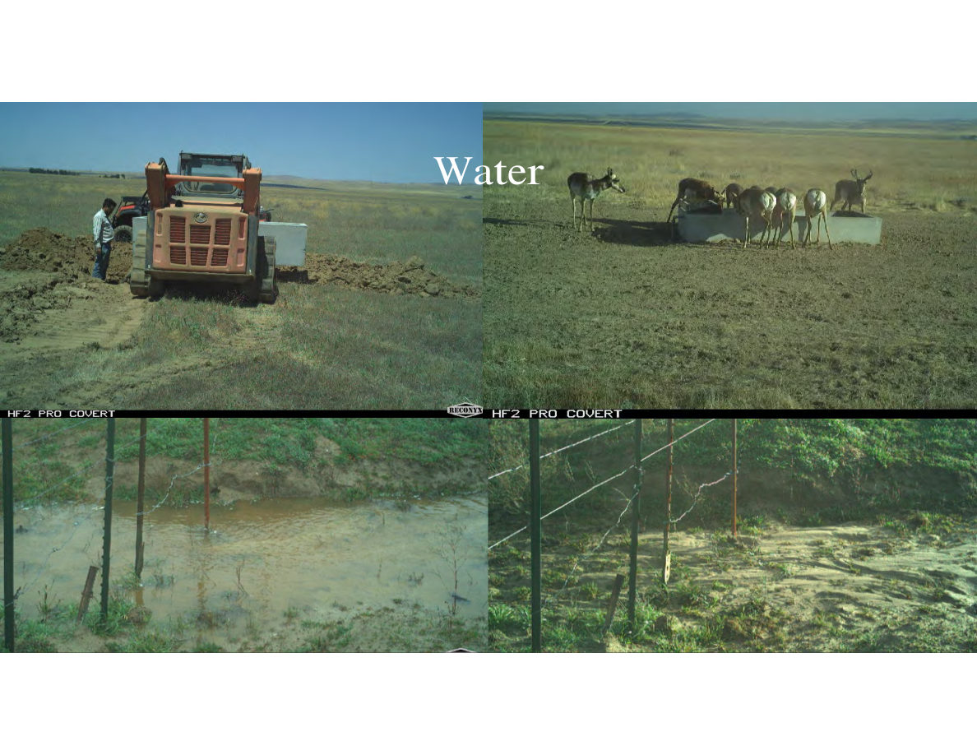
Notes:
SLIDE 15 of 71: Water – Construction and Use Photos
SLIDE: Water (construction and wildlife use photos)
IMAGE – four camera trap/field photos in a 2x2 grid:
TOP LEFT: Daytime construction photo. A large orange bulldozer/skid steer is excavating a trench in flat, dry grassland under a deep blue sky. A worker stands beside the machine. The landscape is completely flat, typical of the Carrizo Plain. Purpose: installing underground water pipeline.
TOP RIGHT: Trail camera photo. A group of 5–6 pronghorn standing at a low concrete water trough in dry golden grassland. The animals are drinking. Wide-angle view shows open flat plain to the horizon.
BOTTOM LEFT: Trail camera photo (HF2 Pro Covert). Shows a small muddy pond/seep area with wooden fence posts and wire visible. Water is pooled on the surface, indicating a functioning water source. Vegetation is sparse around the muddy area.
BOTTOM RIGHT: Trail camera photo showing same area in drier conditions. Fence posts and wire remain but the water surface is much reduced. Shows seasonal variation in water availability.

Slide 8
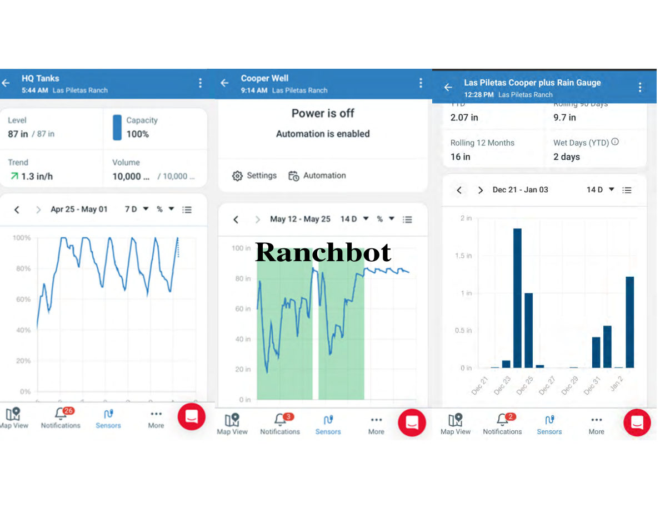
Notes:
SLIDE 16 of 71: Ranchbot – Remote Water Monitoring
SLIDE: Ranchbot Remote Water Monitoring App
Three smartphone app screenshots from Ranchbot (ranch water IoT monitoring):
SCREENSHOT 1 – "HQ Tanks" (5:44 AM, Las Piletas Ranch):
• Level: 87 inches / 87 inches (100% capacity)
• Trend: Rising at 1.3 in/hr
• Volume: 10,000 gallons / 10,000 gallons
• Chart (7-day, Apr 25–May 1): Bar/line chart showing tank level fluctuating between 60% and 100%, cycling up and down as water is consumed and replenished. 26 notifications shown.
SCREENSHOT 2 – "Cooper Well" (9:14 AM, Las Piletas Ranch):
• Status: Power is off / Automation is enabled
• Chart (14-day, May 12–25): Line chart showing well water level. Green shaded area indicates target range. Level dropped from ~80 inches to ~40 inches (low), then recovered back to ~80 inches. Shows pump cycling behavior. 3 notifications.
SCREENSHOT 3 – "Las Piletas Cooper plus Rain Gauge" (12:28 PM, Las Piletas Ranch):
• YTD rainfall: 2.07 inches
• Rolling 90 Days: 9.7 inches
• Rolling 12 Months: 16 inches
• Wet Days YTD: 2 days
• Bar chart (Dec 21 – Jan 3, 14-day): Daily precipitation bars. Notable rain events: Dec 24–25 (~1.7 inches), Dec 26 (~1.0 inch), Dec 31 (~0.35 inch), Jan 1–2 (~0.3 and ~1.2 inches). 2 notifications.

Slide 9
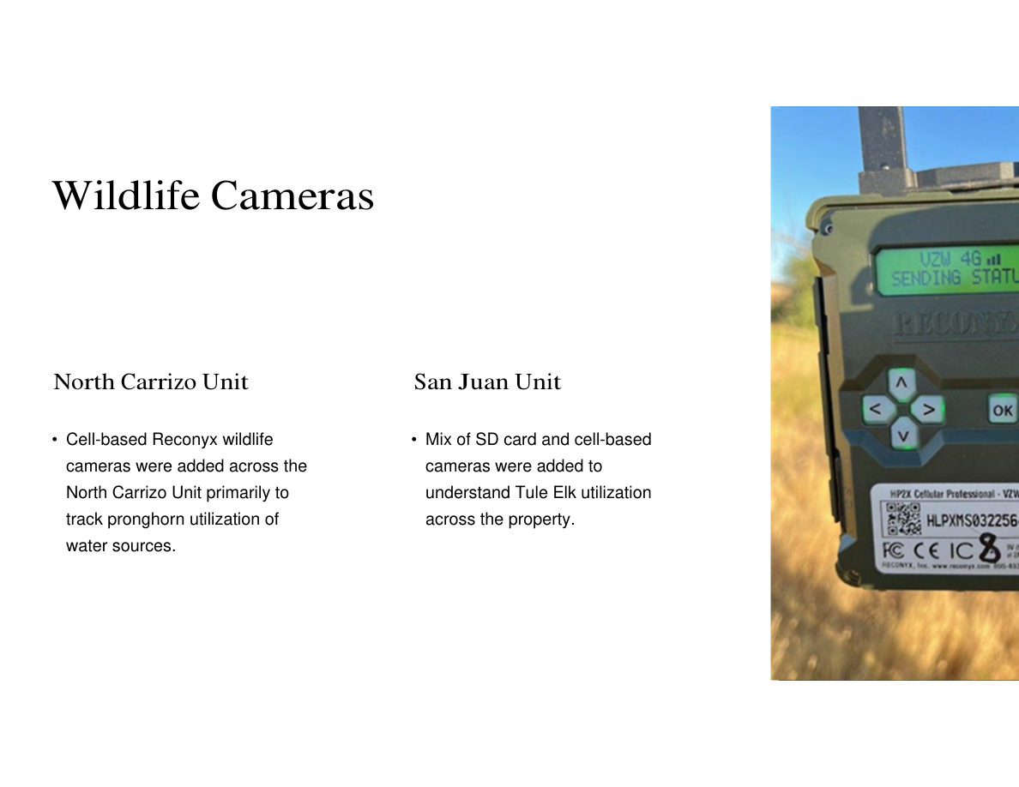
Notes:
SLIDE 17 of 71: Wildlife Cameras – Deployment
SLIDE: Wildlife Cameras
NORTH CARRIZO UNIT:
• Cell-based Reconyx wildlife cameras were added across the North Carrizo Unit primarily to track pronghorn utilization of water sources.
SAN JUAN UNIT:
• Mix of SD card and cell-based cameras were added to understand Tule Elk utilization across the property.
IMAGE DESCRIPTION: Close-up photograph of a Reconyx HP2X Cellular Professional wildlife camera mounted on a metal post in golden dry grassland. The camera body is olive/tan colored. The LCD screen displays "VZW 4G" signal indicator and "SENDING STATUS" — showing active cellular transmission. Model label visible: "HP2X Cellular Professional – VZW" with serial number HLPXMS032256. Camera is mounted at approximately 3–4 feet height with a long antenna extended upward.

Slide 10
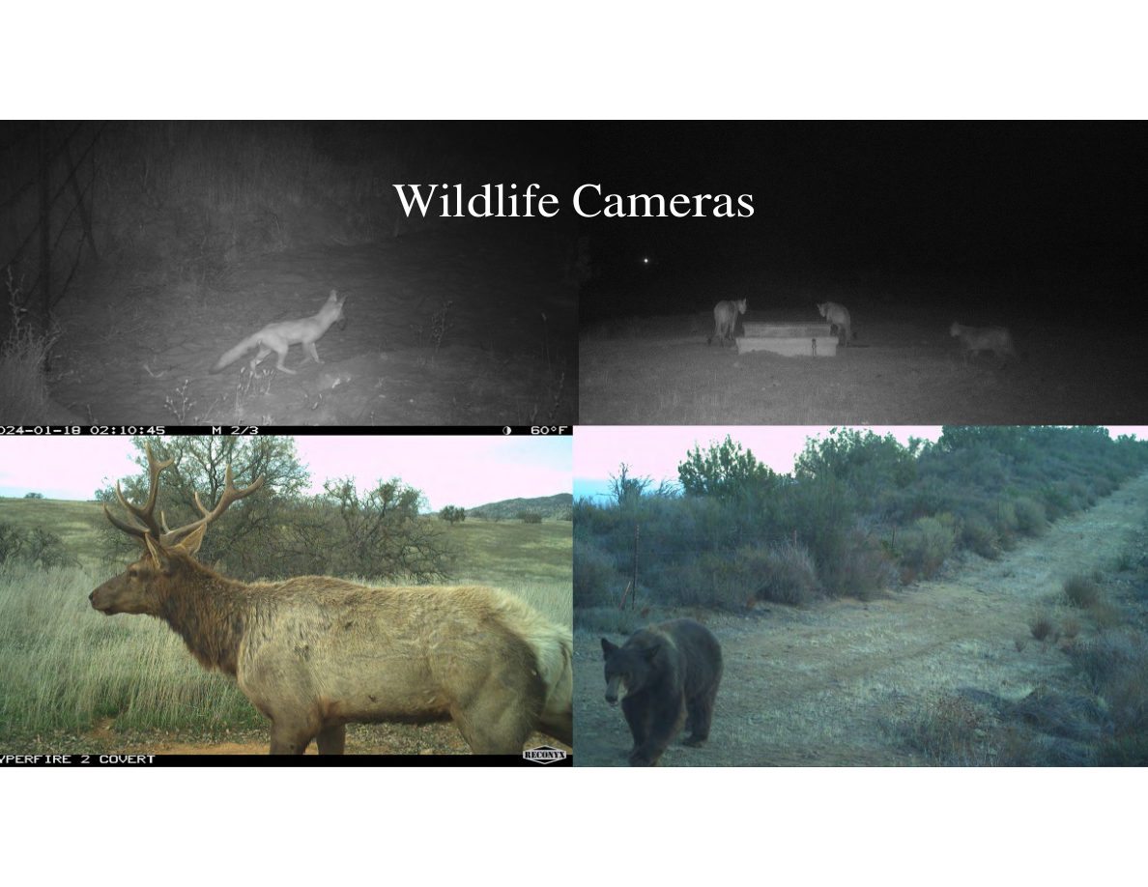
Notes:
SLIDE 18 of 71: Wildlife Camera Images – Large Mammals
SLIDE: Wildlife Camera Images
Four wildlife camera photographs:
TOP LEFT (nighttime, infrared): A coyote walking through sparse scrub vegetation. Timestamp: 2024-01-18 02:10:45, M 2/3, 60°F. The animal is captured mid-stride, moving left to right. Infrared black-and-white image.
TOP RIGHT (nighttime, infrared): Two coyotes at a water trough. Both animals are drinking from opposite ends of the trough simultaneously. Dark nighttime background, infrared illumination.
BOTTOM LEFT (daytime, color): A magnificent large Tule Elk bull standing in oak woodland. The bull has a massive, fully-developed antler rack. Brown body with pale rump patch visible. Bare-limbed oak trees in background. Rolling grassy hills in distance. "HYPERFIRE 2 COVERT" camera stamp visible.
BOTTOM RIGHT (daytime, color): A large black bear walking on a dirt road through dense chaparral/scrub vegetation. Bear is moving toward the camera. Reconyx camera stamp visible.

Slide 11
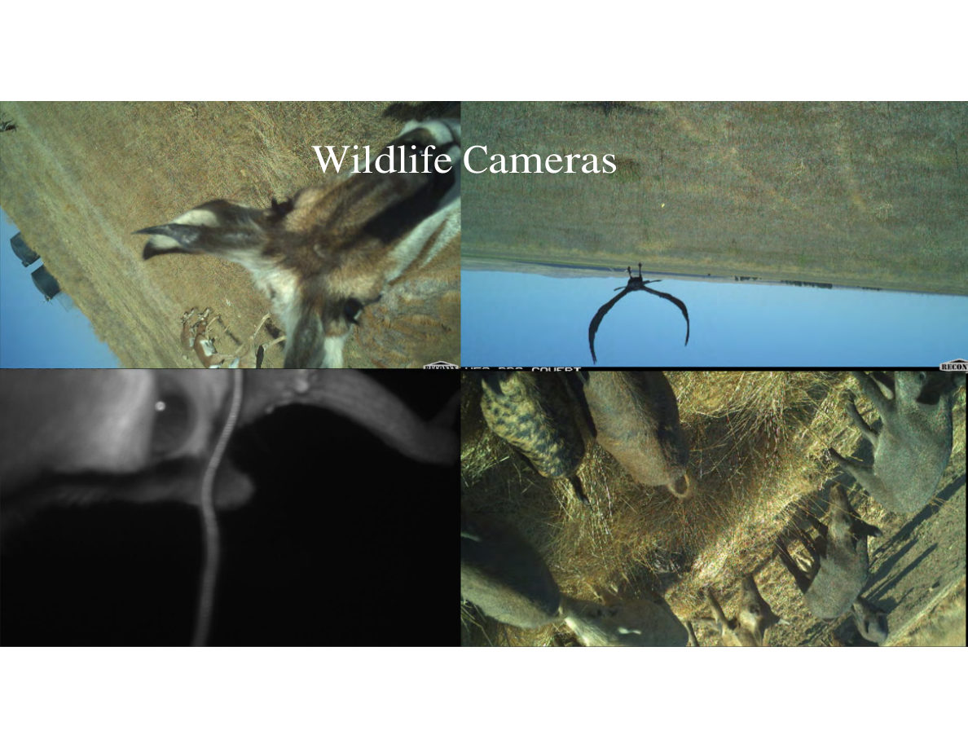
Notes:
SLIDE 19 of 71: Wildlife Camera Images – Close-Ups
SLIDE: Wildlife Camera Images (close encounters)
Four close-up trail camera images:
TOP LEFT: A pronghorn's head and neck extremely close to the camera — the animal is investigating or sniffing the camera housing. Camera is apparently mounted on or near a water trough. Bright blue sky background. The pronghorn's distinctive facial markings (brown and white) are clearly visible.
TOP RIGHT: Looking up at the sky from a water trough level — a raptor (hawk or falcon) is captured in flight directly above, reflected in the still water surface. The bird's silhouette and wing shape visible in the reflection. Blue sky and grassland visible.
BOTTOM LEFT (infrared, nighttime): Very close-up infrared image of an animal's leg and lower body, likely a large animal (cattle or elk). The image captures the texture of hair/hide at very close range.
BOTTOM RIGHT (daytime): An image of bird feet (talons) and grassland stems at ground level — likely a raptor that landed in front of the camera. Yellow-green grass stalks and the bird's scaly feet/talons are in sharp focus.

Slide 12
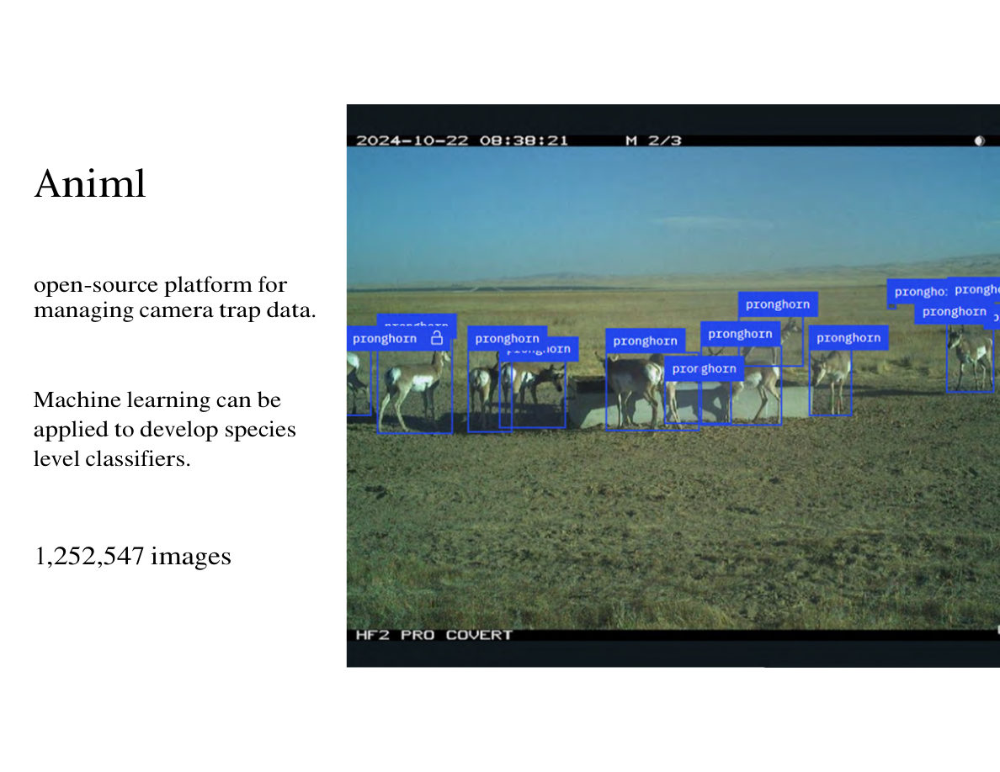
Notes:
SLIDE 20 of 71: Animl – AI Camera Trap Image Management
SLIDE: Animl – AI-Powered Camera Trap Management
Platform description: Animl is an open-source platform for managing camera trap data.
Machine learning capability: Can be applied to develop species-level classifiers.
Total images processed: 1,252,547 images
IMAGE DESCRIPTION: Daytime trail camera photo (HF2 Pro Covert, 2024-10-22 08:38:21) showing a group of 8–10 pronghorn gathered around a low concrete water trough in dry brown grassland. The Animl AI detection system has processed this image and placed blue bounding boxes with text labels around each pronghorn. Labels visible: "pronghorn" (multiple), "pronghorn [locked icon]" (one verified/locked detection). Wide flat Carrizo Plain terrain extends to distant mountains. The automated detection correctly identified all visible pronghorn individuals.

Slide 13
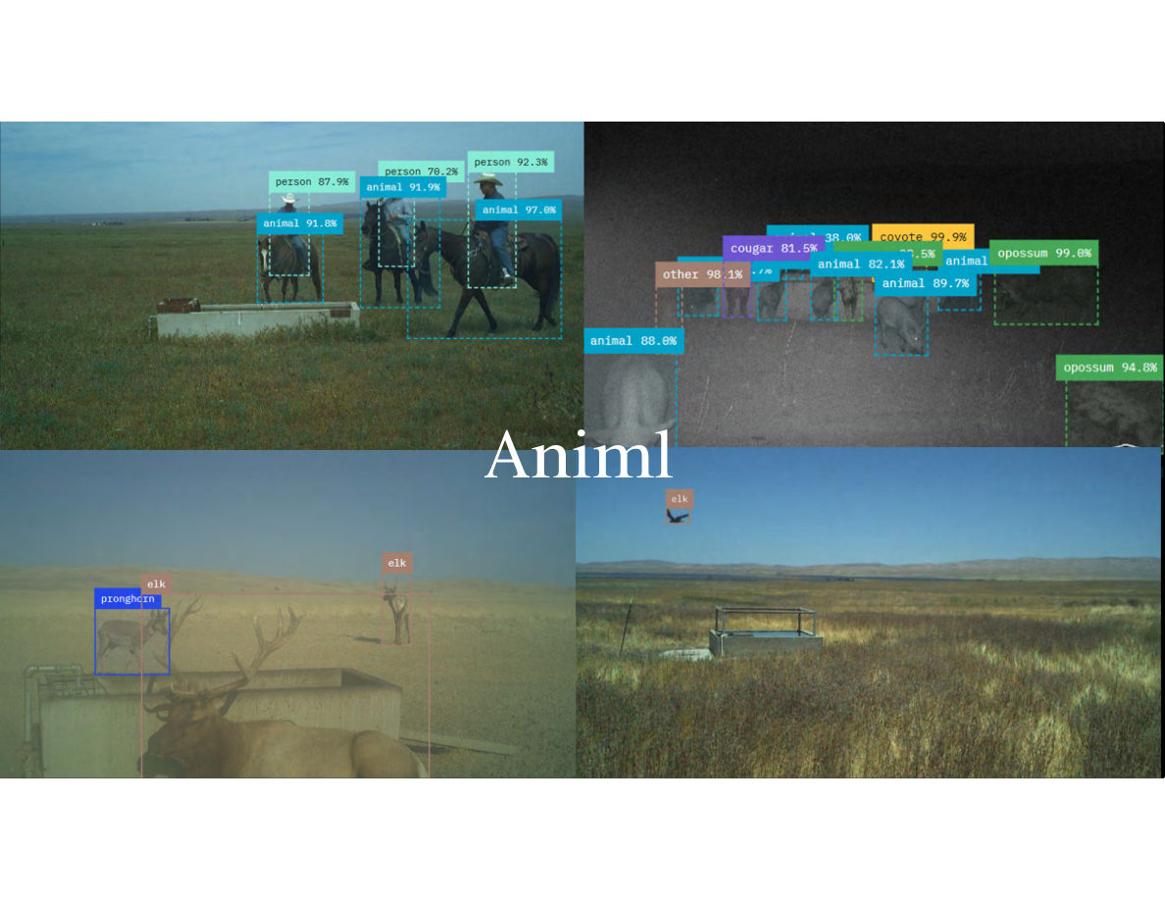
Notes:
SLIDE 21 of 71: Animl – Multi-Species Detection Examples
SLIDE: Animl Multi-Species AI Detection
Four camera trap images with AI detection boxes and confidence scores:
TOP LEFT (daytime): Two riders on horseback at a water trough in open grassland. AI detections: "person 87.9%", "person 70.2%", "person 92.3%" (riders and a third person), "animal 91.9%", "animal 97.0%", "animal 91.8%" (horses/cattle). Multiple bounding boxes in teal/cyan color.
TOP RIGHT (nighttime, infrared): Multiple animals at night. AI detections: "cougar 81.5%", "coyote 99.9%", "opossum 99.0%", "opossum 94.8%", "other 98.1%", multiple "animal" labels at 82–90% confidence. Purple boxes for most detections, green for opossum. Shows system's ability to distinguish multiple species in a single nighttime frame.
BOTTOM LEFT (daytime, dusty/hazy conditions): A large Tule Elk bull and a smaller pronghorn near a water trough. AI detections: "elk" (orange small box on pronghorn, possible misclassification), "elk" (on the bull, correct). Two animals present simultaneously at the water source.
BOTTOM RIGHT (daytime): Empty water trough with flat grassland. A flying bird (appears to be a raptor/eagle) is captured at the very top edge of the frame. AI detection: "elk" (orange small box on the bird — likely a misclassification). Demonstrates AI system limitations with unusual views.

Slide 14
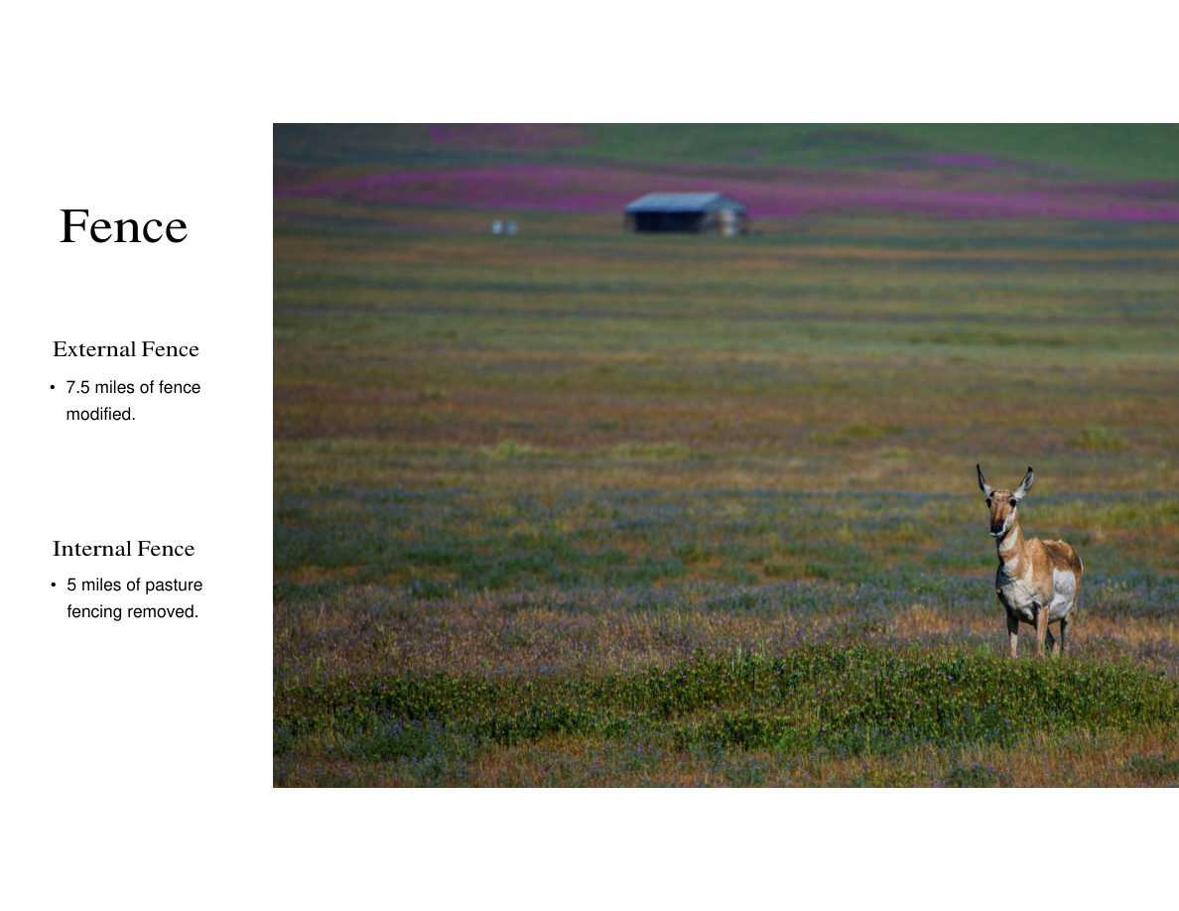
Notes:
SLIDE 22 of 71: Fence – Modification and Removal
SLIDE: Fence Modification
EXTERNAL FENCE:
• 7.5 miles of fence modified (for wildlife-friendly crossings for pronghorn)
INTERNAL FENCE:
• 5 miles of pasture fencing removed (to open landscape for wildlife movement)
IMAGE DESCRIPTION: A solitary pronghorn doe standing in an open wildflower meadow at Carrizo Plain. The meadow is covered with brilliant purple phacelia and gold/yellow goldfields wildflowers. The pronghorn is alert, ears forward, looking directly at the camera. A historic wooden ranch building/barn is visible in the mid-background. Mountains rise behind. The image exemplifies the open habitat pronghorn require for free movement — the goal of the fence modification project.

Slide 15
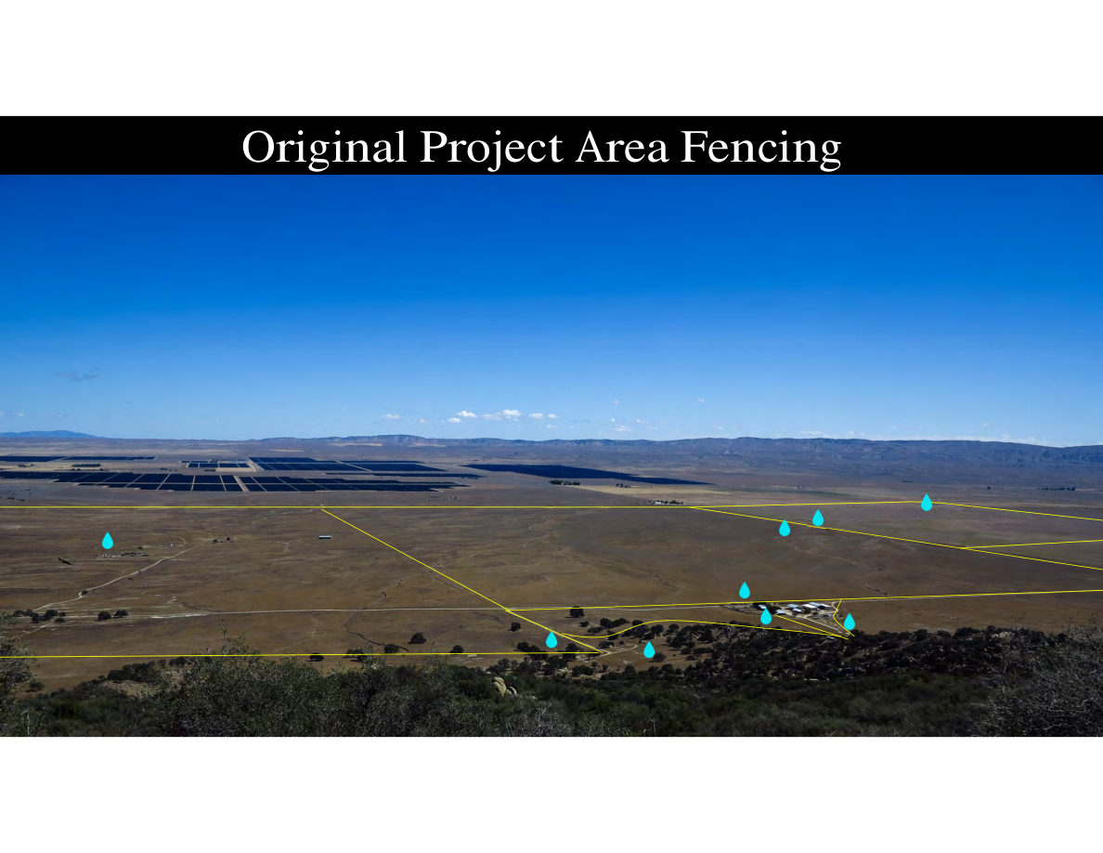
Notes:
SLIDE 23 of 71: Original Project Area Fencing
SLIDE: Original Project Area Fencing (BEFORE)
IMAGE DESCRIPTION: Aerial photograph looking north across the North Carrizo Unit project area in dry late-summer conditions. Solar panel arrays on adjacent private land visible in upper left.
FENCE LINES (yellow solid lines): Multiple fence lines running diagonally across the landscape, dividing it into several enclosed pastures. The fences create a complex patchwork pattern that fragments pronghorn movement corridors.
WATER POINTS (cyan water-drop icons): Approximately 7 water source locations shown, clustered primarily in the southern and central portions of the property. Large areas of the northern plain have no water coverage.
CONTEXT: The original fencing configuration created barriers to pronghorn movement and the limited water distribution left large portions of the landscape inaccessible to pronghorn.

Slide 16
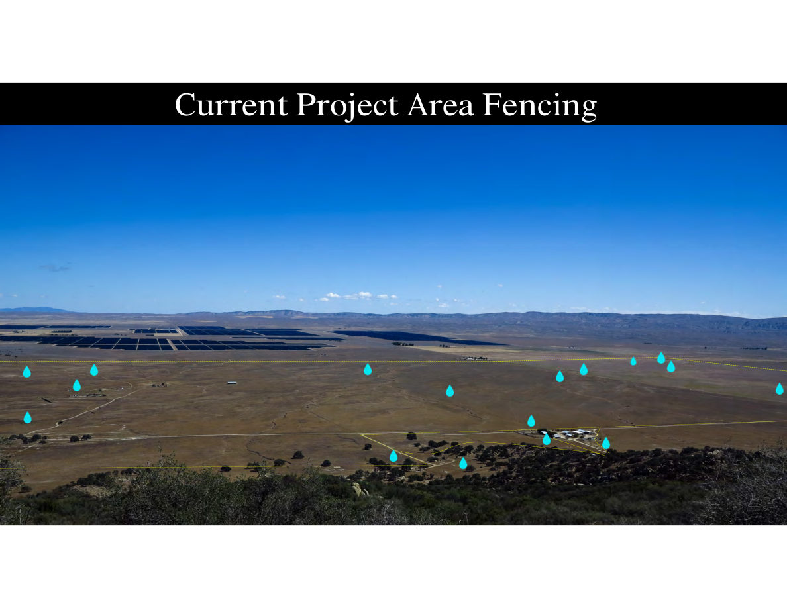
Notes:
SLIDE 24 of 71: Current Project Area Fencing
SLIDE: Current Project Area Fencing (AFTER)
IMAGE DESCRIPTION: Same aerial photograph of the North Carrizo Unit, same viewpoint, after fence modification and water expansion work.
FENCE LINES: Most diagonal interior fences have been removed or modified (shown as dotted/dashed lines rather than solid). Remaining fences (solid yellow lines) are clustered near the headquarters area in the south-central portion. The landscape is now largely open for wildlife movement.
WATER POINTS (cyan water-drop icons): Approximately 14–15 water source locations now shown — roughly double the original number. Water points are distributed much more evenly across the entire unit, including the previously unwatered northern sections.
IMPROVEMENT: Fence barriers to pronghorn movement significantly reduced; water coverage expanded to within 1 mile of virtually all areas in the unit.

Slide 17
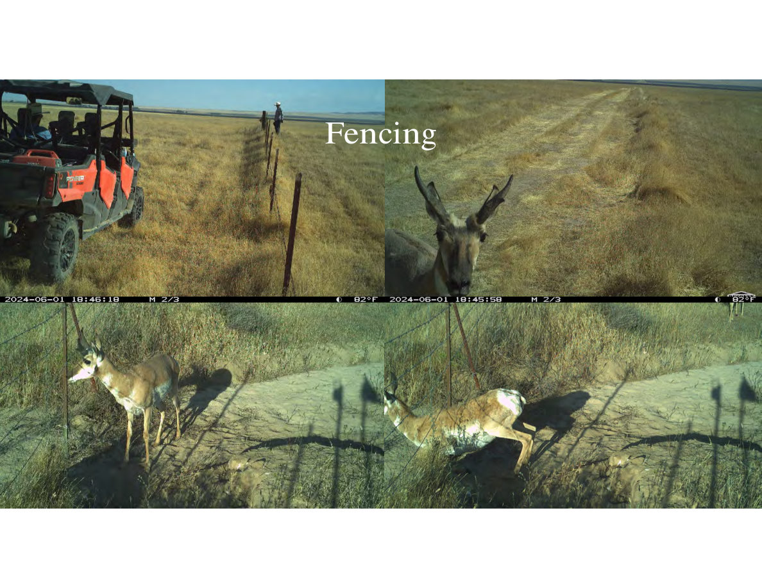
Notes:
SLIDE 25 of 71: Fencing – Camera Documentation
SLIDE: Fencing (camera trap documentation)
Four camera trap images documenting fence modification work and immediate pronghorn response:
TOP LEFT (June 1, 2024, 6:46 PM, 82°F): Work side-by-side UTV (Honda Pioneer, red) parked next to a fence line. A worker in a hat stands in the background. The camera documents active fence modification work in progress.
TOP RIGHT (June 1, 2024, 6:45 PM, 82°F): Just one minute earlier: a pronghorn is standing in the fence corridor/opening, looking directly at the camera. The animal is alert and appears to be assessing the modified fence crossing.
BOTTOM LEFT: A pronghorn (wearing a pink ear tag) approaching a modified fence. The animal's body posture indicates it is preparing to duck under or through the fence. The smooth bottom wire modification is visible.
BOTTOM RIGHT: Same or similar pronghorn actively crouching and ducking under the modified fence wire, successfully crossing to the other side. The sequence documents the fence modification working as intended — pronghorn can now cross where previously they could not.
NOTE: Pronghorn used the modified fence crossing within minutes of installation being documented, confirming immediate wildlife response.

