Slide 1
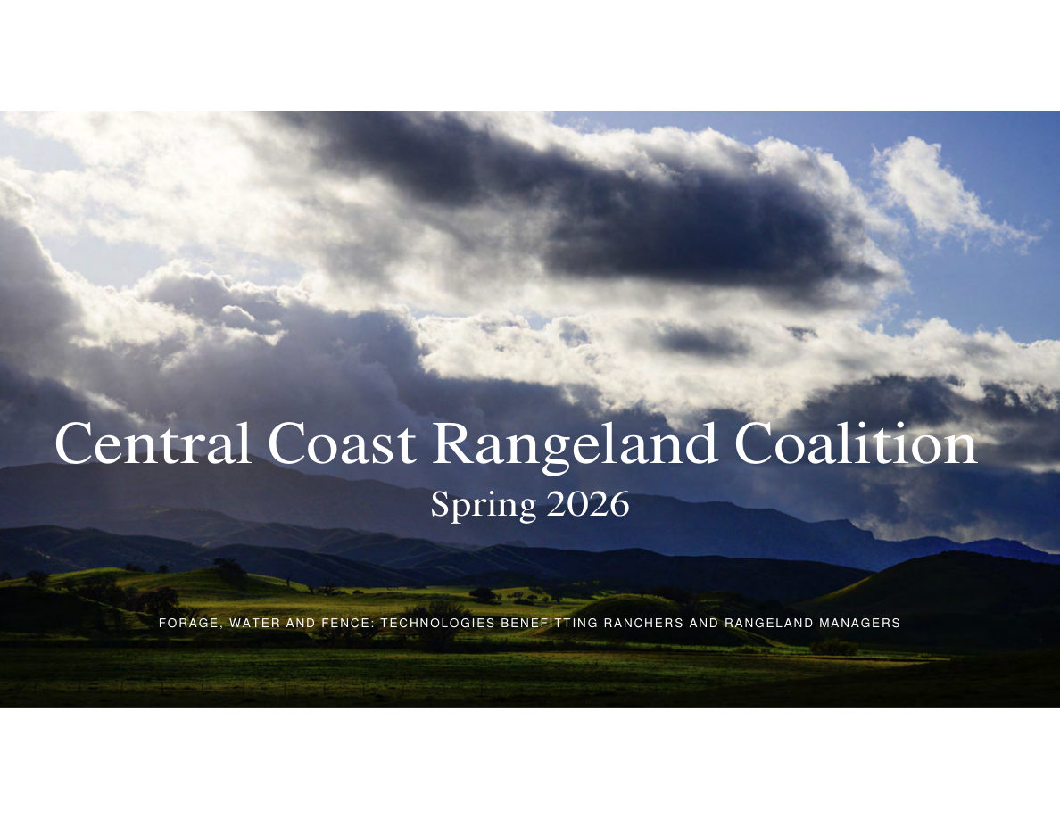
Notes:
SLIDE 1 of 71: Cover Slide
COVER SLIDE – Central Coast Rangeland Coalition, Spring 2026
Theme: "Forage, Water and Fence: Technologies Benefitting Ranchers and Rangeland Managers"
IMAGE DESCRIPTION: Aerial panoramic view of rolling green California rangeland hills under a dramatic sky at dusk. Dark storm clouds with light breaking through illuminate the grassy hillsides. Mountain ridgelines visible in background. The landscape is lush green, indicative of winter/spring conditions.
ACCESSIBILITY NOTE: This presentation has been enhanced with speaker notes on every slide containing full image descriptions and accessible text versions of all content, for use with screen readers or as a standalone accessible reference.

Slide 2
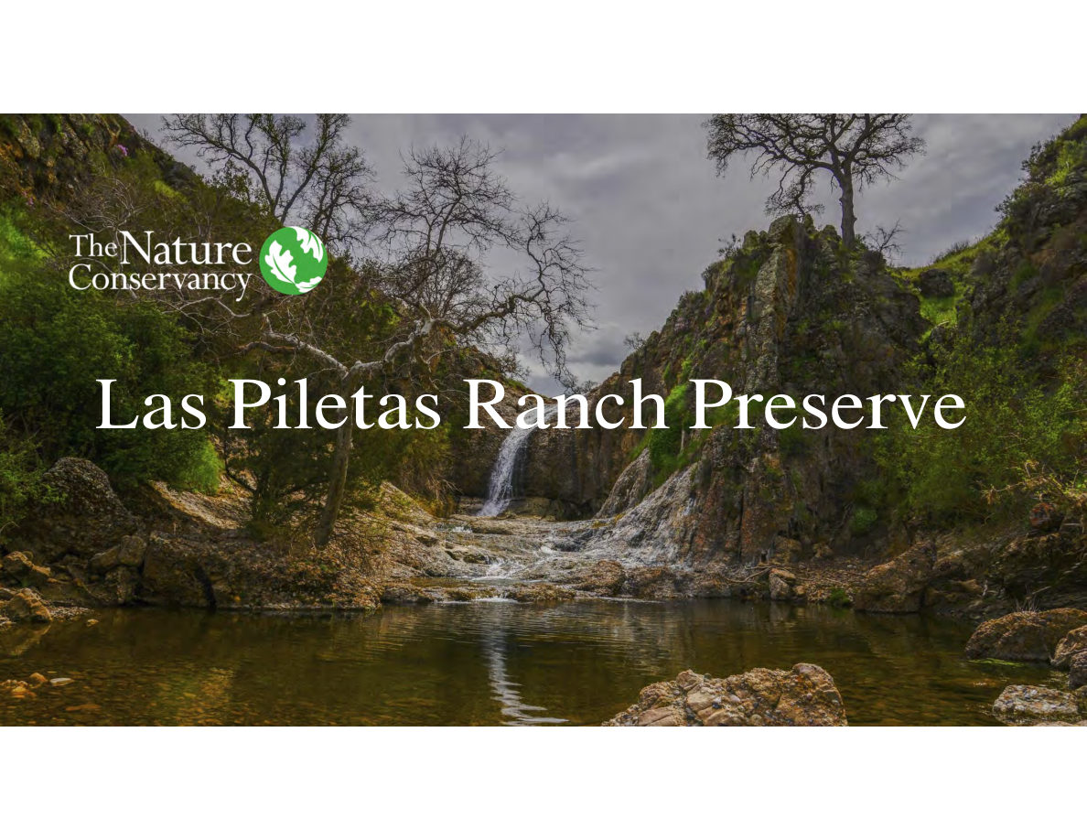
Notes:
SLIDE 2 of 71: Las Piletas Ranch Preserve – Section Title
SECTION TITLE SLIDE – Las Piletas Ranch Preserve (The Nature Conservancy)
IMAGE DESCRIPTION: Title text "Las Piletas Ranch Preserve" overlaid on a dramatic landscape photograph. A waterfall cascades over tiered rocky outcroppings into a clear natural pool. Bare-limbed sycamore or cottonwood trees frame the scene. Canyon walls rise steeply on both sides. Hillsides show green winter grasses. The Nature Conservancy logo (green globe with leaf) appears in upper left.

Slide 3
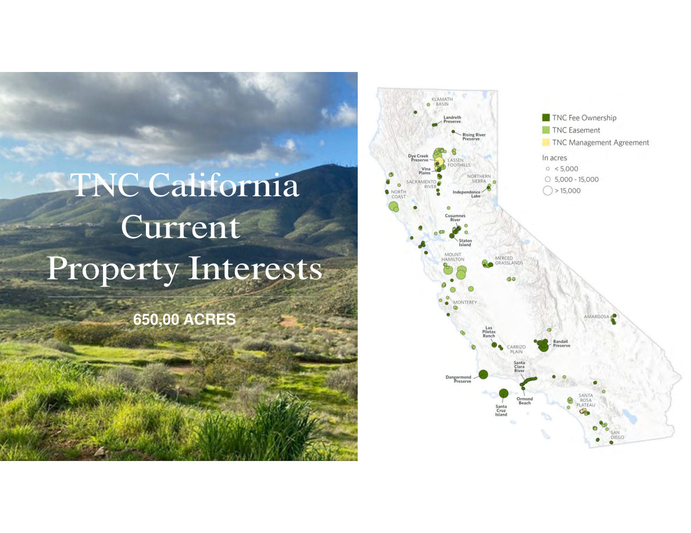
Notes:
SLIDE 3 of 71: TNC California Current Property Interests – 650,000 Acres
SLIDE: TNC California Current Property Interests
IMAGE LEFT: Hillside grassland with golden grasses and sage scrub under cloudy blue sky.
IMAGE RIGHT (MAP): Map of California showing all TNC property interests as graduated circles sized by acreage. Legend:
• Dark green filled circles = TNC Fee Ownership
• Light green filled circles = TNC Easement
• Yellow/pale circles = TNC Management Agreement
• Small circles < 5,000 acres | Medium = 5,000–15,000 | Large > 15,000 acres
Key labeled properties on map: Klamath Basin, Landreth Preserve, Rising River Preserve, Dye Creek Preserve, Vina Plains, Lassen Foothills, Northern Sierra, Independence Lake, North Coast, Sacramento River, Cosumnes River, Staten Island, Mount Hamilton, Merced Grasslands, Monterey, Amargosa, Las Piletas Ranch, Carrizo Plain, Randall Preserve, Santa Clara River, Dangermond Preserve, Ormond Beach, Santa Cruz Island, Santa Rosa Plateau, San Diego.
TOTAL: 650,000 acres of California property interests across all types.

Slide 4
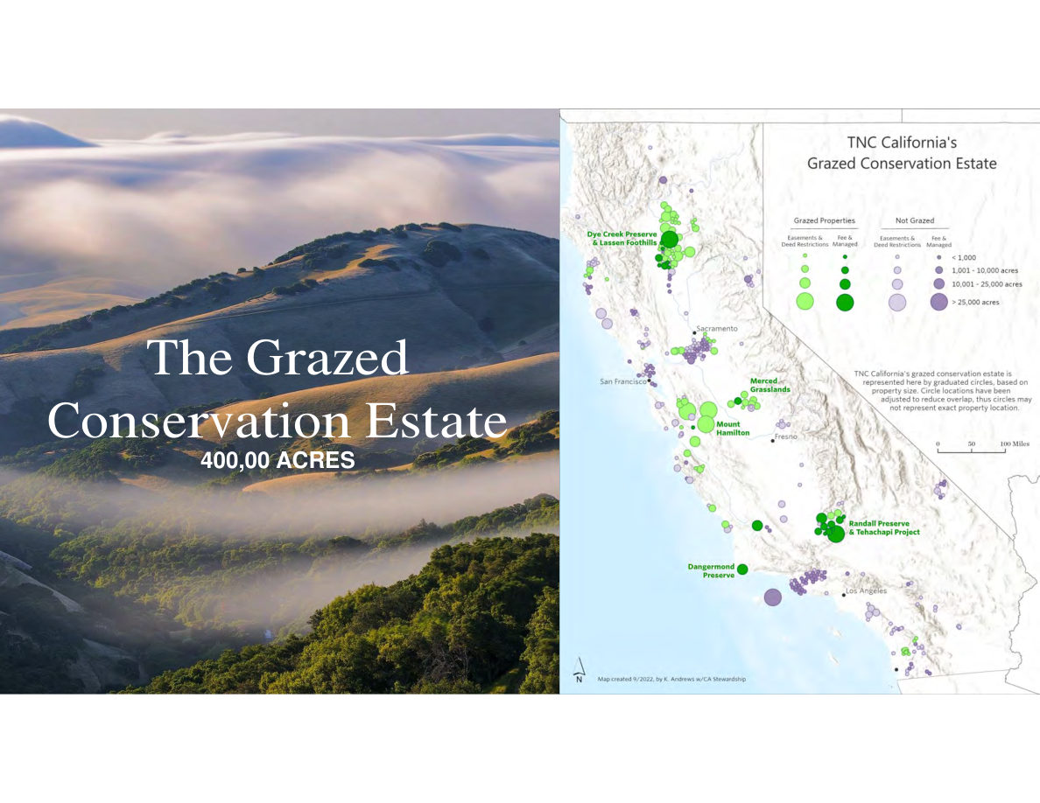
Notes:
SLIDE 4 of 71: The Grazed Conservation Estate – 400,000 Acres
SLIDE: The Grazed Conservation Estate
IMAGE LEFT: Fog-draped forested mountains at dusk. Rolling hills with golden grassland in foreground partially obscured by low clouds.
IMAGE RIGHT (MAP): TNC California's Grazed Conservation Estate. Two categories of circles:
GRAZED PROPERTIES (green circles): Easements & Deed Restrictions | Fee & Managed
NOT GRAZED (gray/purple circles): Easements & Deed Restrictions | Fee & Managed
Circle sizes: <1,000 | 1,001–10,000 | 10,001–25,000 | >25,000 acres
Key labeled grazed sites (green): Dye Creek Preserve & Lassen Foothills (largest, north), Merced Grasslands (central valley), Mount Hamilton (Bay Area), Randall Preserve & Tehachapi Project (south-central), Dangermond Preserve (central coast).
TOTAL: 400,000 acres of grazed conservation estate in California.
Map created September 2022 by K. Andrews, CA Stewardship.

Slide 5
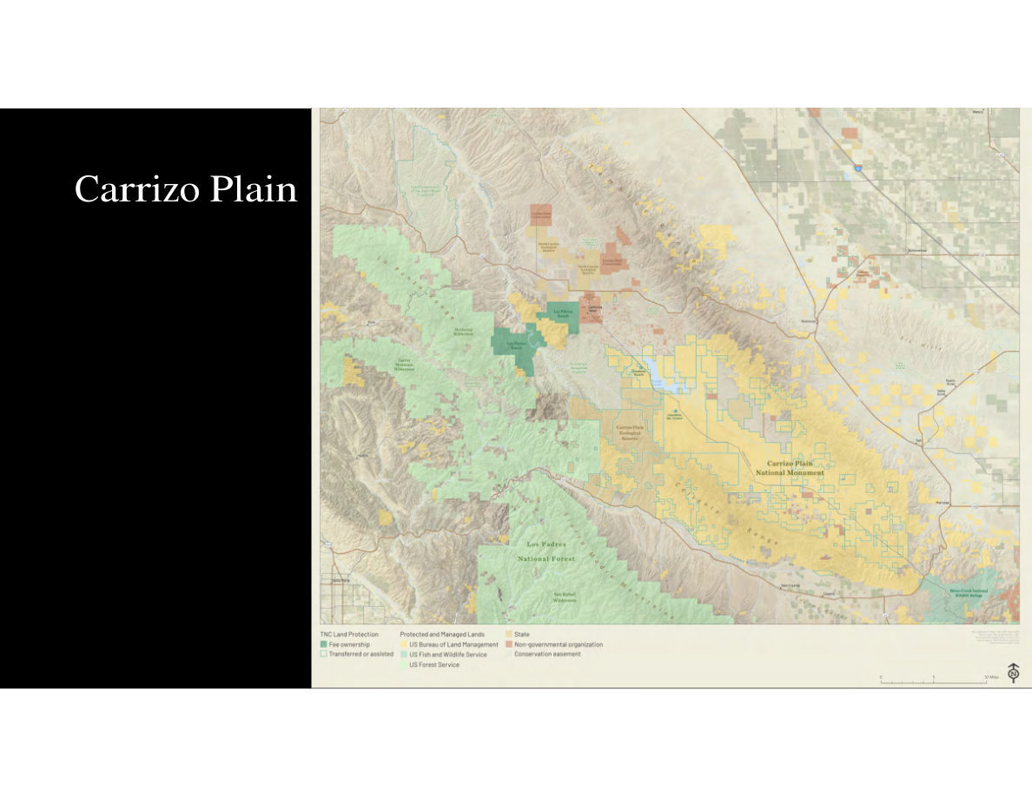
Notes:
SLIDE 5 of 71: Carrizo Plain – Regional Map
SLIDE: Carrizo Plain Regional Map
IMAGE (MAP): Detailed topographic/land management map of the Carrizo Plain region. Color-coded land management categories:
• Dark green = TNC Fee Ownership
• Light green = TNC Transferred or Assisted
• Tan/yellow = US Bureau of Land Management (BLM)
• Blue-green = US Fish and Wildlife Service
• Pale green = US Forest Service
• Orange-brown = State lands
• Pink = Non-governmental organization lands
• Tan outline = Conservation easement
Key labeled features:
• Las Piletas Ranch (center, TNC fee ownership – small dark green area)
• Carrizo Plain National Monument (large BLM area to the east)
• Carrizo Plain Ecological Reserve
• Machesna Mountain Wilderness (northwest, USFS)
• Los Padres National Forest (southwest)
• San Rafael Wilderness
• Bitter Creek National Wildlife Refuge (southeast)
• Private agricultural lands (brown grid pattern, east side)

Slide 6
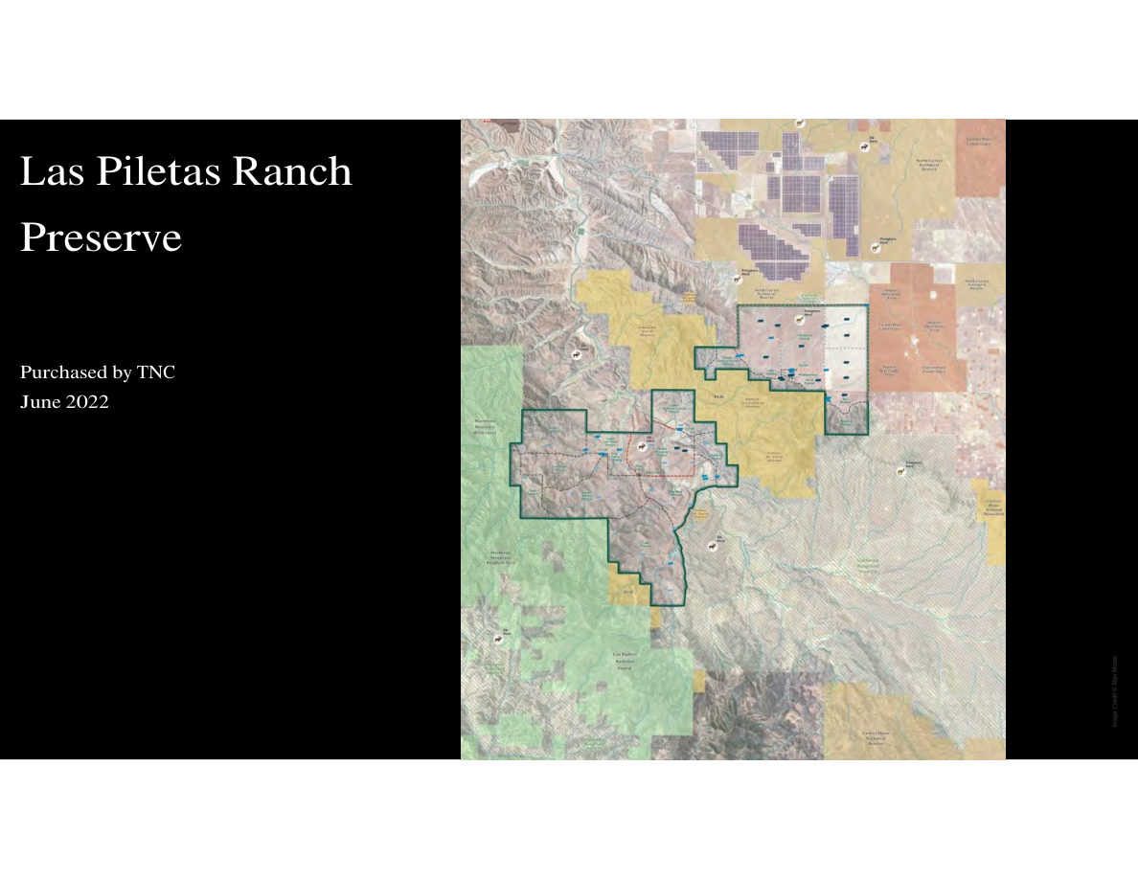
Notes:
SLIDE 6 of 71: Las Piletas Ranch Preserve – Property Map
SLIDE: Las Piletas Ranch Preserve Property Map
IMAGE (AERIAL MAP): Satellite aerial map with property boundary outlined in dark green. Located in San Luis Obispo County east of the Caliente Range.
Property features visible:
• North/East: Flat arid Carrizo Plain terrain (tan/brown)
• South/West: Rugged canyon and mountain terrain (darker)
• Blue icons: Water point locations (troughs, tanks, wells) distributed across the property
• Adjacent lands: Large solar panel arrays on private land to the north
• Surrounding context: BLM land (yellow-tan), private farmland with center-pivot irrigation circles (northeast)
Property was purchased by The Nature Conservancy in June 2022.
Location: San Luis Obispo County, California.

Slide 7
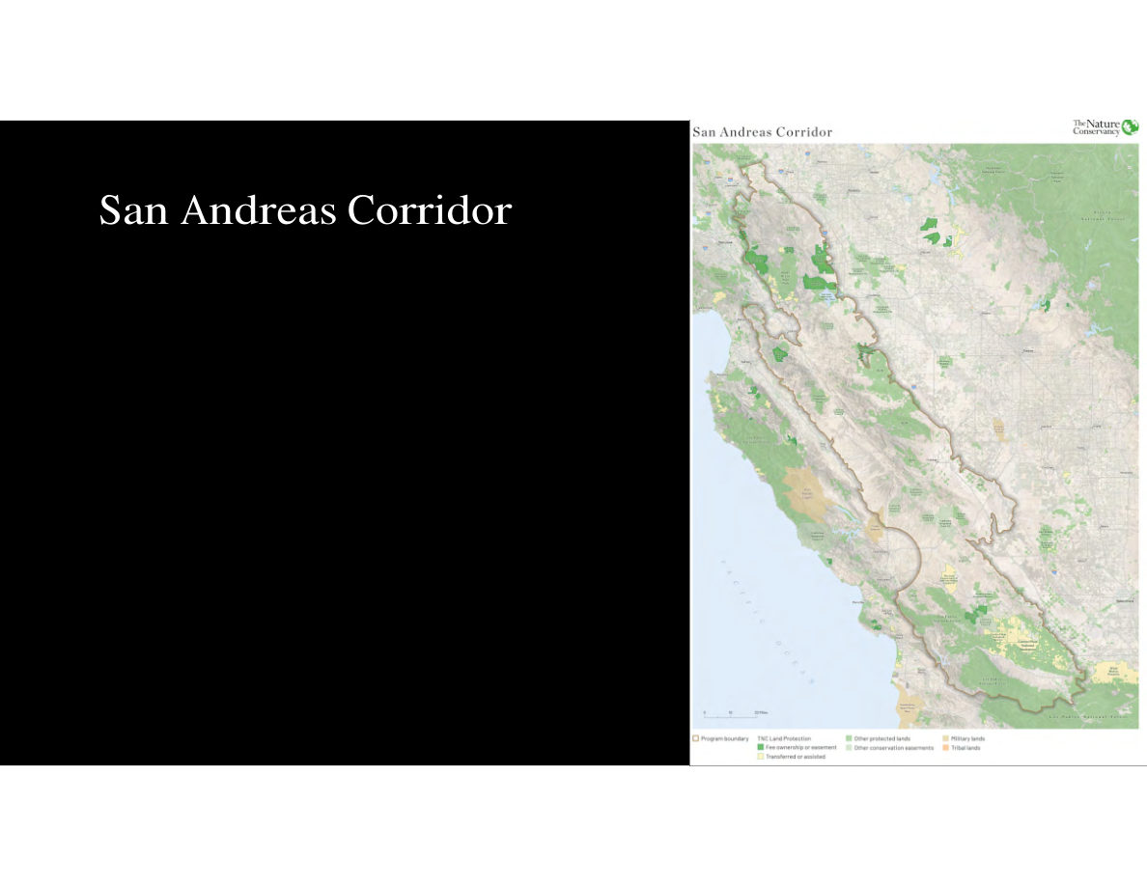
Notes:
SLIDE 7 of 71: San Andreas Corridor
SLIDE: San Andreas Corridor
IMAGE (MAP): Map showing the San Andreas Corridor project area running along the San Andreas Fault through Central California. The corridor extends from north of the San Francisco Bay Area southward along the Diablo Range to south of the Salinas Valley.
Legend:
• Program boundary (blue outline) = defines the corridor extent
• TNC Land Protection:
- Dark green = Fee ownership or easement
- Light green/tan = Transferred or assisted
• Other protected lands (various greens)
• Other conservation easements
• Military lands (tan)
• Tribal lands (orange)
The corridor connects multiple TNC properties and conservation areas along the fault zone.

Slide 8
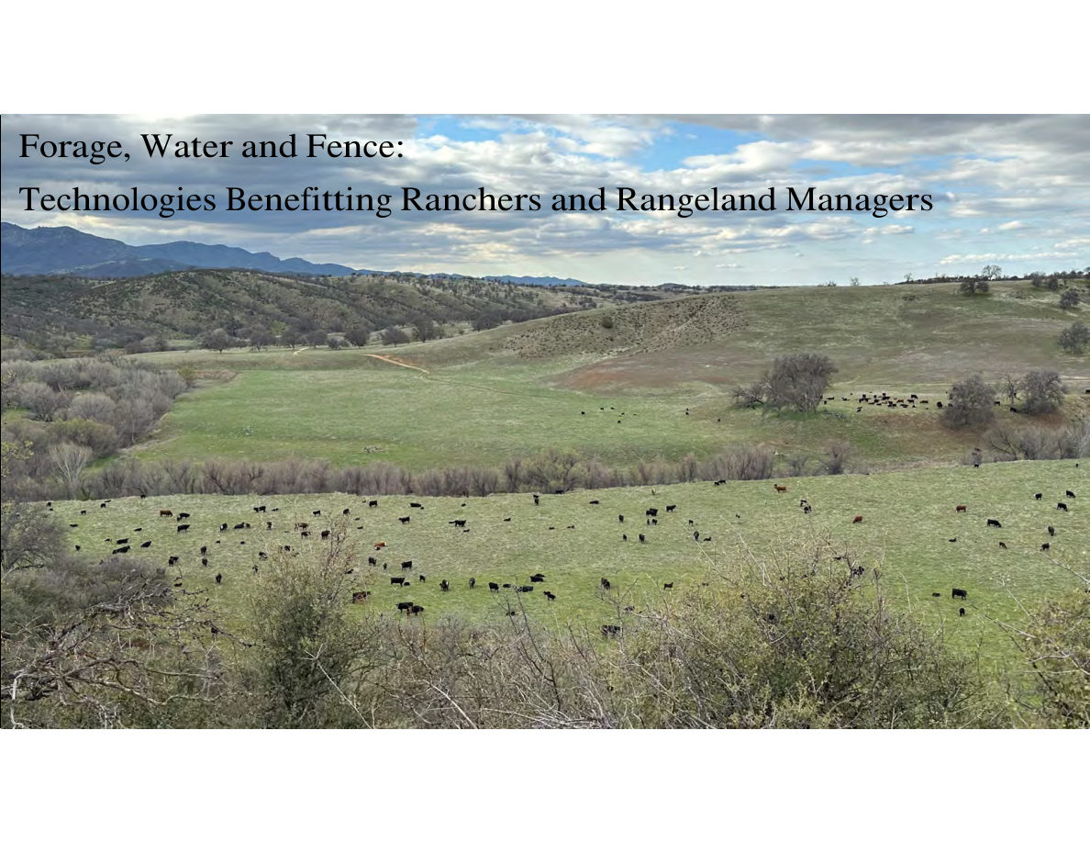
Notes:
SLIDE 8 of 71: Technologies: Forage, Water and Fence – Section Header
SECTION HEADER SLIDE: "Forage, Water and Fence: Technologies Benefitting Ranchers and Rangeland Managers"
IMAGE DESCRIPTION: Wide landscape photograph of a large herd of black Angus cattle grazing on a lush green hillside pasture. Rolling hills with oak trees visible in middle ground. Mountains in background under partly cloudy sky. Cattle are spread across the green hillside in a natural grazing distribution pattern.

