Slide 1
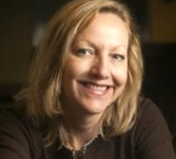
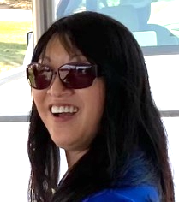
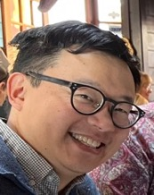
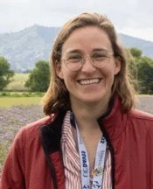
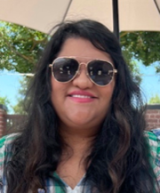
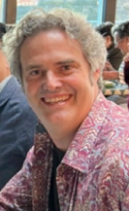
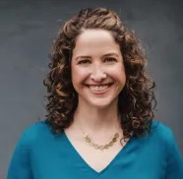
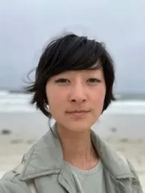
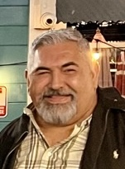
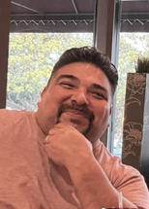
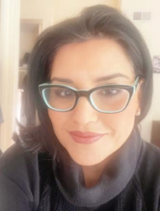
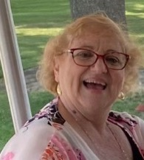
Making an Impact with Strategic Communications
Linda Forbes
Director
April 15, 2026

Slide 2
Who Are We?
Strategic Communications is a small (but mighty) team serving more than 1,600 employees across the state.
We partner with academics and programs to promote the impact and value of UC ANR and extend research-based information to new audiences.
Caroline Champlin, Science Communication Specialist
Diana Cervantes, Broadcast Communications Specialist
Dora Garay, Social Media Strategist
Erin Greenfield, Digital Content Strategist
Ethan Ireland, Sr. Videographer
Heather Hayashi, Web Content Administrator
Leticia Iroygen, Translator
Linda Forbes, Director
Lisa Rawleigh, Admin Asst
Miguel Sanchez, Broadcast Communications Specialist
Mike Hsu, Sr. Public Information Officer
Pam Kan-Rice, Assistant Director
Ricardo Vela, News & Information Outreach in Spanish Program Manager

Slide 3
Strategic Priorities
Modernize the content generation and delivery system to carry out our mission effectively
Expand reach and improve targeting to all audiences including internal audiences
Facilitate adoption of a clear brand/identity

Slide 4
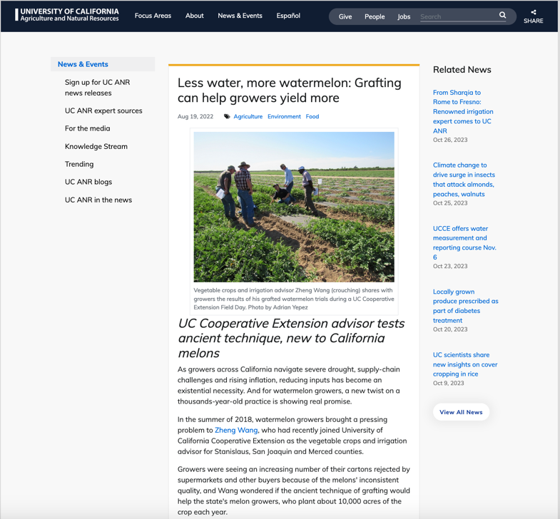
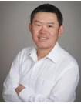
Public Relations Impact
“I had a pleasant experience working with the Strategic Communications team to broadly share my vegetable grafting research stories and associated impacts via various ANR blogs and other outlets.
The related articles were reproduced by other industry media and with the broad reach and help from the Communications team, I received interest in knowing more about my work and collaboration from other states (Oregon, Washington and Michigan). It is an important and effective way to get publicity for what we have done. I highly recommend ANR academics, especially newcomers, think about reaching out to the Strategic Communications team to speak loudly for your fantastic work.”
Zheng Wang, vegetable crops and irrigation advisor for Stanislaus, San Joaquin and Merced counties

Slide 5
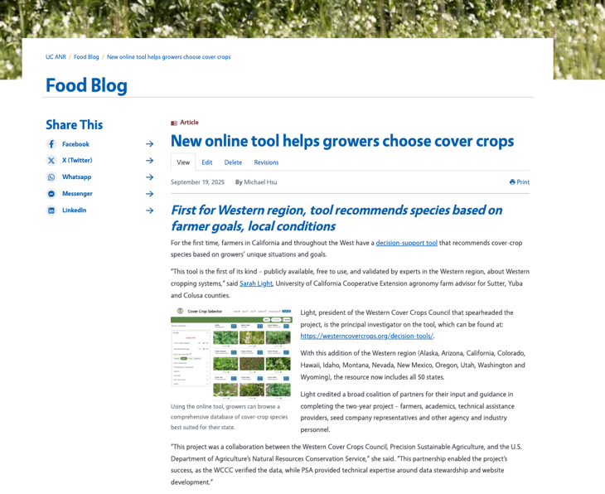
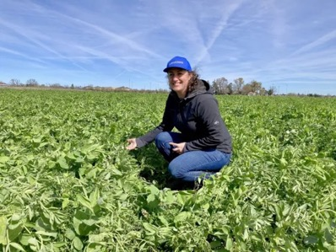
Public Relations Impact - 2
Our web story about Sarah Light's work on a cover-crop species selection tool resulted in:
A press release distributed to 468 media members and other key contacts had a 47% open rate
Related social media posts on Facebook, Instagram, LinkedIn, X, and Bluesky accounts resulted in over 15,000 views and over 600 engagements, with the Facebook post garnering 97 likes and 13 shares
Republication on Morning Ag Clips and Ag Alert (California Farm Bureau)
Additional coverage by California Ag Today and Capital Press
In-depth interviews of Sarah Light by MyAgLife Daily News Report and Sustainable Winegrowing podcast
Notes:
Stephanie Mar’s social media feature led to her being invited to Sacramento to speak to legislators.
organic materials management advisor

Slide 6
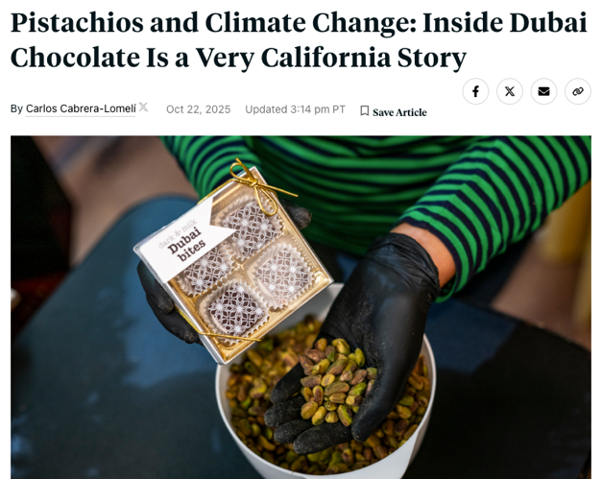
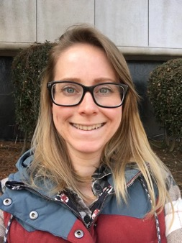
Public Relations Impact - 3
Our reporter relationships lead to others:
“I'm Carlos Cabrera-Lomelí, reporter with KQED in San Francisco. My colleague, Ezra David Romero, shared your contact with me as someone who could potentially be really helpful as I work on my next story.”
In order to make every single drop of water count, growers have teamed up with environmentalists to design more efficient irrigation methods and in some instances, abandoning more water-intensive crops. But a drought that lasts multiple years could strain even pistachios, which can normally weather more saline conditions, says Phoebe Gordon, orchard systems advisor at the UC Agriculture and Natural Resources unit.
“How long can you keep on irrigating these trees under limited water conditions and have them continue to perform, to be able to pay the bills?” asks Gordon.
“Yield will decline — that is absolutely not a question,” she says.
Notes:
Strat Comm relationships with reporters lead to other opportunities

Slide 7
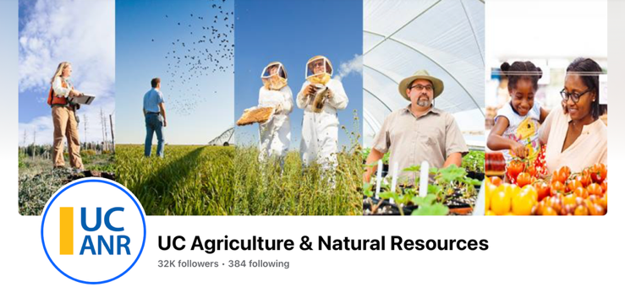
Social Media Impact
During 2025–26, UC ANR social media content generated more than 12 million views and reached 280,000 highly engaged users through targeted paid campaigns on LinkedIn, Facebook, and Instagram.
This content highlighted UC ANR programs and academic expertise, strategically reaching diverse audiences, including farmers, ranchers, legislators, and individuals in underserved communities.
Notes:
Stephanie Mar’s social media feature led to her being invited to Sacramento to speak to legislators.
organic materials management advisor

Slide 8
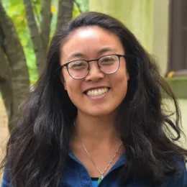
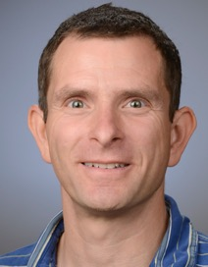
Social Media Impact - 2
Stephanie Mar, Organic Waste Management Area Advisor, was featured on UC ANR’s social media channels introducing her role and how UC ANR supports her work. This content resulted in an opportunity for her to participate in UC ANR Advocacy Day with the state legislature.
Maurice Pitesky, UCCE Poultry Specialist, asked us to promote his poultry app study. The study grew from 15 initial respondents to 2,633 after promotion on UC ANR’s LinkedIn, X, Facebook and Instagram, and the posts led to NBC Bay Area coverage.

Slide 9
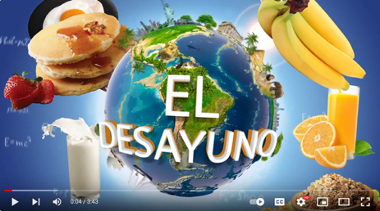
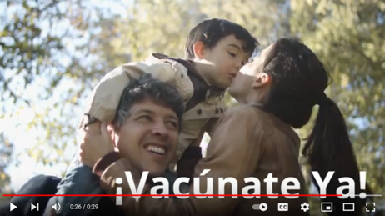
Community Impact
Two successful campaigns by News and Information Outreach in Spanish (NOS) won several awards:
“Breakfast on the Playground” campaign for CalFresh Healthy Living and Coachella Valley Unified Child Nutrition Services
Student participation doubled; two schools had 75% participation
COVID-19 vaccination campaign for Spanish-speaking Latinos and for Indigenous migrant workers in their languages of comfort
7.5 million people reached; 100% engagement on TV, radio and social media platforms (Nielsen and Entravision/Univision data)

Slide 10


















Branding Impact
Visually aligned the UC ANR sub-brand family based on brand audit recommendations
Designed 18 new logos for a fraction of the cost of higher education branding projects

Slide 11

Thank you!
@ucanr
TikTok @uc_anr
lforbes@ucanr.edu
530-750-1204

