Slide 1
Clientele Group Baseline and Civil Rights Compliance Planning
Daniel Obrist, Vice Provost
David White, Analyst, Office of Civil Rights
Kit Alviz, Analyst, Program Planning & Evaluation
Priyanka Vyas, GIS Analyst, Informatics and Geographic Information Systems
Jocelyn Mobley, Evaluation Coordinator, UC Master Gardener Program
August 4, 2026 - 10AM-12PM
Notes:
Ask participants to introduce themselves in chat. Name, position, location.

Slide 2
Non-Discrimination Statement
In accordance with all applicable state and federal laws and University policy, the University of California, Agriculture and Natural Resources, does not discriminate on the basis of race, color, religion, national origin, (including limited English proficiency) (Title VI of the Civil Rights Act of 1964 (Title VI)), disability (including having a history of a disability or being regarded as being disabled) (Section 504 of the Rehabilitation Act of 1973 (Section 504)), Section 13 of the Federal Water Pollution Control Act Amendments of 1972 (FWPCA)), and age (Age Discrimination Act of 1975) (Age Discrimination Act), gender, gender identity, gender expression, gender transition, pregnancy (including pregnancy, childbirth, and medical conditions related to pregnancy or childbirth), physical or mental disability, medical condition (cancer related or genetic characteristics), predisposing genetic information (including family medical history), ancestry, marital status, citizenship, ancestry, sexual orientation, family/parental status, income derived from a public assistance program, political beliefs, or reprisal or retaliation for prior civil
rights activity, or veteran or military status.
As required by Title IX, the University of California, Agriculture and Natural Resources, does not discriminate on the basis of sex in its educational programs, admissions, employment, or other activities.
UC Cooperative Extension program or activity conducted or funded by the U.S. Department of Agriculture (USDA) must comply with all applicable USDA guidance and requirements.
Persons with disabilities who require alternative means of communication for program information (e.g., Braille, large print, audiotape, American Sign Language, etc.) should contact the UC ANR Office of Civil Rights, contacts: EEO Representative David White at 530-786-0206 or email: dewhite@ucanr.edu, or Interim Civil Rights Compliance Officer Tina Jordan at 530-750-1280 or email tljordan@ucanr.edu.
Individuals may also contact USDA through the Telecommunications Relay Service at 711 (voice and TTY). Upon request, program information may be made available in languages other than English.
To file a program discrimination complaint, complete the USDA Program Discrimination Complaint Form, AD-3027, found online at How to File a Program Discrimination Complaint and at any USDA office or write a letter addressed to USDA and provide in the letter all of the information requested in the form. To request a copy of the complaint form, call (866) 632-9992. Submit your completed form or letter to USDA by: (1) mail: U.S. Department of Agriculture, Office of the Assistant Secretary for Civil Rights, 1400 Independence Avenue, SW, Mail Stop 9410, Washington, D.C. 20250-9410; (2) fax: (202) 690-7442; or (3) email: program.intake@usda.gov.
Alternatively, a program discrimination complaint may be filed with the UC Harassment & Discrimination Assistance and Prevention Program (HDAPP) by email at hdapp@ucdavis.edu or via phone at 530-304-3864. Individuals can also contact the UC ANR Title VI and Title IX Coordinator Danesha Nichols at dnnichols@ucdavis.edu or via phone at (530) 747-3864.
Notes:
Kit – Modeling
As a recipient of federal funds are are required to always post a non-discrimination statement. This is the UC ANR full version. In summary, UC ANR is prohibited by law from discrimination on the basis of identities listed. Program information may be made available in languages other than English and in alternative means of communication. This slide also provides information on how to file a program discrimination complaint.
UC ANR templates: https://ucanr.edu/site/uc-anr-human-resources/office-civil-rights-0

Slide 3
Agenda
10:00 - Welcome and overview
10:10 - Introduction to civil rights compliance: Lecture and activity
10:40 - Choose Your Own Adventure:
25 minutes on your own then group discussion
11:10 - 5 minute break
11:15 - Mapping tools for assessing parity and civil rights compliance
11:30 - Using statistics to develop goals: Demo and activity
11:45 - Goal examples and other civil rights compliance resources
11:50 - Open discussion and wrap up
12:00 - Adjourn
Notes:
Kit

Slide 4
Desired Outcomes
As a result of participating in today’s training, participants will have:
Understanding of how-to define clientele groups and strategies for collecting baseline data
Understanding of civil rights compliance goal examples
Understanding of tools available to track annual progress against goals.
Notes:
Kit

Slide 5
UC ANR Leadership Welcome
2025 USDA NIFA Civil Rights Research Compliance Review
  ANR passed with (very minor) clarifications (ongoing)
  Next review focused on extension expected in 3-4 years
USDA NIFA Civil Rights Compliance requirements
  Today and next week’s training: Define clientele, establish baseline, document and report contacts, conduct all reasonable effort.
  Public notification requirements:
    Notification Requirement: post full UC ANR nondiscrimination statement on all print and non-print materials (alternatively, use short form: “This institution is an equal opportunity provider.”).
    Notification Requirement: Recipients are required to notify individuals with disabilities of their right to free accommodations.
    “…And Justice for All” Posters: Posters must be “prominently displayed in all offices where there is a USDA presence and where it may be read by customers.”
Notes:
Daniel

Slide 6
UC ANR Academic Program Review Dossier Requirements
Documentation of Civil Rights Compliance in Extension Activities is a legal requirement of your program reporting and should be addressed in this section
  document efforts to define your clientele group baselines
  show evidence of program efforts to reach and serve your defined clientele
  report the efforts you have made to increase equitable opportunities for participation in your program
Document additional contributions and activities that support ANR’s Principles of Community in personnel or programmatic activities (can be described throughout your dossier, not only in this section).
  https://ucanr.edu/site/division-agriculture-and-natural-resources/principles-community
Notes:
Daniel

Slide 7
Why Do We Have
Civil Rights Laws?
David White, Analyst, Office of Civil Rights
Notes:
David
Why do we have civil rights laws?

Slide 8
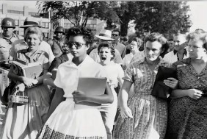

Brief History
Because the journey from . . .
here... to here...
                Is on-going
                Some steps forward, some backward
                But it is on-going
Notes:
David
Because the journey from here. . . to here . . . Is on-going. Some steps forward, some backward. But it is on-going.
We at UC ANR are committed to working together to ensure our workplace community thrives within an environment of respect that values each member – that values each individual contribution.
Let’s examine some of the federal laws that continue to help us shape our way forward.

Slide 9
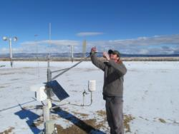

Civil Rights Program Authorities (1 of 2)
Title VI of the Civil Rights of 1964
Sections 504 of the Rehabilitation Act of 1973, the Americans with Disabilities Act (ADA), & the ADA Amendments Act of 2008
Title IX of the Education Amendments of 1972
Age Discrimination Act of 1975
Notes:
David
Title VI of the Civil Rights Act of 1964 ---
Sections 504 of the Rehabilitation Act of 1973, the Americans with Disabilities Act (ADA), & the ADA Amendments Act of 2008 ---
Title IX of the Education Amendments of 1972 ---
Age Discrimination Act of 1975

Slide 10
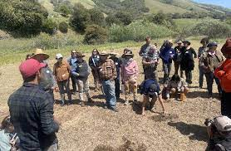
Civil Rights Program Authorities (2 of 2)
Civil Rights Restoration Act of 1987
7 CFR Part 16, “Equal Opportunity for Religious Organizations”
Executive Order 13166 – “Improving Access to Services for Persons with Limited English Proficiency" (August 11, 2000)
USDA LEP Policy Guidance (79 Fed. Reg. No. 229, page7077. Friday, November 28, 2014)
Notes:
David
Civil Rights Restoration Act of 1987
Title 7, Subtitle A, Part 16, Code of Federal Regulations, entitled: “Equal Opportunity for Religious Organizations”
Executive Order 13166 – “Improving Access to Services for Persons with Limited English Proficiency" (August 2000)
USDA Limited English Proficiency Policy Guidance from 2014)

Slide 11
Essential Terms (1 of 7)
Civil Rights: The rights of individuals to receive equal treatment and to not be denied equal treatment because of the color of their skin or for any other list of characteristics known as the legally protected classes (i.e. age, sexual orientation, nationality, etc.).
Notes:
David
More information on Affirmative Action, Civil Rights and Equal Opportunity can be found on the website: https://ucanr.edu/site/uc-anr-human-resources/office-civil-rights

Slide 12
Essential Terms (2 of 7)
Discrimination: Different treatment which makes a distinction of one person or a group of persons from others; either intentionally, by neglect, or by rude or discourteous treatment, or by other actions or lack of actions based on…
race,
color,
religion,
sex,
gender,
gender identity,
gender expression,
national origin,
disability,
veteran status,
sexual orientation,
genetic information
or any other characteristic
protected by law.
Notes:
David
More information on Affirmative Action, Civil Rights and Equal Opportunity can be found on the website: https://ucanr.edu/site/uc-anr-human-resources/office-civil-rights

Slide 13

Essential Terms (3 of 7)
In a given county or program, the potential clientele consists of all those individuals or organizations who have a need for, would benefit from, and who are eligible for participation in any existing or planned educational activity that might be conducted in the fulfillment of the program’s mission. Depending on how the potential clientele is defined, the demographic makeup (i.e. the race, ethnicity, and gender breakdown except for organization clientele groups) of that particular population is derived from the “best” available source(s). This demographic breakdown becomes the baseline for that particular clientele group; it is the population of persons eligible to participate in programs and related activities.
Notes:
David
More information on Affirmative Action, Civil Rights and Equal Opportunity can be found on the website: https://ucanr.edu/site/uc-anr-human-resources/office-civil-rights

Slide 14

Essential Terms (4 of 7)
Actual participants in the applied research and/or educational programs carried out in the accomplishment of the UCCE program’s mission are the actual clientele contacts.
New and for implementation by 2026: Advisory committees that are convened by UC ANR employees and include external members are also considered actual clientele contacts.
The number of contacts (broken down by race, ethnicity, gender, and/or organizational attendees) are documented in Project Board AND enrollees in CE programs are tracked in systems outside of Project Board (i.e. 4-H enrollees, EFNEP participants, Master Gardener or Master Food Preserver participants enrolled by volunteers) are not counted as contacts in Project Board in most cases. (Call the Office of Civil Rights for clarification.)
Notes:
David
Adapted from Civil Rights Compliance and Outreach slide deck.
More information on Affirmative Action, Civil Rights and Equal Opportunity can be found on the website: https://ucanr.edu/site/uc-anr-human-resources/office-civil-rights

Slide 15

Essential Terms (5 of 7)
Targeted clientele are a subgroup of potential clientele and are potential participants in an education program or research project an academic is planning for a specific program year. They may also include a group whose percentage of participation is lagging behind their percentage in the baseline. For example, if Hispanics make up 40% of a clientele group but are only 5% of the actual clientele contacts, Hispanics in that particular clientele group could become a “targeted clientele” for additional all reasonable effort and engagement in an attempt to increase their percentage of participation.
Notes:
David
More information on Affirmative Action, Civil Rights and Equal Opportunity can be found on the website: https://ucanr.edu/site/uc-anr-human-resources/office-civil-rights

Slide 16


Essential Terms (6 of 7)
Compliance: A program is in compliance
when parity of participation is
achieved or when outreach efforts demonstrate that an all reasonable effort (ARE) has been exerted to equitably offer the opportunity to participate to all potential clientele (i.e. when the All Reasonable Effort standard has been met, see next slide).
C o m p l i a n c e:
Notes:
David
More information: https://ucanr.edu/site/uc-anr-human-resources/office-civil-rights

Slide 17
Essential Terms (7 of 7)
P A R I T Y :
Parity: For the ethnicity and racial groups under consideration – when their percentages with the actual clientele contacts (or program participants) mirror (to at least 80 percent) their percentages in the potential (i.e. the baseline), then parity of participation (or parity) has been achieved.
All Reasonable Effort is defined as the utilization of at least three recommended outreach methods to increase opportunities for program outreach methods to increase opportunities for program participation.
All Reasonable Effort:
Notes:
*changes related to ARE activity types are covered in the next training
More information: https://ucanr.edu/site/uc-anr-human-resources/office-civil-rights

Slide 18
Your Civil Rights Compliance Responsibilities
Notes:
David

Slide 19
Civil Rights Reporting and
Data Collection
Statewide program systems
Statewide program system s (4-H Enrollment System, WEBNEERS, VMS, etc.) and Project Board have civil rights data components. This documentation helps demonstrate that ANR is executing its CE mission with equality – that the “quantity and quality of benefits and services” is the same for both people of color and whites.
California courts have held that the collection of racial data to monitor for non-discrimination does NOT violate state law prohibiting the consideration of race, sex, or ethnicity in areas of public employment, public contracting, and public education.
California courts
Notes:
David
Slightly revised in 2022
Copy-pasted from Appendix J
More information on Affirmative Action, Civil Rights and Equal Opportunity can be found on the website: https://ucanr.edu/site/uc-anr-human-resources/office-civil-rights

Slide 20
Your Responsibilities: Identify Your Potential Clientele
Your PVA & PD should provide key clientele information. Work with your county director and program colleagues to discover additional groups who may also become potential clientele
  Ask who would be interested in or benefit from your educational program
  Consider the geographic area of your potential audience/clientele
Work with collaborators, agencies and stakeholders who represent and serve groups you are trying to reach.
Notes:
David

Slide 21

Your Responsibilities: Establish Your Baseline
Define potential audience for each program
Learn about the demographics of your county by viewing US Census, Ag Census, Ag Commissioners Report, local data, and local knowledge.
ANR’s Office of Civil Rights will have Excel spreadsheets of US Census data by county for California – we update these spreadsheets every three years.
Notes:
David; Kit will demo after last bullet. https://ucanr.edu/site/uc-anr-human-resources/office-civil-rights

Slide 22
Your Responsibilities: Baseline Documentation and Reporting
Keep of documentation of your baseline for three years, including your sources and copies of either Assurance of Nondiscrimination forms or website statements about nondiscrimination of non-governmental organizations.
Academics: Report in Project Board your clientele groups and baseline information. Revise your baseline when new information becomes available. (Statewide Programs utilize Census or CBEDS provided by UC ANR)
Notes:
David
Community educators don’t have to collect baseline data; that is established by statewide program/supervisor.

Slide 23
Frequently Asked Questions
Is it bad that I am not in parity?
No. You can achieve compliance by either parity or establishing All Reasonable Effort (A.R.E.). The “Improving A.R.E. and Engagement with New Audiences” training will give examples of A.R.E.
It is very challenging to develop baseline for my clientele, what should I do?
The baseline for your clientele group(s) is not expected to be “absolutely accurate” and it is understood that it may, at best, be only an estimate arrived at through a good-faith effort if conventional methods do not provide the demographic information you need. You should document and be able to explain how your baseline was developed.The examples shared in this training should help give you ideas.
Notes:
David White’s last slide for this section

Slide 24
Recap - Essential Terms
  Poll
Notes:
Kit slides - Poll #1 - 3 questions
What is this category of clientele?: All individuals who have a need for, benefit from, and who are eligible for participation in any educational activity that might be conducted in the fulfillment of the program’s mission.
Category:
Actual clientele
Potential clientele
Targeted clientele
A subgroup of potential clientele in an educational program that is being planned for a program year. They may also include a group whose percentage of participation is lagging behind their percentage in the baseline.
Category:
Actual clientele
Potential clientele
Targeted clientele
What are appropriate sources to use for your baseline? Select all that apply.
US Census
Ag Census
Dept. of Ed data
UC ANR Office of Civil Rights Baseline Spreadsheet
Needs assessment
…
SAVE FOR NEXT TRAINING
What are ways to achieve civil rights compliance? (select all that apply)
Achieve parity (percentages of protected groups in actual clientele/participants mirror their percentages in the potential population)
Demonstrate All Reasonable Effort (use of federally-approved methods to ensure that individuals from protected groups are aware of, invited to participate and benefit from appropriate UCCE programs)
Through having a conversation with the Office of Civil Rights

Slide 25
Civil Rights Compliance Cycle
Define
Define clientele. Develop baseline, if applicable. Develop civil rights compliance action goals.
A.R.E.
Invite potential new audiences that reflect the demographic composition of the area/state.
Deliver
Implement Extension projects/programs that are adaptive, accessible, and culturally responsive and relevant. Collect participant and advisory council REG data for contacts (two-way interactions).
Always use ADA and non- discrimination statements in materials and “Justice for All” posters in office and meeting locations.
Document
Report ARE. Report participant reach and REG data. Save records of ARE, contacts, and partner organizations’ non-discrimination statements for 3 years.
Are contacts in parity with baseline? If not, what were the barriers and have you invited new audiences? What additional strategies might help?
Evaluate
Notes:
Kit: Recap slide if time.
Adapted from NIFA.

Slide 26
Statewide Program Clientele
Some statewide programs that have a reporting system that captures participant demographics: 4-H, EFNEP, Master Food Preserver, Master Gardener.
Data from these systems are analyzed against a previously agreed upon census baseline that is provided by UC ANR’s Office of Civil Rights.
So, baseline does not need to be developed for participant data reported into these systems. But the remainder of this training can provide additional ways to understand the demographic makeup of potential clientele in communities.
Findings are shared with program to inform and develop future actions and procedures to achieve compliance.
Notes:
Kit

Slide 27
Choose your own adventure!
Handout in chat

Slide 28
Choose Your Own Adventure
Special thanks to UCCE colleagues who provided these examples!
(1) For the next 20 minutes, choose an adventure of UCCE examples (link in chat)
(2) After 20 minutes, we’ll have a group discussion (what was helpful, what might you apply, Q&A).
Tip: Don’t limit yourself to your program area. Consider exploring clientele group types that are similar to yours.
Questions?
Notes:
David White reviewed all videos to make sure they are accurate. When excel spreadsheets were provided, modified or added comments.
After reading slides, next time may want to screenshare the document and go through each option.

Slide 29
Group Discussion
Unmute to share verbally or type in the chat:
Name, position, clientele, what example(s) you selected
What was helpful? Did you learn anything new?
Describe one thing that you might apply in your work.
What additional questions do you have? (We will follow up later if needed!)

Slide 30
5 minute break

Slide 31
Mapping tools for assessing parity and civil rights compliance
Priyanka Vyas
Notes:
Kit will invite Priyanka to introduce herself and first mention excited to add this portion to this year’s training. Goal is not for you to become a mapper in 15 minutes but get an idea of how the tools shared could help you with defining clientele, understandin the baseline numbers about clientele.
Previous notes
Excel tools with screencast recording (7/8/25)
Search for specific industry classifications codes and sectors and export data and tools and also buffer to look at social demographics
Environmental Stewards example statewide look at sites and add the buffer to look at social demographics

Slide 32

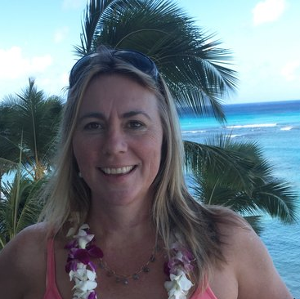
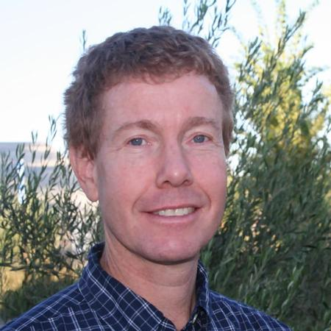
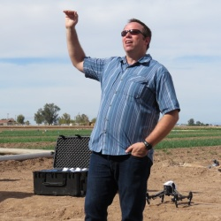
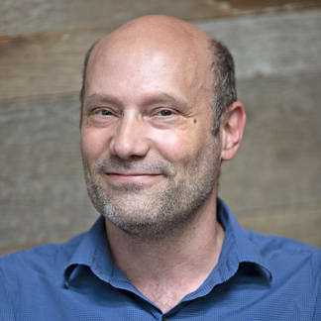
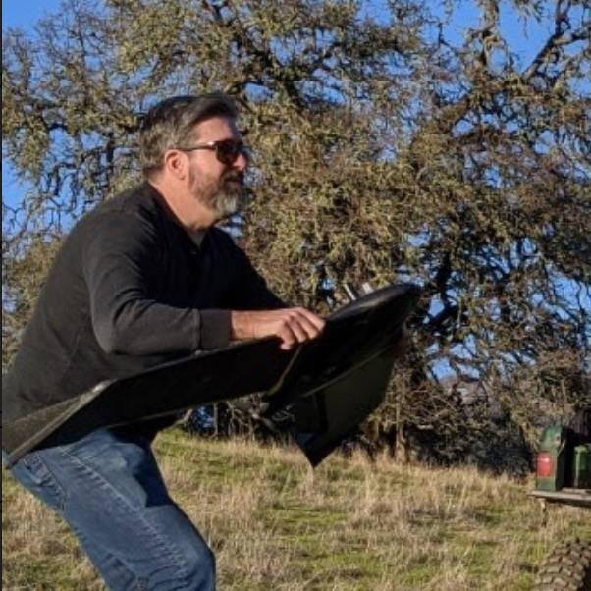
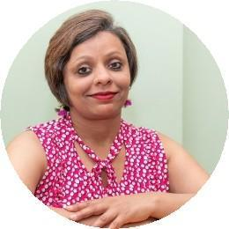
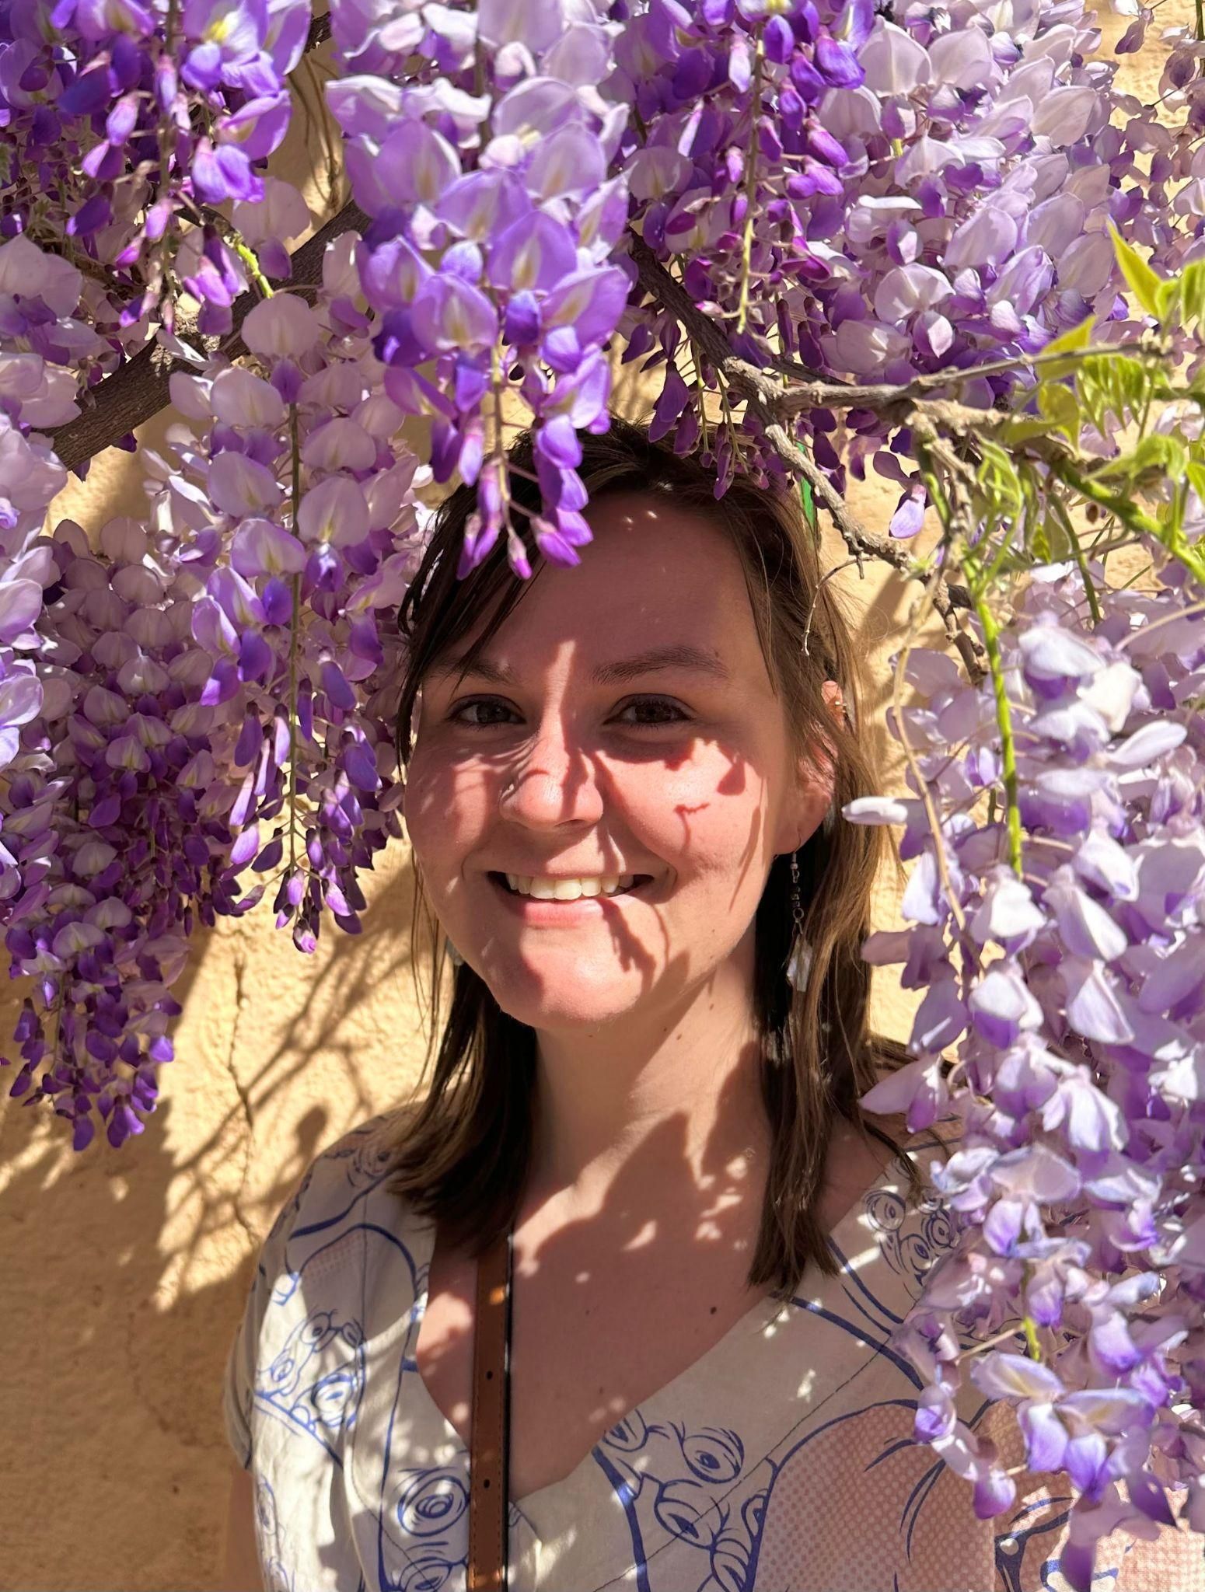

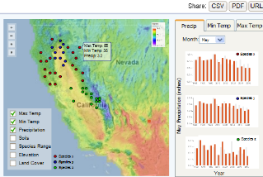
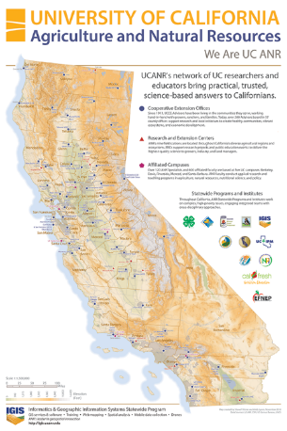
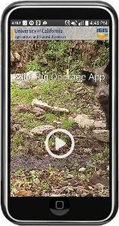

Informatics and Geographic Information Systems (GIS) Program
Maggi Kelly
Andy Lyons
Sean Hogan
Shane Feirer
Robert Johnson
Priyanka Vyas
Genoa Starrs
GIS & Drone Services
Workshops
Office Hours
Using spatial data in research & extension | Finding data • Spatial analysis Questions → workflows
Software & apps | ArcGIS • Pix4D • ENVI • WebGIS • mobile apps
Drones | drone hardware • mission planning • regulations
Research Data | Cal-Adapt • Earth Engine
Programming | R • Python • Google Apps
sign-up link
ArcGIS Story Maps
Geoprocessing with Python
ArcGIS Field Maps
Intro to ArcGIS Online
Spatial Analysis with R
DroneCamp
Notes:
GIS is ANR’s hub to access the latest innovative and integrative
geospatial data technology.

Slide 33
Using Statistics to Develop Goals
Jocelyn Mobley
Notes:
Kit will invite Jocelyn to introduce herself and first mention excited to add yet another guest speaker to this training. Goal is for get some hands on experience interpreting clientele group baseline and actual to inform goals. Mention that all statewide program statistics might differ slightly due to the systems, but the overall concept is the same.

Slide 34
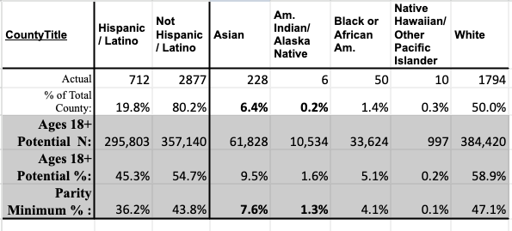
Parity Calculator County Example
Notes:
Jocelyn
Explain definitions of each row
This follows David’s spreadsheet (we put in actuals)

Slide 35
Parity Calculator Questions
How many people DID participate in the program?
Out of the program, what % of participants?
How many people COULD participate?
What % could each group represent?
What % do we need to hit to parity?
Notes:
Jocelyn
Explain definitions of each row
This follows David’s spreadsheet (we put in actuals)

Slide 36
Sample Calculator Findings
Compare
Notes:
Jocelyn: Please replace/add new slides to demo the MG calculator
Compare to find if we are in parity

Slide 37
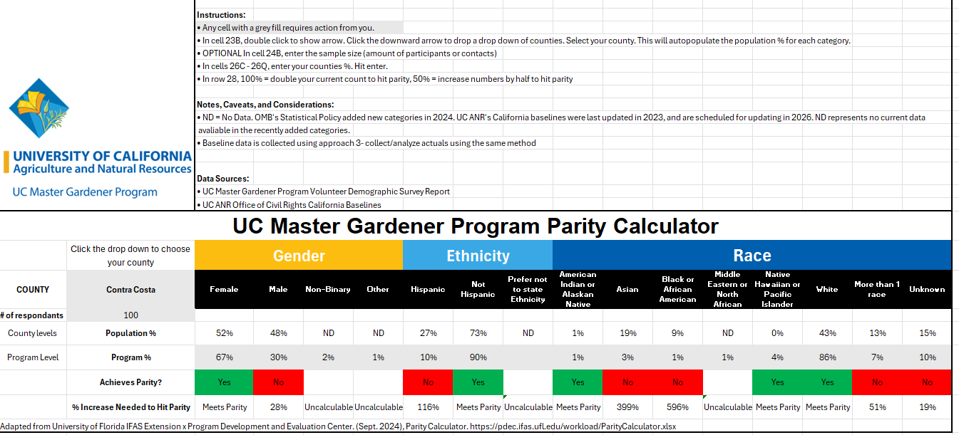
UC Master Gardener Program Parity Calculator
Notes:
Screenshare the calculator.
Last slide had a lot of numbers > simplified to highlight main points (are we in parity? If not, how far away?)
In parity = represented ; not in parity = under-represented group
Why is this an issue? Tie to ANR condition changes
Improved living and working conditions
Increased equitable access to resources (e.g., information, education, technology, services, land, capital, clean air and water, healthcare)
Discussion:
Which group would you start with and why?

Slide 38
Civil Rights Compliance Goals
David White
Notes:
David will present Katherine Soule’s slides

Slide 39
Civil Rights Compliance Goal Examples
Increase participation from your potential clientele groups.
Provide feedback to volunteers/staff about beginning and end of year civil rights compliance plans.
Review and update baseline data.
In collaboration with key community leaders, develop, implement, and assess new All Reasonable Effort methods to improve engagement with one group who was under-represented in my program’s statistics. For example: Latino communities. Form partnership with a local Spanish radio station, identify key educational messages for the community, deliver mass media outreach and education, and assess differences in in-person and virtual/remote Latino participation.
Conduct and report A.R.E. when I form a new advisory committee with external members.
Notes:
David will present Katherine Soule’s slides. Kit revised slightly7/8/25
Activity: Share in the chat one new goal for affirmative action that you can commit to in the next year. Will provide list of the group’s brainstormed goals.

Slide 40
OTHER CIVIL RIGHTS RESOURCES
UC Office of the President/Systemwide Title IX Office: The Systemwide Title IX Office addresses the university’s obligation to prevent and address sex discrimination, including sexual violence and sexual harassment, in all university programs and activities.
Academic and Staff Assistance Program (ASAP): This office offers non-emergent confidential, cost free assessment, intervention, consultation and referral services to all employees and their immediate families.
Center for Advocacy, Resources & Education (CARE): CARE advocates are able to provide confidential help with processing emotions, going over reporting options, resource referral and more if you or someone close to you has experienced sexual harassment or any form of sexual violence.
Notes:
David

Slide 41
OTHER CIVIL RIGHTS RESOURCES (cont.)
Confidential Whistleblower Reports and Complaints – ANR employees can anonymously and confidentially report issues, concerns and questions regarding activities that appear to be unethical, illegal or threatens anyone’s health or the safety of UC employees.
Abusive Conduct in the Workplace policy prohibits abusive conduct and retaliation. ANR Employee and Labor Relations Office intake complaints of abusive conduct through the following email: anr_abusive_conduct@ucdavis.edu.
Notes:
David

Slide 42
Academics: Project Board Tips
To streamline reporting: Consider condensing multiple clientele groups identified in your needs assessment into a single Project Board clientele group
Use available US Census data provided by UC ANR
All Project Board clientele groups are assessed for compliance. Omission of reporting on a clientele group may result in a non-compliance finding.
Project Board training is Sep. 24th 10AM
See Project Board civil rights compliance user manual
Notes:
Kit
*IWP website for PB civil rights compliance user manual is updated. Still need to update the other PB user manuals. And due to transition to IWP still finding links and files that need updating. Thanks in advance for your patience.

Slide 43
Q&A & Feedback
Notes:
Kit facilitate
Survey URL to chat

Slide 44
Contact Information
For Project Board Assistance:
Kit Alviz
Program Policy Analyst
Phone: (510) 987-0027
kit.alviz@ucop.edu
Tina Jordan
Interim Civil Rights Compliance Officer
Academic HR Manager
Phone: (530) 750-1280
tljordan@ucanr.edu
David White
Civil Rights Compliance Analyst
Phone: (530) 786-0206
dewhite@ucanr.edu

