Slide 1
Improving All Reasonable Effort and Engagement with New Audiences
Kit Alviz, Analyst, Program Planning & Evaluation
Elizabeth Moon, Director, Workplace Inclusion & Belonging
David White, Analyst, Office of Civil Rights
Aug. 11, 2026 from 10 AM-12 PM
Notes:
Ask participants to put name, position at UC ANR, and location

Slide 2
Non-Discrimination Statement
In accordance with all applicable state and federal laws and University policy, the University of California, Agriculture and Natural Resources, does not discriminate on the basis of race, color, religion, national origin, (including limited English proficiency) (Title VI of the Civil Rights Act of 1964 (Title VI)), disability (including having a history of a disability or being regarded as being disabled) (Section 504 of the Rehabilitation Act of 1973 (Section 504)), Section 13 of the Federal Water Pollution Control Act Amendments of 1972 (FWPCA)), and age (Age Discrimination Act of 1975) (Age Discrimination Act), gender, gender identity, gender expression, gender transition, pregnancy (including pregnancy, childbirth, and medical conditions related to pregnancy or childbirth), physical or mental disability, medical condition (cancer related or genetic characteristics), predisposing genetic information (including family medical history), ancestry, marital status, citizenship, ancestry, sexual orientation, family/parental status, income derived from a public assistance program, political beliefs, or reprisal or retaliation for prior civil
rights activity, or veteran or military status.
As required by Title IX, the University of California, Agriculture and Natural Resources, does not discriminate on the basis of sex in its educational programs, admissions, employment, or other activities.
UC Cooperative Extension program or activity conducted or funded by the U.S. Department of Agriculture (USDA) must comply with all applicable USDA guidance and requirements.
Persons with disabilities who require alternative means of communication for program information (e.g., Braille, large print, audiotape, American Sign Language, etc.) should contact the UC ANR Office of Civil Rights, contacts: EEO Representative David White at 530-786-0206 or email: dewhite@ucanr.edu, or Interim Civil Rights Compliance Officer Tina Jordan at 530-750-1280 or email tljordan@ucanr.edu .
Individuals may also contact USDA through the Telecommunications Relay Service at 711 (voice and TTY). Upon request, program information may be made available in languages other than English.
To file a program discrimination complaint, complete the USDA Program Discrimination Complaint Form, AD-3027, found online at How to File a Program Discrimination Complaint and at any USDA office or write a letter addressed to USDA and provide in the letter all of the information requested in the form. To request a copy of the complaint form, call (866) 632-9992. Submit your completed form or letter to USDA by: (1) mail: U.S. Department of Agriculture, Office of the Assistant Secretary for Civil Rights, 1400 Independence Avenue, SW, Mail Stop 9410, Washington, D.C. 20250-9410; (2) fax: (202) 690-7442; or (3) email: program.intake@usda.gov.
Alternatively, a program discrimination complaint may be filed with the UC Harassment & Discrimination Assistance and Prevention Program (HDAPP) by email at hdapp@ucdavis.edu or via phone at 530-304-3864. Individuals can also contact the UC ANR Title VI and Title IX Coordinator Danesha Nichols at dnnichols@ucdavis.edu or via phone at (530) 747-3864.
Notes:
Kit – Modeling
As a recipient of federal funds are are required to always post a non-discrimination statement. This is the UC ANR full version. In summary, UC ANR is prohibited by law from discrimination on the basis of identities listed. Program information may be made available in languages other than English and in alternative means of communication. This slide also provides information on how to file a program discrimination complaint.
UC ANR templates: https://ucanr.edu/site/uc-anr-human-resources/office-civil-rights-0

Slide 3
Training Desired Outcomes
Participants will have…
Understanding of public notification requirements
Understanding of programmatic strategies to conduct and document All Reasonable Effort
Understanding of programmatic strategies UCCE employs to increase opportunities for program participation
Understanding of how to collect, tally, and report external audience attendance and demographics into an online reporting system
Notes:
Kit

Slide 4
Agenda
10:00 - Welcome and overview*
10:10 - Your civil rights compliance responsibilities
10:20 – Programmatic Example by Jhalendra Rijal
10:30 – Data collection and reporting responsibilities
11:10 - 5 minute break
11:15 - Engaging Our Communities - Elizabeth Moon
11:55 - Wrap up and feedback
12:00 - Adjourn
Notes:
Kit *Mention there is some unavoidable repetition between raining and today’s training. Especially when it comes to the background and essential terms. It is important to define compliance and essential terms in both trainings as the two trainings together makeup the full civil rights compliance cycle. Thanks in advance for your patience.

Slide 5
Welcome – Why is this important?
Civil rights compliance is an integral part of our positions with the University of California and is meant to ensure benefits of programs are made available to all eligible participants.
When done well:
Support UC ANR priority challenge area of address systemic inequities as well as increasing the impact of all of our programs
Address barriers to participation, while improving our programs, systems, and environments to increase relevance and sense of belonging for all
Notes:
Daniel if available; if not, Kit
Removed for 2025: Protect the University and ANR from impacts of not meeting compliance at the individual level and university level.
Brent Hales notes: Civil rights compliance is all of our work. Not owned by one person; not just a requirement for a review. Funding is based in our work to build capacity, work with organizations to ensure our government and food systems work. Each of us should own it.

Slide 6
Essential Terms
David White, Office of Civil Rights

Slide 7


Essential Terms (1 of 2)
Compliance: A program is in compliance
when parity of participation is
achieved or when outreach efforts demonstrate that an all reasonable effort (ARE) has been exerted to equitably offer the opportunity to participate to all potential clientele (i.e. when the All Reasonable Effort standard has been met, see next slide).
C o m p l i a n c e:
Notes:
More information: https://ucanr.edu/site/uc-anr-human-resources/office-civil-rights

Slide 8
Essential Terms (2 of 2)
P A R I T Y :
Parity: For the ethnicity and racial groups under consideration – when their percentages with the actual clientele contacts (or program participants) mirror (to at least 80 percent) their percentages in the potential (i.e. the baseline), then parity of participation (or parity) has been achieved.
All Reasonable Effort is defined as the utilization of at least three recommended outreach methods to increase opportunities for program participation.
All Reasonable Effort:
Notes:
More information: https://ucanr.edu/site/uc-anr-human-resources/office-civil-rights

Slide 9
Activity: Essential Terms
  Use the chat to provide your response:
  What are ways to achieve civil rights compliance?
Achieve parity (percentages of actual clientele/participants mirror (to within 80%) their percentages in the potential population)
Demonstrate All Reasonable Effort (use of approved methods to increase opportunities for program participation)
Through having a heartfelt, meaningful conversation with the Office of Civil Rights
All of the above
What are ways to achieve civil rights compliance?
Notes:
David
What are ways to achieve civil rights compliance? (select all that apply)
Achieve parity (percentages of protected groups in actual clientele/participants mirror their percentages in the potential population)
Demonstrate All Reasonable Effort (use of federally-approved methods to ensure that individuals from protected groups are aware of, invited to participate and benefit from appropriate UCCE programs)
Through having a conversation with the Office of Civil Rights

Slide 10
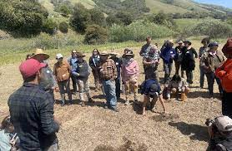
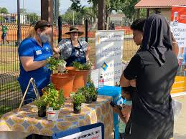
Civil Rights Responsibilities
Notes:
David: Civil Rights Responsibilities

Slide 11
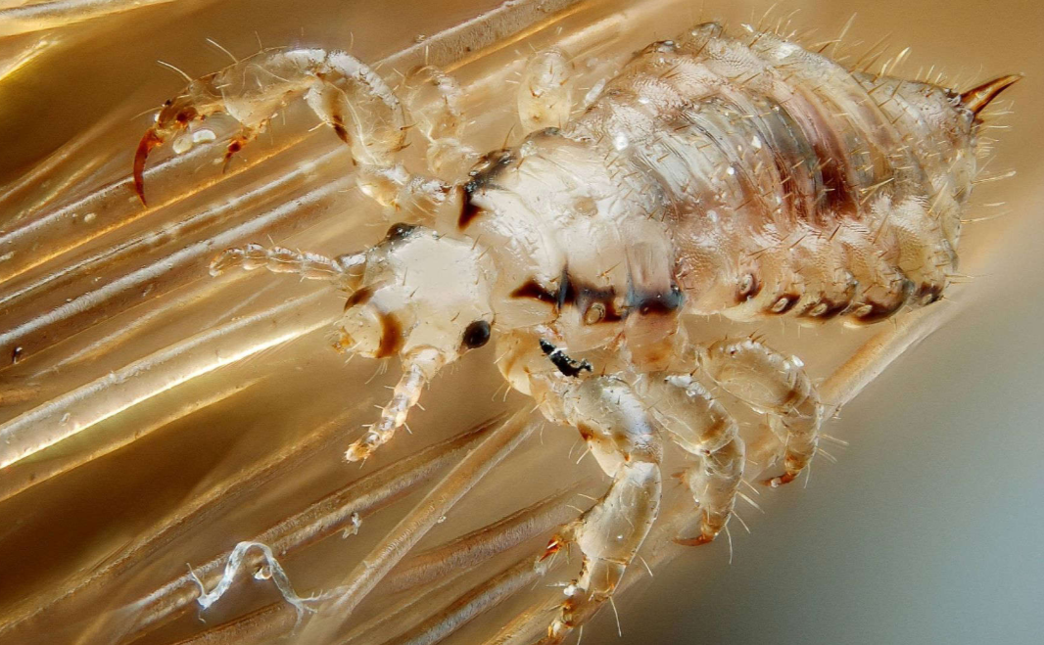
Notification Requirements
Recipients will post the nondiscrimination statement in its entirety, containing those protected bases mandated in applicable federal and state law for federally assisted programs (i.e. race, color, national origin, sex, gender, gender identity, disability, age, reprisal or retaliation for prior civil rights activity, etc.)
The nondiscrimination statement must be included on all print and non-print materials (including but not limited to, audio, video, website, brochures, newsletters, etc.).
Notes:
David

Slide 12

Notification Requirements (Cont.)
If the number of words in the printed material is so large that there is not room for the full statement, the material will, at a minimum, include the following statement in the same size font: "UC ANR is an equal opportunity provider."
Recipients are required to notify individuals with disabilities and LEP individuals of their right to free, reasonable accommodations including language assistance. Recipients are required to provide free, reasonable accommodations and language assistance upon request.
Notes:
David

Slide 13
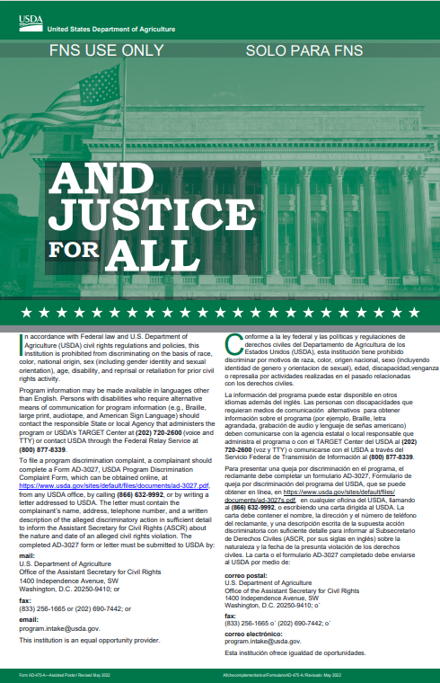

“…And Justice for All” Posters
Posters, one green, one orange, must be “prominently displayed in all offices where there is a USDA presence and where it may be read by customers.” Including 4-H summer camps.
Poster information includes not only the Nondiscrimination Statement but also an ADA Statement informing those who are in need, how they can request an accommodation or language assistance if they are not English proficient. The orange poster also contains Title IX information.
Posters may be printed from the USDA/NIFA website
Virtual events can display the nondiscrimination statement, which is the same information on the green posters, in a different format.
Guidance on Equal Opportunity Public Notification Policy (10/17/19) is posted on USDA guidelines Directives and Regulations | USDA.
Notes:
David
Correspondence with Daniel, Tina, David, and Kit Aug. 2026 about poster guidance.
The guidance is to use sound judgement for when to display the poster and anytime you can’t display the poster, make sure you display the NDA instead.
This is background info, not speaking notes for the presentation:
The 2019 guidance on Equal Opportunity Public Notification Policy (10/17/19) is posted on USDA guidelines Directives and Regulations | USDA. This includes the poster display requirements, which should be posted as follows: The Non-Discrimination Statement provided below must be posted in all USDA Mission Areas, agencies, and staff offices and included on all materials produced by USDA for public information, public education, or public distribution.

Slide 14
Your Responsibilities for ARE
Conduct all reasonable efforts (ARE)
Conduct all reasonable efforts (ARE) to invite to your programs/projects individuals who are representative of the cultures and ethnicities, genders and ages of your county/area
Utilize at least three of six methods:
ersonal invitations (phone, zoom, face to face, live)
Personal letters/emails
Promotional material (newsletters, flyers, mass mailings)
Mass media (radio or TV announcements, social media)
ORg
Other
If not meeting participation goals, you may want to implement different methods or additional methods.
Personal invitations
Personal letters/emails
Promotional materials
Mass media
Organization collaboration
Other
Notes:
David
Mention this is the floor.
For 2027 training: Discuss language on this slide with Bethanie. Also make a reference to other protected classes?

Slide 15
Your Responsibilities for Project/Program Delivery
Promote nondiscrimination and the valuing of differences among clientele
Partner with groups, agencies and organizations to reach target audiences you want to reach
Include people from the communities you want to reach on program planning committees, on survey lists and on research projects
Conduct meetings/trainings in facilities welcoming and accessible
Adapt programs to be culturally responsive and relevant
Collect race, ethnicity, and gender (REG) using self-identification forms or organizational attendance data when there is a significant, educational, two-way, live exchange with participants
Notes:
David please add any additional responsibilities for contact reporting
Clarification: For one-way exchanges with participants like newsletters, blog posts, recorded webinars, videos, etc. do not require REG data collection. These can fall under ARE as well as reported as other Extension activities that are part of your job responsibilities.

Slide 16
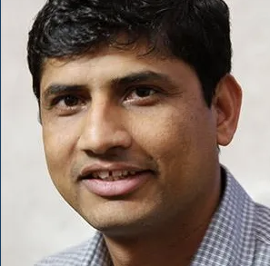
Programmatic Example
Pest Management Example by CE Advisor and Program Area Chair Jhalendra Rijal
All Reasonable Effort and Engaging New Audiences Presentation (9 minutes)
Notes:
Let’s put the content David presented from this training and a little bit of first civil rights training into context! Here is a programmatic example.
I like the examples of A.R.E. that he discusses. We hope it gives you ideas that are applicable to programs other than pest management (magazines, whatsapp groups, attending meetings organized by other agencies to make connections with clientele you don’t normally work with).
Covered in future slides: He mentions academics reporting in PB but also 4-H and MG staff put ARE information into an annual surveys from statewide office. Other program staff report up through their supervising academics to report.

Slide 17
Your Responsibilities for Civil Rights Compliance Reporting
Notes:
Kit

Slide 18
Your Responsibilities for Reporting
Extension Activities
All Reasonable Effort
Significant, educational, two-way, live exchanges with participants.
Race/Ethnicity and gender (or organization attendance) data collection and reporting is required.
New: Include advisory committees (with external participants) who inform your program
Inviting potential and target clientele. Building relationships.
Race/Ethnicity and gender data collection is not required.
New: Include advisory committees (with external participants) who inform your program
Notes:
Kit - Very common question or point of confusion is when REG is required.
Significant, educational, 2-way exchanges are things like meetings, Zoom conferences, technical assistance meetings. Also call them direct extension. In contrast, indirect extension are one-way exchanges like YouTube videos, newsletters, blog posts, distributing tip sheets, etc. Don’t have to collect and report REG for those.

Slide 19
Collecting race, ethnicity, and gender information
Training videos by CE Advisors about collecting race, ethnicity, and gender (REG) data
Method A: Uses close-ended questions on a Zoom poll https://youtu.be/BsE2QuzTtW4
Method B: Uses open-ended questions on an end-of-session evaluation survey https://youtu.be/duL4ynT9GeA
Notes:
Kit
Introduce Rebecca Ozeran and Gerry Spinelli
Method A 9min18sec Method B 12min33sec

Slide 20
Collecting race, ethnicity, and gender information continued
It is optional for participants to provide race/ethnicity and gender (REG) information for individual or family-type clientele groups.
It is our job to ASK.
Self-identification by the applicant/participant is the only recognized method. Resources for REG collection including templates, training examples, and a two-pager on how to aggregate and tally.
Staff may not “second guess,” or in any other way change or challenge a self-declaration made by the applicant/participant.
Attendees who are part of organization clientele group types attendees do not require REG collection.
Notes:
Kit

Slide 21
Your Responsibilities for Reporting continued
Enter participant REG data into Project Board, 4-H system, WEBNEERS, or VMS annually. Include the number of with undetermined REG data if system allows. Annual due dates vary by online system.
Academics: Participant REG data already reported by staff/volunteers in 4-H system, WEBNEERS, or VMS should not be entered again into Project Board. Can enter total #, but REG not required again.
Academics: When reporting organizational attendees, report # of individuals (not # of orgs)
Academics: Activities delivered to internal ANR staff or volunteers are reported separately in Project Board, no REG data required.
CDFA-funded CES report their participant reach through quarterly reporting, not online systems. Supervising academic should report in Project Board.
Notes:
Kit
Significant, educational, 2-way exchanges are things like meetings, Zoom conferences, technical assistance meetings. Also call them direct extension. In contrast, indirect extension are one-way exchanges like YouTube videos, newsletters, blog posts, distributing tip sheets, etc. Don’t have to collect and report REG for those.

Slide 22
Recordkeeping
Keep records of All Reasonable Effort for 3 years
Keep records of Extension activities and participant information for 3 years.
It is important that this information be kept private and secure during the collection process. One strategy is to separate names and other identifying information from demographic data as soon as possible for record keeping.
Notes:
Kit

Slide 23
Your Responsibilities for Evaluation
Employees:
Commitment to Principles of Community
Compliance with Federal and State Civil Rights Laws
Communicating your successes with reaching new and diverse audiences can be good for advocacy!
Academics: Communicating your civil rights compliance accomplishments and impacts to your clientele groups is part of your merit and promotion packages.
Notes:
Kit
Remind participants that the previous training had a demo of how analyzes contact data against baseline.

Slide 24
Feedback Loop
Program year data collected and submitted in respective reporting systems and is analyzed by Office of Civil Rights.
The following year, Office of Civil Rights supplies compliance findings to statewide programs with online reporting systems, academics, and their supervisors.
Expectation: Academics and programs use previous year compliance finding to inform and develop specific actions and procedures for the current year, intended to achieve compliance.
Compliance trends are used to inform training and technical assistance.
A three-year history is provided to UC ANR leadership.
Notes:
Kit – brand new slide for 2026

Slide 25
4-H Resources and Trainings
Annual 4-H Parity Reporting and 4-H Program Planning
By September, previous 4-H program year data collected and submitted to David White in Office of Civil Rights for parity analysis.
By October, County parity reports are provided to county directors, advisors, community educators, and 4-H Regional Program Coordinators.
Overall Statewide data is presented by the Office of Civil Rights Analyst on 4-H October Monthly Updates call for discussion and review of program.
October forward: County staff use previous year parity data results to inform and develop specific actions and procedures for the current year, intended to achieve parity.
Resources
4-H Policy, Chapter 3, https://4h.ucanr.edu/Resources/Policies/Chapter3/
ANR Administrative Handbook, Section 603, Programmatic Compliance https://ucanrpolicy.ellucid.com/documents/view/138/active/
Notes:
Kit
Program staff not in 4-H should connect with their supervisors for more info about their procedures.

Slide 26
Activity
Poll - What are your civil rights compliance responsibilities in each of the scenarios?
Notes:
1 poll, 5 questions:
1. I provided a workshop announcement through my county’s newsletter. Select one.
This is an Extension Activity. I should collect and report the demographic data of newsletter recipients.
This is an All Reasonable Effort. I should include this in my ARE reporting as a “promotional material” method.
Do not report this.
Not sure.
2. I appeared on a radio show and was interviewed for 30 minutes about pest management. I also talked about Cooperative Extension and upcoming workshops people might attend. Select one.
This is an Extension activity. I should collect and report the demographic data of the radio show’s audience.
This is an Extension activity. I should not try to collect and report the demographic data since it is a one-way, indirect contact with listeners.
This is an All Reasonable Effort. I should include this in my ARE reporting as a “mass media” method.
Not sure.
3. I met residents at a local farmers markets. I created and handed out nutritious recipe cards and information about local Cooperative Extension programs in multiple languages. Select one.
This is an Extension activity. I should collect and report the demographic data of every person I spoke with.
This is an Extension activity. But no demographic data collection or reporting is required since handing out recipe cards is not a direct, significant, educational, two-way exchange.
This is an All Reasonable Effort. I should include this in my ARE reporting as an “personal invitation” method.
Not sure.
4. Every year, I deliver workshop that is attended by over 100 clientele. Research findings and best practices are shared. Select one.
This is an Extension activity. I should collect and report the demographic data of every participant.
This is an Extension activity. But no demographic data collection or reporting is required since I deliver this workshop every year.
This is an All Reasonable Effort. I should include this in my ARE reporting as a “personal invitation” method.
Not sure.
5. Intentionally difficult scenario: My partners hosted a symposium for community and industry stakeholders. I was invited to give a presentation about water use efficiency. Select one.
This is an Extension activity. I should collect and report the demographic data of the participants.
This is an Extension activity. I do not have to collect and report the demographic data of participants since I was not the host of the event.
This is an All Reasonable Effort. I should include this in my ARE reporting as a “personal invitation” method.
Not sure.
…
Kit notes for discussion
1. I provided a workshop announcement through my county’s newsletter. Select one.
Answer: This is an All Reasonable Effort. I should include this in my ARE reporting as a “promotional material” method.
2. I appeared on a radio show and was interviewed for 30 minutes about pest management. I also talked about Cooperative Extension and upcoming workshops people might attend. Select one.
Answer: This is an Extension activity. I should not try to collect and report the REG data since it is a one-way, indirect contact with listeners.
Answer: This is an All Reasonable Effort. I should include this in my ARE reporting as a “mass media” method.
3. I met residents at a local farmers markets. I created and handed out nutritious recipe cards and information about local Cooperative Extension programs in multiple languages. Select one.
NOT the answer; would be different if you did a hands-on class or demonstration and it was feasible to collect. This is an Extension activity. I should collect and report the REG data of every person I spoke with.
Acceptable answer. Indirect Extension. If you report in PB or your reporting system has a place for you to document this important outreach work, please do!: This is an Extension activity. But no REG data collection or reporting is required since handing out recipe cards is not a direct, significant, educational, two-way exchange.
Answer: This is an All Reasonable Effort. I should include this in my ARE reporting as an “personal invitation” method.
4. Every year, I deliver workshop that is attended by over 100 clientele. Research findings and best practices are shared. Select one.
Correct answer: This is an Extension activity. I should collect and report the REG data of every symposium participant.
This is an Extension activity. But no REG data collection or reporting is required since I deliver this workshop every year.
This is an All Reasonable Effort. I should include this in my ARE reporting as a “personal invitation” method.
Not sure.
5. Intentionally difficult scenario: My partners hosted a symposium for community and industry stakeholders. I was invited to give a presentation about water use efficiency. Select one.
Ideal: This is an Extension activity. I should collect and report the REG data of the participants.
Not ideal, but realistic: This is an Extension activity. I do not have to collect and report the REG data of participants since I was not the host of the event.
Not the primary intent; invited to share expertise. This is an All Reasonable Effort. I should include this in my ARE reporting as a “personal invitation” method.
Not sure.
Ideally, it would be #1. Maybe ask that partner if they collected the info and if they can have a summary (no names) to use in our civil rights compliance documentation, which is about ensuring non-discrimination and equitable distribution of program benefits. Also, if you continue to work with them in the future, you could anticipate this and ask them in the planning phase some procedures for collecting REG.

Slide 27
Civil Rights Compliance Cycle
Define
Define clientele. Develop baseline, if applicable. Develop civil rights compliance action goals.
A.R.E.
Invite potential new audiences that reflect the demographic composition of the area/state.
Deliver
Implement Extension projects/programs that are adaptive, accessible, and culturally responsive and relevant. Collect participant and advisory council REG data for contacts (two-way interactions).
Always use ADA and non- discrimination statements in materials and “Justice for All” posters in office and meeting locations.
Document
Report ARE. Report participant reach and REG data. Save records of ARE, contacts, and partner organizations’ non-discrimination statements for 3 years.
Are contacts in parity with baseline? If not, what were the barriers and have you invited new audiences? What additional strategies might help?
Evaluate
Notes:
Recap slide if time.
Adapted from NIFA.

Slide 28
5 minute break

Slide 29
Engaging Our Communities
Building & Expanding Clientele/Community Trust & Engagement
Presented by Elizabeth Moon
Fall 2026

Slide 30
Desired Outcomes
Discuss and have a deeper understanding of three models of community engagement
Exploring how these models of engagement can be utilized tactically for long-term impact

Slide 31

Why Engagement Matters
Extension’s strength: evidence-based information + collaboration
Trust and engagement = expanded clientele and sustained programs

Slide 32
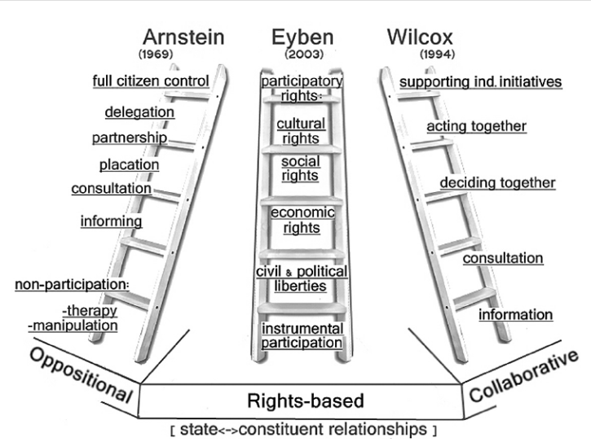
Models of Participation
Models are examples of frameworks that guide deeper more effective engagement.
Aylett,Alex. Participatory planning, justice, and climate change in Durban, South Africa. Environment & Planning A, 2010, Vol. 42, pages 99-115.
Aylett,Alex. Participatory planning, justice, and climate change in Durban, South Africa. Environment & Planning A, 2010, Vol. 42, pages 99-115.
Notes:
Arnstein’s Ladder of Participation:
Arnstein’s Ladder illustrates the levels of citizen involvement in decision-making, ranging from non-participation to full citizen control, emphasizing the importance of moving beyond tokenism to genuine partnership and empowerment.
Eyben’s Framework:
Eyben’s Framework focuses on the quality of relationships and power dynamics in engagement, encouraging reflexivity and transparency to build trust and adapt programs based on community feedback.
Wilcox’s Spectrum of Participation:
Wilcox’s Spectrum describes a range of engagement approaches—from simply informing to supporting independent community action—highlighting the value of tailoring participation to community needs and readiness.

Slide 33
Poll
Have you heard of or researched any of these models?
Yes, have researched all three of these models
Yes, have researched only one or two of these models
Yes, have utilized at least one of these models in my extension work
Not yet

Slide 34
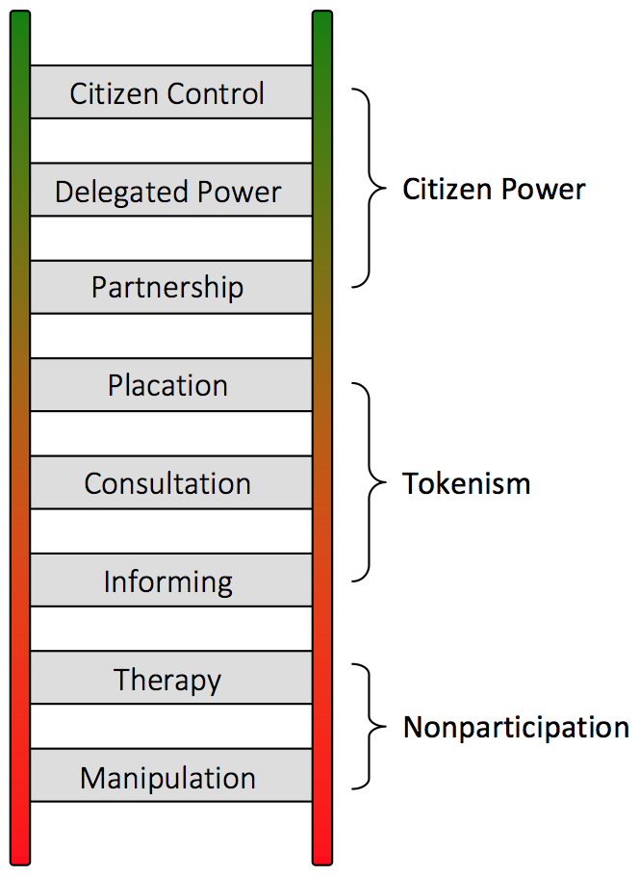
Arnstein’s Ladder of Participation
KEY TACTICS:
Move beyond informing - invite feedback and co-design
Create advisory groups
Empower community leadership

Slide 35
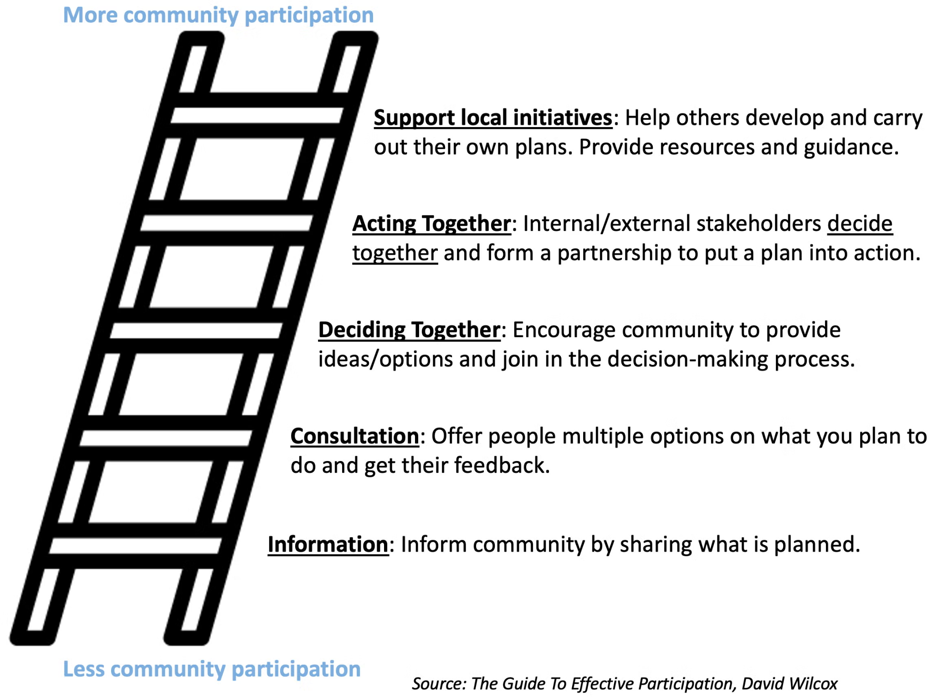
Wilcox’s Spectrum of Participation
KEY TACTICS:
Use surveys/focus groups for input
Co-host events/programs
Support community-led projects

Slide 36
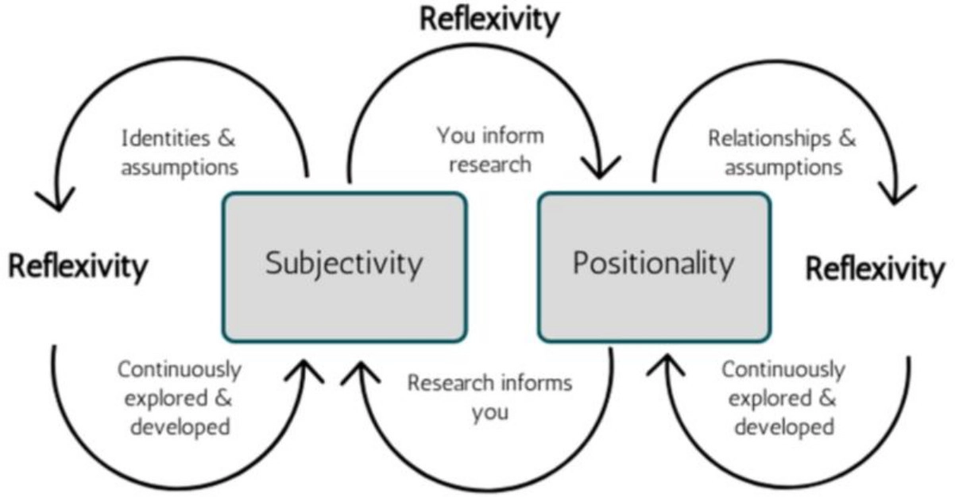
Eyben’s Framework
KEY TACTICS:
Build trust through transparency
Practice reflexivity - assess and adapt
Facilitate dialogue
Notes:
Eyben’s Framework:
Eyben’s Framework focuses on the quality of relationships and power dynamics in engagement, encouraging reflexivity and transparency to build trust and adapt programs based on community feedback.

Slide 37

Tactical Strategy: Expanding Extension Activities
Move from consultation to “deciding and acting together”
Host webinars/workshops with community partners
Share research findings in accessible formats (infographics, short videos)
Empower community members in program planning

Slide 38

Tactical Strategy: Foster Two-Way Communication
Build trust through transparency and reflexivity
Schedule regular community forums (virtual/in-person)
Use surveys, listening sessions and focus groups
Create feedback loops: follow up and report back on the data

Slide 39

Tactical Strategy: Build Partnerships and Networks
Support independent community initiatives
Collaborate with local organizations, schools, agencies
Co-host events/programs to leverage trusted networks
Identify and connect with key community leaders

Slide 40
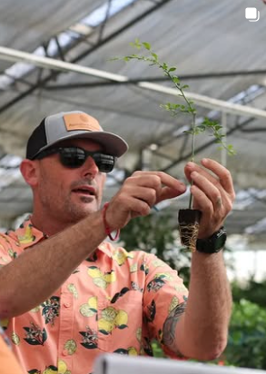
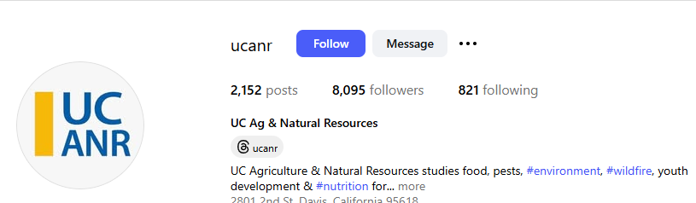
Tactical Strategy: Demonstrate Impact and Transparency
Practice reflexivity and share outcomes
Publish annual impact reports
Use social media to highlight client testimonials and program/research successes
Be transparent about goals, processes and limitations

Slide 41
Building Trust & Expanding Clientele
Consistent communication
Shared decision-making
Support for independent community action
Understand barriers to access and engagement
Explore curiosity questions
Establish community advisory boards
Engage in participatory workshops
Host citizen participatory science events
Networking with your local community and more established advisors

Slide 42

Share one specific successful experience you have had in reaching out to new clientele.
What made it successful?
How did you continue to maintain that relationship?
What were some of the barriers or fears you encountered?
Notes:
Breakout rooms -3 people

Slide 43
References
Aylett,Alex. Participatory planning, justice, and climate change in Durban, South Africa. Environment & Planning A, 2010, Vol. 42, pages 99-115. (usage of image)
Arnstein, S. R. (1969). A Ladder of Citizen Participation
Eyben, R. (2006). Exploring Power for Change
Eyben, R. (2013). Six Aspects of Reflexivity (Blog)
Wilcox, D. (1994). The Guide to Effective Participation

Slide 44
Annual UC ANR Trainings
Defining Clientele and Civil Rights Compliance Planning
How to define clientele groups, strategies for collecting baseline data and civil rights compliance goal examples.
Improving All Reasonable Efforts and Engagement with All Audiences
Programmatic strategies to conduct All Reasonable Effort, how to demonstrate compliance through documentation, collecting and reporting race/ethnicity/gender using self-identification forms, strategies to successfully reach and engage all audiences.
Project Board Training – September 24, 2026 from 10AM
Project Board is UC ANR's online system for UC Cooperative Extension academics that integrates academic program review, civil rights compliance, and organizational reporting requirements.
Notes:
Kit
Skipped in 2026 because ran out of time and they will get the info other ways

Slide 45
Harassment & Discrimination Assistance and Prevention Program
Title VI & Title IX Coordinator:
Danesha Nichols
dnnichols@ucdavis.edu
Harassment & Discrimation Assistance and Prevention Program
530-747-3864 (Davis) or 916-734-3417 (Sacramento)
Anonymous Line: 530-7473865 (Davis) or
916-734-3417 (Sacramento)
hdapp@ucdavis.edu
Notes:
David - Resources
Another aspect of the Office of Equal Opportunity is the ANR sexual violence and harassment prevention program under our Title IX Coordinator, UC Davis’ Wendi Delmendo – her email address is given here. If you have been a victim of sexual violence, or have experienced any type of harassment or discrimination you may 1) contact any of the numbers listed here; 2) notify your supervisor or manager; or 3) if you wish to remain anonymous, you can use the Anonymous Line phone numbers listed here.
The Harassment & Discrimation Assistance and Prevention Program’s email address is provided there on the bottom of the slide.

Slide 46
OTHER CIVIL RIGHTS RESOURCES
UC Office of the President/Systemwide Title IX Office: The Systemwide Title IX Office addresses the university’s obligation to prevent and address sex discrimination, including sexual violence and sexual harassment, in all university programs and activities.
Academic and Staff Assistance Program (ASAP): This office offers non-emergent confidential, cost free assessment, intervention, consultation and referral services to all employees and their immediate families.
Center for Advocacy, Resources & Education (CARE): CARE advocates are able to provide confidential help with processing emotions, going over reporting options, resource referral and more if you or someone close to you has experienced sexual harassment or any form of sexual violence.
Notes:
David - Don’t repeat but can mention Sept. 2 training and you can reference these slides

Slide 47
OTHER CIVIL RIGHTS RESOURCES (cont.)
Confidential Whistleblower Reports and Complaints – ANR employees can anonymously and confidentially report issues, concerns and questions regarding activities that appear to be unethical, illegal or threatens anyone’s health or the safety of UC employees.
Abusive Conduct in the Workplace policy prohibits abusive conduct and retaliation. ANR Employee and Labor Relations Office intake complaints of abusive conduct through the following email: anr_abusive_conduct@ucdavis.edu.
UCOP Anti-Discrimination Policy University policy that prohibits discrimination, harassment and retaliation.Retaliation is an adverse action against an individual based on their reporting/disclosing an alleged instance of discrimination and/or harassment – or based on their participation in, or assistance with, the investigative, reporting, remedial, or corrective/disciplinary processes related to an instance of discrimination and/or harassment.
Notes:
David - Don’t repeat but can mention Sept. 2 training and you can reference these slides

Slide 48
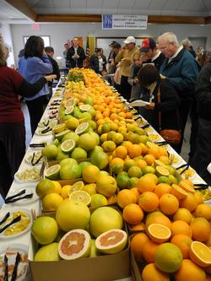


UC ANR Principles of Community
And finally . . .
as employees of UC ANR we all have a responsibility to uphold the principles of equal opportunity and non-discrimination, as well as our community values (UC ANR Principles of Community). So, let’s respect each other and value our individual contributions!
Notes:
David - And finally, as employees of UC ANR we all have a responsibility to uphold the principles of equal opportunity and non-discrimination, as well as our community values as expressed in ANR’s Principles of Community. So, let’s respect and value each other and value our individual contributions – together.

Slide 49
Contact Information
For Project Board Assistance:
Kit Alviz
Program Policy Analyst
Phone: (510) 987-0027
kit.alviz@ucop.edu
Tina Jordan
Interim Civil Rights Compliance Officer
Academic HR Manager
Phone: (530) 750-1280
tljordan@ucanr.edu
David White
Civil Rights Compliance Analyst
Phone: (530) 786-0206
dewhite@ucanr.edu
Notes:
David

Slide 50
Q&A + Feedback
Notes:
Kit and paste survey link

