Slide 1

Conducting A Needs Assessment
August 18, 2026
Welcome!
While we wait for everyone to join…
Please respond to the poll
Katherine Webb-Martinez, Program Planning & Evaluation Director
Vikram Koundinya, CE Evaluation Specialist & Professor of Extension
Devii Rao, Livestock & Natural Resources Advisor
Nicole Marshall-Wheeler, 4-H Youth Development Advisor

Slide 2
Desired Outcomes
Participants gain …
Understanding of needs assessments basics (why, what, how, when)
Understanding of how to use the findings to inform how you focus and develop your program
Feedback on your needs assessment plan

Slide 3
Agenda
10:00 | Welcome & Overview
10:05 | How-to Needs Assessment Presentation & UCCE Examples
10:55 | Break
11:00 | UCCE Academics Share Their Approaches
11:30 | Small Group Discussion
11:55 | Wrap-up & Training Evaluation

Slide 4
What is Needs Assessment?
Is the first step in the overall program planning process. It is an essential step in the program planning, development and evaluation cycle (Etling & Thomas, 1995).
Driven by the question “What do clients need and how can those needs be met?” (Patton, 1982).
One of the first priorities for a new extension educator is to conduct a needs assessment to inform their programming (Caravella, 2006).
Needs assessment is one of the key educational competencies for extension educators (Ghimire, 2010; Koundinya, 2010).

Slide 5
Needs Assessment Approaches
Asset-based needs assessment
Identify what is available or potentially available to a community.
This approach can identify the available organizational, community, fiscal, and individual people skills .
Traditional needs assessment
Identify what is needed or lacking in a community.
“Asset-based needs assessment is a useful tool when we don’t know enough about both assets and needs in a community”.
(Elhadi, A. F., & Lewis, D. K., 2016)

Slide 6
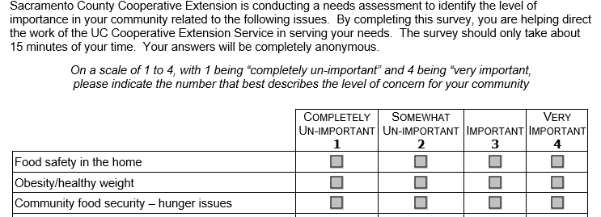
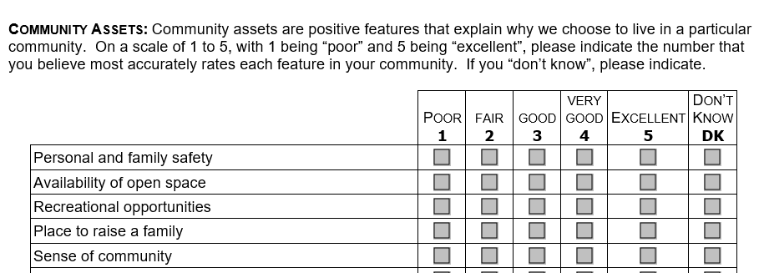
Excerpts from UCCE Sacramento County Needs Assessment

Slide 7
When to conduct a Needs Assessment?
The program is brand new.
You are new to the job.
You want to learn more about what your clients need related to a specific condition.
You need to document the needs for funding (Angima et al., 2014)
You need additional information to communicate with your stakeholders.
If the program evaluation focus is on how well it meets the needs of the intended audience (Patton, 1982)

Slide 8
Why do it?
Different potential uses
  Definitely
    Developing your program: from goal setting to evaluation
    Performance appraisal
  Maybe
    Collaborative statewide or regional needs assessment
    Commissioned study
    Journal article
    Justify requests for funding/grants
    Collaborative research project
    Identify partners/community organization collaborators

Slide 9
Benefits of Collaborative Needs Assessment
Better understanding of needs at a big picture or regional level
Addressing shared goals more efficiently
Leveraging subject-matter expertise
Leveraging limited resources
Serving as a strategic planning tool for other program areas

Slide 10
UCCE Climate Smart Agriculture (CSA)
Educational Needs Assessment
Purpose: Identify the CSA education needs of growers in California. Use needs assessment data for developing CSA education programs for growers.
Methods and sample: Mixed methods (surveys, focus groups). Survey sent to more than 12,000 farmers, 341 usable sample.
Benefits: Inform extension and research programming of the diverse team, leverage expertise.
Outputs: Journal articles, conference presentations both on the methods and results.

Slide 11
UCCE Dairy Collaborative & Ongoing NA
2017-2019
2024-2025
Purpose: Identify dairy producer needs and how best to direct & deliver UCCE programming
Target audience: CA Grade A dairy producers (list from CDFA)
Benefits: collective expertise leveraged
Outputs: Peer-reviewed journal publication; presentations at meetings
Why again? CA dairy landscape (# farms, farm size, etc.) has shifted so want to update the data to see how needs and desired outreach has changed.
Changes? Deploying same survey. New advisor taking the lead.

Slide 12
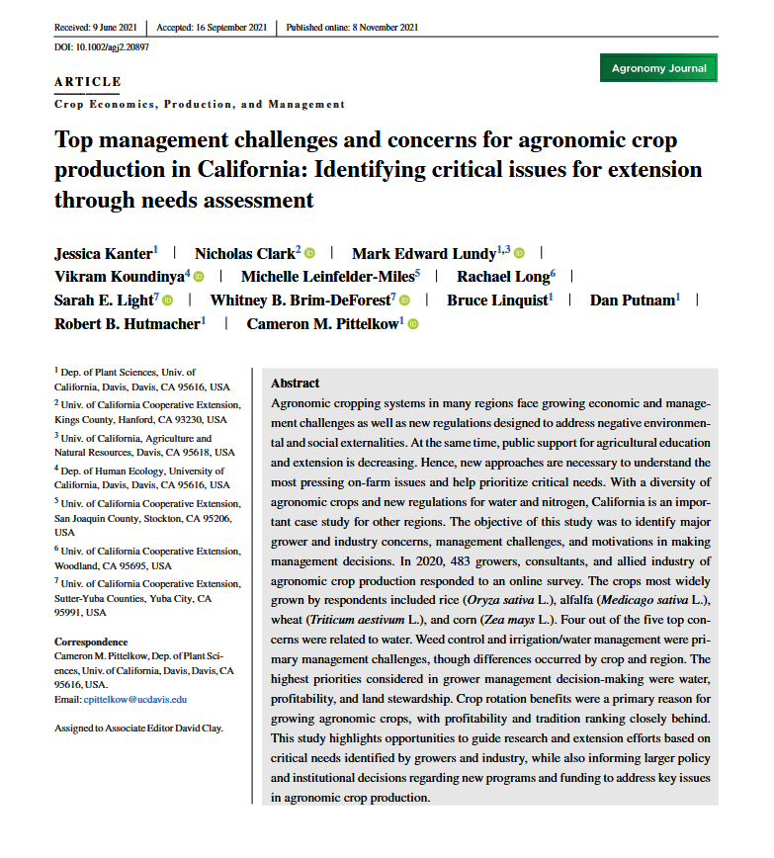
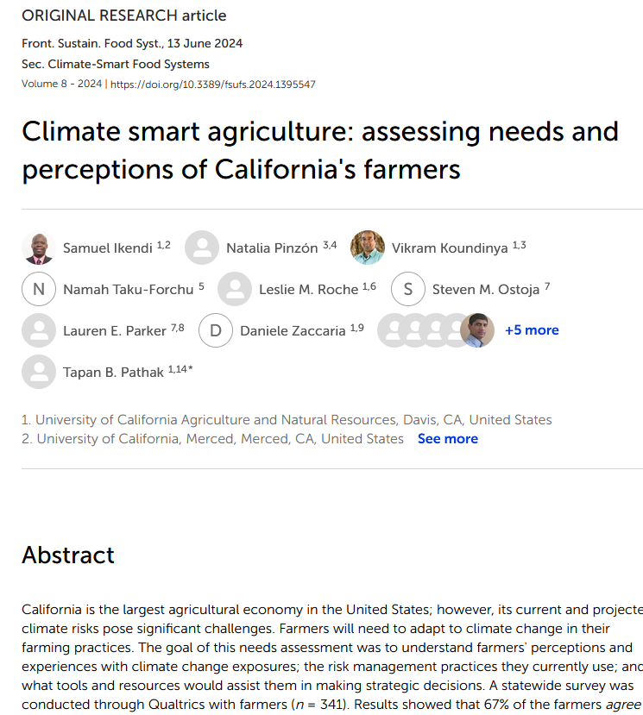
CE Specialist Needs Assessment
PT Collab
No fundamental difference in how advisor or specialist conducts; same principles, processes, and methods but…
how the sample is selected and the identified needs prioritized may differ because of CE Specialists’ statewide focus, compared to CE Advisors’ more local (county/ies) focus.
CE Spec led Collab

Slide 13
First steps for new advisors
  Find out what is already known or available
  Get out and introduce yourself
  Develop relationships
  Define your clientele
  Get the lay of the land
  This informs who and what to ask about needs

Slide 14
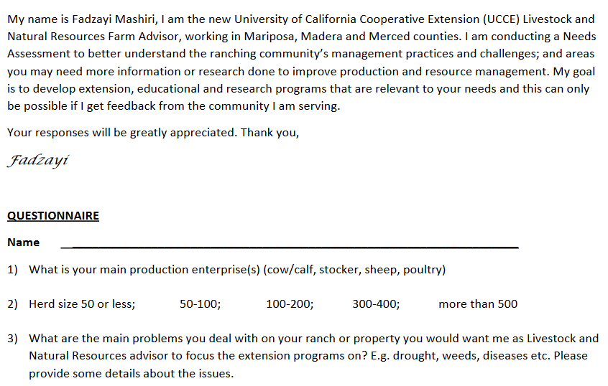
Intro Letter

Slide 15
Best Practices for Community Engagement
Participatory approach in developing, pre-testing, analyzing, and interpreting questionnaires with members of the community.
Tell that you are a UC ANR/UCCE person.
Specify the purpose of the study.
Discuss how their participation would contribute to improvements in others' lives and their society.
Do not use subordinating language.
Dillman, Smyth, and Christian, 2014

Slide 16
Examples of Subordinating Language
“For us to help solve the school problems in your community, it is necessary that you participate in this study.”
Better alternative: “Will you please be part of helping to solve the school problems in your county? Your responses can assist the county residents and school administrators in fully understanding the issues facing the schools here.”

Slide 17
Best Practices for Community Engagement cont.
Establish trust.
Ask for advice.
Stress that the opportunities to contribute to this study are limited.
Convey that others are also participating.
When appropriate, use incentives as social exchange.

Slide 18
How to Organize a Needs Assessment
Phase 1: Exploration
  Needs assessment purpose, potential uses, audience, explore secondary data sources, what & how to collect data
Phase 2: Assessment
  Implement the needs assessment plan: collect, analyze, & synthesize data
Phase 3: Utilization
  Use the data to set program priorities, develop action plan to address needs/issues, communicate results
McKillip (1998) and Lepicki and Boggs (2014) as cited in Donaldson and Franck (2016)

Slide 19
Commonly Used Data Collection Methods

Slide 20
For secondary data:
Literature/Document review
GIS data
For primary data:
Individual Interviews
Group interviews (focus groups)
Key-informant interviews
Observation
Surveys
Delphi Technique
GIS

Slide 21
Considerations given increased virtual methods
Many methods can be done online & could make data collection easier
  Zoom interviews with clientele and partners
  Surveys often already online
  Building on existing meetings - some are now online, e.g. commodity mtgs. and ramped up other online forums (e.g. Dairy Facebook); it is a lot easier to visit virtual meetings
Notes:
Vikram

Slide 22
Document/Literature Review
Content analysis of existing information, secondary data
Little to no participant burden
Best practices:
Have an audit trail
Systematic analysis and documentation

Slide 23

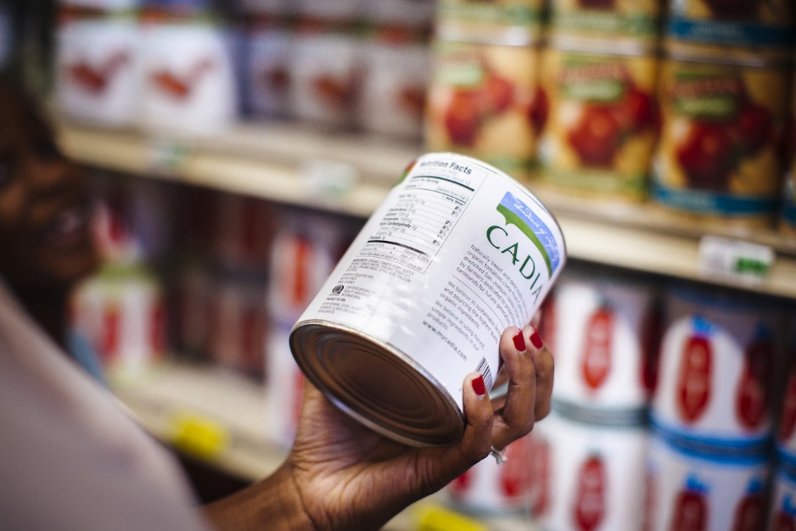
Natalie Price,
UCCE Community Nutrition
and Health Advisor
Mixed methods:
Reviewed county health improvement plans, health center community needs assessments, and relevant health data and policy reports, and informal interviews with ANR academics and key partners

Slide 24
Individual Interviews
Personal contact is desirable
Sample group is smaller
Sample group is unlikely to respond to a written survey
Sample has people incapable of taking a survey
You are not sure what is most important to potential respondents
Best practices
State the purpose upfront
Be consistent and neutral
Use probing questions
Send questions 1-2 days in advance
Notes:
Vikram
From the UCCE needs assessments that I have reviewed and posted, this is the most common method to seek needs input
information collected by talking with and listening to people, either face-to-face or over the telephone
Range from those which are tightly structured (as in a survey) to free flowing, conversational interviews.
Best practices:
TO BE CONSISTENT, INTERVIEWERS SHOULD:
• Always read the instructions to each participant as stated.
• Ask every question as stated.
• Ask questions in the order as stated.
• Memorize and use standard phrases in response to a participant if a participant does not understand a question, or gives tangential or overly lengthy answers.
TO BE NEUTRAL, INTERVIEWERS SHOULD:
• Avoid agreeing or disagreeing with a participant.
• Avoid indicating that a participant’s answer is ‘right,’ ‘wrong,’ ‘good,’ ‘poor,’ or ‘interesting.’
• Avoid suggesting an answer or interpreting a question for a participant.
• Avoid giving their own opinions during the interview.
• Memorize and use standard phrases in response to a participant who is “chatty” or asks for the interviewer’s opinion.
Often need probing because when ask “What did you like about the program?” Often hear: “Everything was great.”
In informal interviewing, probes cannot be planned in advance. It is impossible to know what relevant issue the person might raise and how you might need to probe to learn more. However, it is helpful to be familiar with probing and some general ways to probe.
For example:
· Could you please tell me more about…
· I’m not quite sure I understood …Could you tell me about that some more?
· I’m not certain what you mean by… Could you give me some examples?
· Could you tell me more about your thinking on that?
· You mentioned….Could you tell me more about that? What stands out in your mind about that?
· This is what I thought I heard…Did I understand you correctly?
· So what I hear you saying is…”
· Can you give me an example of…
Mention tipsheets on both best practices posted now posted

Slide 25
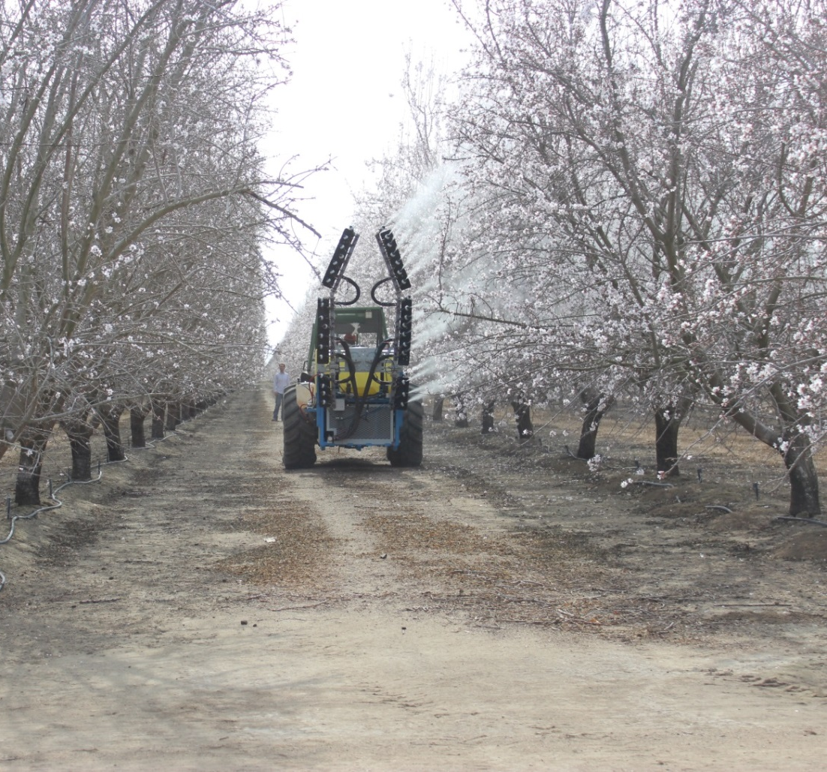
Elizabeth
Fitchner,
UCCE Farm/Orchard Systems Advisor
Informal Interviews piggy backing on existing meetings

Slide 26
Key-informant Interviews
Verify collected data (e.g.: to understand needs vs wants)
Get inputs from knowledgeable and influential people
Explore unanticipated ideas
Best Practices
Have a mix of people from different ages, races, ethnicities etc.
~10 people

Slide 27
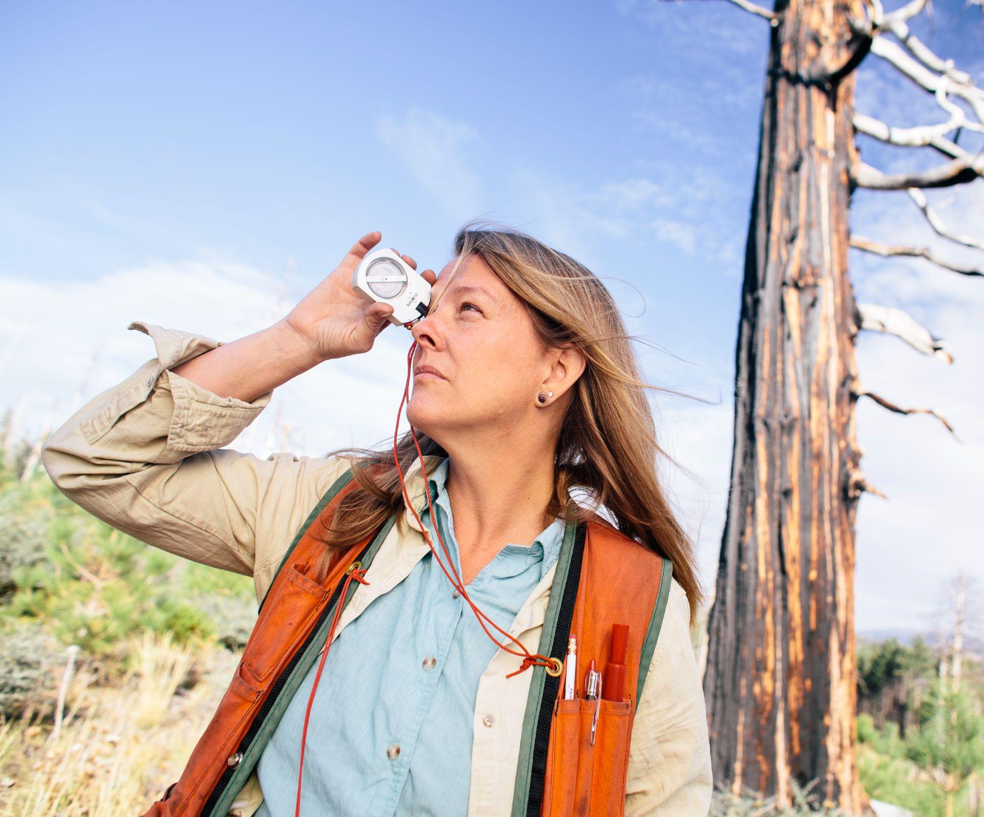
Susie Kocher,
UCCE Forestry/ Natural Resources Advisor
Mixed Methods including key-informant
interviews and focus groups

Slide 28
Group Interviews/Focus Groups
Understand common issues or needs
Don’t know what questions to ask
Want to know more from survey responses
Foster trust and relationship-building
Piggyback off existing meetings
Best Practices
6-12 people
Explain the rules
Make deliberate efforts to get answers from everyone

Slide 29
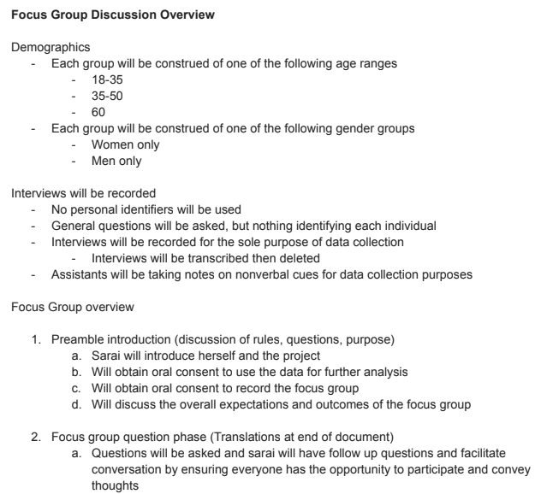
Clarissa Reyes & Katherine Jarvis Shean, UCCE Orchard Systems Advisors, with Amanda Crump, UC Davis professor
Mixed methods:
Focus Groups for Spanish speaking farmworkers and survey for growers

Slide 30
Observation
Observe practice/behavior
Want to see and listen
Confirm fidelity of implementation
Best Practices
Have an observation guide
Take field notes

Slide 31
Observation Guide: Elkus Ranch Summer Camp (June 25th – Aug. 26th, 2018)
Observation Prompts | Actions You See or Comments You Hear
1) Engagement/Delivery How are students engaging in the activities? What is their body language?
2) Learning Are students expressing what they are learning? Is the environment conducive to learning? Are students forming new connections? Why? How?
3) Staff friendliness & circulation Warm tone of voice and respectful language Attentive and responsive One-on-one interactions with every student
Adapted from
Klink, J. (2014). Field Day Observation Guide. Environmental Resources Center, University of Wisconsin-Extension.
Carlson, S. P., Heimlich, J. E., Storksdieck, M., & Meyer, N. (2009). Best practices for field days. Assessment tools and observation protocols. University of Minnesota Extension.

Slide 32
Surveys
To collect standardized information from large sample
Privacy is important or independent opinions and responses are needed
When there are resource constraints (mainly time and money)
Best practices
Be clear about the purpose
Be focused: only ask what you need to
Establish reliability and validity of the questionnaire
Follow design principles

Slide 33
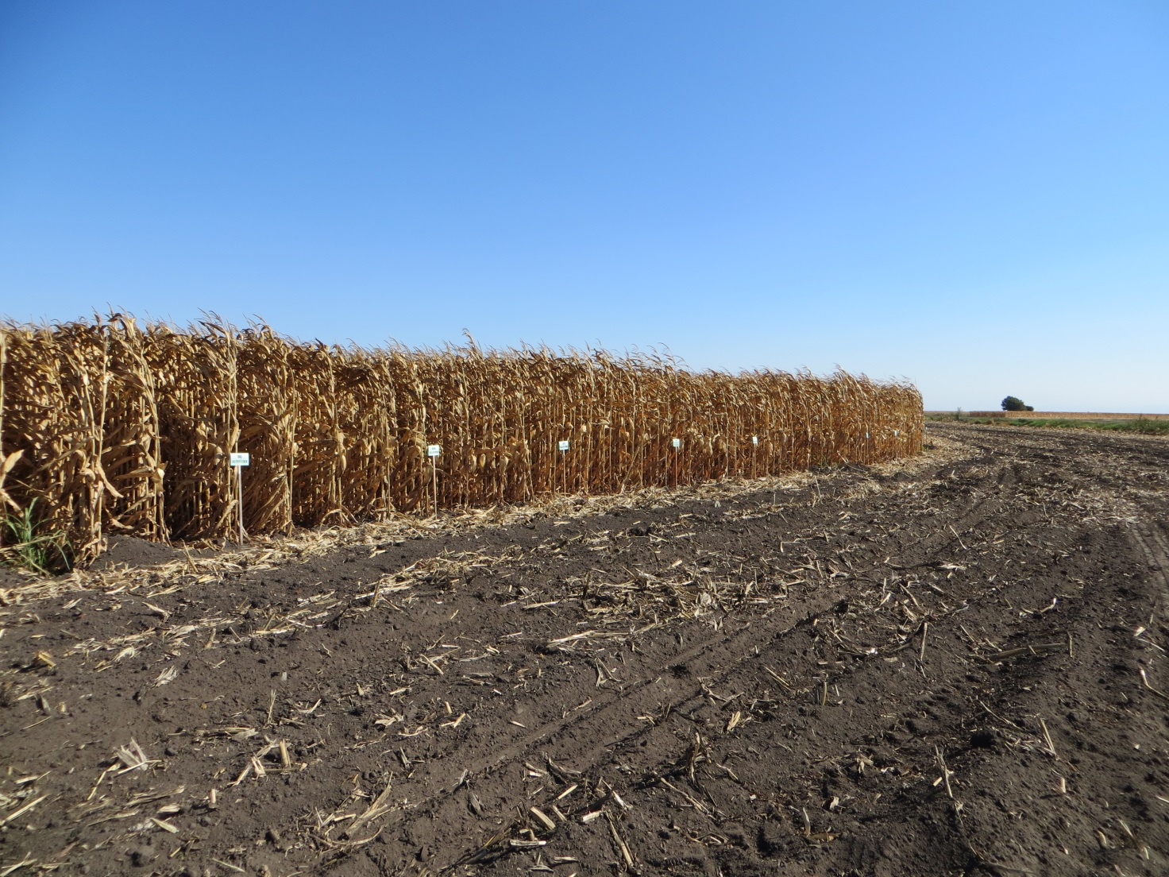
Michelle Leinfelder- Miles,
UCCE Farm / Delta Crops Advisor
Mixed Methods:
Document review,
Survey using Clickers & Informal Interviews

Slide 34
Ensuring Inclusive Access to All through Need Assessment
Consider participants
Language
Age
Abilities
Communication and decision-making styles, e.g., family relationships
Approaches to knowing and ways of knowing
Etc.
Adapted Building Capacity in Evaluating Outcomes, UW- Extension
Best Practices
Work with clientele/partners to develop needs assessment
Cannot know everything about another culture, but can ask questions and learn in service of others
Self-reflection
Secondary data might not include all your clientele groups; identify and contact organizations working with those groups American Evaluation Association blogs
“Always place the people who are most impacted at the center of conversations which seek to find solutions to problems affecting them.” MPHI

Slide 35
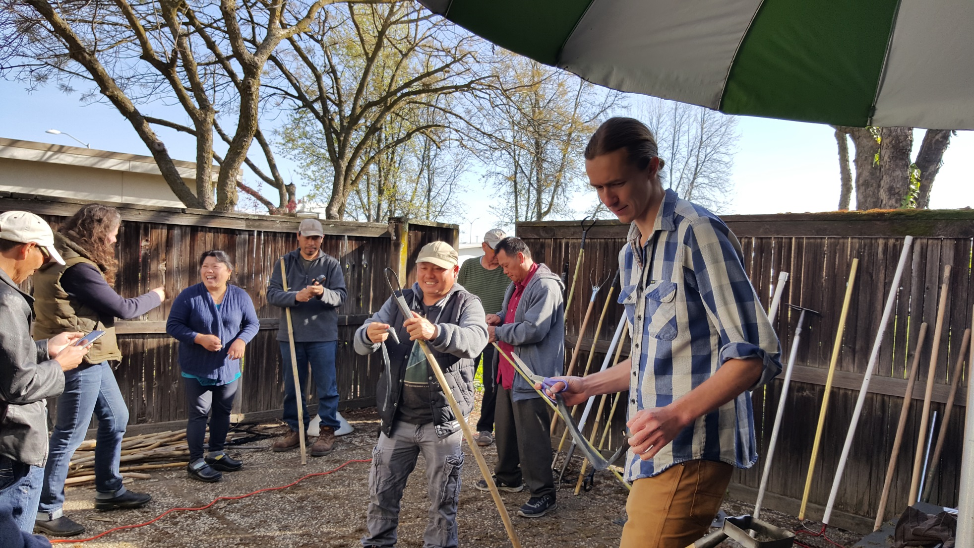
Margaret
Lloyd,
UCCE
Small Farms
Advisor
On farm
Observation
& Interviews

Slide 36
Using the Findings to
Focus and Develop Your Program

Slide 37

Priority Setting
You may not ask clientele to prioritize their needs, but even if you do -- clientele priorities are not the only things to be considered…
You can take a qualitative approach to analyze all that you know using a variety of filters/considerations to help you determine the priorities on which you will focus

Slide 38

Priority Setting Considerations
Individual - job description, expertise, collaborations, resources
Organization - strategic vision, public value framework, comparative advantage
Clientele - what’s important to them, extent & frequency of problem
Likelihood of Impact - Probability of successful resolution (i.e., probability of an economically feasible solution)

Slide 39
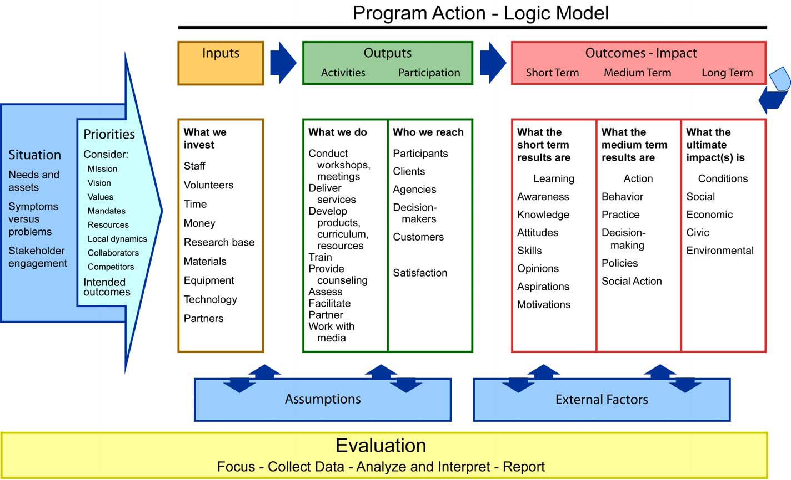
Using Your Needs Assessment Findings
To Develop Focused, Relevant Programs

Slide 40


Slide 41
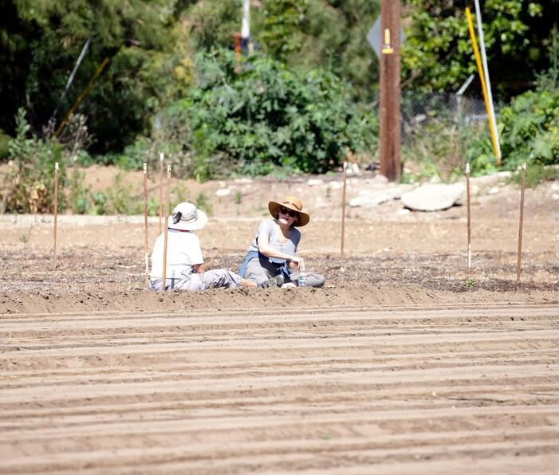
BREAK

Slide 42
UCCE Needs Assessment Speakers
Devii Rao, Livestock & Natural Resources Advisor
Nicole Marshall-Wheeler, 4-H Youth Development Advisor

Slide 43
Collaborative Needs Assessment
Livestock & Natural Resources
Devii Rao
Livestock & Natural Resources Advisor
August 18, 2026
Program Development & Evaluation Capacity Building Trainings Series

Slide 44
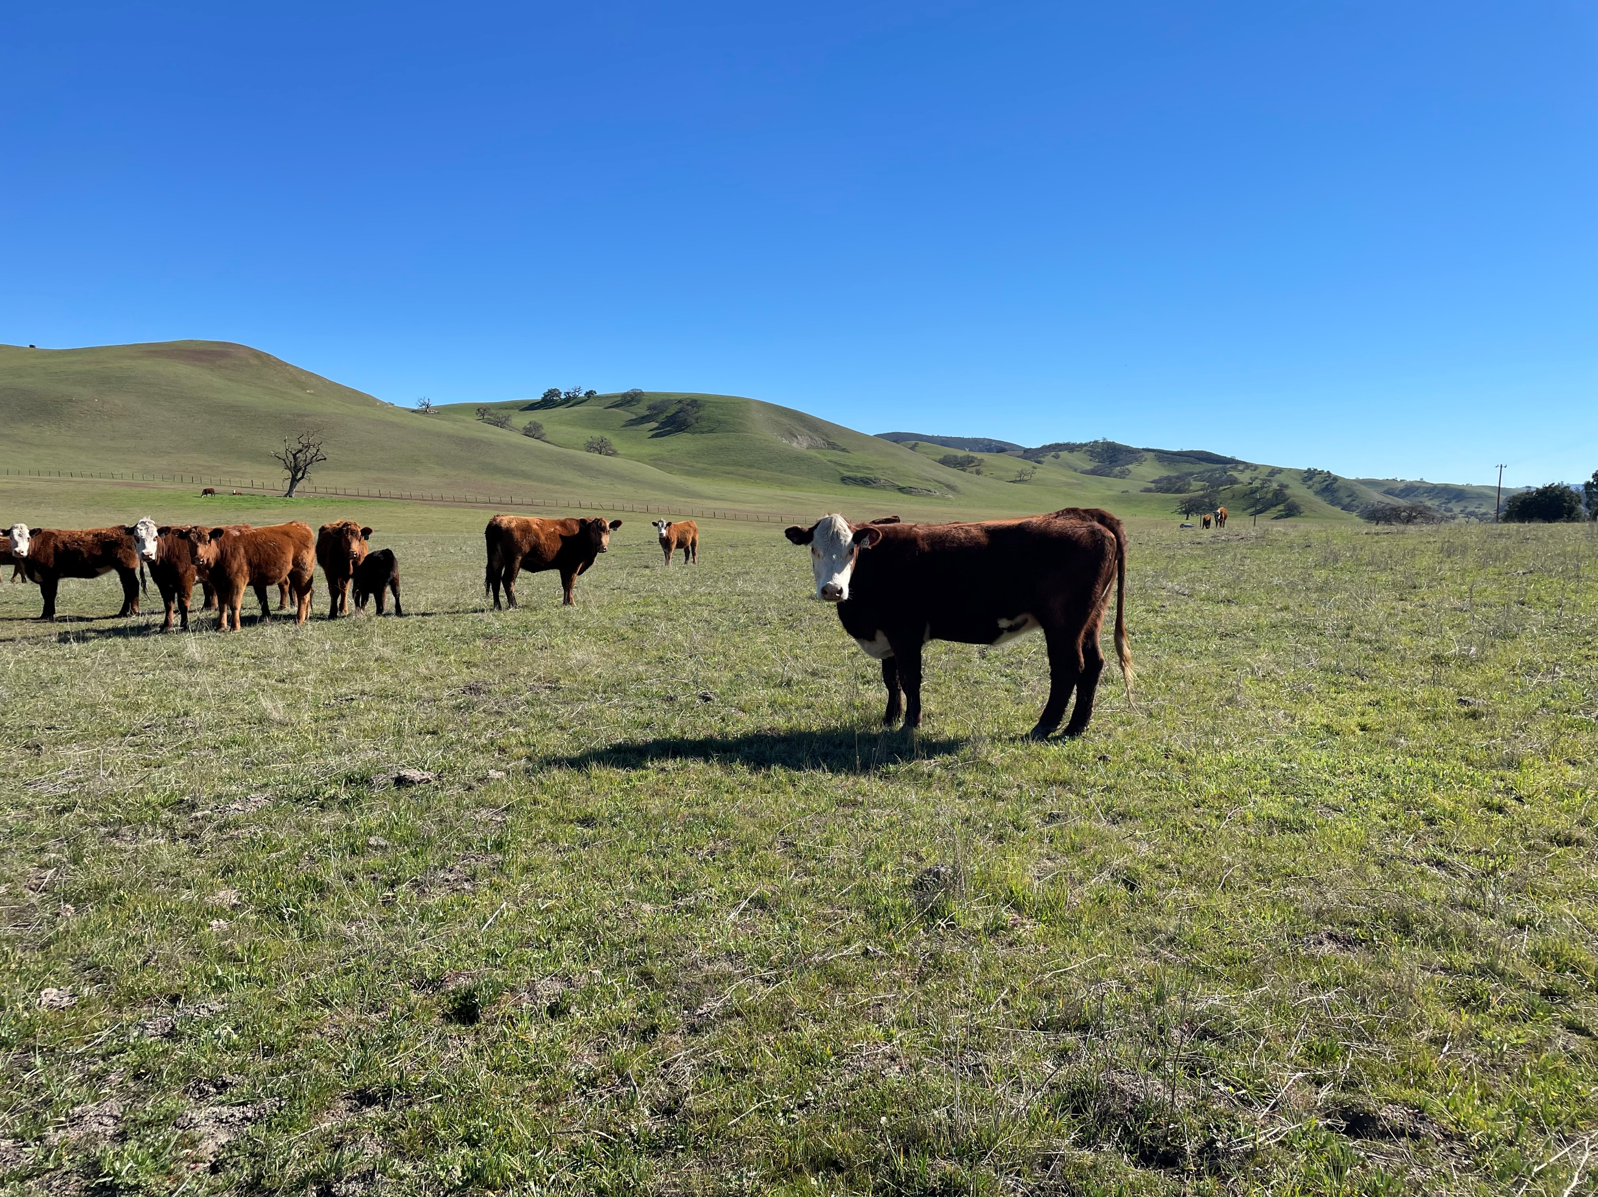
Key Components of Our Needs Assessment
In-progress
7 collaborating advisors
2 clientele groups
Developed to be publishable
Using Importance Performance Analysis (IPA framework)

Slide 45
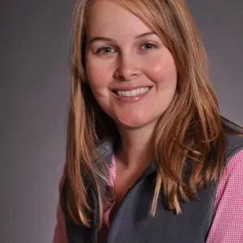
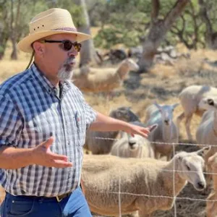
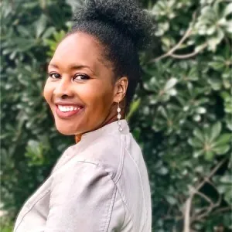
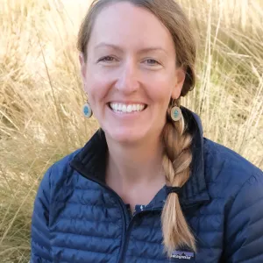
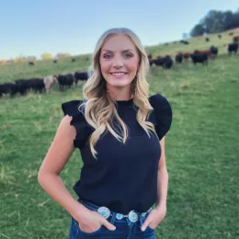
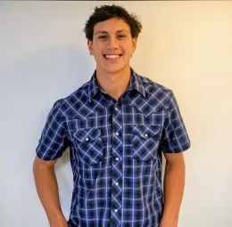
Collaborating Advisors
Co-PI Julie Finzel - King, Kerns, Tulare
Dan Macon - El Dorado,
Amador, Calaveras, Tuolumne
Fadzayi Mashiri
San Benito, Monterey,
Santa Cruz
Jenny Lane
Lake, Mendocino
Andrea Warner
Placer, Nevada,
Yuba, Sutter
Justin Vigil
Shasta, Trinity, Lassen

Slide 46
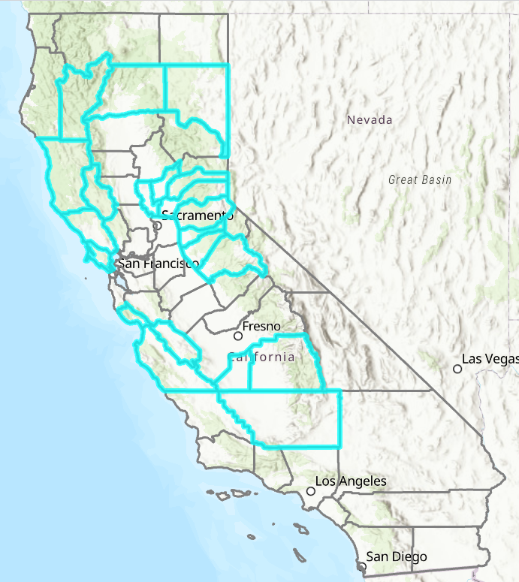
Counties Covered
21 counties included (>1/3 of California counties)
From Trinity to Kern
Participating advisors
  3 recently moved
  3 new advisors
  1 with new clientele

Slide 47
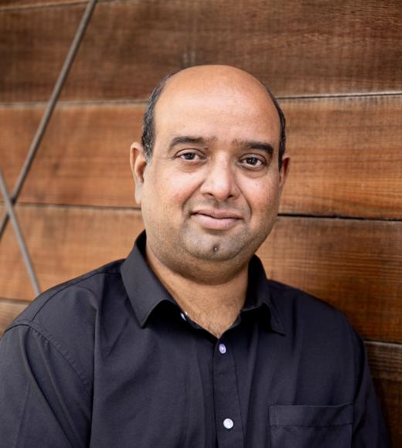
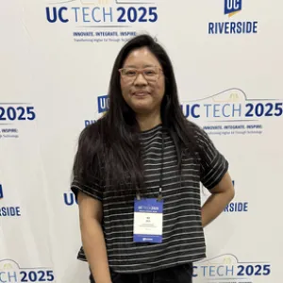
Additional Collaborators
Vikram Koundinya - Professor of Extension & Extension Specialist, Program Evaluation
Kit Alviz - Program Policy Analyst

Slide 48
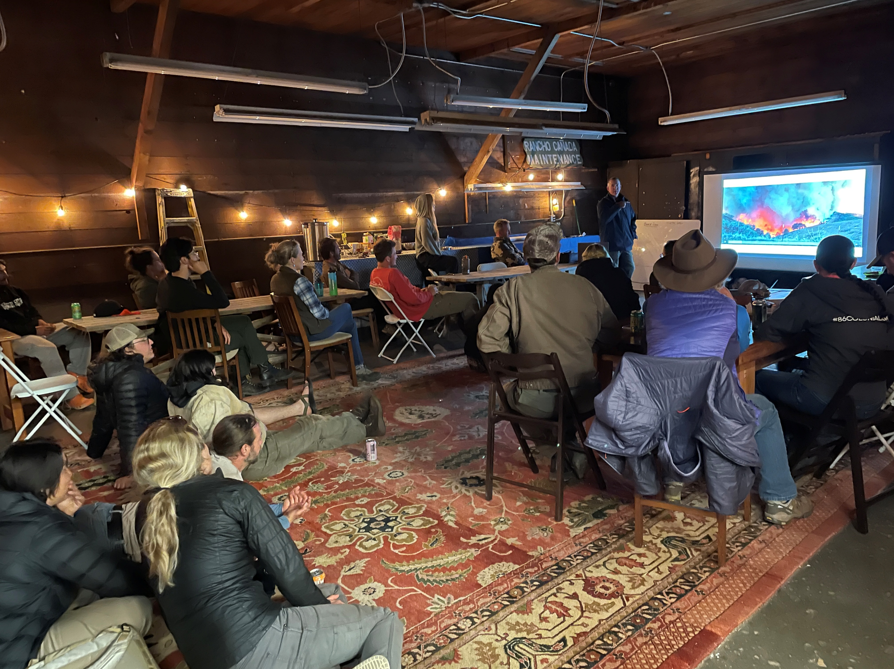
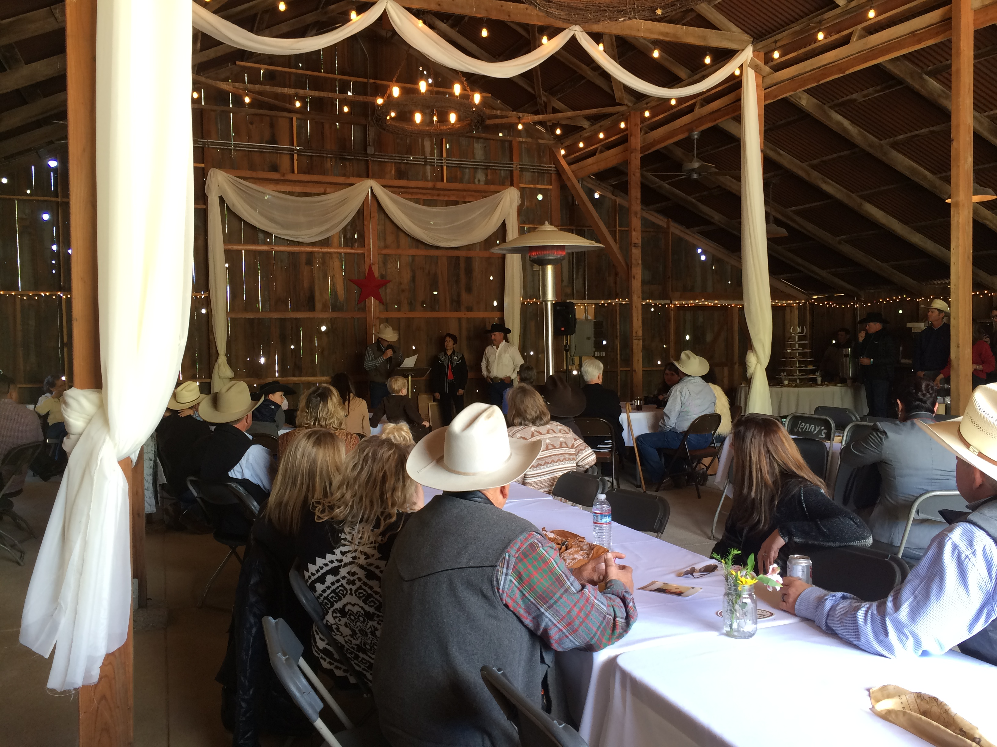
Two Clientele Groups
Ranchers
Land management agencies, non-profits, other orgs

Slide 49
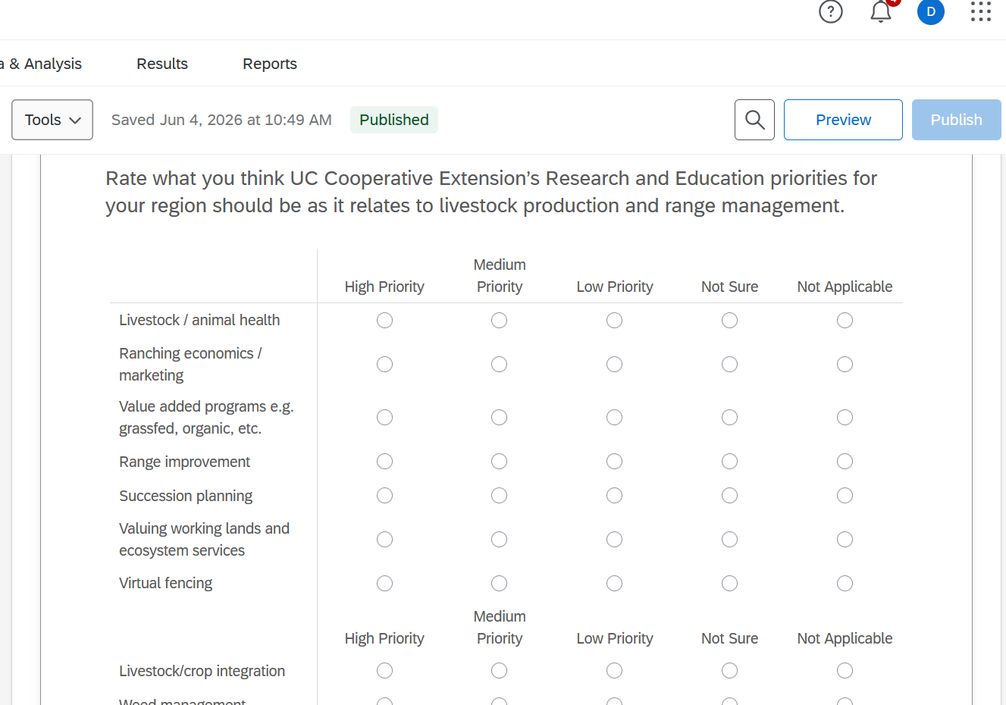
Developed to be Publishable
Goal: 20-25 in-person rancher interviews
Goal: 20-25 Qualtrics survey responses from agencies
Questions developed with initial Advisors, Vikram, and Kit
Both multiple choice and open- ended questions
Considered previous needs assessments and UC ANR’s Strategic Vision 2040

Slide 50
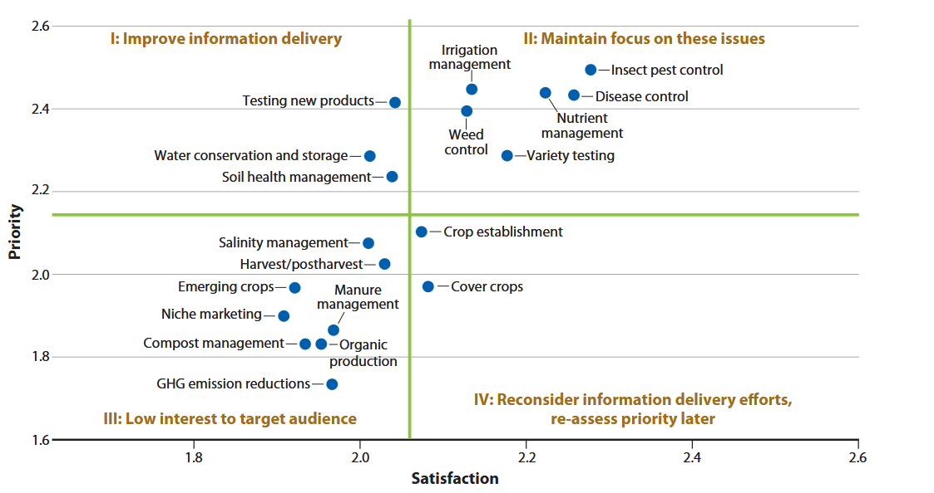
Importance Performance Analysis (IPA) Framework
Rate both the importance of an issue and their satisfaction with UC on that issue
Agencies only
Focus on high priority–low satisfaction quadrant
Kanter, J., Leinfelder-Miles, M., Clark, N., Lundy, M. E., Koundinya, V., Long, R., Light, S. E., Brim-DeForest, W. B., Linquist, B., Putnam, D., Hutmacher, R. B., & Pittelkow, C. M. (2024). Setting research and extension priorities for agronomic crops in California. California Agriculture, 78(2). https://doi.org/10.3733/001c.118769

Slide 51
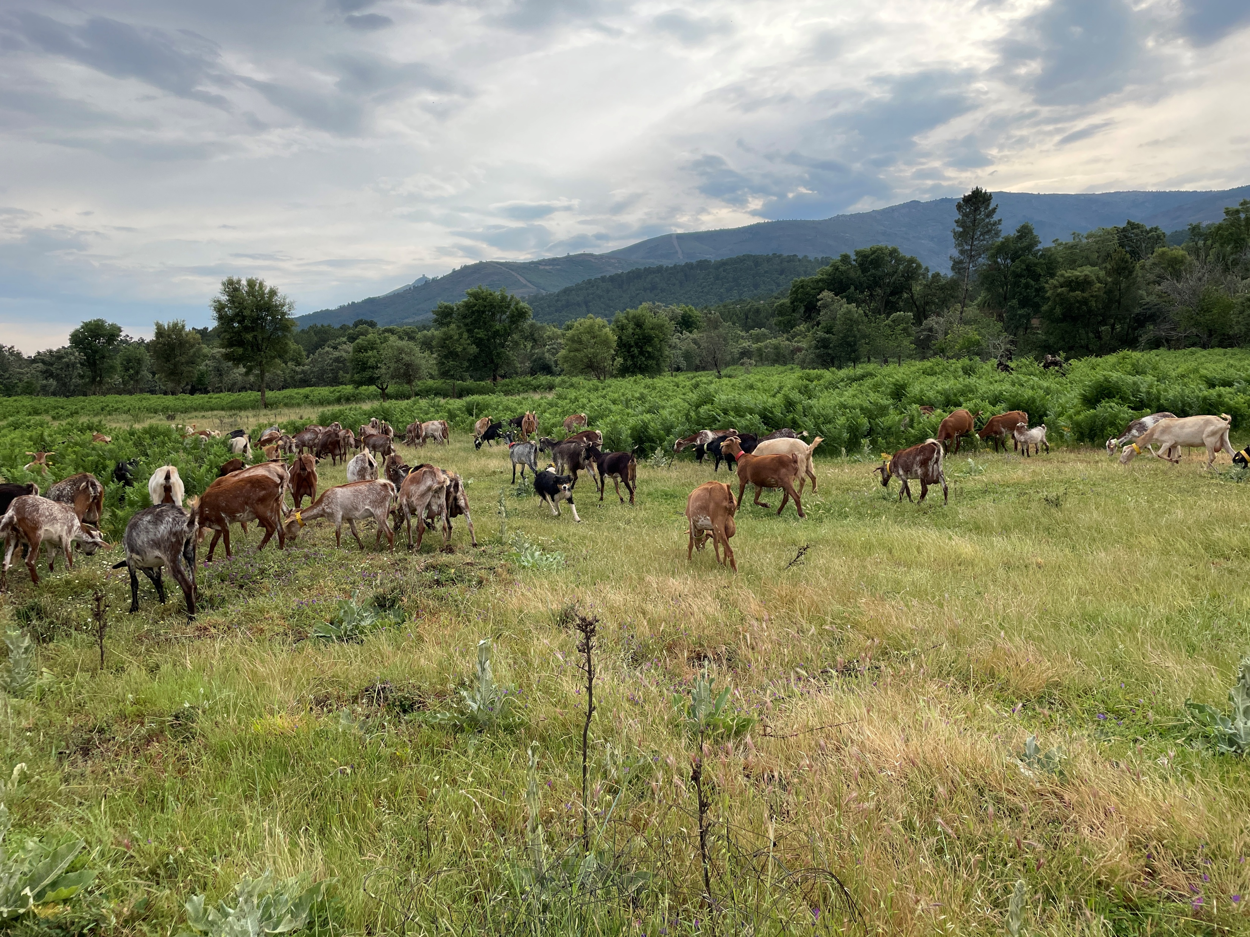
Next Steps
March 2025 – start talking about approach
December 2025 – IRB complete
January 2026 – started reaching out to clientele
December 31, 2026 – complete data collection
2027 - begin analysis and drafting manuscript during my sabbatical

Slide 52
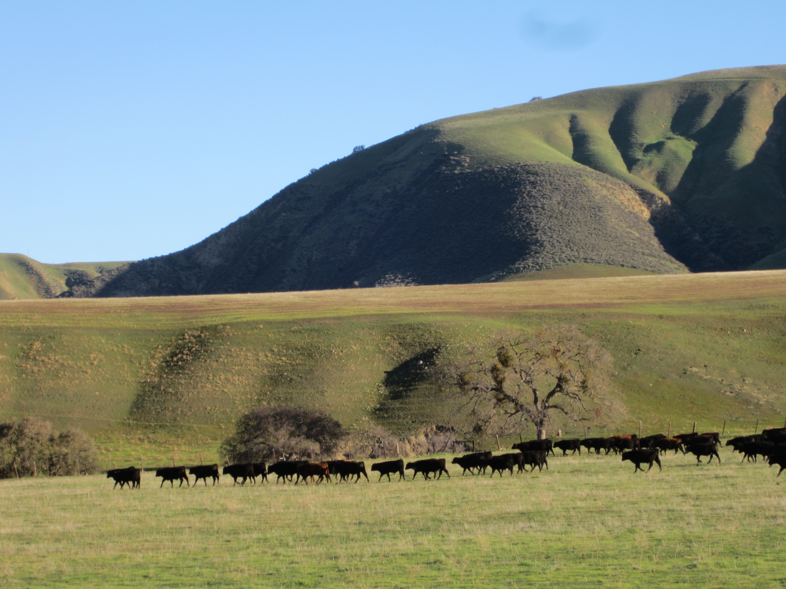
Thank You
Please fee free to contact me
deviirao@ucanr.edu
707-583-9706

Slide 53

Notes:
Questions

Slide 54
Youth Civic Engagement
Needs Assessment
California 4-H Civic Engagement Advisory Committee
Presented by Nicole Marshall-Wheeler
4-H Youth Development Advisor
August 18, 2026

Slide 55
Situation & Context
4-H Statewide Civic Engagement Advisory Committee
  Funded by the Statewide 4-H Program
Made of teenage youth members, adult volunteers, and 4-H professional staff
Programmatic lull led to the needs assessment

Slide 56

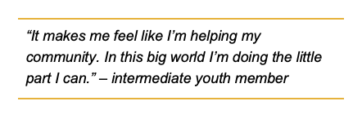
Assessment Development & Analysis
Questions developed collaboratively with the committee
Qualtrics
  Combination of closed and open-ended questions
Where we collected responses from
  Statewide newsletters
  Social media
  Tabled at an event
Analysis
  Frequencies, descriptive data, & themes from open-ended questions

Slide 57
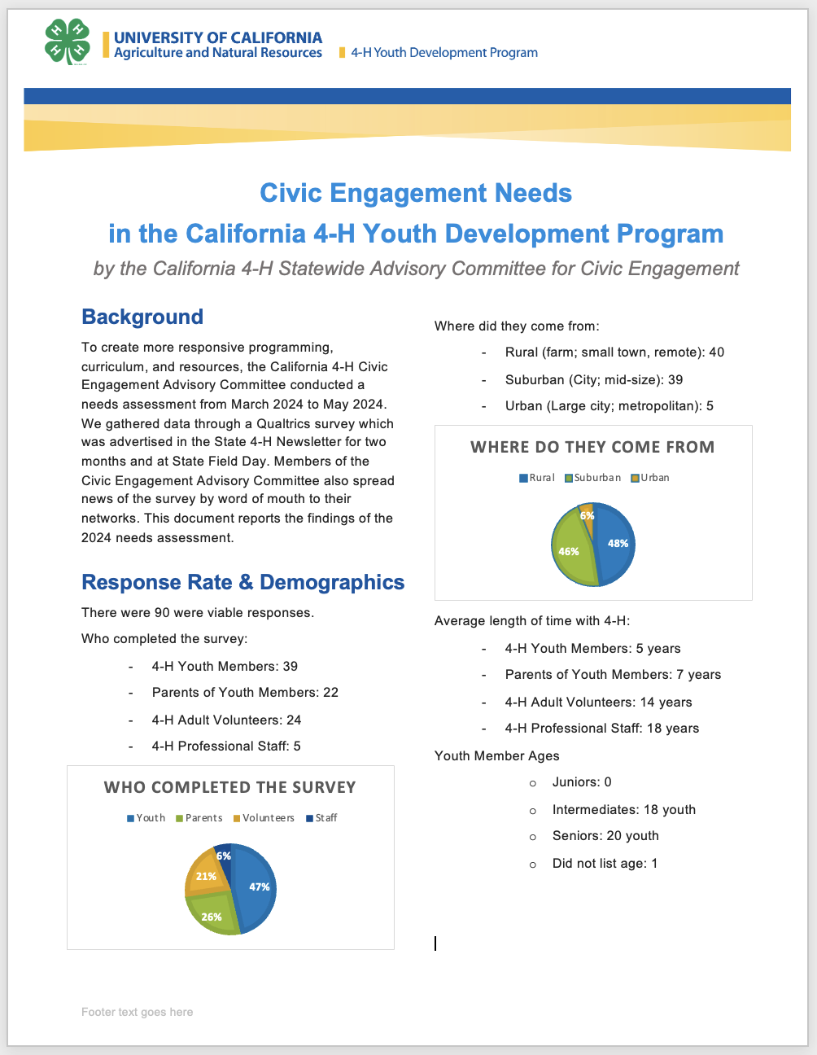
Reporting Out
Developed a report with infographics
Shared the report with:
  Statewide Committee
  Statewide 4-H Director
  Some data was shared on social media

Slide 58
Use of the Data
Locate, review, and make recommendations on educational materials.
Determine the what training and development needs of 4-H staff, volunteers and youth.
Assist in delivering appropriate training opportunities.
Seek collaborative opportunities with other groups or organizations as appropriate.

Slide 59
Keeping up with the times & Lessons Learned
See who does (or does not!) adopt the new program options
  Use this as a baseline and adjust from there
Boots on the ground: Local word of mouth and networks helped provide the most responses

Slide 60
Statewide Civic Engagement Needs Assessment
Civic Engagement Advisory Committee 2024-2025

Slide 61

QUESTIONS
Notes:
Questions

Slide 62
Peer-to-Peer Learning
Small groups based on UC ANR Program Areas
Introductions
Describe your needs assessment approach, including which data collection method(s) you used/plan to use & why
How will you use the results of your needs assessment?

Slide 63
Program Areas | Program Teams
Agronomy & Horticulture Chair Tom Turini | Agroecology, Organic & Regenerative Systems Agronomic Crops Environmental Horticulture, Floriculture, Berries & Nurseries | Fruit & Nut Tree Crops Urban Agriculture & Community Gardens Vegetable Crops Viticulture
Animal Production Systems Chair Dan Macon | Aquatic Food Production Systems Dairy Production | Meat Production Specialty Livestock & Poultry
Community & Economic Development Chair Keith Taylor | Agri-Food Technology & Innovation Biobased Products & Bioeconomy Disaster Preparedness & Response | Food Systems, Food Waste & Business Support Labor & Workforce Development
Integrated Pest Management Chair Jhalendra Rijal | Entomology, Arthropod & Vertebrate Pests Plant Pathology & Nematology | Weed Management
Natural Ecosystems & Working Landscapes Chair Jeff Stackhouse | Biodiversity Conservation & Stewardship Climate Science & Ecosystem Impacts Fire Management, Policy & Resilience Forest & Upper Watershed Systems | Human-Wildlife Interactions Rangeland & Grazing Systems Soil Health & Management Water Quantity, Quality & Security
Youth, Families & Communities Chair Natalie Price | Community Nutrition & Health Native American Community Partnerships Positive Youth Development & 4-H | Science Literacy & Critical Thinking Systemic Inequalities

Slide 64
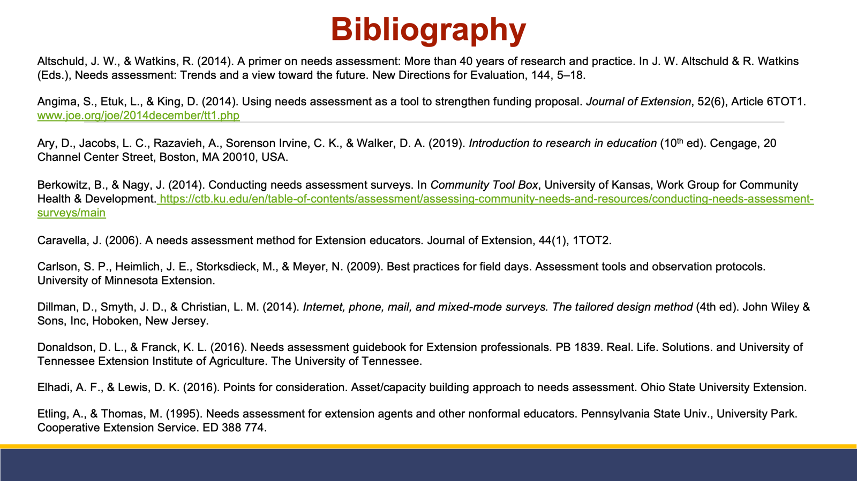

Slide 65
