Slide 1

Project Board Training
(CE Specialists with campus merit/promotion)
Sept. 18, 2026
Kit Alviz and Evan Talmage
UC ANR Program Planning and Evaluation (PP&E)
Welcome: UC ANR Associate Vice President Darren Haver
Resources: Uriel Gonzalez (IT), Christopher Hanson (PP&E)
UC ANR is an equal opportunity provider.

Slide 2
Agenda
10:00 – Leadership Welcome & Project Board Overview
10:20 – Project Board Themes: Outputs vs Outcomes & UCCE Specialist Outcome Examples
10:55 – Break
11:00 - Project Board reporting checklist, demos, tips, Q&A
11:55 - Wrap up and evaluation
12:00 – Adjourn
Notes:
Kit

Slide 3
Desired Outcomes
CE Specialists will have:
Understanding of Project Board, UC ANR’s informational reporting system, how the information is used, how it can help you, and what is required for the Dec. 7 due date.
A demo of the Project Board system, user manual and how to enter the information required for the Dec. 7 due date.
Recording derived from this live training.
Notes:
Kit

Slide 4
Timeline
Open year round
July 2026: Due date for program FTE for SFY 2025-2026 (July 1, 2025-June 30, 2026) and planned multistate FTE for FFY2026-2027 (October 1, 2026-September 30, 2027)
Dec. 7, 2026: Due date for entering project and theme information for FFY 2025-2026 (October 1, 2025-September 30, 2026)
Click submit button as many times as needed.
Notes:
KA
Submit button can be clicked as many times as needed. We see the time stamps every time you click submit, so every time you update, click submit!

Slide 5
UC ANR Leadership Welcome
Associate Vice President Darren Haver
Notes:
Here are the talking points provided in the past. Feel free to add any others.
The expectation to complete annual reporting for accountability purposes, to meet federal requirements for funds that pay part of their salary.
The importance of reporting for telling UC ANR’s impact story

Slide 6
UC ANR Leadership Welcome – Civil Rights
USDA NIFA Civil Rights Compliance requirements:
Notification Requirement: post full UC ANR nondiscrimination statement on all print and non-print materials (alternatively, use short form: “This institution is an equal opportunity provider.”).
Notification Requirement: Recipients are required to notify individuals with disabilities and Limited English Proficiency (LEP) individuals of their right to free accommodations and language assistance.
“…And Justice for All” Posters: Posters must be “prominently displayed in all offices where there is a USDA presence and where it may be read by customers.”
Know your Title IX Campus contact.

Slide 7
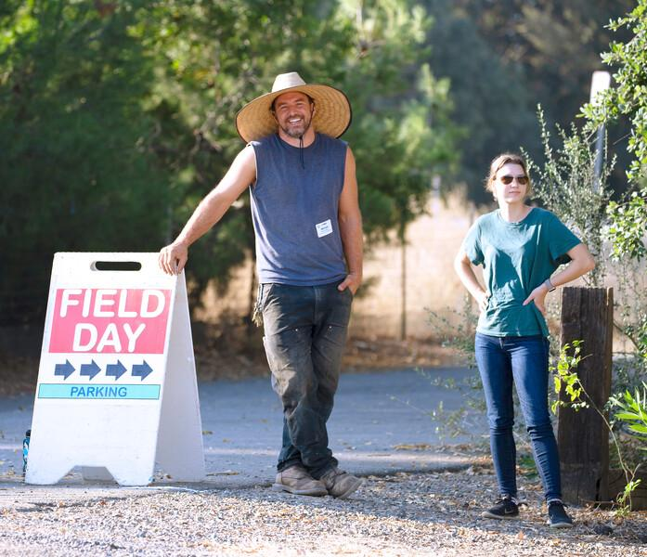
Project Board Purpose
Designed with UCCE academic input to
Reduce duplicative data entry
2. Make data accessible for multiple purposes
Accountability
Advocacy Efforts
UC ANR’s Academic Merit and Promotion
Notes:
Project Board is our in house built online system for ALL UC Cooperative Extension academics
Designed with academic and administrative input to reduce duplicative data entry where possible. Interactive testing occurred.
Accountability: to our funders and tax payers
Advocacy Efforts: Information is used for talking points and marketing materials for UC ANR leaders when talking to legislators, partners, and others.
Academic Merit and Promotion: The data fields are designed to capture the information that is reported in merit and promotion. It is more closely integrated for CE Advisors merit and promotion since UC ANR oversees that process

Slide 8

How UC ANR Uses Project Board Information
UC ANR Annual Report
Mandated annual federal reporting
(CE portion $8.7 million)
Annual condition change impact stories
FTE for Programmatic Footprint Maps
County and campus uses
Ad hoc queries (such as for award nominations)
UC systemwide reports
Legislative/external/internal requests
on About web page
Notes:
Included information from themes projects, activities/contacts, FTE, publications, and statewide program information
Federal requirements - and compliance with other federal requirements to maintain funding levels (multi-state!)
Ad hoc queries from workgroups, Program Teams (FTE to inform new PTs), ANR Strategic Communications, senior leadership, etc.
UC systemwide - ANR's contributions to the annual UC accountability report, sustainability report, Office of the President budget reports, other ad hoc requests
Legislative Analyst's Office as well as Association of Public Land Grant Universities who advocate for federal funding

Slide 9

Quote from UC ANR Vice President
“Kudos to academics for giving us these impact stories. Thanks to your work and the organization’s work in developing the public values, we now have a straightforward easy way to understand our impact.
These are what captures stakeholders, lay audiences, legislators, and policy makers at all levels. They want to know what’s in it for them.”
Glenda Humiston, UC ANR Vice President
Notes:
Especially important to have impact stories now; working on research impact to address federal competitive funding cuts
Historic $32 million increase from state
Photo March 2019 Regents mtg.

Slide 10
How YOU Can Use Project Board Information
Tell your CE Story in your merit/promotion.
Theme narratives with outcomes/impact must be submitted on an annual basis and can be used as a starting point for candidate statements and supplemental documents.
Grow your network!
Search for other UCCE academics’ Projects and Activities. Keep an up-to-date list so that potential collaborators can search for you too.
Get recognized!
Your work can be picked up for inclusion in communications such as the UC ANR Annual Report, UC systemwide reports, materials shared with legislators, other Strategic Communication outlets, and more.

Slide 11
Project/Program Data Collected
Generic UCCE Logic Model with Indicators
Outputs
Outcomes
Research & Extension
Methods
Participation
Learning change
Behavior change
Condition
change
Activities, products, tools, publications, etc.
Clientele, partners, collaborators (NGO, agency, scientists, industry, owner/
operators, etc.)
Measured or observed changes in knowledge, attitudes, or skills
Measured/ observed changes in clientele actions, decision-makingand policies
Measured, observed, or “safe inferences” using “outcome linkage literature” that communicate the public value for Californians
Notes:
11

Slide 12
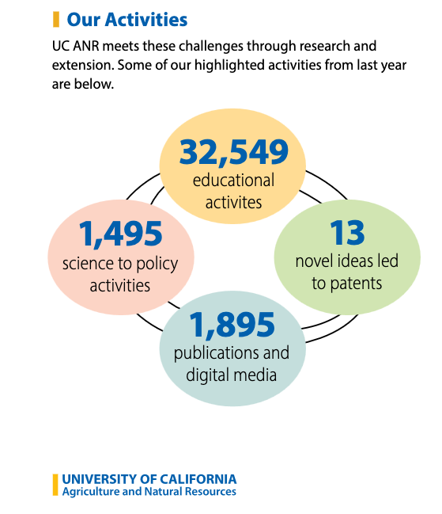
UC ANR Aggregated
Programmatic Metrics
UC ANR Aggregated
Programmatic Metrics
Notes:
Patent data is from office of tech transfer the rest from PB
Last one just for Advisors

Slide 13
UC ANR Project Board Definitions of Outcomes
changes in learning (knowledge, attitudes, or skill)
change in behavior/practice
changes in policy or decision-making (science-based information applied to decision-making or results form policy engagement)
changes in conditions (social/health, economic, environmental)
Notes:
For UC NAR and you to best be able to communicate the value of your work we focus on collecting outcomes in the Themes section
Here are the definitions

Slide 14
Refreshed UC ANR Condition Changes
Planet
Improved land stewardship (e.g., equitable land access, land use planning, restoration, and management strategies)
Increased ecological sustainability of agriculture, working landscapes, and natural ecosystems
Improved air quality
Improved soil health and productivity
Improved water quality
Improved water use efficiency and water supply security
Improved biodiversity (e.g. protected, restored)
Increased ecosystem resilience to extreme weather and change in climate
Increased agriculture and food system resilience to extreme weather and change in climate
Increased carbon sequestration and mitigation of greenhouse gas emissions
Enhanced waste reduction, recovery, and economic reuse
Reduced reliance on fossil fuels
Prosperity
Increased stability, efficiency, and profitability of agriculture and working landscapes
Improved animal management (e.g, welfare, profitability, and sustainability)
Enhanced food systems and markets (e.g., crops/products, supply chains, diversified/niche markets)
Improved workforce development for individuals, communities, and industry
Enhanced business and community leadership
Improved individual and household financial stability
Enhanced community economic development
People
Improved mental and physical well-being across an individual’s lifespan
Improved community health and wellness
Improved built environment, landscaping, and access to green spaces
Increased community disaster preparedness and resilience to extreme weather and change in climate
Improved readiness and access to post-secondary education and career opportunities
Increased civic engagement
Increased public engagement and confidence in science
Improved living and working conditions
Increased equitable access to resources (e.g., information, education, technology, services, land, capital, clean air and water, healthcare)
Improved food and nutrition security, food sovereignty, and access to culturally relevant foods
Improved food safety
Enhanced regional-based food supply chains
Notes:
In Themes sections we encourage all UCCE academic to connect your work to the UC ANR longer-term, broader public benefits called condition changes in the field of program evaluation
These were recently updated with input from across the UC ANR network
Simplified umbrella topics to align with commonly understood 3Ps of sustainability
Added those highlighted and edited some to add words of programmatic importance

Slide 15
Outputs, Outcomes, and Impact
Notes:
VK slides

Slide 16
Understanding Outputs and Outcomes
Outcome is something that comes out of a program
Output is activity or product under the control of a project team, whereas outcome is not under the full control of a team.
(Davidson, J. E., 2016)
Notes:
Vikram
Outcome: We can’t control the level of accomplishment.

Slide 17
Understanding outputs and impact
Outcome is “so what” of an output/activity
Impact is “so what” of an outcome
Notes:
Vikram

Slide 18
Understanding outcomes
Short term outcome - expect to see as a result of your program
Medium term outcome - like to see as a result of your program
Long term outcome/impact/condition change - love to see as a result of your program
[Rockwell, S. K,; Jha, L.; Krumbach, E. (2003)]
Notes:
Vikram

Slide 19
Examples of Outputs
What you do:
Classes Trainings Workshops Meetings Videos Blog posts Social media Brochures Factsheets Field trials Field days | Curriculum Counseling Technical assistance Facilitation sessions Evaluation activity Working with media Journal articles Extension reports Graduate students mentored Student committees served
Notes:
Vikram

Slide 20
Examples of Outputs - Reach
Who you reach:
Participants
Extension clients
Agencies
Decision-makers
Customers
Notes:
Vikram

Slide 21
Examples of Outcomes
Examples of Outcomes
Awareness Knowledge Perceptions Attitudes Skills Opinions Aspirations Motivations Behavioral intention | Behavior Practice/Adoption Research citations (by others) Decisions Policies
Notes:
Vikram
Mention these are mostly examples of short and medium term outcomes. This is okay because I will transition to longterm outcome / condition changes.

Slide 22
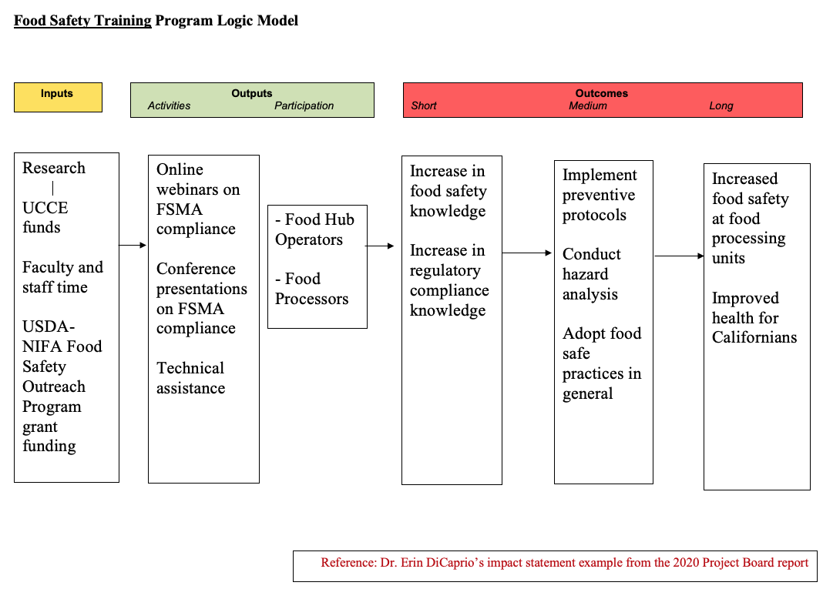
Food Safety Training Program Logic Model
Notes:
VK
Source: Vikram got this from Erin. Clear what the output and outcome is.
FSMA= Food Safety Modernization Act

Slide 23
How to Connect YOUR Work to Condition Changes
Explain as potential, anticipated impact…
  Cannot always conduct longitudinal studies to measure impact
  Doesn’t happen as a result of a single event or product
I only just
started
my work
I’m not responsible for all the change
Refer to how your work contributes …
Link your work to existing research (outcome linkage literature) to make a safe inference about your program’s impact
Notes:
VK
to tell a compelling story about how your program contributes to public value.

Slide 24
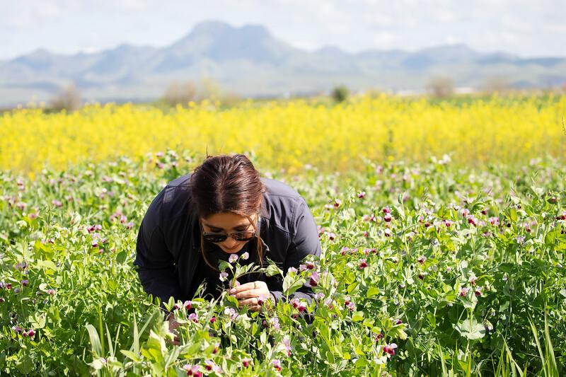
Project/Program Outcome Indicators
The specific information or evidence that represents the desired change that you are interested in
Can be measured with observation, interviews, surveys, research methods, or by leveraging secondary data and existing research
Notes:
Transition to thinking about how to measure indicators for outcomes and condition changes and communicate the public value of your work.
→ can be seen (observed), heard (participant response), read (agency records), felt (climate of meeting), touched, or smelled (food science)

Slide 25
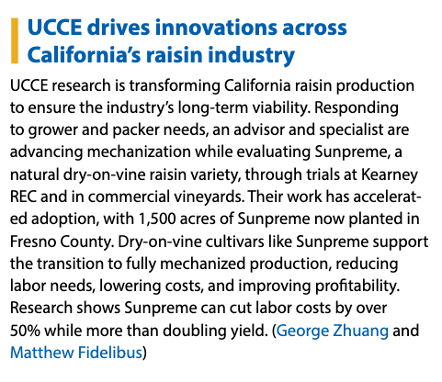
Measured Action Outcome
Included in 2025 UC ANR Annual Report
Notes:
2025 annual report

Slide 26
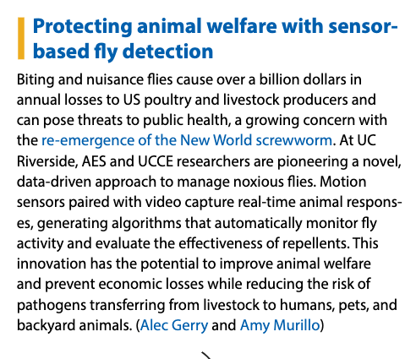
Describing Potential Impact of Research
Included in 2025 UC ANR Annual Report
Notes:
2025 annual report

Slide 27
Informing Policy Outcome - Christy Getz
Improved community health and wellness
UCCE Specialist at UC Berkeley bolsters nutrition education and farming businesses
A UCCE evaluation helped shape state policy, securing continued funding for farm-to-school programs in 2024. The findings showed that these programs not only stabilize farmers’ businesses but also promote climate-friendly farming practices and provide critical support to small and mid-sized farms. The evaluation also found that farm-to-school programs have increased the availability of fresh, local, and organic produce, meat, and dairy in schools. These results played a key role in the California Legislature’s decision to expand funding for farm-to-school projects. Since 2021, funding has grown from $8.5 million to $52.8 million in 2024, strengthening local agriculture while ensuring students have access to healthy, nutritious food.
Notes:
KWM
UCB
2024 Annual Report (keeping this example as we had less highlights in the new 2025 annual report format)

Slide 28
Measured Condition Change - Johanna Del Castillo Múnera
Increased ecological sustainability of agriculture, landscapes, and forestry
UCCE Specialist prevents pathogens from spreading in restoration nurseries
A UCCE Specialist from UC Davis coordinated and facilitated the Accreditation to Improve Restoration (AIR) program statewide for restoration nurseries to prevent the spread of Phytophthora into native ecosystems. Restoration nurseries grow native plants that are used for ecological restoration projects. As of 2024, ten restoration nurseries were fully accredited, an additional ten are actively participating in the program, and eight more are in consultation to join. Crucially, among AIR-accredited nurseries, no Phytophthora has been detected, indicating the effectiveness of the proposed management practices at reducing the risk of introducing these pathogens into restoration sites.
Notes:
KWM
UCD
Reduced pest incidence
2024 Annual Report (keeping this example as we had less highlights in the new 2025 annual report format)

Slide 29
Practice - Poll
Notes:
Kit lead - 5 questions 3 minutes to respond and 3 minutes to discuss
Kit launch poll
Youth that participated in the healthy food tasting indicated that they are willing to eat the food again at school (71%) and willing to ask for this food at home (66%). - outcome
Over 50 community officials and interested residents attended a poverty simulation that focused on specific county data surrounding the issue of poverty and food security. - output (participation)
1400 farmers and 35 elected county officials were provided research findings about agricultural land use. - output (reach)
After the workshop on microgreens as a new enterprise for urban farmers, one attendee indicated that they would grow microgreens as a new part of their business after the workshop. - outcome (mention not always about a large # of people, e.g early adopters, acres)
Ninety-three percent of the 50 participants reported increased understanding of groundwater and the potential for groundwater contamination. - outcome (gold standard both # and %)

Slide 30
Testimonial: Emphasis on
Measuring Outcomes and Communicating Impact
What motivates you to measure your outcomes every year?
Not every project lends itself to this type of measurement (in fact, in my experience, most outcomes are not easily measured or documented). For this reason, when there is a good context/opportunity to take this measurement, I usually try to seize it.
This information is valuable in the context of a particular project/content development project because it helps us understand what's working and how to make adjustments/tweaks moving forward. It's also important both for internal communication among teams of colleague and external communication/relationships because it provides a tangible point of discussion regarding what works/doesn't work in the eyes of our clientele.
Notes:
Kit - Testimonial from a UCCE Specialist in the Department of Plant Sciences

Slide 31
Testimonial: Emphasis on
Measuring Outcomes & Communicating Impact
What motivates you to write them up in Project Board each year?
There is a lot of great extension and outreach work going on in the Department of Plant Sciences and the College of Agriculture and Environmental Sciences at UC Davis that doesn't always get noted. The dean's office at UC Davis has been very active in making sure that we understand the value of this exercise and contribute to it as best we can. It's nice to see the aggregated results that the UC ANR team has been putting together showing that we are collectively making a big impact in CA and beyond.
Do you have any program evaluation, impact writing, and/or reporting tips?
I think it is important to structure the data you collect around the statements you'd like to be able to make. So, incorporating a hypothesis-testing mindset into the structure of the surveys is helpful to being able to interpret their results and make declarative statements at the end of the process.
Notes:
Kit

Slide 32
Resources for
Measuring Outcomes and Communicating Impact
CE Program Evaluation web pages include:
Recordings of training, how-to materials, UCCE examples, links to related Extension publications, and other resources
UC ANR’s condition change web page includes:
List of condition changes by public value
Statewide impact stories with examples of UCCE measured outcomes connecting to condition changes
Tipsheets -- Putting Condition Changes to Work fact and Measuring Condition Changes
More examples in the UC ANR Annual Report
Schedule a technical assistance Zoom meeting!
Notes:
Kit
Start thinking now about what to measure or systematically document

Slide 33
Break until 10:53

Slide 34
Project Board Demo
URLs for system and user manual
Notes:
Kit
Project Board: projectboard.ucanr.edu
ANR MP user manual: https://ucanr.edu/sites/ProjectBoardHelp/User_Manual_-_ANR_MP_/

Slide 35
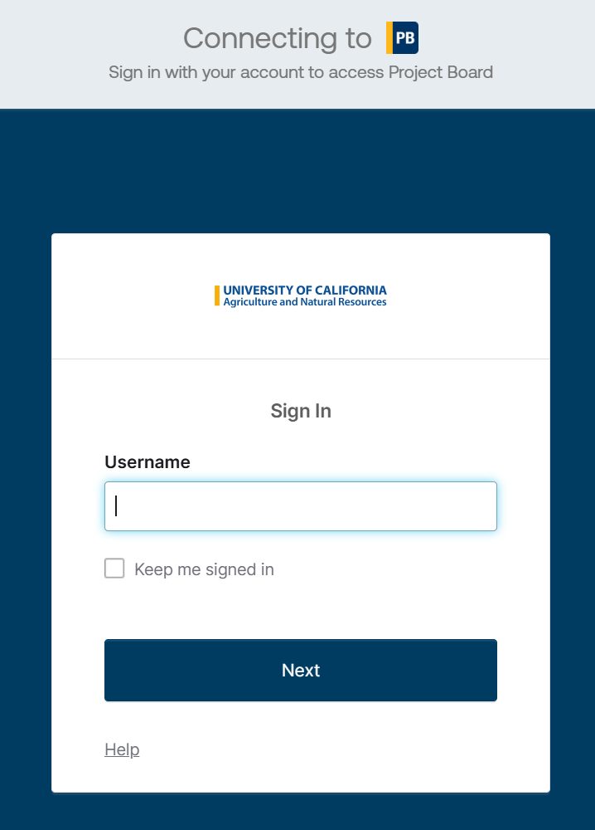
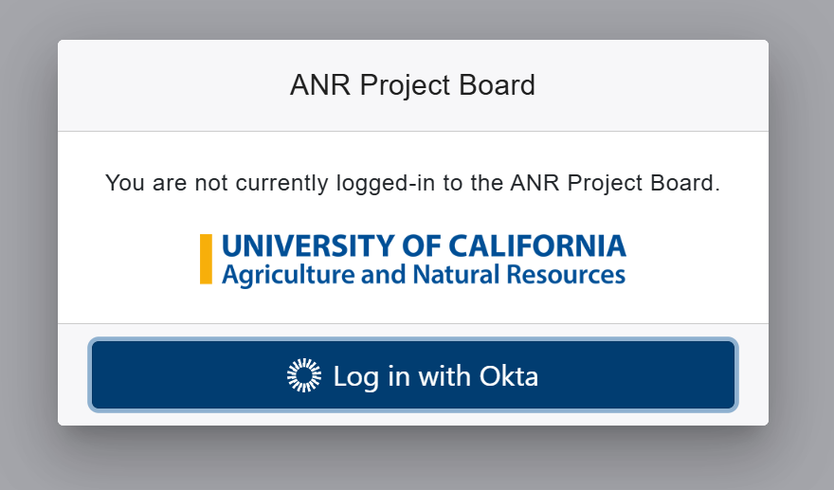
Logging in
Notes:
Microsoft login has been replaced with Okta.
Open Firefox, Edge, or Chrome (NOT Internet Explorer or Safari, which may work intermittently)
Go to https://projectboard.ucanr.edu and click “Log in with Okta”.
Enter your ANR username. This is the same username and password used for portal (See next screen for example)

Slide 36
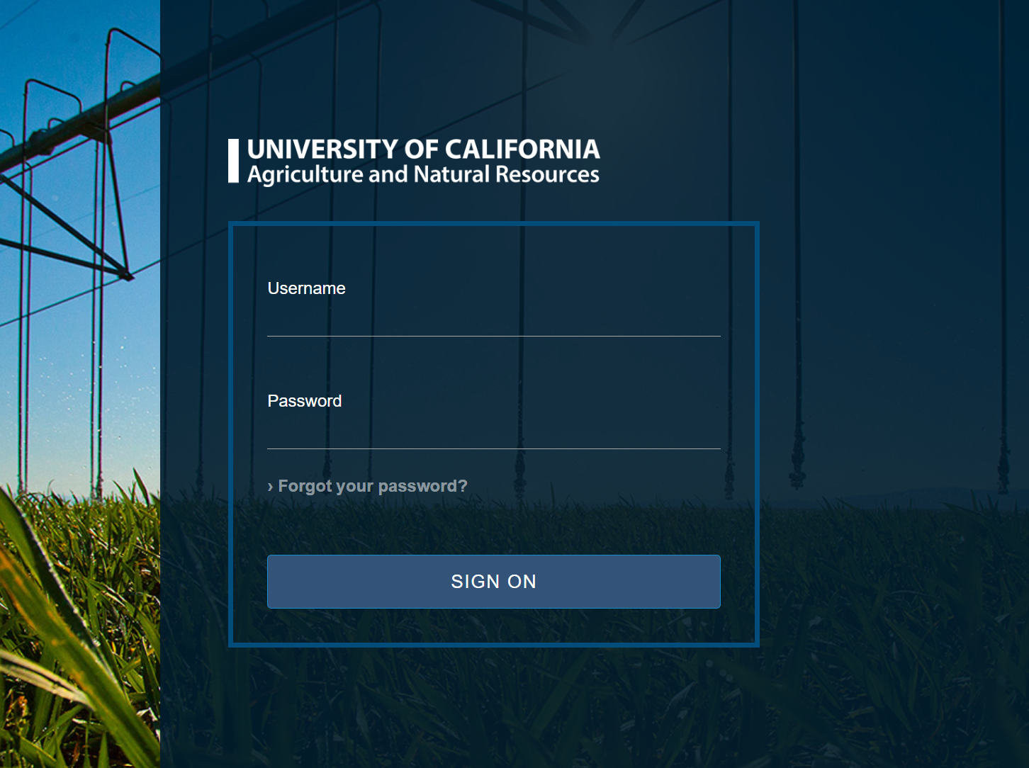
Logging in - Credentials
Same credentials used on this login page
Notes:
Quick tip
To make it easy to remember, use the same credentials you use on this login page.
If you entered the correct credentials, proceed with DUO authentication and the page will redirect you back to Project Board.

Slide 37
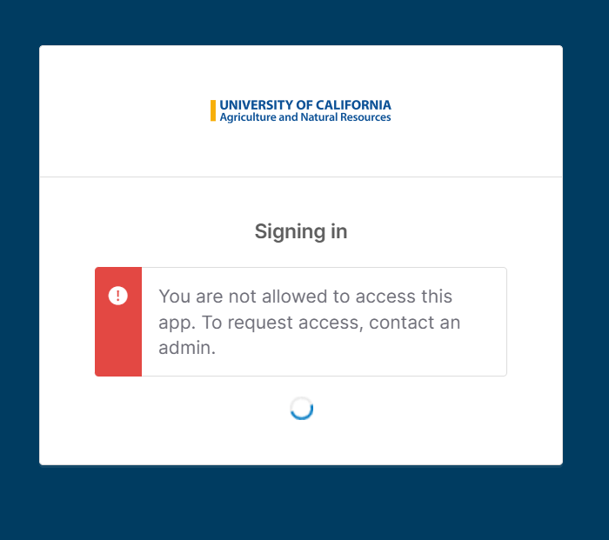
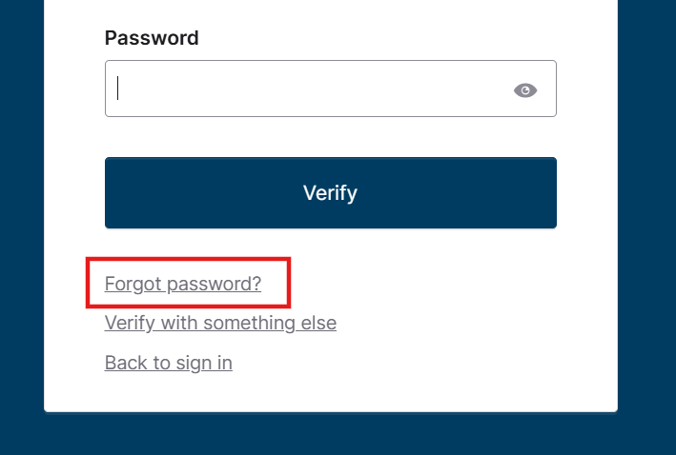
Troubleshooting
Follow the instructions in the email to reset password
Email help@ucanr.edu to request access
Notes:
Forgot Password?
Click on the “Forgot Password” link. The next page will allow you to verify your email before sending password reset instructions via email.
NOTE: Since Okta is Single Sign On (SSO), resetting your password for Project Board will also affect how you login to other apps via Okta such as ANR Bot. (SELF NOTE: Need to verify if it also resets password on the login from the previous page)
No access?
If you get a no access message, contact help@ucanr.edu to request access.

Slide 38
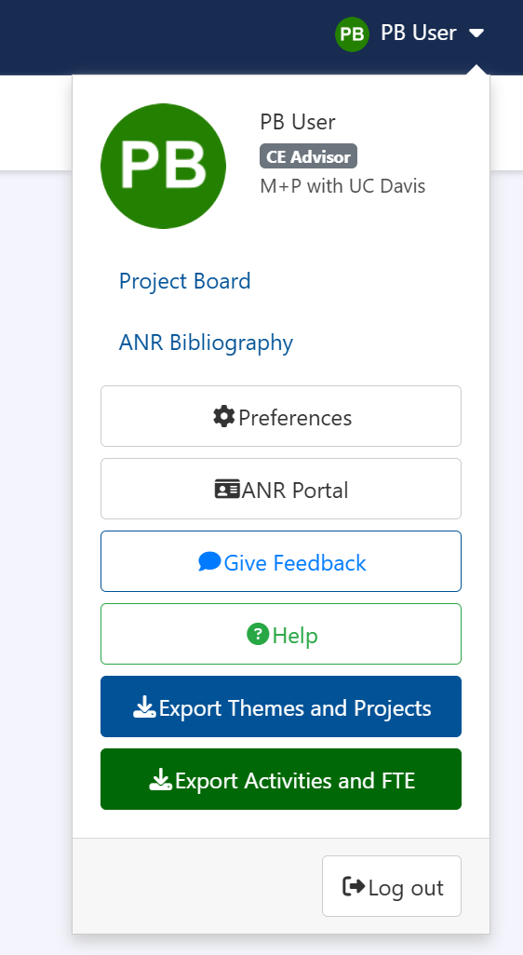
Useful Links

Slide 39
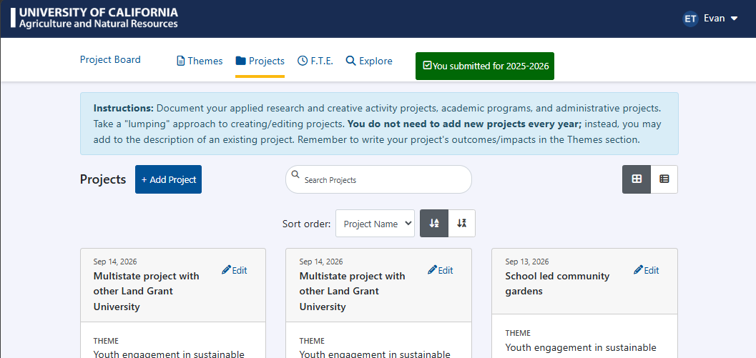
Navigation
Notes:
Uriel
USING PROJECT BOARD SYSTEM
General information that may help you use Project Board better:
You move to the different screens by clicking on the blue links in the top menu.
If you enter or change data, remember to click the Save button before you leave the page.
For narrative sections, you can cut and paste from word processing applications into the text boxes.
Hover over the “i” icons to get more information, definitions, and tips.
GETTING HELP
You can come back to Project Board Help at any time by clicking the Help button that appears at the top right drop down menu.
If you need further assistance, please contact the Program Planning and Evaluation Office in Oakland: Chris Hanson at christopher.hanson@ucop.edu or at (510)987-0628 or Kit Alviz at kit.alviz@ucop.edu or at (510)987-0027.

Slide 40
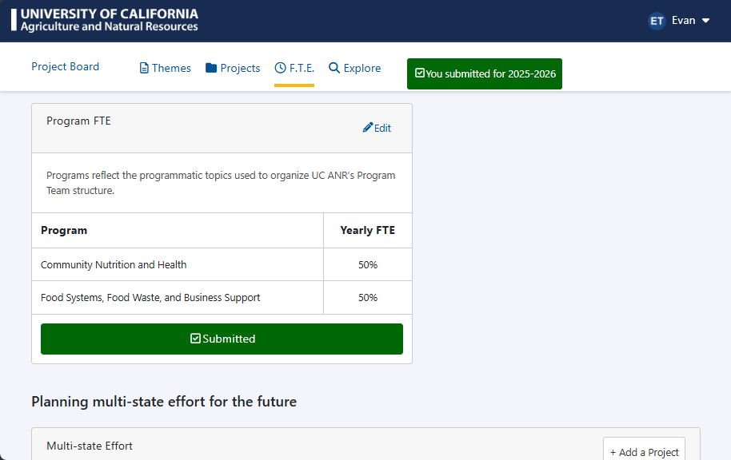
Program FTE
User Manual - FTE new hires campus MP | Project Board Help
Notes:
Report how time is spent against programmatic topics. This data populates the Programmatic Footprint Maps, allowing administrators and colleagues to identify expertise across the state.
To add/change your title, discipline, and specialty - please see the Update your ANR Portal Profile webpage.

Slide 41
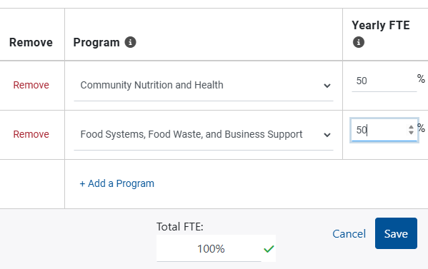

Editing Program FTE
Report your effort as 100% of your Cooperative Extension appointment, even if you do not work an entire fiscal year, have a split appointment, or have less than a 1.0 appointment.
If you add multiple topics, each topic should be at least 10% FTE.
You will not be able to continue through the screen without 100% FTE and Project Board will alert you if you haven’t reached 100%.
Notes:
Only use the "administration" program area if you have an administrative appointment such as County Director, Statewide Program Director, Research and Extension Center Director, etc.

Slide 42
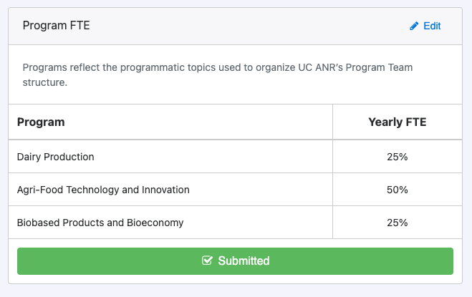
Submitting Program FTE
Due every July during ‘Call for FTE’
Updates Programmatic Footprint Maps daily
Notes:
When you are finished, click on the blue Submit or green Submitted bar in the Program FTE module. You can re-submit at anytime.

Slide 43
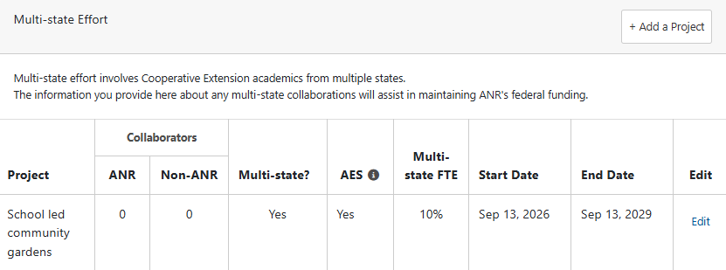
Planned Multistate FTE
More about multistate reporting after Projects overview
Due in summer for multistate fund reporting
Based on end dates, no submission button
Insert end dates that represent total length of planned collaboration

Slide 44
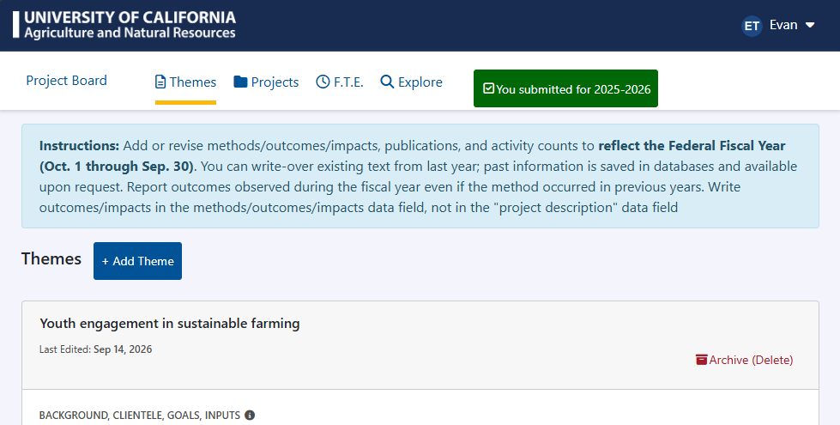
Themes (1 of 3)
Themes help share impact stories of your Cooperative Extension work.
Theme names can mirror your candidate statement sections (e.g., Research, Extension Knowledge and Information) or reflect broader programmatic categories (e.g., UC ANR Program Teams or Condition Changes)
Notes:
Click on the Themes link in the top menu of Project Board
Click on the blue Add Theme button or click on the blue edit link of an existing theme tile.
Follow the onscreen instructions (hover over the “i” for even more help!) to complete each item in bold below.
To edit an existing theme, click on the Themes link in the top menu of Project Board, then click on the field of the theme which you would like to edit.
The primary intent of completing a theme narrative is to share impact stories of your Cooperative Extension work. Themes are the subject matter around which your academic program is organized. Theme names can mirror your candidate statement sections (e.g., Research, Extension Knowledge and Information) or reflect broader programmatic categories (e.g., UC ANR Program Teams or Condition Changes).

Slide 45
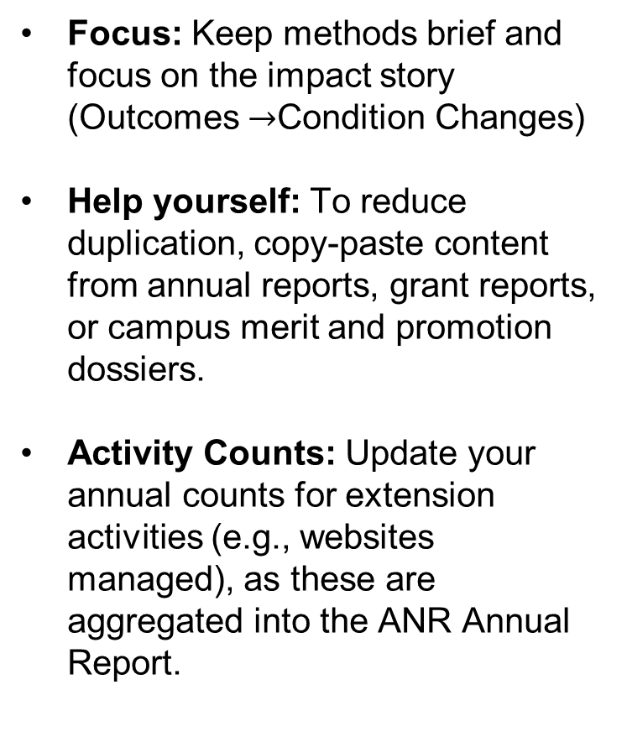
Themes (2 of 3)
Focus: Keep methods brief and focus on the impact story (Outcomes $→$Condition Changes)
Help yourself: To reduce duplication, copy-paste content from annual reports, grant reports, or campus merit and promotion dossiers.
Activity Counts: Update your annual counts for extension activities (e.g., websites managed), as these are aggregated into the ANR Annual Report.
Notes:
Themes (The Core Impact Story)
This is the most important section for demonstrating value.
Focus: Keep methods brief and focus on the impact story (Outcomes $→$Condition Changes).
Tip: To reduce duplication, copy-paste content from annual reports, grant reports, or campus merit and promotion dossiers.
Activity Counts: Update your annual counts for extension activities (e.g., websites managed), as these are aggregated into the ANR Annual Report.
Consider including the following components when describing your theme:
Clientele: People or groups of people that a program aims to serve.
Goals: The purpose toward which an effort is directed.
Inputs: What is invested? Faculty, staff, students, infrastructure, federal, state, and private funds, time, knowledge, etc.

Slide 46
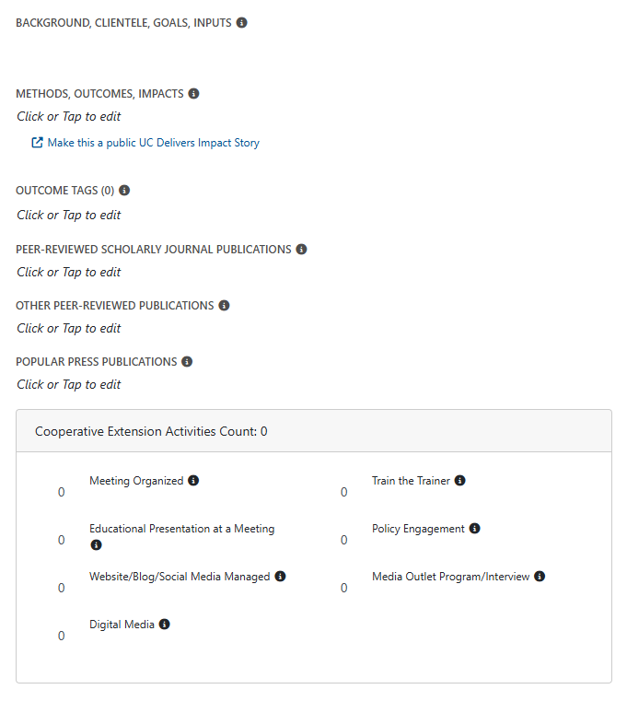
Themes (3 of 3)
Outcomes/Impacts: Use data (people, acres, etc.) to show changes in Learning (short-term), Action (medium-term), and Condition (long-term). Align results with UC ANR values using empirical evidence or literature.
Methods: Concisely link research/extension activities and products to your measured impacts.
Contributions: Describe how you've promoted equitable participation and UC ANR’s Principles of Community.
Notes:
Describing the methods, outcomes/impacts
Include the following:
Outcomes/Impacts: Include quantitative, observational, and/or participatory evaluations to determine outcomes such as the number of people, acres, and other units affected when possible. More examples of what constitutes and outcome can be found in the Project Board user manual.
Keep the narrative about methods short. Describe the research/creative/extension activities and products created through such activities specifically as they relate to the measured outcomes/impacts you are reporting.
Contributions to increase equitable opportunities for participation in your program and foster UC ANR's Principles of Community.

Slide 47
Outcomes
Outcomes may be achieved or realized years after projects and activities were conducted. Please describe the outcomes achieved or measured during the reporting period, even if they are resulting from activities from past reporting periods. Describe the previous methods used. These impact stories are very important!!
Notes:
Outcomes may be achieved or realized years after projects and activities were conducted. Please describe the outcomes achieved or measured during the reporting period, even if they are resulting from activities from past reporting periods. Describe the previous methods used. These impact stories are very important!!
If preferred, you can create program/project sub-headings. Try to articulate the particular method to which an outcome/impact relates, otherwise it can be confusing for reviewers to match up outcomes/impacts with methods.

Slide 48
Theme Outcomes
Video presentation on Urban Pest Management Symposium outcomes presented by Dong Hwan Choe CE Specialist
Notes:
Themes (The Core Impact Story)
This is the most important section for demonstrating value.
Focus: Keep methods brief and focus on the impact story (Outcomes $→$Condition Changes).
Tip: To reduce duplication, copy-paste content from annual reports, grant reports, or campus merit and promotion dossiers.
Activity Counts: Update your annual counts for extension activities (e.g., websites managed), as these are aggregated into the ANR Annual Report.

Slide 49
Example from CE Specialist
https://youtu.be/5yUZc6ZJKx8
Notes:
Themes (The Core Impact Story)
This is the most important section for demonstrating value.
Focus: Keep methods brief and focus on the impact story (Outcomes $→$Condition Changes).
Tip: To reduce duplication, copy-paste content from annual reports, grant reports, or campus merit and promotion dossiers.
Activity Counts: Update your annual counts for extension activities (e.g., websites managed), as these are aggregated into the ANR Annual Report.

Slide 50
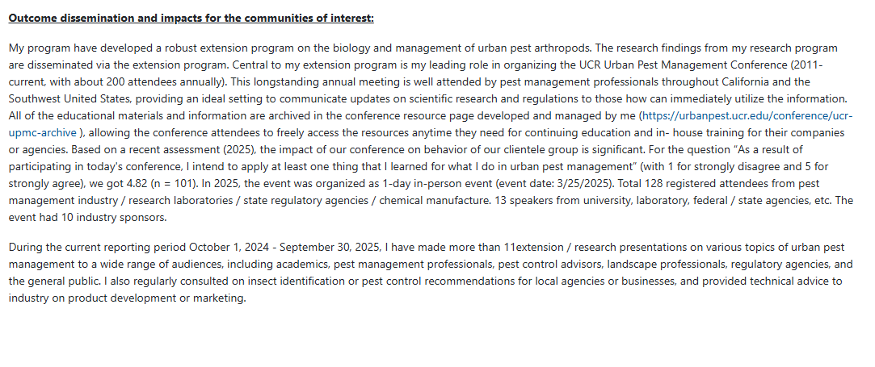
Themes Outcomes Example
Urban Pest Management Symposium outcomes from Dong Hwan Choe CE Specialist
Notes:
Themes (The Core Impact Story)
This is the most important section for demonstrating value.
Focus: Keep methods brief and focus on the impact story (Outcomes $→$Condition Changes).
Tip: To reduce duplication, copy-paste content from annual reports, grant reports, or campus merit and promotion dossiers.
Activity Counts: Update your annual counts for extension activities (e.g., websites managed), as these are aggregated into the ANR Annual Report.

Slide 51
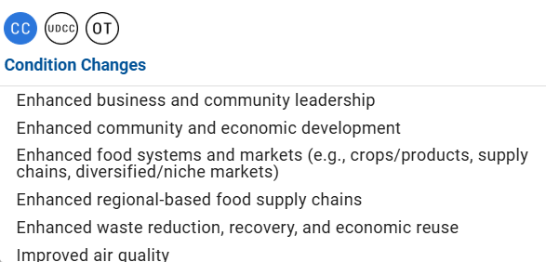
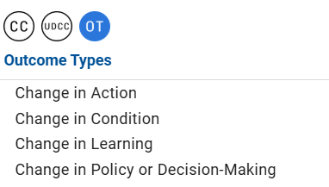
Themes - Tags
Condition changes represent broad environmental, health or economic benefits. Selecting condition changes enables administration to know how the efforts and outcomes reported in this theme relate to changing conditions in California and beyond.
Outcome types represent short, medium, and long-term changes that occurred as a result of the work described in your theme. Selecting one or more outcome types enables administration to know what level of outcome has been actually measured/articulated.
Notes:
If possible, select at least one anticipated condition change and one measured outcome type from the lists provided.
Condition changes represent broad environmental, health or economic benefits at a societal level (recognizing that UC ANR may be only one contributor towards these long-term outcomes). Selecting one or more condition changes will enable administration to know how the efforts and outcomes reported in this theme relate to changing conditions in California and beyond.
Outcome types represent short, medium, and long-term changes that occurred as a result of the work described in your theme. Selecting one or more outcome types enables administration to know what level of outcome has been actually measured/articulated.

Slide 52
Theme Activities
Activity types were developed with input from CE academics to specifically document the type of work that is conducted in Extension. Since campus merit & promotion systems already capture detailed activity information, it was agreed that Project Board would only collect activity counts.
Notes:
Themes (The Core Impact Story)
This is the most important section for demonstrating value.
Focus: Keep methods brief and focus on the impact story (Outcomes $→$Condition Changes).
Tip: To reduce duplication, copy-paste content from annual reports, grant reports, or campus merit and promotion dossiers.
Activity Counts: Update your annual counts for extension activities (e.g., websites managed), as these are aggregated into the ANR Annual Report.

Slide 53
Themes and Outcomes Resources
Cooperative Extension Program Evaluation has evaluation templates, examples, and resources
(https://ucanr.edu/group/15228)
Annual Practical Methods for Measuring Outcomes Training
(https://ucanr.edu/site/anr-ce-program-evaluation/measuring-outcomes)
UC ANR's tipsheet, Making Your Policy Work Visible
      (https://ucanr.edu/sites/default/files/2018-11/294833.pdf)
Notes:
Cooperative Extension Program Evaluation contains helpful tools like trainings, logic models, needs assessments, measuring outcomes and data collection, to name a few.
Annual Practical Methods for Measuring Outcomes Training contains trainings on measuring outcomes, examples of UCCE approaches to measuring outcomes, tips on culturally responsive evaluation, and focus group best practices. Again these are just a few of the helpful resources available.
Making Your Policy Work Visible is a one pager that gives tips on documenting policy engagement in your performance review.

Slide 54
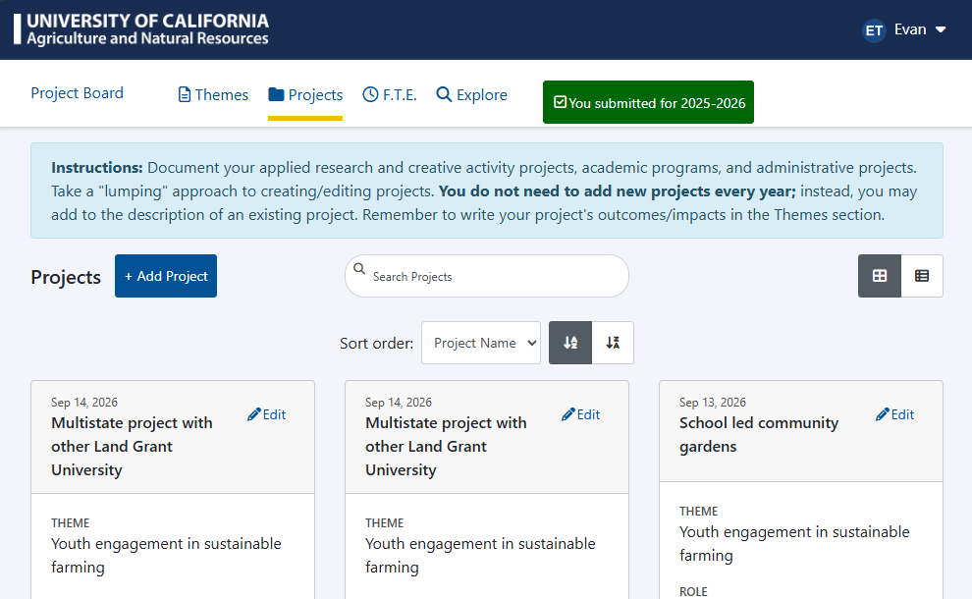
Projects (1 of 3)
High-level descriptions of research and extension work
Strategy: "Lump" similar activities into umbrella projects rather than creating a new entry for every single grant
Add Collaborators: Tag ANR colleagues, other UC campuses, and other Land Grant institutions including efforts with out-of-state institutions. For international collaborations, always include the country name
Notes:
Projects
High-level descriptions of research and extension work.
Strategy: "Lump" similar activities into umbrella projects rather than creating a new entry for every single grant.
Collaborators: Tag ANR colleagues, other UC campuses, and other Land Grant institutions. For international collaborations, always include the Country Name.

Slide 55
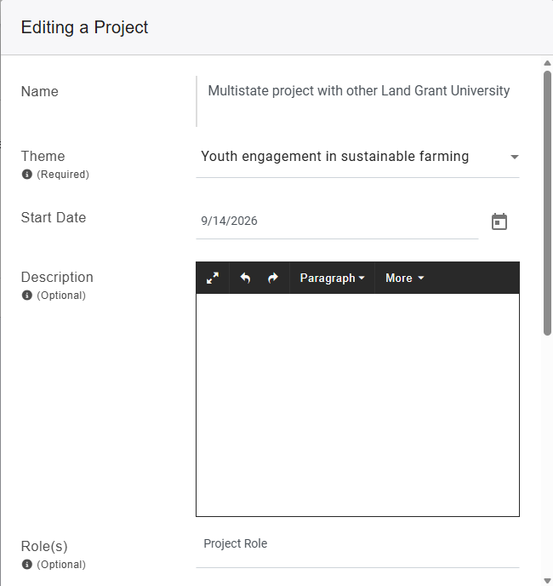
Projects (2 of 3)
Reporting projects help ANR plan and report qualifying multi-state and integrated activities
Be concise but descriptive: Projects will be searchable by others in ANR in the "Explore" feature of Project Board, which will hopefully facilitate collaboration and inform advocacy efforts.
Goals not outcomes: Add and update descriptions of projects to describe the goals and methods for each project. Do NOT report outcomes by project; report your outcomes in the themes narrative.

Slide 56
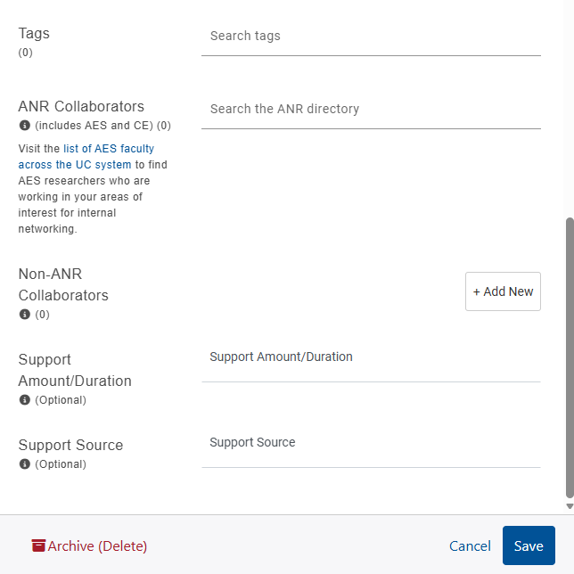
Projects (3 of 3)
When selecting tags, try to use an existing option from the drop down menu
ANR collaborators can be added using the ANR directory. Non-ANR collaborators need to be added manually including full name, institution, and country, if international.
Tip: If you have a long list of collaborators, consider only reporting your main contacts or project leaders. Prioritize reporting those with other UC, Land Grant Institutions, or international institutions.

Slide 57
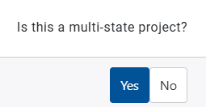
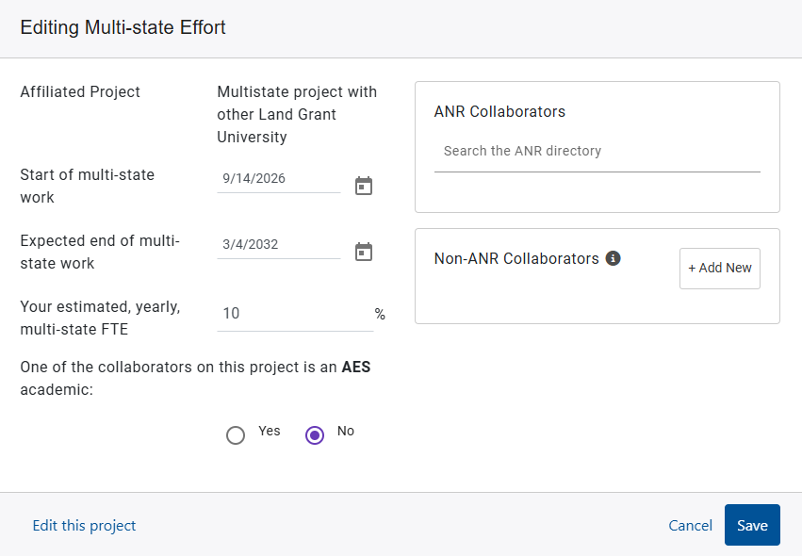
Planned Multistate FTE
When saving a new project for the first time, you will be asked if it is a multistate project.
Multi-state: Efforts that involve Cooperative Extension academics from two or more states or Agriculture Experiment Station academics from two or more states.
Integrated: Efforts that involve at least one Cooperative Extension academic and at least one Agriculture Experiment Station academic, regardless of state.

Slide 58
Planned Multistate FTE (2 of 2)
Always add the out-of-state collaborators.
Estimate end dates as far into the future as plausible. For example, for a career long collaboration you might put in your estimated retirement date.
Describe the multistate efforts in the project description.
Including out-of-state Land Grant collaborators and using prospective end dates that cover multiple fiscal years helps us use Federal funds intended for multistate projects.

Slide 59

Explore What's Happening in Cooperative Extension
All UC ANR employees and contingent workers have access to Project Board's Explore feature.
Project Board's Explore feature allows searching and querying to facilitate collaboration.
Explore help can be found at https://ucanr.edu/site/project-board-help/explore and is linked through the User Manual

Slide 60
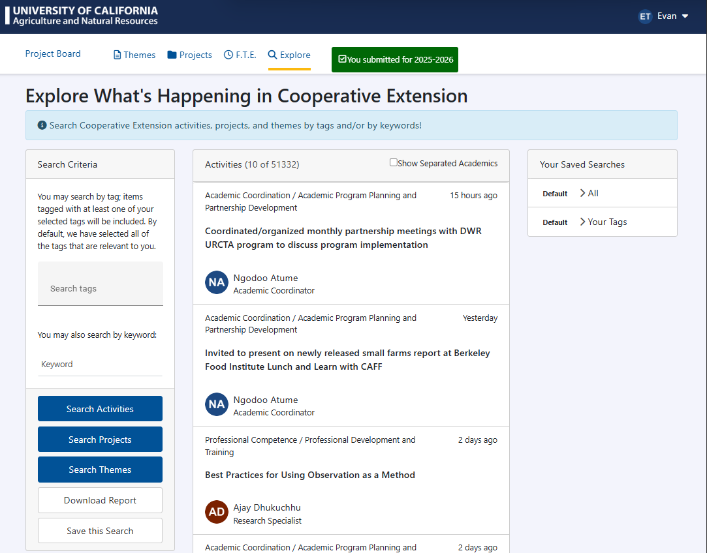
Explore What’s Happening in Cooperative Extension
Notes:
Within Explore you can search tags and keywords by activities, projects, and themes. To facilitate collaboration within UC ANR, Explore automatically removes separated Academics but you can see activities from separated academics by clicking on the box. You can also save searches for future reference or download reports and get access to the data in Excel format.

Slide 61
Project Board Improvements
1. Improved digital accessibility (e.g., color contrast, mobile/zoomed in views on web browsers)
2. Non-ANR collaborator reporting - in Projects, please use the fields (new last year):
Country name for international collaborations
UC dropdown list for non-ANR collaborators
Link to UC ANR Ag Experiment Station (AES) faculty so you can determine if an academic is AES or not
Notes:
Revisit with NRS guidelines

Slide 62
Reporting Checklist
https://ucanr.edu/sites/ProjectBoardHelp/User_Manual_-_Campus_MP/#checklist

Slide 63
CE/AES Split Appointments
Agriculture Experiment Station (AES) academics are required to report into NRS (typically one project) – Hatch $
CE Specialists are required to report into Project Board – Smith Lever + CA $
Reporting should reflect FTE split (example: 40% AES, 60% CE) only 40% of effort/activities/outcomes would be reported in NRS
  Tip: In NRS projects, never write more than AES FTE in the project FTE form. For a 0.25 AES FTE, that’s 1.25 over 5 years. That’s the ceiling; you can report less but not more. Benefit of reporting less is it gives you wiggle room to easily join other projects without having to go back and edit active project FTE.
  Tip: In Project Board, report 100% program FTE (PPE prorate to actual CE appointment). Try to report your CE effort, but if your work is very integrated, don’t worry about splitting hairs.
Notes:
Revisit with NRS guidelines

Slide 64
CE/AES Split Appointments (2 of 2)
Project names in Project Board and NRS can be the same. However, do NOT double report:
  Outcomes/impacts
  Publications (if you do duplicate, note in Project Board that they are also in NRS)
  FTE can be carefully assigned in both places.
Contact us for consultation
Note: Information (outputs/pubs) for competitive grants reported in REEport can be copy-pasted into Project Board. This is not duplication.

Slide 65

FAQs
What are some concrete examples of outcomes/impacts? See slides and UCANR Annual Report
How do I update my Project Board? Recap of reporting checklist:
◦Themes: write over. Focus on communicating new observed outcomes/impacts even if the method occurred in a previous period.
◦Projects: barely do anything, should be high level goals and description. Write over descriptions to update and add to a “lumped” projects.
Click SUBMIT (top right corner) when you are finished updating.
Notes:
If time: final poll “PB training – Outcomes”

Slide 66
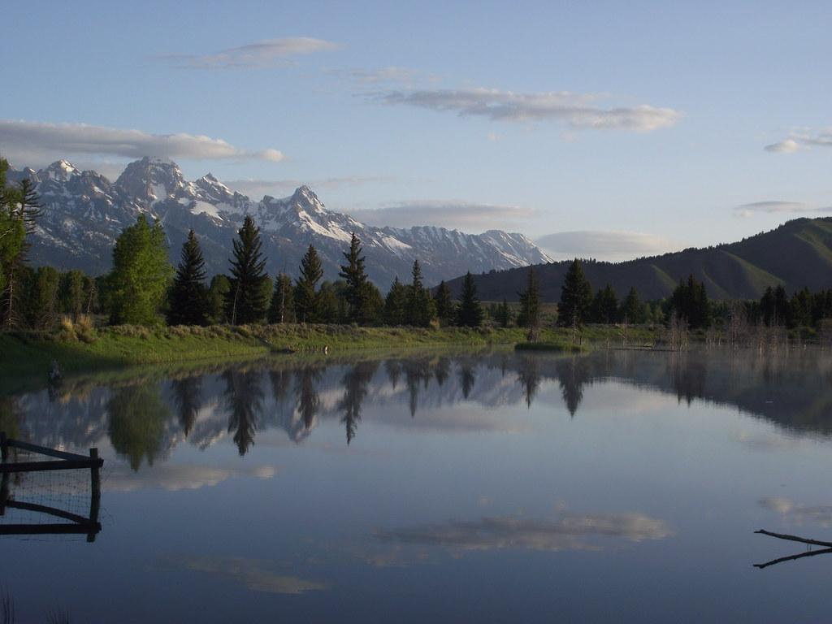
Reflection
Reflection
Answer anonymous survey*
Use the chat box to share your thoughts on today’s training and Project Board in general.
What went well?
What was challenging/can be improved?
Other comments/questions?
Notes:
*Paste link in chat https://ucanr.co1.qualtrics.com/jfe/form/SV_2a6sgxQ6XoS3f9Q

Slide 67
Contact Information
Help site: https://ucanr.edu/sites/ProjectBoardHelp/
General Project Board and Program Planning and Evaluation Questions
Evan Talmage – evan.talmage@ucop.edu
Chris Hanson - christopher.hanson@ucop.edu
Notes:
Mention Calendly for scheduling 30 minute technical assistance, especially for measuring outcomes and communicating your impact

Slide 68
Bibliography
BIBLIOGRAPHY
BetterEvaluation (2018). https://www.betterevaluation.org/
Davidson, J. E. (2013). Actionable evaluation. Getting succinct answers to the most important questions. Professional development workshop, American Evaluation Association Conference.
Evaluation Essentials Workshop materials of the Program Development and Evaluation Office. University of Wisconsin-Extension.
Kay Rockwell, S., Jha, L., & Krumbach, E. (2003). Success Outcome Markers in Extension (SOME): Evaluating the effects of transformational learning programs. Journal of Extension. 41(5). 5FEA4.

