Slide 1

Using Delphi Method for Needs Assessment
August 25, 2026
Vikram Koundinya, CE Evaluation Specialist & Professor of Extension
Katherine Webb-Martinez, Director UC ANR Program Planning & Evaluation
Guest Speakers
John Diaz, Associate Professor & Extension Specialist, University of Florida
Anil Kumar Chaudhary, Associate Professor, Pennsylvania State University

Slide 2
Agenda
Presenter Introductions, Overview, & Anticipated Outcomes
Delphi Method presentation
Guest Speakers – Diaz & Kumar Chaudhary
Break (10 min) - 11:00-11:10
UCCE Example – Van Soelen-Kim
Participant Reflections and Q/A
Additional Resources and Training Evaluation

Slide 3
Anticipated Learning Outcomes
Participants will gain understanding of:
The different steps involved in Delphi method.
How Delphi method is used in needs assessment.
How Delphi method can be adapted for different situations.
How Delphi method is being used in extension studies.
Notes:
#3: Julia
#4: John & Anil and literature shared

Slide 4
Introduction
Needs assessment is an essential step in the program planning, development and evaluation cycle (Warner & Harder, 2020; Etling & Thomas, 1995).
One of the first priorities for a new extension educator is to conduct a needs assessment to inform their programming (Caravella, 2006).
Driven by the question “What do clients need and how can those needs be met?” (Patton, 1982).
Extension professionals can use different qualitative and quantitative methods for needs assessment. Needs data can be collected from an expert panel also.
Notes:
Needs Assessment is the first step in the overall program planning process. It is an essential step in the program planning, development and evaluation cycle (Etling & Thomas, 1995).

Slide 5
Delphi Method
A group method for identifying and prioritizing needs.
Delphi method was established in 1953 to gain the perspectives of military officers regarding war planning decisions.
Delphi is credited to Norman Dalkey and Olaf Helmer and was pioneered by the US Department of Defense for making predictions about large-scale issues including war and population changes.
(Donaldson & Franck, 2016; Linstone & Turoff, 2002; Taylor-Powell, 2002)
Notes:
Dalkey and Helmer of the Rand Corporation

Slide 6
Delphi Method Contd.
Delphi Method is an “iterative process that involves repeated rounds of questionnaires to a selected group of respondents, considered to be experts in a given subject matter, until consensus is achieved”.
Responses to one round are summarized and developed into the next round questionnaire that seeks agreement or consensus.
(Taylor-Powell, 2002)

Slide 7
Delphi Method Contd.
Delphi has been used in Cooperative Extension for needs assessments, program planning, and evaluation.
This method allows different groups to identify their own key needs and issues without influence from other groups.
One of the main features - having multiple rounds of questions allows participants to consider and potentially revise or refine their original ideas based on the feedback of other participants.
The Delphi process allows a more focused and thoughtful response than the one-time cross-sectional answers of a focus group or survey.
(Donaldson & Franck, 2016; Linstone & Turoff, 2002; Lorenzo, Balance, & Henson, 2003; Taylor-Powell, 2002)

Slide 8
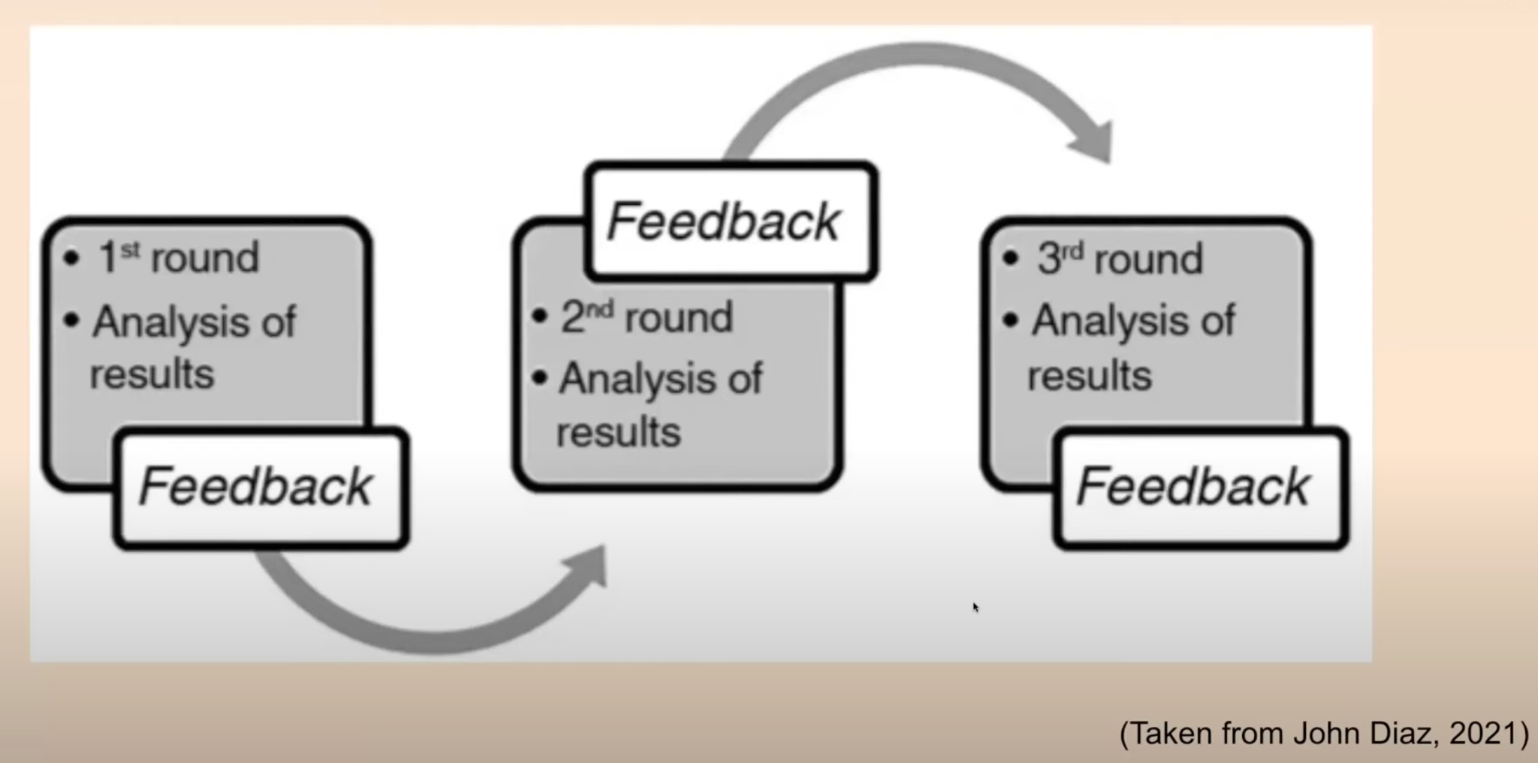
Steps in Delphi Method

Slide 9
Steps in Delphi Method Contd.
Form a team and monitor resources to implement Delphi.
Identify the expert panel. Define “expert”.
Contact Delphi panel and solicit participation. Be clear about the purpose.
Develop Round 1 Delphi questionnaire. (Usually open-ended).
Send the first questionnaire and collect returns. Track nonrespondents and follow up.
Analyze the first-round responses. Usually sorting qualitative data.
Administer Round 2 questionnaire. Panelists rate items. Quantitative data.
Analyze Round 2 responses. Develop consensus definition apriori.
Repeat Round 3. Consensus is usually achieved in three rounds.
Prepare report and share with participants.
(Adapted from Taylor-Powell, 2002)
Notes:
Round 1: pretest the questionnaire for ambiguities and vagueness.
Round 2: possible testing
Number of rounds range from 2 to 4

Slide 10
Example Round 1 Questions
What are the main issues farmers have in adopting regenerative agriculture practices in their farming?
What is the most important issue facing youth in your county?
What services do underserved residents in the county require to achieve food security?
What competencies do UC ANR County Extension Advisors need to successfully evaluate their programs?
What skills do students graduating from your high school need to be effective leaders in their community?
(Warner & Harder, 2020)
Notes:
In the context of a needs assessment, this open-ended question may ask what an audience must achieve to reach the desired state, or what criteria would define the desired state.

Slide 11
When to Use Delphi
Panelists are recognized as experts in the topic and have credibility with the broader audience whose needs are being assessed.
There are at least 13 people to serve on the panel.
There is enough time available for needs assessment. There will be at least 3 rounds of data collection and analysis.
Provide group interaction without having to meet face-to-face.
Avoid direct confrontation of people with opposing views.
(Taylor-Powell, 2002; Warner & Harder, 2020)
Notes:
The reliability of panel results is over 0.90 when 13 panelists complete the process.

Slide 12
Purposes for Which Delphi Can Be Used
Establishing program objectives
Planning for budget modifications
Identifying professional competencies
Supporting elements of curriculum development
Exploring perceptions on policy
Understanding personal motivations and values
Exploring potential future options
(Taken from Warner, 2014 and 2021)
Notes:
Surgical Education, Anesthesiology

Slide 13
Fields Where Delphi Method Has been Used
Cooperative Sector
Rural Development
Health Sciences
Agricultural Education and Communications
Private Industries
Nonprofits
Policy Space
Agriculture Systems
Public Health/Community Health
Notes:
Surgical Education, Anesthesiology

Slide 14
Benefits of Using Delphi Method
Ability to identify needs without influence from outside groups.
It is participant-driven.
Avoidance of travel and meeting costs.
Not limited by geographic area or time zone.
Technique driven by participants.
Participant anonymity and privacy.
Flexible format.
Avoidance of conflict among experts who may disagree.
(Taken from Warner & Harder, 2020)

Slide 15
Limitations Associated with Delphi Method
Participants need stronger reading and analytical skills, which may exclude some experts.
Need higher level of motivation to complete several rounds.
Is time-intensive.
May need other priority setting filters if consensus is not achieved.
(Warner & Harder, 2020)

Slide 16

1. Share an example of how you used Delphi for needs assessment.
2. What have you found to be the main advantages of using Delphi for needs assessment compared to other methods?
3. Did you face any challenges while using Delphi, and if so, what best practices would you advise to overcome them?
4. Any other important points to keep in mind for using Delphi Method
Guiding Questions
Delphi Guest Speakers
John Diaz
Anil Kumar Chaudhary
Notes:
KWM introduces
They share screen

Slide 17
Large Group Reflection
What do you think about this method for needs assessment?
Has anyone already used this method in their work or how might you use this method in your work?
General questions for the presenters and guest speakers
Notes:
KWM facilitates and Jen captures notes

Slide 18
References
Caravella, J. (2006). A needs assessment method for extension educators. Journal of Extension, 44(1), 1TOT2.
Diaz, J. (2021). The Delphi Technique: A tool for achieving consensus on needs. Guest lecture delivered to UC Davis IAD.
Donaldson, J. L., & Franck, K, L. (2016). Needs assessment guidebook for extension professionals. P. 35-36. https://eesd.tennessee.edu/wp-content/uploads/sites/242/2021/10/PB1839-1.pdf
Etling, A., & Thomas, M. (1995). Needs assessment for extension agents and other nonformal educators. Pennsylvania State Univ., University Park. Cooperative Extension Service. ED 388 774.
Patton, M. Q. (1982). Practical evaluation. Newbury Park, CA: Sage Publications.
Program Development and Evaluation, Collecting Group Data: Delphi Technique, Quick Tips #4, University of Wisconsin-Extension, Madison, WI. 2002. https://fyi.extension.wisc.edu/programdevelopment/files/2017/07/Tipsheet4.pdf
Warner, L., & Harder, A. Conducting the needs assessment #10: The Delphi Technique. 2021. UF|IFAS Extension. AEC701. https://edis.ifas.ufl.edu/publication/WC364
Warner, L. A. Using the Delphi Technique to achieve consensus: A tool for guiding extension programs. 2020. UF|IFAS Extension. AEC521. https://edis.ifas.ufl.edu/publication/WC183
Notes:
Vikram

Slide 19
Thank You
Questions

Slide 20
Steps in Delphi Method
Step 1. Ask for nominations for experts to serve on the panel.
Step 2. Invite nominees to participate in the process.
Step 3. Round 1: Traditionally an open-ended question on the topic of interest (e.g. What is the great issue facing X in your county?
Step 4. Round 2: Survey developed based on Round 1 responses. Participants asked to rank order using a rating scale.
Step 5. Round 3: Survey developed from Round 2 survey. Participants provided summary of ratings for Round 2 and then asked to revise ranking based on the group scores and to clarify reasons.
Step 6. Round 4: Final summary of rankings. Participants asked to review and revise rankings if needed.
(Taken from Donaldson & Franck, 2016)
Notes:
Step 1: Nominations should be solicited from key stakeholders or others who are knowledgeable in the area of interest. For example, in a study of 4-H professionals related to healthy living, state 4-H leaders were contacted by email and asked to nominate county 4-H professionals who had worked with this project.
Step 3. X could be farmers, agricultural producers, families, children, students, teachers, health care practitioners, etc. [Pretest the questionnaire]
Step 4. apriori consensus (2/3rd agree and strongly agree)

