Slide 1


F3 LOCAL FEASIBILITY STUDY
Market Analysis
Aggregation, Small-Scale Processing & Food Hub Infrastructure
Fresno • Kings • Madera • Merced • Tulare Counties
August 5, 2026
Prepared by New Venture Advisors, Feasibility Study supported by UC Agriculture & Natural Resources

Slide 2





TODAY'S SESSION
Agenda
The full market analysis was shared in advance; today we will summarize key points and discuss these findings. More conversations will take place to further refine and move the concept forward.
Context & Where We Are
15 min
Project scope, study region, and how this phase connects to what comes next
What We Found
30 min
Headline findings across the literature, data, mapping, and stakeholder research
Next Steps
10 min
Concept modeling and remainder of project
Open Discussion / Breakouts
35 min
Input to shape the questions concept modeling needs to answer
2

Slide 3
01
PART ONE
Context & Where We Are
Study objectives and focus, and how the findings connect to next steps
3

Slide 4
WHY THIS STUDY EXISTS
Agricultural Strength, Local Food Challenge
$25.38B
17.0%
21.6%
in regional agricultural sales in 2023 - 36.4% of California's total
average food insecurity rate across the five counties, vs. 13.7% statewide
child food insecurity rate- rising to 24.4% among Latino residents
The core finding: production alone doesn't explain food access challenges.
Produce grown in the Central Valley is often shipped outside the region for washing, cutting, and packing before returning to serve local schools and retailers. Small and mid-scale producers face real barriers to aggregation, cold storage, processing, and reliable distribution.
4

Slide 5



STUDY REGION
Five Counties
Fresno
Kings
Madera
Merced
Tulare
Population
1,012,152
Population
152,830
Population
158,790
Population
285,597
Population
475,774
Median Income
$71,434
Median Income
$68,750
Median Income
$75,496
Median Income
$65,044
Median Income
$90,157
2,085,143 residents regionwide - population up nearly 8% since 2010
majority Hispanic/Latino (60%)
median household income $22,000 below the California average ($74,176 vs. $96,334).
12,300+
7–12%
< 1%
farms across the five-county region
decline in farm counts, every county, 2017–2022
of farms produce value-added products
5

Slide 6




STUDY PURPOSE
What This Feasibility Study Is Designed to Answer
Commissioned by UC Agriculture & Natural Resources as part of the F3 Local initiative, this study is assessing the viability of food infrastructure models across the region - not proposing a single predetermined solution.
Function & Scale
Site(s)
Infrastructure Types
Audiences
What combination of facility types and scales would best serve the region's needs?
Which communities have the highest potential for successful implementation, based on existing infrastructure, market access, and stakeholder interest?
Which infrastructure types - processing, shared kitchens, mobile units, aggregation, food halls, etc - best fit documented needs?
Which producers, entrepreneurs, buyers and/or communities stand to benefit most, and what would it take to serve them well?
Today's session covers the market analysis (Part 1) that grounds these questions in evidence —
concept modeling (Part 2) is where we work to develop answers or solutions.
6

Slide 7




METHODOLOGY
Market Analysis Tools
Each tool offers valuable insight on its own - the clearest picture of regional opportunities and challenges emerges where they intersect.
Literature Review
Secondary Research & Landscape Analysis
Mapping
Primary Research
20+ studies, regional plans, and precedents aligning findings with existing food-system and economic-development initiatives.
The quantitative picture - demographics, agriculture, food access, spending, and existing infrastructure.
The spatial picture - where assets exist, where they don't, and where production and people are most disconnected.
The qualitative picture - what farmers, buyers, and organizations said directly, through interviews, focus groups, and partner surveys.
7

Slide 8
PROJECT TIMELINE
Where Today's Findings Fit in the Overall Study
F3 Food Economy Summit
Primary Research & Mapping
Modeling
Oct 2025
Winter – Spring 2026
Now – December 2026
Landscape & Secondary Research
WE ARE HERE
Final Recommendations
Market Analysis Report
Fall 2025 – Spring 2026
Complete — July 2026
December 2026
Part 1 (this report) is complete.
Part 2 — concept modeling — runs now through December 2026 and is where scale, siting, governance, and financial questions get resolved.
8
Notes:
Internal team notes (not for stakeholder view):
- Consider whether this timeline needs more detail, or could be combined with the previous slide.
- Decide whether to flag that the timeline has been extended 6 months for additional outreach.

Slide 9
02
PART TWO
What We Found
A multi-method research effort drawing on four complementary sources of evidence.
9

Slide 10

RESEARCH BREADTH
A Comprehensive Look at the Region
20+
38
2
studies & regional plans reviewed
stakeholder interviews across 6 categories
in-person workshops and activities
4
3-4
5
GIS maps + regionwide ecosystem mapping
complementary partner research streams
Counties represented
10

Slide 11
LITERATURE REVIEW
The Research Nationally Points the Same Direction
The “missing middle” of the supply chain - cold storage, processing, commercial kitchens, aggregation - is the consistent gap named across 15+ food system plans nationally.
CASE STUDIES CITED
Veggielution Food Hub Feasibility Study
Santa Clara County — recommended a phased regional network over one centralized facility
Networked, hub-and-spoke models are more commonly documented as successful than single centralized facilities in comparable regions.
New England Food Hub Network
Shared logistics & cross-docking achieved economies of scale without full centralization
Long-term success depends on trusted relationships and inclusive governance as much as on physical assets, not capital investment alone.
Butte County Baseline Food Assessment
A strong ag economy exporting ~98% of its food while 14–19% of residents face insecurity
11

Slide 12
SECONDARY RESEARCH
Big Agricultural Economy, Small Share Reaching Local Markets
45%
of ag sales come from fruit & nut production ($11.37B)
~50%
of all farms operate on 1-49 acres - too small to invest independently in infrastructure
3%
of farms sell direct-to-consumer; just 119 farms (< 1%) produce value-added goods
Source: USDA 2022 Census of Agriculture; CDFA County Crop Reports, 2022–2024
12

Slide 13
SECONDARY RESEARCH
Demand Exists
Consumer Spending (avg. household / year)
$6,401
spent on food at home
$3,591
spent on food away from home
$1,413
on meat, poultry, fish & eggs - the single largest category
Source: Feeding America Map the Meal Gap, 2023; County Health Rankings, 2024; Esri Consumer Spending, 2024
13

Slide 14



SECONDARY RESEARCH
Capacity Is Uneven
15
8
11
239
certified farmers markets
existing food hubs
shared kitchens & kitchen incubators
food manufacturing establishments
(+343 non-employer micro-enterprises)
SIZE is a critical lever in supporting capacity, growth and opportunity.
Despite a high volume of “food manufacturing” being represented in the region – a large majority are reported to be beyond the reach of existing producers and small food businesses for needed functions (processing, cut/wash/pack, co-pack).
New opportunity will have to be evaluated with SIZE as a main factor (both for producer scale and production scale).
Source: NVA research compilation; CDFA Certified Farmers Market Directory; SAREP Food Hub Directory; U.S. Census Bureau / NAICS
14

Slide 15
MAPPING
Support Organization Density Varies by County
Local organizations mapped across six support categories, shown by raw count and adjusted for population—accounting for the wide range in county sizes (Fresno's population is roughly 6–7x that of Kings or Madera).
County | Population | Local Orgs (non-statewide) | Per 100K Residents
Fresno | 1,012,152 | 22 | 2.17
Tulare | 475,774 | 8 | 1.68
Merced | 285,597 | 3 | 1.05 (lowest)
Kings | 152,830 | 9 | 5.89 (highest)
Madera | 158,790 | 5 | 3.15
Thirteen statewide organizations provide nominal coverage in every county.
Fresno's larger population accounts for much of its lead in raw local organization counts, but on a per-capita basis, Kings has the highest density of local organizations in the region, and Merced has the lowest.
15

Slide 16
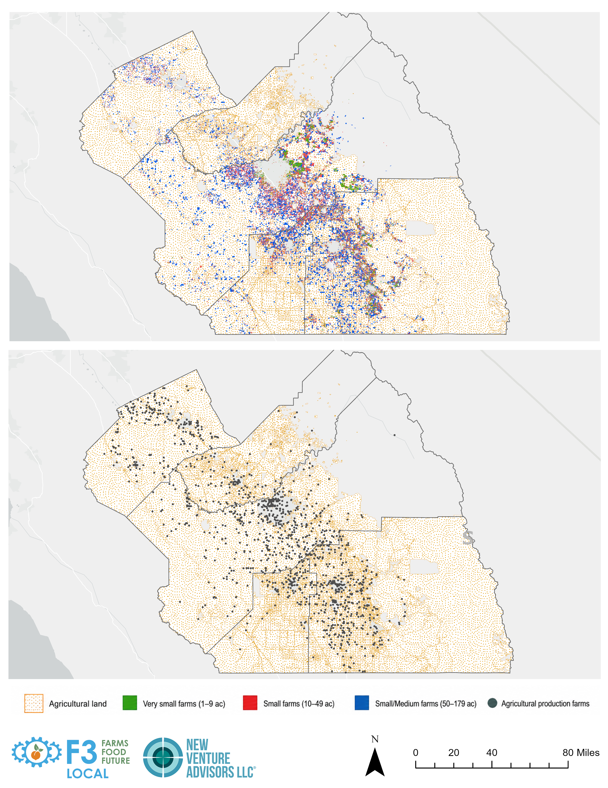
MAPPING
Where Production
& Infrastructure
Are Misaligned
Agricultural Logistics
In preliminary mapping, at least 5 distinct corridors showed significant agricultural production with limited processing and logistics connectivity.
The most acute: a corridor running north and south of Mendota, in western Fresno and Merced counties.
Updated production mapping (RIGHT) shows SMALL scale farms and production capacity is being refined for the next round of site/corridor discussions.
16

Slide 17


PRIMARY RESEARCH
Stakeholder Distribution
Agricultural & farm businesses
Buyers & distributors
Community & food access orgs
Food businesses & entrepreneurs
Government partners
Resource & program support orgs
38 interviews across five counties and statewide partners, spanning six stakeholder categories — including interviews conducted in Spanish with translation support.
A concrete illustration: Fresno Unified School District
$29M annual food budget, with $5.4M (≈19%) already directed to locally produced food. Yet stakeholders reported local producers often can't meet institutional requirements — not because of limited production, but limited access to facilities for washing, processing, packaging, and preparing to spec. Produce sometimes travels to South San Francisco or Los Angeles for processing before returning to the Valley for distribution.
17

Slide 18


PRIMARY RESEARCH
One Theme Rose to the Top, Consistently
Cold storage
The infrastructure gap most frequently cited across interviews, field visits, and focus groups alike — named more often than any other single need.
Post-harvest processing
Regulatory navigation
Relationships & trust
Washing, packing & light processing — described as interconnected with cold storage, not separate
Permitting & administrative complexity, especially for new and small food businesses
Market coordination, buyer relationships, and trusted intermediaries — as important as physical assets
INFRASTRUCTURE OPPORTUNITY
SERVICE/PROGRAM NEED
SERVICE/PROGRAM NEED
18

Slide 19
PRIMARY RESEARCH
On the Ground: Field Visits + Interviews
7
$300K
$3,000
150
on-site farm, kitchen & food-service visits
est. cost to build a private 2,000 sq. ft. cold storage facility
per month in electricity — one producer's cost to run existing cold storage
registered users at the shared commercial kitchen the site team visited; it is operating near capacity, self-sustaining through user fees
A concrete opportunity: Fresno Economic Opportunity Center's plans for an adjacent processing facility
FEOC, a multi-program community impact nonprofit operating a production kitchen and a refrigerated delivery fleet, is exploring the development of adjacent property into a processing facility for small- and medium-scale producers — one of several existing organizations positioned to expand regional capacity.
Source: NVA field research — on-site visits to 7 locations and a food entrepreneur focus group, Fresno County, 2026
19

Slide 20
PRIMARY RESEARCH
Three Partner Sources
Triangulated findings
Three independent partner research efforts — different methods, different stakeholder groups — converge on the same core infrastructure gaps this study identified directly.
BIPOC Food Hub Study
TA Needs Assessment
RFSI Mapping Survey
Among 13 interviewed farmers, 62% identified cold storage as an unmet need and 85% reported losses from unsold product.
Business development — 37%
Existing cold storage, kitchens & processing assets typically serve one organization at a time, not a connected network.
Regulatory assistance — 36%
Infrastructure & equipment — 31%
Marketing & market access — 25%
Grants & funding assistance — 23%
*A 4th study – focused on consumer access to produce and grocery (and consumer preferences) also conducted in the region is finalizing and will be integrated into study findings at a later date (early fall 2026).
20

Slide 21
CROSS-SOURCE SYNTHESIS
A Fragmented System
“The San Joaquin Valley is not starting from a blank slate.” -Interviewee
Commercial kitchens, food hubs, farms, processors, and food recovery organizations already exist throughout the region — but largely operate independently rather than as an integrated network.
Interconnected, context-specific needs
Accessibility vs. efficiency trade-off
Compatibility & relationships across infrastructure
Cold storage, processing, aggregation & distribution reinforce one another — no single facility meets the full range of regional demand.
Producers want facilities within ~25–30 miles; larger shared infrastructure benefits from economies of scale. Both matter.
Market coordination, multilingual communication, and trusted intermediaries determine whether physical assets get used at all.
21

Slide 22
OVERALL CONCLUSIONS
Five Conclusions Ground the Next Phase
1
Infrastructure needs emerged AND are interconnected
Cold storage, post-harvest processing, aggregation, refrigerated transport, and appropriately scaled value-added processing — limitations in one affect the viability of the others.
2
A connected regional network is a strong opportunity model
The region's scale and diversity suggest a single facility likely can't serve everyone. Some functions favor regional scale; others favor distributed, community-level access.
3
Geographic context should inform infrastructure planning
Kings County and portions of Madera, Tulare, and western Fresno/Merced show comparatively fewer assets, need and opportunity aren't evenly distributed.
4
Capacity requires relationships as much as infrastructure.
Buildings and equipment solutions alone are insufficient. The relationships behind them, supporting market coordination, buyer development, regulatory navigation, and business support, determine whether they get used.
5
Concept modeling should connect opportunity AND capacity
This market analysis documents needs — how to best support needed function, adjust to scale, fine tune siting, and address governance and financing are the next steps ahead.
22

Slide 23
03
PART THREE
Next Steps
What concept modeling will help resolve between now and December 2026.
23

Slide 24
CONCEPT MODELING — PART 2
Documented Needs to Testable Concepts
Concept modeling takes what this market analysis heard and observed and translates it into concrete infrastructure options for the region.
1
2
3
4
Model the system, not just one site
Refine the mapping
Evaluate opportunity corridors
Resolve governance & financing
Explore function and scale and how the relationships between existing organizations and facilities (existing or in progress) will impact the overall ”system”
A small-farm-filtered agricultural map can now be combined/matched to refined infrastructure
and can highlight what is in progress and where need still exists
Transportation access, zoning, utilities, wastewater capacity, and proximity to supply & demand
Ownership structure, operating model, and realistic financial resources to support BOTH function and scale
24

Slide 25

CONCEPT MODELING — PART 2
The Questions Concept Modeling Will Address
Function & Audience — which infrastructure and services should be prioritized, and who will they best serve?
Scale & Configuration — which functions work regionally vs. locally, and how can they best connect or interact?
Existing Assets & Partnerships — which sites or entities could serve as partners, pilots, or growth opportunities?
Siting & Accessibility — which locations (corridors) offer the right mix of access, zoning, and support functionality?
Ownership & Governance — how does this structure to support the intended users and services?
Financial Feasibility & Resources — what capital and operating costs are needed, and who supports those?
Funding & Capital Sources — what is the existing funding landscape and how does it support this growth/opportunity?
25

Slide 26


CONCEPT MODELING — PART 2
How to Stay Involved Between Now and Finalization
Today's discussion
Targeted follow-up
Your breakout input directly shapes the priorities and concepts that will focus the next round of work
What conversations do we need to allow space for as the concept/model moves forward? (support next steps)
Advisory Committee touchpoints
Michelle DiMuzio michelle@newventureadvisors.net
Upcoming reviews will be scheduled to shape concept and model, before recommendations are finalized
Primary point of contact for questions, data requests, or partnership conversations between sessions
26

Slide 27
OPEN DISCUSSION
Breakout Prompts
We will now break into small groups to discuss the following — we will share (post call) key takeaways to the full group.
QUESTION 1 — FUNCTIONS, USERS & SCALE
Which infrastructure functions — cold storage, processing, aggregation, commercial kitchens — feel most urgent for the users (audience) you represent? Are there top priorities?
QUESTION 2 — EXISTING ASSETS & PARTNERSHIPS
Are there existing facilities, organizations, or sites in your area that could serve as partners, pilot locations, or growth opportunities— rather than starting from scratch?
QUESTION 3 — GOVERNANCE, FINANCING & IMPLEMENTATION
What management or resource model would you trust to run/support shared infrastructure long-term, and what support (multilingual, technical assistance, logistics) would make it most usable for the people you serve?
27

Slide 28
Thank You
The full market analysis report and today's slides are available for reference.
Questions or follow-up? Contact michelle@newventureadvisors.net
New Venture Advisors • F3 Local Initiative • UC Agriculture & Natural Resources
28

Slide 29
04
APPENDIX
Reference Tables: Primary Research Detail
Supplementary detail for those who want to go deeper on what different groups said and how the research streams compare.
29

Slide 30
APPENDIX
What We Heard, By Group
Stakeholder Group | Top Priorities / Needs Cited | Notable Pattern or Distinguishing Note
Agricultural & Farm Businesses | Cold storage; post-harvest wash/pack; barriers entering institutional & wholesale markets (food safety certs, volume, format) | Strong preference for facilities within 25–30 miles; many rely on informal, self-built solutions rather than shared infrastructure
Buyers & Distributors (institutional & for-profit) | Reliable volume, food safety certification, consistent delivery, product format/spec compliance | Genuine local-procurement interest (Fresno Unified directs ~19% of its $29M food budget locally) but blocked by processing/prep capacity, not producer interest
Community & Food Access Organizations | Freezer/cold storage capacity for donated protein; distribution logistics; closing population-vs-retail-access gaps | Emphasize operational capacity (staffing, logistics) as much as physical space — infrastructure alone doesn't close access gaps
Food Businesses & Entrepreneurs | Capital/financing (ranked #1 in focus group); sales channels & buyer connections; shared processing space; packing; transportation | Existing shared kitchens seen as valuable but underused — awareness and a preference for home-based production limit uptake
Government Partners | Streamlined permitting/zoning support; siting guidance; economic-development framing for investment | Noted the region lacks dedicated staff to help producers navigate permitting — unlike some Northern California counties
Resource & Program Support Organizations | Multilingual technical assistance; regulatory navigation help; business development support | Flagged uneven capacity across counties (Kings & Madera comparatively sparse) and disruption from the end of LFPA funding
30

Slide 31
APPENDIX
Primary Research Sources Compared
Research Stream | Scope & Method | Where It Aligns With Others | Where It Diverges / Adds Tension
NVA Stakeholder Interviews | 38 interviews, 6 stakeholder categories, regionwide + statewide partners | Cold storage, post-harvest processing & aggregation are the top-cited gaps — consistent with every other source | Only source capturing government-partner and community/food-access perspectives directly
NVA Field Visits & Focus Group | 7 on-site visits + entrepreneur focus group (~20 participants), concentrated in Fresno County | Same infrastructure gaps confirmed with concrete costs ($300K to build cold storage, $3K/mo to operate) | Focus group ranked capital/financing above infrastructure as the #1 barrier — a nuance interviews alone didn't surface as sharply
BIPOC Food Hub Study (partner) | 13 farmer interviews from a 200+ grower network; English/Spanish/Hmong | Cold storage again the top need (62% unmet); reinforces reliance on a trusted intermediary for multilingual/market support | Sharpest quantified losses in the data — 85% reported losses from unsold product; SJV has less mid-supply-chain infrastructure than the Bay Area
TA Needs Assessment (partner) | 87 respondents, 4 languages, weighted toward Tulare & Fresno counties | Regulatory/permitting complexity confirmed as a widely shared barrier | The only source ranking business development (37%) and regulatory assistance (36%) above physical infrastructure (31%)
RFSI Infrastructure Mapping Survey (partner) | 7 regional respondents; ongoing survey, not statistically representative | Confirms "not a blank slate" — cold storage, kitchens & processing assets already exist across organizations | Existing infrastructure typically serves one organization at a time —evidence that coordination, not new construction, is a gap
31

