Slide 1
A long time ago, in a forest far far away…
Notes:
When I was first starting out in forestry, before I got into the academic side of forestry, I worked as a field forester. And like most field foresters, I started out marking trees to cut for a timber harvest. And one of the first trees I had to make a decision about- whether to cut it or leave it, was this tree here in this picture. It is an incense cedar which still stands today, so you can see what decision I made. At the time of the decision, the standard protocol was telling me to cut this tree. This was in a shaded fuelbreak and the crown of this tree was connected to another tree and it had a low height to crown base and also it was one of the more valuable trees for timber because it’s an incense cedar. The reason I didn’t mark it was because when I took the long view- when I looked as far down the road as far as I could, it made more sense to leave it when I considered the other less-traditional factors. It has a lot of leaf area, it was one of the bigger incense cedars in the local area, and it seemed to meet these other non-traditional objectives a little better- things like wildlife habitat, water yield, resilience to climatic stress. And so I decided to leave it. And I’m proud of leaving it, but I still wonder how this spot would look if I had cut it. Maybe I’d be telling a story about how it was better to cut this tree and therefore provide more growing space to the one behind it. So as I got into research, I found that I could solve this conundrum that Robert Frost was talking about. We don’t always have to choose one road or the other. And in fact we can experience both roads through the magic of field experiments. Now when I face this decision, I don’t chose one road or the other. I create multiple roads and travel them all and see where they all lead. That’s what I’ve done in the past and it’s what I’d like to do in the future. I want to offer landowners and policy makers and stakeholders a view of the different roads that they can take and what the consequences of taking each road are.

Slide 2
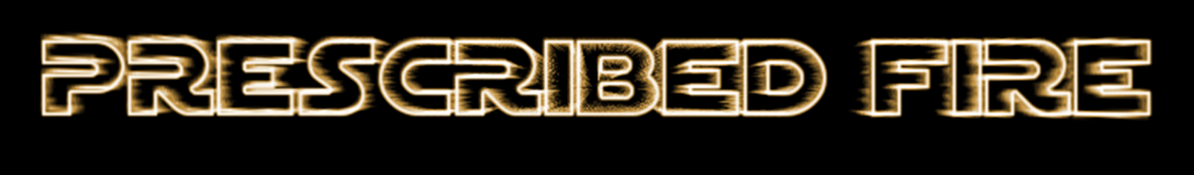
Using
To manage forest ecosystems

Slide 3
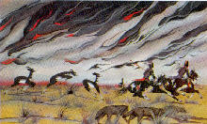
Native Americans Burned for Specific Objectives
Evidence
  Footnotes of early explorers
  Interviews of elders for their traditions
  Fire scar studies

Slide 4
Composite Fire History of Blodgett Forest
Median fire return interval 4-5 years
1905: End of fire as an ecosystem process
79% latewood fires, 21% dormant
Stephens and Collins 2004

Slide 5

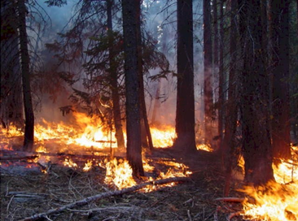
How was fire an ecosystem process?
Nutrient cycling
Wildlife habitat variability
Plant species diversity = stability
“Stocking” was kept WAY below carrying capacity
60 v. 250 ft2/acre
All species are adapted to fire
Yoda and fire- bringing balance to the force and ecosystem, respectively

Slide 6
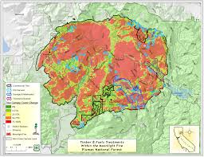

Fire is still an ecosystem process
It’s function is different
Often high severity
Conversion: forest to shrubland
  (Forests going to the dark side)

Slide 7
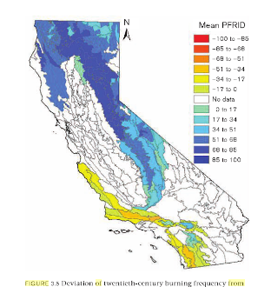
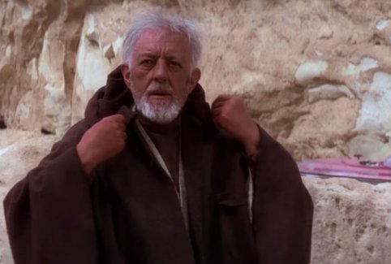
Fire as it once was is essentially gone from the ecosystem
Good fire and Obi Wan
-Both in hiding
Keeley and Safford 2016

Slide 8
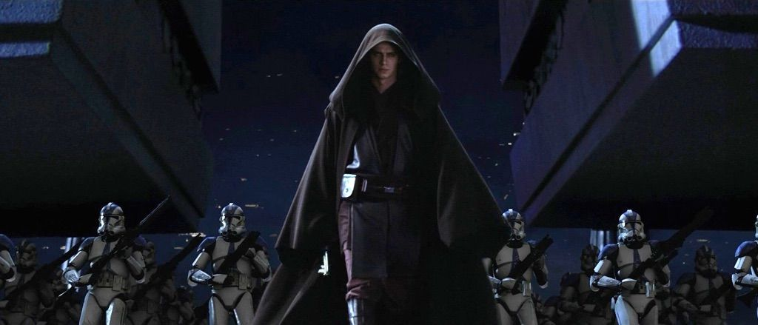
Fire Suppression ~ Order 66
98-99 percent of all wildland fires out at less than 5 acres in size
95% of area burned today is from 1-2% of the fires that escape initial attack
1.1 million acres of forests per year once burned in CA
  10-25% of this area burns today, much at high severity

Slide 9
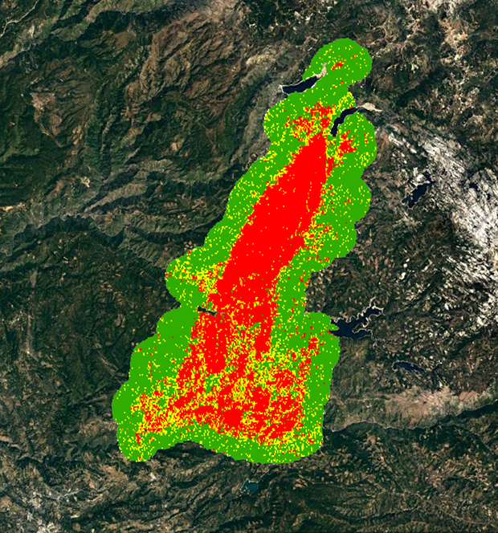
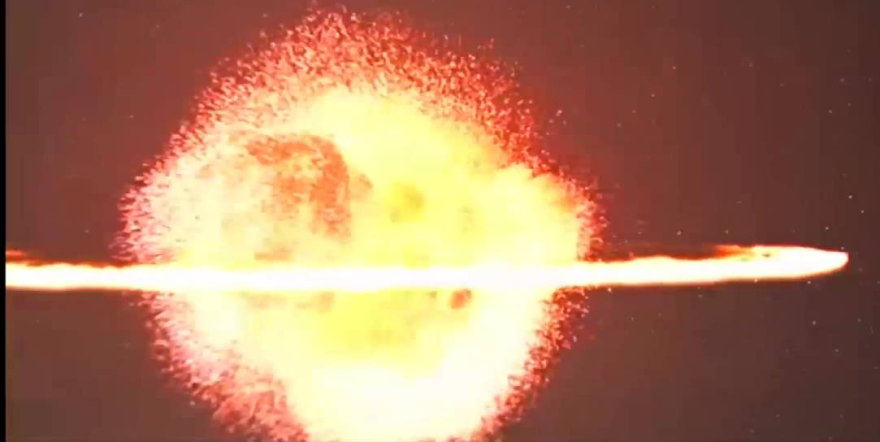
Fire Supplosion
Not yet in the dictionary (not even the Urban Dictionary):
  “When a fire occurs and burns with high intensity, as a result of past fire suppression”
  “The King Fire killed all trees across a 50,000
  acre patch. Wow, that’s crazy fire supplosion!”
Death star and Fire supplosion doing some damage

Slide 10
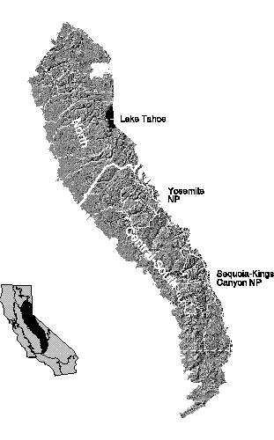
Avoiding Fire Supplosion in the Sierra Nevada mixed conifer forest
North boundary = Feather River
South Boundary = Tehachapi Pass
15.6 million acres
  50% federal
  31% private nonindustrial
  19% private industrial

Slide 11
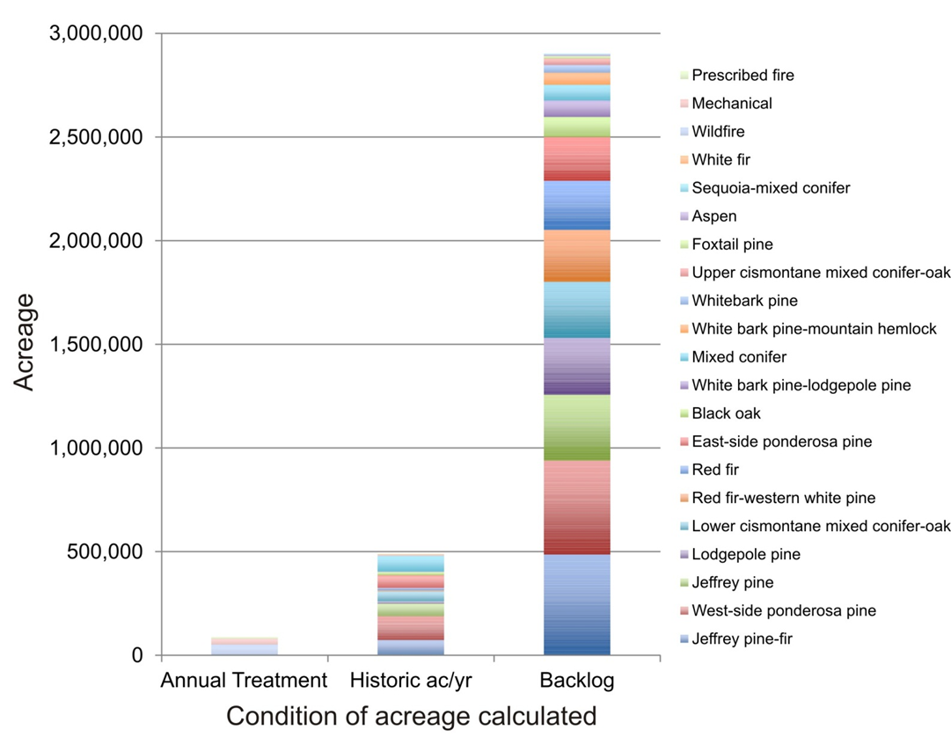
USFS lands: There is a will, but currently not a way
Backlog on USFS lands
North et al. 2014

Slide 12
State Forests
State lands 0.1%
- Not enough
But research and demonstration may be key
Flatwoods
Latour
Mt. Home

Slide 13
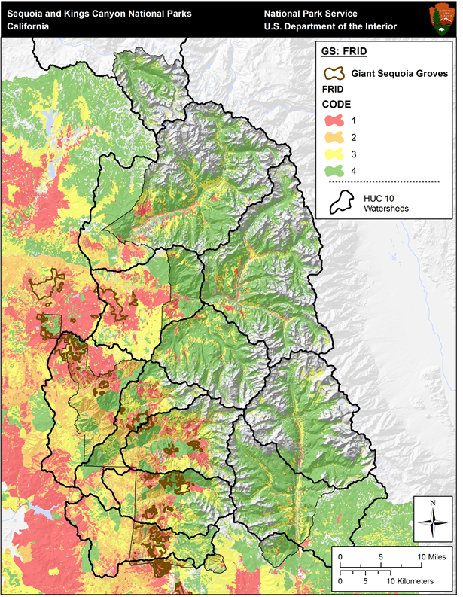
National parks
Closest, but still way off
York et al. 2014

Slide 14
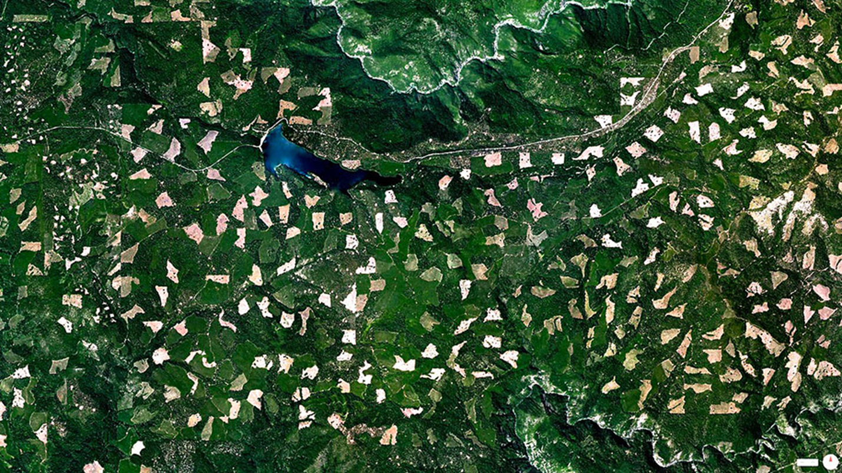
Industrial lands
Mostly don’t want fires

Slide 15
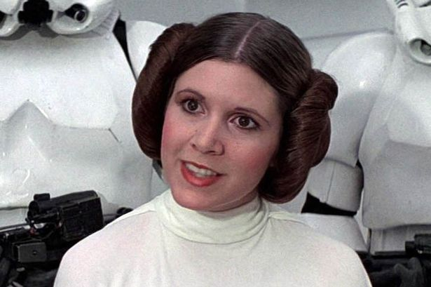
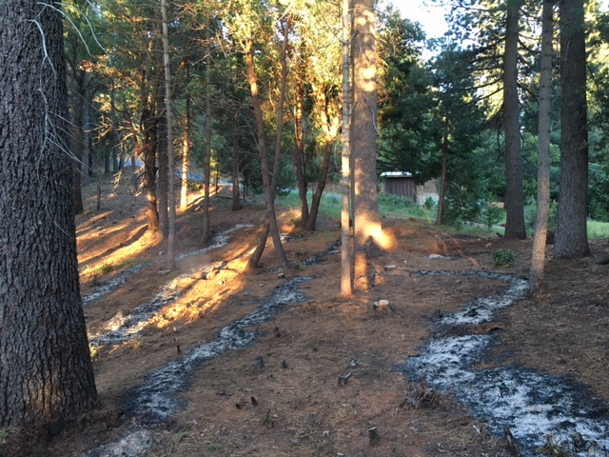
Private non-industrial – the New Hope?
Conservation easements / trusts
University and state lands
Private parcels

Slide 16
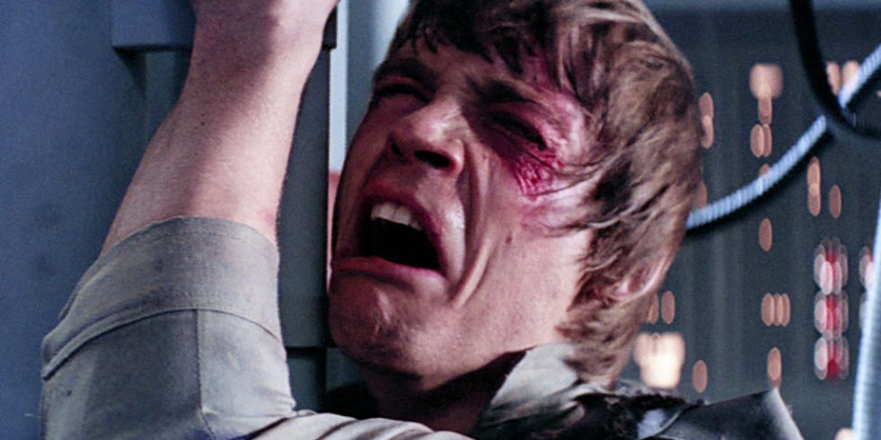
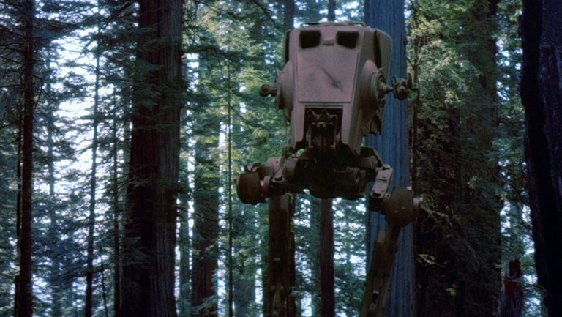
All Hope is Lost?
Suspension of burn permits
Air quality restrictions
Risk of liability

Slide 17
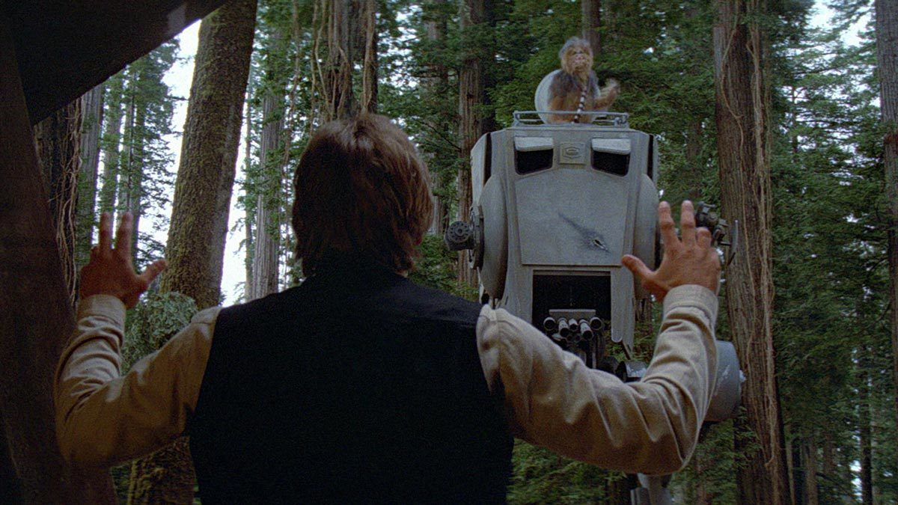
Some hope that’s been around
Winter Burning
Smoke management
Limited Liability
Risk can be reduced
  1% of fires escape

Slide 18
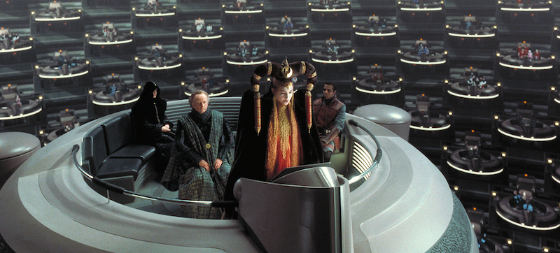
New Hopes from the Galactic Senate
Funding to conduct fuel treatments
Landowner partnerships
Cal Fire goals for rx burns

Slide 19
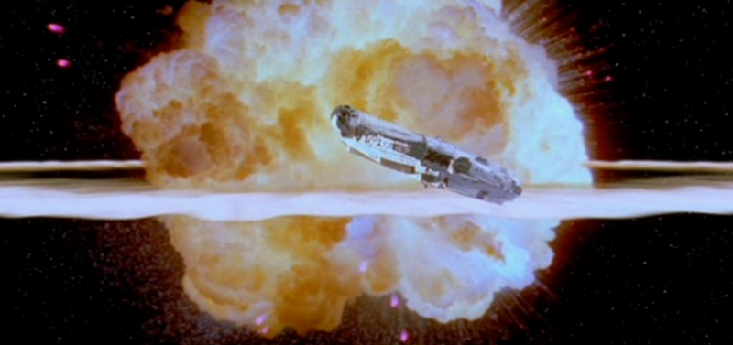
‘Death star blowing up’ moment not here yet
Laying the ground work

Slide 20

Can’t currently do true ecosystem management with fire
Can do Pyro-silviculture in stands
Pyrosilviculture
The integration of fire ecology, history, and use into decisions about forest manipulation
If you are not ready to use fire, try using it as a guide
Mimic the disturbance regime
Severity
Seasonality
Frequency
Quality

Slide 21
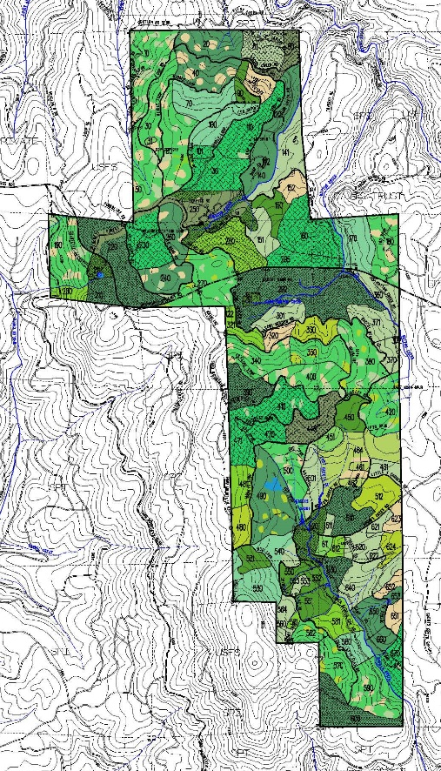
An example from Blodgett Forest’s expansion of Rx fire use
Blodgett Forest:
Private land (UC Board of Regents)
2,900 acres
Productive mixed conifer (60” precip/yr)
4000 ft elevation
Point FRI: 12 yr median, 40 yr max

Slide 22
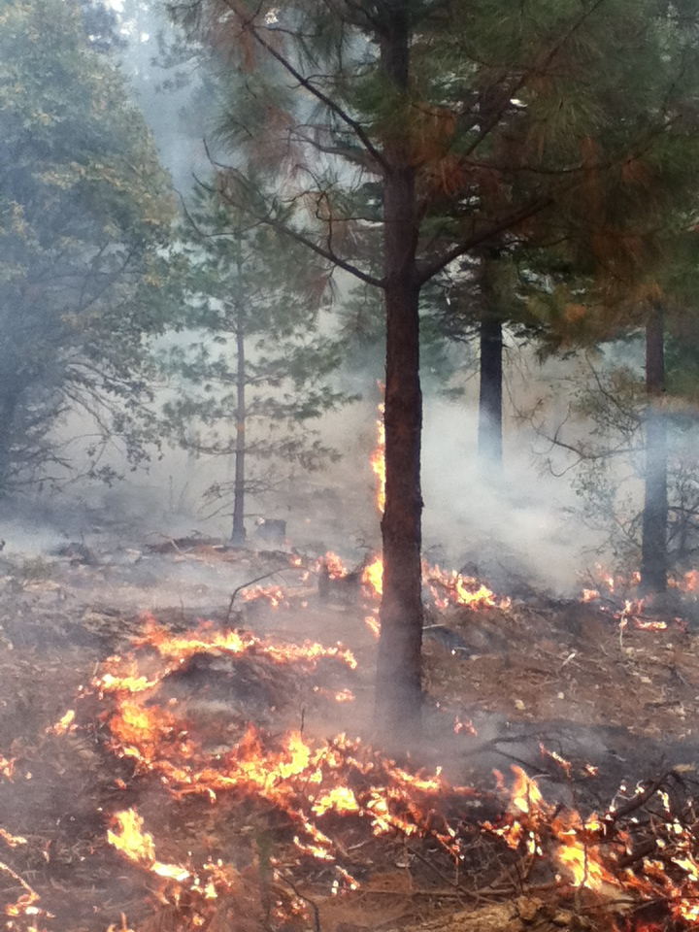
Why expand use of fire at Blodgett?
Research
Resilience
Protect timber
Protect habitat diversity
Protect infrastructure
To be a good neighbor
Demonstration/Education
Experimental young stand burning

Slide 23
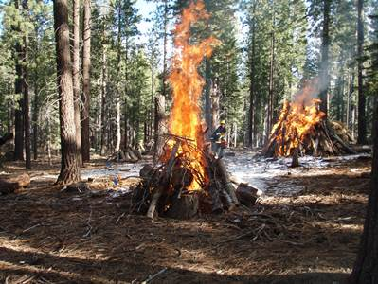
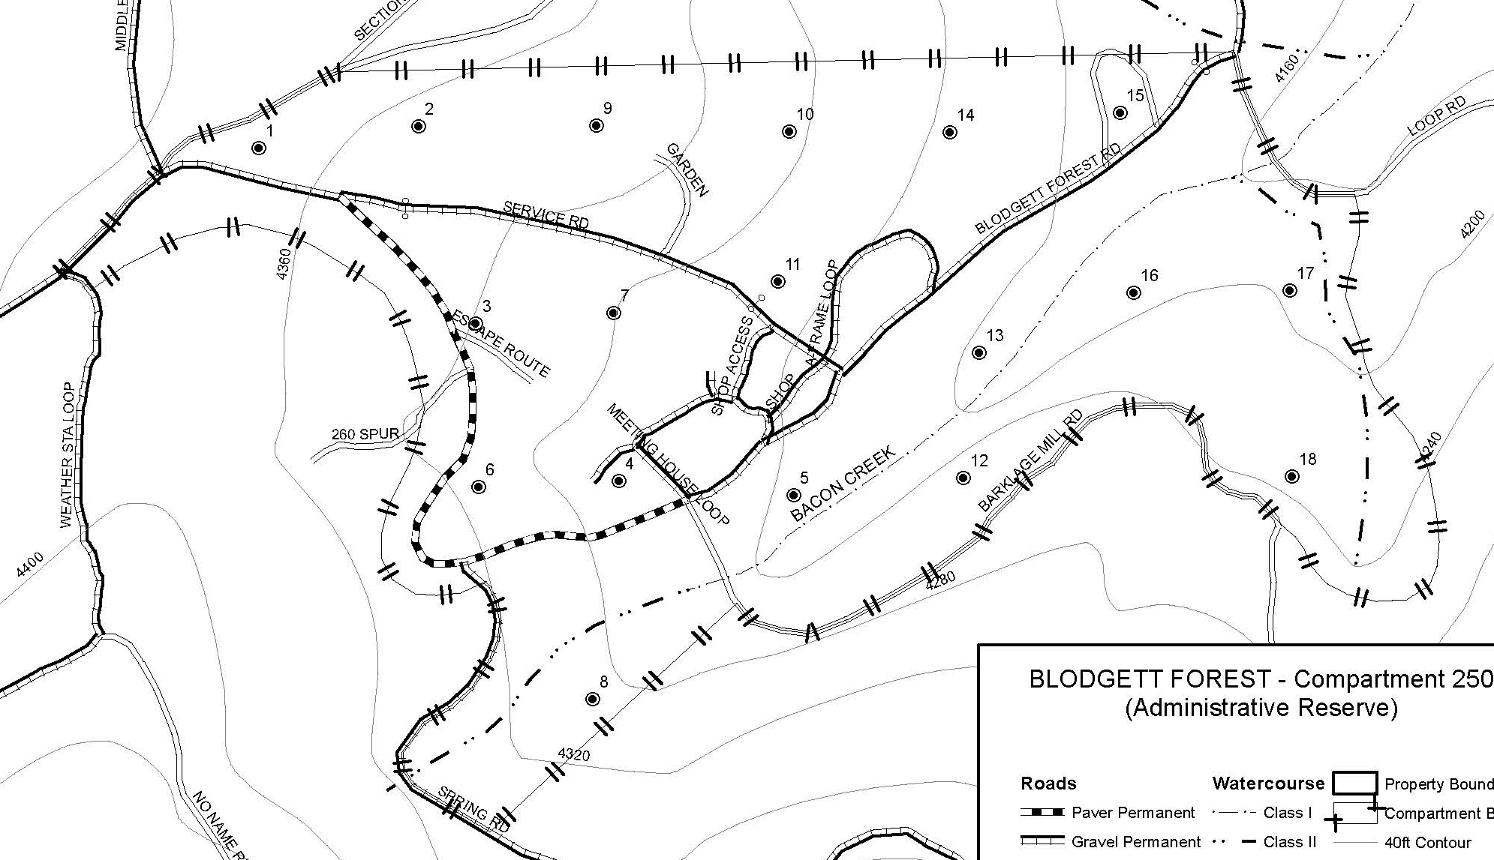
Risk Reduction – how we’ve done it
From pile burning to small broadcast burns
From small broadcast burns to small and medium burns
  0.10 acres to 40 acres (still do small burns)
From park-like structures with little fuel to dense structures with heavier fuel
Started with fire suppression equipment:
  Quick attack
  Water tender
  Hose
Added:
  Brush rig, UTV pumper
  Fol-da-tanks and pumps (2)
60 acres
Burn ~6 acres/yr

Slide 24
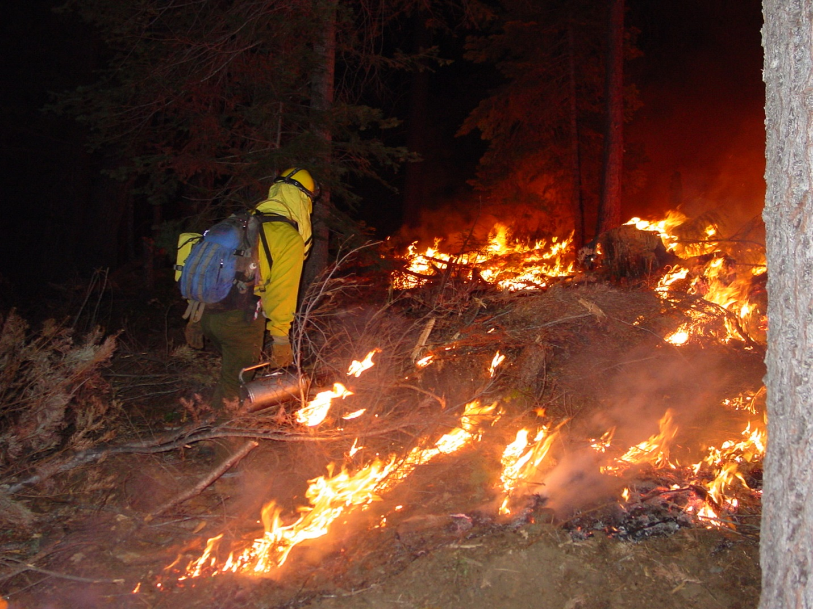
When?
Fall with permit (USFS or Cal Fire)
Fire and Fire Surrogate burns
With and w/o Cal Fire help
Night and day

Slide 25
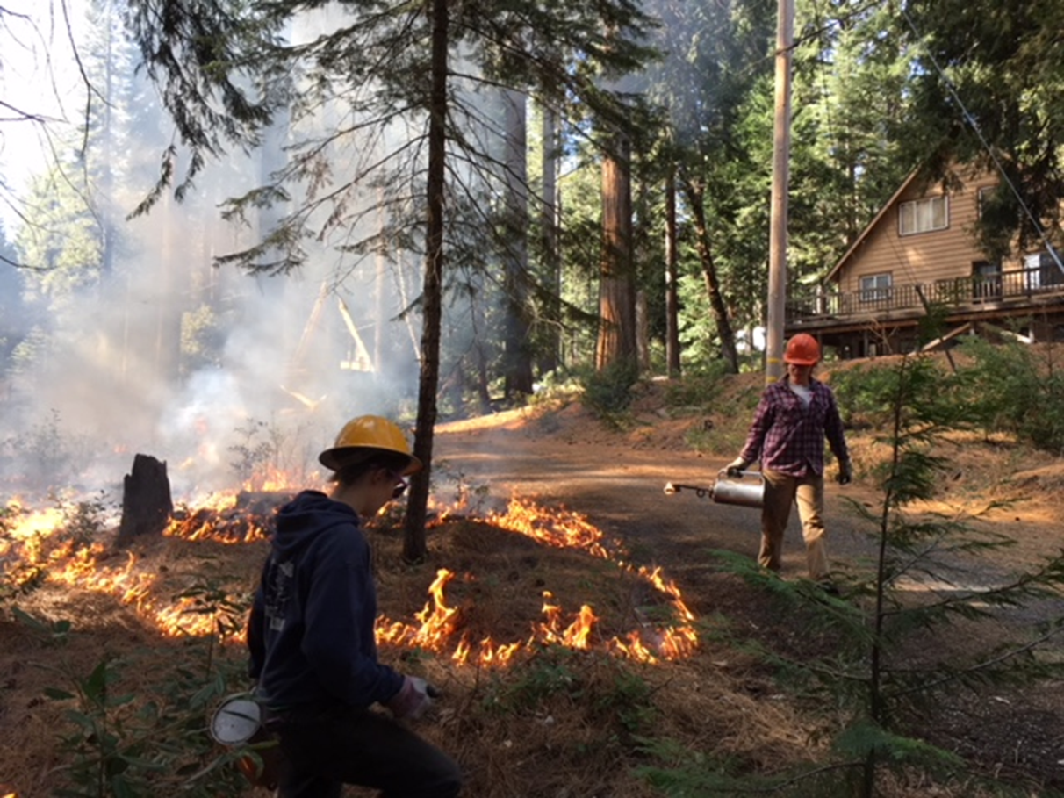
When?
Winter (Jan – April), without permit; must be NIMBLE
With Blodgett staff (1-4)
Feasible where canopy cover was low (50%)
Feasible where fuel bed was dry: masticated fuel, pine needle beds
Feasible where plants were flammable: Bear clover, bracken fern
Feb 9, 2018
4,000’ elevation

Slide 26
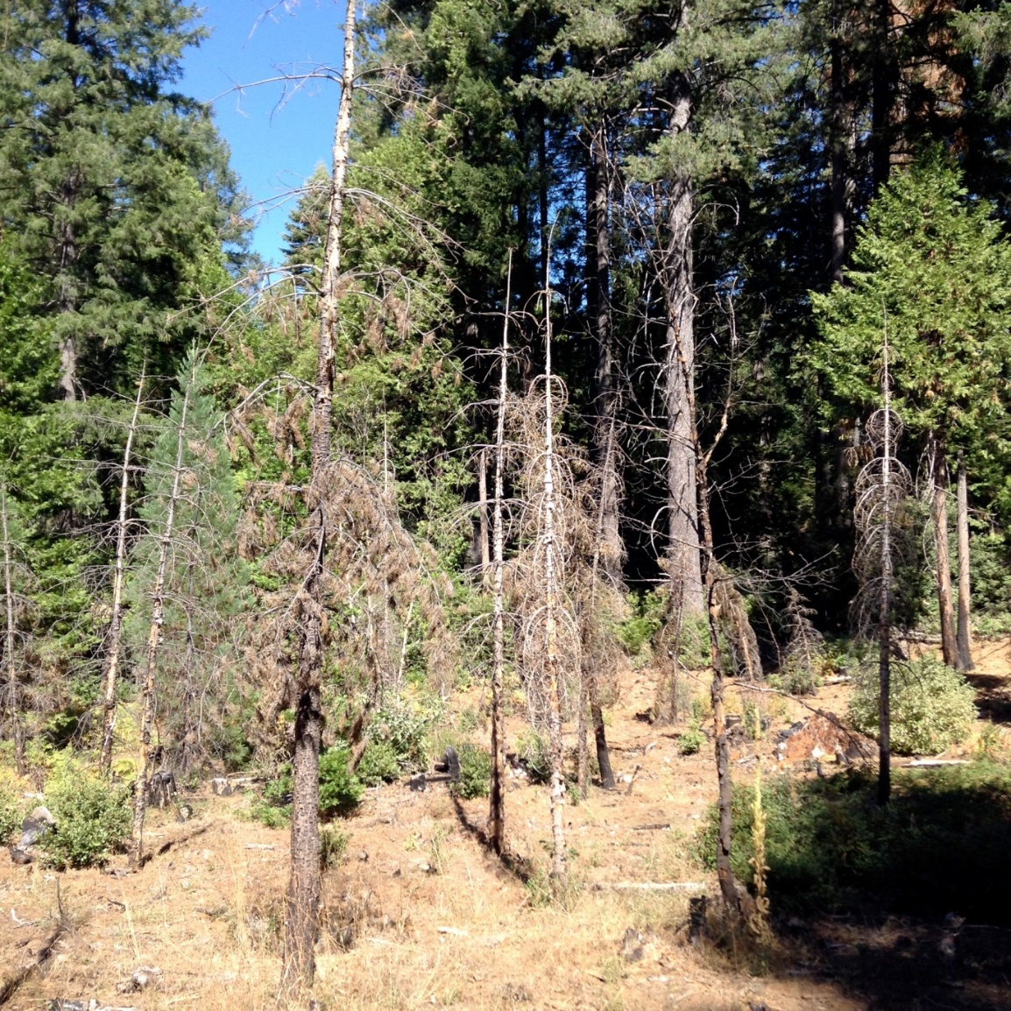
When?
Spring, with/without permit (~April-June)
Have shied away b/c not synchronous with natural regime
E.g. ground nesting song birds
Young stand undesired effects
“Fire is a blunt tool”

Slide 27
Where?
Has evolved from strategic placement (fuelbreaks) to stand-wide
1 to 30 acres at a time
Area regulation:
Treatable acres (A) = 2000
Rotation (R) = 13 yrs (the FRI)
Per yr target Ai = A/R = 154 acres/yr

Slide 28
Has it worked?
Getting there…
Fire was necessary, but not sufficient
Chainsaws were necessary, but not sufficient

Slide 29
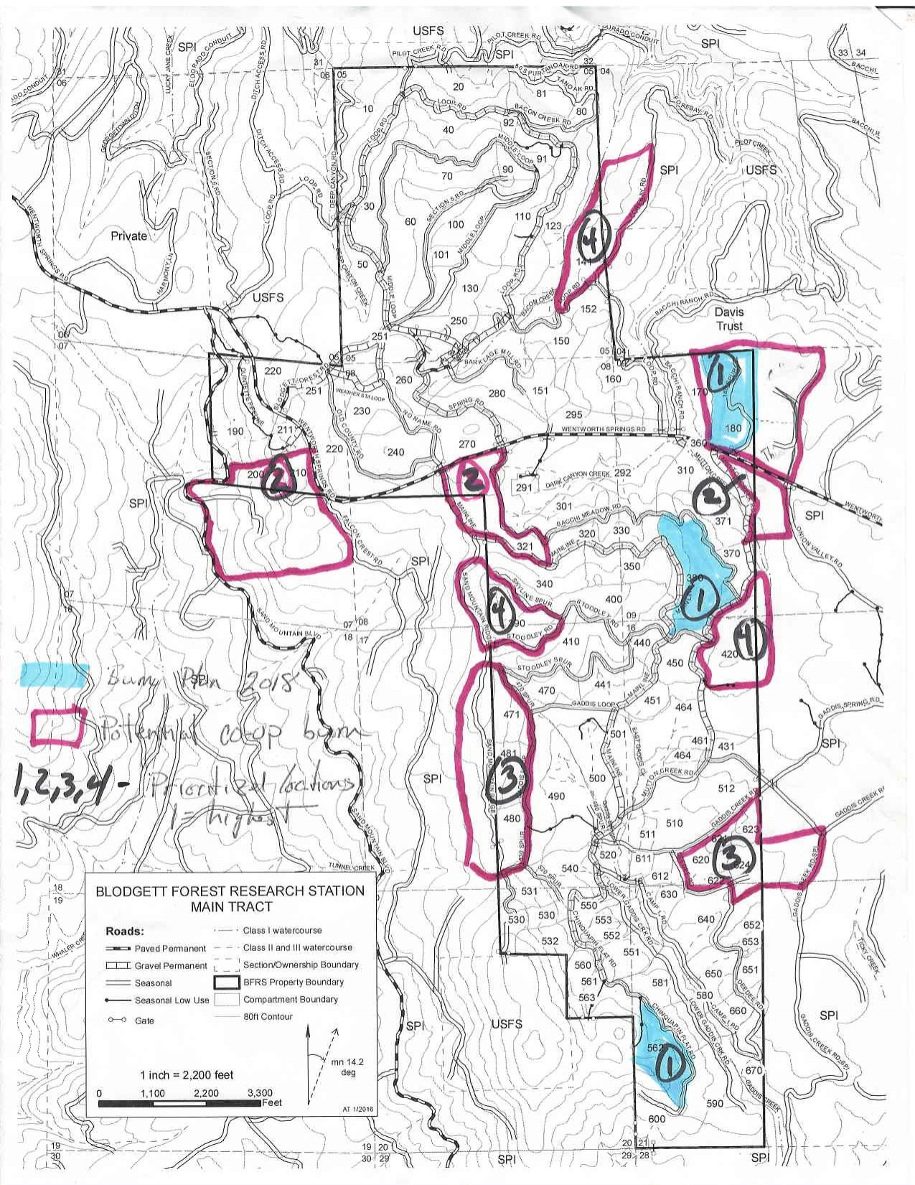
The future:
Build upon foundation with more burning, plus:
Co-op with neighbor (SPI)
Maintenance burns

Slide 30
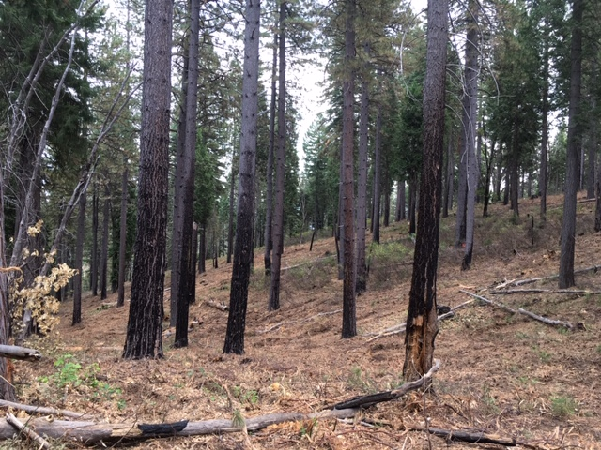
What we will burn at Blodgett
Environmental Prescription:
Mid-flame wind: 1.5-3mph
Temp: 38-85
10-hr Fuel Moisture: 5 – 14%
RH: 20-70%
Resources:
Cal Fire?
3000 gal water tender
Hose lay
Brush rig
Taco wagon
Objectives:
Support research
Consume surface fuel
Learn!

Slide 31
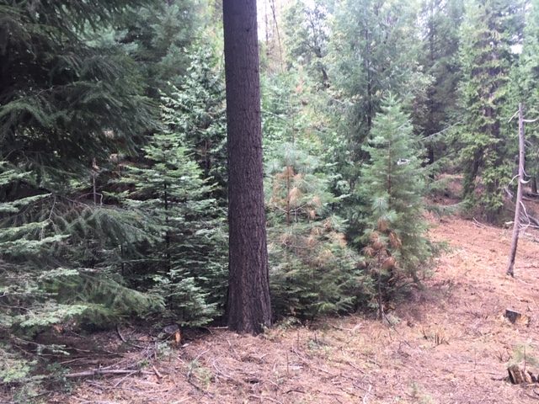
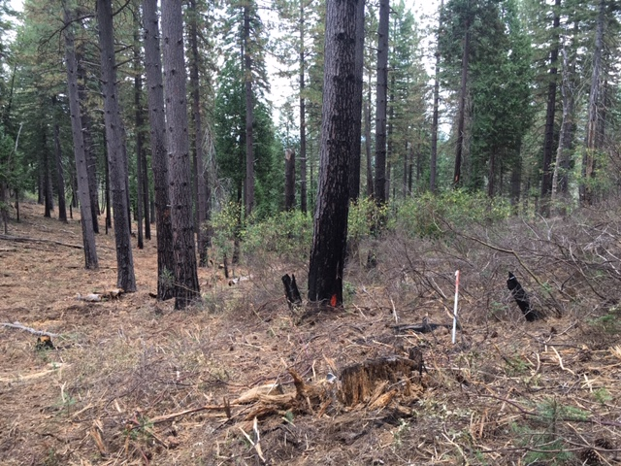
Some interesting features of burn
Nested young tree patches, aged 2 to 30 years old
Nested shrub patches

Slide 32
What I will burn on my 10 acres
3000 ft elevation, south aspect
Probably “chunk and skunk”
Windrows of litter
Corner of two roads
~ 2 acres
After fire season (no permit)
Neighbors notified
My kids’ help patrol
Containment = McLoed and Indian Pump

Slide 33
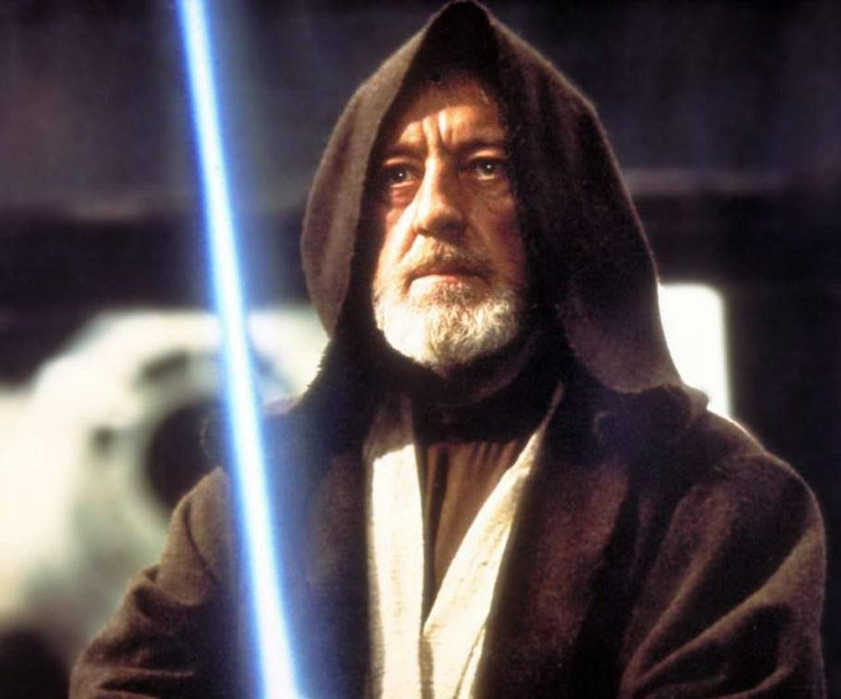
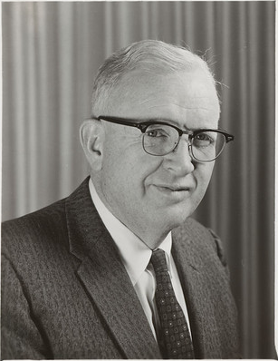
Obi Wan
Harold Biswell
=
“The truths we cling to depend greatly on our point of view”
                - Obi Wan
“Fire in the Sierra Nevada is as important as rain”
- Harold Biswell

