Slide 1
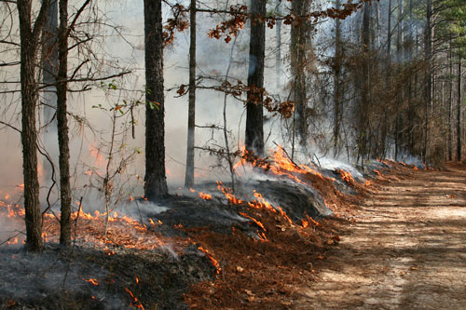
Prescribed Burning: Smoke Management Regulations
Doug Carson
Air Pollution Control Specialist II
Calaveras County Air Pollution Control District

Slide 2
Air Pollution Regulatory Framework
Federal – U.S. Environmental Protection Agency
  Clean Air Act (1970 with amendments in 1990)
State – California Air Resources Board
  California Clean Air Act – 1988
Local – Air Pollution Control & Air Quality Management Districts
  Local Rules and Regulations
  Stationary sources of air pollution
Notes:
Federal Clean Air Act
National Ambient Air Quality Standards
Planning requirements for attaining air quality standards
Interstate commerce
California Clean Air Act and Health & Safety Code
More restrictive ambient standards
Planning
Rulemaking
Enforcement
Public Outreach
Agricultural Sources
Portable Equipment
Air Toxic Sources
Incentive Programs such as Carl Moyer
Mobile Sources and Fuels (some District crossover)
Stationary Sources (some District crossover)
Next slide is a transition into air quality standards.

Slide 3
Major Ozone
Precursors Sources
Notes:
We have both Man-made and Natural Sources of air pollution
Some Natural include Geo-genic, as in from soil/rocks
Bio-genic is from plants. As an aside liquid amber trees and many oaks have high biogenic emissions
We have both federal and state standards for air pollutants
Ozone or more commonly called smog is created by two chemicals, mixed with high temperatures.

Slide 4
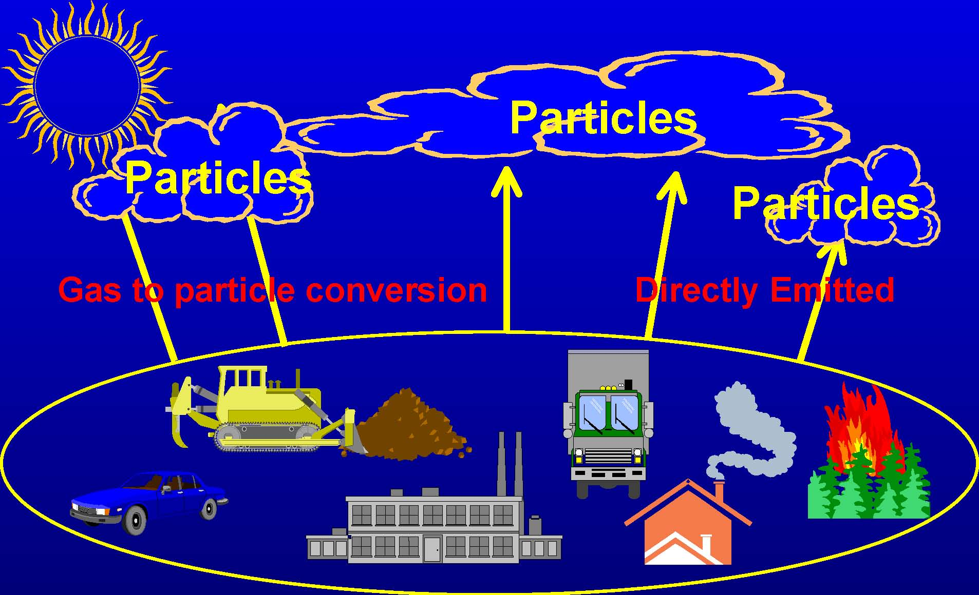
major pm sources
Notes:
We have state and federal standards for particulate matter.

Slide 5
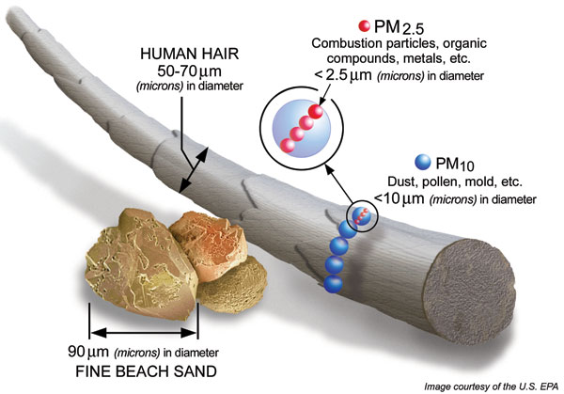
particle size
Notes:
PM 10 and PM 2.5

Slide 6
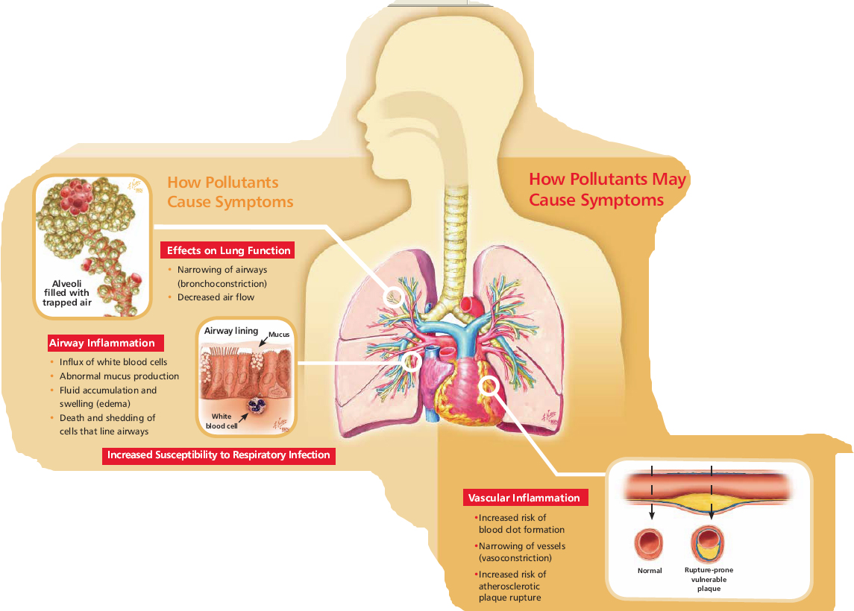
How pollutants affect our health
Notes:
Health Affects such as:
Airway Inflamation
Effects on Lung Function
Increased Susecptability to Respitroy Infection
Vascular Inflamation
Take home is very small PM2.5 particles can get into one’s lungs and then more than likely don’t come out.

Slide 7
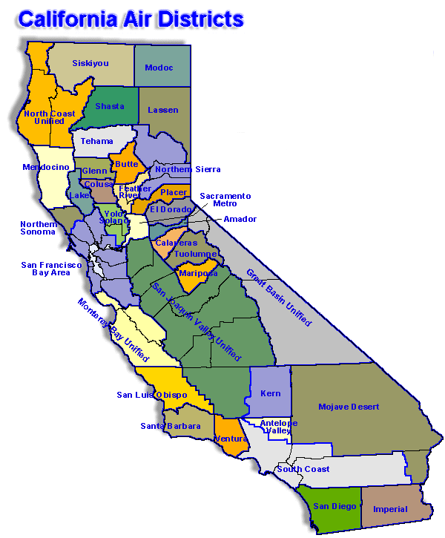
California Air districts
35 Air Districts
Calaveras County
Notes:
35 - Air Pollution Control Districts (APCDs) and Air Quality Management Districts (AQMDs)
Board of Directors/Board of Supervisors
Operating revenues can come from any combination of the following:
Fees
Designated funds from the US EPA (fyi, that’s subvention)
state DMV
local mitigation funds and
per capita assessment

Slide 8
Air District Programs
Permitting and Inspections
CEQA and Land Use Mitigation
Air Quality Planning
Incentive Programs
Public Information
Smoke Management Program
Notes:
Stationary sources, portable equipment, and complaints
Environmental review and commenting for land use projects; dust control plans
Air Quality Management Plans, State Implementation Plans, Rule Development, air monitoring, and emission inventories
General education and outreach, media relations, advisories and press releases
Agriculture burning, backyard burning & prescribed fire

Slide 9
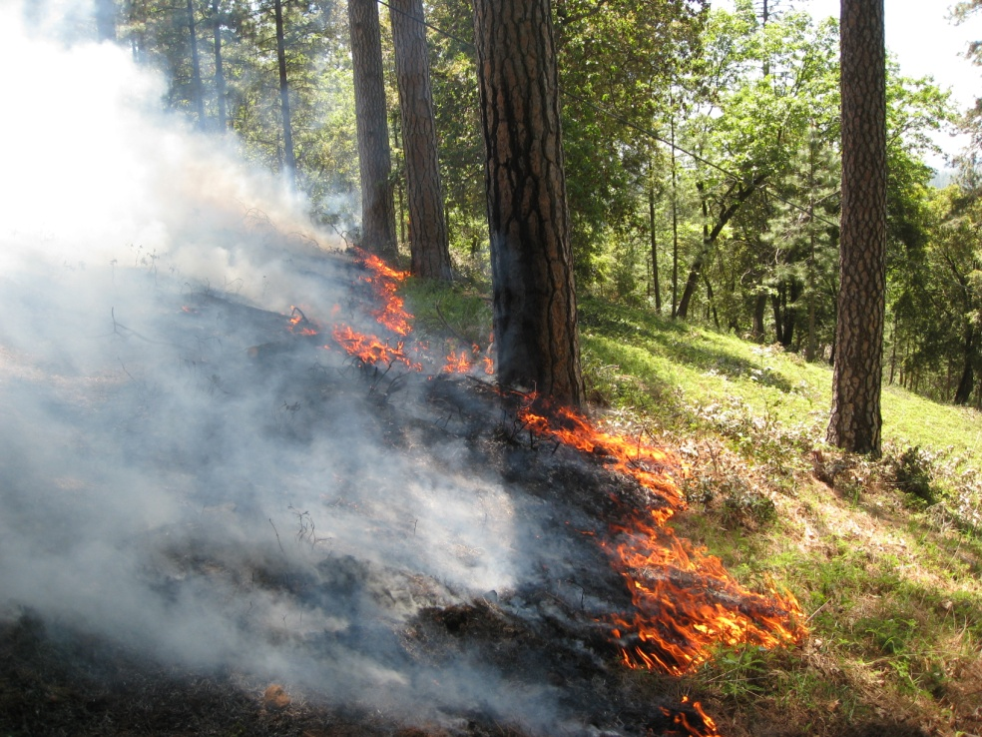
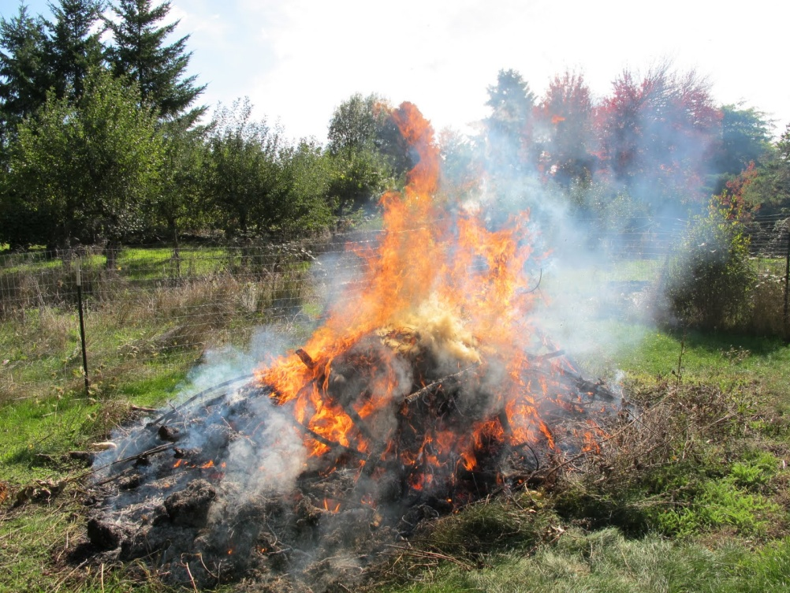
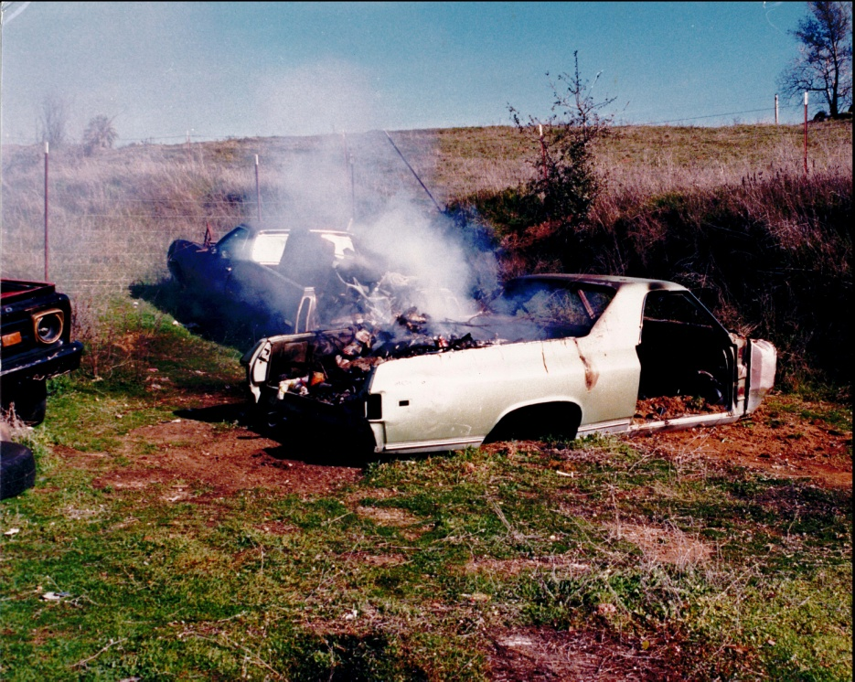
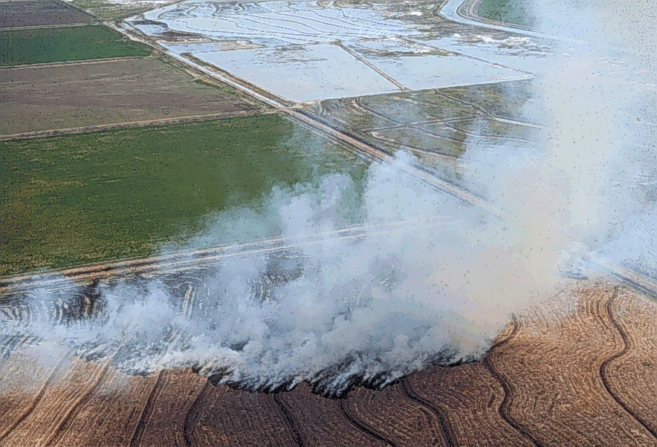
Notes:
Typical burn pile
Illegal burn
Ag Burning (rice stubble in Sacramento Valley)
Prescribed burn on Cal Fire’s property – Mt. Howell, Colfax

Slide 10
Agricultural Burning Regulations
California Health & Safety Code Article 3 – Section 41850 Agricultural Burning administered through the Title 17 California Code of Regulations-Subchapter 2 Smoke Management Guidelines for Agricultural and Prescribed Burning
Prescribed burning is the planned application and confinement of fire to wildland fuels on lands selected in advance of that application to achieve specific identified objectives.
Prevention of high intensity wildland fires
Watershed Management
Range Improvement
Vegetation Management
Forest Improvement
Wildlife Habitat Improvement
Air Quality Maintenance
Planned Application of Fire
Smoke Management Program
District Rules – Smoke Management of Prescribed Burning
Burn Permit Issued and Fees Paid
Submittal of a Smoke Management Plan
Notes:
California Health and Safety Code:
Defines Agricultural Burning which includes Prescribed Burning
Same definition in the Public Resources Code (CAL FIRE’s), changed in 2004
Requires District to adopt a Smoke Management Program which is approved by the state
District Rules also may have the same language that the state requires, but may not depending if they are updated or not.
Regardless, the state rules on this are required to be followed as per the adopted program
Submittal of a Smoke Management Plan which will be covered more in-depth shortly
Issuance of a burn permit. Each District may be a bit different.
And in some cases there could be burn permit fees associated

Slide 11
Title 17 CCR Smoke Management Guidelines
Required each air district to adopt a Smoke Management Program
Planning: submits a Smoke Management Plan (SMP)
Permitting: Air District may issue a Burn Permit or a different type of approval for the SMP
Authorization: Based on the burn day status, the Air District authorizes burning
Use Prescribed Fire Information Reporting System (PFIRS) to manage our burn program
Notes:
Title 17 is ultimately a communication program
Planning
Permitting
Authorization System
Can use an online system PFIRS

Slide 12
Program Objectives
Minimize smoke impacts to the public and the air shed
  Allows for the continuation of agricultural and prescribed burning as a resource management tool
  Provides increased opportunities for agricultural and prescribed burning
  Helps in the prevention of catastrophic wildfires by reducing vegetation through burning

Slide 13
When is a Smoke Management Plan Needed?
Four levels to determine if and how much of a SMP is or is not needed.
Less than 1 ton of Particulate Matter and/or less than 10 acres (see end of handout)
1 to 10 tons of Particulate Matter and/or 10 to 100 acres
10 tons of Particulate Matter and/or over 250 acres
Regardless of size and Particulate matter, potential to impact a smoke sensitive area
Contact your air district to help decide the level needed
Notes:
PM 10 was the regulatory level at the time that the regulations were created and have not been changed. Calculations are part of the SMP handed out.

Slide 14
What is Needed for a Smoke Management Plan (SMP)?
(How Much Smoke is Expected?)
SMP Begins with Basic Information (Sec.1)
Landowner Information
  Name
  Address
Prescribed Burn Staff Contact Information
Alternative Contact Information
Map of the location
Notes:
Planning

Slide 15
Project Information and Location Information (Sec. 1)
Type of Burn
  Broadcast/Understory - Acres
  Piles – Machine/Hand piles and how many
    Any Stumps?
    Dirt in the piles?
Vegetation Type – What is being Burned?
How Dry/Wet is the Vegetation? (Fuel Moisture)
How long is the burning expected to last?
Is the burn on a slope and what is its aspect - topography?
How much PM10 will be created?
Notes:
Type of Burn:
Underburn/Broadcast
Machine Piles how are they built – with a brush rack to keep out dirt
Stumps can be burned but with the caveat: Free from dirt, split at cut point if over 12” diamater
Stumps need a lot of fuel to burn.
Hand piles
Vegetation to be burned. How big?
When was it cut? Dry vegetation burns better than wet (woodstove firewood example)
How long will it burn?
Slope can determine how a burn travels, up or down hill
Aspect – South drier North wetter

Slide 16
Smoke Sensitive Areas
Public Notification (Sec.1&3)
Where are the closest neighbors?
  Direction and Distance
Are there any places close that could be impacted by smoke?
Public Notification Contact Methods
  Telephone
  Email
  Flyers
  Social Media – Next Door or Neighborhood Facebook Page
  Signage
Notes:
Next is Smoke Sensitive Information and Public Notification

Slide 17
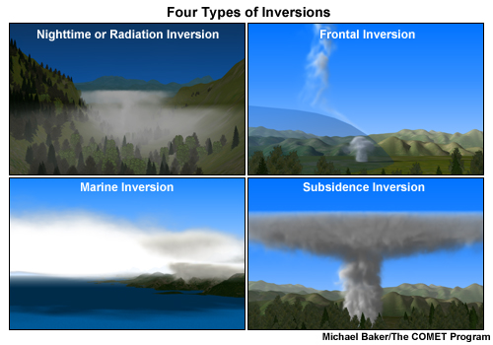
Weather – Ignition Prescription
Where will the Smoke Go?
(Sec. 1&2)
Burn Days
  Marginal?
Wind Speed and Direction
  Forecasts
  Surface and Transport Winds
Specific Temperature
Time of Day for Burning
  Morning – Evening Variations
  Inversions
Relative Humidity
Notes:
Weather – Ignition Prescription: Where will the Smoke Go?
Burn Days:
No Burn
Burn Day:
Marginal
Fair
Good
Superior
FYI: No Burn Day is based on whether smoke will linger
CARB meteorologists call it based on:
Surface winds
Transport winds
Inversions/Heights
Forecast
Population densities
APCD may also call it based on local factors
CalFire may also call it based on fire conditions
Wind Speed and Direction – where will the smoke go
Need a specific temperature for burning?
Time of day and Relative Humidity.

Slide 18
Smoke Mitigation (Sec.2)
What happens if Smoke Becomes a Problem?
What Contingencies are Considered?
    Is there a containment line?
    Stop lighting
    Allow burn down
    Have Water
    Consider Mopping Up
    Get it all lit faster
How will you Monitor Smoke? (Sec.4)
Work with Air District Staff
Notes:
Go / No Go is up to Land Owner/Manager

Slide 19
SMP Complete – What’s Next
SMP Submitted to District
District Approves – Disapproves
District issues Air District Burn Permit
Wait for Burn Day to Burn
Request Approval for Ignition Day of Burn (Sec.5)
Notes:
Go / No Go is up to Land Owner/Manager

Slide 20
Monitoring
Smoke Conditions
What is the Plume doing?
Where is it going?
How high is it getting?
Could the neighbors be getting too much smoke?
Post-burn report (Sec.6)
Notes:
Go / No Go is up to Land Owner/Manager

Slide 21
Technical Tools
PFIRS – Prescribed Burn Information Reporting System
Control Burn Notices (aka burn day)
Sacramento Valley Acreage Allocation
Fire Information Map
  Integration of Air Monitoring Information - Statewide
  Wildfire Information - Wildfire smoke affects allocation

Slide 22
What is PFIRS ?
Prescribed Fire Information Reporting System
  Communication tool
  Interactive mapping
  Not a regulatory tool
Notes:
What is PFIRS?
Interfaces between air quality managers, land management agencies, and individuals that conduct prescribed burning in California
Provides a map of current projects
What burns are planned?
What burns were occurring?
Contains a database on smoke management plans, burn approvals, & emissions information
Shows information statewide: if the public sees smoke, by looking at the map you can see if it’s from a prescribed burn
We use it because its less paper, but for some a paper version of the SMP works better. We would work with folk on what would be the best choice to use.

Slide 23
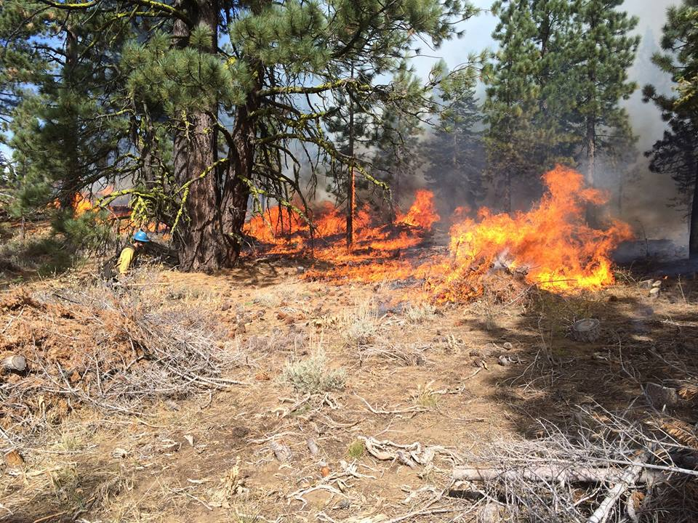
PFIRS Overview
Land Manager Use
Request An Account
Fill in SMP application
Review SMP
Approve SMP
Approve Ignitions

Slide 24
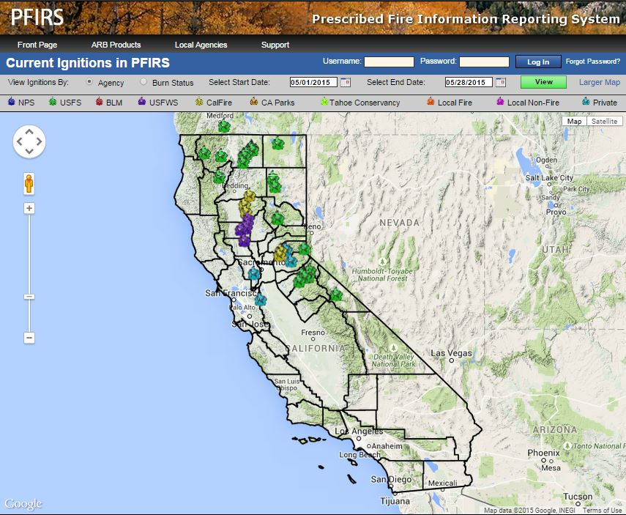
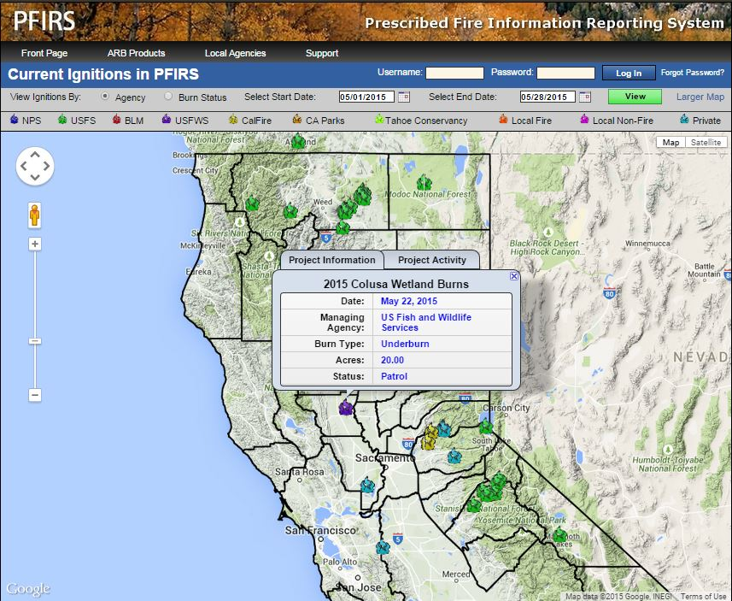
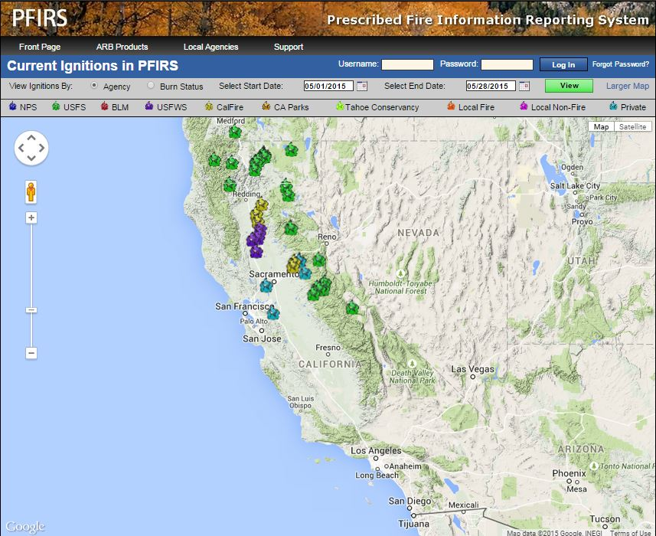
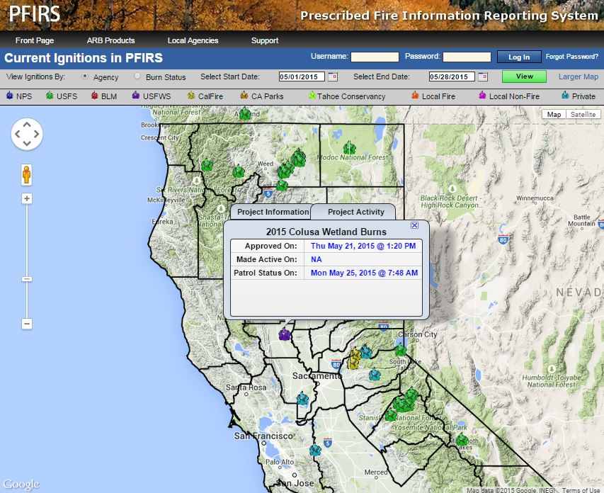
Notes:
Started as a tool where prescribed burns could be viewed on a map both valley-wide and state-wide
Land Managers input project information

Slide 25
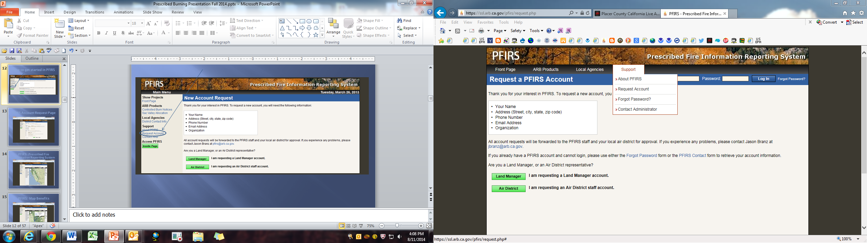
Request an Account

Slide 26
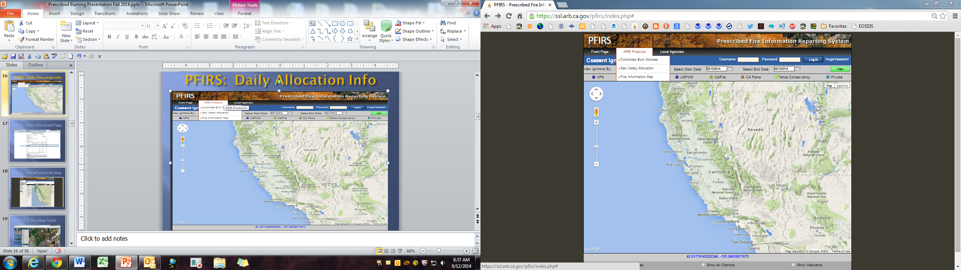
PFIRS: ARB Products

Slide 27
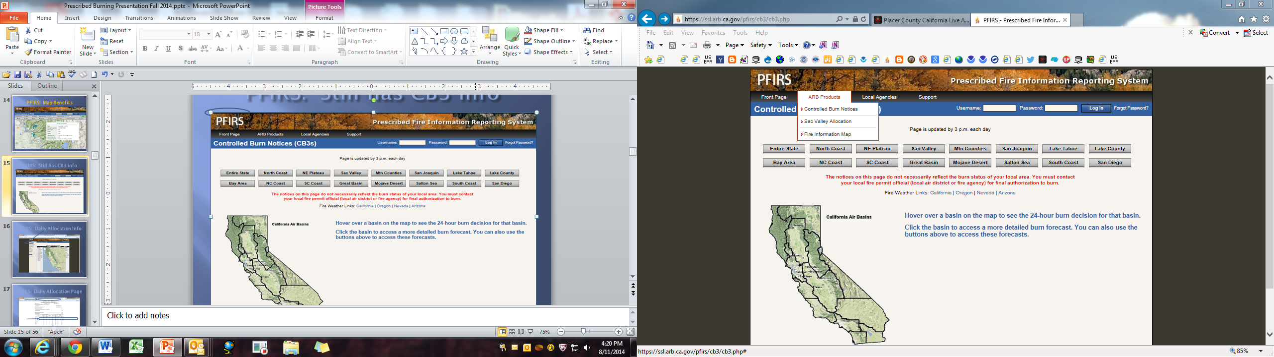
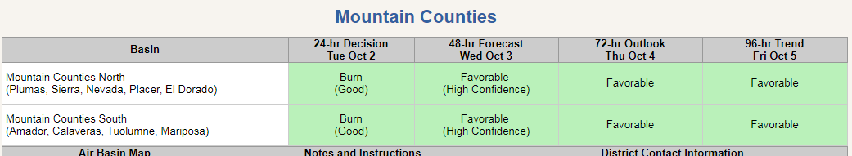
Notes:
Burn Day Criteria established by the Air Resources Board
Factors affecting No Burn Days:
Weather – inversion layers
Warm air aloft sinks; as it continues warm it becomes more stable, creating an inversion over the cooler air below it.
Inversion (the stable air) acts like a lid on the pollution below not allowing it to mix and disperse
Stability is a measure of the atmosphere’s ability to lift smoke away from the ground
More stable less smoke rise - Less stable better smoke rise
Poor air quality or “Spare the Air Day”
Fire safety
High fire hazard declared by local fire agencies/CAL FIRE

Slide 28
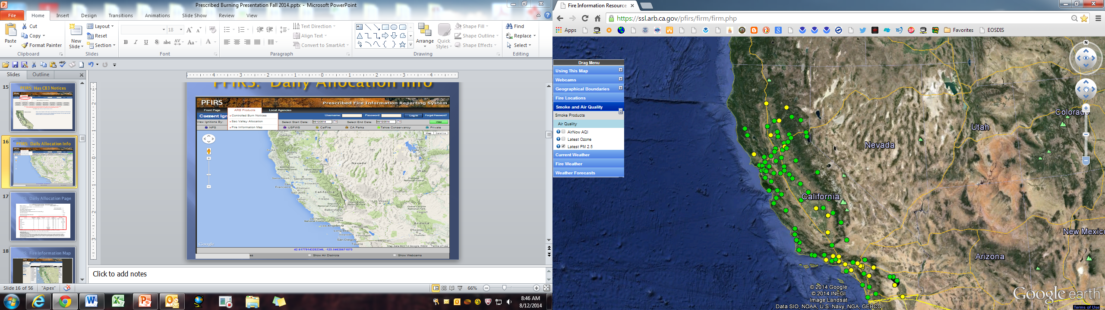
PFIRS: Fire Information Map
Provides real-time
information

Slide 29

Collaboration is KEY
Continue to protect Air Quality while providing for opportunities to dispose of vegetation by burning where appropriate.
Continue to strive towards achieving and maintaining air quality standards
Work with those conducting prescribed fire operations to minimize, smoke impacts on the public.
Maintain good working relationships with cooperators.

Slide 30
Helpful Websites
Prescribed Fire Information Reporting System: https://ssl.arb.ca.gov/pfirs/index.php
California Local Air District Directory
http://www.capcoa.org/districts/
Northern and Southern Predictive Services https://californiasmokeinfo.blogspot.com/p/fire-potential_27.html
National Weather Service
https://www.weather.gov/

