Slide 1
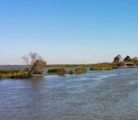
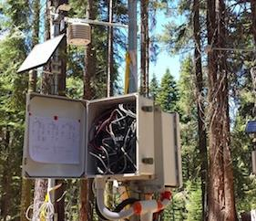
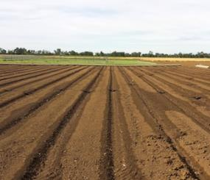
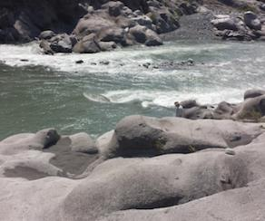
The Dilemma of Water Management –
Soil Storage and Surface/Ground Water Interactions
Helen Dahlke Assistant Professor in Integrated Hydrologic Sciences, Dept. of Land, Air and Water Resources, UC Davis
December 9, 2014
Email: hdahlke@ucdavis.edu

Slide 2
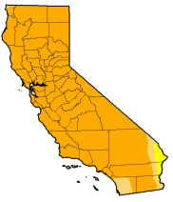
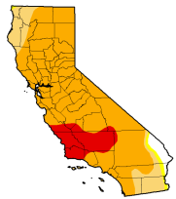
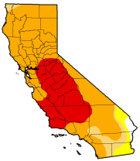
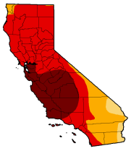
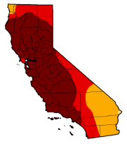
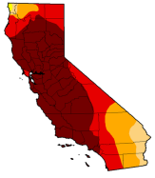
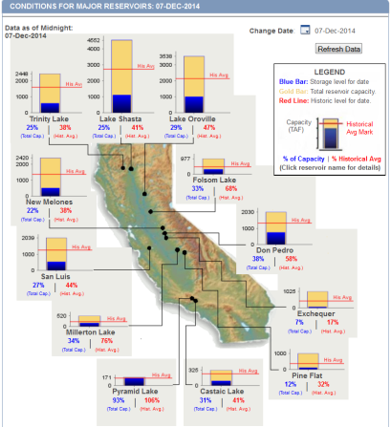
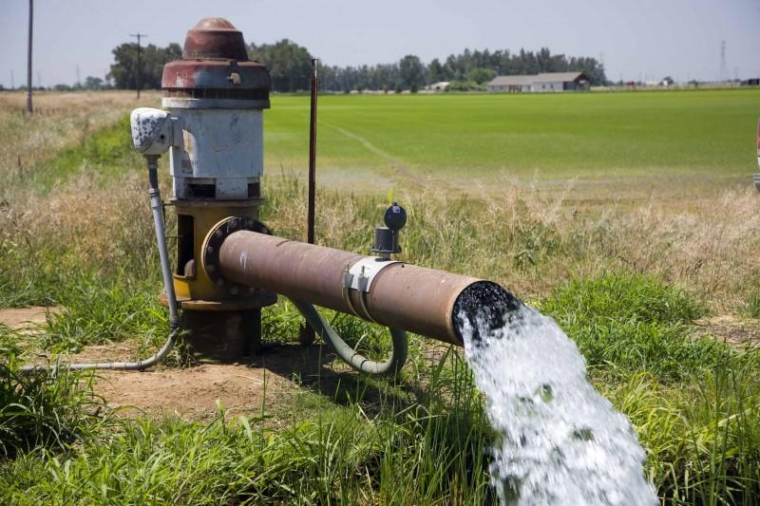
Signs of a 3-year drought – NOAA drought index
Aug 2013
Nov 2013
Jan 2014
May 2014
Aug 2014
Dec 2014
Source: www.watereducation.org
Notes:
NOAA drought index calculated based on the precipitation that the state receives

Slide 3
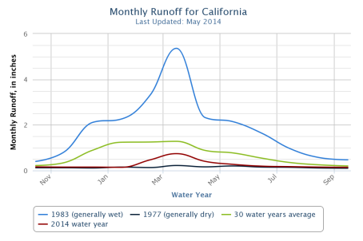
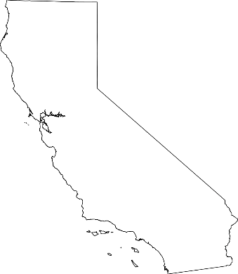
How did we get here?
The California Water Budget
Evapotranspiration
~ 125 MAF
Precipitation
~ 200 MAF
RUNOFF
NO RUNOFF
3 Storages in California
SNOW
RESERVOIRS
Water available as runoff ~ 75 MAF
GROUNDWATER

Slide 4
Changes in cropping patterns in the Sacramento Valley
Average values (in acres) for five northern Sacramento Valley counties.
Crop | 2003-05 | 2009-12 | Change
Deciduous Nuts & Fruits | 219,182 | 258,113 | 38,931
Olive & Citrus | 28,997 | 37,002 | 8,005
Vineyard | 4,000 | 3,676 | -324
Rice | 348,389 | 350,316 | 1,927
Pasture | 112,623 | 127,528 | 14,905
Grain & Hay | 71,774 | 61,434 | -10,340
Field Crops | 58,440 | 37,874 | -20,566
Truck Crops | 33,788 | 33,594 | -194
Idle Land | 32,204 | 26,609 | -5,595
Total | 909,397 | 936,146 | 26,749
Source: Northern Region, Land Use Section, 2012

Slide 5
Changes in irrigation methods in the Sacramento Valley
Average values (in acres) for five northern Sacramento Valley counties.
Irrigation Method | 2003-05 | 2009-12 | Change
Basin Flood | 353,691 | 354, 238 | 547
Surface Drip | 60,232 | 83,393 | 23,161
Micro Sprinkler | 46,725 | 88,390 | 41,665
Border Strip | 117,521 | 76,581 | -40,940
Furrow | 87,912 | 59,392 | -28,520
Hand Move Sprinkler | 24,704 | 19,609 | -5,095
Buried Drip | 600 | 2,515 | 1,915
Solid Set Sprinkler | 1,624 | 1,588 | -36
Source: Northern Region, Land Use Section, 2012
Notes:
Border strip, otherwise known as border check or bay irrigation

Slide 6
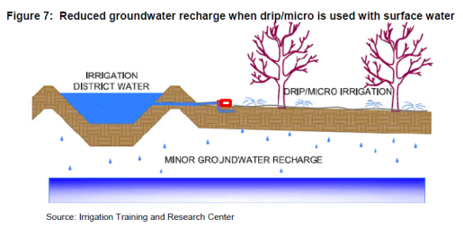
Farm level decisions are part of active soil storage and groundwater management – Example: Conversion from flood to drip and micro irrigation in CA agriculture
Advantages:
Reduced crop stress, more efficient crop fertilization
Increased yields, improved crop quality
More food grown per unit of water and land
Important to feed growing US and world population
Even though acreage of perennial crops in CA has increased in the 2000’s, the total water going to CA farms has held steady.
In the last 20 years, almond growers have reduced the amount of water they use per pound of almonds by 33%

Slide 7
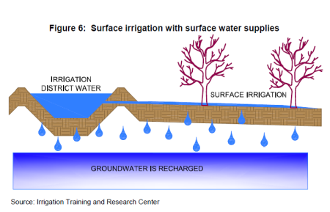
Farm level decisions are part of active soil storage and groundwater management – Example: Conversion from flood to drip and micro irrigation in CA agriculture
Consequences (unintended) of drip/micro irrigation :
Less deep percolation of water protects groundwater quality but decreases groundwater recharge
Irrigation “inefficiency” is a major source of groundwater recharge!
More reliance on groundwater than surface water for drip/micro-irrigation
Large uncertainty about surface water availability (for many reasons)
More flexibility to meet high frequency, low volume demand of drip and micro irrigation
Less filtering and clogging problems with drip and micro irrigation

Slide 8
What is groundwater banking?
…is the active and intentional recharge of groundwater aquifers during years when rainfall is abundant to increase water supply reliability during drought years
General
Have a void in a groundwater aquifer to store recharge
Have source of surface water to infiltrate and recharge
Banking implies a savings account for a “not so rainy day”
Water banking implies managing for a drought when a drought is not occurring.
Less costly than surface storage
Ecosystem advantages
Many forms of banking
Natural recharge
Direct percolation recharge
In-lieu recharge
Fallowing
Aquifer injection

Slide 9
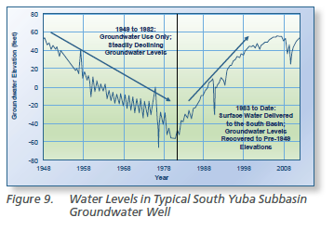
Concept of groundwater banking (GB) through active groundwater management
(Source: Sacramento Valley Groundwater Assessment – Call to Action, Tech Supplement, June 2014) http://www.norcalwater.org/groundwater-technicalsupplement/

Slide 10
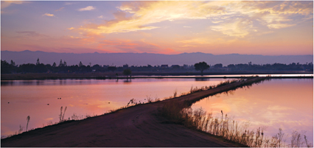
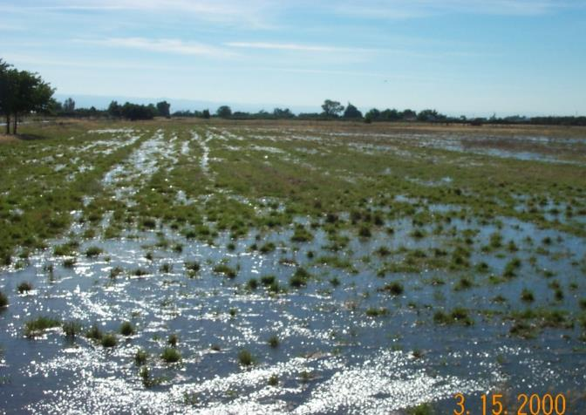
What form of banking is an agricultural systems approach?
Direct percolation … but possibly not in the form we might first envision.

Slide 11
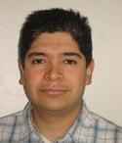
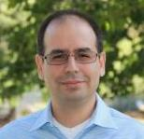
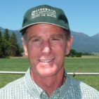
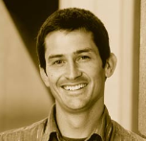
UC Davis groundwater banking project team
Helen E. Dahlke, Asst. Prof. in Integrated Hydrologic Sciences, UC Davis
Samuel Sandoval Solis, Asst. Prof. and CE Specialist in Water Management, UC Davis
Thomas Harter, Prof. and CE Specialist in Groundwater Hydrology, UC Davis
Toby O’Geen, Prof. and CE Soil Resources Specialist, UC Davis
Daniele Zaccaria, Asst. Prof. and CE Specialist in Agricultural Water Management, UC Davis
Josué Medellín-Azuara, Professional Researcher in Hydro-economic modeling, UC Davis
Daniel Putnam, CE Agronomist and Forage Specialist, UC Davis
Steve Orloff, CE County Director and Farm Advisor, Siskiyou County
Allan Fulton, CE Irrigation and Water Resources Advisor, Tehama County
Mark Lundy, CE Agronomy Advisor, Colusa County

Slide 12
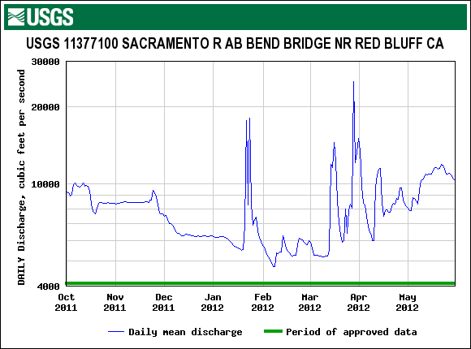
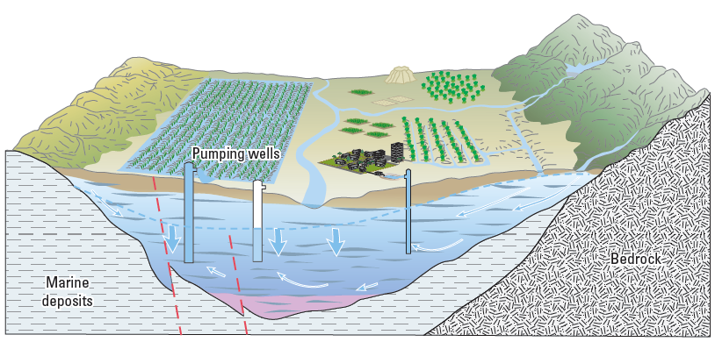
Feasibility study of agricultural groundwater banking
Surface water source and conveyance
Suitable cropping system
“Clean” recharge and effective retention
Cost-benefit, legal constraints
?
?
Figure: Faunt, 2009, p. 22

Slide 13
Begin with emphasis on agricultural systems growing alfalfa and irrigated pasture. Why?
Large acreage in CA (~ 1.5 million acres) → higher probability to find land parcels with the right soils and suitable groundwater aquifers for banking
Relatively low use of fertilizers, pesticides → low risk for leaching
Flood irrigation with surface water more common → suitable conveyance system for banking
Preliminary assessment suggests Costs/Benefits more favorable than other crops
But we are also interested in other annual low-value, low-nutrient crops and possibly tree crops

Slide 14
Current status of project?
Commitment from two water/irrigation districts
Scott Valley Irrigation District
Orland-Artois Water District (OAWD)
Potential interest
Lower Tule River ID and Pixley ID
Tulare ID
Mono County Resource Conservation District
Madera ID

Slide 15
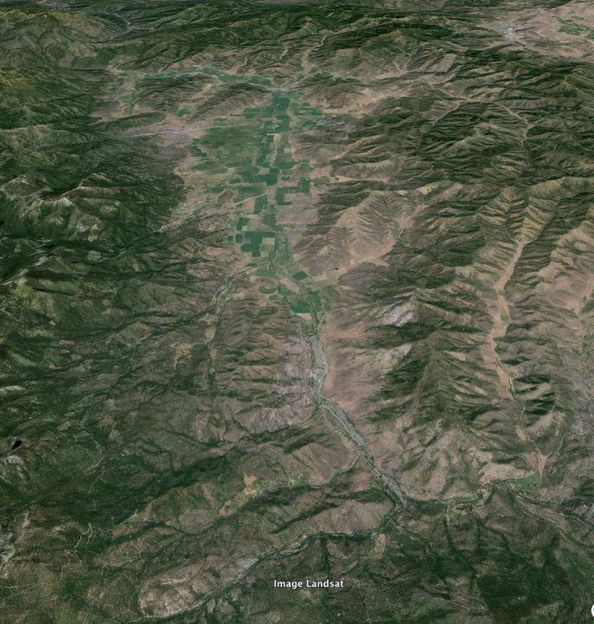
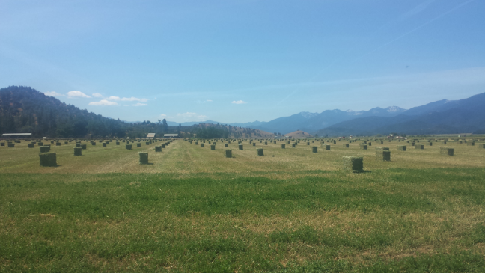
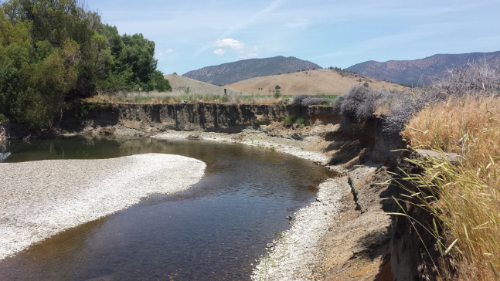
Scott Valley
Scott Valley

Slide 16
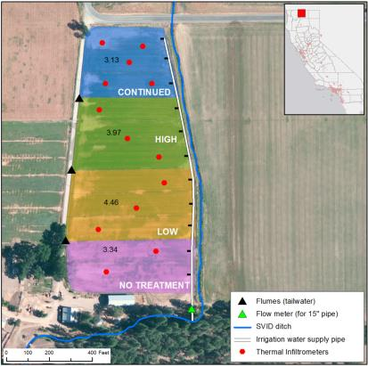
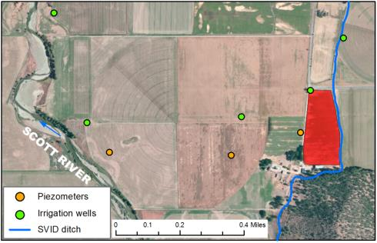
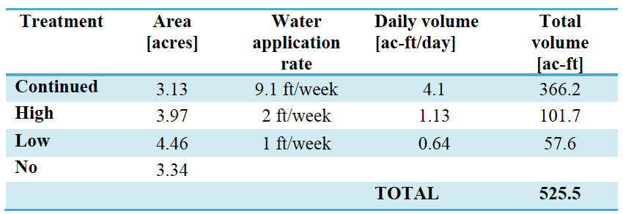
Field level recharge study

Slide 17
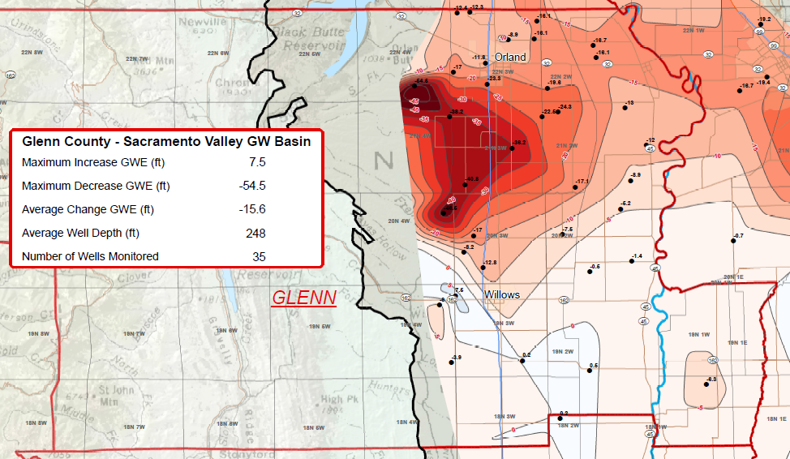
Glenn County, Target Work Area - Groundwater elevation change from Spring 2004 through Spring 2014

Slide 18
Outcomes: web-based decision support tools to:
Assess site specific feasibility for groundwater banking based on a farm’s soils, climatic, water supply and water-infrastructure
Estimate production risks with flooding specific crops
Provide crop-specific and soil-landscape specific management guidelines to minimize risk to crop while banking groundwater
Give a holistic estimate of on-farm costs of groundwater banking:
costs associated with yield, reduction in crop quality, water, labor, permits, and other management practices)

Slide 19
Thank you!
Questions?

Slide 21
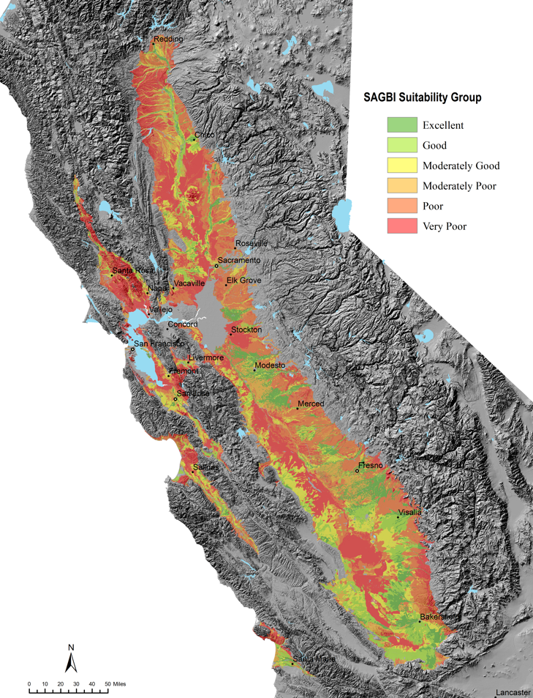
Which soils are suitable
Soil characteristics:
Hydraulic conductivity
Occurrence of water restrictive layers,
Topographic Limitations (slope),
Chemical Limitations (EC),
Surface Condition (e.g. erodibility)
Notes:
Deep Percolation, Root Zone Residence Time, Topographic Limitations, Chemical Limitations, and Surface Condition
suitability of a soil landscape to accommodate deep percolation, maintain a freely drained root zone, distribute water evenly on the landscape, minimize groundwater contamination by salts, and resist erosion and soil crust formation

Slide 22
Alfalfa flooding tolerance study – UC Davis Farm
70 ft
Test 2 different water application durations at 3 different times during winter season (3 x 2 + 1 control)
Measure plant parameters: initial stand density, vigor, stem count, yield
Measure physical parameters: Soil moisture, soil, air, water temperature, redox potential, control volume
7 treatments
7 treatments
470 ft
7 treatments

Slide 23
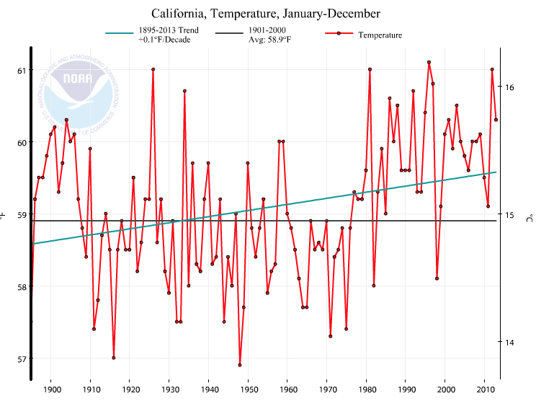
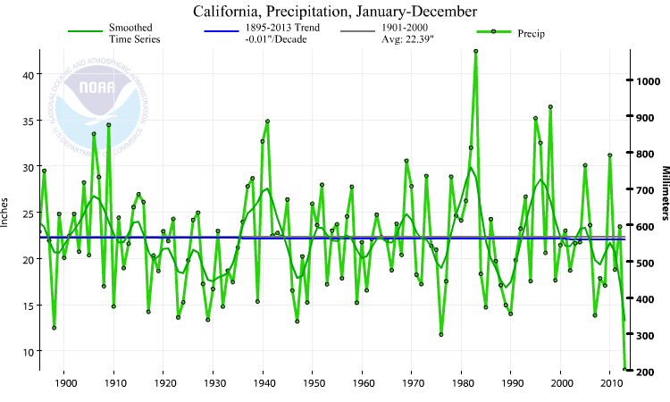
Signs of a 3-year drought – NOAA drought index
Aug 2013
Nov 2013
Jan 2014
May 2014
Aug 2014
Dec 2014
Annual average temperature:
2014 – 3rd warmest year
Total Annual Precipitation:
2013 – Driest year to date
Notes:
NOAA drought index calculated based on the precipitation that the state receives

Slide 24
Prerequisite work in OAWD
GIS analysis:
Land use (1993-2014)
Water infrastructure (digitized)
Soil suitability index for groundwater banking
Groundwater level data
Surface water availability:
Analysis of annual and daily historic stream flow data
Constraint - capacity
Modeling:
CVHM – development of groundwater depression based on historic land use and water use data (change in GW level and pump rate)
Notes:
Prerequisite work to enable planning of and evaluation of future groundwater banking investigations in years 2 and 3 of project.

Slide 25
Timeline/Tasks – August 1, 2014 – July 31, 2017
2014/15
Identify cooperators and field sites.
Complete water balance for study areas
Develop flood/storm water availability index
Develop and calibrate groundwater model with historic data
2015/16
Perform crop flooding experiments
Develop land and crop suitability indices for flooding/banking
Apply groundwater model to simulate larger scale potential for banking
Perform farm economic analysis
2016/17
Wrap up flooding experiments
Finish large scale modeling and assessment of banking potential
Avail web-based decision support tools
Provide stakeholder workshops
Publish findings and experience

Slide 26
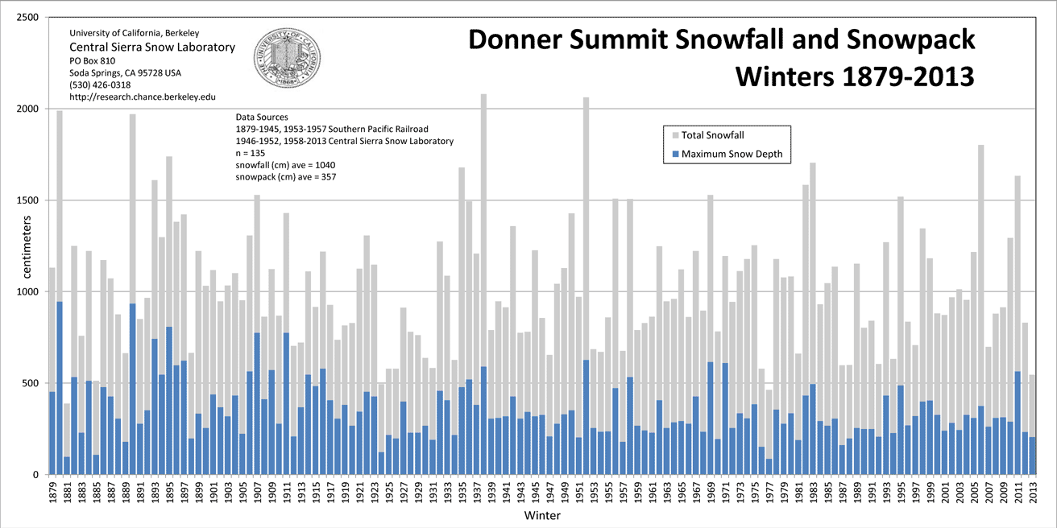
Historic Snowpack trends
Trend: 0.92 °C/decade

Slide 27
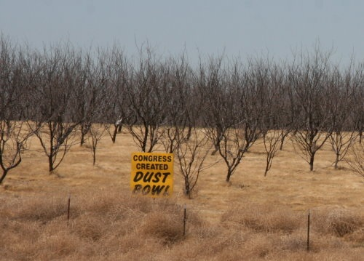
Surface water supplies

Slide 28
What is the proposed work?
Conduct water balance analysis to estimate current and future water supply/demand, availability and amount of water needed to stabilize water reliability
Identify potential groundwater banking sites through GIS analysis of land use, soils, geology, groundwater levels, irrigation practices, and existing drainages and canals
Estimate surface water surplus frequency and magnitude for banking
Surface water-groundwater modeling → estimate storage capacity, specific and safe yield, recovery and contaminant transport potential
On-farm experiments
Soils and hydrologic investigations
Crop suitability for groundwater banking
Demonstrating feasible BMPs to groundwater banking
Cost-benefit analysis based on existing agricultural systems, water infrastructure, and institutional constraints
j
Notes:
Soils, geology and groundwater levels have priority because we want to get water fast into the ground, without contaminating the groundwater and we want to achieve high recovery rates
Water balance analysis – using models

