Slide 1
Tahoe Basin Black Bear Project: Home Range Analysis and Use of Urban Areas
California Department of Fish and Wildlife
Principle Investigator: Mario Klip
Presenter: Canh Nguyen
December 01, 2015

Slide 3
Study Design
Capture Methods
Box trap/Leg hold snare
Drug Immobilization
Satellite/Radio collars
Aversive Condition

Slide 4
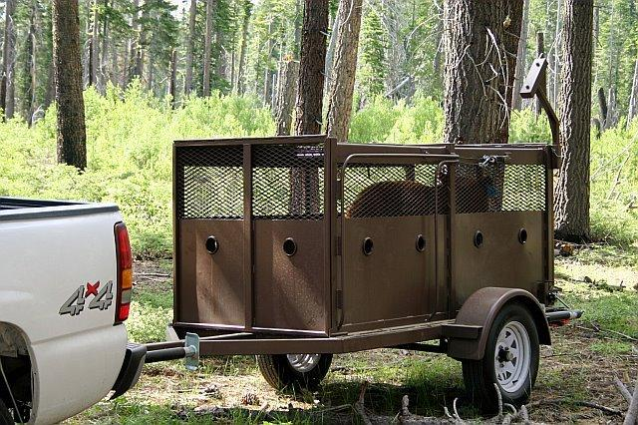
Box Trap
Heavy-duty box trap mounted on a trailer
Round port holes on all sides provide access by jab stick
Easily move to the release area

Slide 5
Drug Immobilization
Telazol per CDFW Wildlife Investigation Laboratory specifications
Pencillin and Blu-kote® to preventive infection
Permanently marked with an ear tag
Bears captured during the hunting season (August - December) were also outfitted with an ear tag containing a warning to contact CDFW prior to consuming the animal, due to potential drug residue
Age classes as follows:
cubs are animals less than one year of age and accompanied by a sow;
sub-adults are animal over one year old, unaccompanied by a sow, and weigh between 40 and 100kg;
Adults are solitary bears weighing over 100kg.
Data collected from each bear was recorded on individual data sheets.
Bears recovered for a minimum of six hours in a quiet location prior to release.
Notes:
The animals had access to clean drinking water upon waking up and recovered without disturbances.

Slide 6
Collars
Communication via email was received twice daily
First six weeks of deployment; location every 20 minutes to monitor for mortality
After six weeks, positions were gathered every two hours
All collars were also equipped with VHF (Very High Frequency) transmitters to facilitate locating on the ground in real time
Remote drop off mechanisms
Cotton spacers degrade over time
Notes:
Cotton spacers allow dropping, but at unpredictable rates. It provided a sure way for the animal to shed the collar after approximately two years.

Slide 7
Other Capture Method Considerations
Sub-adults were not included in the study because the risk of collar embedment was considered too severe.
Bears also participated in an Aversive Conditioning (portion of this study was not completed)
AC with dogs, dogs and firing less-lethal ammo and control

Slide 8
Criteria For Trapping
Safety
Ability to monitor trap
Recent bear activity
Areas where recent (< 2 weeks) depredation bears were active were not utilized until the offending bear either had been removed humanely or until the damage stopped for at least two weeks, indicating that the offending bear had moved to a new area.
Limited opportunity for trap tampering
Ability to obscure the trap from the road

Slide 9
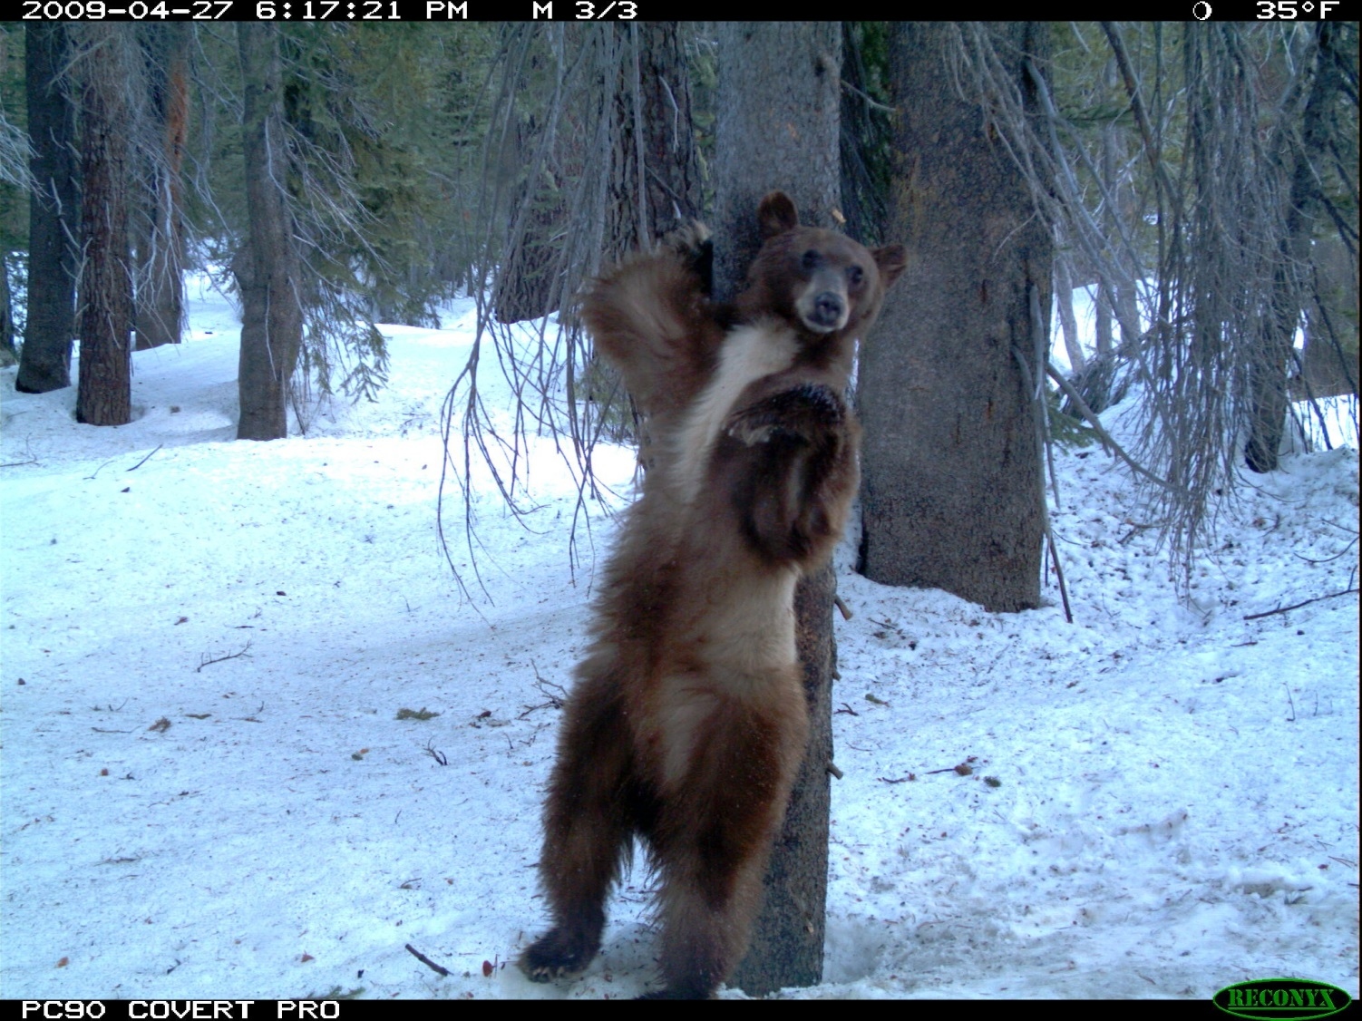

Slide 11
BEARID | SEX | Total positions | on | off | number of days
13205 | Female | 4749 | 5/15/2014 | 11/21/2014 | 190
13206 | Male | 4552 | 5/23/2014 | 4/1/2015 | 313
13207 | Female w Cubs | 4293 | 5/24/2014 | 4/2/2015 | 313
13208 | Female | 1047 | 11/7/2013 | 4/4/2014 | 148
13209 | Female | 3367 | 8/5/2013 | 3/6/2014 | 213
13210 | Female w Cubs | 7875 | 10/22/2013 | 3/5/2015 | 499
13211 | Male | 567 | 11/15/2013 | 1/15/2014 | 61
13212 | Female w Cubs | 4541 | 9/28/2013 | 3/3/2014 | 156
15441 | Male | 5078 | 6/14/2014 | 3/5/2015 | 264
15442 | Female | 4372 | 6/14/2014 | 11/27/2014 | 166
15544 | Female | 2212 | 9/7/2014 | 3/24/2015 | 198
15448 | Female | 706 | 9/7/2014 | 2/15/2015 | 161
Notes:
Bear 13209 and 15444 are same bear. Collars got switched out.

Slide 12
Home Range Analysis
Home Range Definition:
Area traversed by an individual in its normal activities of food gathering, mating and caring for its young
Bear full home ranges were calculated based on Minimum Convex Polygon (MCP), Kernel Density Estimate (KDE) and Brownian Bridge Movement Model (BBMM) including variation as a result of method and sex
Seasonal home range variation was compared based on sex, season and year
Home range overlap with urban areas based on sex and season
Notes:
The size of the home range might indicate how much space a bear needs, how this area varies across seasons and how this overlaps with urban areas. This is a key step when trying to understand potential for conflict and mitigation strategies.

Slide 13
Home Range Analysis--continued
Home range overlap was based on the urban definition as defined as “Combined” (Klip, unpublished data)
“Combined” is a combination of the urban definitions that include “Census”, “City Limits”, and “eVeg” data
“Wild” is the portion of the home range not overlapping with the urban area

Slide 14
Home Range Analysis--continued
MCP home ranges were calculated at 50%, 95%, 99% and a 100%
KDE and BBMM calculations were at 50%, 95% and 99%.

Slide 15
Minimum Convex Polygon
MCP calculates the area utilized
Does not provide insights into which areas might be of disproportionate importance

Slide 16
Kernel Density Estimate
KDE considers the intensity of use in different areas by an animal
More than one center of activity and the method is not dependent on outlying points
Likelihood where a bear can be found
Utilization distribution that describes the relative amount of time that an animal spent in one place

Slide 17
Brownian Bridge Movement Model
BBMM estimates the probability that the animal occurred in an area over the analysis period
Locations are not independent and specifically incorporates time between locations in the model

Slide 18
Results: Full Home Range Sizes
The average home range at 95%
Males: 77.96km² (MCP); 77.37km² (KDE); 34.82km² (BBMM)
Females: 17.57km² (MCP); 16.85km² (KDE); 10.17km² (BBMM)
Females with cubs: 25.70km² (MCP); 22.36km² (KDE); 14.95km² (BBMM)

Slide 23
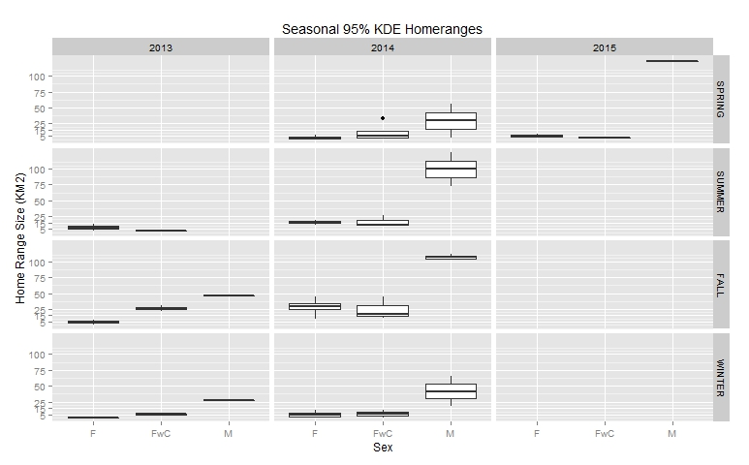
Seasonal Home Ranges
Notes:
Males had larger home ranges (4X) than females or females with cubs
Differences between male and female home ranges were considerable, the fall of 2014 females recorded a home range of 28.75km², females with cubs 24.68km² and males 102.48km²
Females without cubs at times recorded a smaller home range than females with cubs; for instance, the Fall of 2013 or Spring of 2015, but in the Spring of 2014 recorded a higher than females home range.

Slide 24
Discussion
While home ranges differed, distinct patterns were not observed and varied across seasons
Understanding overlap with the urban envelope is important because seasonal and inter-annual variation might provide insights into resource partitioning
Male bears might actively exclude females and females with cubs from more profitable wild lands???

Slide 25
Discussion--continued
Currently the Department estimated a population of 300-350 bears on the California side of Lake Tahoe
Calculating home range density and their overlap might provide a quick approach to test this number
Population estimate through a non-invasive mark recapture study

Slide 26
Discussion--continued
The home ranges comparable to home ranges reported elsewhere in California

Slide 27
Use of Urban Areas
Urban Bear vs. Wild Bear?
No previously published clear definition of what urban wildlife or an urban bear was
Understanding “urban” was a requirement when trying to assess whether an animal deserved the label “urban” or “wild”

Slide 28
Urban
“Urban” in the context of urban wildlife
How much time did bears spend in urban areas
How did land cover usage vary between urban/wild areas
How did activity patterns differ between urban and wild areas?
Urban in the context of this study will be used for all areas around developed areas

Slide 29
How Much Time Do Bears Spend in Urban Areas?
If 50% or more of the locations were found within the urban area, then the bear was considered urban.

Slide 30
Definition Source
City Limits
Remote Sensing Data (eVeg)
US Census (2010)
Combination of the three (Combined)
Notes:
City Limits data were collected from the Tahoe Regional Planning Agency (TRPA), and identified town and city boundaries. In the Basin, South Lake Tahoe is the only true city, the definition of City Limits intended to include all population centers, and no changes to the original definition by TRPA were made. City Limits might understate areas by not including developed areas with the definition, or overstate by including areas that have not been developed.
Remote sensing data (eVeg Forest Service Tiles 17Am 17B, 21A, 21B in 1:24,000 and 1:100,000 when 24k was unavailable for 17B and 21A) used satellite data to remotely sense ground cover (USDA Forest Service Pacific Southwest Region 2010). Areas were classified in various categories, roads and buildings were the main spatial elements defined as urban. This approach was thought to increase the urban area, in comparison to City Limits. The number of GPS locations found in urban areas was expected to increase with this definition, especially since major roads were now also included in this definition. Remote Sensing might be limited in penetrating forest cover, and might miss structures under heavy canopy cover (Fassnacht et al. 2006).
Census data was selected because census data included all surveyed homes, and is not gathered through remote sensing. Every home in the Basin was effectively part of the urban definition. Vacation cabins in the forest might not fit the classic "urban" definition, but were included. On the other hand, buildings other than homes might be omitted, which should be part of the urban definition.

Slide 31
Land Cover Use

Slide 36
Temporal Difference between Urban and Wild Patches
Bears utilized the landscape differently over the course of a day
Daily activity patterns showed that bears were less active during day light hours in the urban areas
Before 06:00hrs and after 18:00hrs: bears were found more in wild areas
This pattern was similar for all sexes

Slide 38
Annual patterns in use of the urban or wild interface by sex
Notes:
Red=wild; blue=urban

Slide 39
Discussion
7 of the 12 bears may be considered wild if a threshold of 50% of locations would be applied within the Combined definition
No black and white delineation of what constituted urban or wild.

Slide 40
Acknowledgement
CDFW Big Game Funds
Mario Klip
Numerous constituents in the Tahoe Basin

