Slide 1
Impact Outcome Evaluation Quarterly Call Q1
Presented by:
Amanda Linares
October 17, 2023

Slide 2
Housekeeping
This call is being recorded.
Will be posted here later today: https://ucanr.edu/sites/ioe/Quarterly_Calls/
Slides are available now.
I will take all questions at the end, but feel free to chat as we go.

Slide 3
AGENDA
Announcements
IOE Timeline
TA & Training Survey Follow-up
FFY 23 EATS Statewide Analysis
FFY 24 Progress
FFY 24 Troubleshooting
Q & A

Slide 4
Announcements: Presentations
Student and school characteristics modify the impact of Supplemental Nutrition Assistance Program Education (SNAP-Ed) on student dietary outcomes presented at the 2023 American Society for Nutrition Annual Meeting
CFHL may be more effective at improving eating behaviors among students attending urban (vegetable intake) and high FRPM schools (fruit intake).

Slide 5
Announcements: Publications
CalFresh Healthy Living interventions increase students' fruit and vegetable consumption during COVID-19 school closures is a brief summarizing our January 2023 Public Health Nutrition paper
3-page, easy read that is a great way to highlight the benefits of your school-based work with partners!

Slide 6
Announcements: Upcoming Calls
Q2 IOE Quarterly Call is Tuesday, January 16th at 10am
https://ucanr.zoom.us/meeting/register/tJAkdeGqqDouG9HBLgu7VRbF80XKQvrZCr-N
https://ucanr.edu/sites/ioe/Quarterly_Calls/
Evaluation Cross-Project Office Hours are Thursday, December 14th at 11am
https://ucanr.zoom.us/meeting/register/tJYodeCorjosEtcPiJIEiWMo0L8ygOvRQQDb
Q&A guide from September 21st Office Hours
https://ucanr.edu/sites/LHDEvaluation/files/389058.pdf

Slide 7
FFY 24 IOE Timeline

Slide 8
IOE Timeline
EATS post-test opens
EATS pre-test closure (tentative)
10/17/23

Slide 9
IOE Timeline
If you are struggling to get your sites on board, and unsure if it will happen before end of calendar year, keep in touch with me for options
We understand more flexibility is needed in Year 1 of a new IWP, but we’d really like to wrap pre-testing by end of October in Years 2 & 3
As a reminder, if you don’t have school-based DE in your IWP, there is no need to “recruit” schools for IOE, i.e., you are not required to participate
If you are not planning DE in the number of sites required by your funding tier, that’s ok! Just evaluate in the maximum number of sites you are working in.

Slide 10
TA & Training Survey Follow-up

Slide 11
TA & Training Survey Follow-up
Survey was conducted in Summer 2023 with 48 LHD and/or subcontracted staff
42 received evaluation TA, remaining 6 ended the survey
For the first time, the survey covered the major projects requiring regular training and TA resources:
PEARS
SLAQs
IOE
Adult DE Eval

Slide 12
TA & Training Survey Follow-up
86% reported NPI’s (overall) training and TA were good, very good, or excellent; none said poor
20 respondents (~1/2 the sample) reported being involved in IOE
3 of 20 respondents reported needing additional IOE-related resources
But none were listed in the free response fields!
The most helpful IOE resources that aid in designing or improving your programs were:
Online training modules
Planning worksheets
Site-level infographics

Slide 13
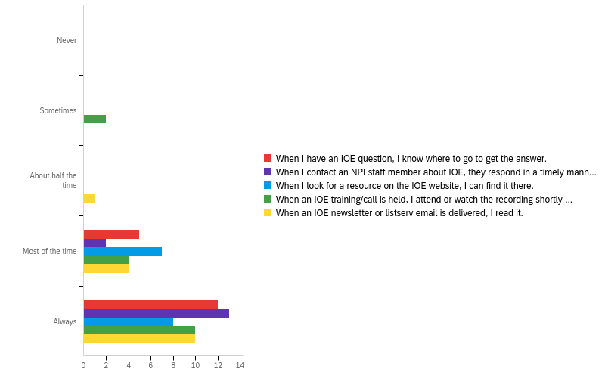
IOE TA
Always or Most of the time
100%
100%
100%
88%
94%

Slide 14
TA & Training Survey Follow-up
64% of the sample heard of Cross-Project Office Hours but never attended and 16% of the sample had never heard of them
From 23 LHD/subcontractor responses, there were a total of 25 new hires in the past year that would require evaluation training
What now?
Continue to publicize office hours and implement Local Evaluation 101 training
Launch the Data Hub for more accessible and useful process and outcome data
Quarterly Call pre-registration
Continue to publicize this survey for next year. Aspects of TA we didn’t get at?

Slide 15
FFY 23 Statewide Results

Slide 16
Demographics
3,539 matched pre/post, intervention only*
Mean age was 10 years
49% were girls
53% were Hispanic/Latino, 23% were Multiracial, 14% were White, 4% were Asian, 4% were Black/African American, <1% were AIAN or NHPI
* Without a comparison sample, we cannot attribute outcomes to our interventions

Slide 17
Fruits & Vegetables
Fruit & Vegetable Outcomes | N | Pre-test Mean (times/day) | Post-test Mean (times/day) | Mean Change (times/day) | P-value
Fruit intake, w/ juice | 3499 | 2.55 | 2.66 | 0.10 | 0.054
Fruit intake, no juice | 3506 | 1.72 | 1.82 | 0.10 | 0.024
100% fruit juice | 3506 | 0.83 | 0.84 | 0.003 | 0.872
Vegetable intake, w/ beans | 3464 | 2.97 | 3.29 | 0.32 | <0.001
Vegetable intake, no beans | 3481 | 2.66 | 2.95 | 0.29 | <0.001
Starchy vegetables | 3504 | 0.67 | 0.75 | 0.08 | 0.001
Orange vegetables | 3501 | 0.60 | 0.64 | 0.04 | 0.070
Salad/Green vegetables | 3501 | 0.68 | 0.77 | 0.08 | 0.001
Other vegetables | 3502 | 0.71 | 0.79 | 0.08 | 0.003
Beans | 3498 | 0.30 | 0.33 | 0.03 | 0.098

Slide 19
Fruits & Vegetables
Beverage Outcomes | N | Pre-test Mean (times/day) | Post-test Mean (times/day) | Mean Change (times/day) | P-value
Water intake | 3493 | 2.33 | 2.35 | 0.02 | 0.498
SSB intake, w/ flavored milks | 3453 | 2.52 | 2.38 | -0.14 | 0.017
SSB intake, no flavored milks | 3458 | 1.97 | 1.90 | -0.08 | 0.146
Fruit drinks and sports drinks | 3502 | 0.79 | 0.79 | 0.01 | 0.792
Regular soda | 3486 | 0.49 | 0.48 | -0.01 | 0.429
Energy drinks | 3489 | 0.19 | 0.19 | -0.001 | 0.924
Sweetened coffee/tea | 3490 | 0.51 | 0.44 | -0.06 | 0.001
Flavored milk | 3492 | 0.54 | 0.48 | -0.07 | <0.001

Slide 21
Fruits & Vegetables
Physical Activity Outcomes | N | Pre-test Mean (days/week) | Post-test Mean (days/week) | Mean Change (days/week) | P-value
Days with 60+ minutes MVPA | 3539 | 4.02 | 4.46 | 0.44 | <0.001
Days with physical activity class like PE | 3539 | 2.35 | 2.54 | 0.19 | 0.248
 | N | Baseline, % | Follow-up, % | Change, % | Adjusted p-value
Spent half or more of PE class being physically active | 2530 | 76.05 | 76.28 | 0.31 | 0.880

Slide 22
Plans for FFY 23 Data
State-level results for new N-PEARS
School-level data visualizations, now available in your Evaluation SharePoint folders
Incorporation into Data Hub, TBD early 2024
Dose Analysis
Lack of comparison sample
Will look at intervention dose, i.e., low to high, instead

Slide 23
FFY 24 Progress

Slide 24
FFY 24 Progress
Target → At least 30 matched pairs in each of 69 schools
Planning Worksheets → 22 LHDs in 83 schools
As of 10/12…
2,526 pre-test surveys
15 LHDs and 38 schools, likely outstanding paper surveys
88% of the sample is 4th and 5th graders

Slide 25
Poll Question

Slide 26
FFY 24 Troubleshooting

Slide 27
Issues- Online EATS
District firewalls: Sometimes inconsistent!
iPads/Apple products: Latest IOS update
Mystery link issues: Also inconsistent
Long links: You can shorten, but be careful

Slide 28
Troubleshooting- Online EATS
Test the link on the type of device that will be used
Test the link at the site it will be used
Have some paper copies on hand, just in case

Slide 29
Troubleshooting- Online EATS
Try to avoid having students type the link into browser, instead house it in a doc in Google Classroom.
If you still need to shorten the link and can’t hyperlink Click Here text, you can shorten it with an app like TinyURL or Bitly.
To prevent link mix ups, use the school name + pre/post as the alias.
Note, that alias may only be available once.

Slide 30
Troubleshooting- Parent Opt Out Forms
Parent Opt Out Forms
In some sites, more students opted out than usual due to use of parent opt out forms
The opt out form process is actually less rigorous than similar surveys, e.g., CHKS
What can be done?
Avoid sending home with other papers that need parent signatures, especially the first week or two of school
Consider using Parent Square or another parent communicator app
Consider whether this will affect the number of classrooms per site you need to reach 30 matched pairs
Listen to and report back on any feedback from schools via parents on why they are opting out

Slide 31
Stay Informed!
Join the listserv
1:1 meeting with NPI evaluators
Next Quarterly Call: Tuesday, January 16th at 10am
Pre-registration: https://ucanr.zoom.us/meeting/register/tJAkdeGqqDouG9HBLgu7VRbF80XKQvrZCr-N

Slide 32
CFHL Forum
Visit the NPI table with Miranda Westfall, Summer Cortez, Janice Kao, Evan Talmage, and Richard Pulvera
Evan → iPad with new Retail Reach Tool
Richard → iPad with Data Hub mock up

