Slide 1
IOE Quarterly Call January 16, 2024
Hosted by:
Amanda Linares

Slide 2
Access the recording & slides
Find the webinar recording and this slide deck on the IOE Website

Slide 3
Agenda
Announcements & reminders
FFY 24​ data collection & data entry
IOE in PEARS
Q & A

Slide 4
Announcements & Reminders

Slide 5
Announcement: New Publication
Check out your data at work in our latest publication in California Agriculture!

Slide 6
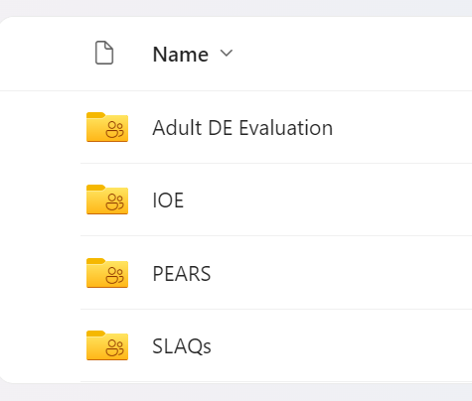
Announcement: LHD Evaluation SharePoint Access
LHD Evaluation SharePoint houses all your evaluation project data and files.
UC recently changed our sharing permissions resulting in:
Inability to bookmark site/folder after you gain initial access, i.e., links “expiring”
Inability to distribute “Anyone with link can access” links
Migration of some project materials, e.g., SLAQs and CFHL Adult Surveys, to the website itself.

Slide 7
Announcement: LHD Evaluation SharePoint Access
Q: How do I access my folder?
New users: Ensure you have your PD’s permission to be a folder editor, then email EvaluateSNAPEd@ucanr.edu with a request to be added. The “add” will generate a link that will be sent to you. SAVE THIS EMAIL. You will need it each time you want to access the folder. Two-factor authentication will be required each time.
Existing users: If you no longer have your original email, email EvaluateSNAPEd@ucanr.edu to obtain a fresh link. SAVE THIS EMAIL.

Slide 8
Reminder: FFY 24 IOE Timeline
Remaining FFY 24 holiday survey closures
MLK Jr Day, 1/16
President’s Day, 2/20 (some districts have two!)
Memorial Day, 5/28
Be mindful of “ski week” or spring break schedules and don’t survey the week following the break.

Slide 9
Reminder: FFY 24 IOE Timeline
Friday, March 29th
Pre-test hard closure (includes paper survey data entry)
Tuesday, April 2nd
Post-test opens
Friday, June 28th
Deliverables due!
1. Updated Planning Worksheet, dates and opt outs
2. Surveys complete/entered

Slide 10
FFY 24 Data Collection & Data Entry

Slide 11
FFY 24 Data Collection
25 LHDs reporting (93% of expected, i.e., Planning Worksheets in)
80 schools (82% of expected and 116% of goal, i.e., power calculation)
5,262 pre-tests in Survey123

Slide 12
Paper Survey Data Entry Protocol
New N-PEARS reporting requires us to report unmatched pairs.
Updated guidance is to enter all surveys, regardless if they have a match or not.

Slide 13
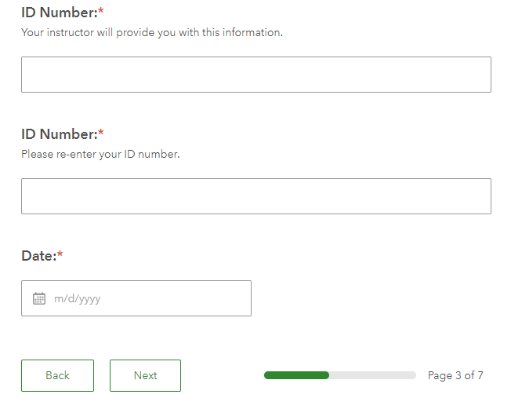
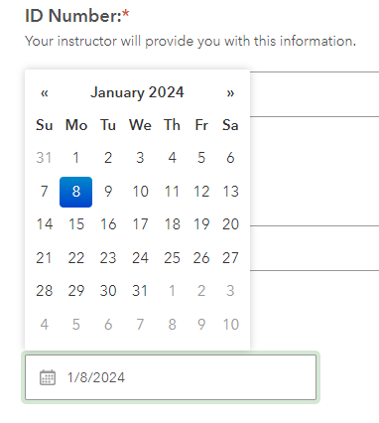
Paper Survey Data Entry Protocol
When entering paper surveys, be sure select the actual date the student took the survey rather than the date you are entering the survey. We use these data!

Slide 14
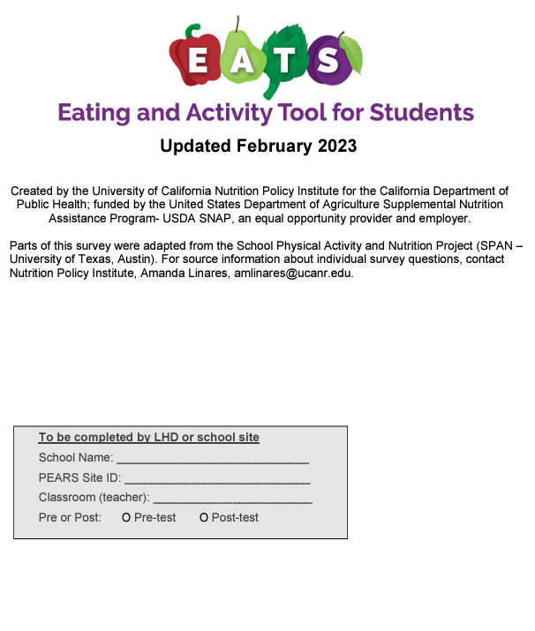
Paper Survey Data Entry Protocol
The online survey is closed:
Friday 4pm – Monday 4pm.
The day after a weekday holiday.
The entire week after a full week holiday.
If you need to enter paper surveys when the online survey is closed, you can reach out to schedule a time for data entry.
Enter all pre-tests by March 29th!

Slide 15
IOE in PEARS

Slide 16
IOE in PEARS
Recall that because we don’t have the ability to recruit and compensate comparison schools, we’ve migrated to what we call a “dose design”.
We will calculate the “dose” of intervention at your IOE site.
DE + IE + PSE (site-level) + PSE (district-level) = dose

Slide 17
IOE in PEARS
All of your interventions include DE, and most also include a mix of PSE (site and/or district) and IE.
As such, all activities contained within your larger IOE intervention will be entered into PEARS.
If you expect the intervention component will likely reach IOE participants, select Yes for Do activities in this report reach youth who participate in IOE?
Even if you are working in school (vs. after school), select Yes for any after school activities that you would expect could reach IOE participants.

Slide 18
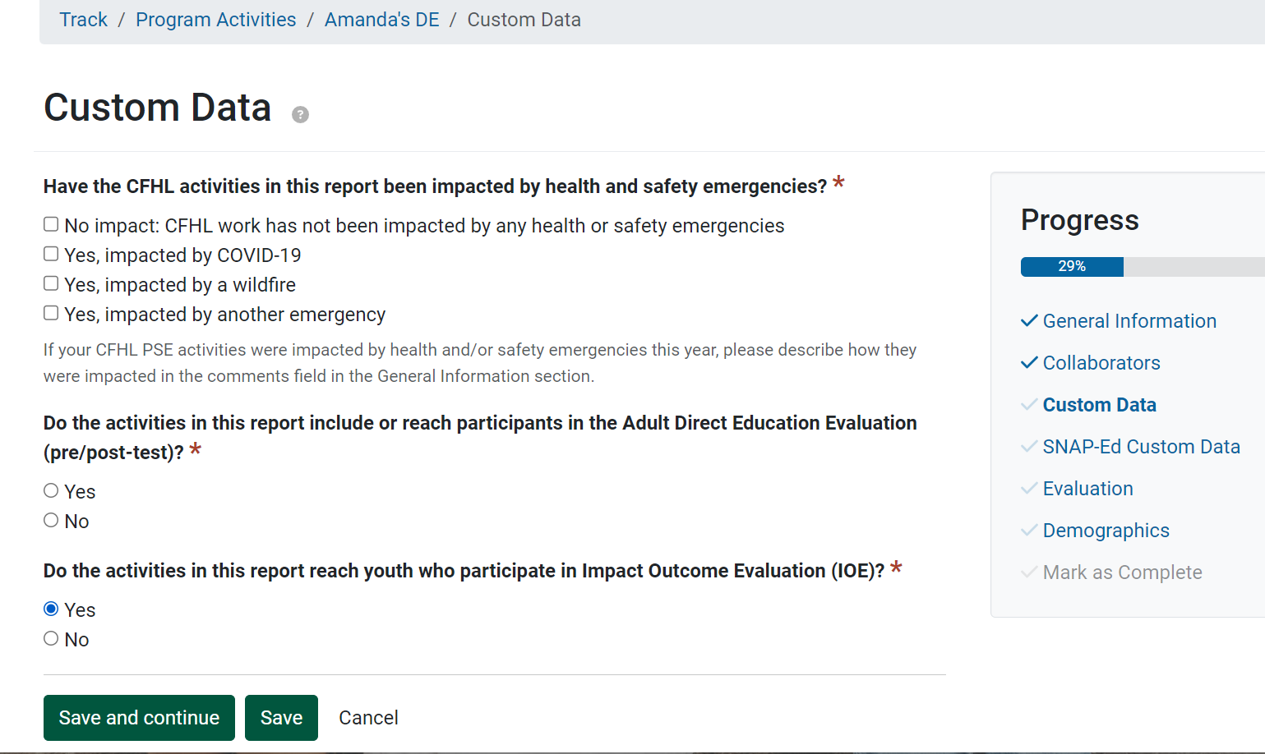
IOE Direct Education in PEARS
For all modules, the IOE question lives in the Custom Data section.

Slide 19
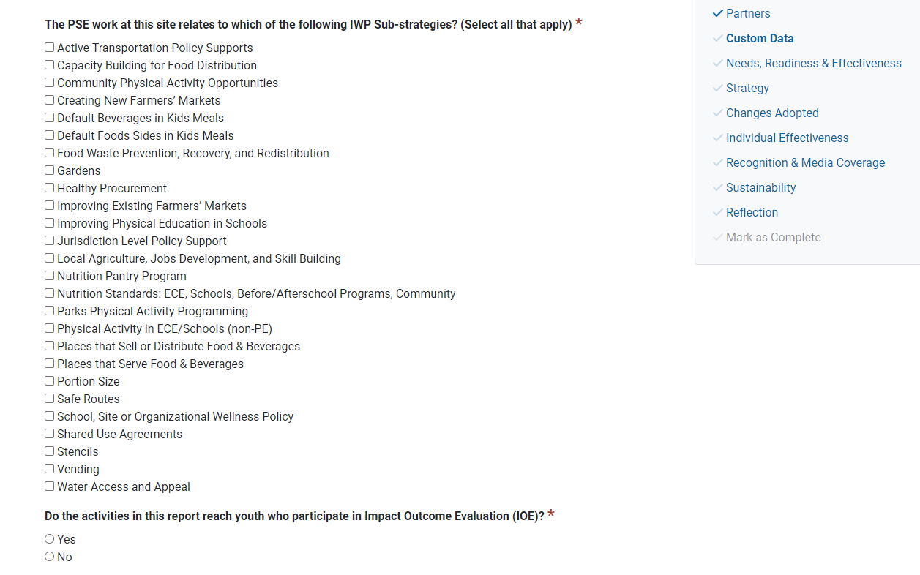
IOE PSE in PEARS

Slide 20
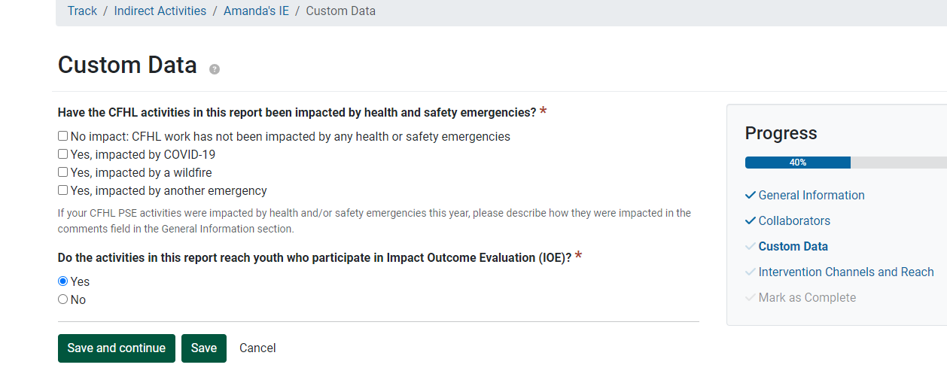
IOE Indirect Education in PEARS

Slide 21
Questions?

