Slide 1
The Louisiana State University Agricultural Center
Sweetpotato Clean Plant Center
A Virtual Tour

Slide 2
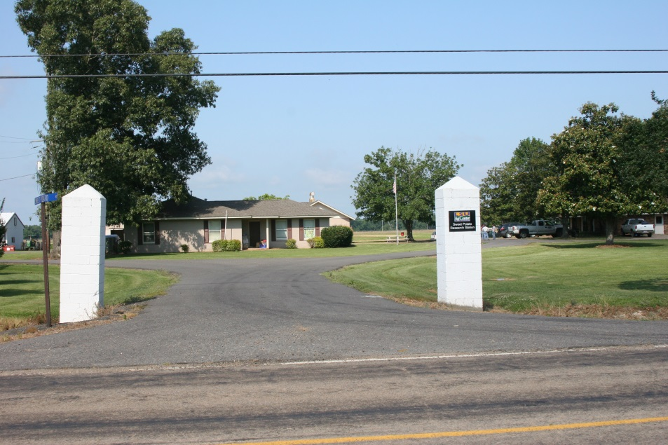
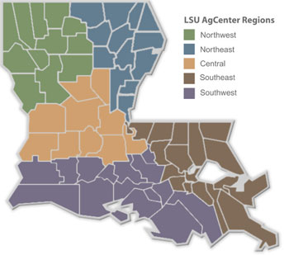
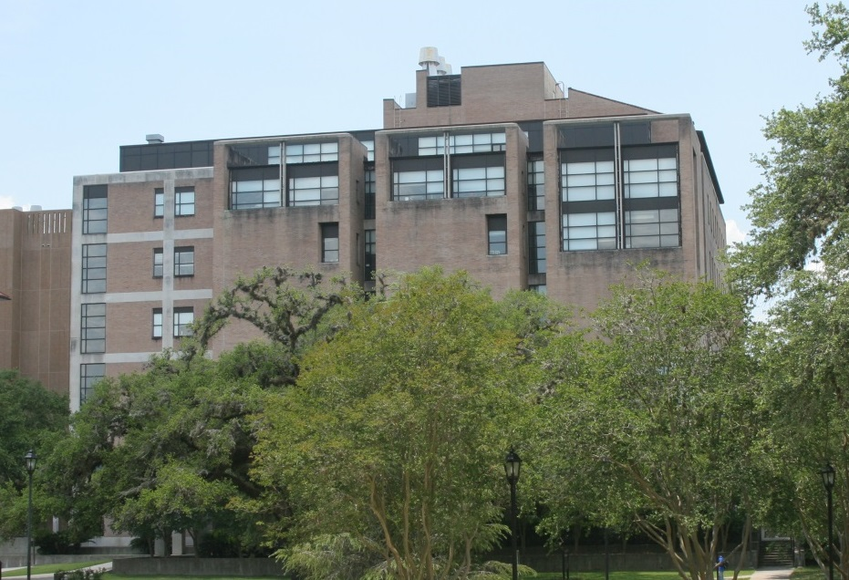
Locations
Sweet Potato Research Station (SPRS)
Department of Plant Pathology & Crop Physiology (PPCP)
Notes:
I wish I had the same information on a less cluttered map

Slide 3
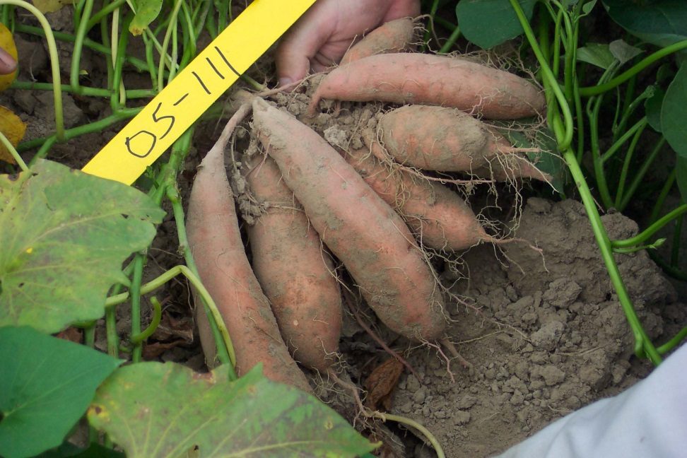
The Clean Seed Processes
Step 1.
The breeder provides a hill or selected root that represents the best specimen of the line to be cleaned up.

Slide 4
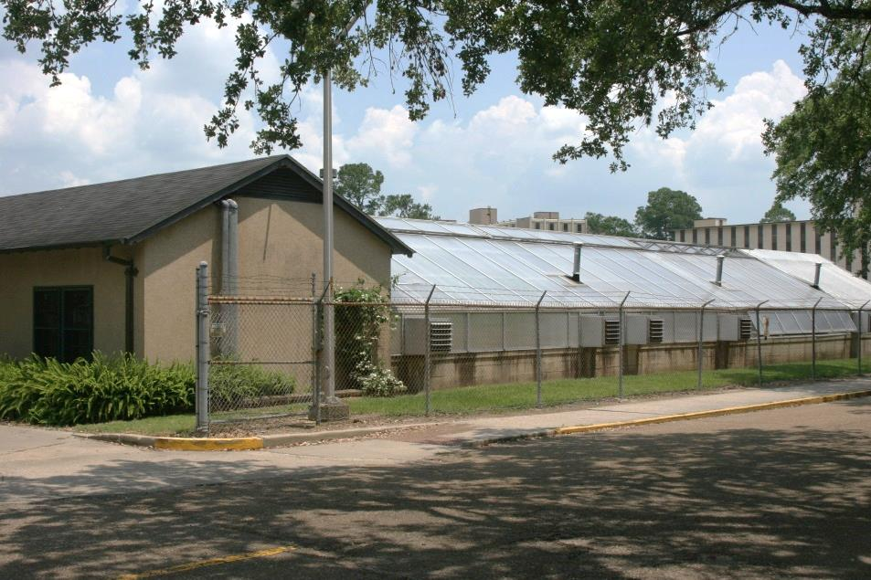
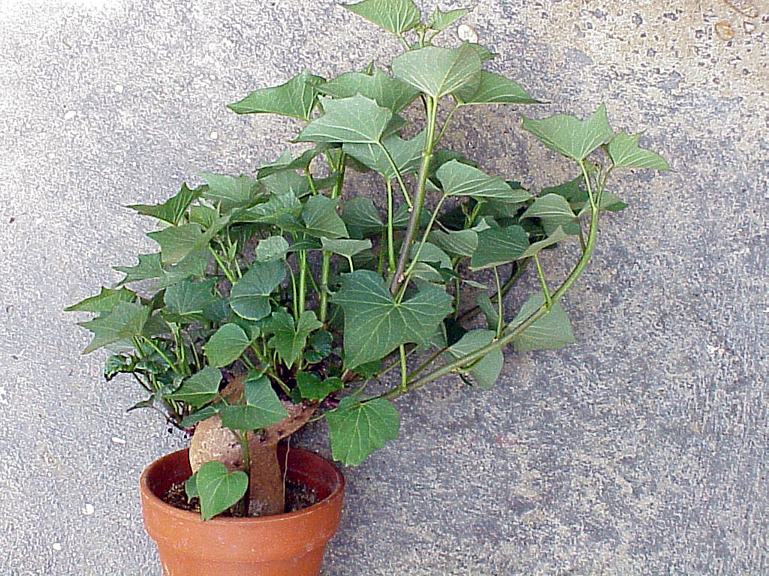
Selected roots are sprouted in the PPCP campus greenhouse to produce vines for cutting meristems.
Notes:
Add photo of sprouted root

Slide 5
Step 2.
Meristems less than 0.5 mm long are cut from apical and lateral buds from the greenhouse vines.

Slide 6
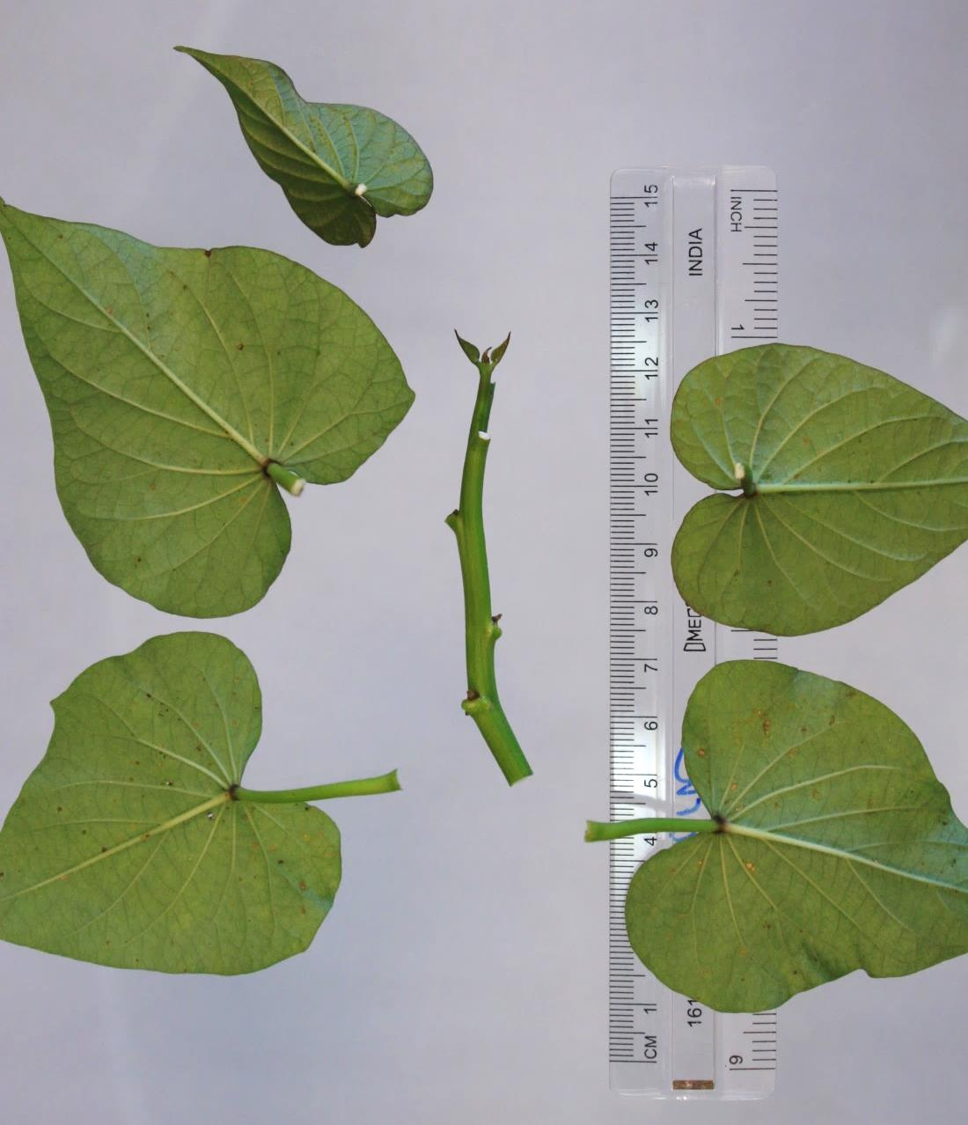
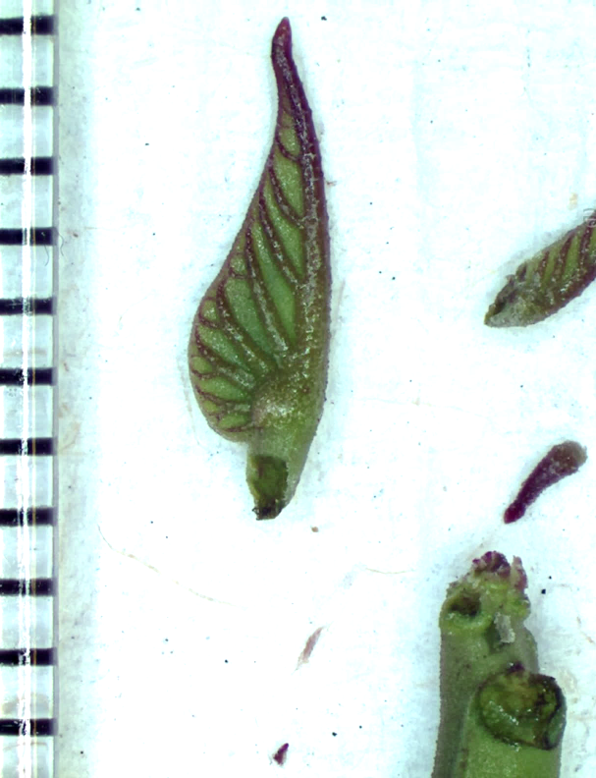
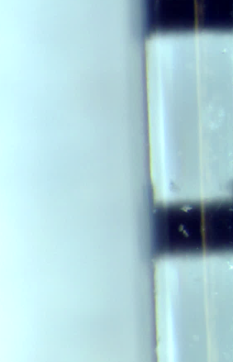
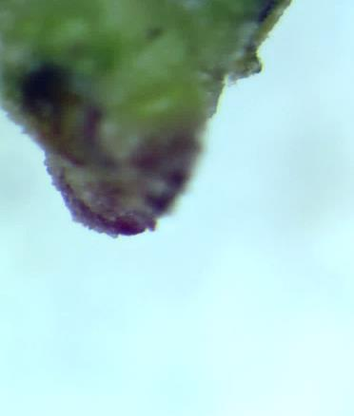
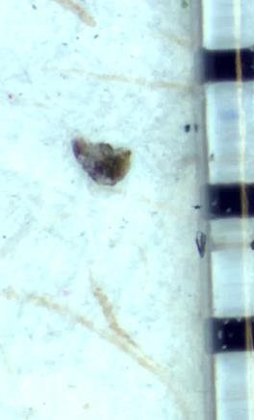
Cutting Meristems
Small unexpanded leaves are removed.
Cut
Large expanded leaves are trimmed off.
1 mm
~ 0.4 mm of apical dome is cut …

Slide 7
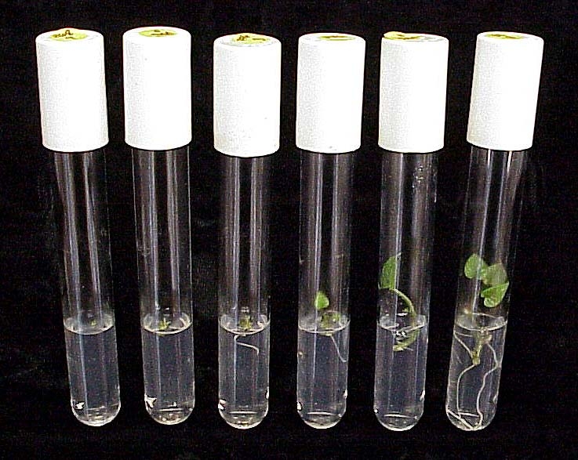
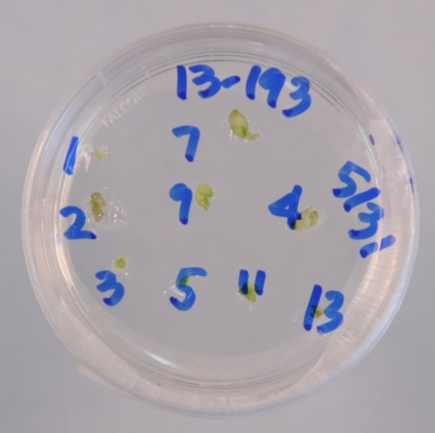
Multiple meristems are cut from each line and placed on media to initiate shoots. As shoots develop, they are transferred to new media and roots form, eventually regenerating a small plant.
Notes:
Better photos for each??

Slide 8
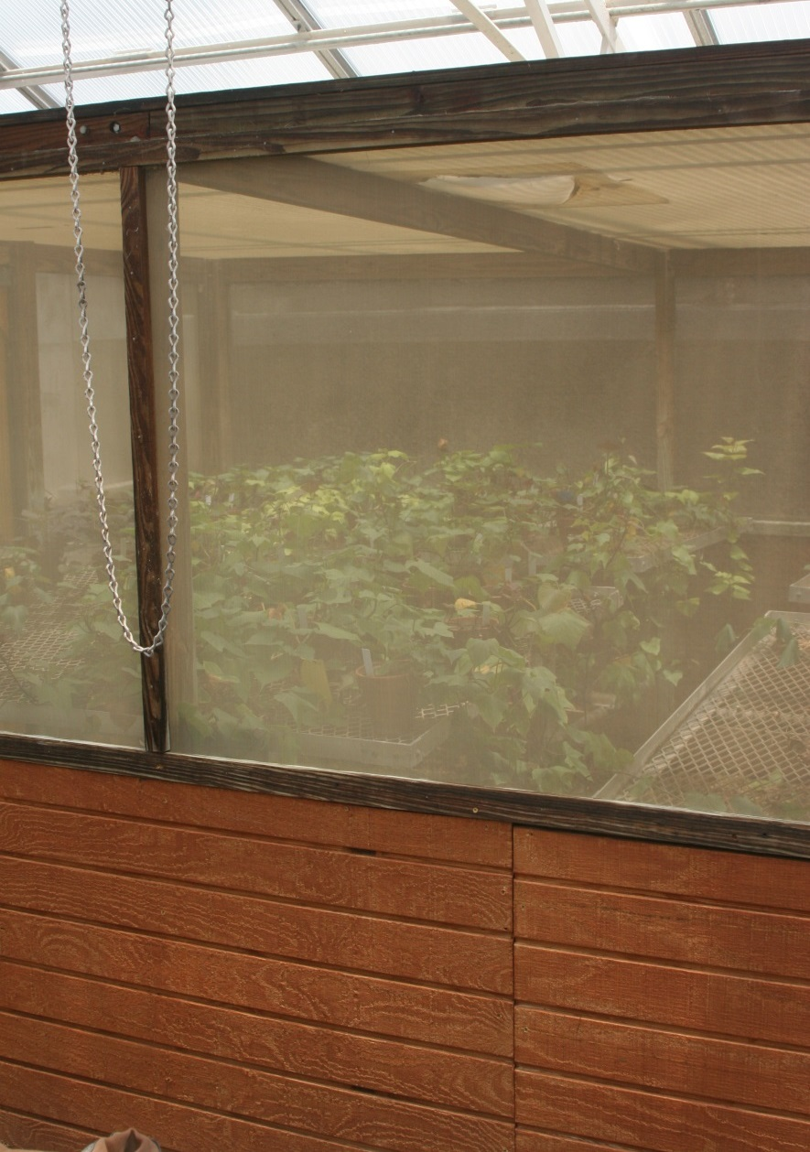
Step 3. Virus Testing
Regenerated plants are kept in tissue culture by nodal propagation, which reduces chances of mutations occurring.
At this time, they are also returned to the greenhouse for testing. They are kept in a screened cage to protect against insect vectors re-infecting them.

Slide 9
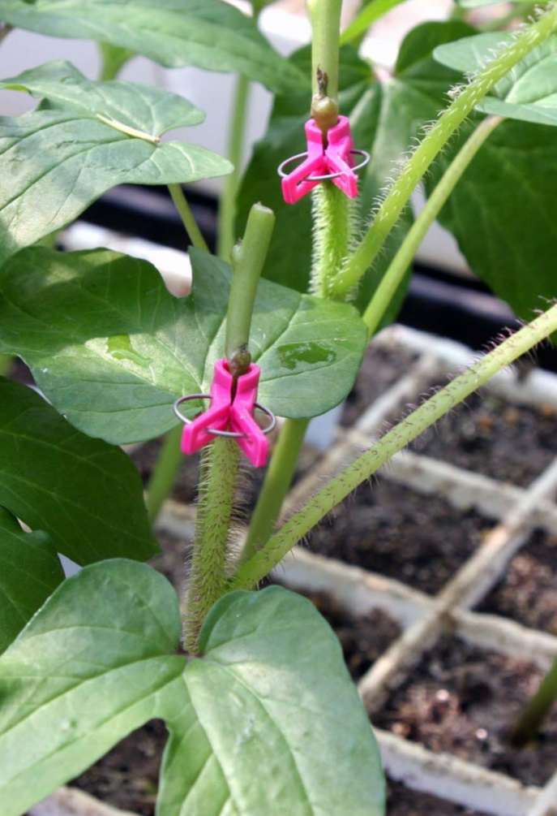
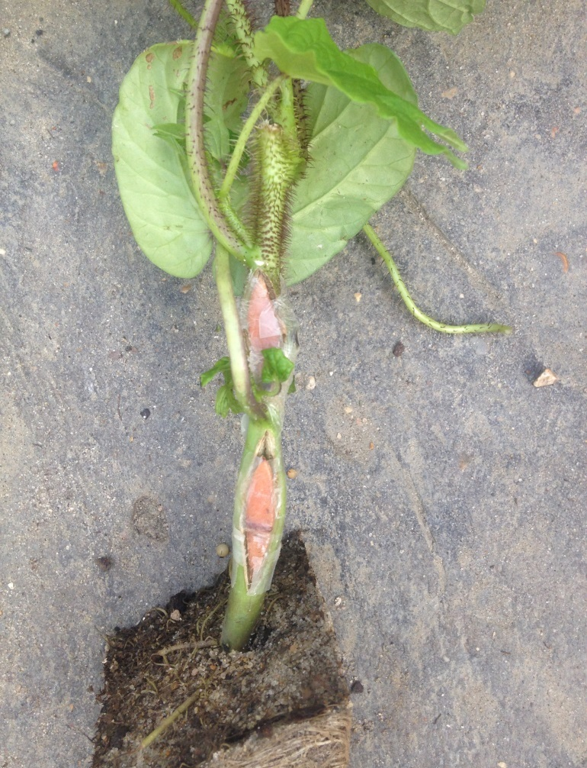
Virus Testing Biological indicators – the traditional approach
Ipomoea setosa, the Brazilian morning glory, is used as an indicator host because virus-free plants can be grown from true seed and because it develops distinctive symptoms when infected with sweetpotato viruses. It can be grafted with sweetpotato stem pieces (left) or storage root pieces (right).

Slide 10
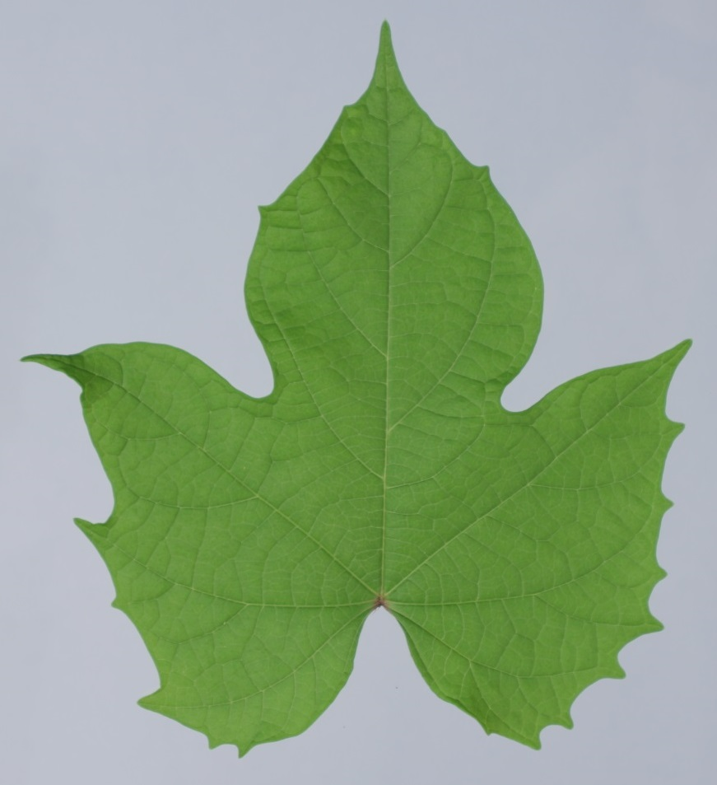
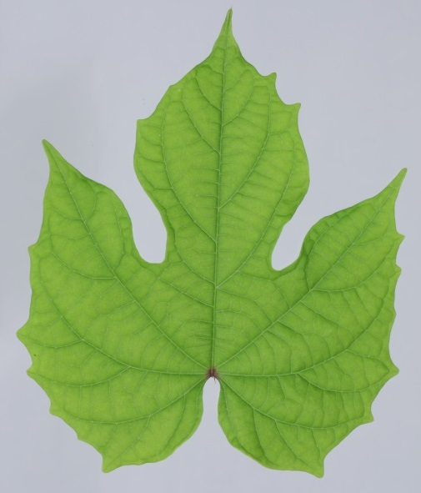
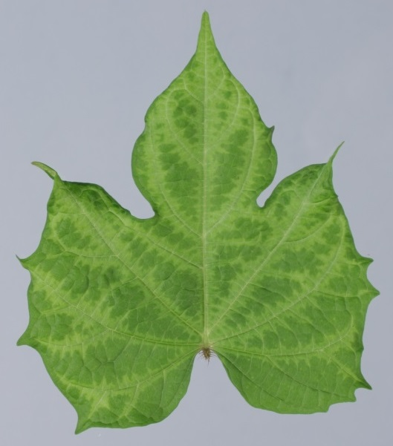
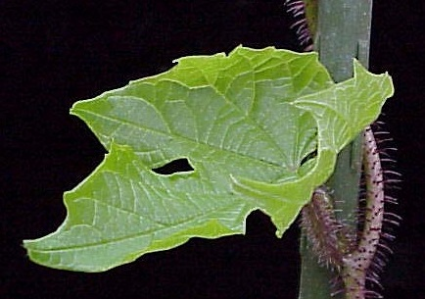
Healthy
SPCSV
SPFMV
SPLCV
Plants that do not induce symptoms on I. setosa after three successive grafts are also tested by molecular tests.
Plants that induce yellowing (SPCSV), vein patterns (SPFMV), leaf curling (SPLCV) or other virus-like symptoms are considered infected and the tissue cultures are discarded.
Notes:
Compendium photos used, request permission?

Slide 11
Virus Testing Molecular tests for the presence of virus nucleic acids
Nucleic acid extraction
Amplification with virus-specific primers
Detection of virus nucleic acid
Potyvirus [SPFMV, SPVG, SPVC, SPV2] multiplex PCR (Li et al., 2012)
Geminivirus [SPLCV] (Li et al., 2004)
Crinivirus [SPCSV] (Wei and Nakhla)

Slide 12
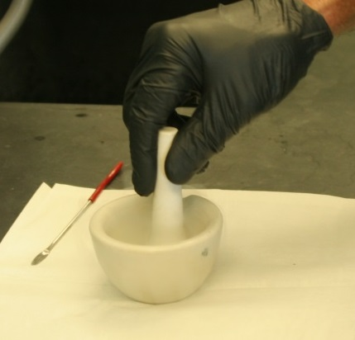
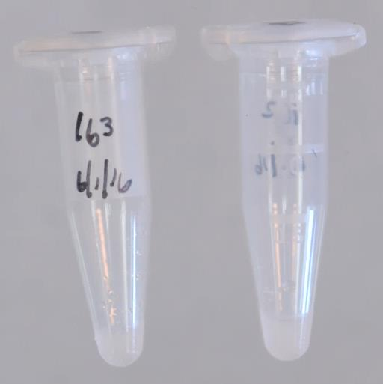
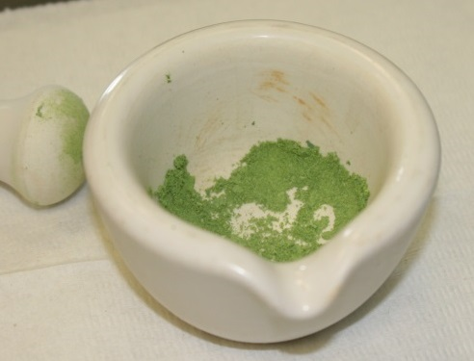
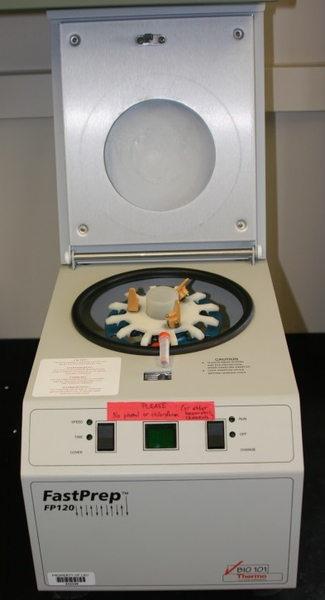
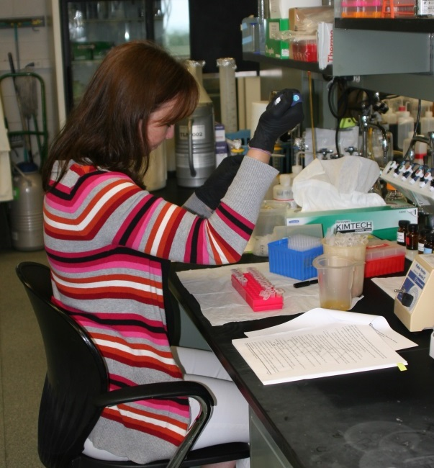
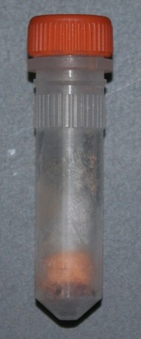
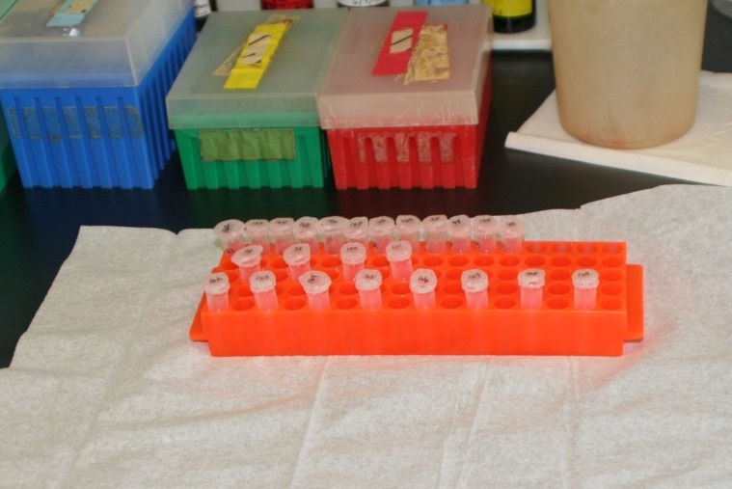
NUCLEIC ACID EXTRACTION
(Li et al., 2008)
Leaf or storage root tissue is ground to a powder with a morter and pestle in liquid nitrogen, further homogenized in CTAB extraction buffer in a FastPrep FP120, extracted with chloroform/isoamyl alcohol, and nucleic acids preciptated with isopropanol, washed and re-precipitated with ethanol.
Notes:
Need photos of storage root sampling, grinding in Liq N, Fast Prep tube, Final NA extract

Slide 13
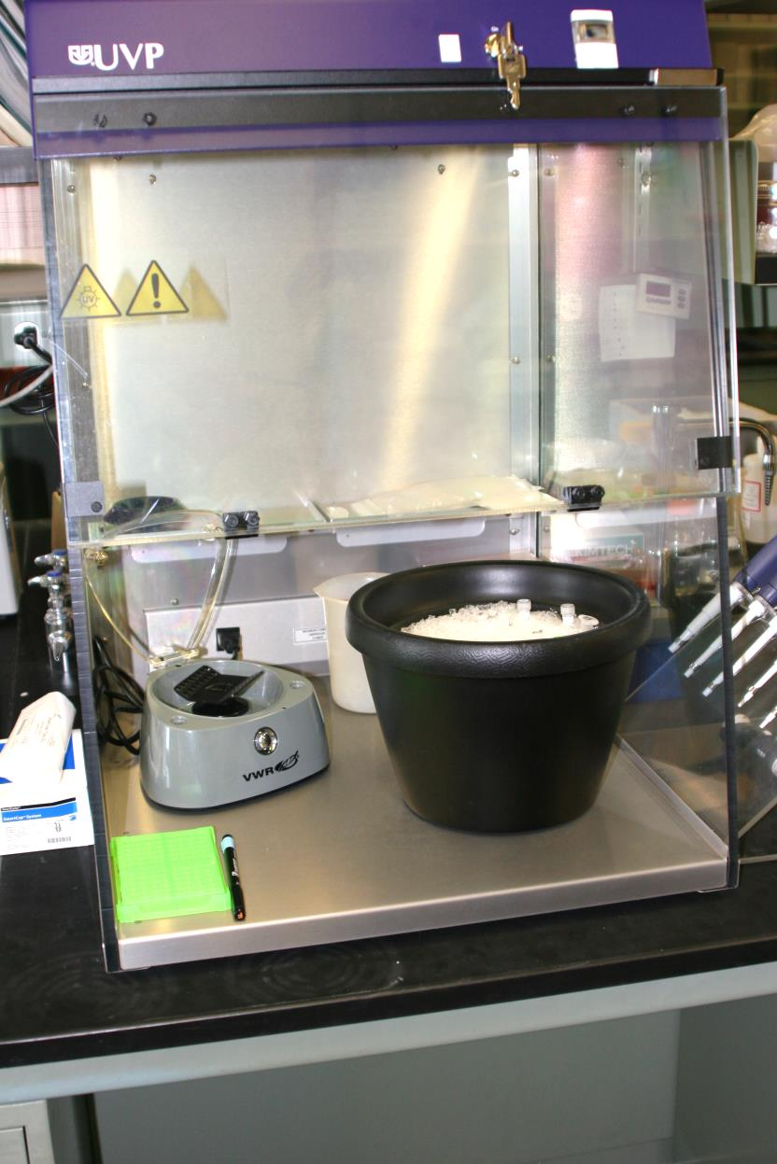
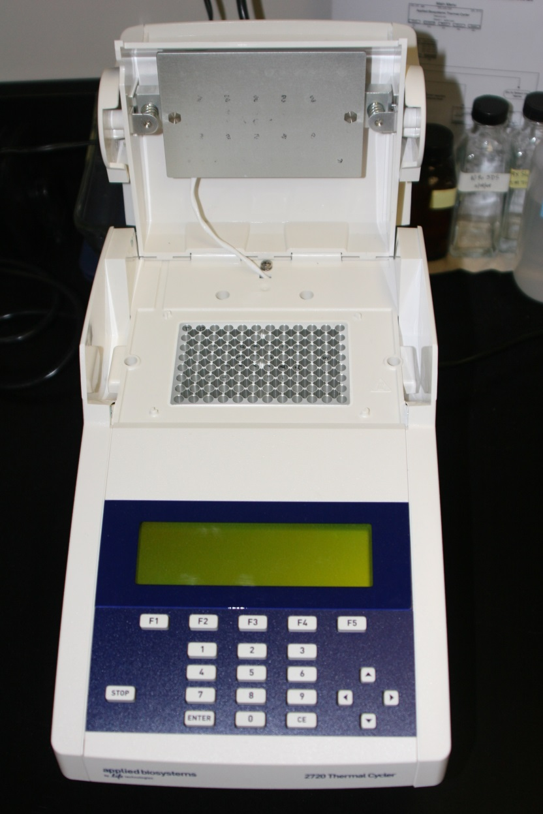
Nucleic acid extracts are added to PCR reagents in a clean hood to avoid contamination of the samples (left), then PCR reactions are run in a thermocycler (right).

Slide 14
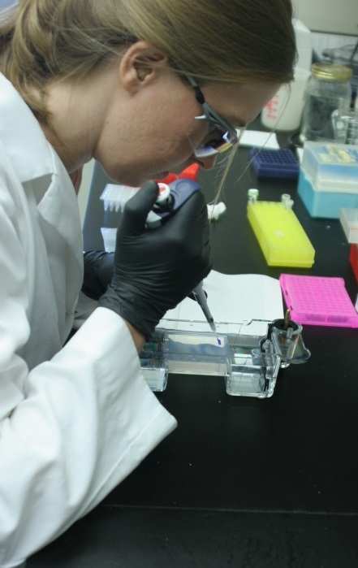
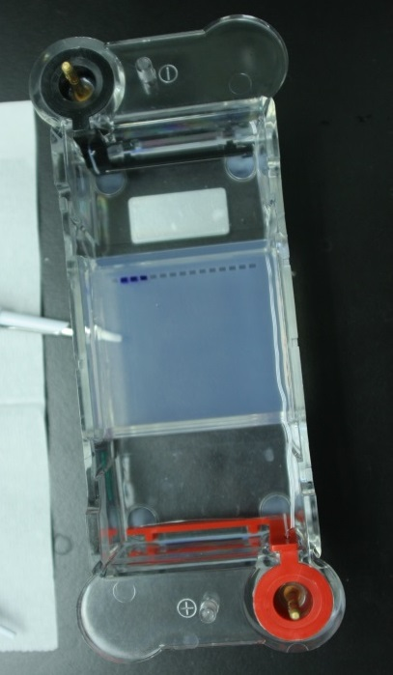
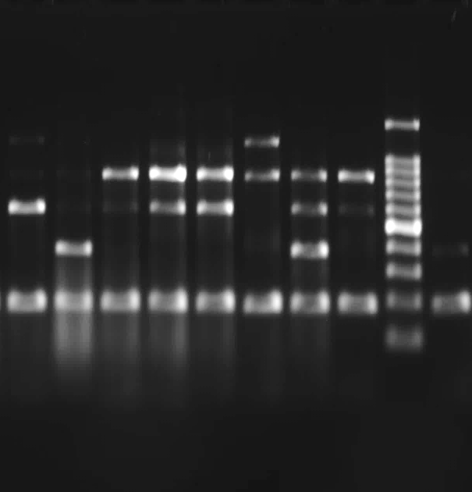
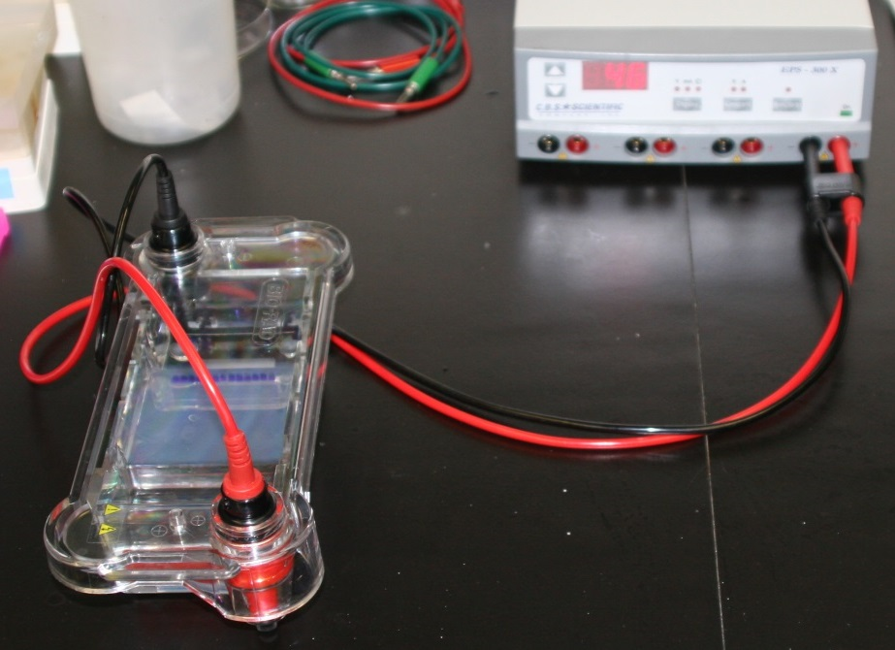
Potyvirus multiplex
- SPVG
- SPVC
- SPFMV
- SPV2
- NAD Int. Std.
Geminivirus
- SPLCV
- Int. Std.
Products of the traditional PCR reactions are loaded into agarose gels (top left) and separated by electrophoresis (bottom left) to reveal bands that represent amplified segments of target virus and an internal control that is normally present in healthy tissue.
Notes:
Add photo of gel rig being loaded. Improve gel photos.

Slide 15
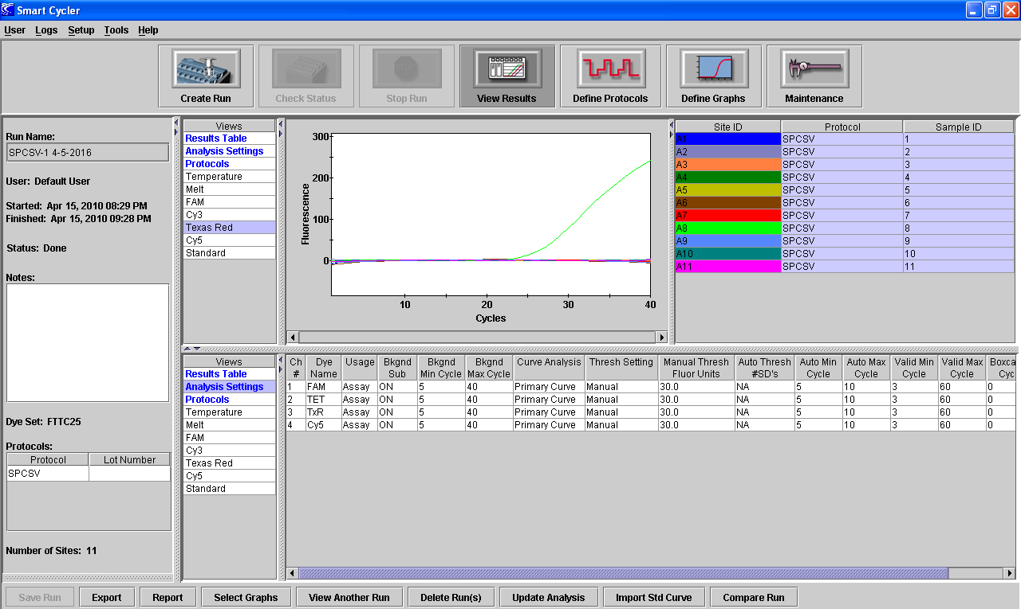
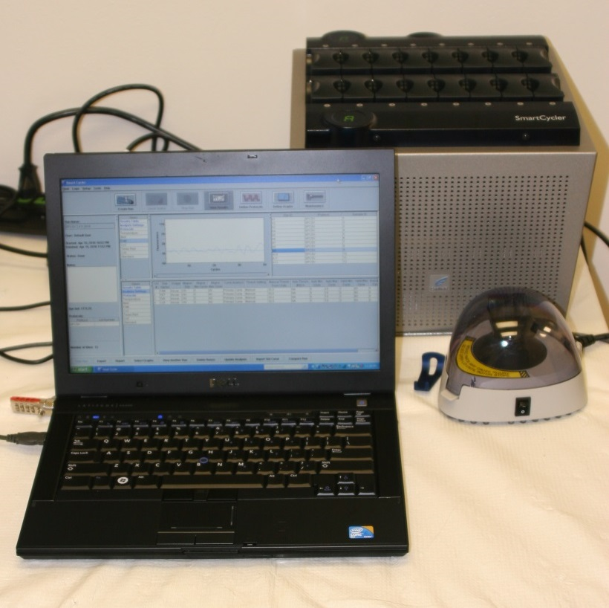
Testing for SPCSV
A Cepheid Smart Cycler housed in the Plant Diagnostic Center (a member of the Citrus NCPN) is used with methods developed by Wei and Nakhla in the USDA, APHIS National Plant Germplasm and Quarantine Lab in Beltsville, MD. This is a multiplex one-step quantitative real time PCR protocol for detection of the East African and the West African strains of Sweet potato chlorotic stunt virus (SPCSV).

Slide 16
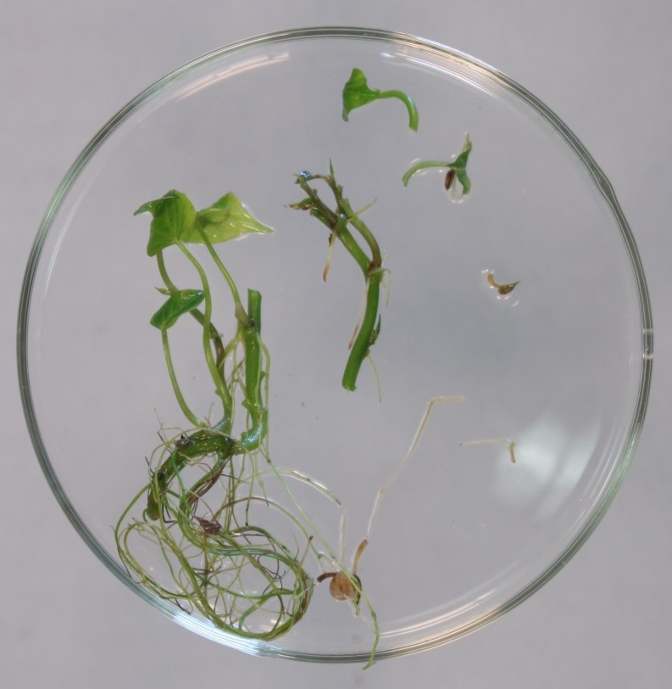
Maintenance
Once tissue cultures are determined to be ‘virus-tested’ (i.e. they are negative in all the preceding tests), they are maintained in tissue culture by nodal propagation. As the plants become large, two-node pieces of stem (encircled) are cut and transferred to fresh media. Since the nodes have preformed buds, they have reduced risk of mutations occurring. For maintenance purposes, one piece would be transferred, however, for rapid micro-propagation, 2-3 pieces would be taken from each plant.

Slide 17
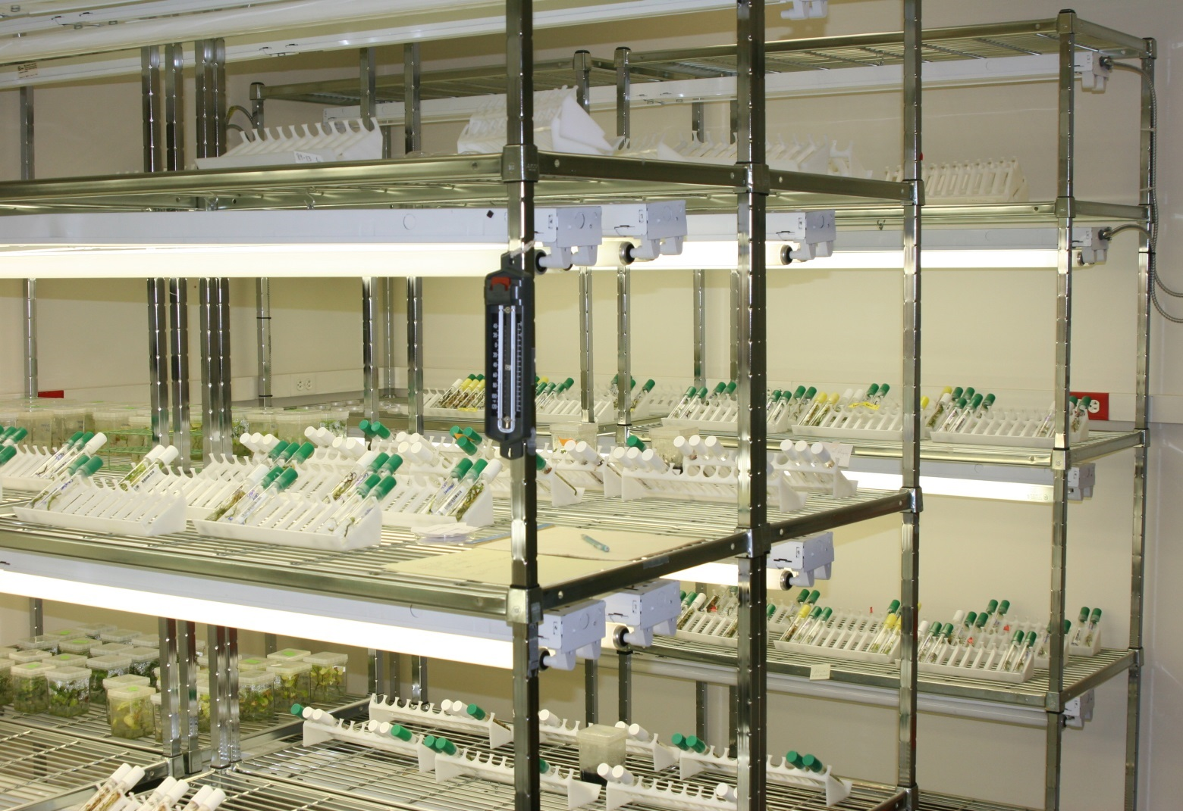
Virus-tested plants and plants undergoing testing are maintained in a tissue culture room with supplemental lighting . The collection generally contains about 100-150 different sweetpotato genotypes.

Slide 18
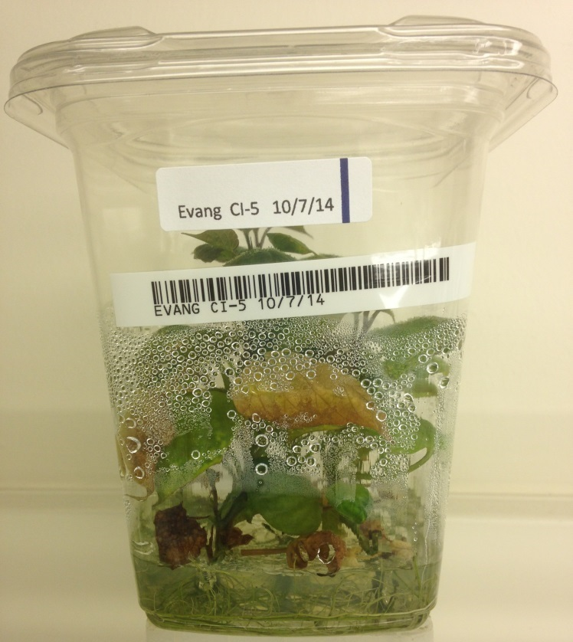
Micropropagation
Each year, those cultivars and breeding lines that will be grown commercially or used in research at SPRS are increased by micropropagation by joint effort with Certis, USA in their lab on the LSUAC campus in Baton Rouge. Tissue cultures are bar coded and tracked through the process. The micropropagated tissue culture plants are then transported to SPRS in Chase…

Slide 19
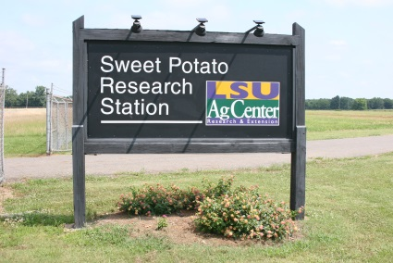
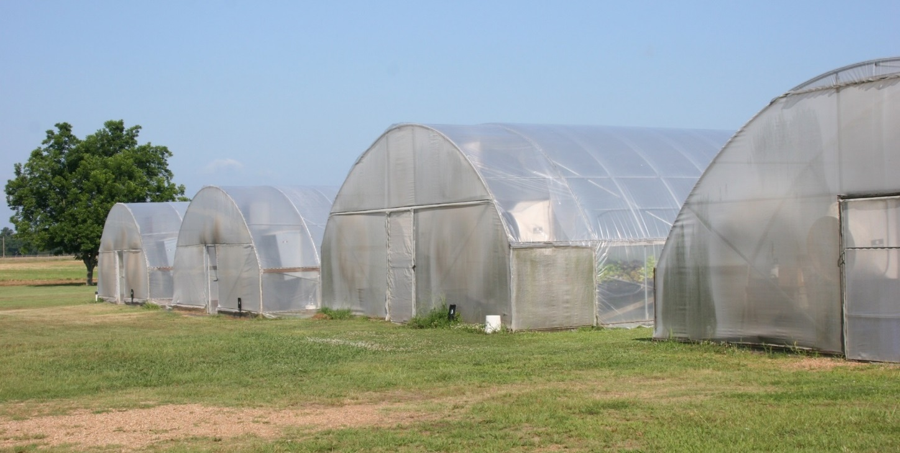
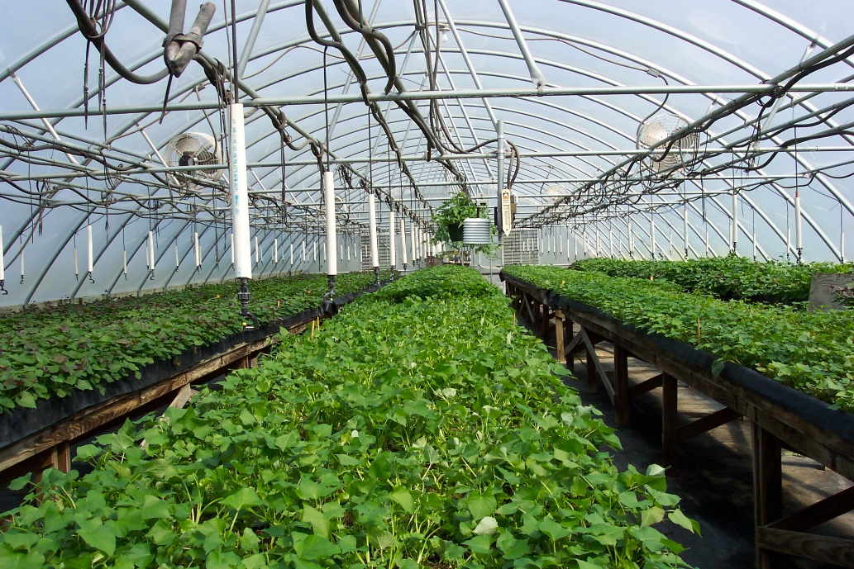
The Sweet Potato Research Station at Chase, LA has five greenhouses totaling 9,200 sq. ft.

Slide 20
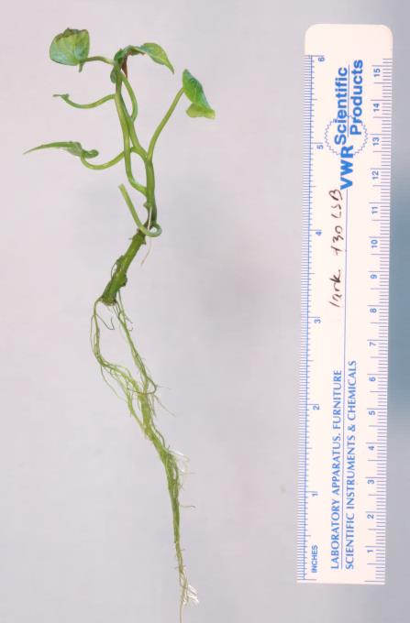
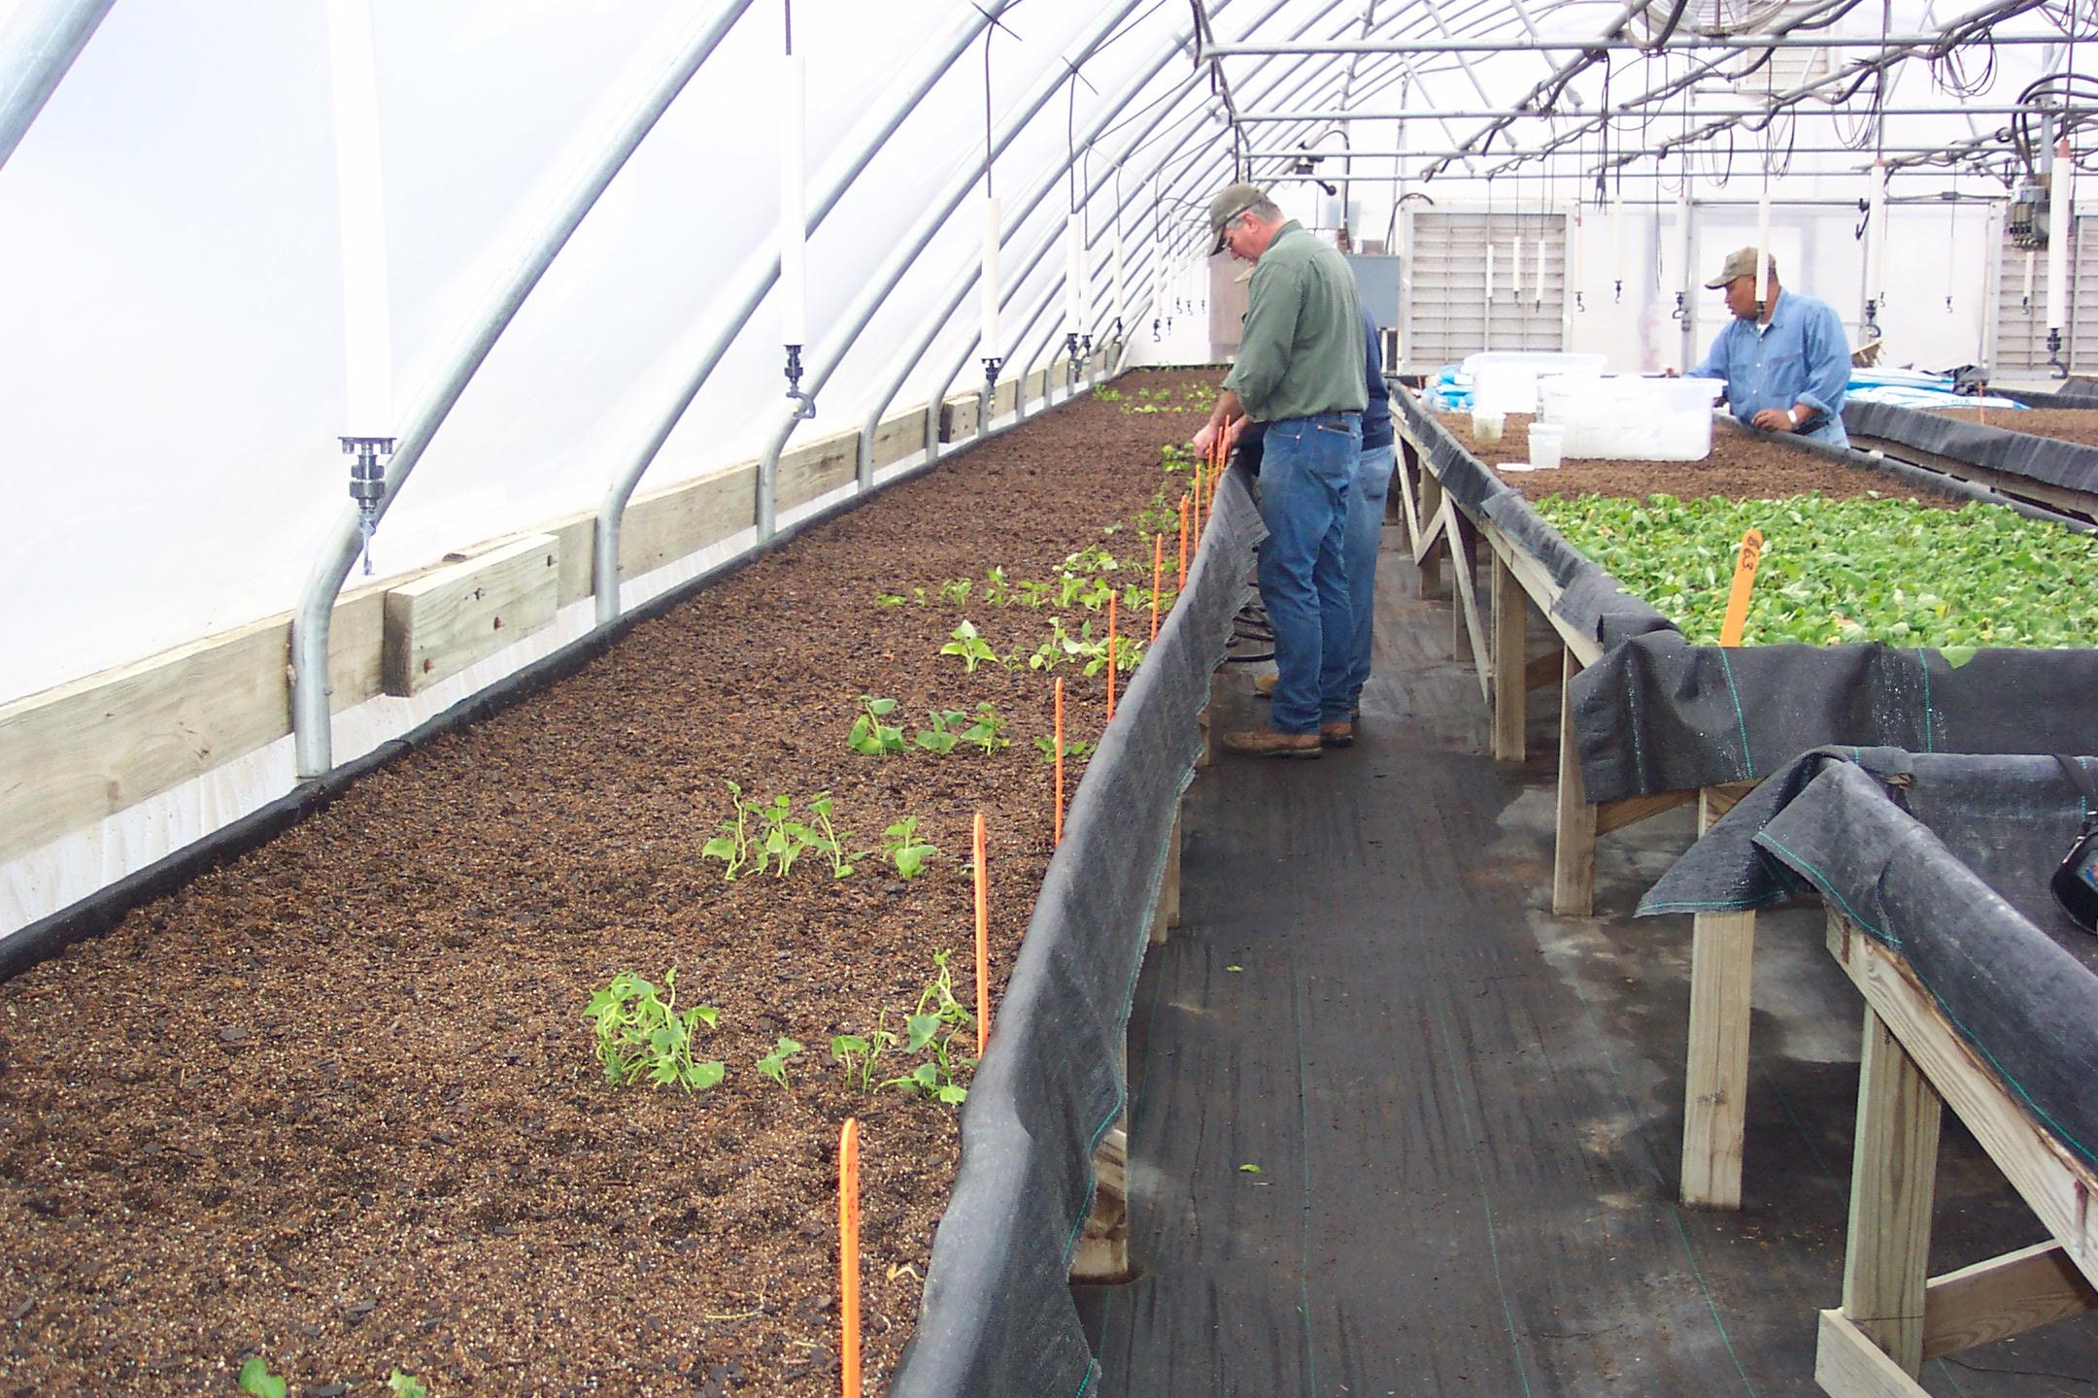
Virus-tested tissue culture plants (inset) are transplanted directly from tissue culture containers into potting mix in benches, or are established…
Notes:
Insert close up of tissue culture plant

Slide 21
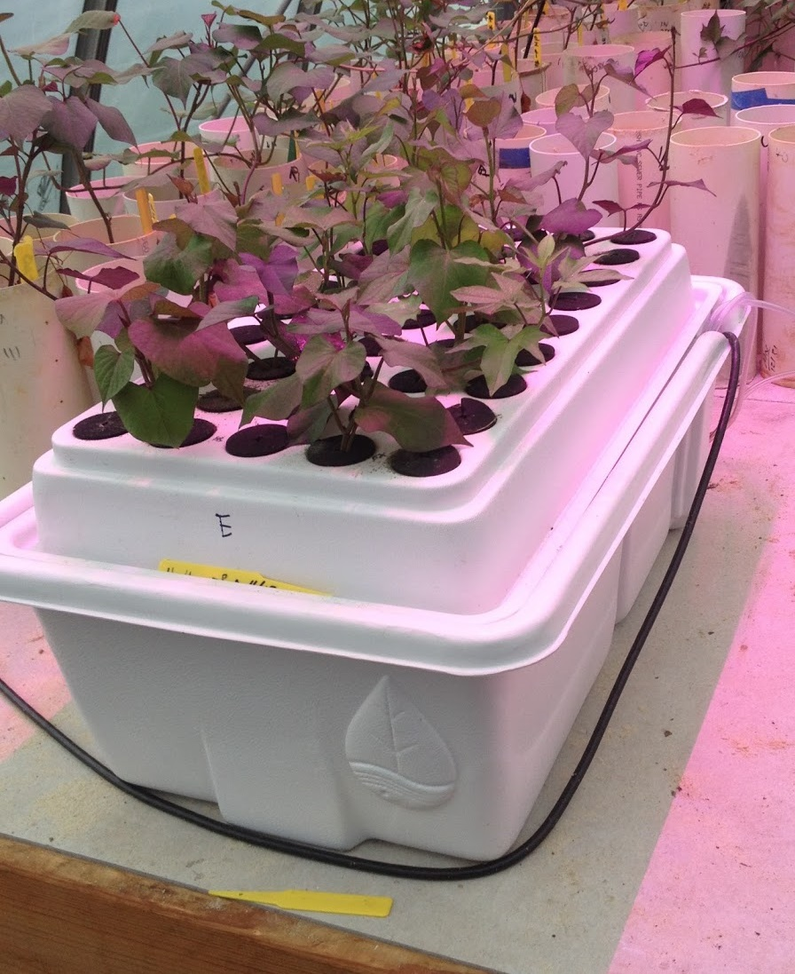
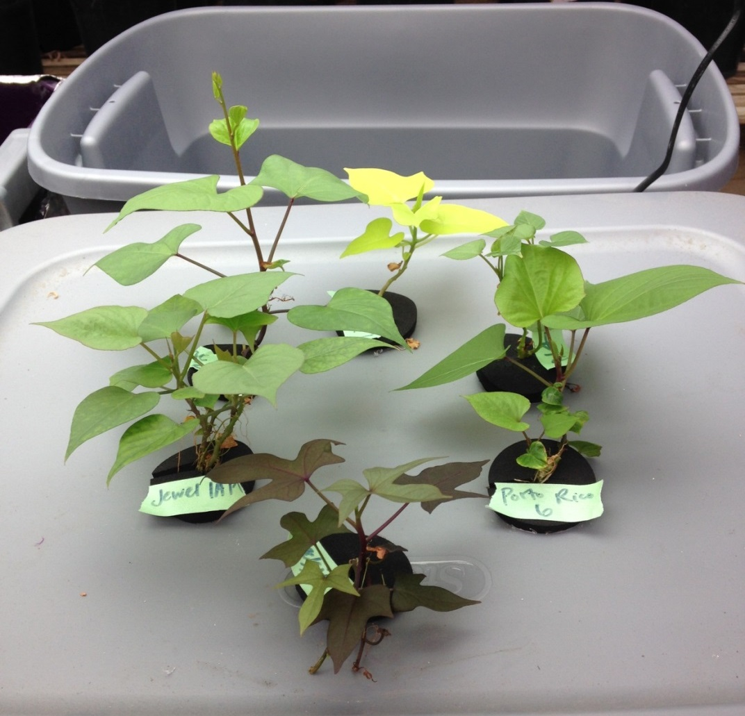
…by planting into aeroponic systems.
Notes:
Campus greenhouse photo – someone at Chase have a better photo?

Slide 22
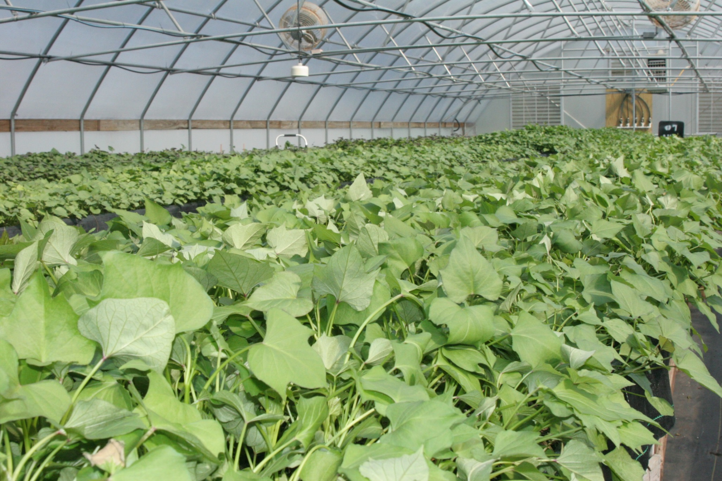
From December through April, the number of plants in the greenhouses is increased by repeated transplanting of vine cuttings.
Notes:
Better to illustrate the vine cutting process

Slide 23
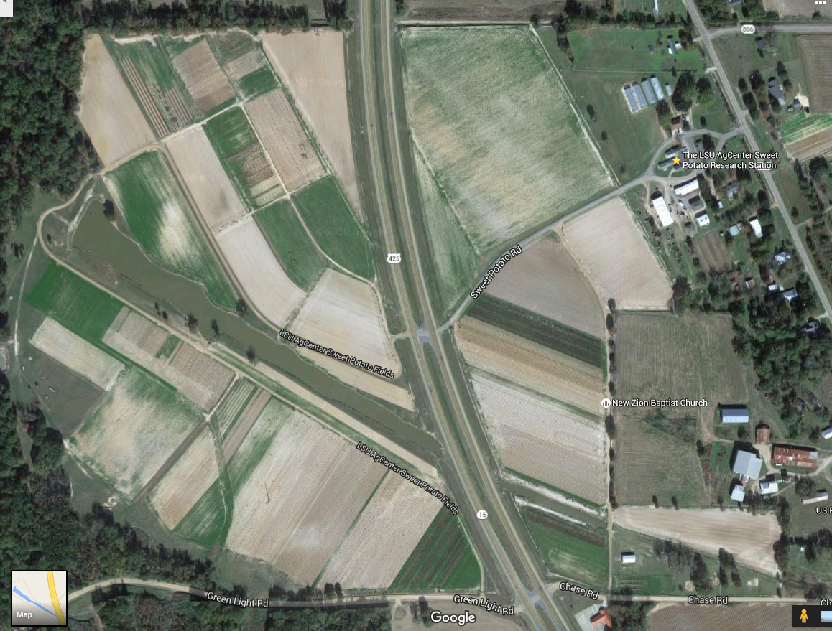
The Sweet Potato Research Station has about 320 acres of cultivated land with an additional 20 acres in use at the Macon Ridge Station four miles north.
In accordance with certified seed law, sweet potato foundation seed is grown in a three year rotation: wheat, soybean, sweetpotato.
Each year, about 45 acres of land are used for foundation seed production.

Slide 24
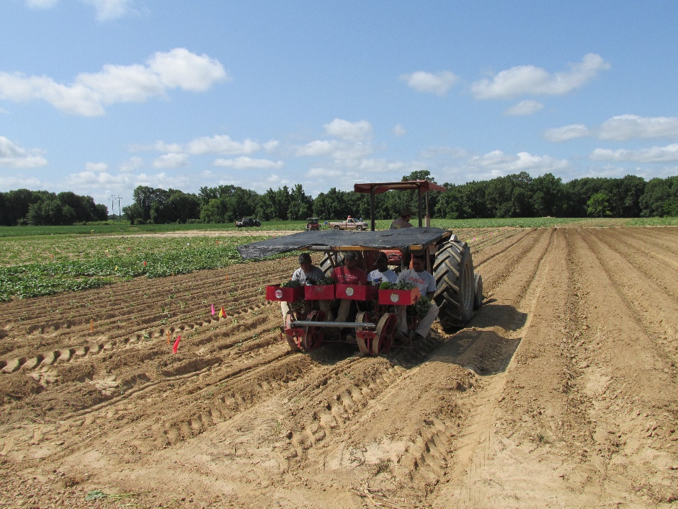
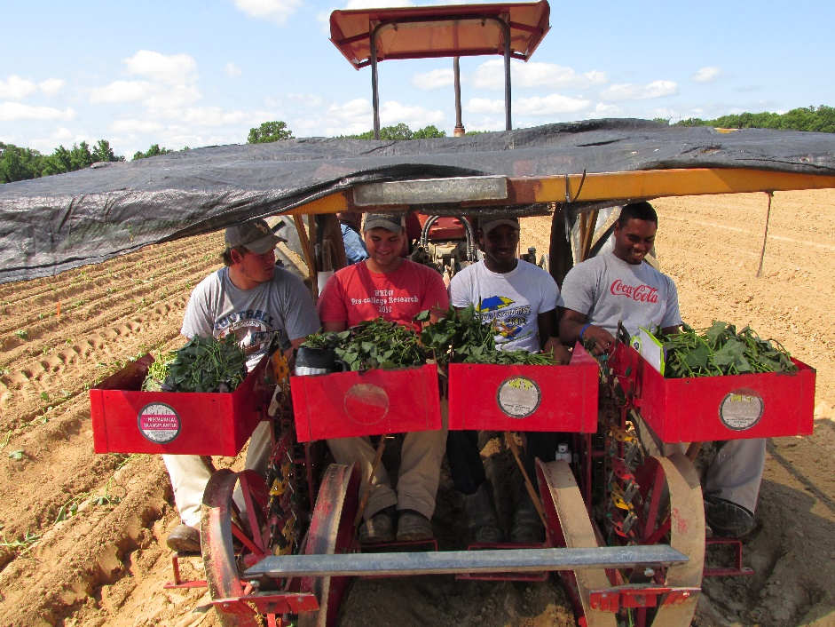
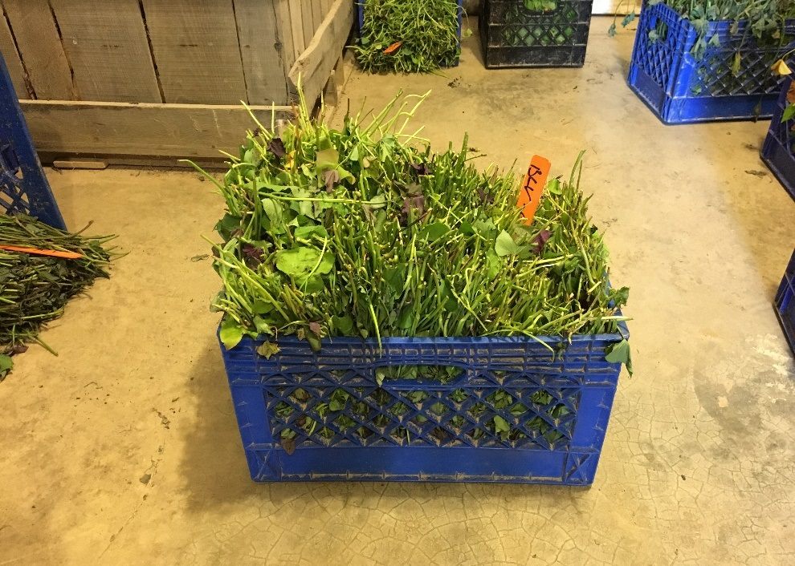
Beginning in late April or early May, vine cuttings from the greenhouses are used to either plant foundation seed fields on the Sweet Potato Research Station (left) or are sold to certified seed growers and/or table stock producers (below).
Notes:
Better planting photo at Chase? Photo of vine cuttings for sale?

Slide 25
Foundation seed is grown at SPRS in accordance with Louisiana Seed Law and is inspected by Louisiana Department of Agriculture and Forestry. In addition, efforts to reduce virus spread include herbicidal control of morning glories.

Slide 26
To further increase production, vine cuttings are also taken from early field plantings to plant late field plantings…

Slide 27
Sweetpotatoes are harvested from August through November and the storage roots are saved as ‘foundation seed’.

Slide 29
The Sweet Potato Research Station has a storage facility with six bays that allows proper curing and storage of up to 15,000 bushels of sweetpotato seed. The seed is stored from harvest until it is distributed to growers in February to March.

Slide 30
SUMMARY
Foundation seed production is focused on production of sweetpotato cultivars developed by the LSU AgCenter, especially Bayou Belle, Beauregard, Belleville, Evangeline, and Orleans but also includes small amounts of heirloom cultivars such as Porto Rico and Heartogold. In the past five years, virus-tested foundation seed has been sold to growers in Louisiana, Mississippi, Arkansas, Missouri, Alabama, Tennessee, Texas, Oklahoma and California; and virus-tested tissue cultures have been provided to Foundation Plant Services in Davis, CA, the Micropropagation and Repository Unit at North Carolina State University, the University of Arkansas at Pine Bluff Biotechnology Laboratory, and Mississippi State University Pontotoc, MS research station. Each year, approximately 20,000 bushels of seed were sold to sweetpotato growers. Sales of vine cuttings from the greenhouses are increasing and efforts are ongoing to expand this aspect of production.
Notes:
Add some summary information on how many plants and seed are sold and to whom they are sold.

