Slide 1
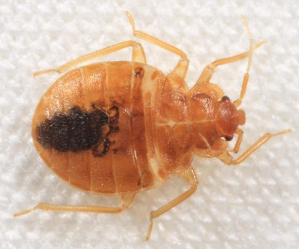


Bed bugs: how to avoid bringing them home with you
Andrew Sutherland
Bay Area Urban IPM Advisor
UCCE and UC IPM
Statewide Integrated Pest Management Program

Slide 2

What’s an Urban IPM Advisor?!
Andrew Sutherland: Bay Area Urban IPM Advisor
  Alameda, Contra Costa, San Francisco, San Mateo, Santa Clara counties
  Professional / commercial landscape IPM
  Structural / industrial IPM
  Urban agricultural IPM
amsutherland@ucanr.edu
http://ucanr.edu/sites/urbanIPM/

Slide 3

What is Cooperative Extension?
Morrill Act 1862, Smith-Lever Act 1914: land-grant colleges CE continuum
  Federal mandates: focus on applied disciplines and extend information to interested public
  Needs shifting from agricultural to health, natural resources, urban community

Slide 4
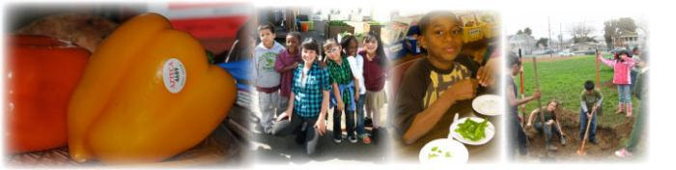

University of California Cooperative Extension
Alameda County:
100 Years & Counting!
We are: Problem-solvers, catalysts, collaborators, stewards and educators.
Since 1914, University of California Cooperative Extension scientists and academics, along with campus and community partners, have been helping make California the nation's leading agricultural state.

Slide 5

http://100.ucanr.edu/Day_of_Science_and_Service/

Slide 6
Outline of presentation
Bed bugs 101
  Biology and ecology
Prevention
  Of introduction (don’t bring them home)
  Of establishment (don’t provide good bed bug habitats)
  Special precautions for at-risk professions
Monitoring for bed bugs
UC IPM (and other) resources

Slide 7
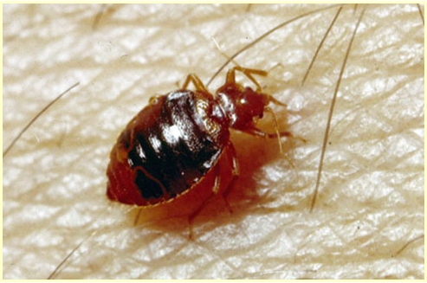
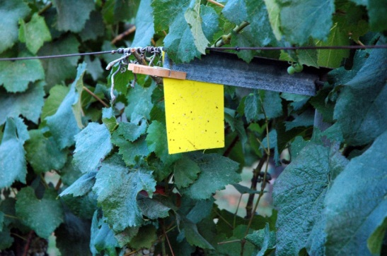
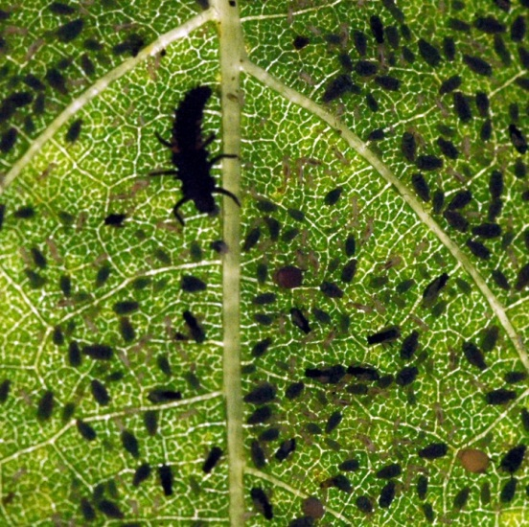
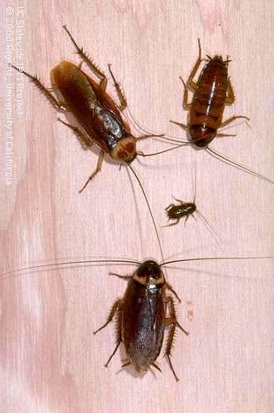
Central tenets of IPM
Education
Prevention
Monitoring
Treatment Thresholds
Multiple Tactics
Integration
Evaluation

Slide 8
IPM for bed bugs
Education
  Biology
    True bug (Heteroptera / Hemiptera)
    Piercing-sucking mouthparts
    Wingless
    Incomplete / gradual metamorphosis
    Obligate haematophages

Slide 9
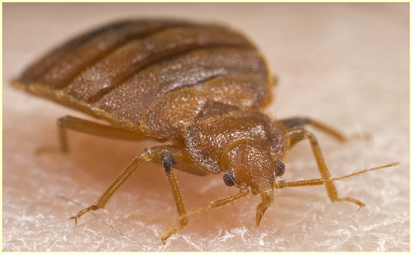
Hemiptera: Cimicidae

Slide 10
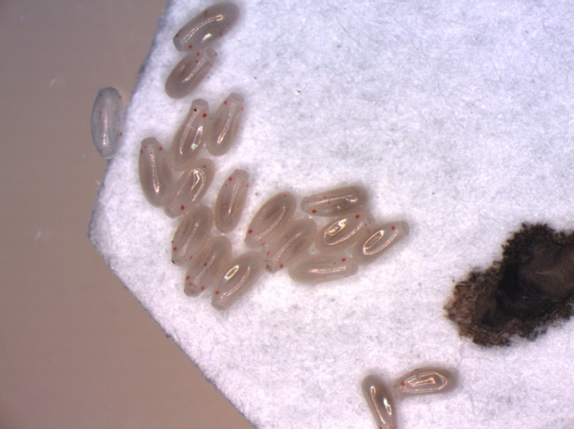

Slide 11
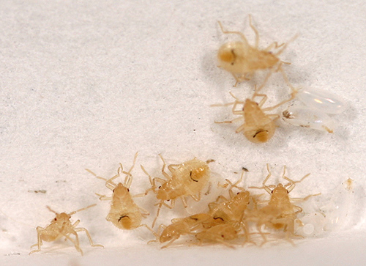

Slide 12
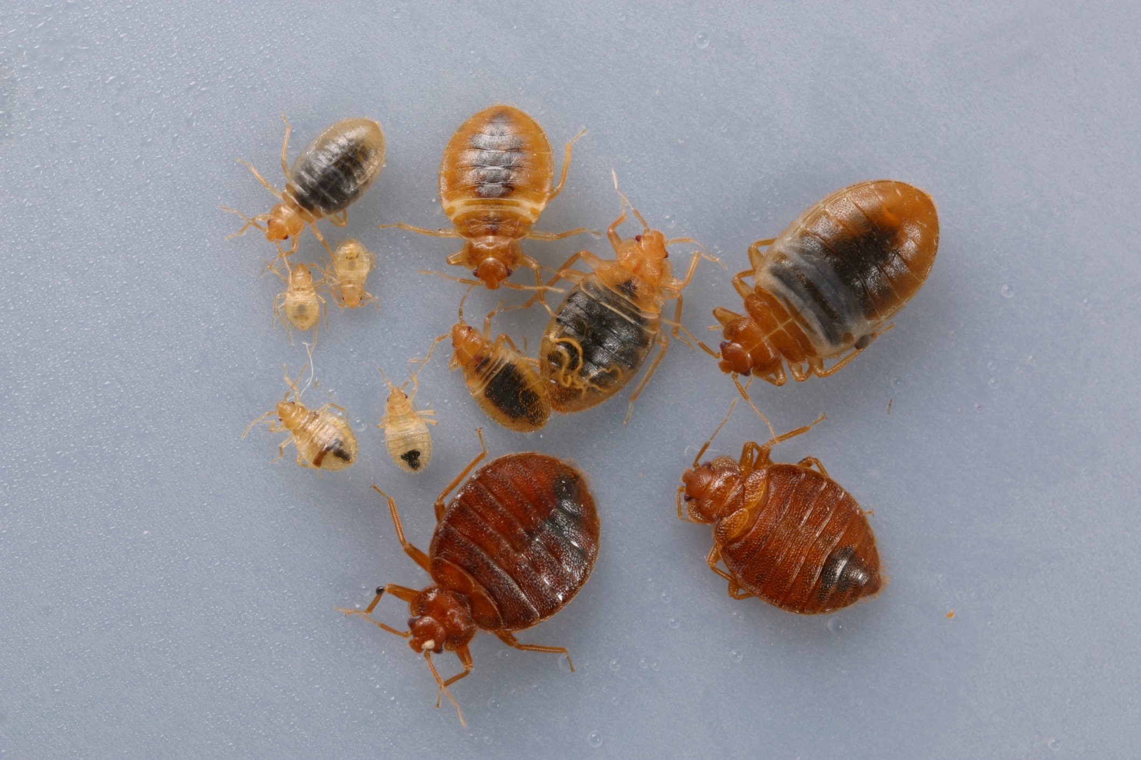

Slide 13
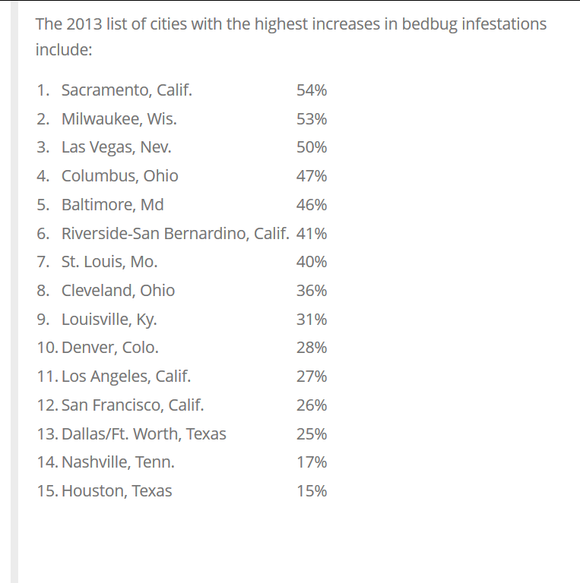

Slide 14
IPM for bed bugs
Education
  Biology
  Ecology
    Nest parasites (require harborage)
    Feed while host is inactive (usually night)
    Development requires regular blood meals
    Can survive months to years without feeding

Slide 15
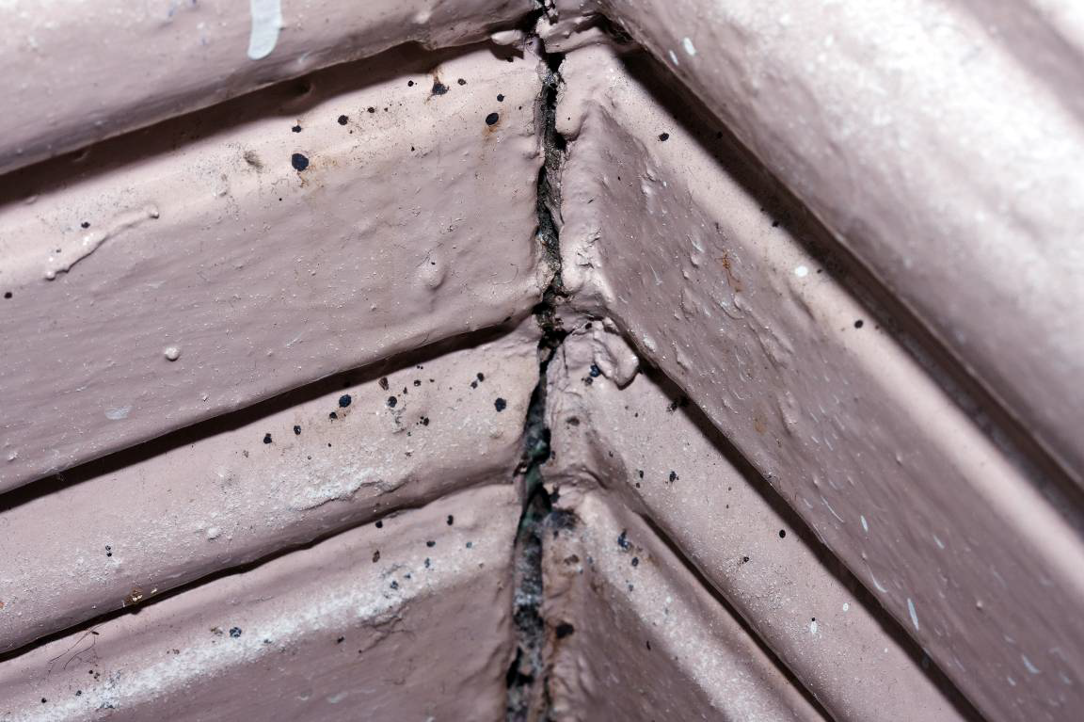
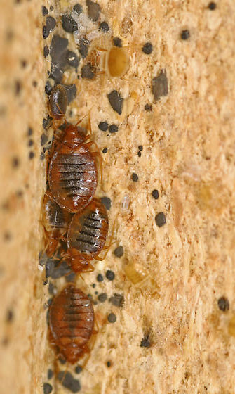
Good bed bug harborage = dark, protected from cold, heat, moisture, within 2m of host, wood, paper or fabric

Slide 16
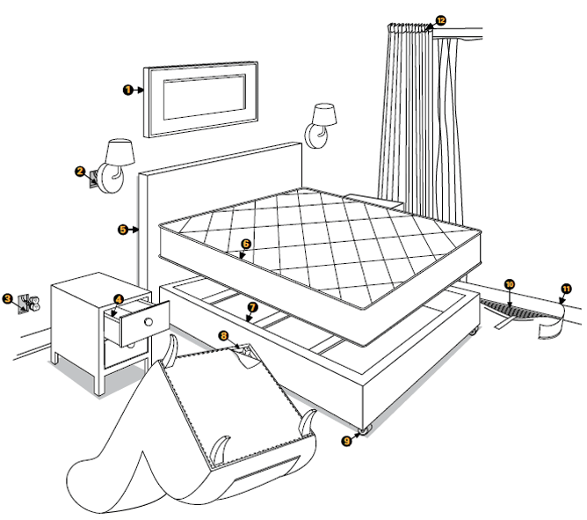

Slide 17
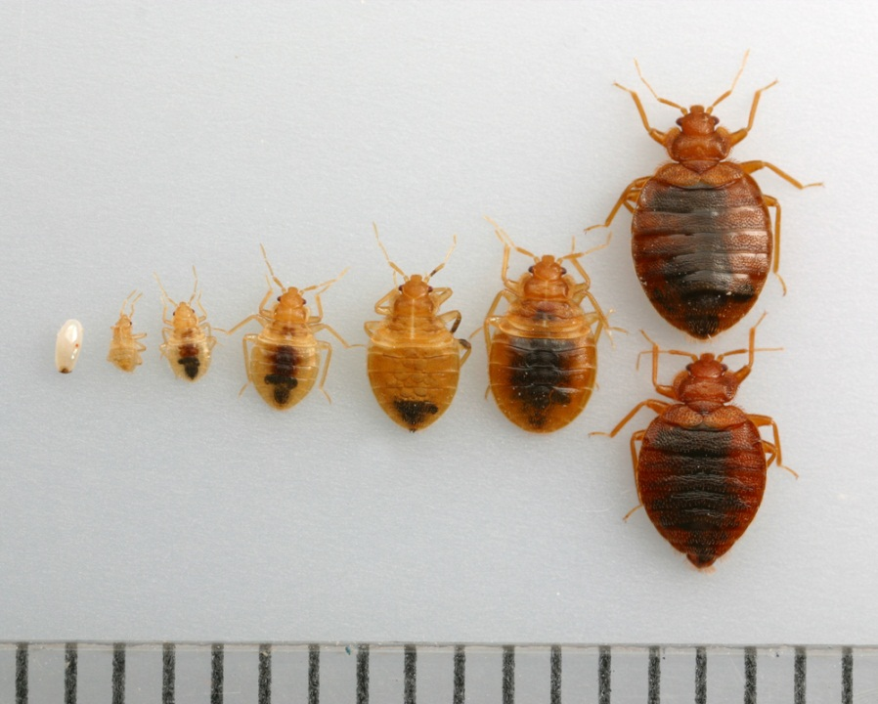
Blood meal required prior to molting, egg-laying

Slide 18
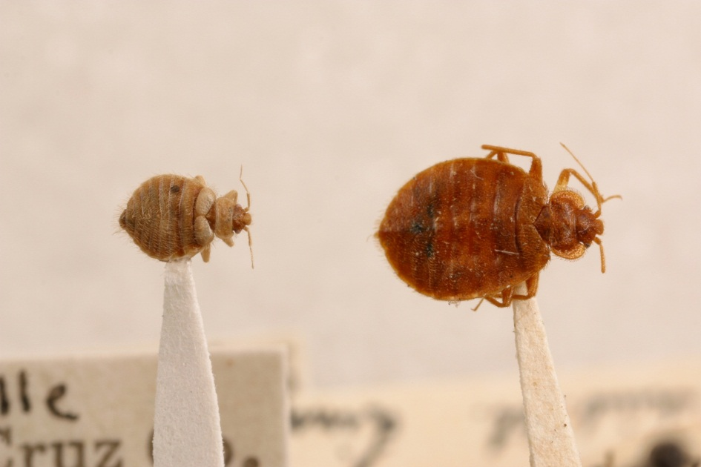
Bat bugs? Swallow bugs?
Related species
Attack bats and birds
Occasionally invade homes
IPM involves management of hosts
Length of hairs on pronotum > diameter of eye

Slide 19
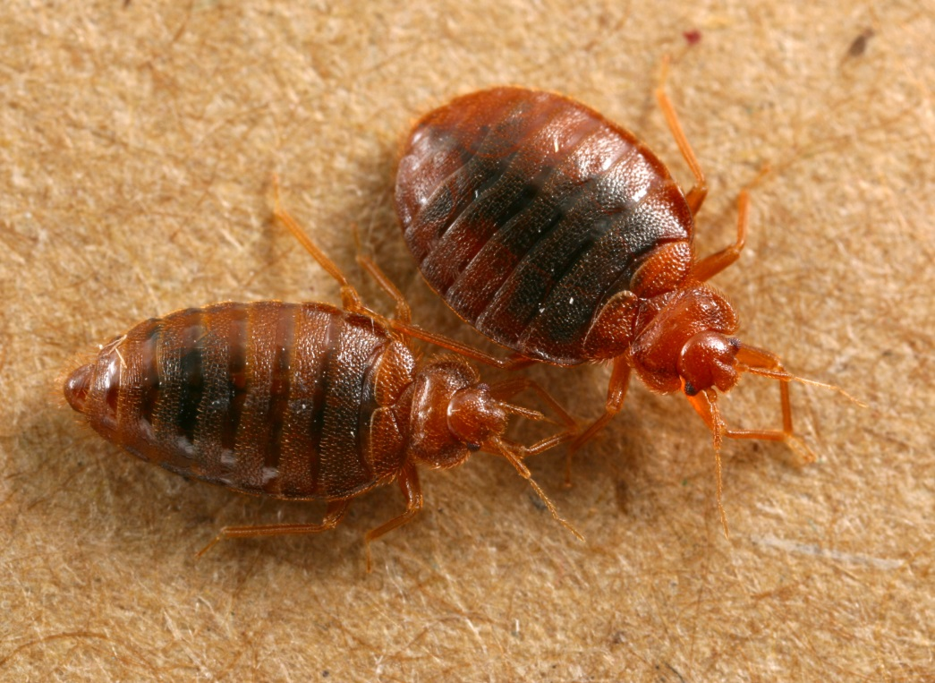
Bed bugs can jump and / or fly
True
False

Slide 20
Bed bugs can jump and / or fly
True
False
Truth: bed bugs must crawl to travel between host and harborage (or be transported)

Slide 21
Bed bugs are microscopic
True
False

Slide 22
Bed bugs are microscopic
True
False
Truth: bed bugs can be seen by the unaided eye during all life stages

Slide 23
Bed bugs are associated with unsanitary, low-class environments
True
False

Slide 24
Bed bugs are associated with unsanitary, low-class environments
True
False
Truth: bed bugs can be found in very clean, very expensive hotels and homes
Bed bugs require only a host and a harborage to become established

Slide 25
Bed bugs have been demonstrated to spread blood-borne disease such as HIV and hepatitis
True
False

Slide 26
Bed bugs have been demonstrated to spread blood-borne disease such as HIV and hepatitis
True
False
Truth: bed bugs have never been demonstrated to transmit any human pathogens

Slide 27
IPM for bed bugs
Education
Prevention
  Of introduction
    Education and communication
    Traveling precautions
    Second-hand furniture
    Infested personal items
    Protection for at-risk professions

Slide 28
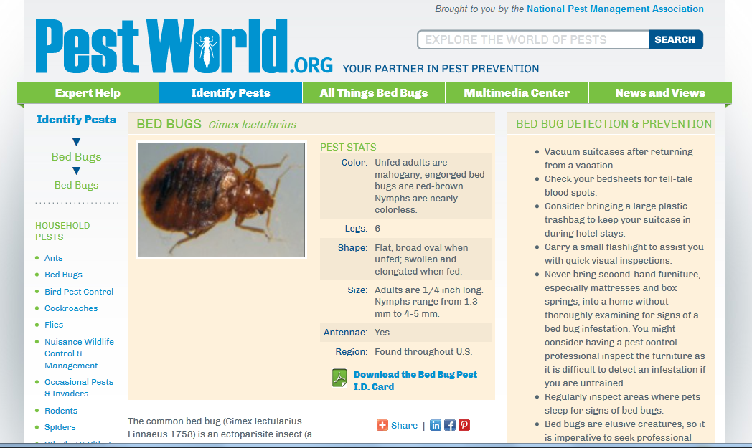
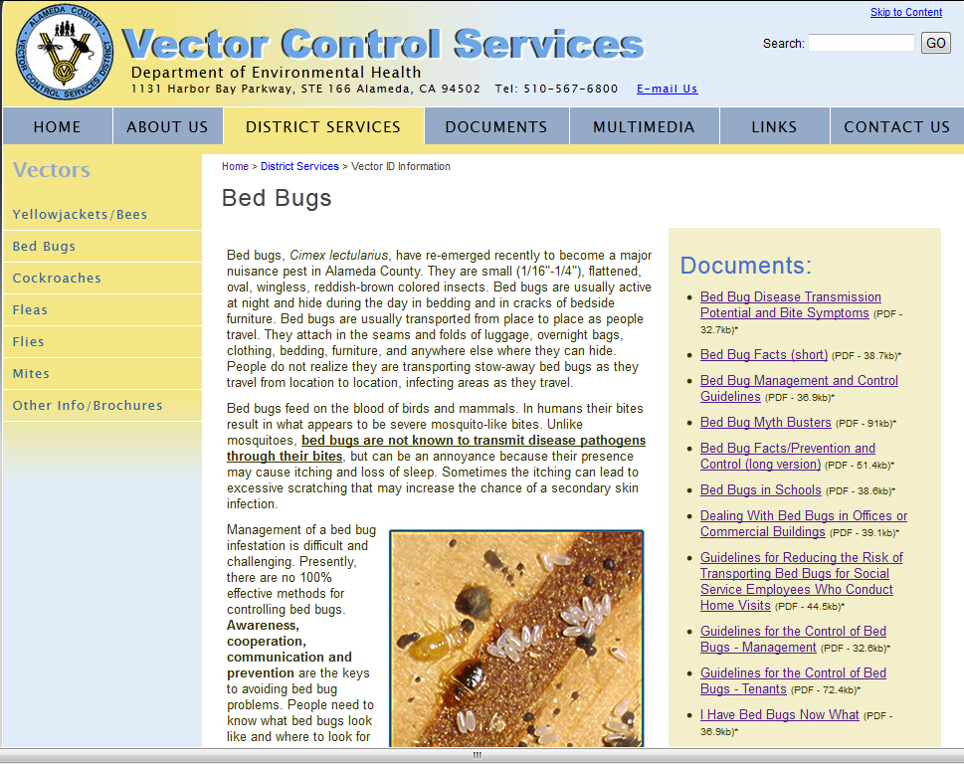
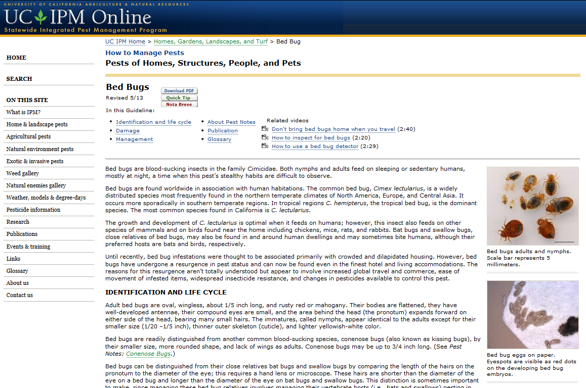
Education for Prevention

Slide 29
Precautions for travelers
Inquire as to bed bug history
Inspect room before unpacking
  Start with mattress (seams, tufts)
  Box spring, head board, bed frame
  Under / in bedside furniture
  Baseboards (within 2m of bed)
  Behind wall hangings
  Carpet joints

Slide 30
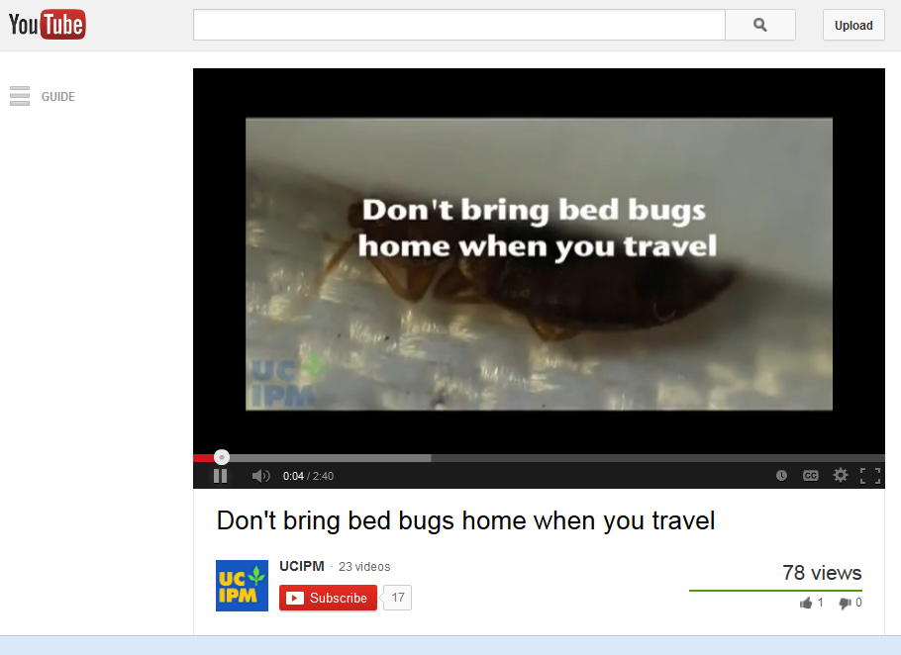
http://www.youtube.com/watch?v=oWCc3Mngo7E

Slide 31
Precautions for travelers
Inquire as to bed bug history
Inspect room before unpacking
Consider sealing luggage
Store luggage on tile surface or on luggage rack, avoid placing near bed, on upholstered surfaces
Report suspected infestation and then change rooms ASAP
Vacuum luggage, wash clothes, properly store luggage upon return home

Slide 32
Precautions for at-risk professions
At-risk: pest management, health care, education and child care, law enforcement, housing / lodging, taxi / bus / transport
‘home visitors’
  Plumbers, electricians, public health, hospice, movers, painters
  County biologists / inspectors

Slide 33
Precautions for at-risk professions
Educate yourself!
Consider dedicated clothing, shoes
  Seal in plastic, leave in vehicle or toolbox
Do not sit down or set down bags on upholstered or wooden furniture
Inspect clothing and shoes often
Consider barriers (Tyvek suit, etc)
Launder at hot settings

Slide 34
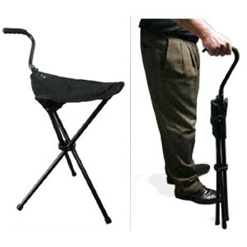
Bring your own chair…

Slide 35
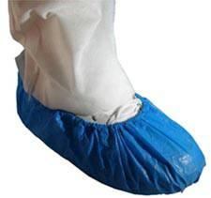
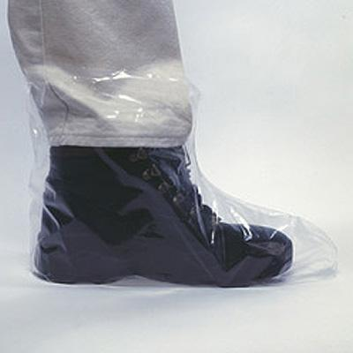

Slide 36

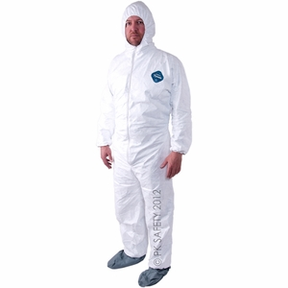

Slide 37
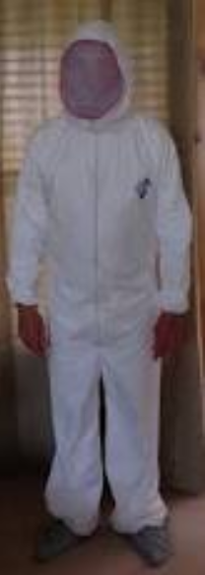
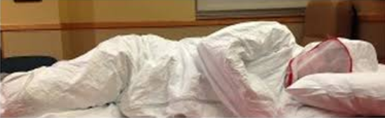
bbpajamas.com

Slide 38
IPM for bed bugs
Education
Prevention
  Of introduction
  Of establishment
    Elimination of harborage sites
    Encasements / barriers
    Appropriate sanitation and maintenance

Slide 39
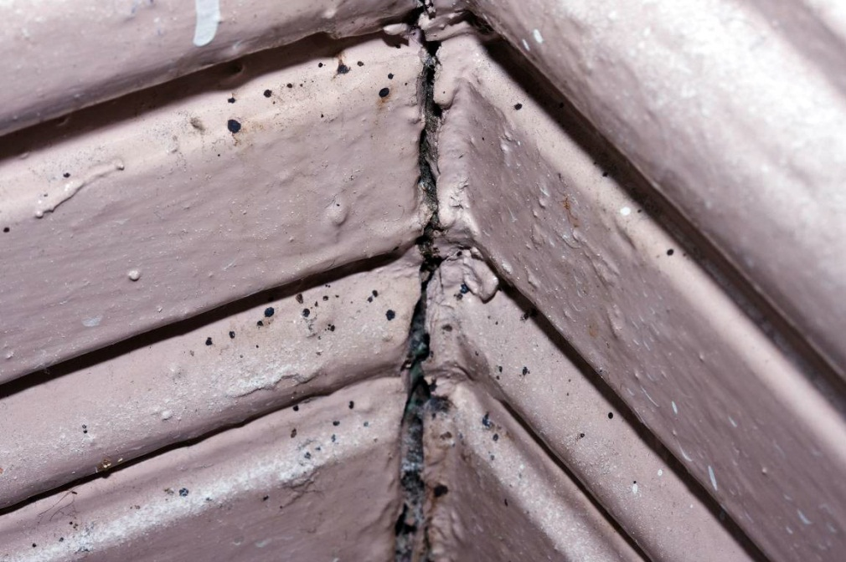
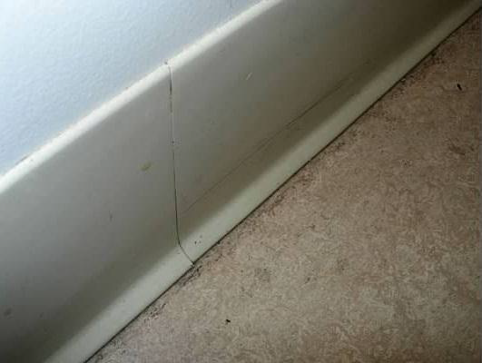
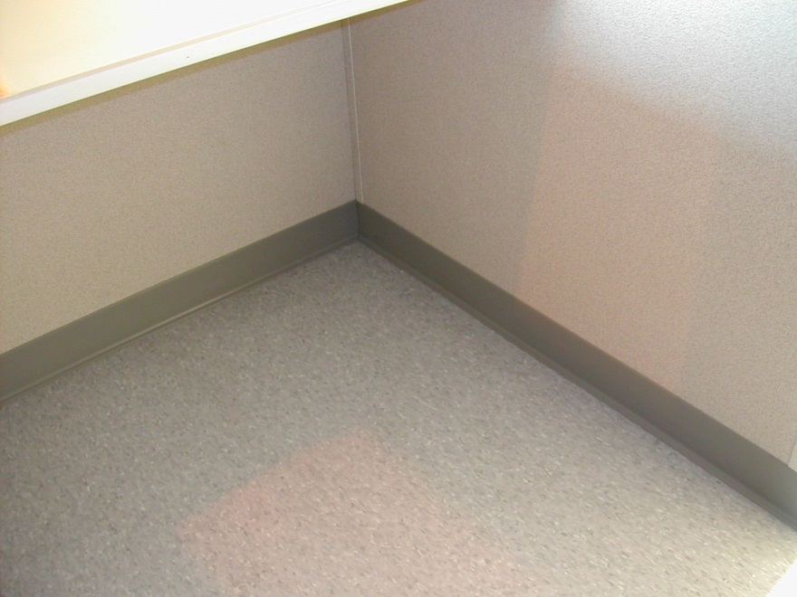
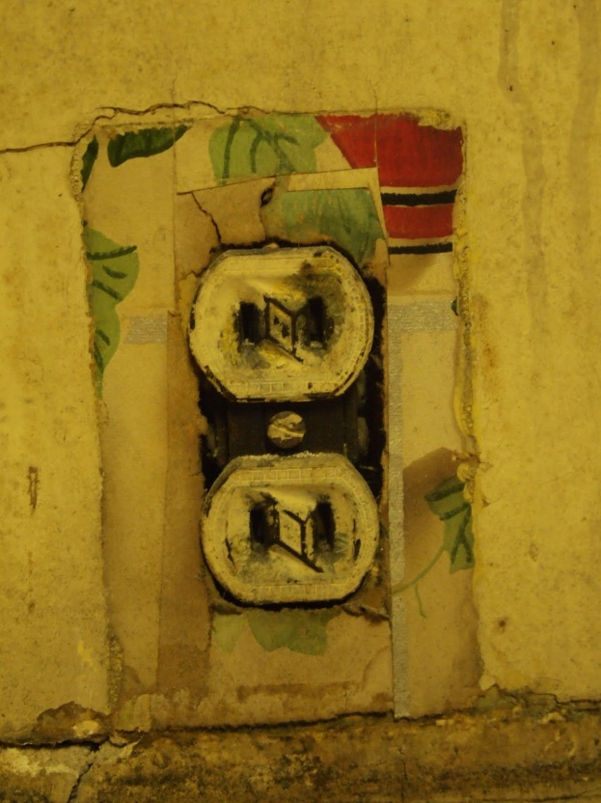
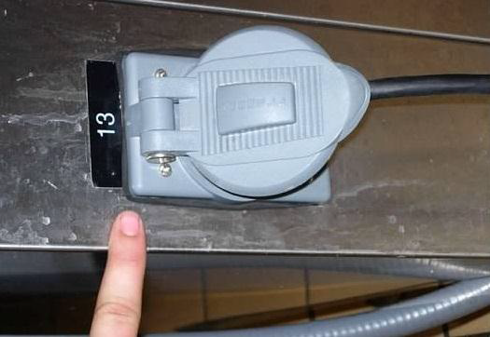
Make rooms ‘bed bug unfriendly’

Slide 40
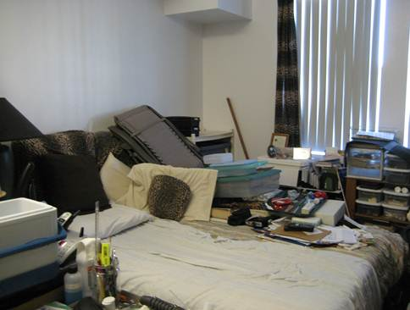
Consideration of ‘clutter’

Slide 41
IPM for bed bugs
Education
Prevention
Monitoring
  Visual / manual inspection
    Bugs, eggs, exuviae, fecal spots, blood smears / spots
  Bed bug monitors
  Canine detection

Slide 42
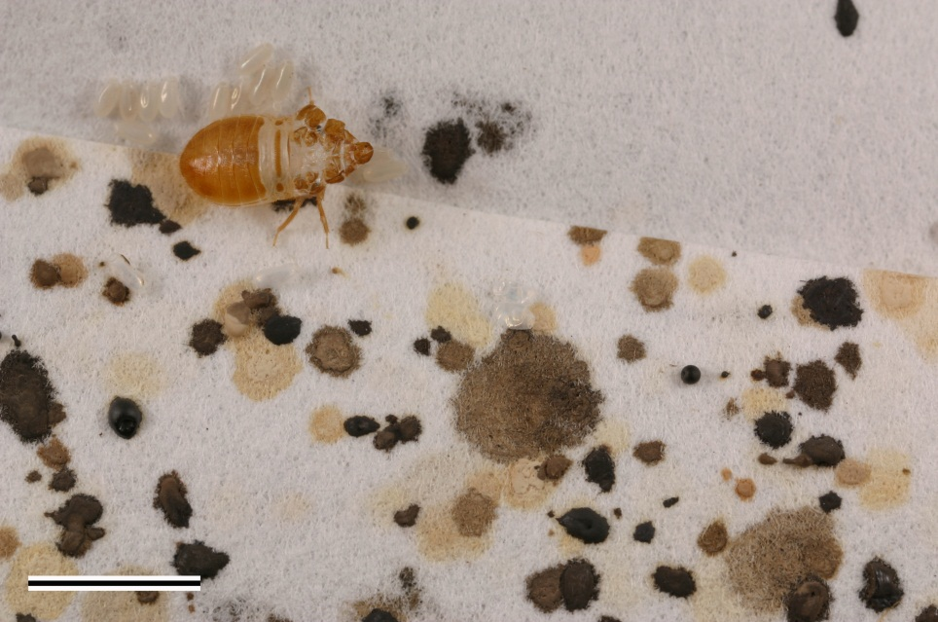
Bed bug signs

Slide 43
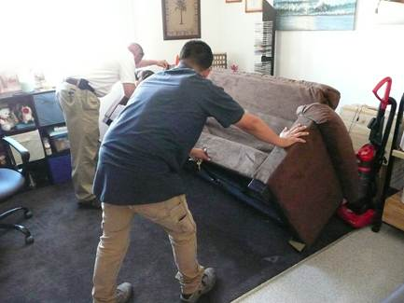
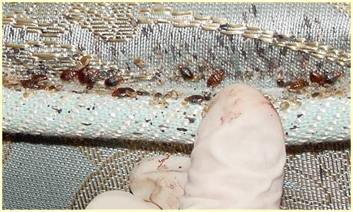
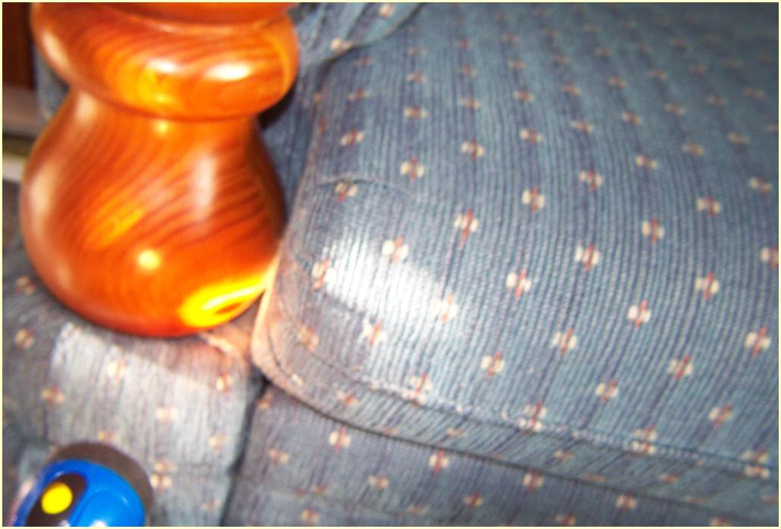
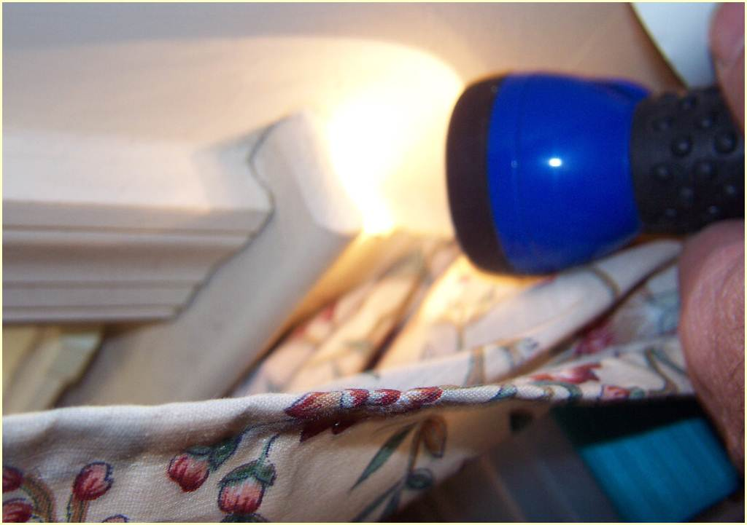
Bed bug inspection

Slide 45
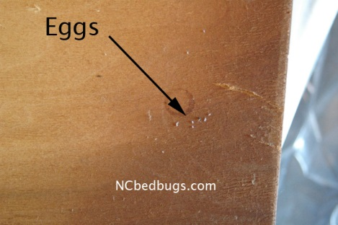

Slide 46
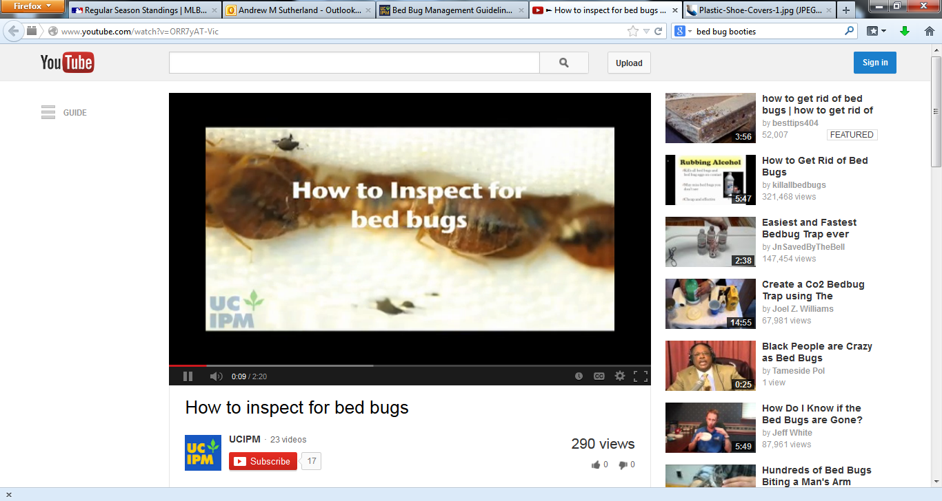
http://www.youtube.com/watch?v=ORR7yAT-Vic

Slide 47
Bed bug monitors
Active monitors
  Employ some attractant
    CO²
    Heat
    Pheromones / kairomones
  Can detect bugs in absence of host
Passive monitors
  Harborage or pitfall traps
Interceptor traps

Slide 48
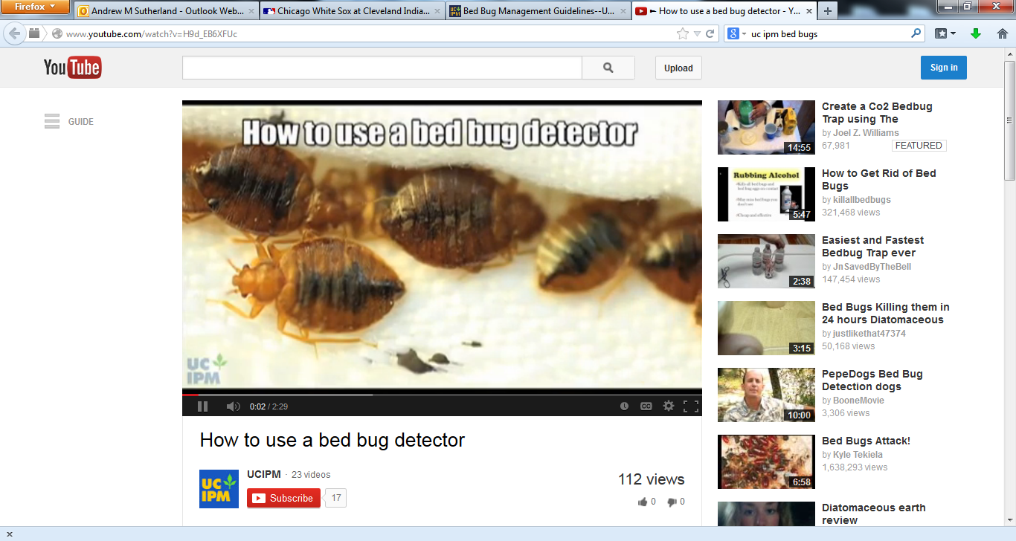
http://www.youtube.com/watch?v=H9d_EB6XFUc

Slide 49
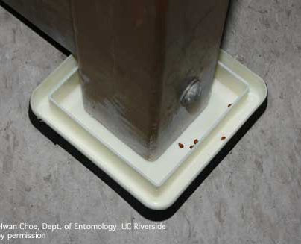

Slide 50
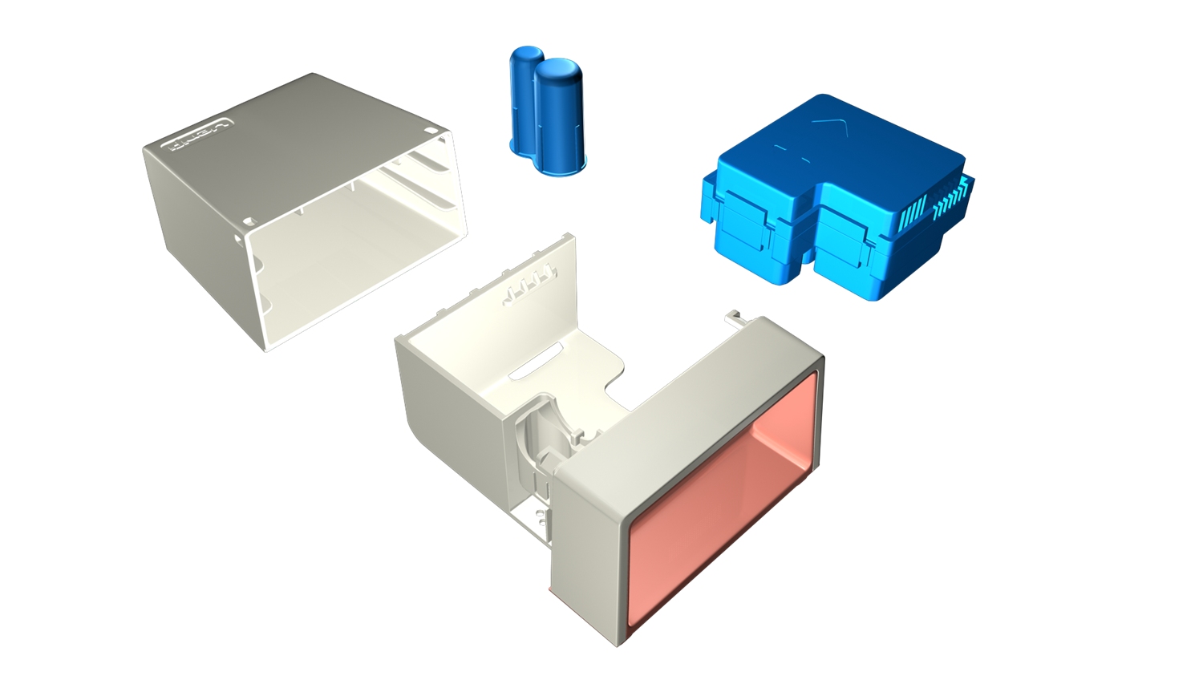


Slide 51
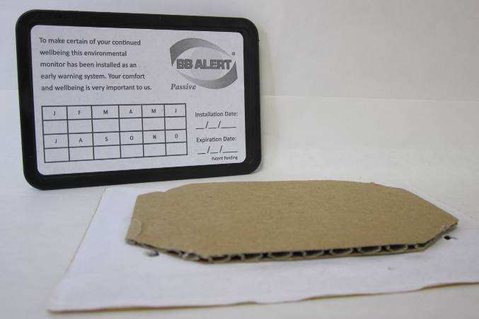

Slide 52

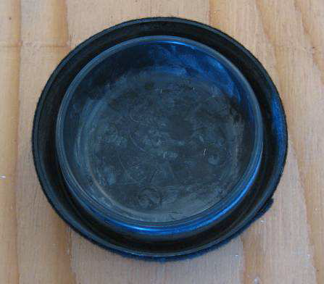

Slide 53
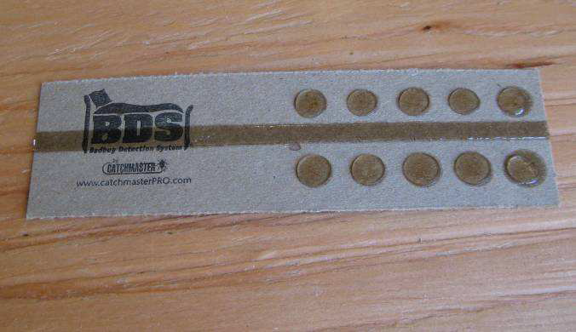

Slide 54
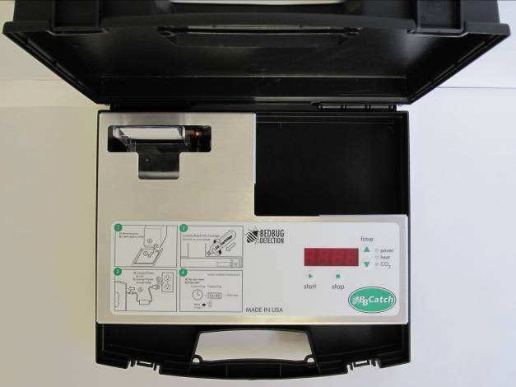

Slide 55
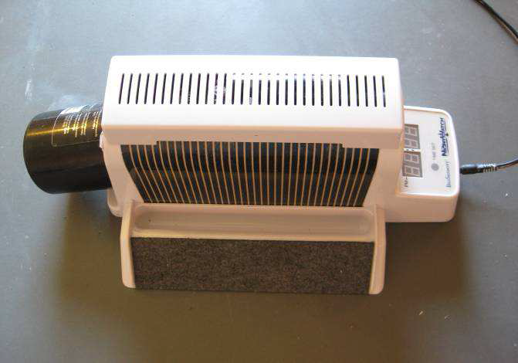

Slide 56
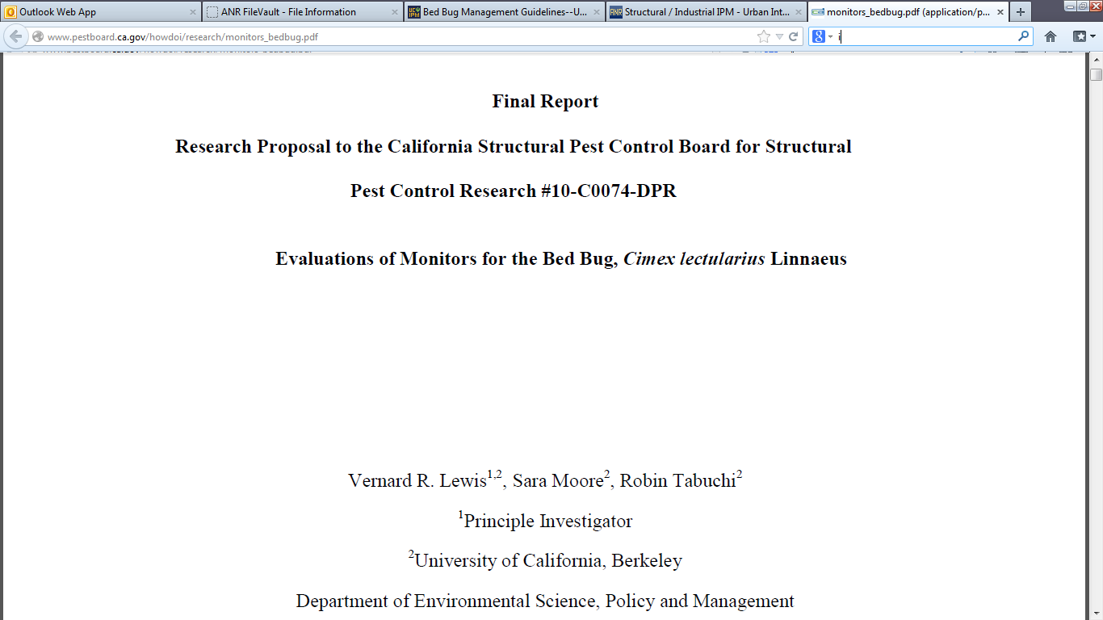
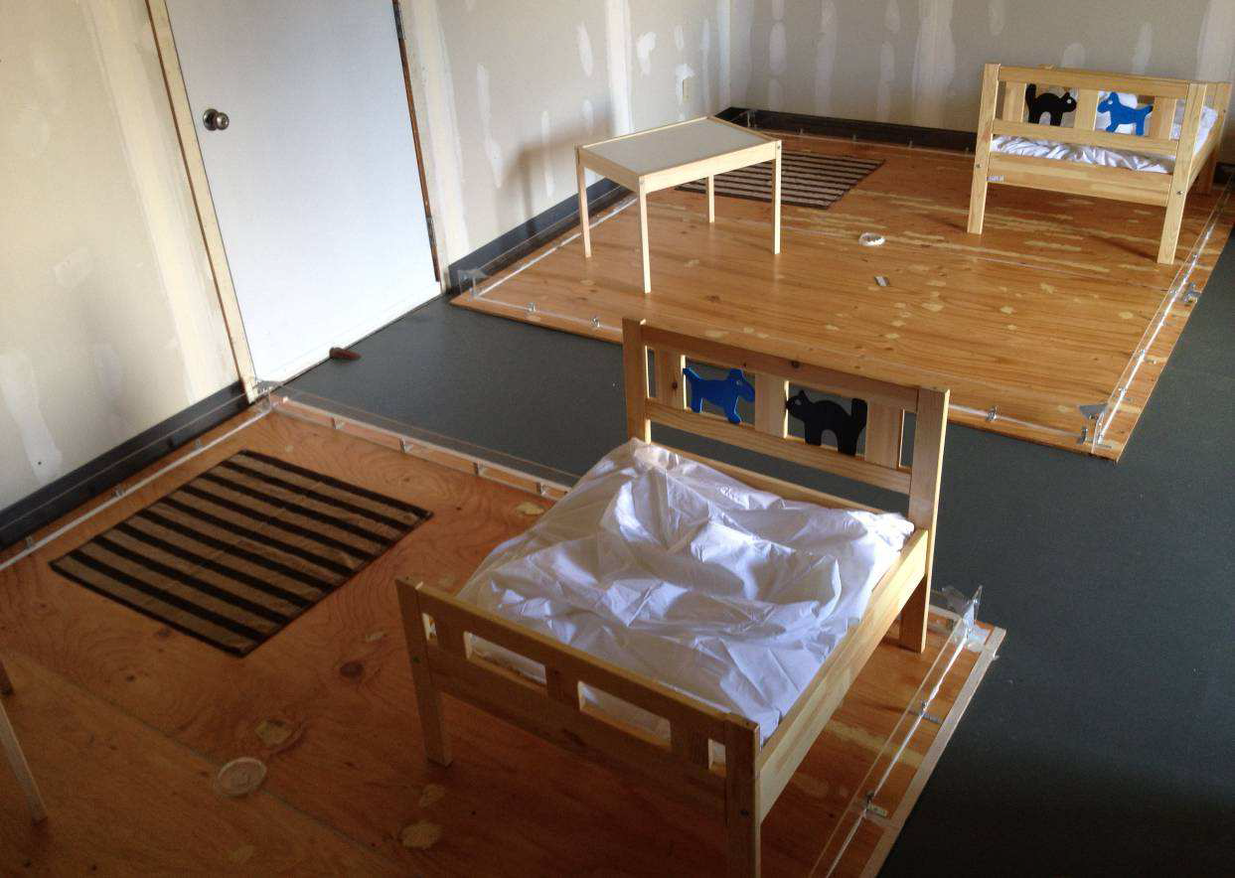
Bed bug monitor efficacy research (Vernard Lewis laboratory, UC Berkeley)
http://www.pestboard.ca.gov/howdoi/research/monitors_bedbug.pdf

Slide 57


Slide 58
Bed bug monitors: summary
Active monitors in absence of host
All tested able to attract bugs…
Best for detection, evaluation purposes
Easier to inspect than furniture
More monitors, more time = better
Proper placement is key

Slide 59



Canine Detection

Slide 60
Canine Detection
Classical conditioning
Potential for very high accuracy (> 90%)
Potential for false positive detection
Canine team requires constant training, re-conditioning
3rd party certification
Should always be confirmed with visual / manual inspection by trained PCO

Slide 61
Canine Detection Accuracy
Pest Control Technology: pctonline.com; August 2011

Slide 62
Canine Detection Accuracy
Pest Control Technology: pctonline.com; August 2011

Slide 63

Certification important, but…SHOW ME THE BUGS!

Slide 64



Alameda County Partnerships
What if I suspect a bed bug infestation at a home I visit?
  Consider a joint / dual inspection with Alameda Co. Vector Control Services District

Slide 65
Bed bug IPM resources
For tenants / general public
  UC IPM
  County Health Services
  EPA / DPR
For housing managers
  EPA / CDC
  HUD
For pest management professionals
  UC IPM
  NPMA

Slide 66

Pest Notes: http://www.ipm.ucdavis.edu/PMG/PESTNOTES/

Slide 67

Quick Tips: http://www.ipm.ucdavis.edu/QT/index.html

Slide 68

http://www.bedbugbmps.org/

Slide 69

http://www.ipm.ucdavis.edu/greenbulletin/

Slide 70
The future…
Bed bugs increasingly common…not going away any time soon
Easing of stigma?
Litigation costs?
Housing / lodging managers need to plan / budget for bed bug program
Better detection tools needed
Eventual consumer tolerance?

Slide 71
Which of the following could be considered a good practice for preventing bed bug acquisition and introduction?
Avoid sitting on upholstered furniture
Wear shoe covers
Minimize items you bring with you to home visits
Launder clothing at the hot setting
Make your home bed bug-unfriendly
Monitor regularly for bed bugs
All of the above

Slide 72
Thanks!...Questions?
Andrew Sutherland
Bay Area Urban IPM Advisor
amsutherland@ucanr.edu
http://ucanr.edu/sites/urbanIPM/
510-777-2481 office
510-499-2930 cell
1131 Harbor Bay Parkway; Alameda

