Slide 1
Ladder Safety

Slide 3
Safety Note #170: http://safety.ucanr.edu/files/191679.pdf

Slide 4
Ladder Safety Tips
Always check the ladder for damage and slippery materials such as grease and oil.
If ladder is damaged, let your supervisor or the safety department know. Post a note on the ladder declaring not to use it.
Do not place ladders on boxes or any other items to raise the height. Ladders must be on solid and level surfaces.

Slide 5
Ladder Safety Tips
Always face toward the ladder and keep your body centered. Do not stretch out to reach.
Do not use A frame ladders as a straight ladders. The ladder must be fully opened with spreaders locked.
Try to get assistance to help with handling the ladder and passing items up and down the ladder.

Slide 6
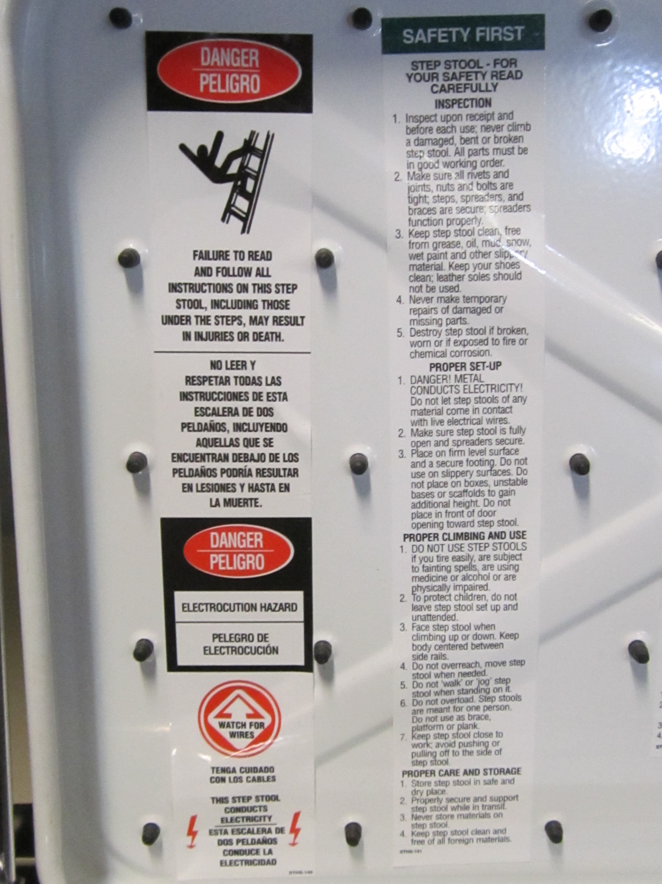
Ladder Safety Labels

