Slide 1
Safe Material Storage in Offices

Slide 3
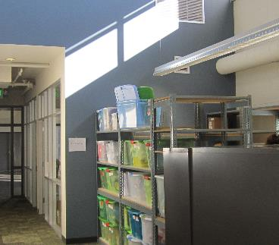
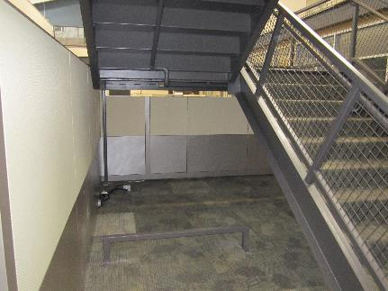
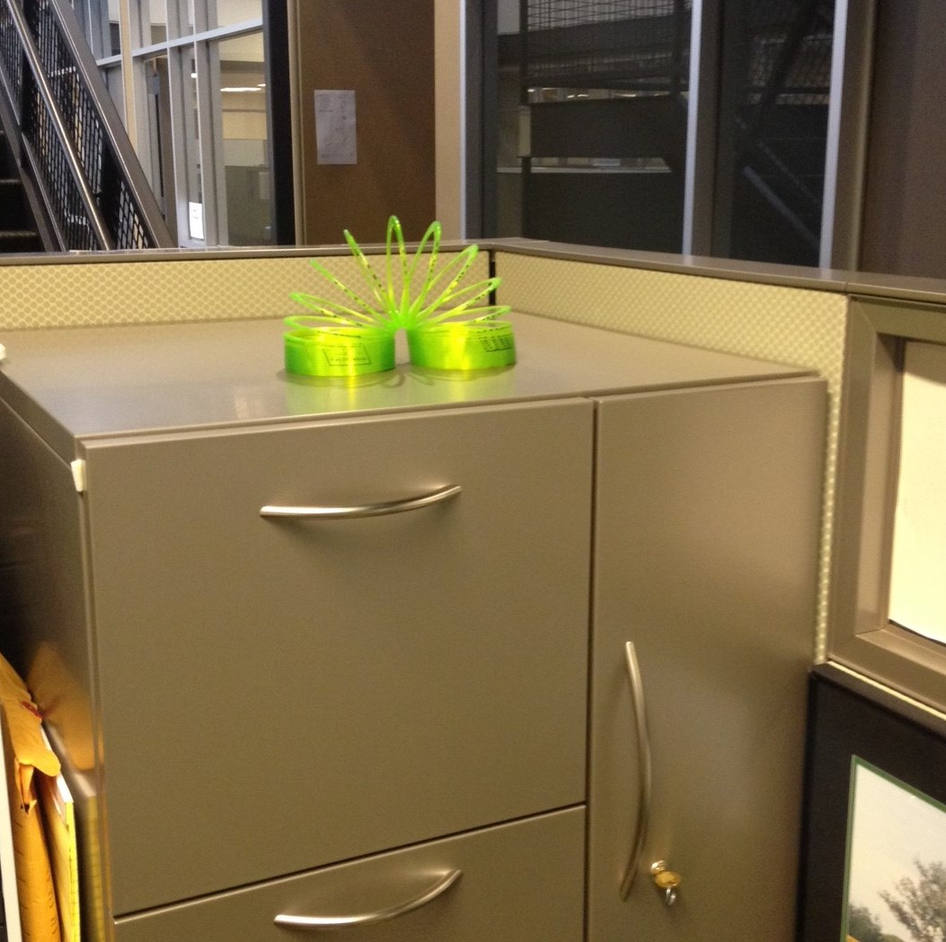
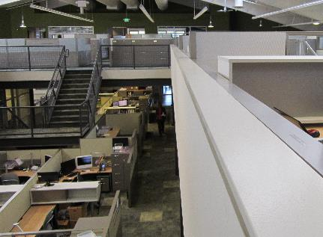
Office Storage Safety
No items over six feet without retainer;
18” below sprinklers or 24” below ceiling
No storage under stairs unless one-hour rated construction
Place only smaller items on top of workspace storage areas
No storage on ledges
Notes:
Also note: Aisleways must have a minimum clearance of 24”

Slide 4
Office Storage Safety
EH&S has developed over 170 Safety Notes as a convenient tool to address the need for training about hazards http://safety.ucanr.edu/Safety_Notes/
Safety Notes are one page summaries of relevant information, regulations, and suggested precautions to prevent topic-related injury or illness
Safety Notes continue to be developed as additional requests for training on specific and general topic are transmitted to EH&S
http://safety.ucanr.edu/
Material Storage info:
Safety Note #171 — Office Storage Safety, &
Safety Note #66 — Good Housekeeping Practices

