Slide 1
Injury and Illness Prevention Program (IIPP)
ANR Building, Davis
Staff Meeting
January, 2016

Slide 2
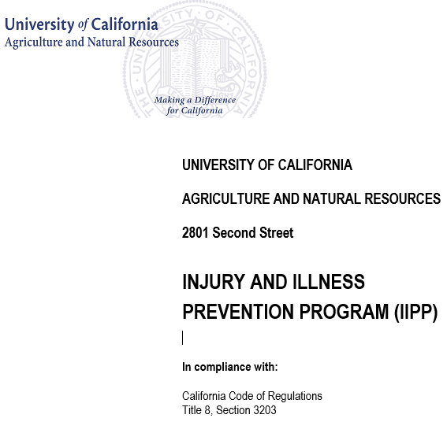
What is an IIPP
I (have to) PP…
I2P2
UC ANR
Injury & Illness Prevention Program
Notes:
What is an IIPP
Is it something children say when they really need to go to the bathroom
Some refer to an IIPP as an I2P2, like R2D2
For our purposes, an IIPP is an Injury and Illness Prevention Program.
It is a written safety program that details how the organization will protect employees from hazards in the workplace and provide a healthful and safe environment.

Slide 3
IIPP – our capstone safety program
Employers are required to provide and maintain a safe and healthful working environment.
In California, employers must establish, implement, and maintain an effective written Injury & Illness Prevention Program (IIPP) – CCR/8-3203
The IIPP is the umbrella under which all health and safety programs and policies are implemented. It is the foundation for our safety programs.
IIPP
Emergency Action/Fire Prevention
Ergonomic Program
Hazard Communication Program
Heat Illness Program
Respirator Protection
Notes:
The IIPP is the capstone, or fundamental safety program
The goal is to reduce injuries and illnesses and promote safe and healthful practices in the workplace.
In California, employers must establish, implement, and maintain an effective written Injury & Illness Prevention Program (IIPP) – CCR/8-3203
The IIPP is the umbrella under which all health and safety programs and policies are implemented. It is the foundation for our safety programs.
Supervisors, with assistance from Safety Coordinators (and EH&S), are responsible for ensuring new employees and as appropriate, students and others receive site-specific IIPP training.
IIPP training shall also take place whenever workplace hazardous substances are introduced or removed, or a person’s responsibilities or actions under the IIPP change.

Slide 4
IIPP – is our promise to you
Notes:
Think of it this way: Your plan is a promise to your employees, a contract if you will…
Reflects UC ANR’s policy on employee safety
Specifies procedures to maintain a safe and healthful workplace

Slide 5
IIPP – Core Program Components
Responsibility: the identities of the persons responsible for implementing the IIPP
Compliance: a system for assuring employees comply with safe work practices and recognizing employees who follow safe and healthy practices
Communication: an employee communication system, including meetings, training programs, postings, written communications, etc.
Hazard Assessment: procedures for identifying and evaluating workplace hazards, including periodic inspections to identify unsafe conditions and work practices
Notes:
Responsibility:
Must have authority and management’s full support
Allocate time, personnel and money
Set a good example
Employees are also responsible for conducting themselves safely (Labor Code Section 6407.1)
Communication:
Establish a system for communicating with employees that is “readily understandable by all affected employees”
Publish a brief safety policy to state that safety is priority
Provide for employees to communicate safety concerns with the employer
Encourage information without fear of reprisal
Hazard Assessment:
Conduct regular inspections of the campus or site
Check for property and work practice concerns
Reviewed by safety committee and/or management
Helps to note trends and prioritize
Document inspections

Slide 6
IIPP – Core Program Components cont.
Accident/Exposure Investigation: a procedure to investigate occupational injuries or illnesses
Hazard Correction: methods for correcting unsafe or unhealthy conditions, work practices, or work procedures in a timely manner
Training and Instruction: about safe work procedures for new employees, or when there are new hazards or job duties
Recordkeeping: methods for recordkeeping and documentation of safety and health training
Notes:
Identifying Hazards and Correction:
Determine potentially hazardous conditions, equipment and procedures
Identify corrective actions
Survey workplace conditions-
Equipment
Chemicals
Work practices
Cal/OSHA standards
Also review:
Accident, injury or illness data
Safety policies and procedures
Records of training programs
Talk to staff responsible for the work
Other safety programs currently in place
Training:
Must be conducted –
When IIPP is first established
For all new employees
New job assignment
When new substances, processes, procedures or equipment are introduced
When a new or previously unrecognized hazard is identified
For all supervisors to assure they understand the hazards to which their employees may be exposed
Recordkeeping:
Essential to all aspects of the program
Compliance with regulation
Tool in evaluating the success of the program
Verification in the event of a loss
If it’s not written down, it didn’t happen

Slide 7
Our IIPP also includes
Instructions for reporting workplace injuries.
A map to the nearest medical facilities.
Procedures for for investigating injuries.
Information to help identify required safety training.
Forms to report a workplace hazard and document correction of hazards.
Inspection checklists.
Written Hazard Communication Program.
An Emergency Action & Fire Prevention Plan (EAFPP)

Slide 8
Rights! As an employee you have a right to
A safe workplace free from recognized hazards
Receive training on hazards associated with your job
Know how to control hazards of your job
Report workplace hazards without fear of reprisal

Slide 9
Roles & Responsibilities Managers and Supervisors
Managers and Supervisors are expected to provide Health and Safety leadership and guidance within their unit
Know the TRICK of a good safety supervisor/manager
Train employees on correct safety practices and safe job performance
Report unsafe conditions and incidents
Inspect for workplace safety and compliance
Correct issues and problems found
Keep records of training
Notes:
In addition to above, also
Ensure employees have the training, knowledge and resources to perform their work in a safe and healthy manner
Inform employees about specifics of the IIPP
Provide safety training consistent with employee job duties
Actively investigate reports of hazardous or unsafe work conditions and take corrective actions
Maintain recordkeeping and documentation

Slide 10
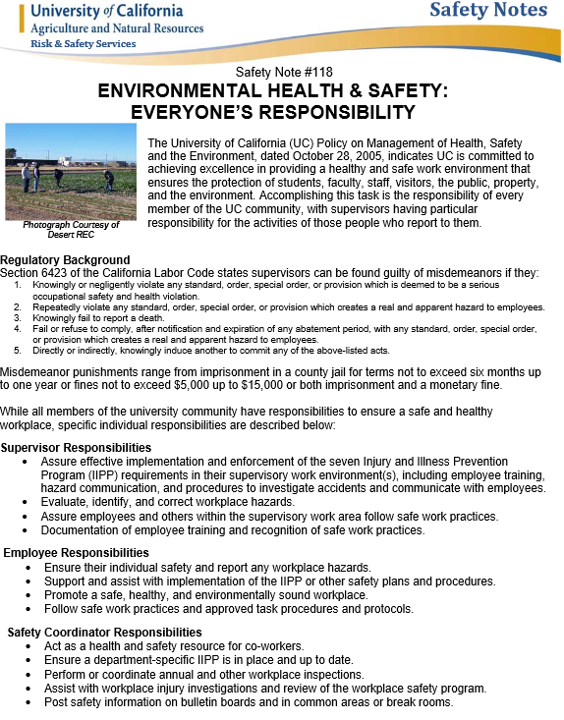
Roles & Responsibilities All Employees
All employees have the
responsibility to maintain a
safe & healthful work
environment

Slide 11
As an employee, you should
Follow safe work practices, including use of applicable PPE
Be familiar with your IIPP and it’s location
Know the potential health and safety hazards of your job and how to protect yourself
Know how to report unsafe conditions
Report any work-related injury or illness to your supervisor
Know what to do in an emergency
Correct unsafe conditions within your authority
If you are unclear about your responsibilities ask your supervisor

Slide 12
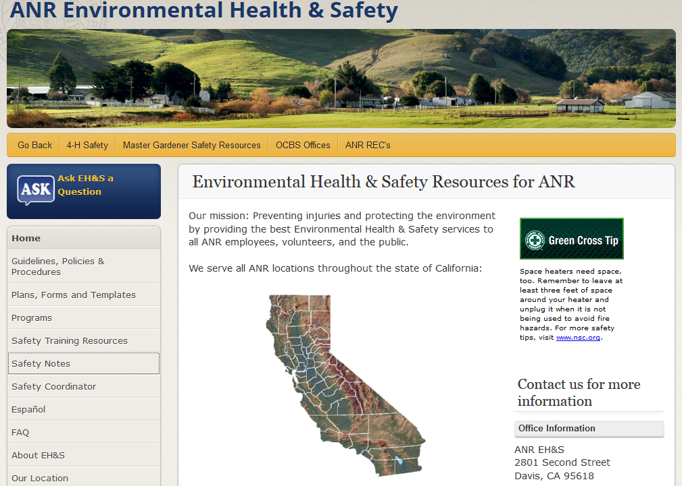
Roles & Responsibilities Environmental Health & Safety
EH&S has responsibility for
maintaining and monitoring
compliance of ANR’s overall
Injury and Illness Prevention
Program, to minimize or prevent
occupational injuries and illnesses,
and to protect the quality of the
workplace and surrounding environment.

Slide 13
EH&S
Advises the ANR community of its responsibilities with respect to health and safety issues
Provide training, resources, and assistance
Recommends appropriate corrective actions and programs
Implements new health and safety programs
Serves as the liaison between ANR and various external agencies and regulatory bodies

Slide 14
Resources for Safety
Your Supervisor
Bulletin Boards & Posting Areas
IIPP (Binder or Online)
Safety Coordinator (Mark Barros or David Alamillo)
EH&S
Visit our website: safety.ucanr.edu
Visit us in person
Use the EH&S Ask Button

Slide 15
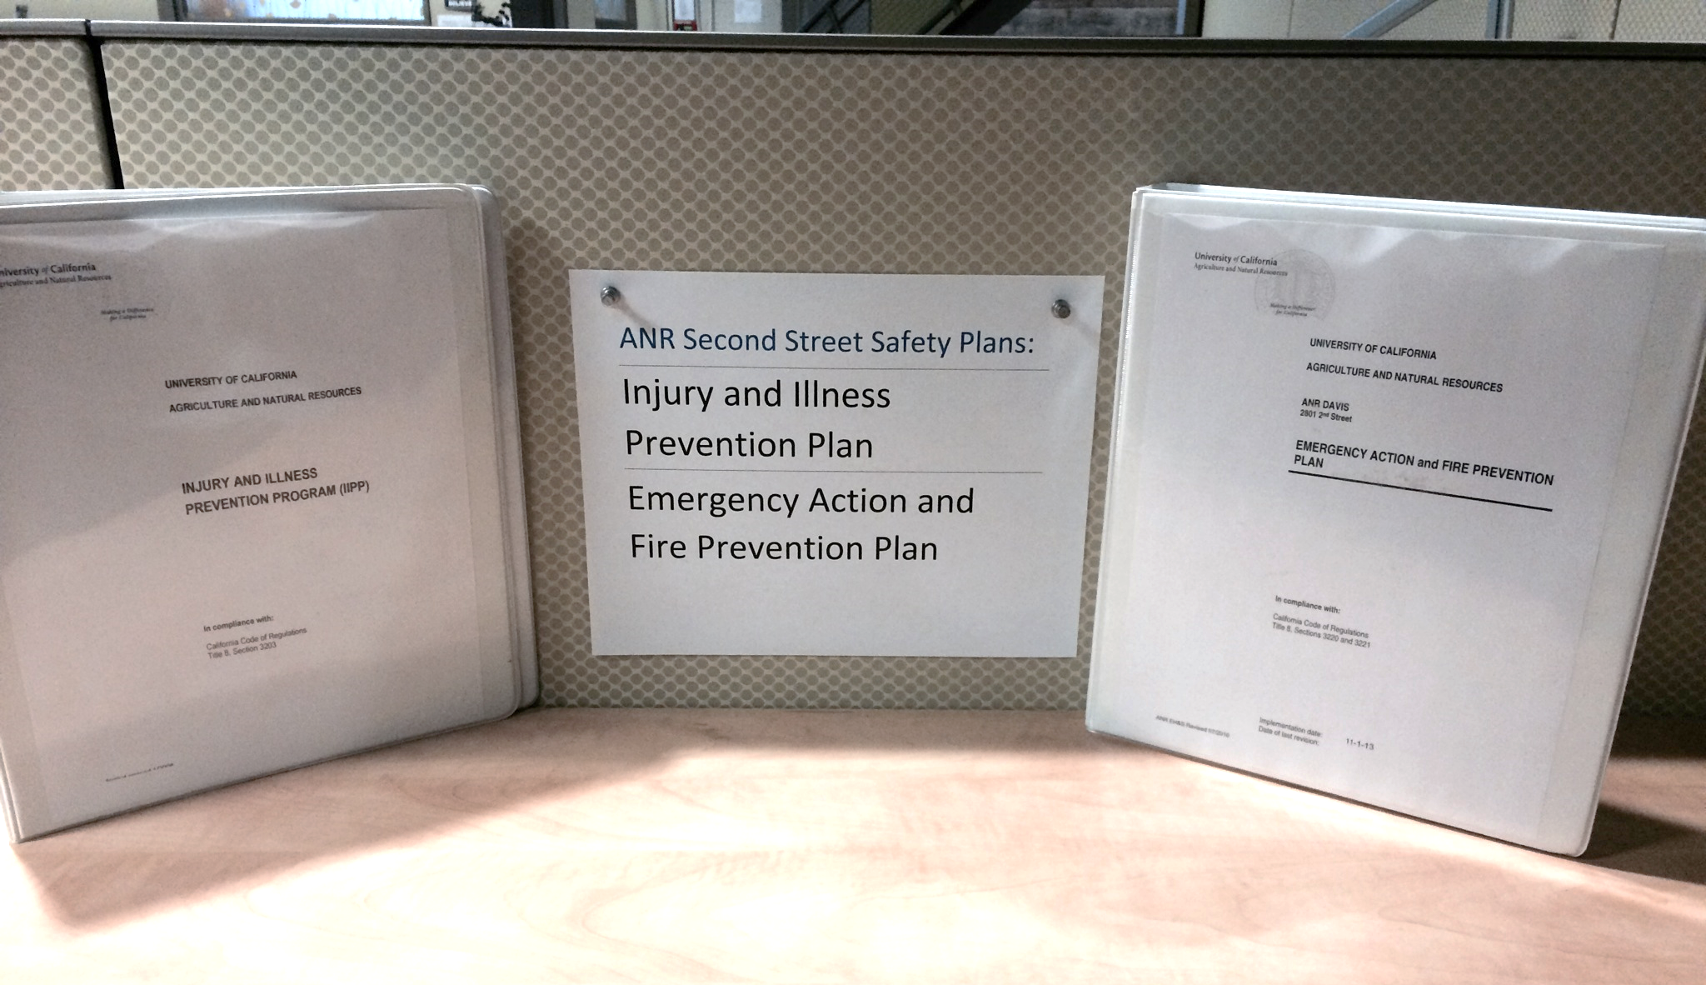
Where to find the IIPP
The Injury and Illness Prevention Program (IIPP) and Emergency Action and Fire Prevention Plan (EAFPP) for all units at the ANR Second Street Building are located:
On the building website at: http://ucanr.edu/2ndstreetsafety
Printed copies are located in the EH&S Library (next to Workspace 162)
For more information:
http://safety.ucanr.edu
http://ucanr.edu/risk

Slide 16
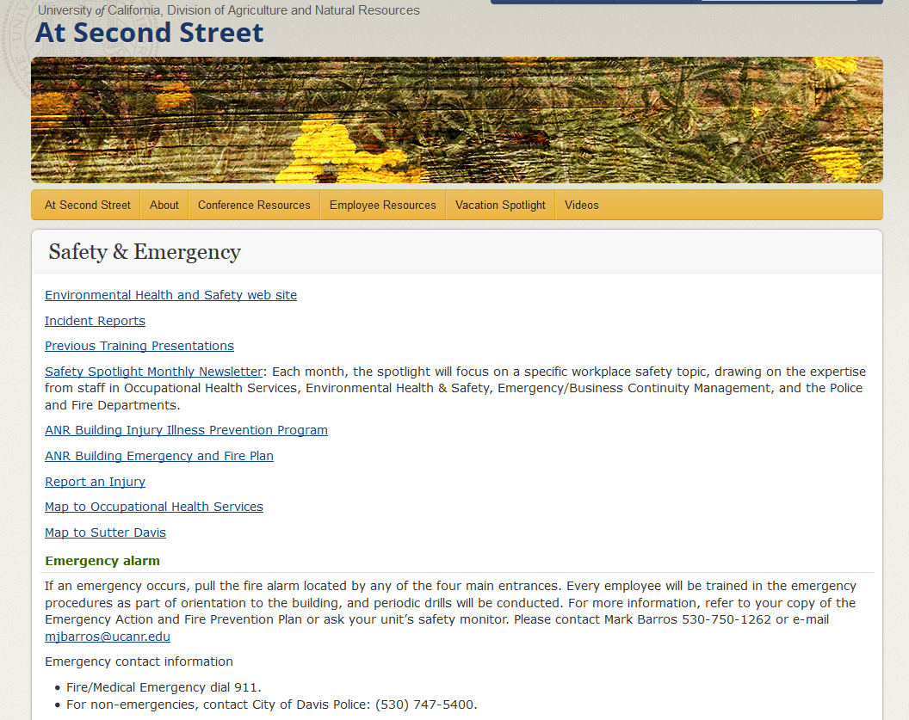
Notes:
Screen shot of the At Second Street website

Slide 17
QUESTIONS?

