Slide 1
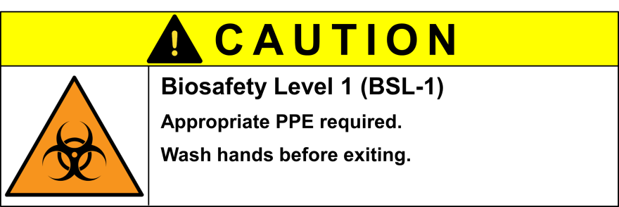
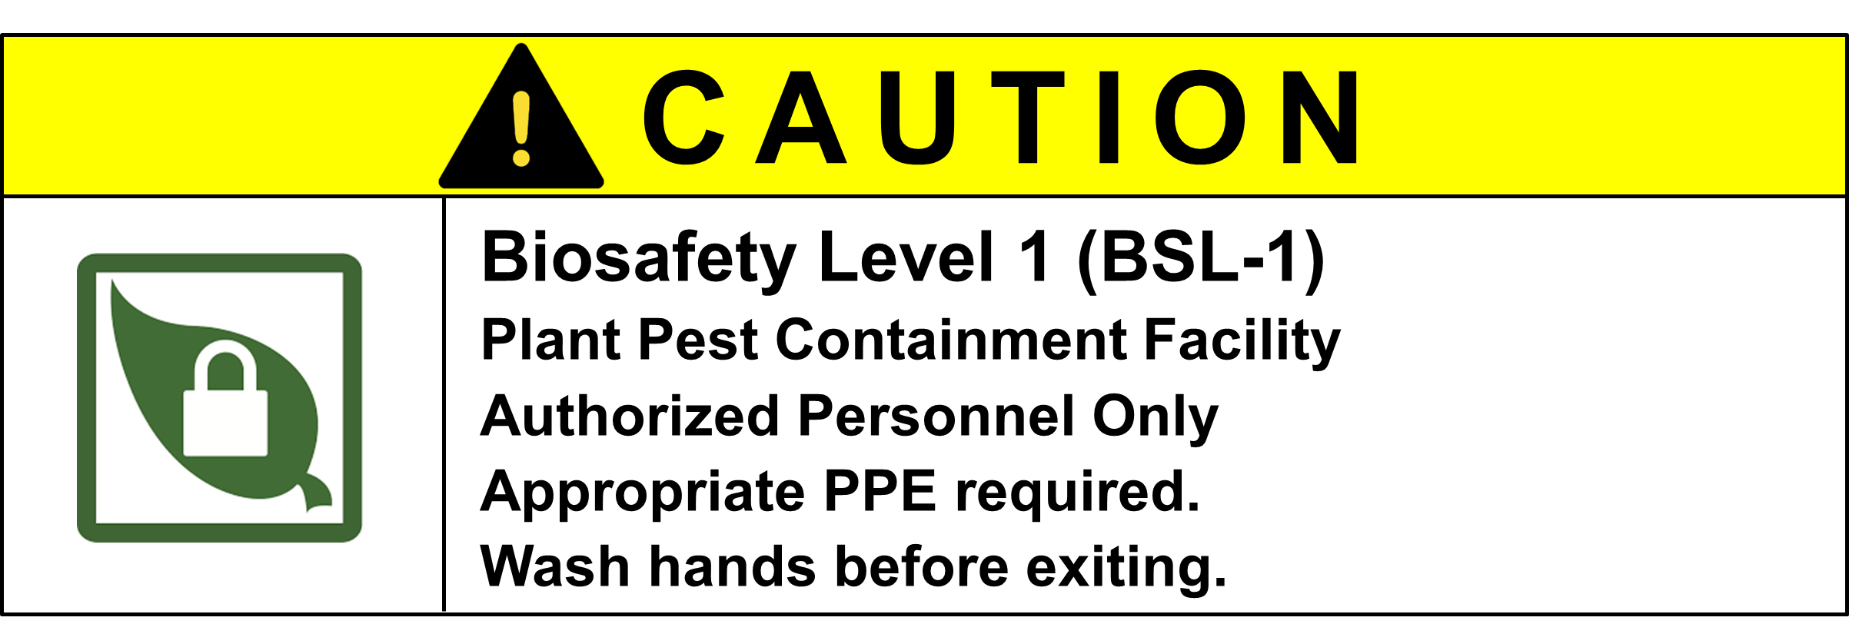
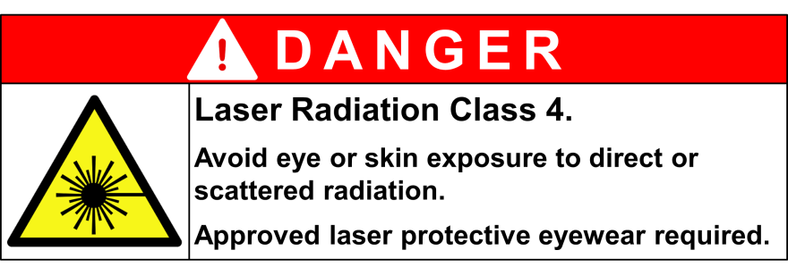
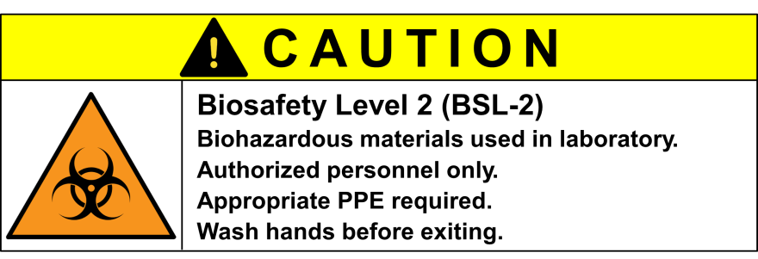
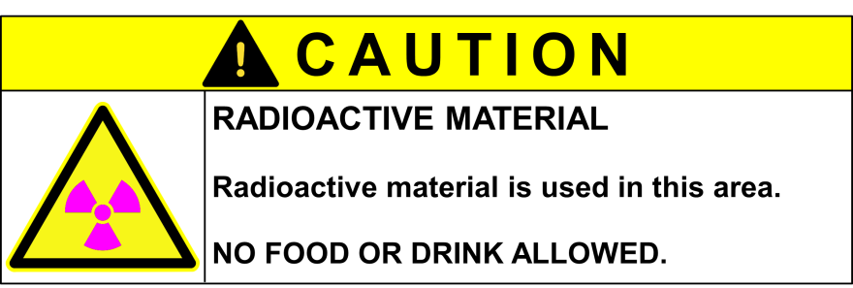
Symbols to use:
Small
Large
Compressed
Gas
Oxidizer
Toxic
Health Hazard
Environmental
Hazard
Compressed
Gas
Oxidizer
Toxic
Health Hazard
Environmental
Hazard
Hazard Notification Information
Building 115| Room 10 | Dr. Jones Lab
Principal Researcher Dr. Spock Office: Bldg 115, rm 4 Phone: 123-4567 | Alternate Mr. Lab Manager Office: Bldg 115, rm 11 Phone: 123-1234 | Location safety Coordinator Office: _______ Phone:_______
Flammable
Liquid, Gas
Harmful/ Irritant
Corrosive
Explosive
Flammable
Liquid, Gas
Harmful/ Irritant
Corrosive
Explosive
Water
Reactive
Flammable Solid
Pyrophoric
CAUTION
Water
Reactive
Flammable Solid
Pyrophoric
NO FOOD OR DRINK PERMITTED IN LAB
HAZARDS PRESENT
REQUIRED LAB PPE
Biological Hazards
Sharps
Vacuum/
Pressurized
Unshielded UV
Cryogens/Cold
Equipment
Nanoparticle
Biosafety Level 1 (BSL-1)
Plant Pest Containment Facility
Authorized Personnel Only
Appropriate PPE required.
Wash hands before exiting.
Sharps
Vacuum/
Pressurized
Unshielded
UV
Cryogens/Cold
Equipment
Nanoparticle
Safety glasses
Radiological Hazards
Cotton lab coat
Strong Magnet
Hot Surface/
Liquid
High Voltage
Sonicator/Loud
Equipment
Crush/Pinch
Strong Magnet
Hot Surface/
Liquid
High Voltage
Sonicator/Loud
Equipment
Crush/Pinch
Chemically resistant gloves
Chemical Hazards
Covered legs
Enclosed shoes
Flammable
Liquid
Irritant
Corrosive
Physical Hazards
Emergency - 911
safety.ucanr.edu | ehs@ucanr.edu
Vacuum/
Pressurized
Unshielded UV
Cryogens
Sept 2018

Slide 2
Personal contact information for back of sign
Emergency Notification Information
Physical Sciences Building | Room 592 | Chemistry and Biochemistry
Principal Researcher John Lee Office: PSB 518 Phone: 459-1124 After Hours: 831-586-2356 | Alternate David Jones Office: JBEB 101 Phone: 502-1234 After Hours: 916-212-5621

