Slide 1
Monterey County Record Book Workshop
Created by Lockwood 4-H - 2021
Notes:
MC Welcomes everyone, hosted by Lockwood 4-H, introduce our committee members, MC, Attendance, Chat Monitor (will monitor the chat box for any questions – list your name and club, then your question), and Speaker.

Slide 2
Pledges
I pledge allegiance to the Flag of the United States of America and to the Republic for which it stands, one nation, indivisible, with liberty and justice for all."

Slide 3
Monterey County encompasses 15 clubs, 800 youths, and approximately 200 adult volunteers:
Aromas
Buena Vista
Carmel Valley
Chualar
Gonzales
Greenfield
Hilltown
King City Rural
King City Blue Ribbon
Lockwood
Mission
Natividad
Royal Oaks
San Benancio
Spring
https//ucanr.edu/sites/uccemontereycounty/files/306813.pdf (ucanr.edu)
Notes:
Quick overview (clubs), let’s see some action in the Chat as we call out your club names.

Slide 4
Our Team:
LOCKWOOD 4-H
Josh Riley – Committee Chair & MC
Seralyn Colton – Committee Member and Tech Advisor
Lochlan Drinkwine – Chat Monitor
Morgan Hancock – Attendance Keeper
Katie Colton – Adult Chair, Speaker
County Council
Carla Ackerman
Lockwood 4-H Club Leader
Misty Hancock
4-H Program Representative
Lorin Hoffmann-Lurz
Notes:
Introduce yourself, and your team members (have them say a quick hello. Introduce Carla, Misty, and then Lorin (Lorin may want to speak)

Slide 5
Ice Breaker!
Name Game
Daring
AMAZING
Curious
Adorable
Adventurous
BOLD
Cuddly
Shy
Notes:
JOSH will run the Icebreaker. When it’s your turn, say your name, with an adjective, give an example to start everyone off.

Slide 6
“Do I have to do a Record Book?”
Benefits of completing a 4-H Record Book:
Practice Records Management - Track your activities, events, profits and losses, skill development and learning experiences. In this competency skill you identify, create, classify, archive and preserve records
Reflect on your yearly work - Document your skill development and learning experiences in a written report.
Measure your achievements and growth throughout your years in 4-H.
Set goals, pursue strategies to meet those goals, and record how you may have had to shift gears in the face of challenges and obstacles.
Completing the Personal Development Report in the Record Book provides you an incentive for participation, learning, and achievement.
We encourage all our 4-H youth to do a Record Book to record their project information and reflections, but 4-H Record Books are not required for membership or participation in 4-H activities such as club events, 4-H camps, or conferences.
A 4-H Record Book may be required to receive participation awards (such as star ranking, medals, or pins based on 4-H Record Book achievements).
Notes:
Why … believe me, LOTS of benefits! Record Books teach Life Skills, such as organization, time-management, record-keeping, communication, critical thinking, self-discipline, and planning. You will use records management in school, college, your job, and throughout LIFE. Having a record of your accomplishments helps you learn to set goals, earn awards, and become an active 4-H member – it is lifelong skill!

Slide 7
Record Book Workshop
A California 4-H Record Book Contains the following SECTIONS:
1. Preliminary Information
Title Page
Table of Contents
2. PDR
Personal Information
Star Rank
Categories of Participation
3. My 4-H Story
Your story should tell about your 4-H experience and meet a minimum word count (based on
Junior (or First Year) 250 – 500 words
Intermediate: 500 – 1000 words
Senior: 1000 – 2000 words
4. Projects (APR’S)
One Annual Project Report for each completed
project (per year).
One expressions page for each project.
Notes:
Section 1 – simple to do, follow the guidelines in the manual. Judged on elements you complete (IT’S ALL IN THE manual); PDR; My 4-H Story; Project Reports …will cover APRs in our next workshop …

Slide 8
Record Book Overview (Sections)
5. Collection of Work
This is where you display your photos, samples and examples of your year. If you listed something in your APR, this is a good place to “show and tell.”
Newspaper or Newsletter Articles (2 pages)
Flyers or Brochures (2 pages)
Letters or Certificates (2 pages)
Photographs (5 pages)
See the Record Book Manual for what can be included. Should not be more than 11+ pages total.
6. Leadership Development Reports (LDR’s)
(Intermediate and Senior Members only)
Complete one LDR (Junior/Teen Leaders)
– Part 1 (Pre) and Part 1 (Post) per year
Complete one LDR (Leadership Roles) – Part 2 (pre) and Part 2 (Post) per leadership role, per year.
7. 4-H Resume (Senior Members only)
Senior members must create a 4-H Resume that highlights their skills, leadership and civic engagement development throughout their 4-H career.
Notes:
5) Collection of Work (photos, newspaper articles, flyers, pictures – check the manual for the guidelines. 6) is LDRs 7) 4-H Resume (not covered – may host another workshop if there is interest.

Slide 9
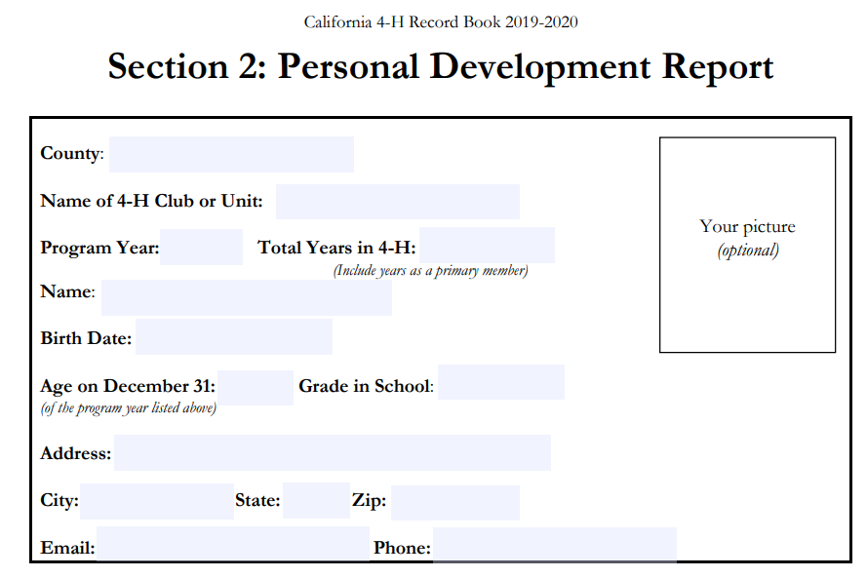
Section 2: Personal Development Record
Gives you a place to keep track of your progress, contact information, age, and even the county and club you are affiliated with.
Page 1 – First Box
Notes:
Section Two of your Record Book is the PDR. Record … report … gives you a place to keep track of your progress.

Slide 10
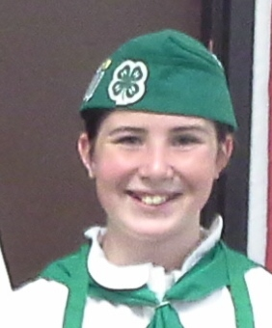
PDR Section 2: First Box
County: M O N T E R E Y
Name of 4-H Club or Unit: ___________________
Name: _________________________
Birth Date: ______________________
Age on December 31: ___ Grade in School: _____
Address: _______________
City: ___________ State: ____ Zip: ______
Email: _______________ Phone: _________
Your Picture (optional)
Notes:
If you are in one of our clubs, your county is “Monterey.” Fill out all the information – You will notice the Picture frame here says “optional” … encourage to put a photo here. On computer, real easy to just paste one in, won’t even cost you … look how nice … can see how you’ve grown!

Slide 11
Why is my age important?
Ages 9 through 10 Junior Member
Ages 11 through 13 Intermediate Member
Ages 14 through 19 Senior Member
Notes:
You might be asking … why does it matter how old I am? Different requirement by age.

Slide 12
Page 1 - Second Box: Club Meeting Attendance
80% attendance is required for any star/achievement rank.
1) Total meetings held for the year is usually 10 (Sept./June).
2) Total meetings YOU attended.
3) Hours Attended is calculated by figuring the hours per meeting, multiplied by the total meetings attended.
4) Percent Attended: Number of meetings attended divided by the Meetings Held.
Notes:
We’re still on the first page of the PDR, second box is for Club Meeting attendance, important for star/achievement rank – show how to calculate the percent attended.

Slide 13
Page 1 PDR Section 2: Third Box
YOU SIGN and DATE when completed (your signature means YOU did the work)
Your PARENT/Guardian SIGNs and dates once you have completed your record book
(… this means they have reviewed your work and you did it correctly).
4-H Adult Volunteer Signature (check with your Club Leader).
Notes:
Last box on Page 1, right at the bottom. Signatures are required if submitted for judging (even at the club level). Its YOUR job to make sure your record book gets signed!

Slide 14
TIPS for Success
Use your PDR to plan your goals for the year.
If this is your first year, leave the first column (Total Past Years) blank.
If this is NOT your first year, transfer your totals from your PDR last year before you start this year, so you can see where you need to go! (… which star rank are you?)
If you did NOT complete a PDR last year, you may still be able to complete one and get credit for your past achievements. Talk to your Club Leader on how to do this.
Notes:
So, when do you think you should start filling out your PDR? Talk about Tips for Success, how to transfer information from last year’s PDR, and what to do if you didn’t complete one last year but want to get credit this year. *** APR’s for Project are required for Year Pin, this may help you to document past achievements – talk to your Club Leader.

Slide 15
Break OUT!
Who has already earned a Star? Two Stars? Three Stars? When did you join 4-H, and how long have you been a member?
GOLD
EMERALD
BRONZE
SILVER
PLATINUM
Notes:
MORGAN to ask these questions?

Slide 16
PDR: Page 2 – Star Ranking
Let’s review this part …
To Qualify for ANY star ranking, you must attend 80% of both the club meetings AND your project meetings held during the year.
To Qualify for the STAR you are working on , you must complete all categories that have an asterisk (*) next to the number …
Notes:
Page 2 of PDR, Star Rank: How to reach each star; Categories of Participation; attendance.

Slide 17
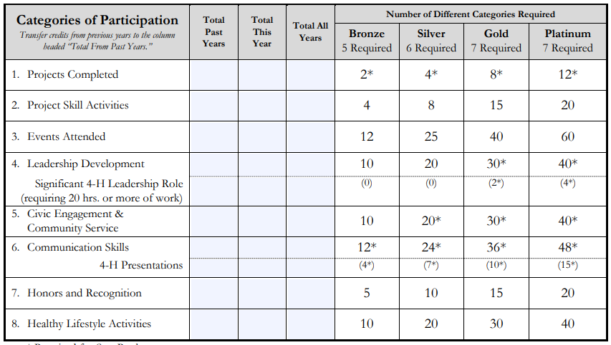
Page 2: Categories of Participation
Eight categories are used to keep track of your participation throughout the year.
Total Past Years
Total This Year
To reach your goals, plan which categories you need to work on.
* Total All Years (Add together past year’s accomplishments, and this year’s achievements.
Notes:
Eight Categories (will go over each one), Total Past Years, Total THIS YEAR, Total ALL Years.
Categories with an asterisk (*); split categories.

Slide 18
Category 1: Projects Completed
This is where you record the projects you have completed. Projects must have a minimum of 6 hours of project instruction for the project to be considered.
You must have attended at least 80% of all of your project meetings throughout the year to receive an achievement rank.
*You CAN talk to your project leader to ‘make-up’ missed meetings (if they allow it).
List your completed projects, total meetings held, meetings you attended, and the total hours of instruction – be sure to calculate the percent attended.
To get the AVERAGE, divide meetings attended by total meetings held.
***REMEMBER to add TOTAL above, and in the columns to calculate your star rank.
Notes:
Category 1: Projects completed this year.

Slide 19
Category 2: Project Skill Activities
These are events or activities where you demonstrate your knowledge to an audience or judge.
You CAN participate in skill activities where you are not enrolled in a corresponding project, as long as the skills are related to a 4-H project.
Exhibits
- Judged Exhibits
- Non-judged Exhibits
Showmanship
Knowledge Contests
Judging Contests
Project Skill Activities Outside of 4-H
You can ADD lines as needed for your 4-H activities, but may only use two Project Skill Activities Outside of 4-H for additional credit. Add the total number of activities – this total also gets listed above, and in the column on page 2.
Notes:
Category 2: Project Skill Activities …

Slide 20
What is “Level of Participation?”
Let’s review this part … this is located on multiple parts of your PDR.
Use the key above to select the correct “Level” of Participation for each activity or event on your PDR. This can be determined by asking yourself, “Was it an Individual, local club event, a County event, or larger?”
One way to decide is to ask yourself, “Who is able to attend?”
Notes:
What is “Level of Participation” and how to decide …

Slide 21
Break OUT!
What PROJECTS …
are YOU
INTO?
Notes:
Seralyn to start this discussion.

Slide 22
Category 3: 4-H Events Attended
These are 4-H sponsored events. Local Fairs can be counted as 4-H events, if they include 4-H/FFA classes for competition.
Do NOT count multiple dates for the same event (only count once, even if it spans more than one date).
Do NOT count Jackpot or Prospector Shows.
Examples:
California Focus
Achievement Night
Fundraisers
Livestock Clinics
Equine Play Days
Presentation Night
Sectionals
Fashion Revue
Field Days
Officer Training
Livestock Clinics
Leadership Conference
Club Holiday Dinner
Color Me Green Run
Add the total number of activities – this total also gets listed above, and in the column on page 2.
Notes:
Category 3: 4-H Events Attended …

Slide 23
Category 4: Leadership Development
This is where you list each project that you lead, or each leadership position you perform.
Committee Chair or Member
Junior Leader (Intermediate)
Teen Leader (Intermediate/Senior)
Lead a 4-H Group or activity (can be planned or spontaneous, see manual for details).
Leadership Outside of 4-H (examples)
Student Body President
School Math Tutor
Youth Group Leader
Team Captain (sports)
Add the total number of activities – this total also gets listed above, and in the column on page 2.
*Required for Star Rank.
***To ADD lines in a WORD Table, move your cursor to the outside of table, to the right of the line you want to add under, and press ENTER.
Notes:
Category 4: Leadership Development

Slide 24
Category 5: Civic Engagement/ Community Service
This used to be called “Citizenship.”
Record active participation in planned, publicized and approved civic engagement, service learning or community service projects.
*If it is a recurring event/activity, you can count each occurrence.
Do NOT list fundraising here (see manual for clarification).
***REMEMBER to add TOTALS above (in the gray area), and in the columns to calculate your star rank.
Examples:
Canned Food Drives, Beach Clean-up, Clothes Drive, Convalescent Home visits.
Service Learning Projects – you can receive two credits (one for planning, and one for attending the actual event)
Civic Engagement and Civic Affairs (i.e. Citizenship Washington Focus, donating to a blood drive, volunteering at a voter registration)
Notes:
Category 5: Civic Engagement/Community Service (used to be called “Citizenship”). Go through what active participation is, how to record , what to list, and what NOT to list here.

Slide 25
Category 6: Communication Skills
Record communication activities that you participate in at any event inside or outside 4-H.
4-H Presentations
Prepared Talk
Radio or Television appearances
Newspaper Articles
Letters to teach others about 4-H or to persuade community members to participate in a 4-H event.
Judge (served as a judge for a contest)
*Do NOT include Thank You letters as communication activities.
For hours, list the time it took to write, or give the talk. For Level, consider your audience as the key.
Note the two sections above for Star Requirements – first one is for ALL, second one is for the required 4-H Presentations.
***REMEMBER to add TOTAL above, and in the columns to calculate your star rank.
Notes:
Category 6: Communication Skills. Notice Star Requirements in gray area, and “Required 4-H Presentations just below it (in white) … split category. Also, you can count two “communication skills” you earned OUTSIDE OF 4-H.

Slide 26
Category 7: Honors/Recognition
Record all “high honors” and recognition you have earned. Other project-specific (seals and ribbons) go in your APR. List it here if it is a “very big deal” to YOU.
You don’t have to get the top award to record it here … if you are very, very, very proud of an award or honor, record it!
Examples:
Grand Champion
Reserve Grand Champion
100% Club Attendance
County Ambassador/All Star
Diamond Clover Award
Emerald Star
Fashion Revue Winner
Record Book Medalist
State Ambassador
Star Ranks
Golden Clover Award
Food Fair Winner
Notes:
Category 6: Honors and Recognition. Go through some examples, doesn’t have to be the TOP award, just something you are VERY proud of!

Slide 27
Category 8: Healthy Lifestyle Activities
This is where you record your participation in organized group activities related to a healthy lifestyle OUTSIDE of 4-H! Each organization, group, or sport counts as one credit for each 25 hours of active participation.
You can list the same activity as long as the dates entered cover a period of time where you have at least 25 hours of credit.
Examples:
School or community Camps
Sports teams
Extra-curricular activities related to school work (choir, tutoring, etc.)
Do NOT count family vacations, homework, caring for pets or livestock, or spectator activities (see Manual).
Faith-based YOUTH group
Employment
Music lessons
Organization meetings and active participation
Notes:
Category 8: Healthy Lifestyle Activities – examples of what counts, one credit for each 25 hours of active participation per quarter/year (up to four times/activity).

Slide 28
Break OUT!
Share your …
Healthy Living IDEAS!
Notes:
Josh or Lochlan? Who wants to start the ball rolling (be sure to ask everyone to share).

Slide 29
4-H Record Book Resources:
Monterey County 4-H Resources
More information can be found on the State 4-H website, 4h.UCANR.edu
4-H Record Book Manual (should be 2020-2021) This Record Book Manual is designed for members.
Also,
PDR Forms (Word or PDF)
APR Forms (Word or PDF)
Summary of Years Form
Cloverbud Report Forms
and various other Project Report Forms
If you have questions while completing your Record Book, ask an Adult Volunteer in your club or county to help you.
State Record Book Competition
State Record Book Competition - University of California 4-H Youth Development Program (ucanr.edu)
Google Doc Record Book Forms
2020-2021 Record Book Manual
4-H Resume Template
The Online Record Book (ORB): As of of July 1, 2020, ORB is no longer being used to complete record books.
Notes:
Where to find more information. Where to find record book forms, samples, tips, the most current Record Book Manual, and a 4-H Resume Template.

Slide 30
4-H Events Happening this YEAR
Other 4-H Events in Monterey County
Presentation Day
Fantastic Field Day
Color Me Green Run
Fashion Review
Interview Contest
Animal Field Day
Record Book Workshops 2021
Youth Summit
State Field Day
State Presentation Day
Salinas Valley Fair
Big Day of Giving, and more!
Check the event calendar on the County Website!
Notes:
Remind everyone to check the event calendar on the county website, put their name in the chat box if they want flyers emailed and to plan on attending the next Record Book Workshop in March on APR’s!

Slide 31
Thank you for joining us!
Be sure to record your Attendance under Category 3: 4-H Events Attended. This is a County Level event (“C”), and the time you spent.
We’d appreciate your feedback, please fill out and return the exit survey (included in your meeting invite).
Any more questions? Put them in the chat box, or in the survey. We’ll stay for a few extra minutes – we will be putting together a “Frequently Asked Questions” (FAQ) sheet for the county website.
If you need some one-on-one help beyond what we provided today, speak to your club record book helper, County Rep., or contact me directly!
Notes:
Thank you. Ask attendees to fill out and return survey, any more questions? Great job everyone!

