Slide 1
Spark Achievements
Gemma Miner Incentives & Recognition Advisory Committee Co-Chair
October Series 2022

Slide 2
Agenda
Achievement Progression
Soft Launch Sparks Achievements
History of Project
Mechanics of Soft Launch

Slide 3
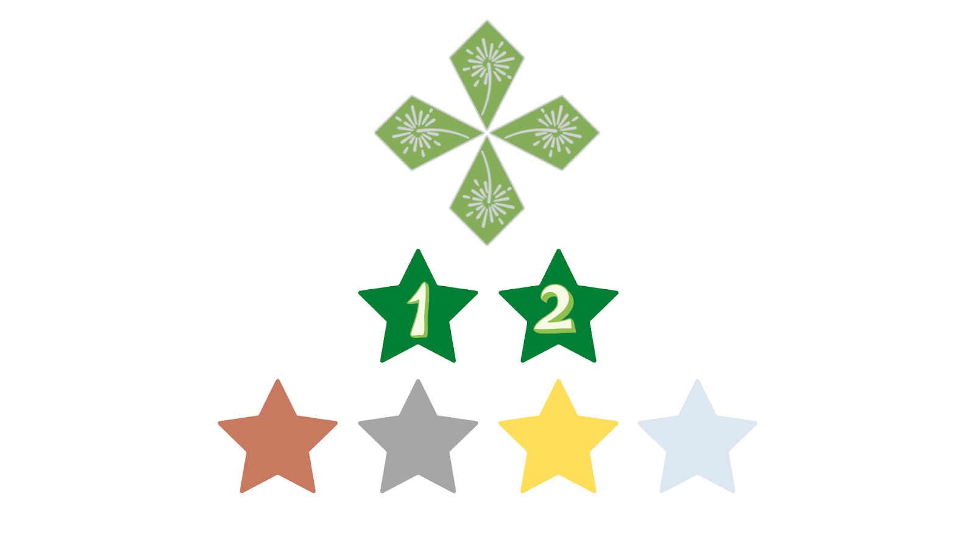
Achievement Program Levels
SPARK
EMERALD
IMPACT

Slide 4
Achievement Program Goals
Progression, vertical and horizontal sequencing
Anchored in the CA 4-H Program Framework and 4-H Thriving Model
Increase ownership of learning to the member and their environments
Increase opportunities for working in teams

Slide 5
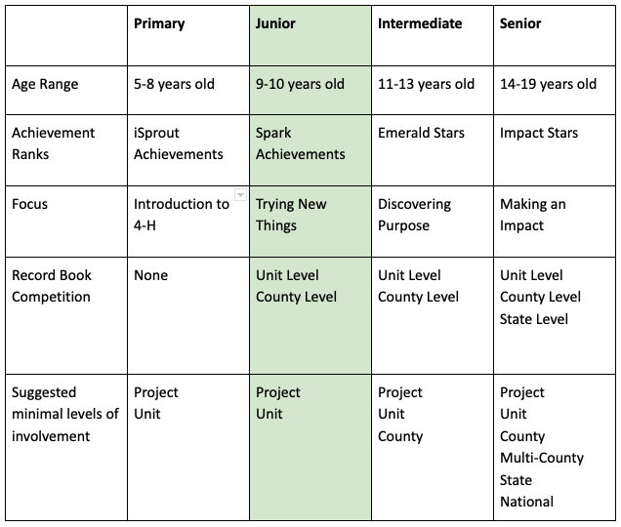
Spark Achievements

Slide 6
Spark Achievements
To earn final rank: Identify at least one spark
*Complete Record Book includes:
Spark Achievement Report
At least one APR + Expression Page for annual pin and stripe
My 4-H Story (multi-media options: written, slide deck, video, audio) + Resume for senior members

Slide 7
Junior Member or New Member?
Yes
Spark Achievements
No Achievements Desired
No
Current Rank holder
Record Book: My 4-H Story, APR +Expression Page for Pin and Stripe
Record Book: Spark Ach Report, My 4-H Story, APR + Expression Page
Current system requirements
Plan switch to new system in 2023-24
Join current pilot of Emerald & Impact Stars 2022-23
No Current Rank
Start Spark Achievements at age
2022-23 Decision Tree

Slide 8
Spark Achievements
Manual and Report

Slide 9
Junior Member or New Member?
Yes
Spark Achievements
No Achievements Desired
No
Current Rank holder
Record Book: My 4-H Story, APR +Expression Page for Pin and Stripe
Record Book: Spark Ach Report, My 4-H Story, APR + Expression Page
Current system requirements
Plan switch to new system in 2023-24
Join current pilot of Emerald & Impact Stars 2022-23
No Current Rank
Start Spark Achievements at age
2022-23 Decision Tree

Slide 11
History
2016: Fourleaf Taskforce; I & R charged to examine Emerald Star and Jr/Teen Leader standardization
2017: I & R begins discussions of Fourleaf recommendations, examine other youth-serving org recognition programs, review literature on learning, development and progression
2018: A design starts to emerge, starting with junior member achievements
2019: Mini pilot junior achievements in afterschool program; simultaneous development of other achievements
2019-2021: Mini pilot of new Emerald Star; continued revisions of all achievements.
2021-22: Pilot Spark Achievements, 70 youth, 20 volunteers

Slide 12
Soft Launch
Overview provided in October
Coaching and support through a Facebook Group, email as needed, lesson study style check-ins Facebook Lives. (Invite to join after Oct. 12th session).
Evaluation rubrics provided, state support for club and county evaluation.
All forms and manuals available on Google.
Highly recommend that all counties adopt Spark Achievements for new & junior members. Moving to full adoption in 2023-24 program year.
Teen Leader mentorship component.

Slide 13
gmminer@ucanr.edu

Slide 14
Literature & Research
Cantor, P., Lerner, R., Pittman, K., Chase, P., & Gomperts, N. (2021). Whole-Child Development, Learning, and Thriving: A Dynamic Systems Approach (Elements in Child Development). Cambridge: Cambridge University Press. doi:10.1017/9781108954600
Worker, S. M., Ouellette, K. L., & Maille, A. (2017). Redefining the Concept of Learning in Cooperative Extension. Journal of Extension, 55(3), Article 27. https://tigerprints.clemson.edu/joe/vol55/iss3/27
Changelab Solutions (2018). Pathways to policy playbook. Oakland, CA. retrieved from: https://www.changelabsolutions.org/sites/default/files/PolicyPlaybook_Final-Updated_20180920.pdf
Smith, M. H., Worker, S. M., Meehan, C. L., Schmitt-McQuitty, L., Ambrose, A., Brian, K., & Schoenfelder, E.(2017). Defining and Developing Curricula in the Context of Cooperative Extension. Journal of Extension, 55(2), Article 22. https://tigerprints.clemson.edu/joe/vol55/iss2/22
https://www.oregon.gov/oha/PH/HEALTHYPEOPLEFAMILIES/YOUTH/Documents/CurriculumYPAR2014.pdf
Lichty, L. (2010). Youth react for social change: A method for youth participatory action research. American Journal of Community Psychology, 46: 67-83. doi: 10.1007/s10464-010-9316-y
The Institute for Community Research (2014). Youth participatory action research curriculum. retrieved from: https://www.oregon.gov/oha/PH/HEALTHYPEOPLEFAMILIES/YOUTH/Documents/CurriculumYPAR2014.pdf
Girl Scout Badge and Awards Guide; Boy Scouts Merit Badge System, Camp Fire Progressions

