Slide 1
Climate Smart Agriculture
Valerie Perez, Community Education Specialist

Slide 2
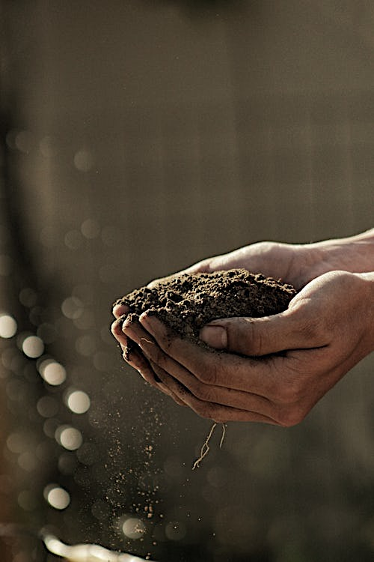
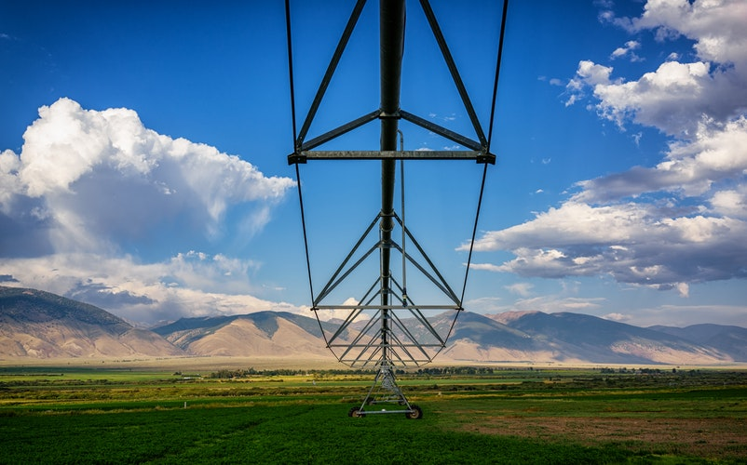
Climate Smart Agriculture Programs:
State Water Efficiency and Enhancement Program (SWEEP)
Healthy Soils Program (HSP)

Slide 3
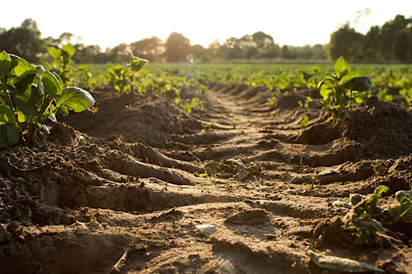
Two components:
1. HSP Incentive Program: grants up to $75,000
2. HSP Demonstration
- Type A Projects: grants up
to $250,000
- Type B Projects: grants up to $100,000
Applications due date: March 8, 2019 by 5:00pm PT

Slide 4
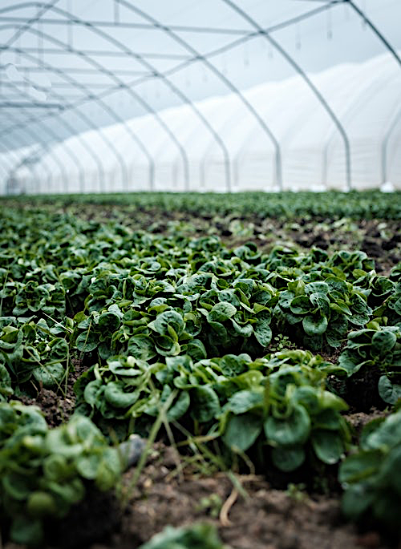
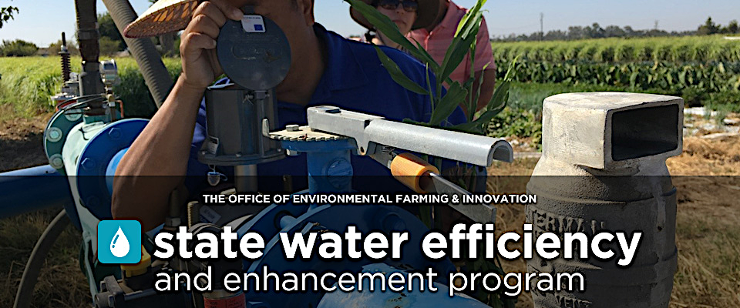
Grants: up to $100,000
Application due date: March 8, 2019 by 5:00pm PT
Example of eligible practices:
Installation of solar panels for irrigation systems
Micro-irrigation and drip systems
Pump retrofits
Variable frequency drives

Slide 5
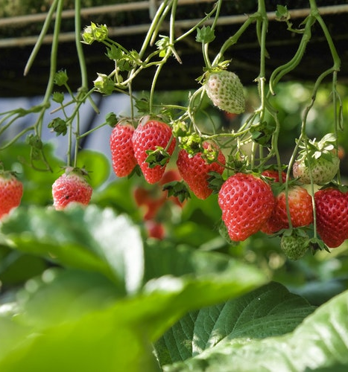
Why should you sign-up?
Save time, money, and water by using technology to monitor soil moisture
Improve soil health
Reduced energy cost
Reduced greenhouse gases

Slide 6
Contact Information:
Valerie Perez
Office: (831) 763-8028
Cell: (831) 595-8545
Email: valperez@ucdavis.edu

