Slide 1
Anaerobic Soil Disinfestation (ASD) Research Update Fumigants/non-fumigant alternatives: Regulatory/research updates April 28, 2017, Ventura, CA
Joji Muramoto and Carol Shennan
University of California, Santa Cruz

Slide 2
Acknowledgements
Special thanks to:
Margherita Zavatta and Lucinda Toyama of UCSC
Mark Mazzola of USDA-ARS, WA
Kelly Ivors, Cal Poly, SLO
The California Strawberry Commission
and many collaborators, the Shennan lab staff, students, and volunteers who have made this work possible
This work was partially funded by;
USDA NIFA MBTP # 2016-51102-25815
USDA Areawide program 58-5350-4-010

Slide 3
Outline
ASD: basics and summary of past studies in CA
2. Cover crop-based ASD trial in Santa Cruz, CA
3. ASD went bad: Fusarium wilt control by ASD in Watsonville, CA
4. Nitrogen mineralization from rice bran

Slide 4
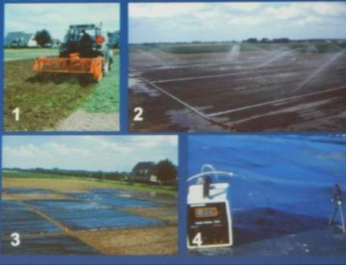
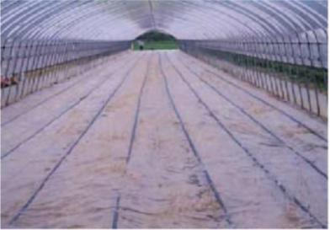
What is ASD?
Developed in the Netherlands and Japan independently ~2000 as a biological alternative to fumigation
Principle: Acid fermentation in
anaerobic soil
(Van Bruggen, 2014)
Four-step process
Incorporate labile C-source
Moisten the amended soil
Cover by plastic mulch to shut down oxygen supply
Maintain anaerobic decomposition
(Chiba prefecture, 2002)

Slide 5
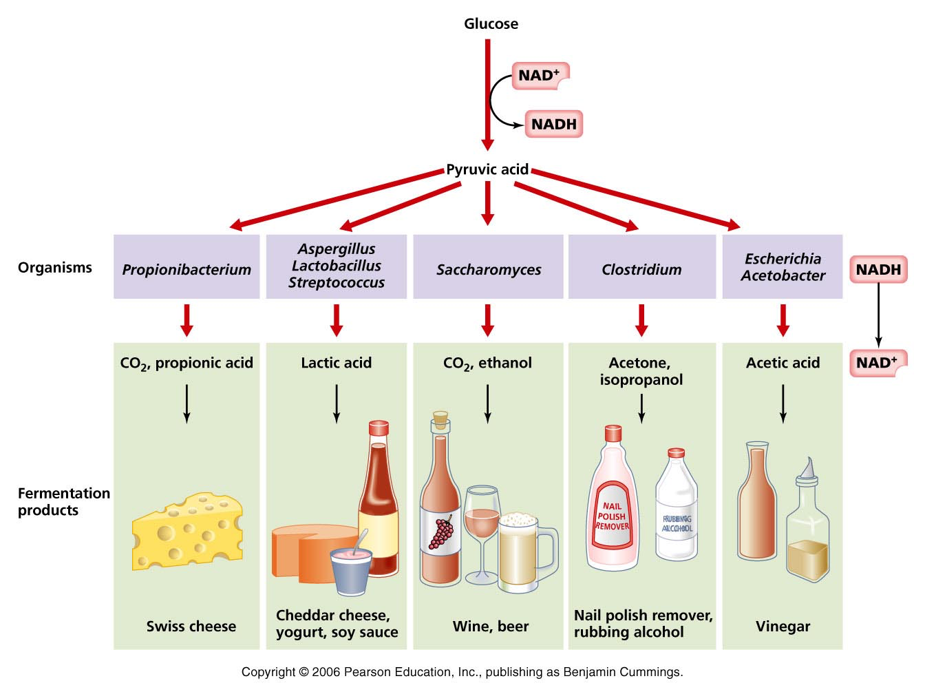
Fermentation ~key process in ASD~
An anaerobic (lack of oxygen)
bacteria, yeast or other microorganisms convert organic foods into simpler compounds
ASD process
use native microorganisms in soil
acetic acid
butyric acid
propionic acid
lactic acid
some other volatiles

Slide 6
ASD pathogen/environment complex
Temperature
Anaerobiosis
Crop genotype
Organic acids
Soil type /management history?
Fe²⁺ Mn²⁺ ions
Volatiles
Pathogen
Microbial shifts
C source
Type & Rate
Water
Depth and time
ASD Management Triangle (Shennan et al, 2014)

Slide 7
Cumulative mV hrs with Eh below 200mV – threshold for V. dahliae control at ~50,000 (25 ºC)
Both anaerobic condition and temperature are important for disease control in ASD
V. dahliae threshold
(=59 deg F)
(=77 deg F)
hrs
Below 200mV
(Shennan et al., 2010)

Slide 8
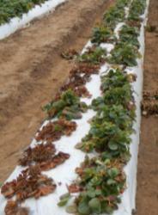
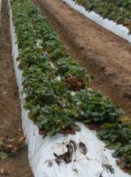
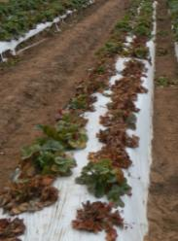
Fusarium infested field
Strawberry plants (8/14/14)
ASD Summer RB 9t/ac
ASD Fall RB 9t/ac
UTC
Higher temperature threshold for Fusarium oxysporum
(>300 hours above 86°F at 8” soil depth (Yonemoto et al., 2006))

Slide 9
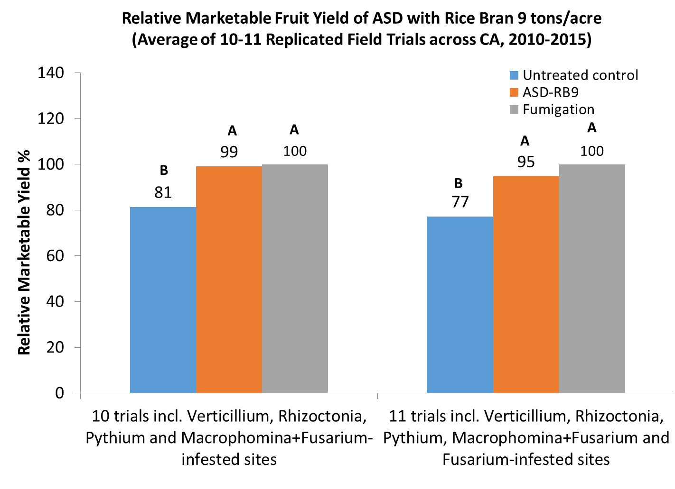
ASD provides comparable fruit yield with fumigant

Slide 10
ASD-treated strawberry fields in California
80% organic sites
20% conventional sites
~20% of CA organic strawberry acreage
~2.5% of CA total strawberry acreage

Slide 11
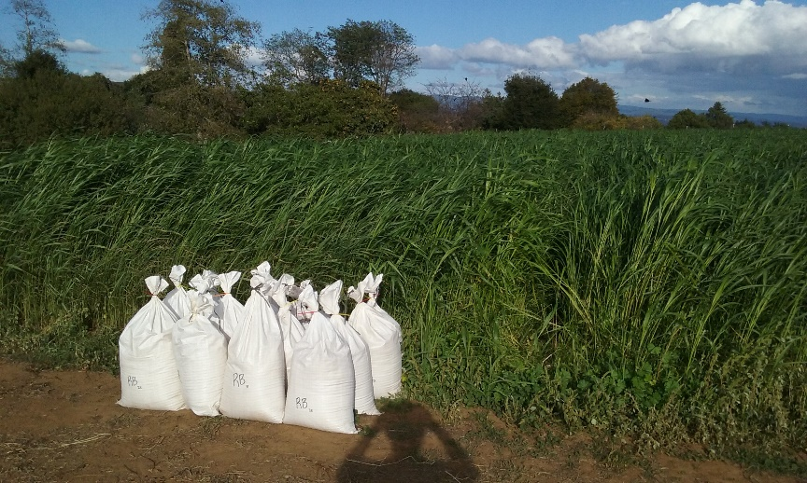
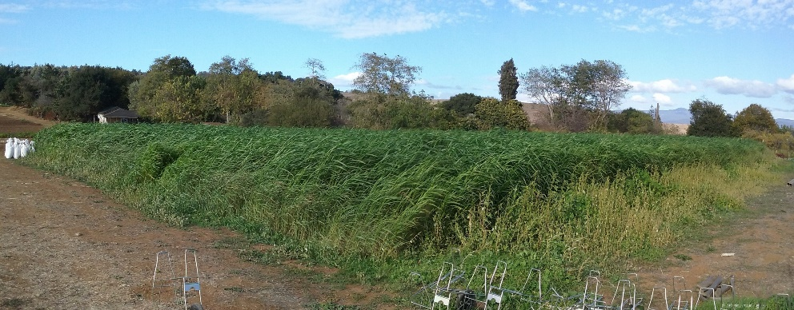
Cover Crop-Based ASD Trial (Santa Cruz, 2015-16)
UCSC Organic Farm (Elkhorn Sandy loam)
Verticillium wilt history
Piper Sudan grass 90 lb/ac
Aug - Oct, 2015
Biomass 3.5 t/ac d.w.
Treatments (CRB, 4 reps)
ASD cover crop only (7 t/ac)
ASD cover crop (7 t/ac) + rice bran (2 t/ac)
ASD rice bran (9 t/ac)
Untreated control
Albion (Dec. 2015 – Sep. 2016)

Slide 12
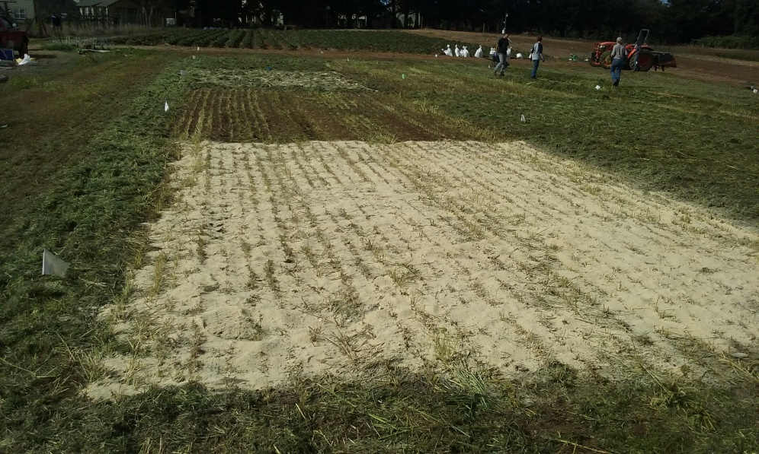
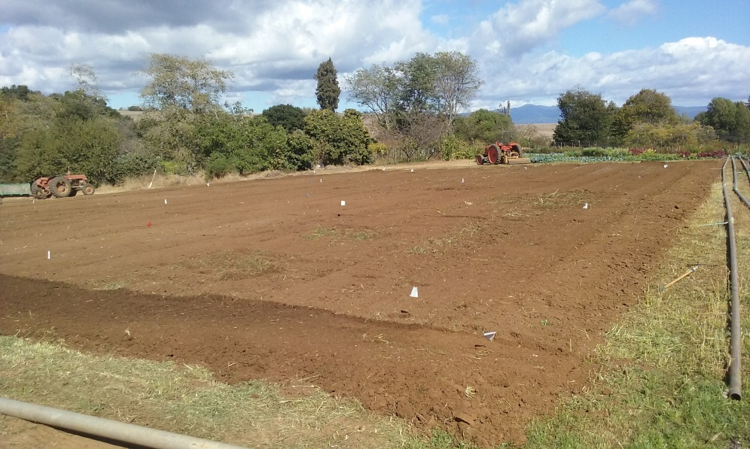
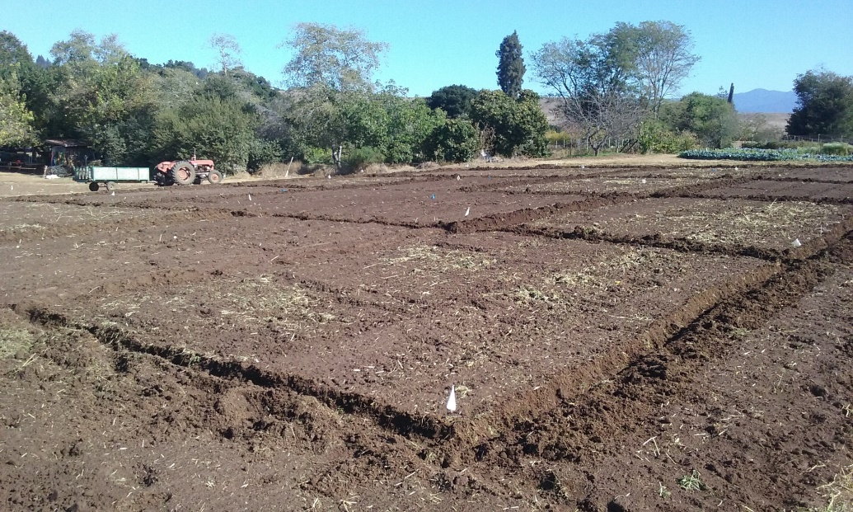
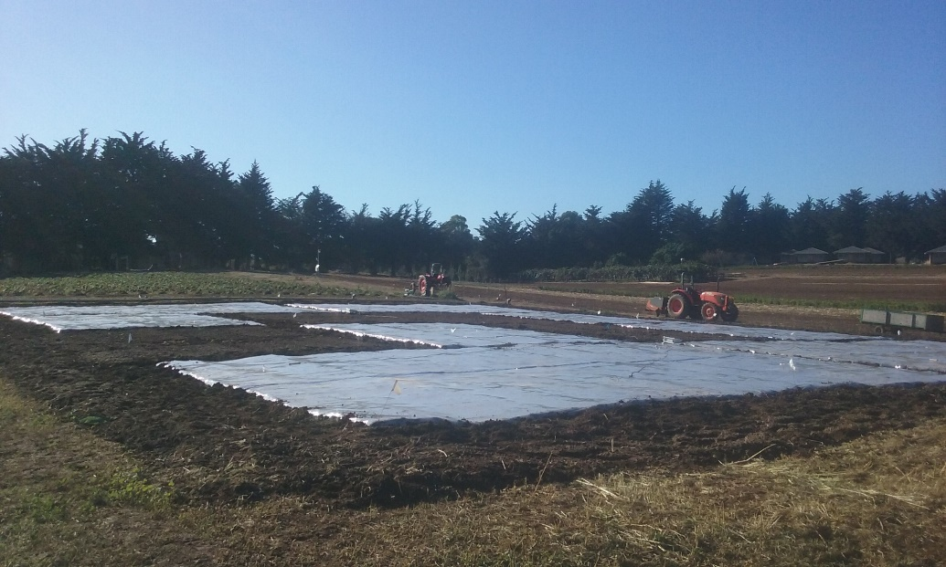
1: Broadcasted C-sources
2: Incorporated with spader
3: Sprinkler irrigation (2 hours)
4: Clear TIF tarping (3 weeks)
Flat ASD Treatment (the Dutch method)

Slide 13
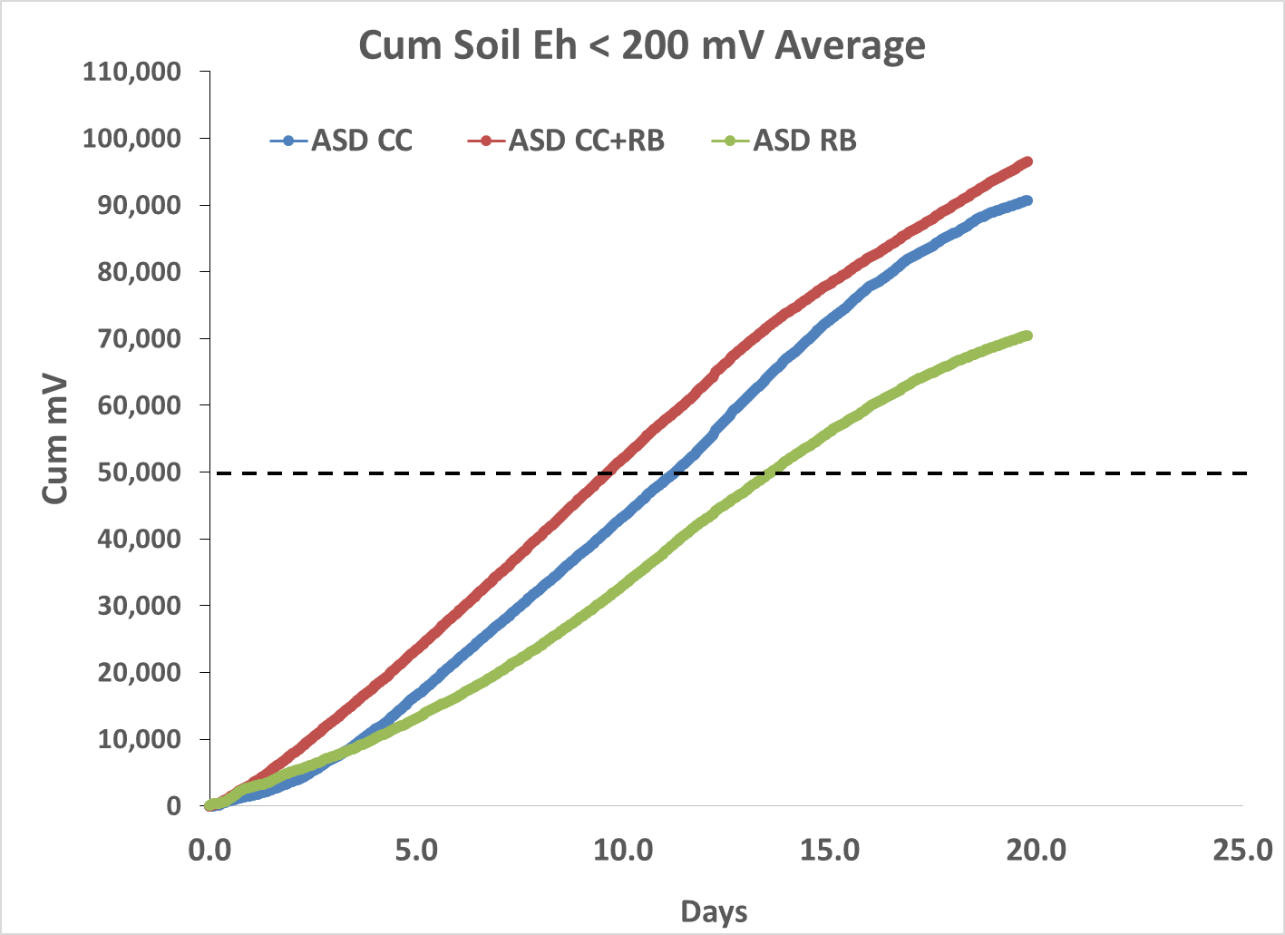

Slide 14
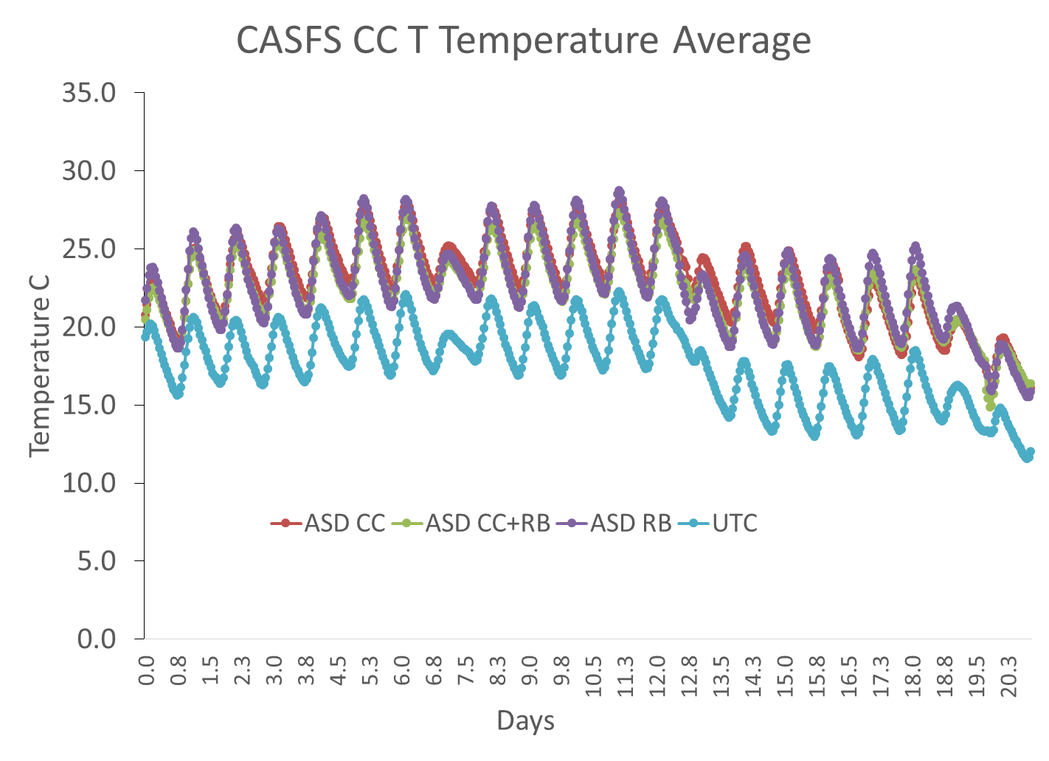
(6” depth)
ASD: Av. 23 °C (= 73 °F)
UTC: Av. 18 °C (= 64 °F)

Slide 15
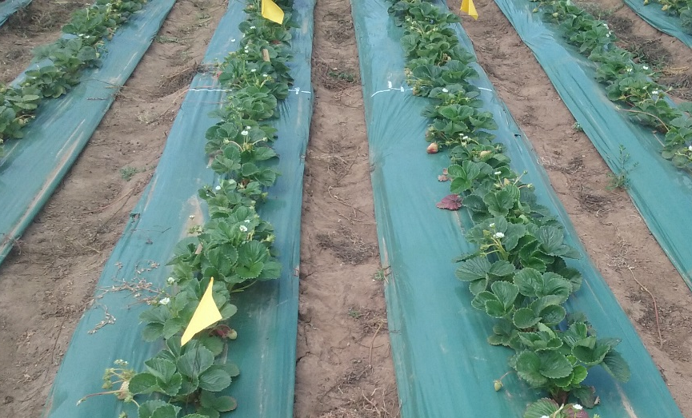
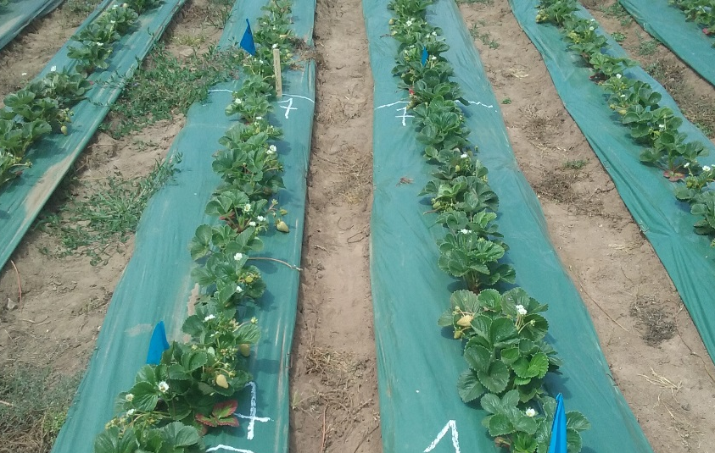
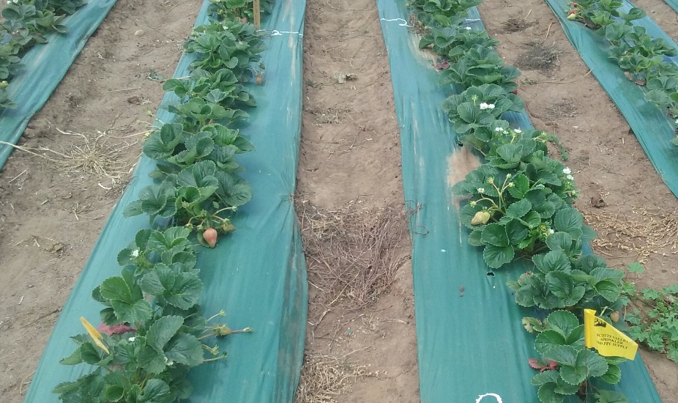
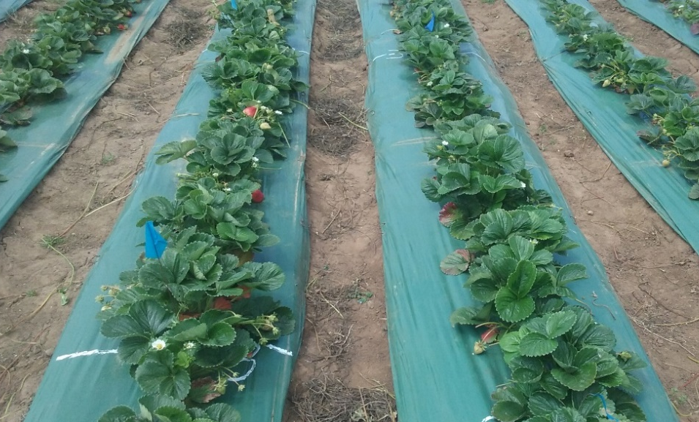
UTC
ASD-CC
ASD-CC+RB
ASD-RB
5/26/2016

Slide 16
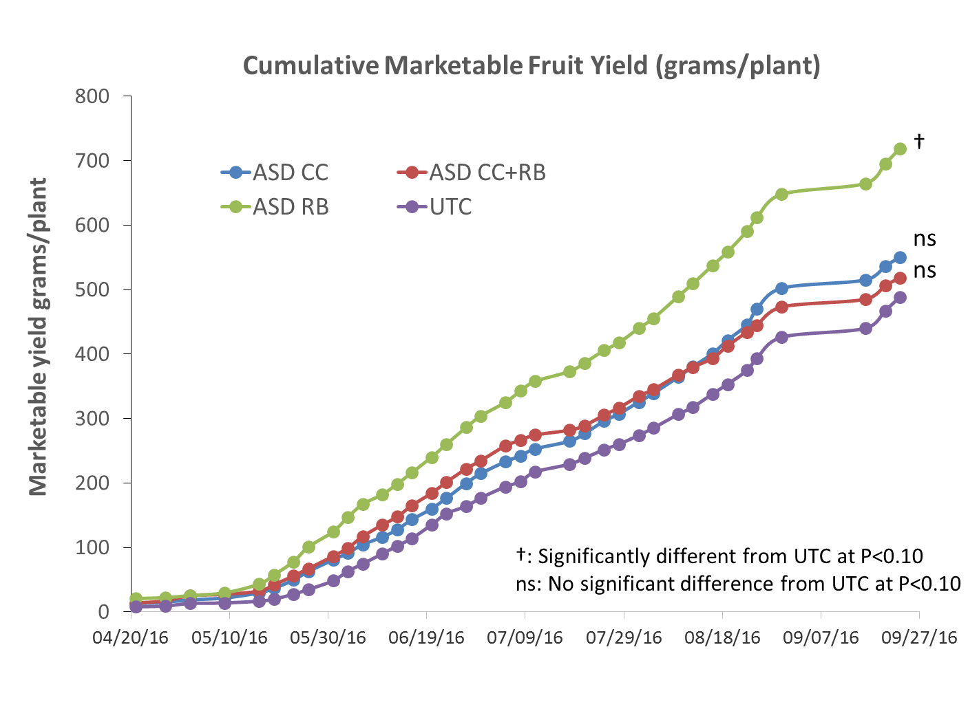

Slide 17
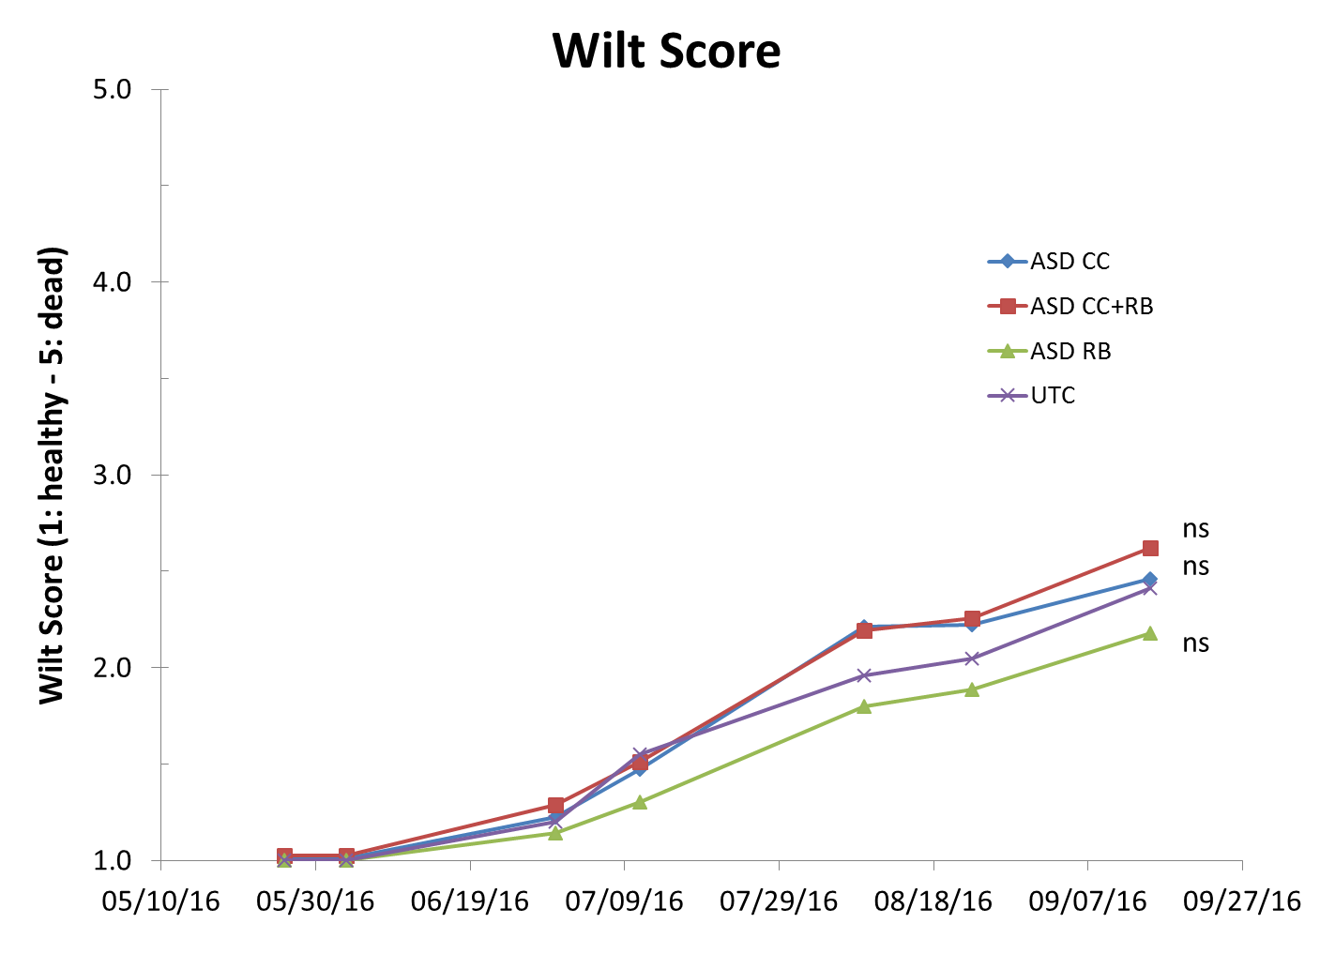

Slide 18
Summary: Cover Crop-Based ASD Trial
Yield was highest at ASD RB9 and no difference between UTC, ASD-CC, and ASD-CC+RB
Overall low disease symptom
Type of summer cover crops and rates need to be further examined
A trial comparing 2 x ryes, triticale, Sudan grass, open pollinated broccoli, and mustard as summer cover crops for ASD will start soon

Slide 19
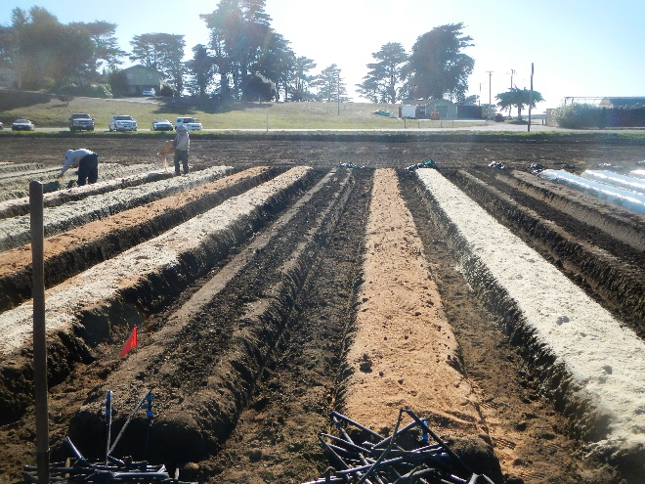
ASD went bad! Fusarium control in Northern CA
Fusarium wilt control by ASD need higher soil temp
>300 hrs above 86 °F at 8” depth (Yonemoto et al., 2006)
With higher C rate ASD can control Fusarium under lower temp (Butler et al., 2014)
High C-rate fall-bed ASD trial at Fusarium-infested field (Watsonville, RCB, 4 reps)
· ASD w/ grape pomace 12 t/ac (GP12)*
· ASD w/ grape pomace 15 t/ac (GP15)*
· ASD w/ grass hay 12 t/ac (GH12)*
· ASD w/ grass hay 15 t/ac (GH15)*
· ASD w/ rice bran 9 t/ac + grape pomace 6 t/ac (RB9+GP6)
· ASD w/ wheat bran 9 t/ac + grape pomace 6 t/ac (WB9+GP6)
· ASD w/ rice bran 9 t/ac + grass hay 6 t/ac (RB9+GH6)
· ASD w/ rice bran 9 t/ac + almond hull 6 t/ac (RB9+AH6)
· Chloropicrin 300 lb/ac*
* pre-plant fertilizer (18-8-13, 700 lb/ac) was applied only at these plots.
· Variety: Monterey

Slide 20
ASD Conditions
* Threshold to control Verticillium dahliae at 77°F (Shennan et al., 2009).
** Threshold to control F.o.f. at 8” soil depth (Yonemoto et al., 2006).

Slide 21
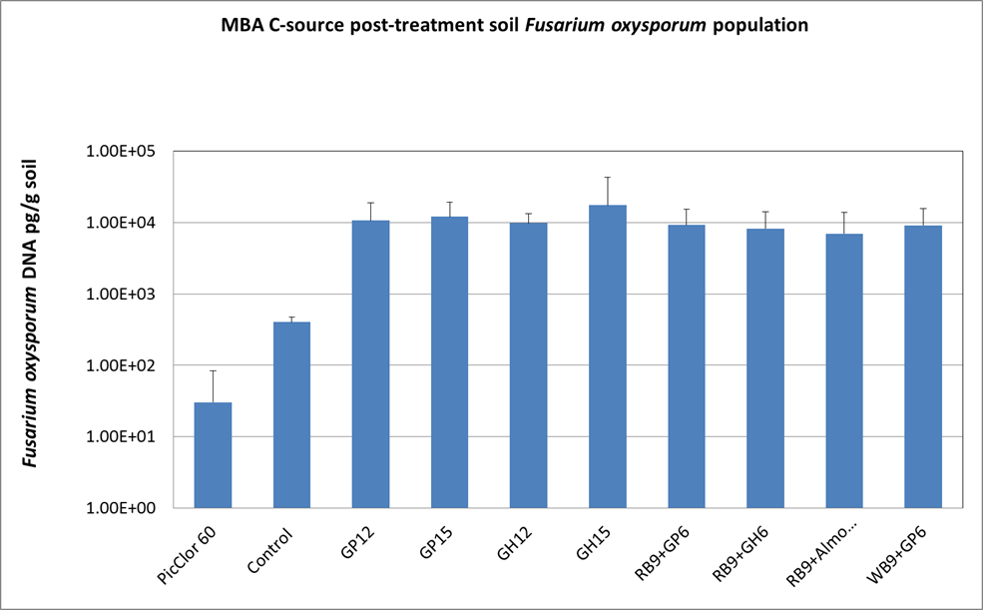
Pic 300

Slide 22
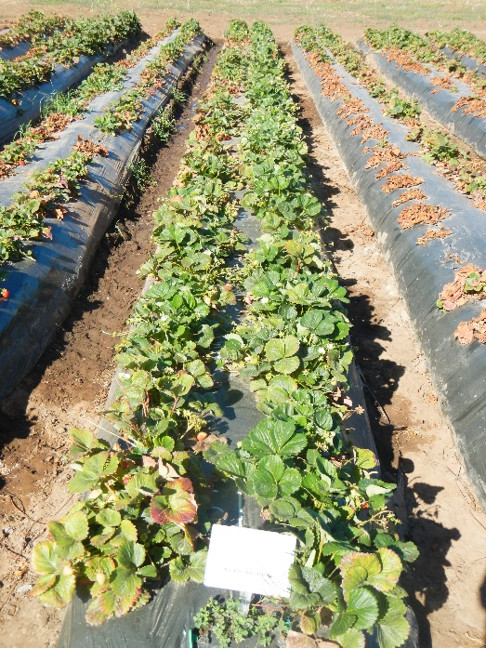
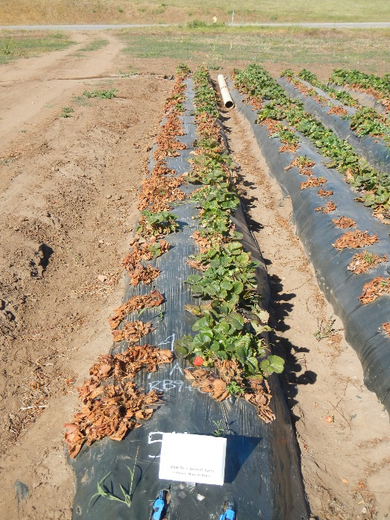
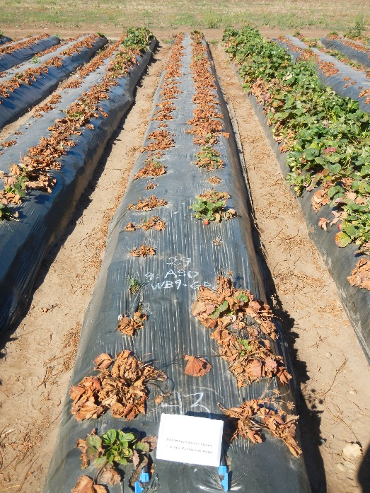
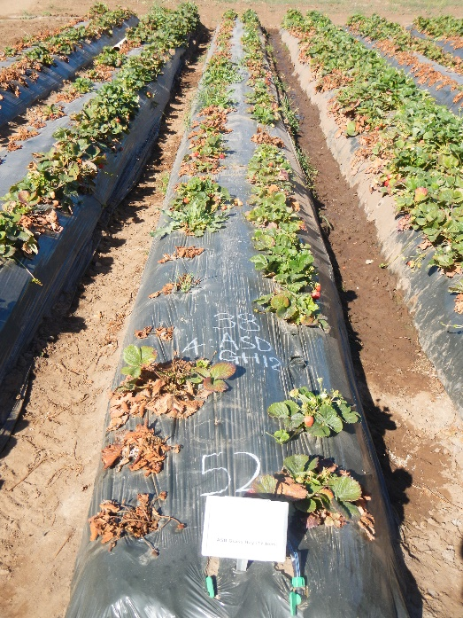
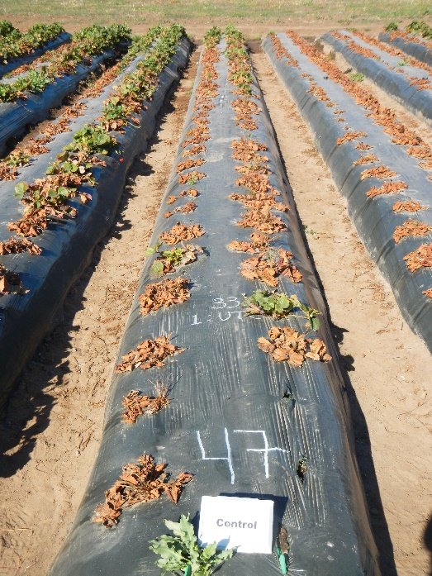
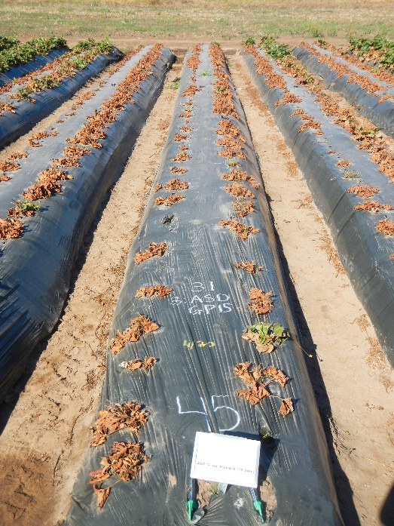
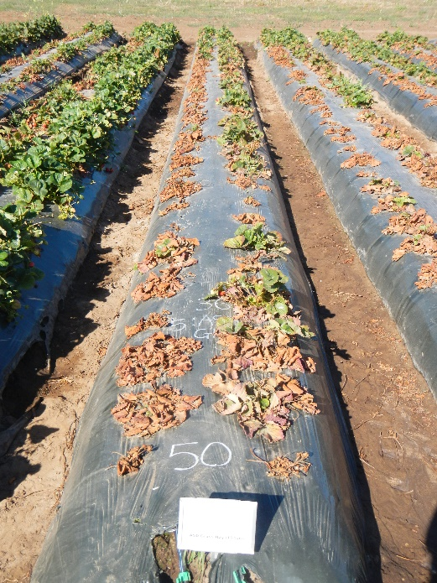
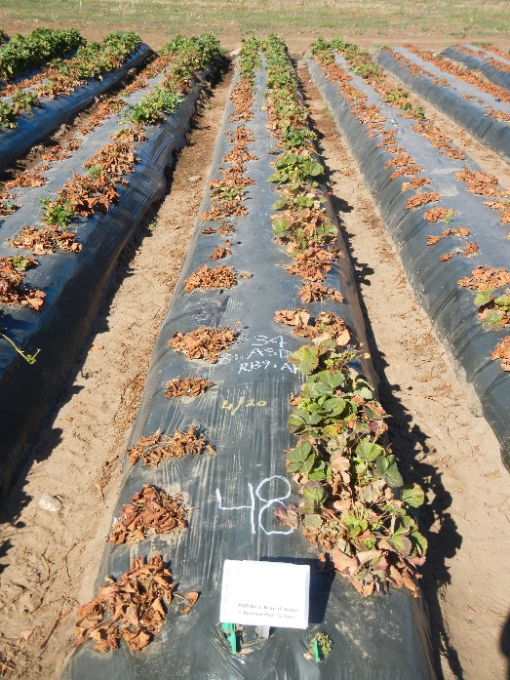
Pic 300
ASD RB9+GH6
ASD WB9+GP6
ASD GH12
UTC
ASD GP15
ASD GH15
ASD RB9+AH6
6/21/2016

Slide 23
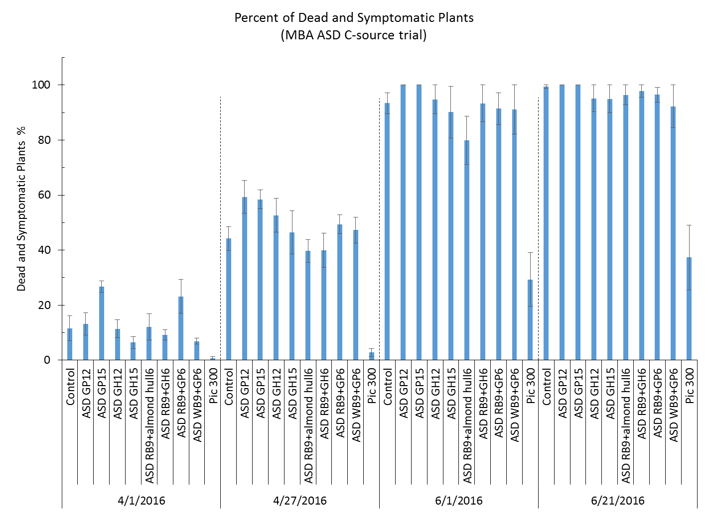

Slide 24
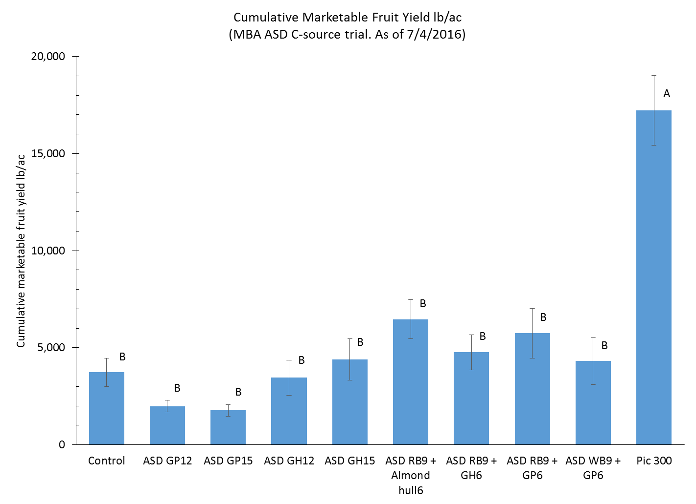

Slide 25
Summary: High C-rate ASD Trial
Fusarium oxysporum population increased by adding high rate of C-sources for ASD in fall
This pathogen can be fed by readily decomposable C-sources at low soil temperature (< 86°F at 8” soil depth)
Do Not Use ASD in fall at Fusarium infested fields
Summer flat ASD with clear-TIF can reduce Fusarium wilt in the coastal CA (Shennan et al., 2015)
Use Fusarium resistant variety (e.g. San Andreas) and sound crop rotation for Fusarium-infested organic fields

Slide 26
Nitrogen management considerations
Rice bran: N-P₂O₅-K₂O: 2-3-1
N mineralization rate: 20-30% per season (further study in progress)
20-30% of TN becomes available to plants per season
e.g. RB 9 tons/acre: 18,000 lb x 0.02 = Total N: 360 lb-N/ac
360 x 0.2–0.3 = 72-108 lb-N/ac of plant available N
Mineralization*
Organic N
[2.0%]
Total N
[2.0%]
Ammonium N
(NH₄⁺-N)
Inorganic N
[< 0.1%]
Nitrate N
(NO₃⁻-N)
[Plant Available N]
* Biological process

Slide 27
Questions/Discussion
joji@ucsc.edu

