Slide 1
Alternative Fumigants and Emissions Reduction
Husein Ajwa
University of California-Davis, Salinas, CA

Slide 2
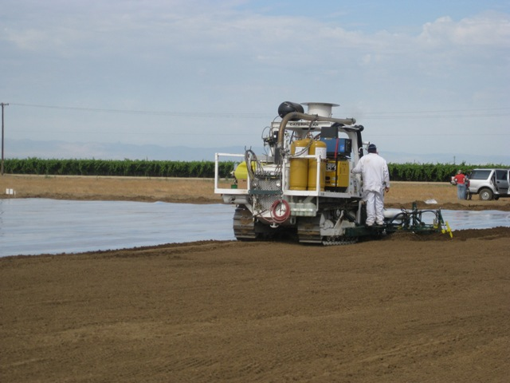
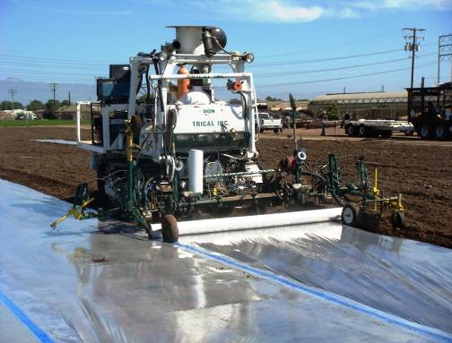
FUMIGATION
+ Reliable; No Residues in Crop; Variable Costs
Conventional Fumigation (Acres, California 2007):
Methyl Bromide/Chloropicrin: 40,000
Telone/Chloropicrin: 17,000
Telone II: 37,000
Chloropicrin alone: 6,000
Metam sodium: 77,000
TOTAL: ~ 180,000 acres annually
Methyl Bromide, Chloropicrin, MITC Generators, 1,3-D,
DMDS in Cal/EPA registration process
Significant Regulatory Pressure:
Buffer zones
VOCs regulations
Application rates
Resulted in development of new film (tarp) technology:
“Virtually impermeable (VIF)”
“Totally impermeable (TIF)”

Slide 3
Agricultural Film (tarp) Types
“Standard” polyethylene tarp (HDPE or LDPE)
LDPE
“Semi-impermeable” Tri-extruded LDPE
LDPE
LDPE
LDPE
LDPE
“Virtually impermeable (VIF)” LDPE + Nylon barrier
Polyamide
LDPE
LDPE
“Totally impermeable (TIF)” 5-layer EVOH resin barrier
Admer Adhesive
EVOH
LDPE
Notes:
HDPE is the current industry standard.
3

Slide 4
Fumigant concentration under tarp

Slide 5
Concentration-time (CT) exposure index (µg cm⁻³·h) of 1,3-D and CP in 2009 Oxnard fumigation trial
Soil depth (cm) | PE field |  | TIF field
 | 1,3-D | CP | 1,3-D | CP
0 | 88 | 10 | 353 | 87
5 | 97 | 14 | 362 | 86
15 | 131 | 28 | 385 | 102
25 | 211 | 83 | 392 | 124
35 | 332 | 243 | 307 | 108
45 | 197 | 122 | 265 | 69
55 | 105 | 54 | 54 | 32
70 | n/a | n/a | 2 | 2

Slide 6
Pests controlled with fumigants
Soil borne diseases
  Pythium
  Phytopthora
  Verticillium
  Others (Macrophomina, Fusarium, Rhizoctonia, Colletotrichum coccodes,…..)
Nematodes
Insects
Weeds
  Volunteer crops
  Annual & perennial weeds

Slide 7
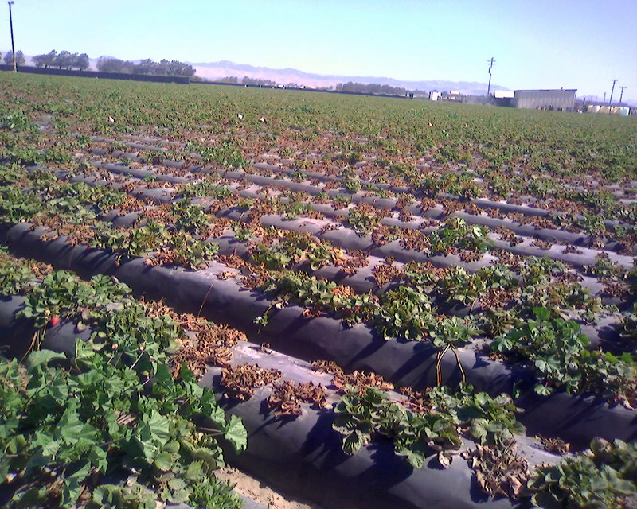
Macrophomina problems are increasing on fields treated consecutively via drip fumigation (or low application rates of alternative fumigants). Growers need to fumigate with methyl bromide or methyl iodide to keep these fields viable for crop production.
Macrophomina (Charcoal Rot)

Slide 8
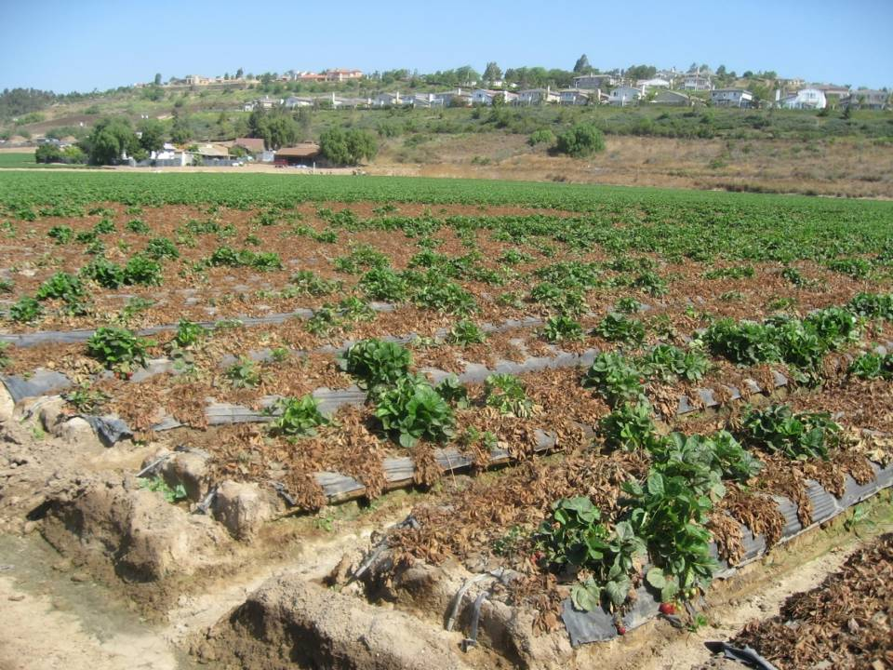
Fusarium wilt control requires methyl bromide

Slide 9
Alternative Fumigants
Summary of Previous Research:
Fumigant application rates required to control soil-borne fungal pathogens

Slide 10
Methyl Bromide + chloropicrin (57%MeBr + 43%Pic)
➢ For control of Verticillium dahliae: 300 to 400 lb/a
➢ Excellent control of Phytophthora cactorum, Pythium sp., and citrus nematode)
➢ Excellent control of Macrophomina and Fusarium
Summary

Slide 11
Telone C35 or Inline (62% 13-D + 33% Pic)
➢ For control of Verticillium dahliae: 425 lb/a
➢ For P. cactorum, Pythium spp., and citrus nematode: 300 to 400 lb/a)
➢ Control of Macrophomina and Fusarium: >400 lb/a under retentive film (VIF/TIF)
Summary

Slide 12
Chloropicrin (Pic)
➢ For control of Verticillium dahliae: 200 to 300 lb/a
➢ For control of P. cactorum, Pythium sp., and citrus nematode: 300 to 400 lb/a)
➢ Control of Macrophomina and Fusarium: 300 lb/a under VIF/TIF
Summary

Slide 13
Pic-Clor 60 (60% chloropicrin + 40% 1,3-D)
➢ For control of Verticillium dahliae: 300 to 350 lb/a
➢ For control of P. cactorum, Pythium sp., and citrus nematode: 250 to 350 lb/a)
➢ Control of Macrophomina and Fusarium: 350 lb/a under VIF/TIF
Summary

Slide 14
MITC Generators
(metam sodium & metam potassium)
➢ For control of Verticillium dahliae: >300 lb ai/a
➢ For P. cactorum, Pythium spp., and citrus nematode: 200 to 300 lb ai/a
➢ Can provide enhanced efficacy of pest control when used in conjunction with other fumigants
➢ Control of Macrophomina and Fusarium: ???
Summary

Slide 15
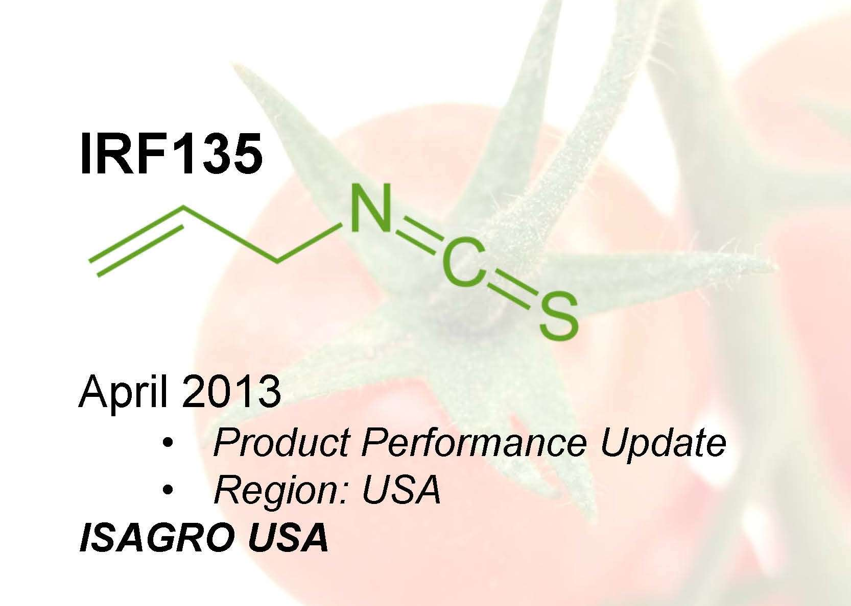
Mike Allan
Summary
Allyl isothiocyanate

Slide 16
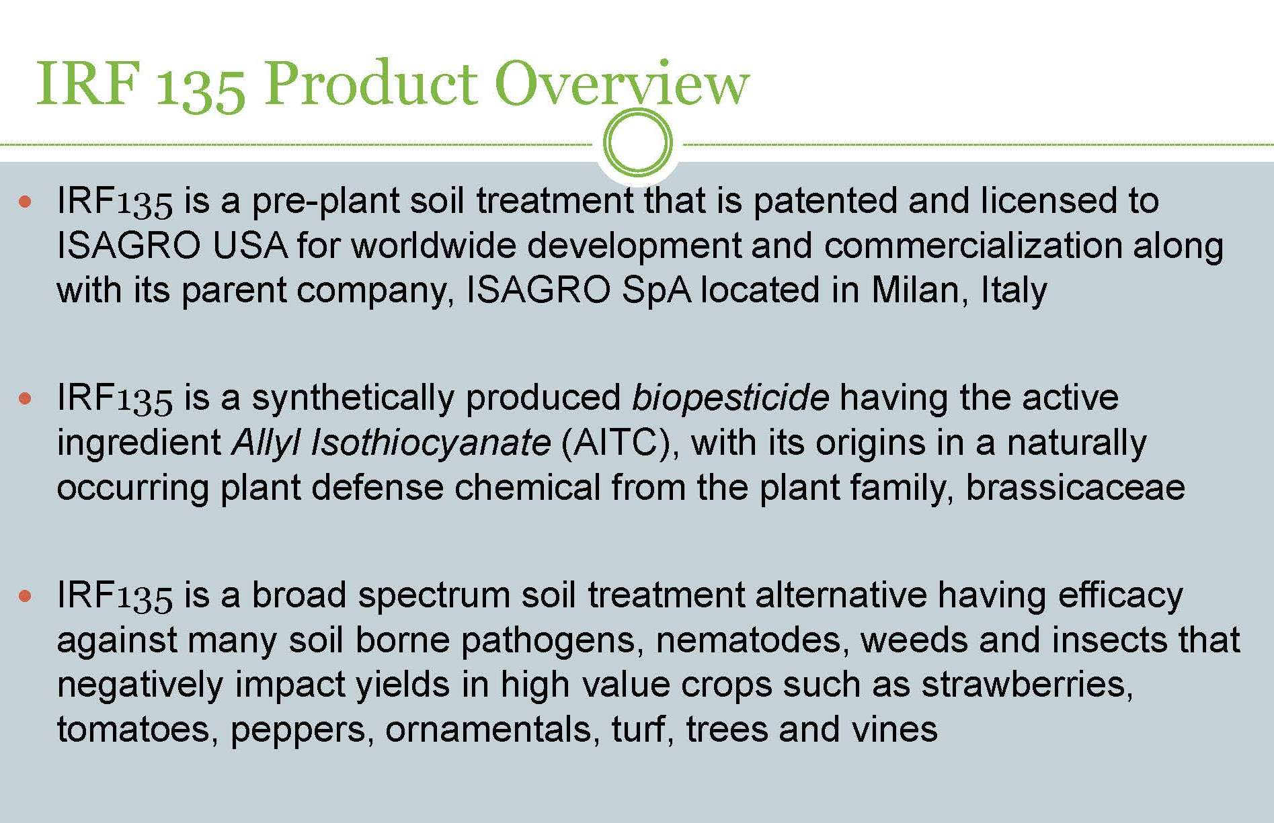
Summary

Slide 17
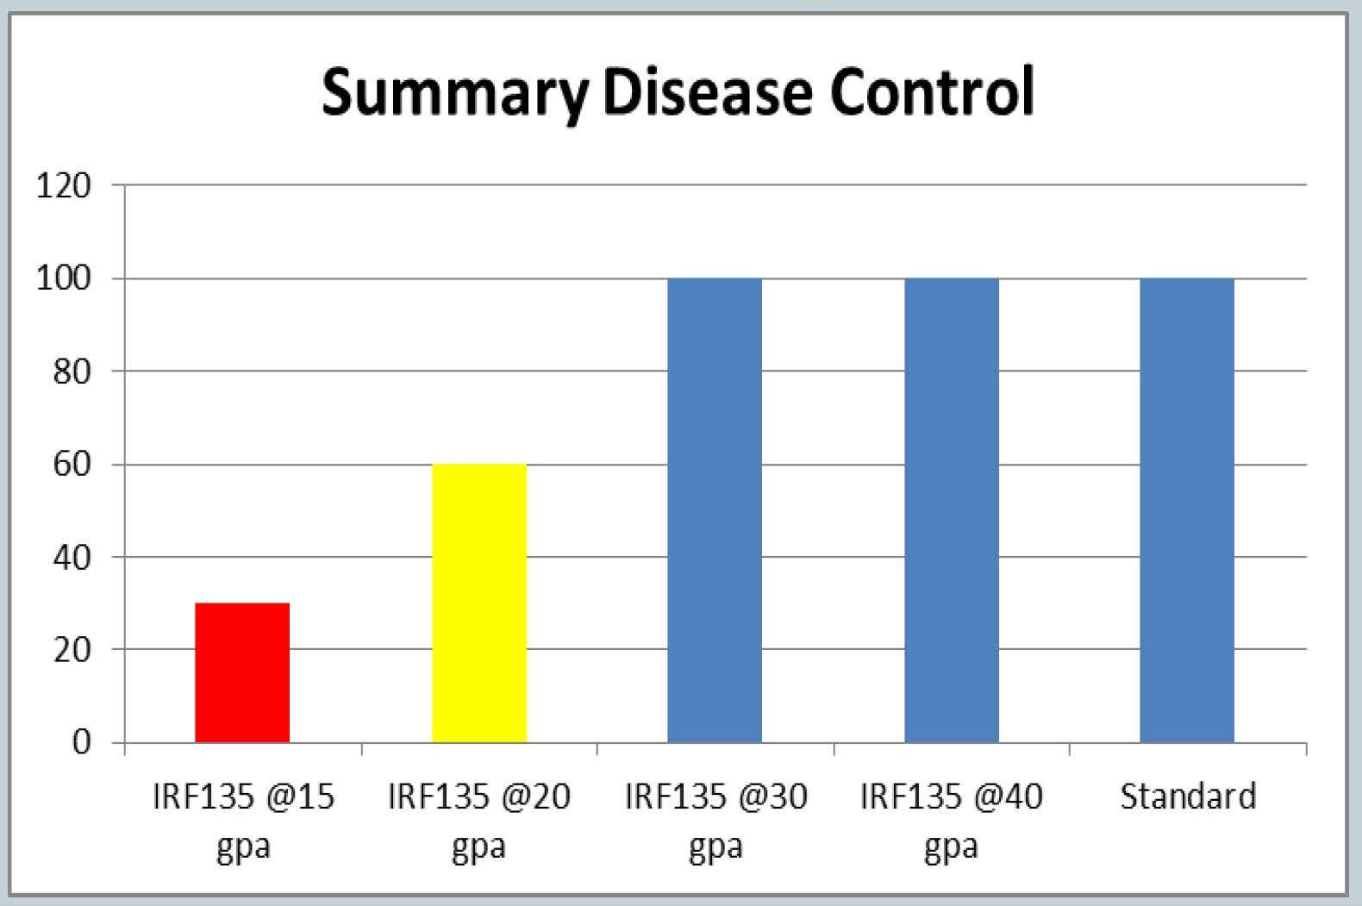
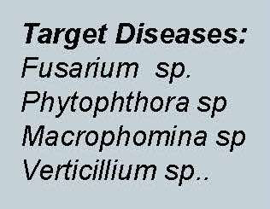
Summary

Slide 18
    Dimethyl disulfide (DMDS)
    ➢ EPA Registration was granted in 2010 (Arkema)
    Applied only under VIF/TIF
    ➢ Used as a flavoring for an onion or garlic taste in some processed cheese and meat (0.02-10 ppm)
    ➢ Efficacy?? (Rates: 400 – 650 lb/a)
Paladin: a new fumigant

Slide 19
ODOR
DMDS (PALADIN® ) has a strong, objectionable odor which can be detected at concentrations significantly below the levels that can potentially cause harm. The odor is a garlic-like or natural gas and may be confused with the odor of or propane leak.
Minimum tarp removal on the label is 14 days. With VIF/TIF tarps and for odor mitigation, minimum tarp removal will be based on soil temp and the plant back chart.

Slide 20
Laboratory dose-response studies
80% inhibitory concentration (MIC₈₀)
Soil fumigant | Application rate to control 80% of pathogens population (lbs/ac)
 | Fusarium Oxysporum | Pythium ultimum | Rhizoctonia solani | Tylenchulus semipenetrans | Verticillium dahlia
DMDS:Pic (79:21) | 288 | 144 | 432 | 72 | 370
MBr:Pic (50:50) | 150 | 75 | 300 | 38 | 275

Slide 21
Paladin research, 2012
Treatment Lbs product/A
Untreated
MeBr (57:43) +Standard Film | 350 lbs
Pic + TIF | 200 lbs
Paladin 70:30 | 280 lbs
Paladin 70:30 | 315 lbs
Paladin 70:30 | 350 lbs
Paladin 65:35 | 260 lbs
Paladin 65:35 | 383 lbs
Paladin 79:21 | 378 lbs
Paladin 79:21 | 500 lbs
Paladin 60:40 | 450 lbs
Paladin 50:50 | 400 lbs

Slide 23
Summary
No phytotoxicity or plant mortality was observed in any of the Paladin treatments.
Maximum yields were obtained with Paladin 50/50 @400 lbs/ac, Paladin 60/40 @450 lbs/ac, and Paladin 79/21 @500 lbs/ac.
Undergoing research on shank and drip applications of IRF135 (allyl isothiocyanate).

Slide 24
Emission Reduction Research
2011 Flux Research: TIF Cutting Time
To determine the best tarp cutting time, studies were conducted on 3 separate fields (2 or 8 acres) in Lost Hills near Bakersfield in June, 2011.
Pic-Clor 60 soil fumigant (60% chloropicrin and 40% 1,3-D) was applied by shank injection under TIF at 12 inches deep.
Target application rate was 588 lbs/ac of Pic-Clor60 (350 lbs of chloropicrin plus 238 lbs of 1,3-D).

Slide 25
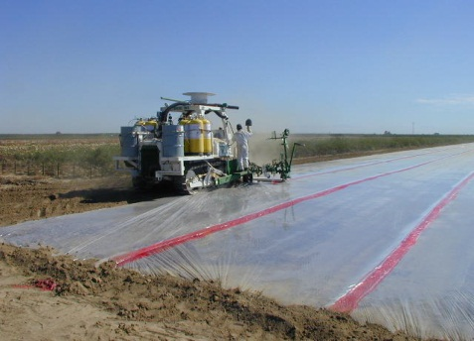
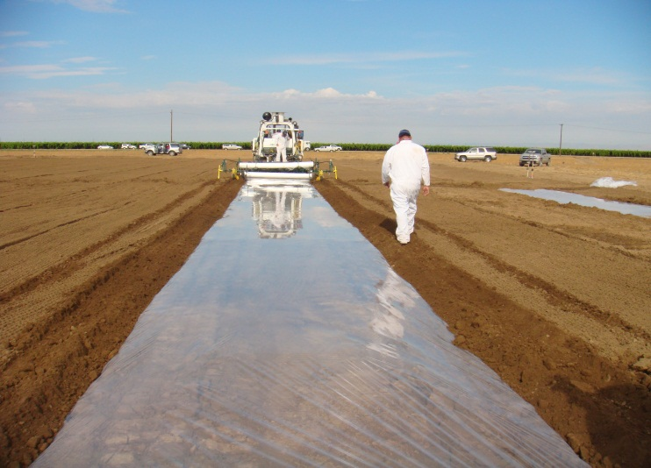
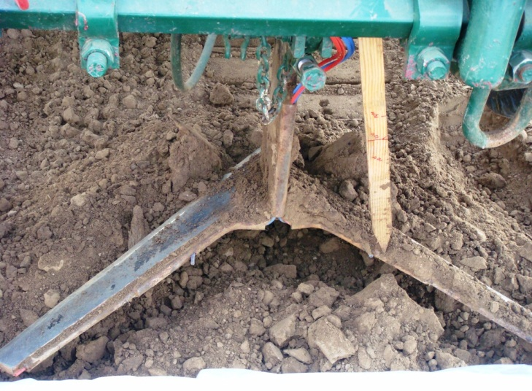
Tarp cutting time
Shank applications, 2 to 8 acres each field

Slide 26
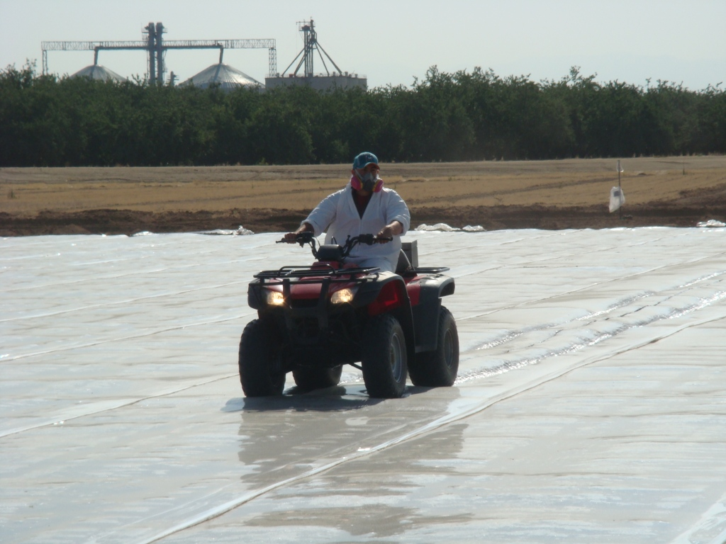
Tarp cutting was done after 5, 10, and 16 days

Slide 27
Field layout showing locations of the monitoring stations
Notes:
Off field samplers are placed in eight directions surrounding each field at approximately 40 feet from the sides and 80 feet from the corners. Sampling height is about 5 feet high to simulate human breathing zone.
27

Slide 28
Lost Hills Flux Study, 2011

Slide 29
Lost Hills Flux Study, 2011

Slide 30
Lost Hills Flux Study, 2011

Slide 31
Summary
For chloropicrin, a tarping period of 7 days should be sufficient for application rates of less than 200 lbs/acre. 10 days of tarping might be needed for application rates >300 lbs/acre.
For 1,3-D, a tarping period of 10 days should be sufficient for application rates of less than 200 lbs/acre. 14 days of tarping might be needed for application rates >250 lbs/acre.

Slide 32
Summary
  TIF significantly reduced total emissions of chloropicrin and 1,3-D. Relative to other flux studies with standard PE tarp, TIF reduced total emissions by 4 to 5 times.
  The use of TIF may allow for smaller buffer zones and/or large fumigant application rates in heavily infested soils.

Slide 33

Thank you very much
Husein Ajwa
CE Specialist, UC Davis
1636 East Alisal St., Salinas, CA 93905
Phone (831) 970-8621
haajwa@ucdavis.edu

