Slide 1
Connecting the Dots: Raspberry Production Challenges
Miguel Ahumada, Sun Belle Inc.
Notes:
Thanks for the invitation,

Slide 2
Raspberry economics
2013 in Ventura 2013 Santa Cruz
  $187 million $142.2
  #3 crop #2 crop
  2012 in Monterrey (Salinas)
  $41,35
  #15crop
#3 berry in US per capita consumption
Can be highly profitable
  $20K-$60K typical profit per acre
  Winter prices can be 3x more than summer, organics prices varied through the seasons
Notes:
2008 the nation consumption was 0.27 pounds (4.32 oz) USDA data,
US raspberry consumption up 300% Fresh Plaza magazine may 17, 2013, source is Ohio State University, this mean we spend around $ 14-15 dollars per person.
Raspberries continue to rank as the third most popular berry in the United States for fresh use, after strawberries and blueberries

Slide 3
Challenges
High production cost
  $60K-$70K per 2-year crop cycle
Complex cropping system
  Multi-cycle production
  Few varieties, adaptability issues
  Fruit quality
Research and innovation still needed
  Trellising systems
  Pest and Diseases management
  Fertigation, Substrate, Plastics/mulches
Mexico; the big challenge
Notes:
Variety earliness is become a challenge for Breeders, and it adaptability to CB in Nov

Slide 4
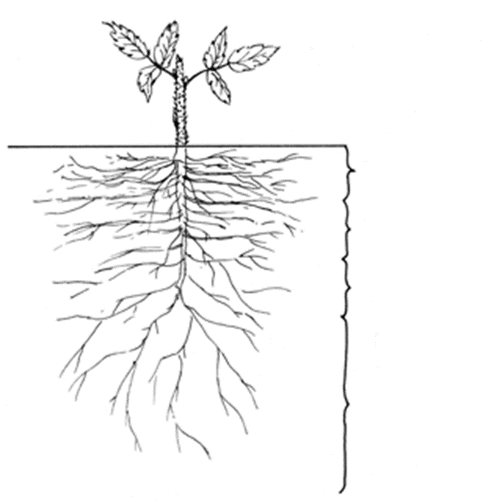
Mediterranean Climate
Shoots 59ºF- 68ºF
Roots 75ºF
Cool Shoots - Warm Roots
Notes:
Santa Ana winds breaks and early morning fog in costal areas
Net carbon exchange model, describe by Percival et al 1996, air and roots-zone temperature contributing 75% and 24% respectively and R=0.96
A north to south direction of rows helps prevent sunburned fruit on the south side of the rows during hot summers and promote uniformity of fruit in both size. Year around production

Slide 5
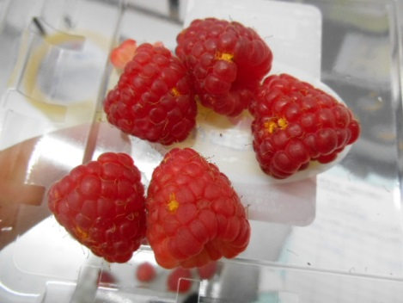
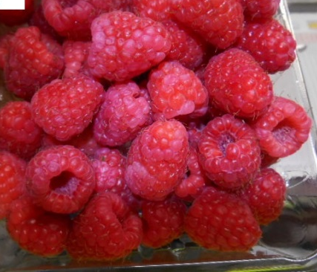
Protected Culture
Wind
Reduces plant growth and development
Fruit damage: rubbing, abrasion, punctures
Rain/Humidity
Increased fungus
Sun
Sun burn, UV light
Notes:
Santa Ana winds breaks and early morning fog in costal areas
Net carbon exchange model, describe by Percival et al 1996, air and roots-zone temperature contributing 75% and 24% respectively and R=0.96
A north to south direction of rows helps prevent sunburned fruit on the south side of the rows during hot summers and promote uniformity of fruit in both size. Year around production

Slide 6
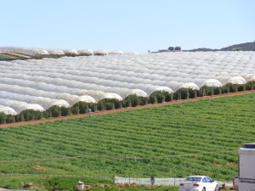
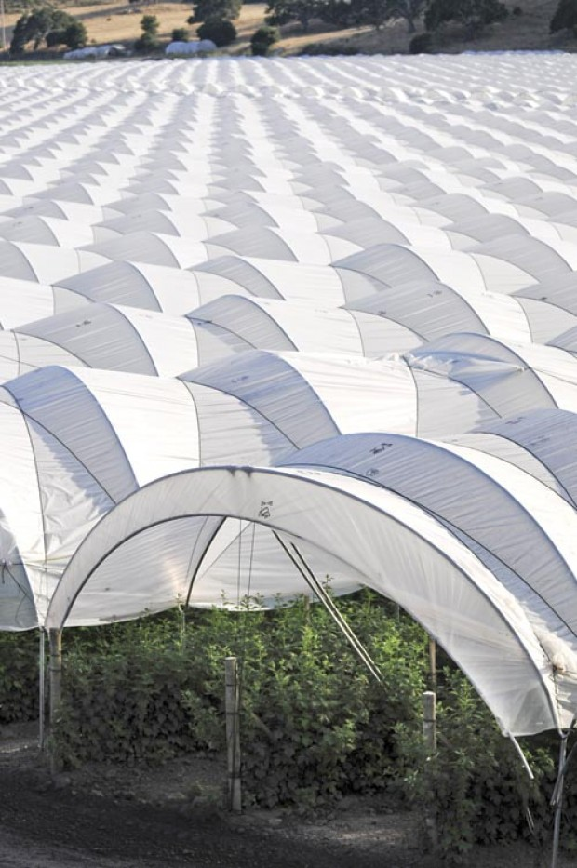
High Tunnel
Higher productivity
Need management !
Notes:
Cost studies by UC Cooperative Ext. has in $35 thousand per year/ of that, $21, 500 K are coming from cost of tunnels and plastic. Plastic 6 ml, highly efficient design in the Market like Haygrove tunnels,
For year round production position of the tunnels, North South sun will heat the evenly
Temperature inside tunnels 2 to 5 F higher inside the tunnel than all side

Slide 7
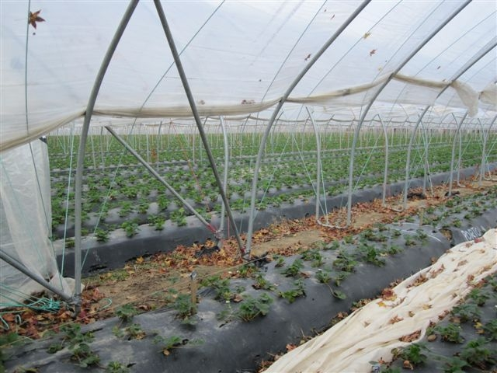
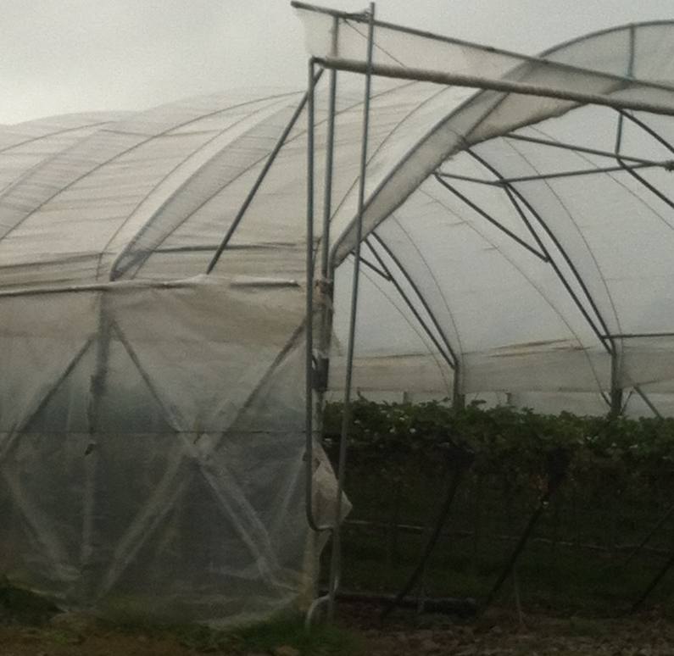
Tunnel types
French Tunnel
Sidewalls and Doors
Notes:
Many types of tunnels in the market, in the left French tunnel, which allow it plastic to reach soil level, or more sofisticated like this in the right with front doors and side venting

Slide 8
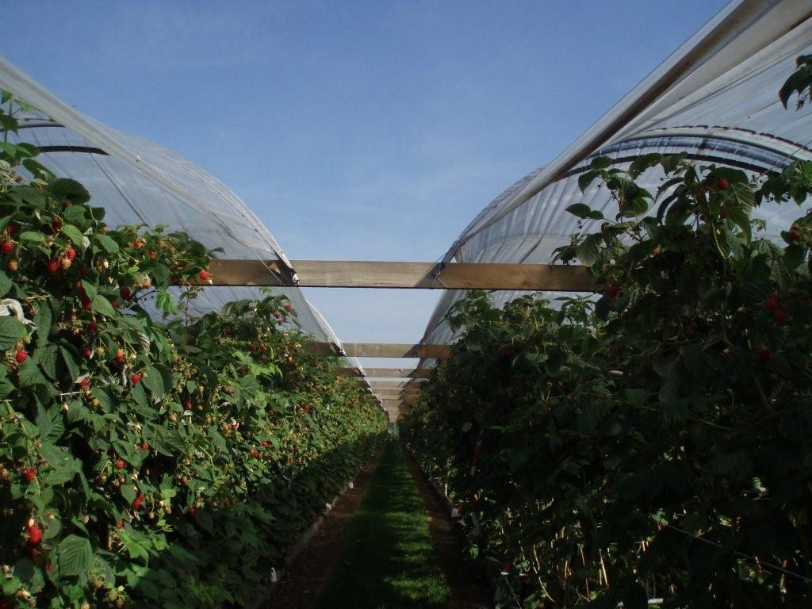
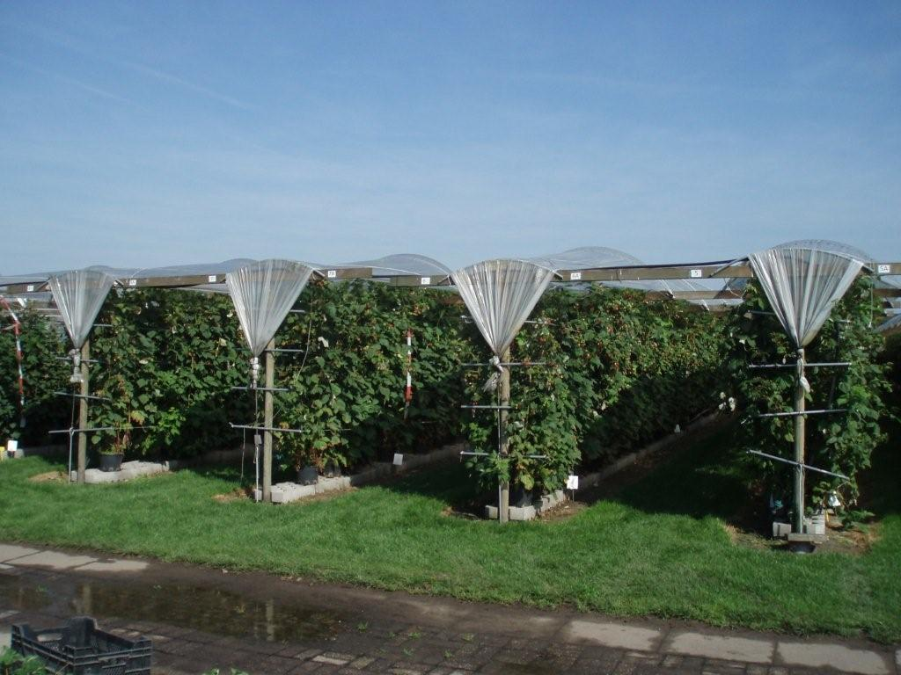
Rain shelters
Lower cost than tunnel
For windless areas

Slide 9
New Varieties
Public
  Diamond Jubilee – Berryworld Plus, UK
  Imara - Advanced Genetics, Netherlands
  Kwanza - Advanced Genetics, Netherlands
  Vintage - USDA ARS Oregon
Proprietary
  Adelita - Planasa
  Alicia - Driscolls
  Erika – Sun Belle (in the Americas)
Others ?
Notes:
Genotype x environment (G x E) interaction pose important problem in developing and selecting new varieties for a wide range of environments.

Slide 10
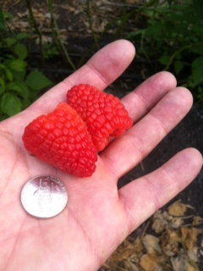
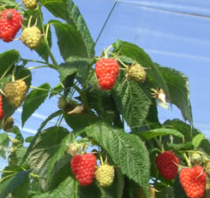
Varieties
Adelita
Erika
Notes:
Adelita left 8-10 grams fruit firm, the plants need to be push early. Breed in Mexico coming into the US this year
Erika top right, vigorous var, good flavor, and light red color. Breed in Italy.
New Vintage from ARS/USDA Oregon, and Kwanza, from Advance genetic in the Netherland, will change the market distribution

Slide 11
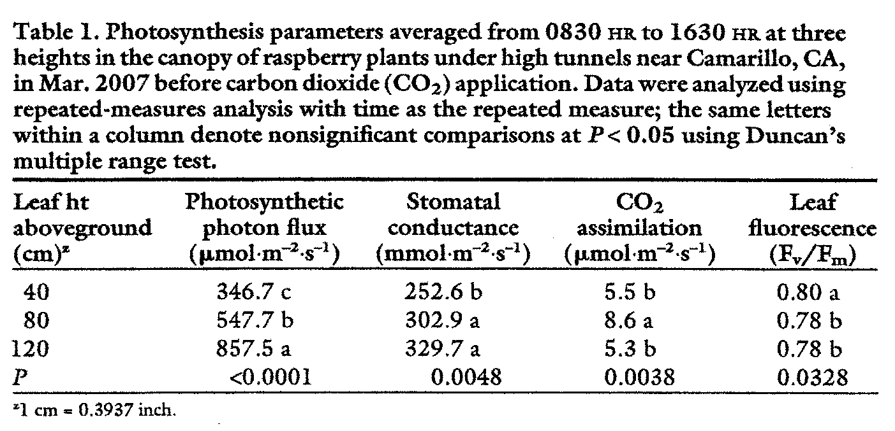
Leaf Height and Photosynthesis
Carbon Dioxide Enrichment May Increase Yield of Field-grown Red Raspberry under High Tunnels
Mochizuki et al 2010
Notes:
Mochizuki et al 2010. I had the opportunity to get involve in this research. We use carbon dioxide enrichments in fields grow raspberries under tunnel. Some of measurements was plant photosynthesis at different height, the finding surprise me due to the most active area was at 47 inches height.
At this height, the present trellis system use is highly shaded, constally pressure with diseases like sprur blight and cane botrytis, further more, we removed leaves for mite control, thus photosynthetic material

Slide 12
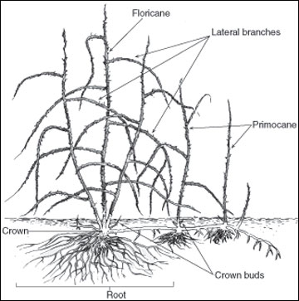
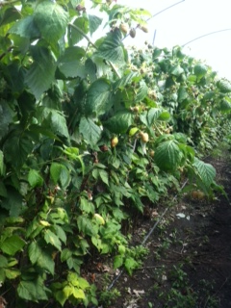
High Plant Density at 120 cm
Overcrowding in highly photosynthetic area
Notes:
Component of Yields: numbers of canes/ac, fruiting laterals per cane, fruit /canes and size of the fruit

Slide 13
Plant Architecture & Flower Position
Sonsteby & Heide, 2009
Notes:
Illustration of plant architecture of ‘Polka’ raspberry plants grown under different temperature and day length conditions.
For simplification, all laterals are drawn on only one side of the stem. Lateral lengths are drawn on the same scale as plant height (cm). Numbers denote the total number of flowers per plant in the respective treatments. By A. SØNSTEBY and O. M. HEIDE 2009.

Slide 14
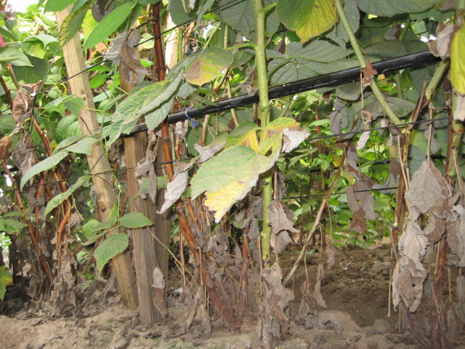
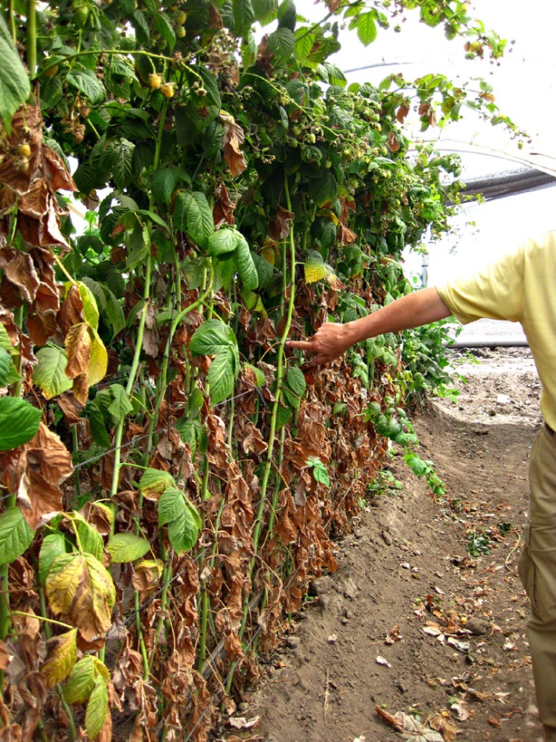
Spur Blight
Didymella applanata
Yield loss
Notes:
Pynospore become abundant from June to August and probably have a major role infesting the leaves which become highly susceptible as they begin to senesce when light is excluded from canes base
Bud failure is the principal cause of yields lost if high proportion of buds in the upper cropping region of canes is affected
Monitoring may plantings: end of June/ July if you see infections on the lower leaves, is an V. Senescence leaves become highly susceptible
Spray with captan, or capteve, avoid Elevate along because resistance been reported

Slide 15
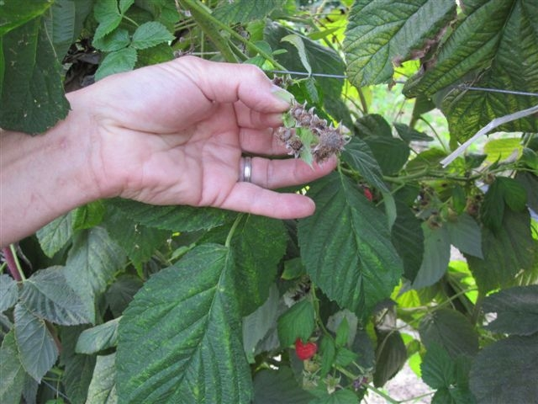
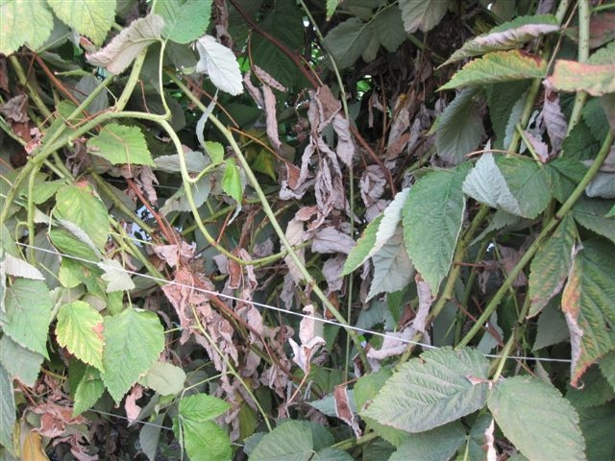
Botrytis
Flower abortion
Yield loss
Notes:
This disease produce abortion of the flowers and can infected the canes killing bud and lowering the yields

Slide 16
Trellising Impacts Quality
Fruit Quality
  Size and Sugars
Disease incidence
Insect control
  Spray penetration
UV light damage
Harvest Speed
SWD
Yield
  Fruit size
  Fruit per laterals
  Laterals per cane
  Numbers of canes/ft
Notes:
Two of the most labor intensive operations on raspberry production are trellising and training of raspberries canes. Yet collectively they have one of the most significant impacts on the overall yields of large fruit and the harvest of diseases free, high quality berries

Slide 17
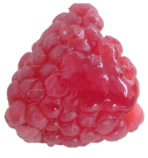
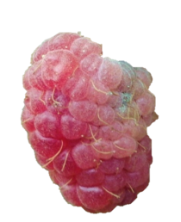
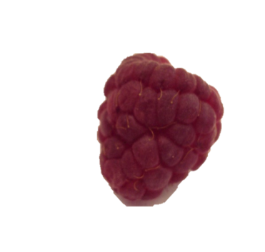
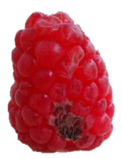
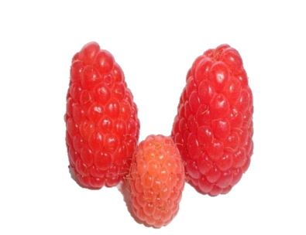
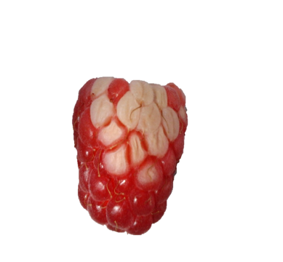
Common Fruit Quality Issues
Soft Fruit
Rot
Small Size
Crumbly Fruit
Overripe
Insect damage
White cells

Slide 18
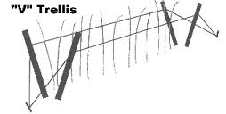
“V” trellis variations
Narrow
Wide

Slide 19
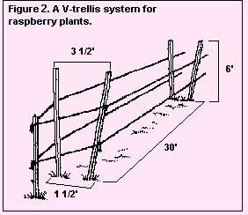
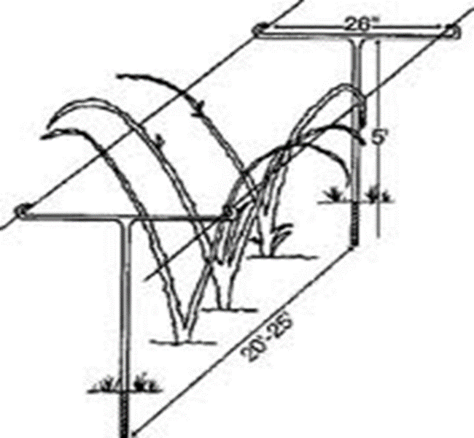
“V” trellis variations
“T” posts
Wide
Notes:
V static system fruiting shoots growth toward to the center making harvest difficult, shading and high humidity favor diseases like spru blight (dilymela)

Slide 20
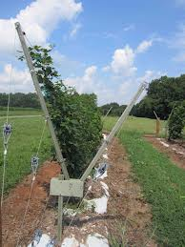
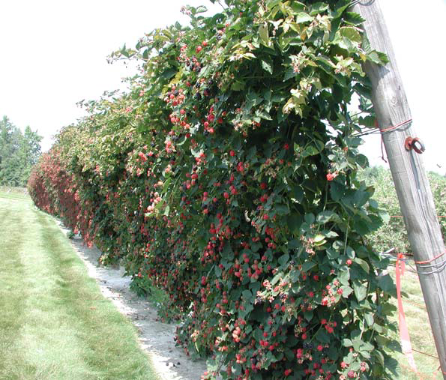
“V” trellis variations
Shift system pre bloom
Post bloom
Notes:
Stiles in 1988 Virginia Tech, modification of the V trellis, he developed the Shift trellis, before him Gjerde in Norway developed the first concept of the spread trellising. The Lincoln trellis or T
AV trellis; fruiting laterals can grow towards the center of the canopy,
Fruiting canes are trained to the outside, allowing new shoots to grow in the center. Posts are set 20 to 30 apart (From: Bramble Production Guide. Northeastern Regional Agricultural Engineering Service. 152 Riley Robb Hall, Cooperative Extension, Ithaca, NY).

Slide 21
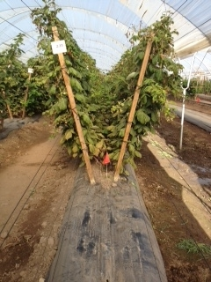
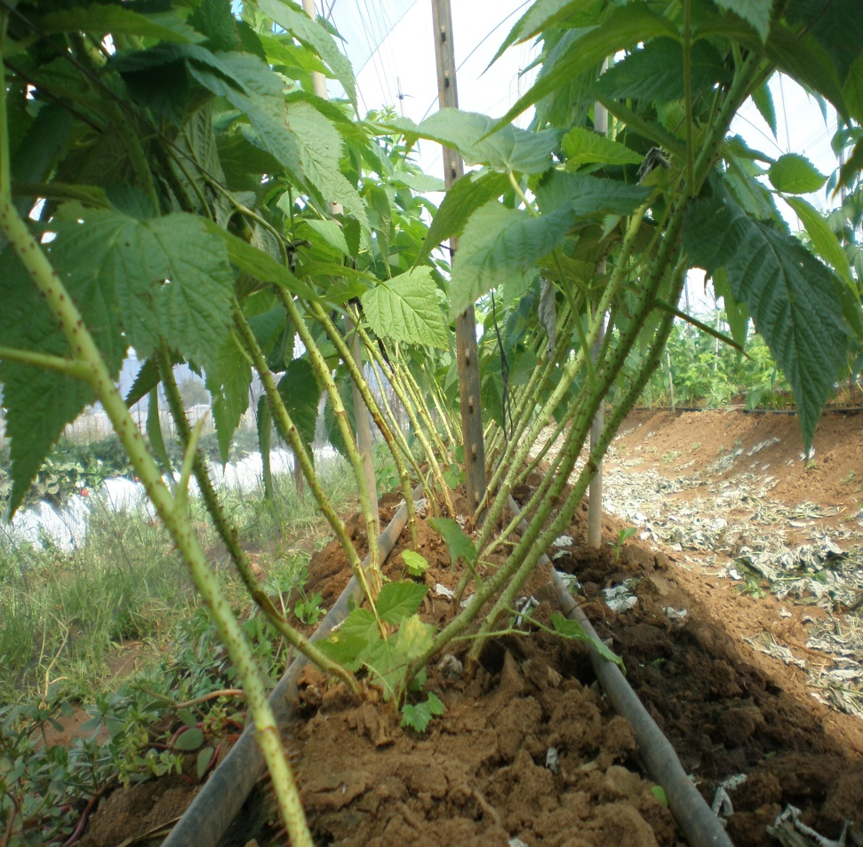
New look to “V” trellis
Wide bed
More light
Notes:
The V-trellis design with wood posts set 20 to 30 degrees from vertical, reduce the use of one pole in the center and simplify the need to have twine that open and closed the canopy. This system is fix, and the wire or twine can be move.
One disadvantage is pickers access to the fruit continue to be the same than the closed V, however, fruit is more visible due to less canopy in the center.

Slide 22
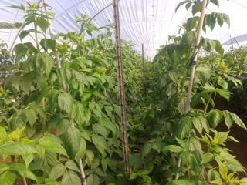
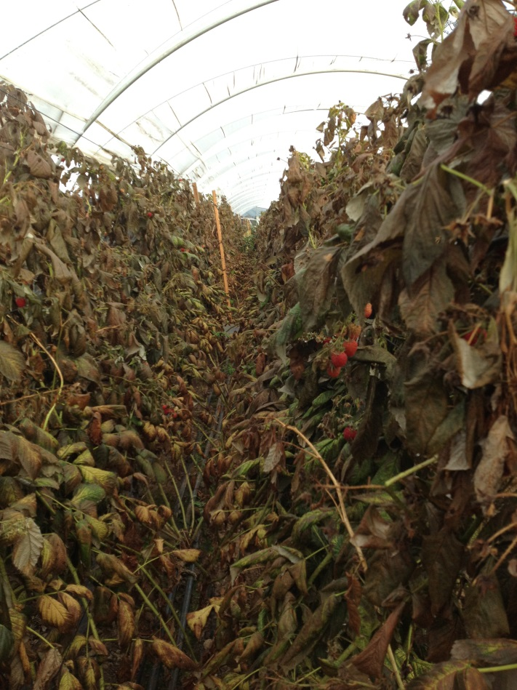
First crop
1st crop on primocane
Defoliation before CB
Notes:
Vanden Heuvel et al. 2000 study the effect Trellising system and cane density and it affect in yield and fruit quality in raspberries, found higher yields in V trellis than hedgerow. Some of the factors where light and spray penetration, air circulation, improving picking speed etc

Slide 23
 | Nitrogen content
 | Hand defoliation |  | Defoliation with AN 20 – 20%
Date sampled | Canes | Roots | Canes | Roots
11/21/2013 | 0.84 | 1.58 | 1.07 | 1.89
1/2/2014 | 1.11 | 2.45 | 1.29 | 2.58
1/14/2014 | 1.40 | 1.49 | 1.82 | 2.51

Slide 24
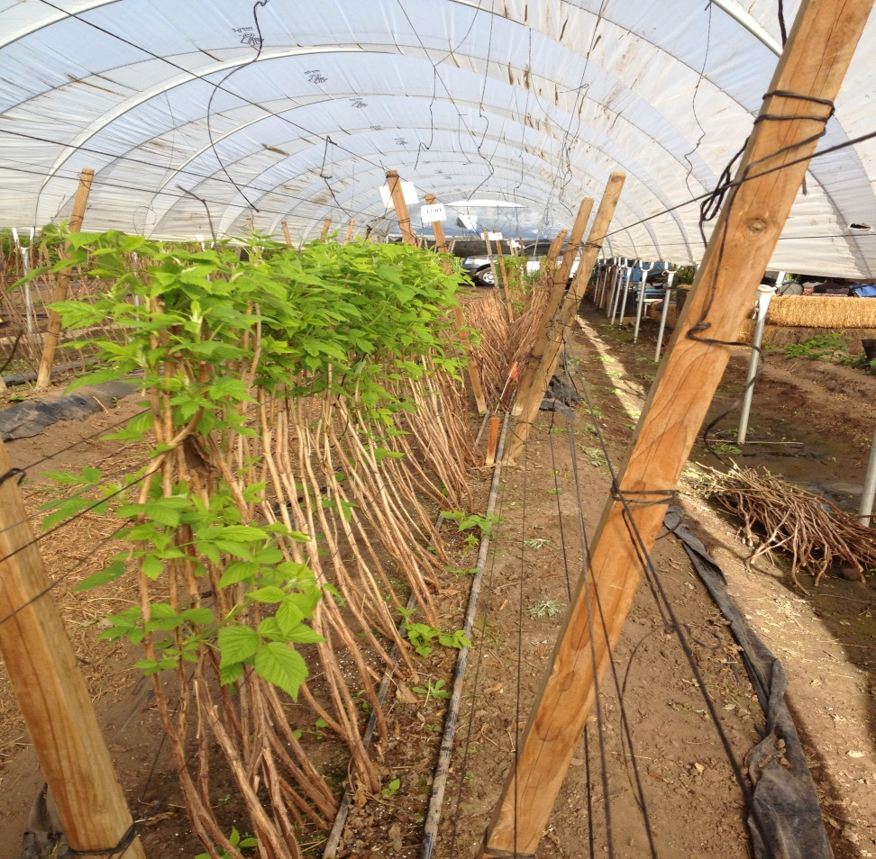
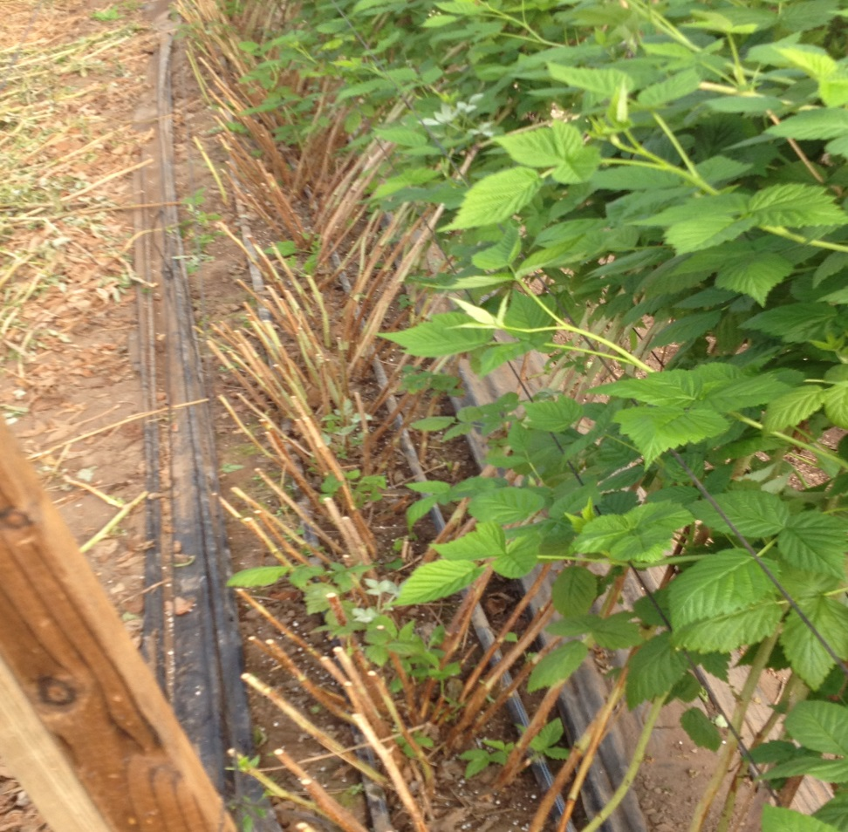
  Alternative Treatments for 2nd crop
Cutback and Mow Down
Low Down and Cutback

Slide 25
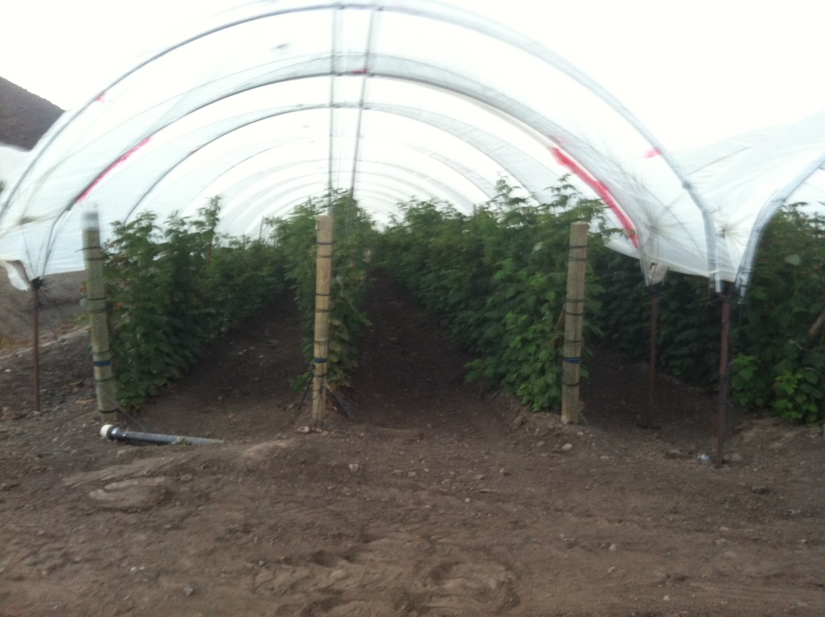
3 rows vs 2 rows;
Lack of light, difficult sprays penetration
More light, space for laterals, air movement
Notes:
Studies on photosynthesis show that the most actives photosynthetic part of the plants is between 2 and 4 ft of height
Work done in comparison of these two system show similar yields, with better holding (postharvest life) in the open V specially in the spring

Slide 26
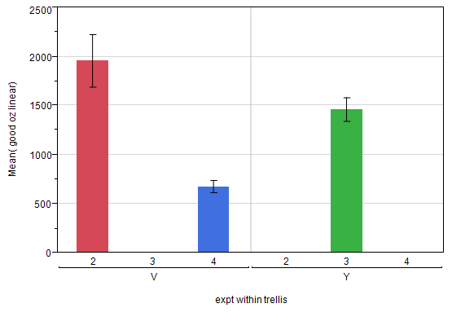

Slide 27
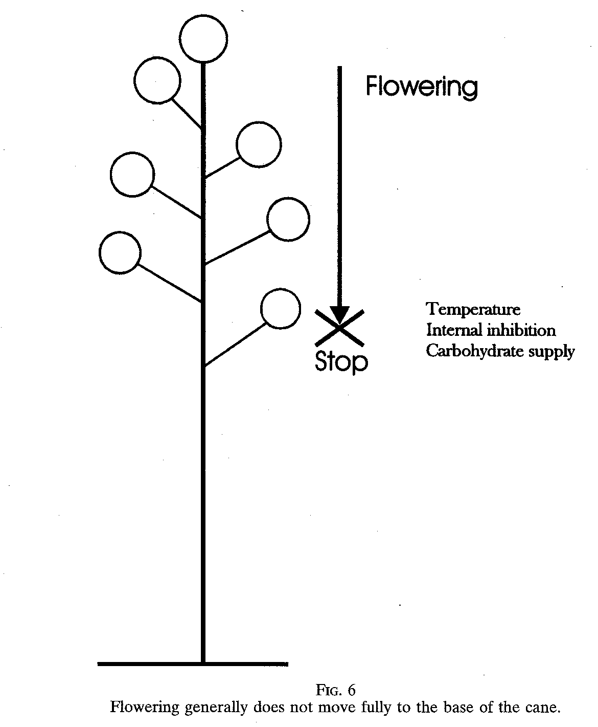
Cutback height affects yield
Carew et al. 2000
Notes:
This picture come from an review article from Carew at all published 2000, in J. Horticulture Science and Biotechnology
Studies in primocanes flowering shown to be closed related to solar radiation, day length and temperature (Prive et al 1993) with temperature been the major control. Time of flowering was shorted in Autumn Bliss, when it occur at 71 F took 110 days versus 160 days at 55 F

Slide 28
Cutback height affects yield
Notes:
Work done by Oliveira et al 1998, shows significant different between 5 nodes with 36 fruit per cane and 15 nodes with 57 fruit per canes.
Remove no more than 25% of the cane

Slide 29
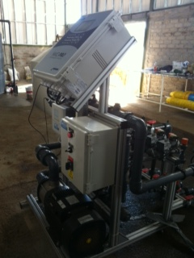
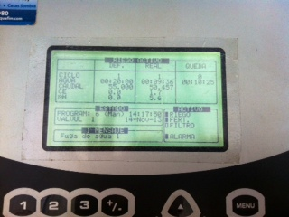
Fertigation
Predictability
Full control=max growth
Notes:
There are several companies that are competing in this area Priva, next step in control, EC, pH and nutrients. Mexico growers are implementing system like this in their farms, with very good results.
Fe, and Mn defieciency in high pH 7.2 – 7.5 and higher
Nitrates vs Ammonium increase photosynthesis when ammonium is apply with calcium carbonate (lime stone and Jepson), compare to application with out

Slide 30
Water use
3-5 acre foot per season
1 acre foot = 326,000 gallons
978,000 to 1,630.000 gallons
Use evapotranspiration (ET) to monitoring plants use or other methods
Education of irrigators

Slide 31
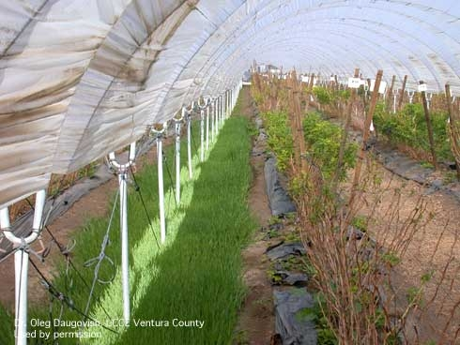
Soil Management: Cover Crops
Add organic matter and N to soil
Reduced pesticide and soil runoff in winter
Reduced dust may reduce mites
Reduced weeds
Cover crops may have many benefits
Notes:
This experiment was done one half year ago, and is part of a study to reduce run off nutrient and soil from farms

Slide 32
the end
mahumada@sun-belle.com
(805)415-5242
“We can not solve our problems with the same level of thinking that created them”
― Albert Einstein
Questions?
Notes:
Raspberry production have change since primocane fruiting varieties where developed. From an open production system with almost no trellising to a highly sophisticated system in pots, high tunnels, glass house, fertigation system, all control by a computer…with different type of plants: TC, roots, long canes and dormant canes…..smart plastic, etc etc.

