Slide 1
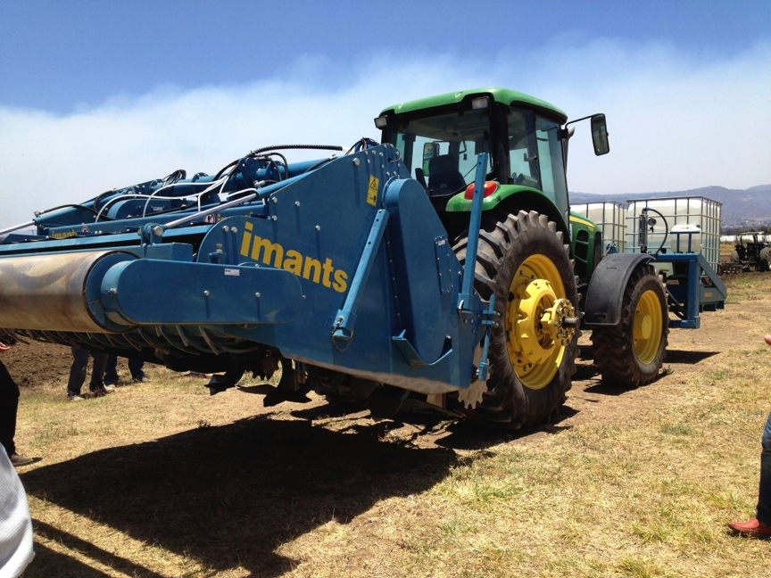
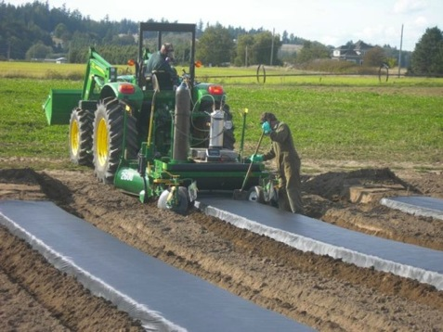
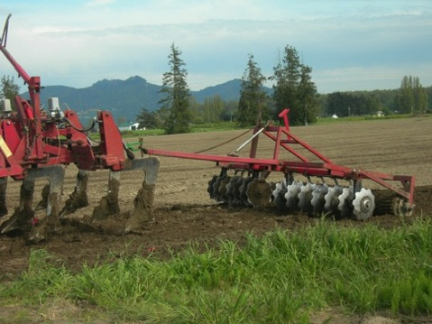

Bed and Flat Fumigation for Caneberries
Put in some kind of relevant photo(s)
Ventura County Caneberry Production Meeting
April 11, 2014
Tom Walters

Slide 2
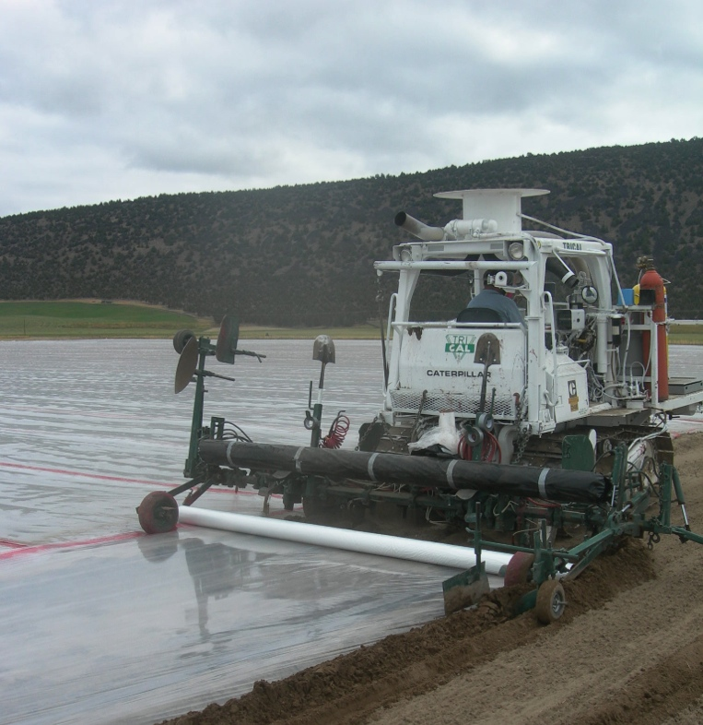
Washingon
California
            Deep shank injected
            Telone C-35, C-17, PC 60. Metam
            Non-tarped.
            Planting life 5-10 years
            Applied noble plow
            MB:pic, Telone C-35, PC 60
            Tarped, sometimes TIF
            Planting life 1.5-5 years

Slide 3

Phase 2 fumigant labels
In effect now
Label requirements are very complex!!!
              Fumigation management plans
              Responder/community outreach
              Applicator training
              No applications near sensitive areas
              Buffers and buffer credits
              Posting
              Emergency preparedness

Slide 4
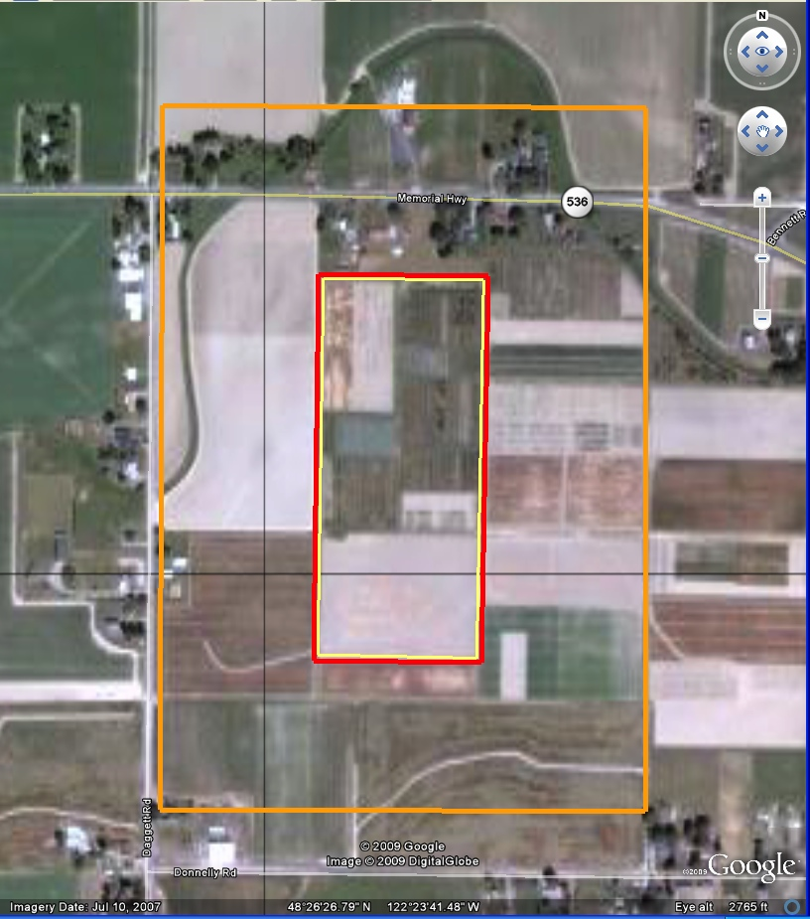
22 Acre Raspberry field (yellow block) fumigated with Telone C-35, 39 gallons/A, no tarp
Broadcast fumigated,
625 ft buffer
Bed fumigated with VIF tarp,
25 ft buffer

Slide 5
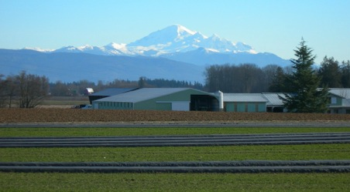
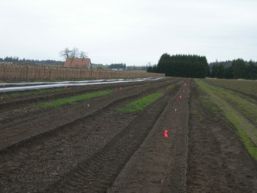
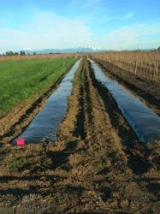
Grower Trials of Bed Fumigation
Five trials established in raspberry fields:
Lynden 1, non-replicated, substantial P. rubi and P. penetrans
Lynden 2, replicated, low P. penetrans and P. rubi; Also trialing non-tarped bed
Lynden 3, replicated, substantial P. penetrans
Burlington, replicated, high P. penetrans and P. rubi; Also trialing middle row management
Mount Vernon, replicated, high P. penetrans
Treatments applied Sept 2010, raspberries planted April 2011
Notes:
To do this, we established five trials in Northwestern Washington, in fields being replanted with raspberry. The first trial was non-replicated, in a field with a history of substantial P. rubi and P. penetrans. This trial was non-replicated. The other four trials were all replicated, with 3-4 replications/trial, laid out in randomized complete blocks. These trials had various levels of P. penetrans and P. rubi pressure. Each broadcast fumigation treatment was an industry standard: 35 gal/A Telone C-35 shank injected, nontarped, with a packed earth seal. The bed fumigations were also made using the same rate of Telone C-35 in the bed only, sealed with a VIF film (Pliant Blockade XL). In the Lynden 2 trial, we also included a bed-fumigated treatment without a tarp, and at Butlington we also included a non-fumigated check and a treatment in which we planted a rye cover crop in the alleyways between the beds.

Slide 6
Treatment and evaluation timeline
Soil fumigated: Sept 2010 (Lynden and Burlington trials), 2011 (Mt Vernon trial)
Raspberries planted April-May 2011
Primocane growth measurements, December 2011
Yield evaluations, July 2012
Soil bioassay for P. rubi, October 2011 (and annually thereafter)
P. penetrans extraction from soil and from roots, April and October of each year
Notes:
These experiments began just under two years ago - Here is the timeline for the evaluations that I’ll talk about today.

Slide 7
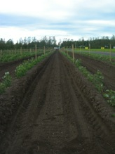
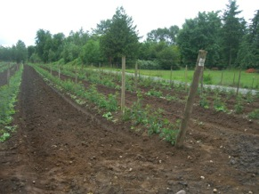
Plants in bed-fumigated plots generally grew as well as those in broadcast-fumigated plots.
Cane Height (cm) 2011
 | Burlington |  | Lynden 1 | Lynden 2 | Lynden 3 | Mount Vernon
Non-fumigated | 130 | c | -- | -- | -- | 46
Bed fumigated | 166 | a | 140 | 201 | 258 | 54
Bed fumigated (custom applicator's apparatus) | -- |  | -- | -- | -- | 60
Bed fumigated+cover crop | 146 | b | -- | -- | -- | --
Broadcast fumigated | 137 | bc | 139 | 218 | 244 | 56
P-value | 0.0012 |  | n/a | 0.1002 | 0.4 | 0.29
Notes:
We chose Cane Height as a measure of initial vigor in these experiments. We measured the height of 10 canes at each of two locations per plot. In general, there was no difference in cane height between plants in bed-fumigated and broadcast-fumigated plots. The exception to this was Burlington, where canes in the bed fumigated plots were significantly higher than those in the nonfumigated or broadcast fumigated plots. You might notice that in the Lynden 2 trial, the canes appear somewhat longer in the broadcast fumigated plots. This difference wasn’t significant, but could be real; that grower told us that he was happier with the tilth of the freshly-made beds in his braoadcast-fumigated plots than that of the bed-fumigated plots (beds made the previous fall).

Slide 8
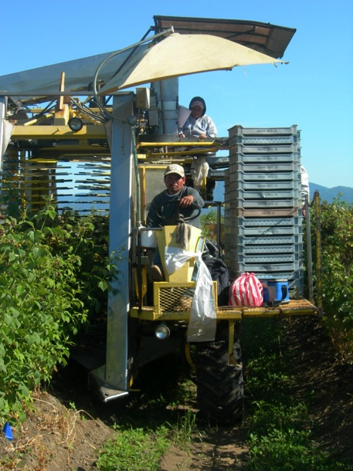
2012 Harvested fruit weight, bed fumigated plots: percent of fruit weight from broadcast-fumigated plots
*
*
Bed-fumigated plots were as productive as broadcast-fumigated plots, sometimes much more productive
Notes:
Processing raspberries ripen over an extended (4-5 week) period. The ripe fruit spoils rapidly, so it must be harvested soon after maturity. Growers harvest their fields 12 or more times per season. Although we were not able to monitor every harvest with every grower, we did monitor a significant number of harvests, and we compared the harvested fruit weights in bed-fumigated and broadcast-fumigated plots.
This graph shows harvested fruit weight expressed as a percentage of harvested fruit weight of broadcast-fumigated plots in the same trial. If the bar ends to the left of the vertical line, yields were less than those of broadcast-fumigated plots. If it ends to the right, the plots had higher yields than broadcast-fumigated ones. .
Bed-fumigated plots were as productive as broadcast-fumigated plots, sometimes much more productive. The bed-fumigated plots were most productive in the Burlington and Lynden 2 trials, the same trials in which bed fumigation controlled P. penetrans more effectively than broadcast fumigation did. In the other trials, bed-fumigated plots were just as productive as their broadcast-fumigated counterparts

Slide 9
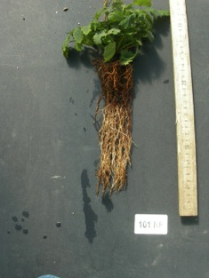
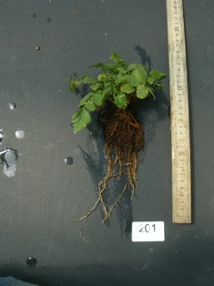
P. rubi bioassay, 2011
Root rot control in bed-fumigated plots has been as good as in broadcast treated plots so far
Root rot severity | Burlington | Lynden 1 | Lynden 2 | Lynden 3
beds
Non-fumigated | 5.5 | -- | -- | --
Bed fumigated, tarp | 5.8 | 6.0 | 4.0 | 2.3 | a
Bed fumigated, tarp+cover crop | 4.3 | -- | -- | --
Broadcast fumigated | 4.8 | 7.0 | 3.8 | 5.3 | b
P-value | 0.68 | n/a | 0.70 | 0.05
alleyways
Non-fumigated | 6.3 | -- | -- | --
Bed fumigated, tarp | 6.0 | 7.0 | 3.8 | 6.7 | b
Bed fumigated, tarp+cover crop | 6.0 | -- | -- | --
Broadcast fumigated | 6.5 | 6.0 | 4.3 | 4.0 | a
P-value | 0.90 | n/a | 0.80 | 0.01
Notes:
We evaluated P. rubi by growing susceptible plants in soil samples taken from the beds and alleyways under conditions favorable for root rot. , We rated root rot severity after washing the soil from the roots. In most of the trials there was no difference between bed fumigated and broadcast fumigated treatments. However, in the Lynden 3 trial, we saw a marked difference: Root rot was severe in the untreated alleyways of bed-fumigated plots, but when we looked at the beds, the bed-fumigated plots had less root rot than the broadcast-fumigated ones. Interestingly, the filed containing the Lynden 3 trial showed extensive root rot this summer.

Slide 10
P. rubi bioassay, spring 2013
In some trials, less root rot in alleyways than in beds.
No treatment differences.
Root rot severity | Burlington | Lynden 1 | Lynden 2 | Lynden 3
Sampling location
alleyways | 5.6 a | 5.8 | 4.1 | 2.7 a
beds | 6.8 b | 6.0 | 3.8 | 7.0 b
Fumigation treatment (all sampled from beds)
Non-fumigated | 6.3 | -- | -- | --
Bed fumigated, tarp | 7.3 | 7.0 | 4.0 | 6.3
Bed fumigated, tarp+cover crop | 6.8 | -- | -- | --
Broadcast fumigated | 7.0 | 5.0 | 4.0 | 7.7
Notes:
We evaluated P. rubi by growing susceptible plants in soil samples taken from the beds and alleyways under conditions favorable for root rot. , We rated root rot severity after washing the soil from the roots. In most of the trials there was no difference between bed fumigated and broadcast fumigated treatments. However, in the Lynden 3 trial, we saw a marked difference: Root rot was severe in the untreated alleyways of bed-fumigated plots, but when we looked at the beds, the bed-fumigated plots had less root rot than the broadcast-fumigated ones. Interestingly, the filed containing the Lynden 3 trial showed extensive root rot this summer.

Slide 11
Nematode recolonization in bed- and broadcast-fumigated plots
Lynden 2
Lynden 3
From Soil
From Roots

Slide 12
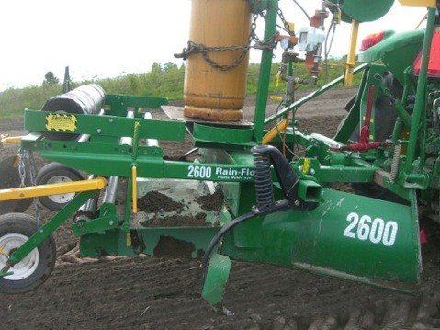
Challenges:
The shaper we used (an adjustable unit for vegetables) can only make beds up to about 8” high. You’d need a different shaper to make larger beds.
You’ll need GPS or some other way to assure that beds are made in the correct location.
It takes more time to fumigate a field this way; we usually travel at about 3 mph when fumigating and laying tarp. (Broadcast rig travels about 5-6 mph.)

Slide 13
Yield-California trial, fall 2011
UTC yields lower than Telone, MB-treated plots

Slide 14
Phytophthora bioassay-California trial, Spring 2012
No significant differences between treatments

Slide 15
Yield and Plant Height-California trial, fall 2013
No significant differences in yield
Plant height of UTC is significantly lower than fumed plots

Slide 16
Phytophthora bioassay-California trial, fall 2013
No significant differences between treatments

Slide 17
Another option-metam (Vapam)
Telone C-35, deep shank injected
35 gal/A
20 A field
20% credit for 2-3% organic material
460 ft buffer
Vapam HL, applied with rotary spader
75 gal/A
20 A field
20% credit for 2-3% organic material
96 ft buffer
?Less volatile?

Slide 18
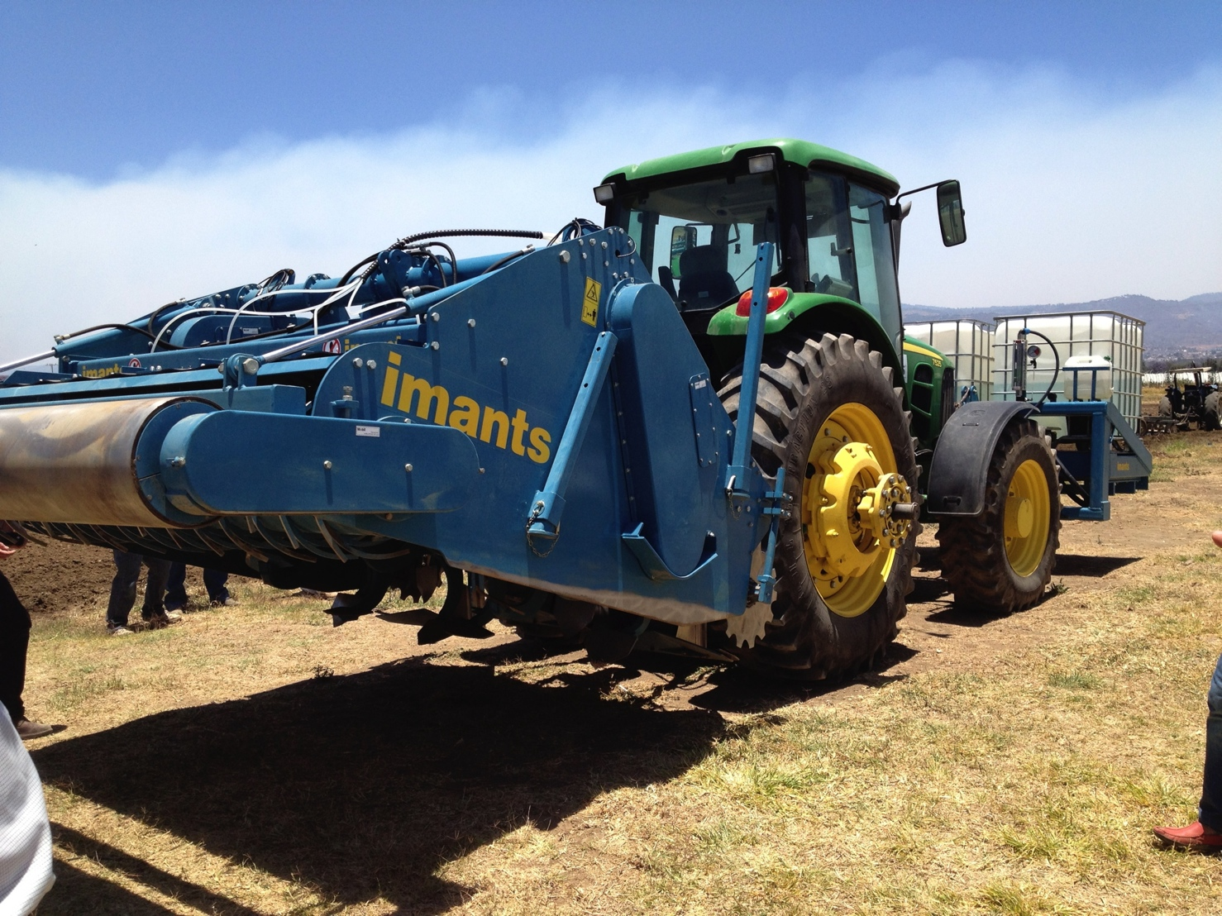
Applying Vapam with a rotary spader

Slide 19
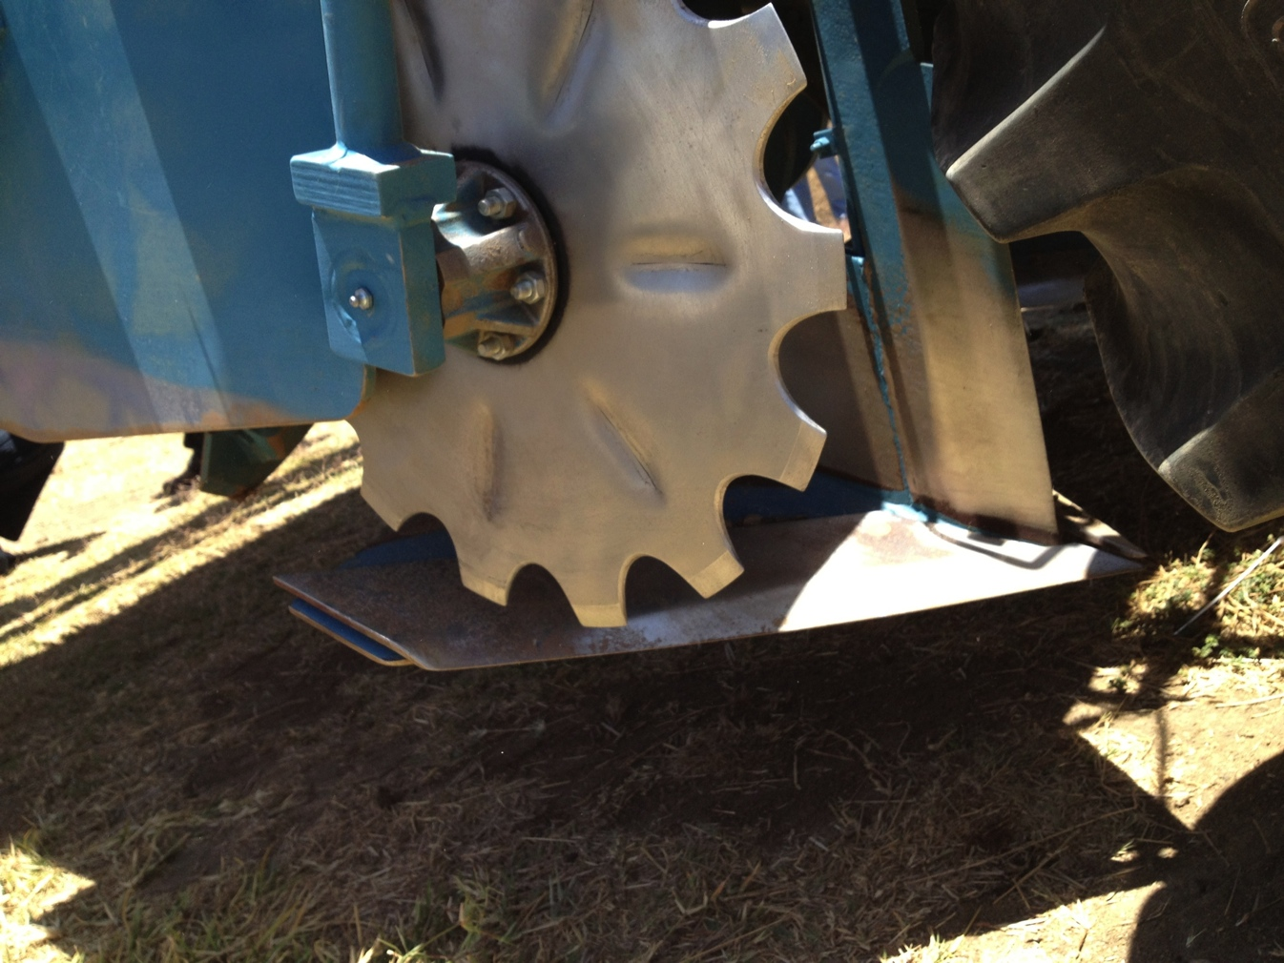
Applying Vapam with a rotary spader
About 75% of the fumigant is injected in these sweeps near the front of the spader

Slide 20
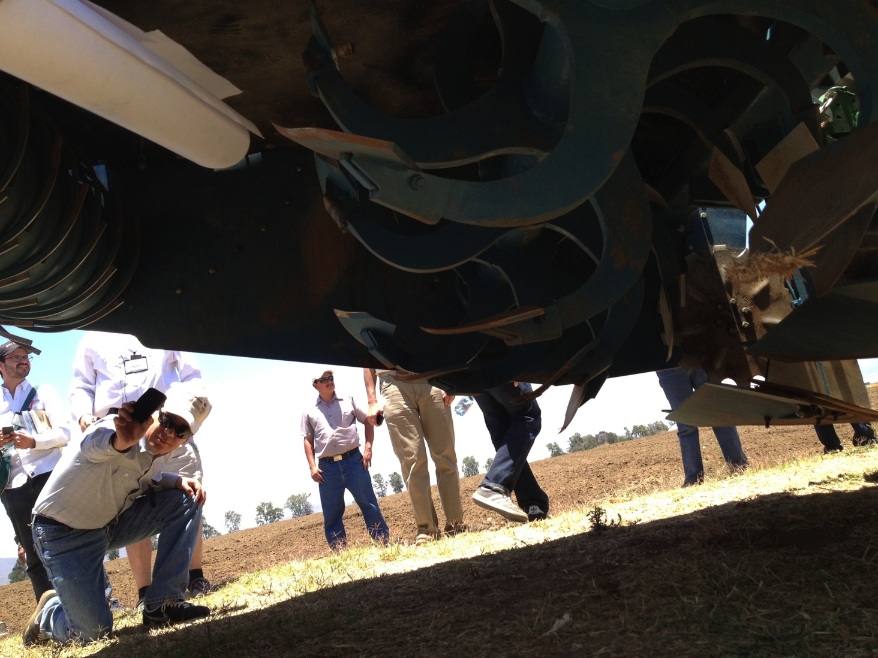
Applying Vapam with a rotary spader
Spader blades rotate slowly, mixing soil and Vapam
Sweep

Slide 21
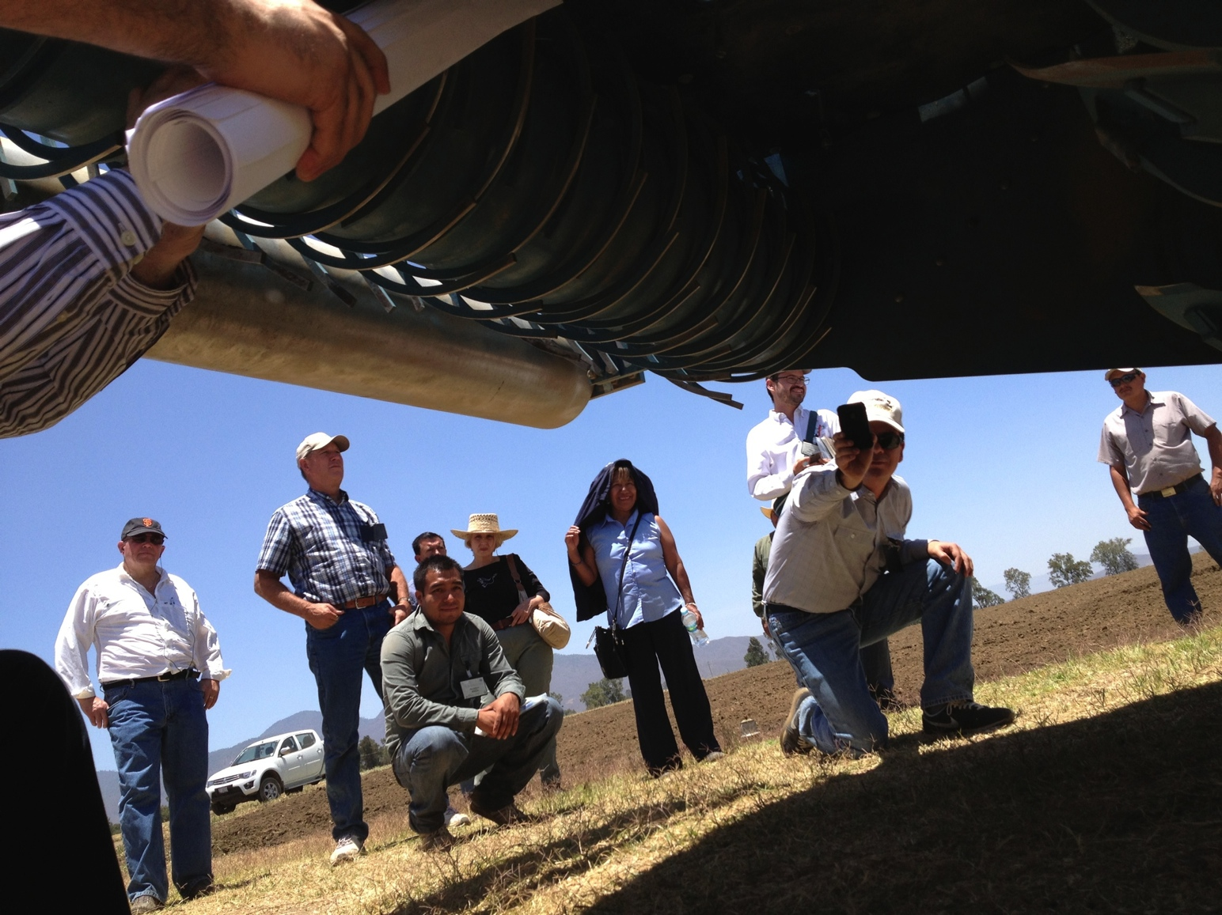
Applying Vapam with a rotary spader
Power roller
Spader blade
Remaining 25% of Vapam is injected ahead of this shallow power harrow

Slide 22
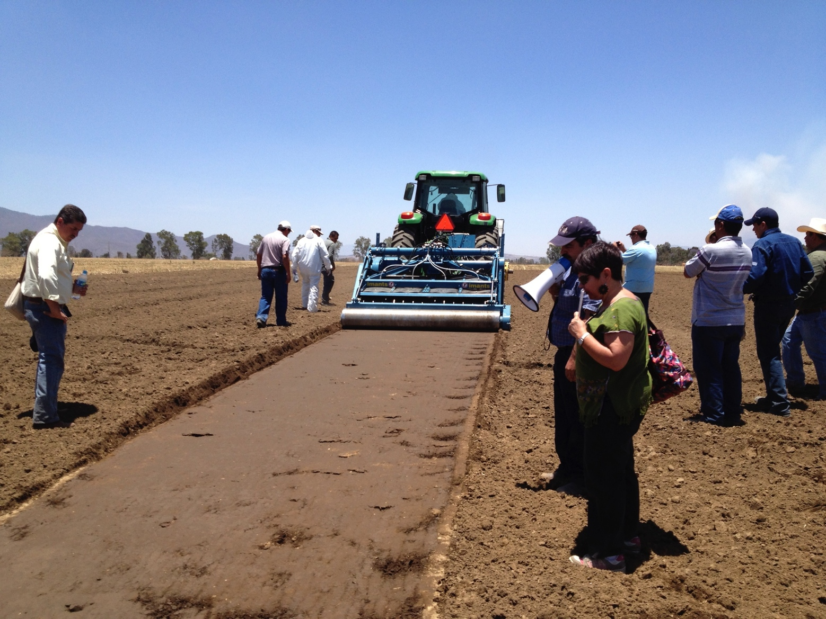
Applying Vapam* with a rotary spader
Seal generated by power roller
*Relax. They are just applying water in this demonstration.

Slide 23
Other options?
Paladin (Dimethyl Disulfide)
  Effective, strong smell
  Must be applied under VIF or TIF tarp
  25 ft buffer for bed applications
Mustard meals
  Effective in greenhouse tests, less encouraging in field
  Incorporate with rotary spader?
  Mustard variety matters

Slide 24
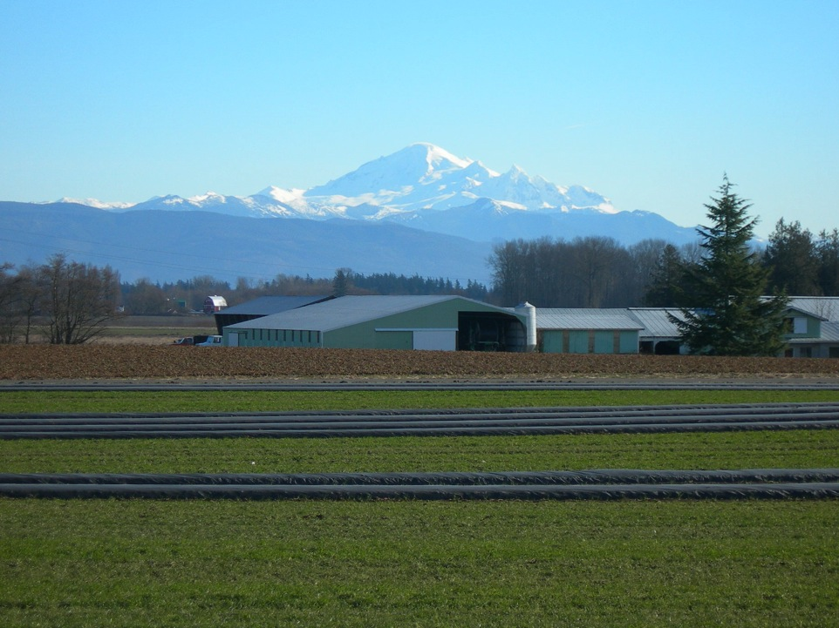
Thanks!!
USDA-ARS:
Duncan Kroese
Amy Peetz
Mariella Ballato
Industry cooperators:
Trident Ag Products
Curt Maberry Farms
Larry Tremaine
Darryl Ehlers
Nate Youngquist
Sakuma Bros. Farms
WSU-Mt. Vernon:
Don Wallace
Paul Han
Jack Pinkerton
Funded by:
USDA-NIFA-RAMP
Washington State-USDA SCRI
Northwest Center for Small Fruit Research

