Slide 1
Integrated Soil-borne Disease Management in Organic Strawberries
UCCE Fumigants and Non-Fumigant Alternatives:
Regulatory and Research updates
Ventura, CA 5/29/2020
Joji Muramoto Ph.D.
UC Assistant Cooperative Extension Organic Production Specialist
Center for Agroecology and Sustainable Food Systems (CASFS)
Department of Environmental Studies
UC Santa Cruz

Slide 2
Outline
Three common soil-borne pathogens in CA strawberries
Needs of diagnostics
Organically acceptable practices
                Crop rotation
                Anaerobic soil disinfestation (ASD)
                Resistant varieties
                Integrated approaches

Slide 3
Three Common Lethal Soil-borne Pathogens in California Strawberry
Disease | Pathogen | Host plant | Survival in soil without a host | Saprophytic
Verticillium wilt (1932)* | Verticillium dahliae | >400 species incl. >100 weed species | 8-10 years | No
Fusarium wilt (2009) | Fusarium oxysporum f. sp. fragariae | Strawberry only | < 3 years | Yes (50-68 °F)
Charcoal rot (2008) | Macrophomina phaseolina | Strawberry only** (strawberry strain found in CA) | <3 years | Yes (50-68 °F)
* The year first reported in CA.
** Non-strawberry strains infect grains, legumes, cucurbits and others.

Slide 4
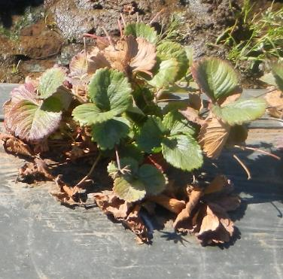
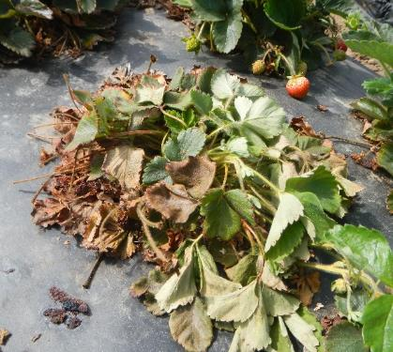
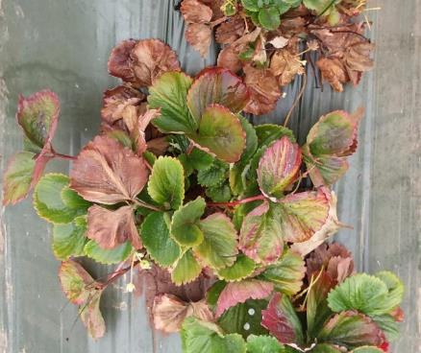
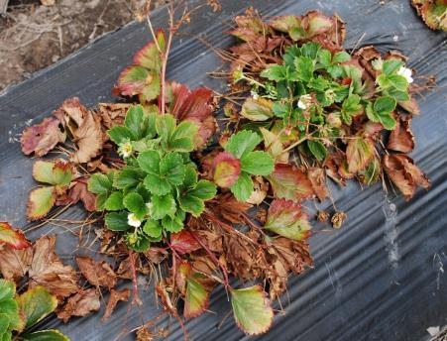
Soil-borne diseases in CA strawberries
Verticillium dahliae
Fusarium oxysporum f. sp. fragariae (F.o.f.)
Macrophomina phaseolina + F.o.f.
Need diagnostic for disease identification!!
Verticillium dahliae + F.o.f.
No pathogen (ill drainage)

Slide 5
Soil-borne Pathogen Diagnostics
Plant test → molecular approach available for all 3 pathogens!
Soil test → quantitative molecular approach
      Available for V. dahliae and M. phaseolina, but not for Fusarium oxysporum f. sp. fragariae(?)
      Soil test economic threshold:
      available only for V. dahliae (?)

Slide 6
Crop Rotation for Strawberry
  Traditional method to avoid soil-borne diseases in strawberries worldwide
    Mandatory for organic strawberry production under the National Organic Program
    Minimum of a 3-year break between two strawberry plantings recommended in EU and Northeast US and Canada
    Anecdotal local evidence: 2 years or more to avoid Fusarium wilt

Slide 7
Verticillium dahliae;
Host Crops vs. Non-host Crops
Host crops
  cane berry (raspberry, blackberry), blueberry, artichoke, cucumber, watermelon, pumpkin, mint, eggplant, lettuce, pepper, potato, spinach, tomato
Non-host crops
  cauliflower, cabbage, celery, parsley, radicchio, onion, garlic, bean, pea, carrot, sweet potato, asparagus
Suppressive crop
  broccoli

Slide 8
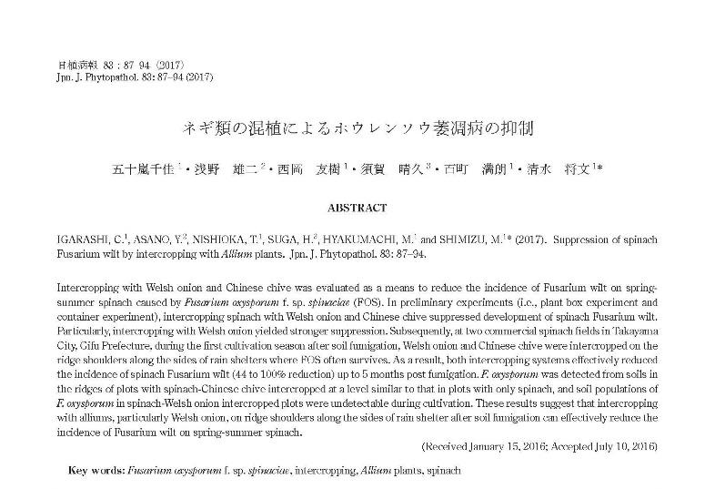
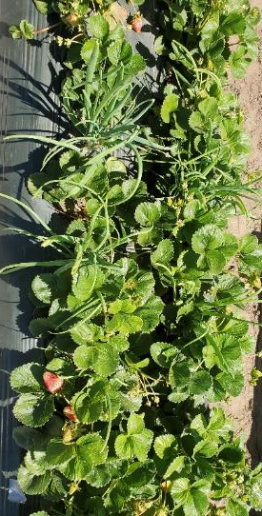
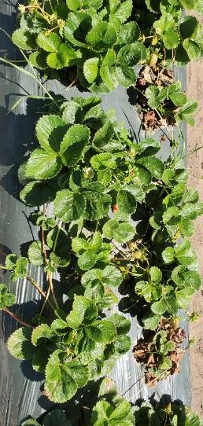
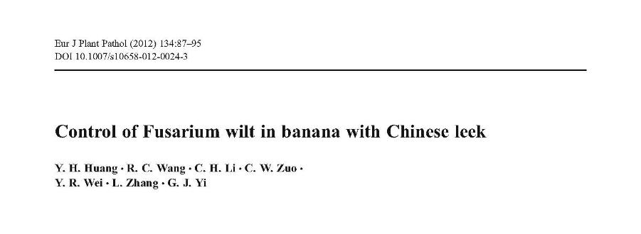
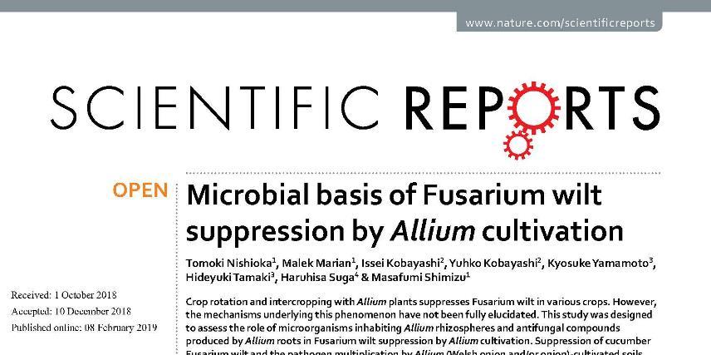
Fusarium wilt suppression by Allium crops
Spinach Fusarium wilt suppression by green onion intercropping (Igarashi et al., 2017)
Onion intercropping
UTC
Allium roots -> gamma-Glutamyl-S-allylcysteine -> Flavobacterium --> Fusarium wilt suppression

Slide 9
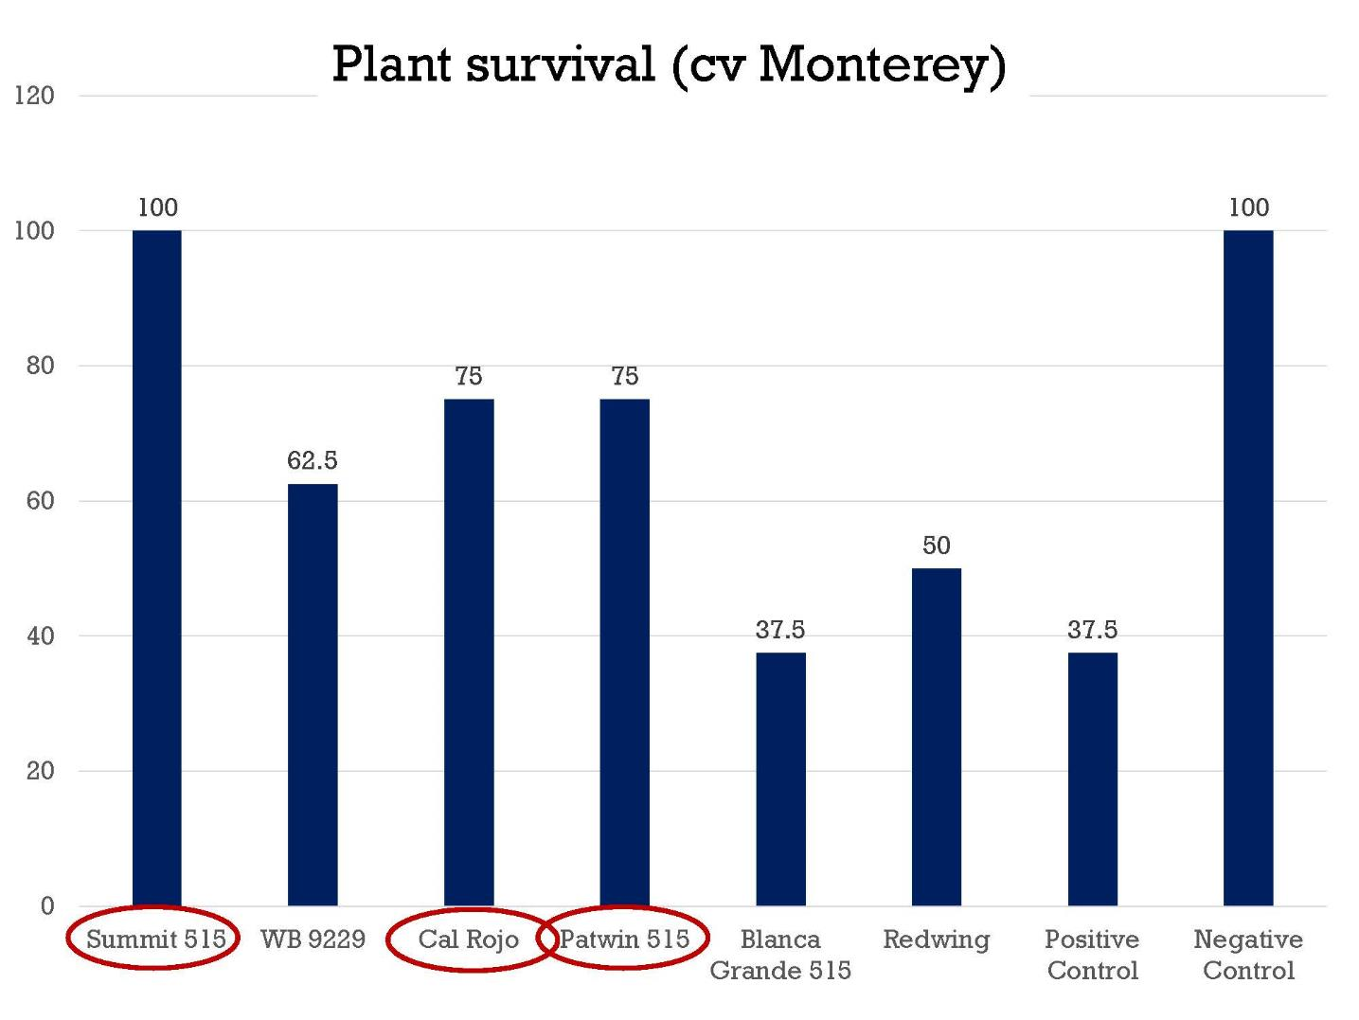
Specific wheat varieties can suppress charcoal rot in strawberries:
Plant Survival Rate (cv. Monterey)
(Ivors, 2015)

Slide 10
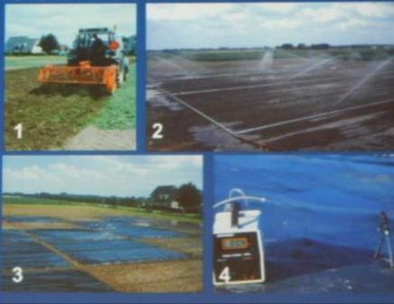
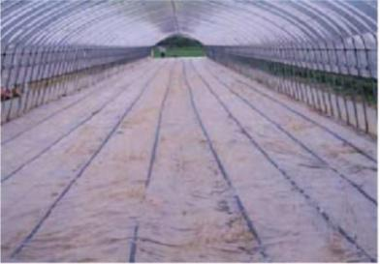
Anaerobic Soil Disinfestation (ASD)
Developed in the Netherlands and Japan independently ~2000 as a biological alternative to fumigation
Principle: Acid fermentation in
anaerobic soil
(Van Bruggen, 2014)
(Chiba prefecture, 2002)

Slide 11
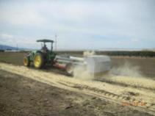
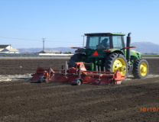
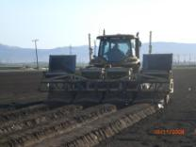
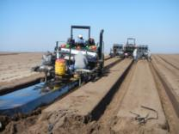
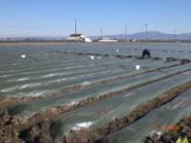
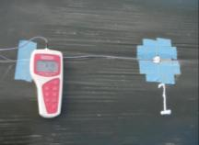
Autumn-Anaerobic Soil Disinfestation (ASD) in California Strawberries
Broadcast rice bran at 6 - 9 tons/acre
Incorporate bran
List beds
Cover w/ plastic mulch
Drip irrigate total 1 to 2 ac-in over 3 wks
Leave 3 wks and monitor soil Eh (redox potential)
1
2
3
4
5
6

Slide 12
Soil-borne disease control by ASD in California strawberries
Verticillium wilt by Verticillium dahliae; 80 to 100% decrease in V. dahliae microsclerotia in soil in field trials (Shennan et al., 2018)---Autumn ASD
Charcoal rot by Macrophomina phaseolina; ~50% reduction of plant mortality compared to un-treated control (Muramoto et al., 2017)---Summer ASD
Fusarium wilt by Fusarium oxysporum f. sp. fragariea can be controlled by summer-ASD but autumn-ASD can make the disease worse (Muramoto et al., 2017) ---Rice bran can feed F.o.f!!

Slide 13
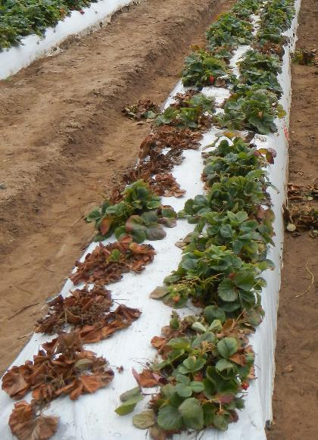
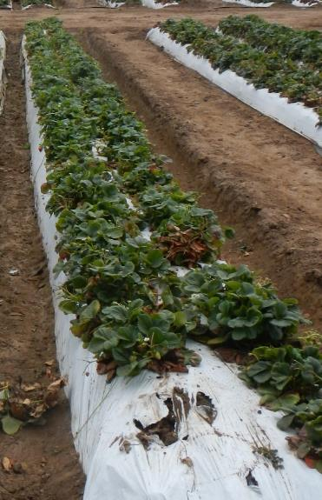
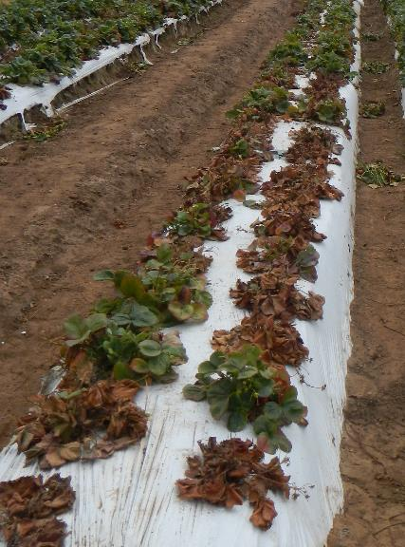
Fusarium oxysporum f. sp. fragariae* infested field
Strawberry plants (8/14/14)
ASD Summer RB 9t/ac
ASD Fall
RB 9t/ac
UTC
Higher temperature threshold for Fusarium oxysporum
(>460 hours above 86°F at 8” soil depth (Muramoto et al., Acta Hort. In Press))

Slide 14
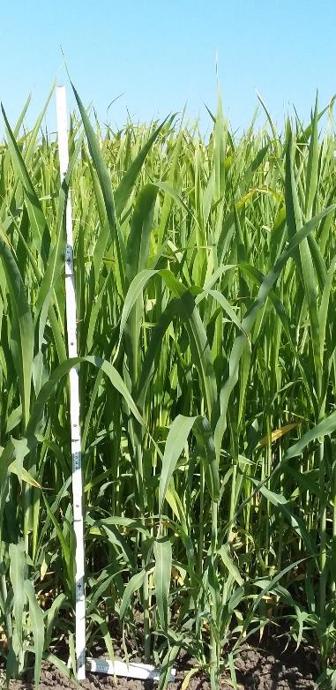
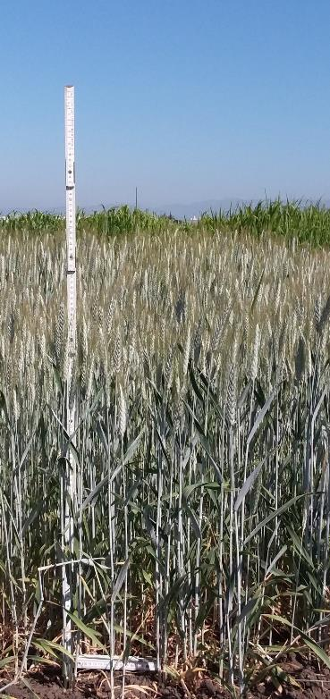
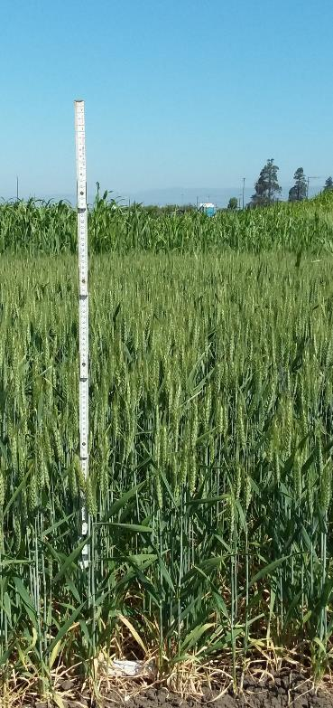
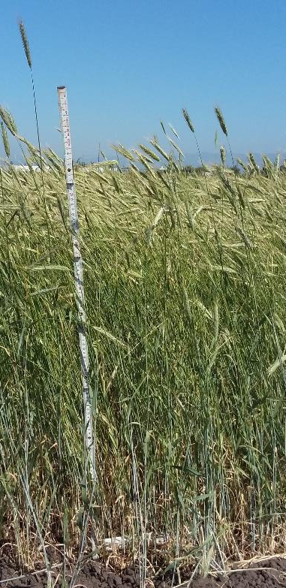
Summer Cover Crops (planted: 5/24/18, harvested: 7/30/18)
42.3”
Sudan grass (Sweet’n honey)
3.9 t-d.w./acre
Merced rye
3.2 t-d.w./ac
Triticale (Pancho)
3.5 t-d.w./ac
Wheat
(Summit 515)
3.8 t-d.w./ac

Slide 15
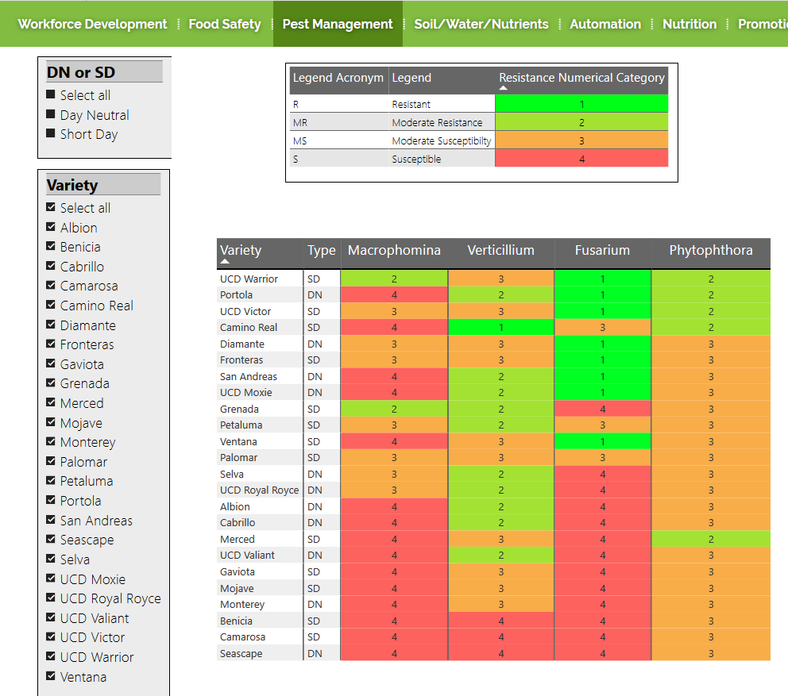
https://www.calstrawberry.com/en-us/Pest-Management/Breeding

Slide 16
8 year organic rotation trial at UCSC farm
Marketable Fruit Yield at year 8 (cv. Albion)
(V. dahliae, F. oxysporum f. sp. fragariae, and M. phaseolina infested site)
Av. 31,365 lb/ac (79%)
Av. 39,800 lb/ac (100%)
s-bf: supplement fertilizer + winter bare fallow
mc: mustard cake + cereal cover crop
asd: summer ASD + mixed cover crop
asd+c: compost + summer ASD + mixed cover crop
4 year (3-year break)

Slide 17


Acknowledgements
USDA-Organic Research and Extension Initiative Grant 2011-51300-30677
USDA-Methyl Bromide Transition Grant 2016-51102-25815
USDA-Specialty Crop Research Initiative Grant 2017-51181-26832
California Strawberry Commission Research Grants
Carol Shennan, Margherita Zavatta, Dept. Environmental Studies, UCSC.
Mark Mazzola, USDA-ARS, WA
Rod Koda, Shinta Kawahara Co
Miranda Ganci, Jenny Broome, Kelly Ivors, Driscoll Strawberry Associates
Steven Koike, Mike Stanghellini, TriCal, Inc
Richard Smith, UCCE, Salinas
Peter Henry, Eric Brennan, USDA-ARS, Salinas
Darryl Wong, CASFS, UCSC
Students and volunteers, the Shennan lab, UCSC

Slide 18
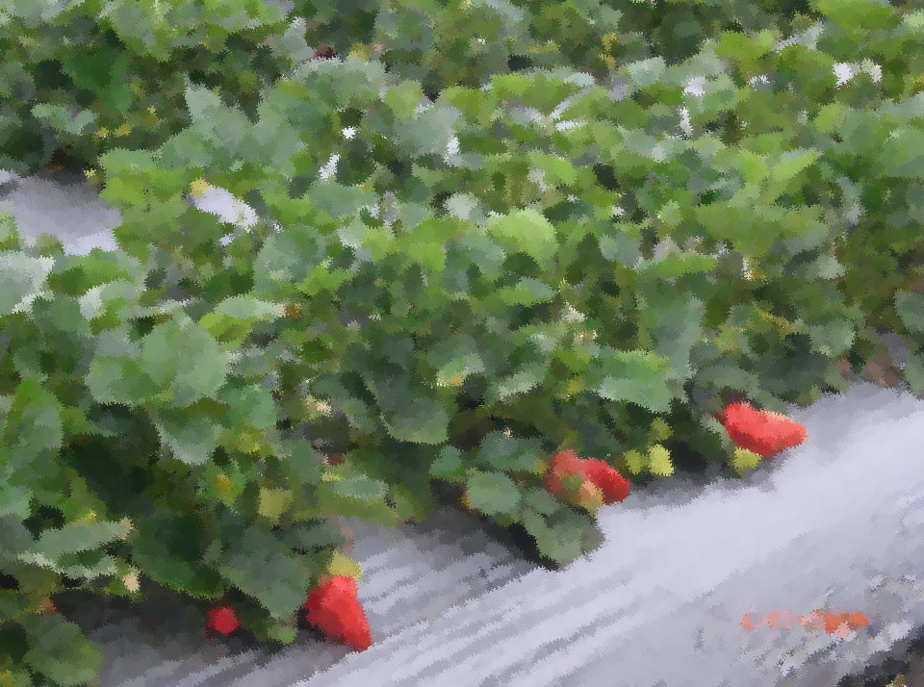

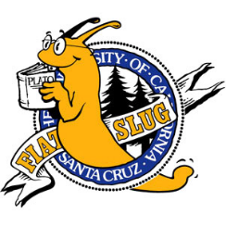

Thank you!
Question? joji@ucsc.edu

