Slide 1
Site-specific management of soil pests in California strawberry production
Steve Fennimore | UC Davis, Salinas, CA
Alexander Putman | UC Riverside, Riverside, CA
Frank Martin and Michael Matson | USDA-ARS, Salinas, CA
Oleg Daugovish and Andre Biscaro | UC Cooperative Extension, Ventura, CA
Rachael Goodhue and Tom Gordon | UC Davis, Davis, CA
Forrest Melton and Lee Johnson | CSU Monterey Bay/NASA Ames, Mountain View, CA
Michael Stanghellini | TriCal, Hollister, CA
Nathan Dorn | FoodOrigins, Salinas, CA
Chris Greer | UC Cooperative Extension, San Luis Obispo, CA

Slide 2

Acknowledgements
Grant number: 17-PML-R004
Grower Cooperators
Matt Conroy and Dave Murray | Andrew and Williamson
Henry Ito | Ito Bros.
Jaime Lopez | Mixtekz Berries

Slide 3
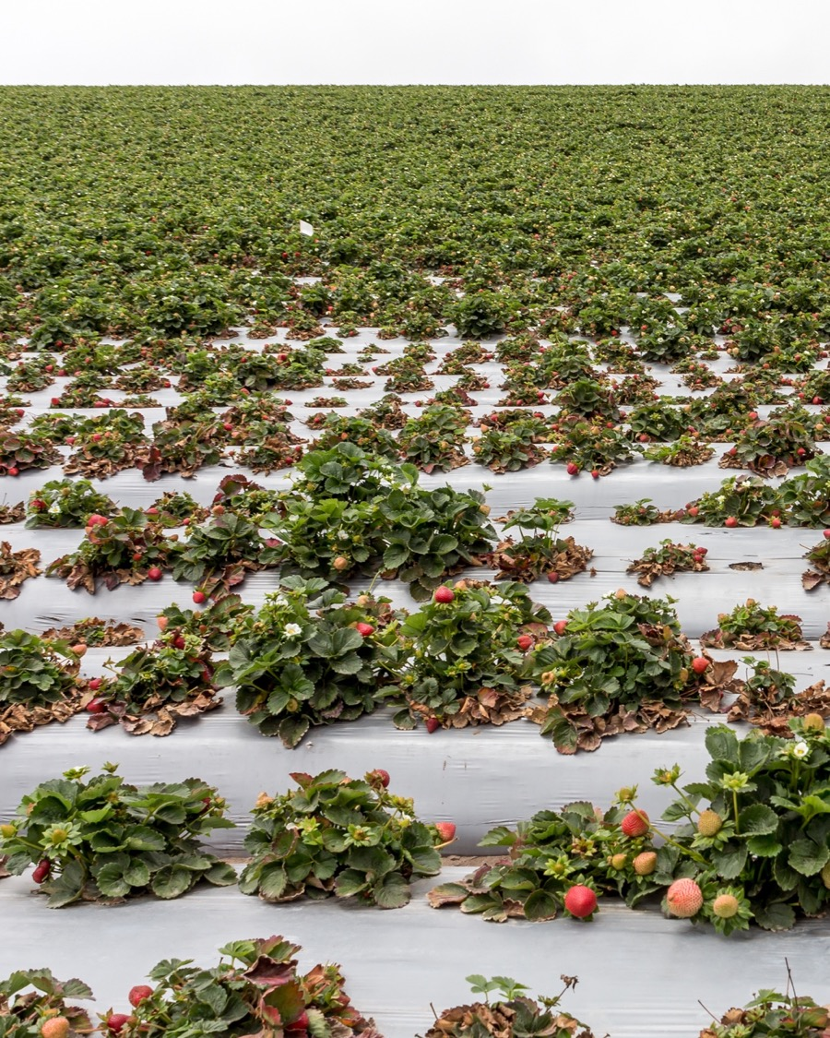
Fumigation
Often applied uniformly at the high label rate when perceived risk is high
  Broadcast/flat
  Drip
Soilborne diseases usually occur in clusters or hot spots

Slide 4
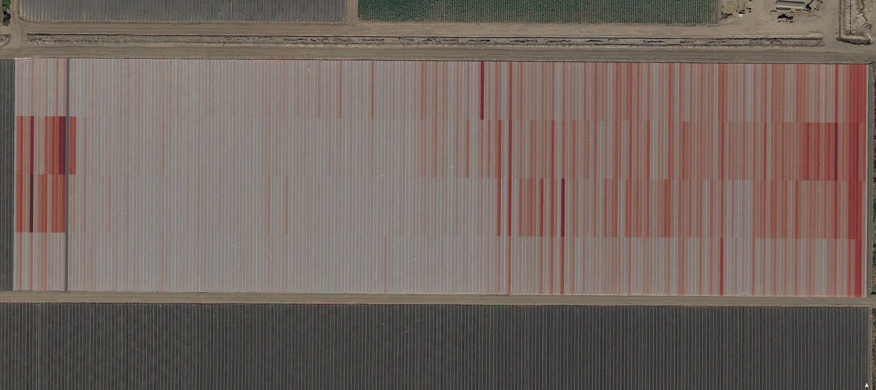

Clustered distribution of disease

Slide 5
How to provide knowledge to growers about the spatial distribution of disease?

Slide 6
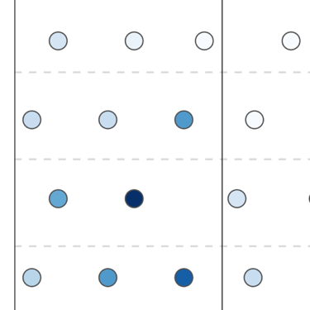
Determine spatial distribution
Pathogen counts in soil
Amount of pathogen in soil is the biggest factor affecting disease severity

Slide 7
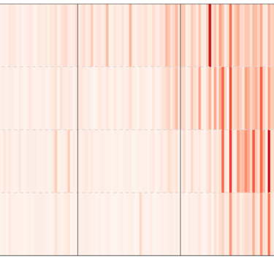
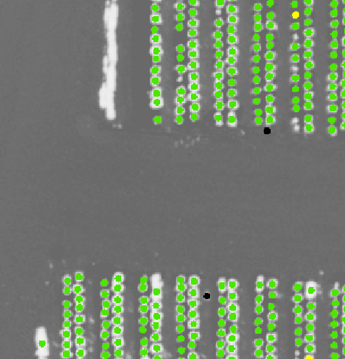
Determine spatial distribution
Mortality and plant health
Pathogen counts in soil
Disease is likely to recur in the same area
Amount of pathogen in soil is the biggest factor affecting disease severity

Slide 8
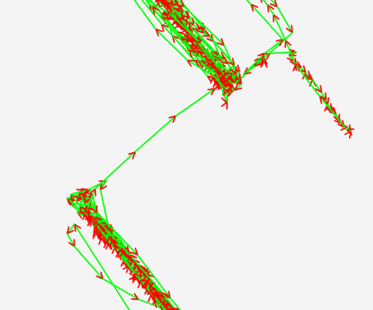
Determine spatial distribution
Mortality and plant health
Pathogen counts in soil
High-resolution yield
Disease is likely to recur in the same area
Amount of pathogen in soil is the biggest factor affecting disease severity
Determine how yield is influenced by plant health, pathogen

Slide 9
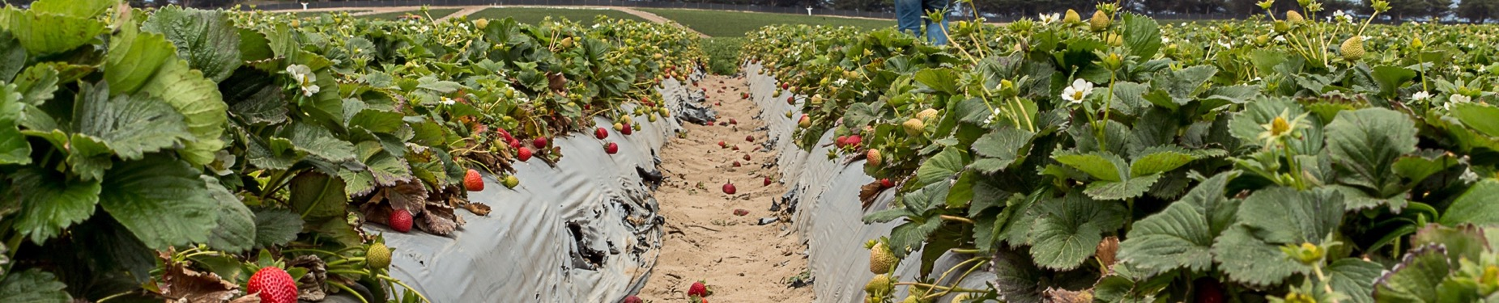
Determine spatial distribution
Mortality and plant health
Pathogen counts in soil
High-resolution yield

Slide 10
Can this information be used to reduce fumigation rate in low disease pressure areas without sacrificing yield?
Determine spatial distribution
Mortality and plant health
Pathogen counts in soil
High-resolution yield

Slide 11
Methods
Treatments
  Standard: broadcast/flat fumigation
  Precision: establish zones and apply fumigant at rate proportional to pressure
Tri-Chlor (chloropicrin)
  250, 300, 350 lbs/acre
Fields: ~10 acres
Randomized complete block with 3 or 4 replications

Slide 12
Study Locations
Oxnard
  Field A (2017-2018): Fall planting, history of Fusarium wilt and Macrophomina charcoal rot
  Field B (2019-2020): Fall planting, history of Fusarium wilt
  Field C (2019-2020): Summer planting, recent history of Macrophomina charcoal rot
Salinas-Watsonville
  2018-2019: Fall planting, history of Verticillium wilt

Slide 13
Timeline (fall, Oxnard)
Yield data
Count mortality
Aerial imagery
Count mortality
Quantify pathogen
JULY
Termination (prev. crop)
OCTOBER
Planting
DECEMBER
JULY
Termination
AUGUST
Fumigation
Field prep
Bedding
Harvest

Slide 14
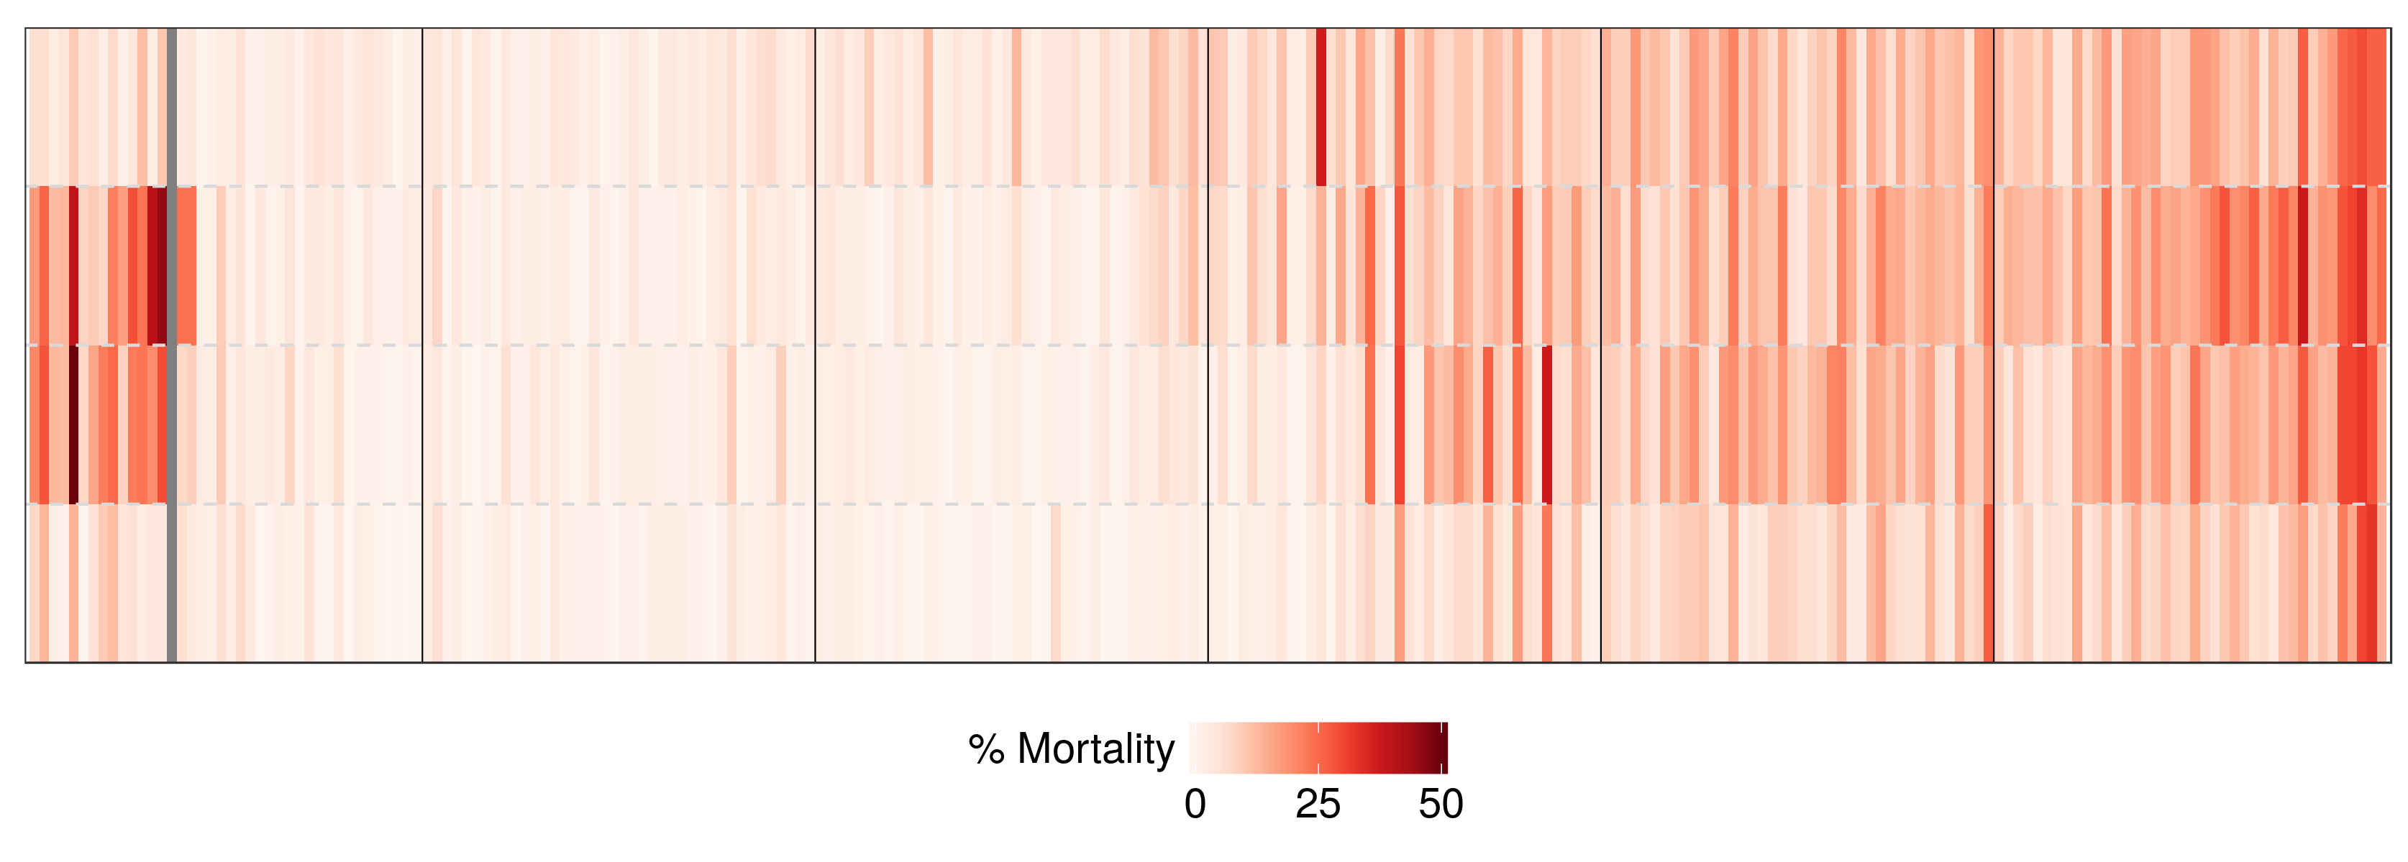
Mortality (previous crop)
Each column = one bed
Beds divided into four 86 ft. sections for counting
Oxnard Field A (2017)

Slide 15
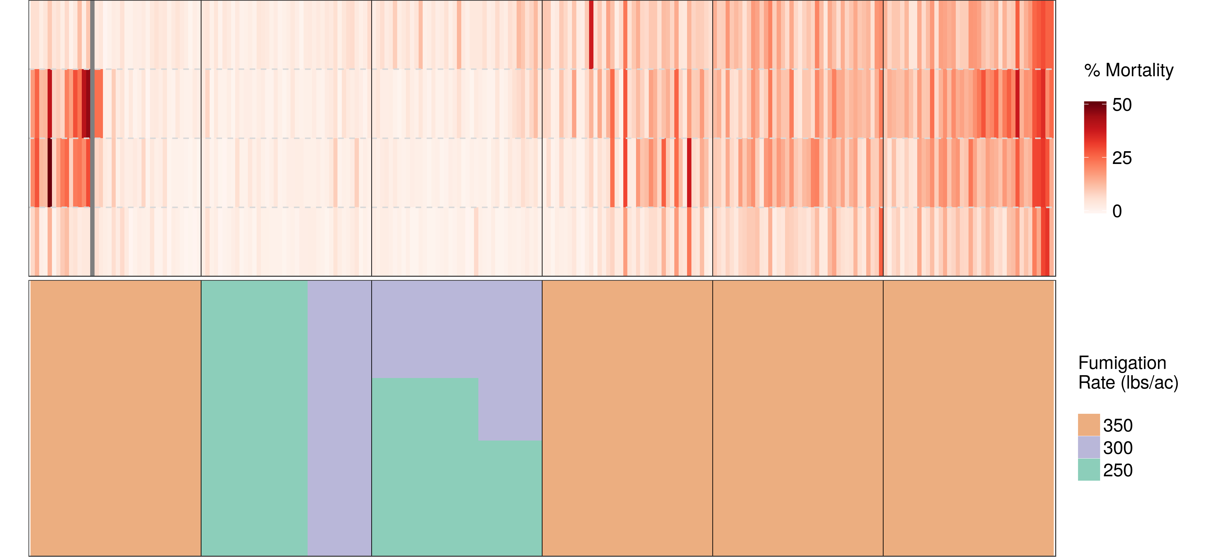
Fumigant Rate Zones
Oxnard Field A (2017)
Standard
Precision
Precision
Standard
Standard
Precision

Slide 16
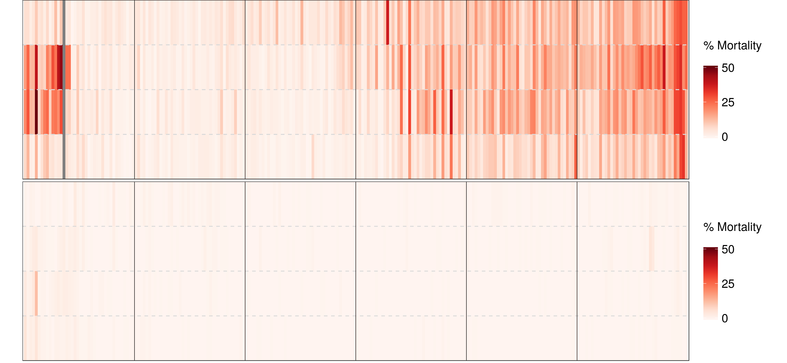
End of Season Mortality
END
Oxnard Field A (2017)

Slide 17
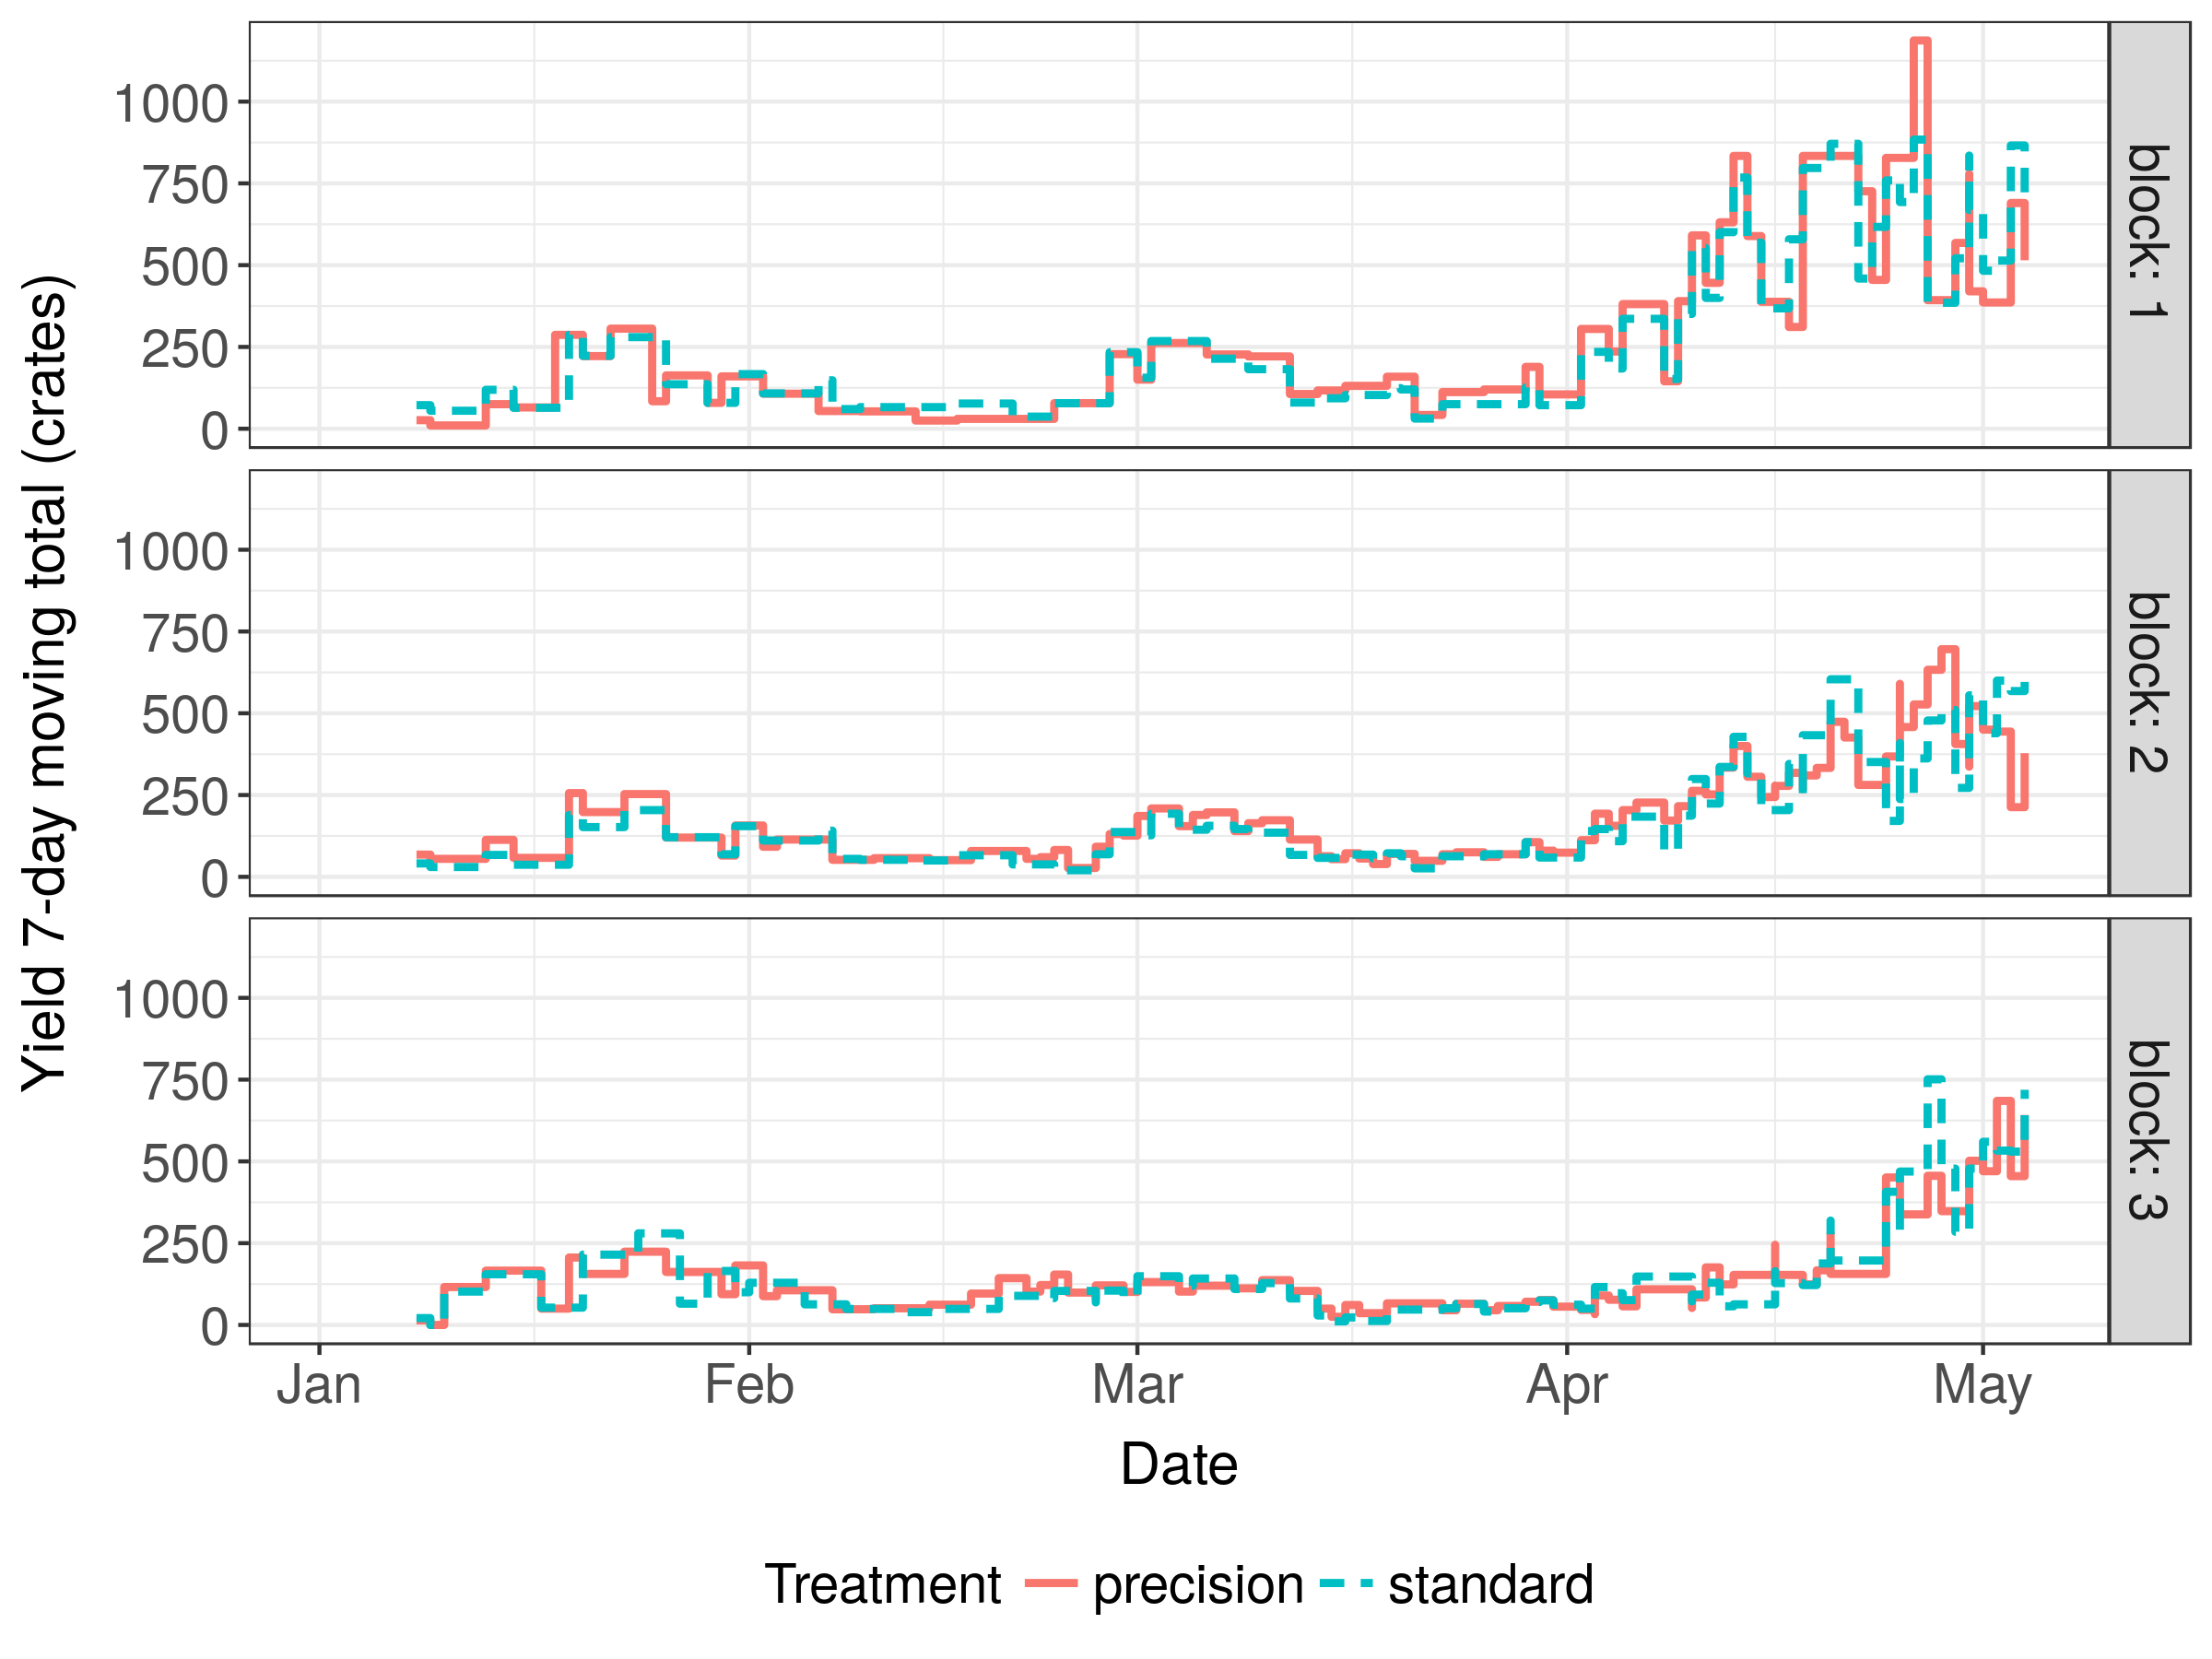
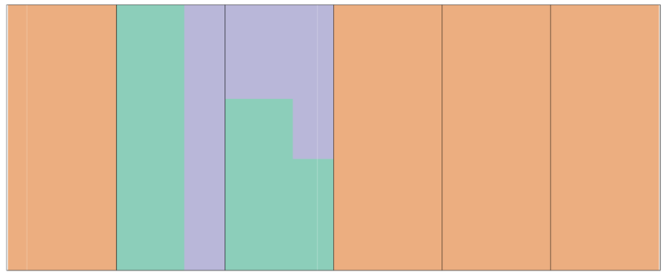
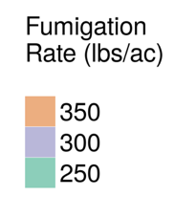
Yield
Oxnard Field A (2017)

Slide 18
Economic Performance (per plot)
Treatment | Plots | Yield | Gross revenues | Net returns
Precision | 1,4,5 | 4,709 | $53,751 | $47,475
Standard | 2,3,6 | 4,580 | $51,750 | $44,939
Partial budgeting analysis: only treatment costs considered
  Precision treatment includes pathogen sampling costs
Daily prices from USDA Agricultural Marketing Service
Oxnard Field A (2017)

Slide 19
Summary – Oxnard Field A (2017)
Precision treatment: 6% higher net returns
  First 4 months of yield
Precision treatment used 15% less fumigant
Low disease pressure
  Mild weather
  Fusarium-resistant cultivar planted during study season

Slide 20
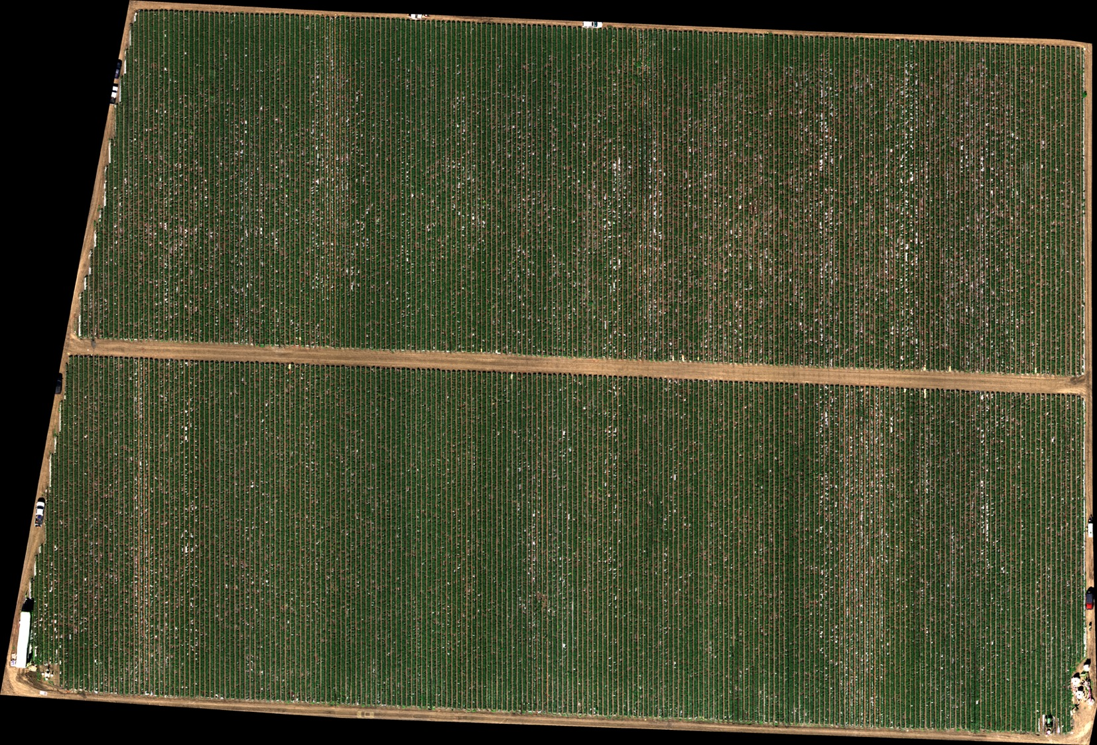
Watsonville (2018)

Slide 21
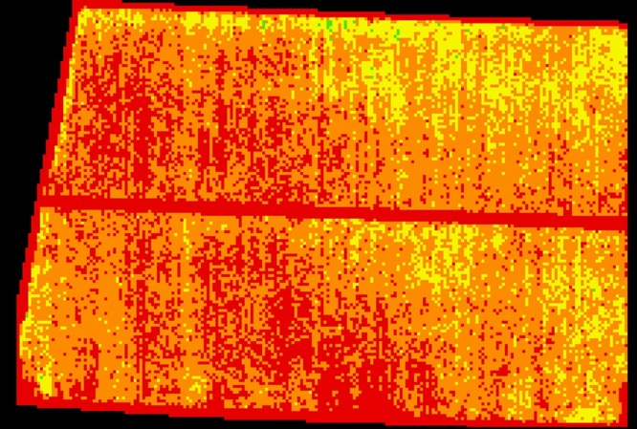
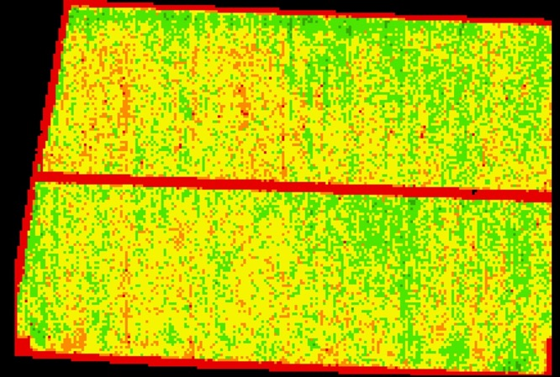
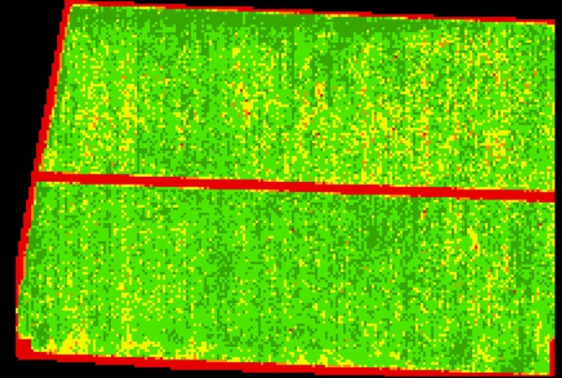

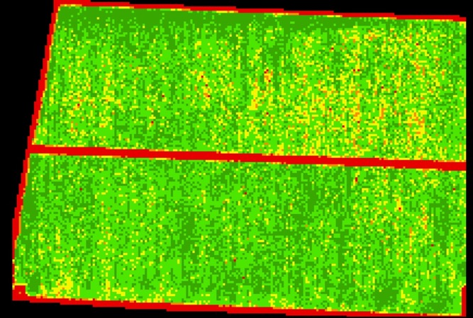
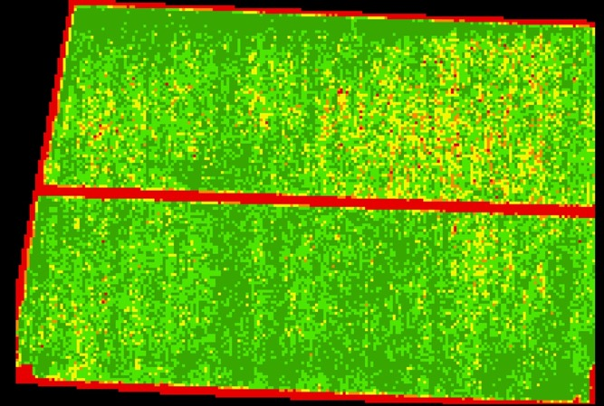
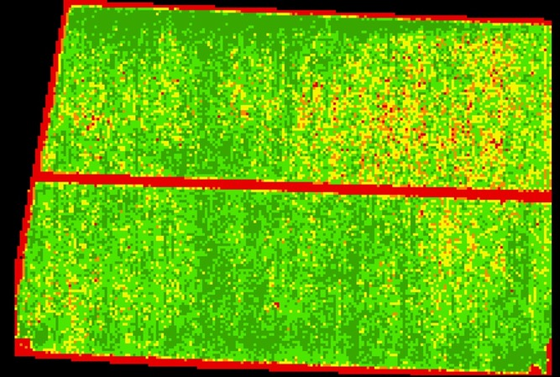
Plant Health Imagery
May 31, 2019
July 11, 2019
August 09, 2019
August 20, 2019
September 19, 2019
October 04, 2019

Slide 22
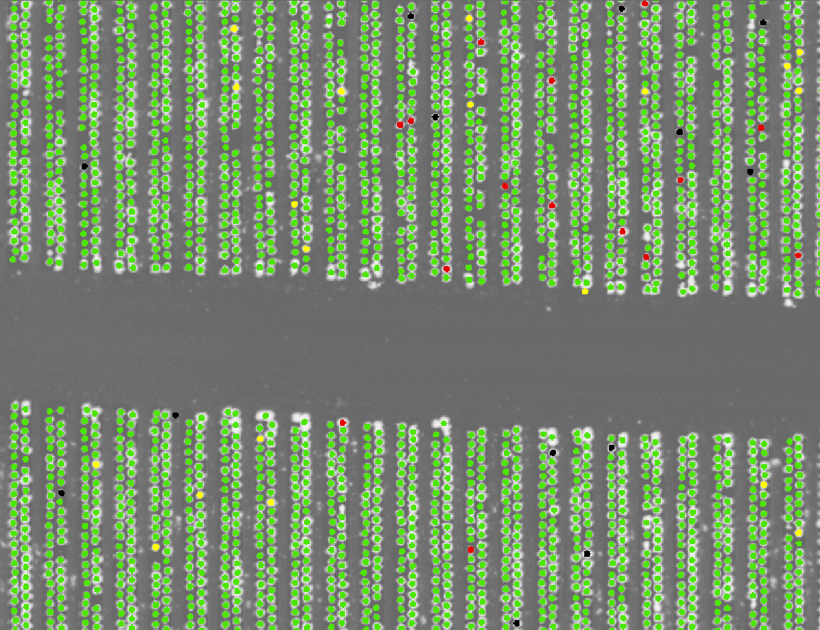

Tracking Individual Plants
Stand and mortality counts
Plant health over time

Slide 23
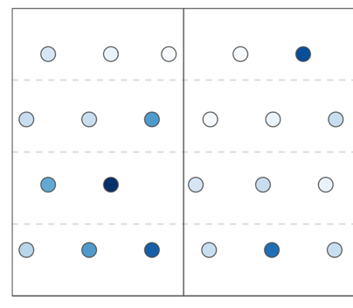
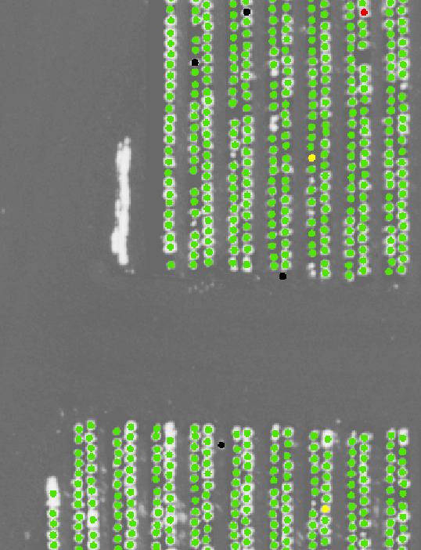
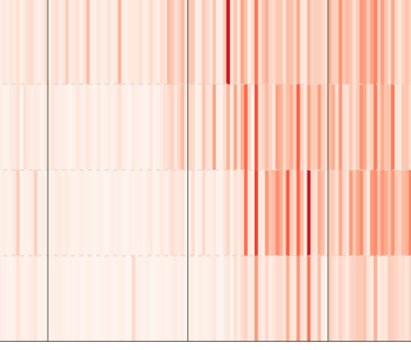
Assess
Treat
Monitor

