Slide 1

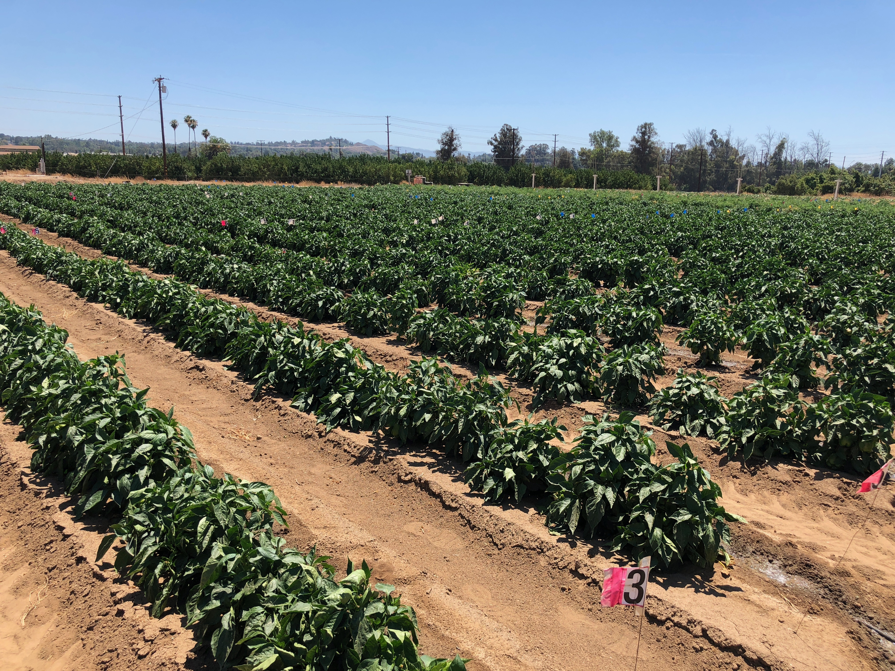
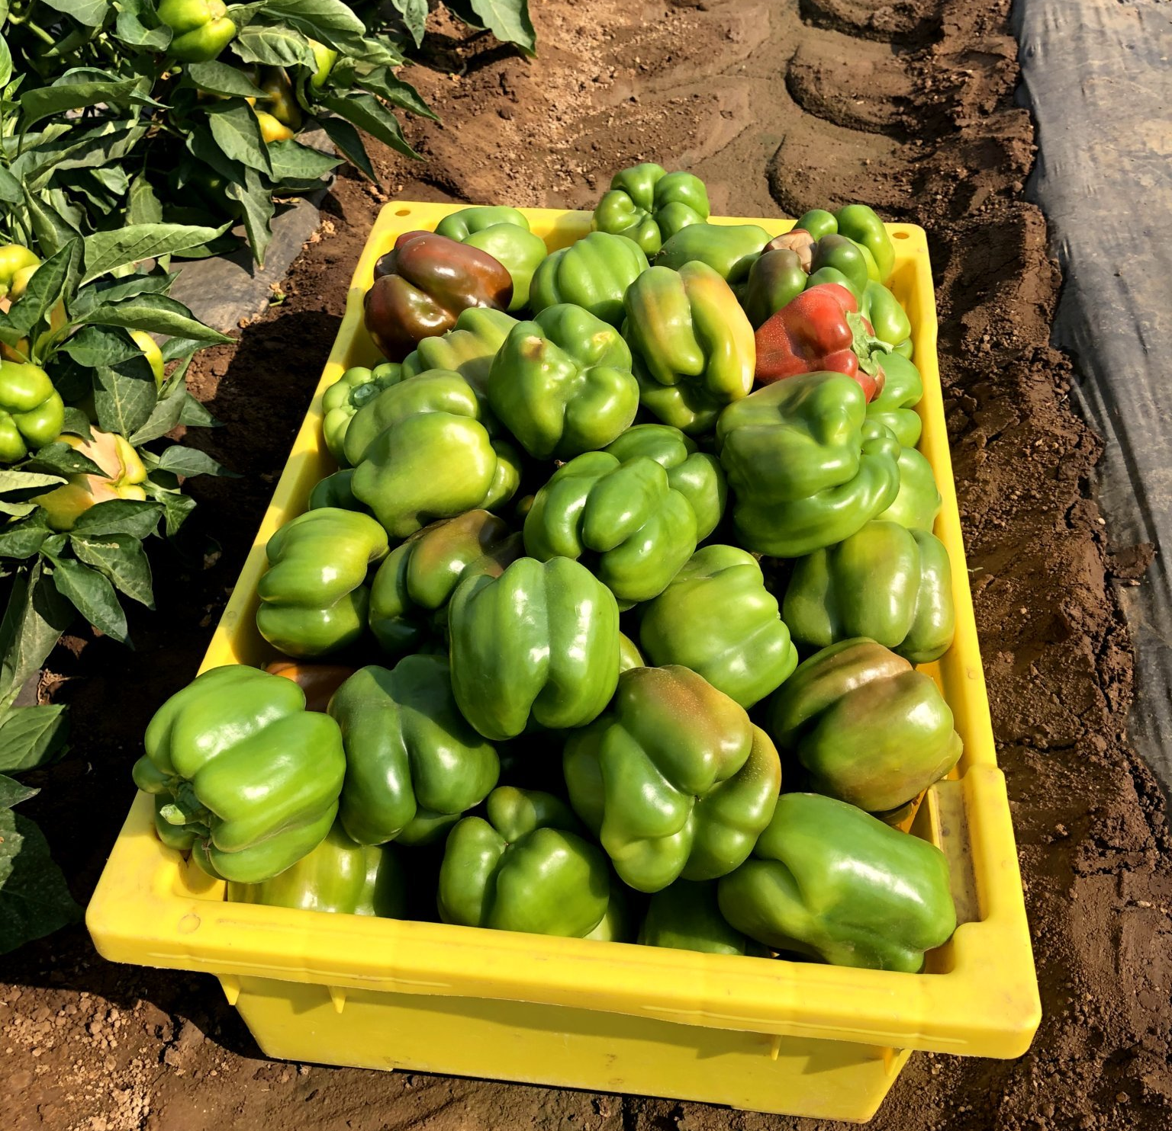
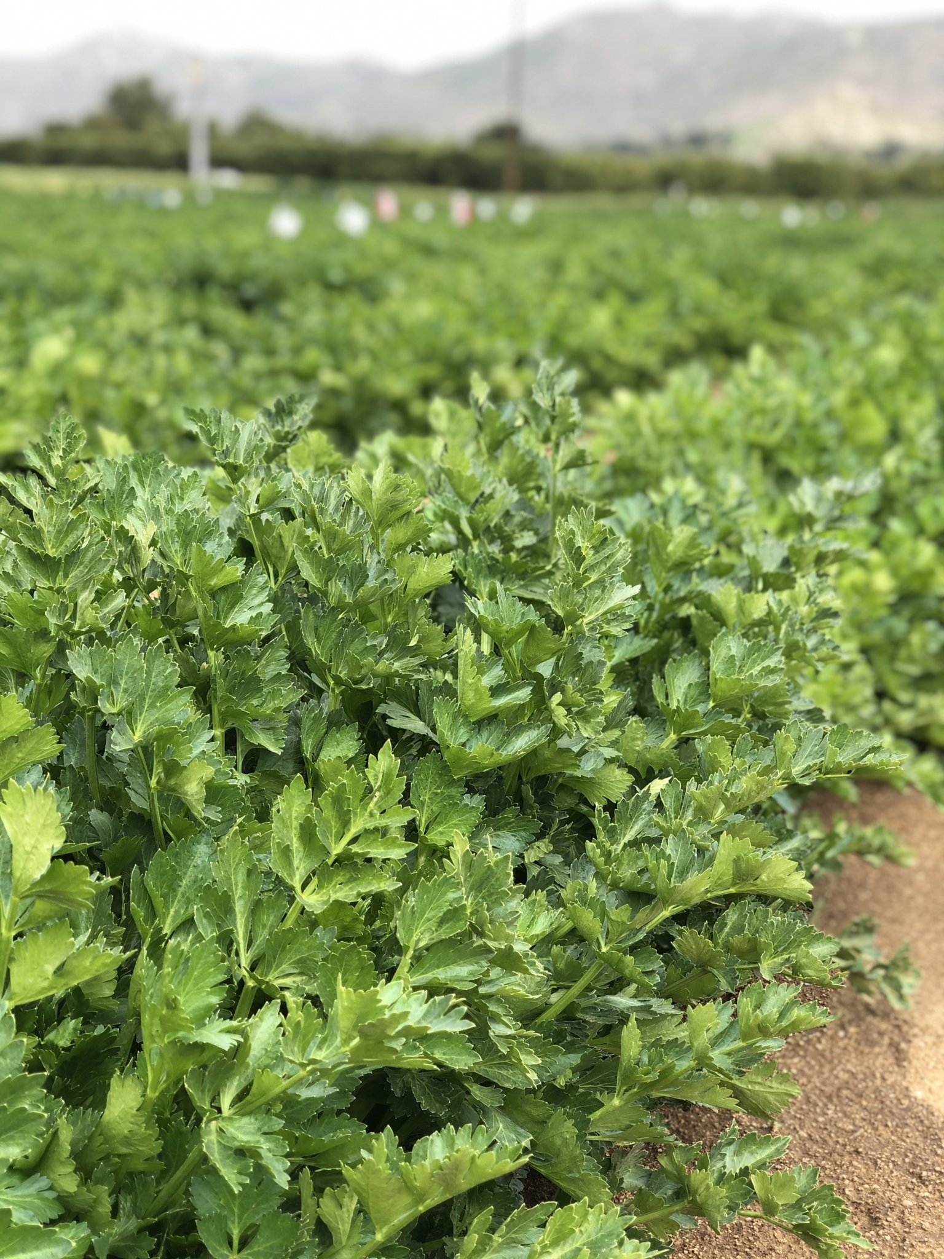
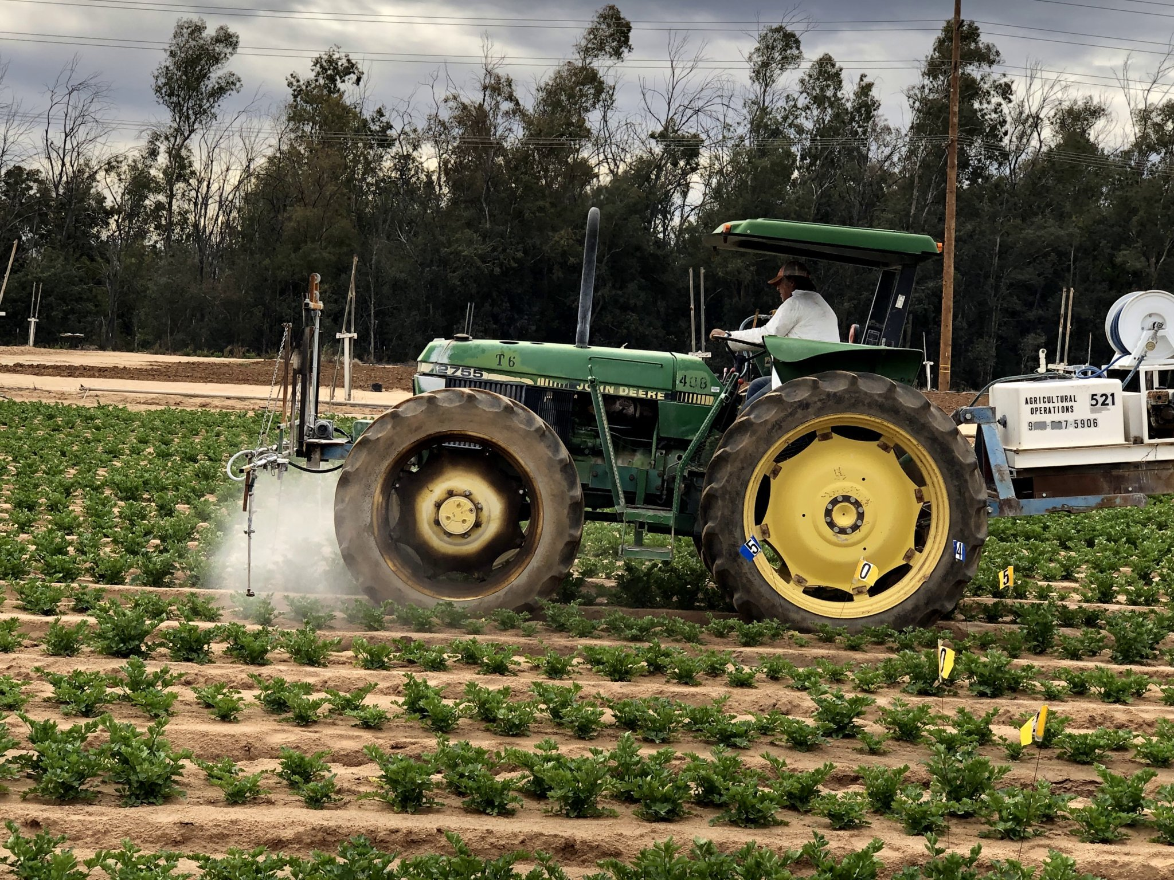
Development of IPM Programs for Peppers and Celery
Greg Kund & Tom Perring
DEPARTMENT OF ENTOMOLOGY
UNIVERSITY OF CALIFORNIA RIVERSIDE

Slide 2
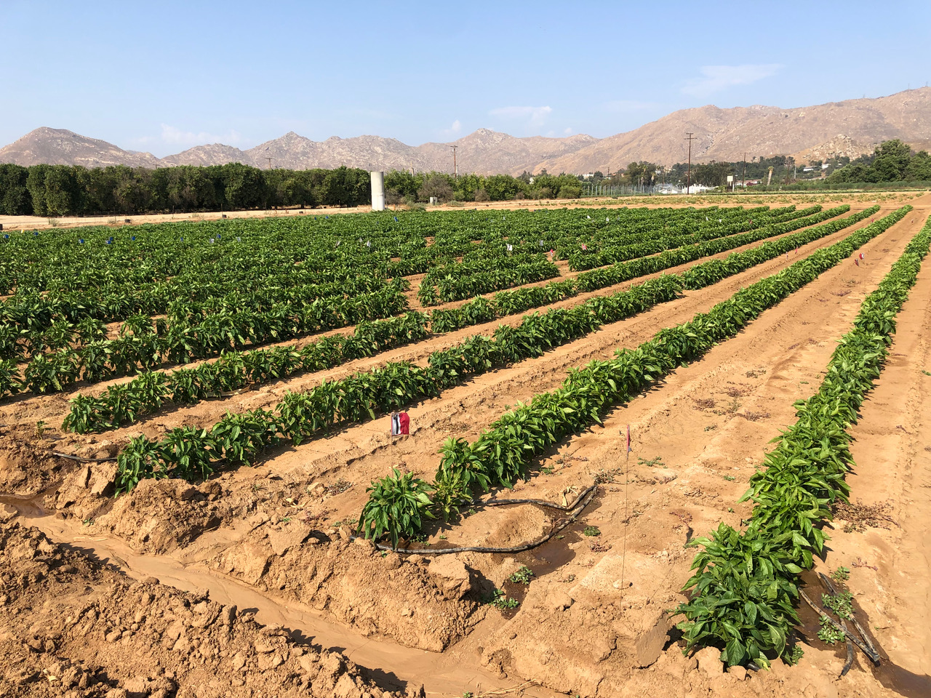
Pepper IPM Research

Slide 3
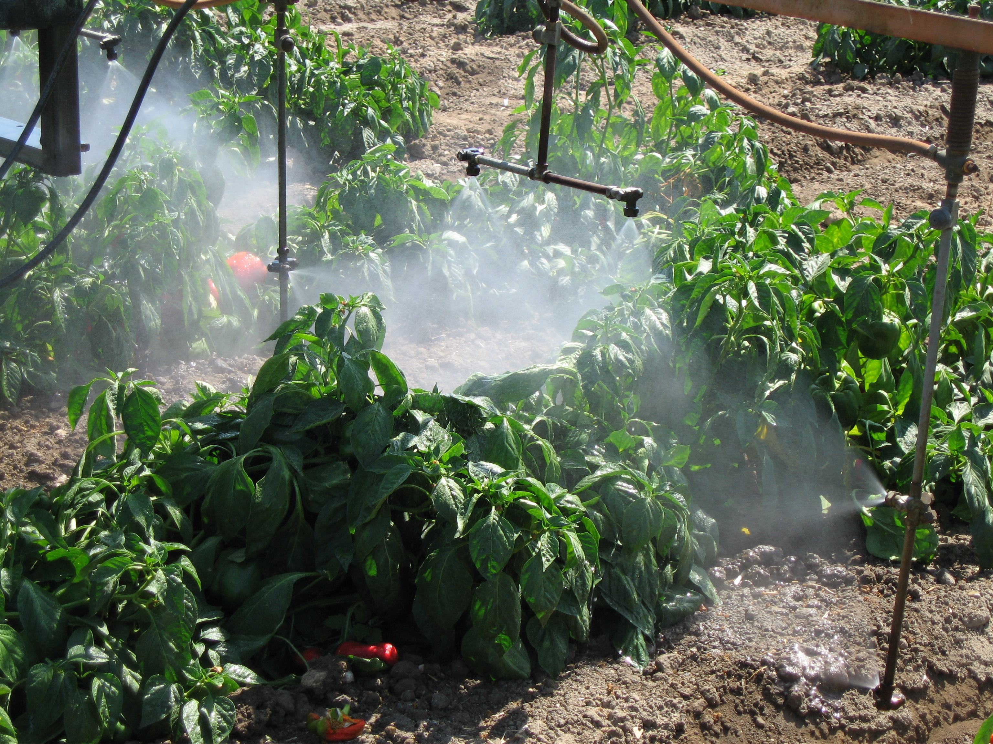
Foliar Application

Slide 4
Screening Trial Treatments
Treatment
Manufacturer
Rate/Ac
#Applied
1-Untreated
*2-Intrepid + Sequoia 2 SC Radiant SC Dyne-amic
*3-Organic IPM Pyganic 1.4EC Trilogy EC Entrust SC
4-Sivanto Prime Soil application
5-Sivanto Prime Foliar application
-
Corteva
MGK Certis Corteva
Bayer
Bayer
-
10 oz 4.5 oz 7.0 oz 0.25%
32 oz 64 oz 8.0 oz
28 oz
14 oz
-
6 foliar
6 foliar
1 soil
1 foliar
*IPM rotations

Slide 5
Screening Trial Treatments
Treatment
Manufacturer
Rate/Ac
#Applied
*6-Intrepid + Sequoia 2SC Spear-Lep + Leprotec Dyne-amic
*7-Spear-Lep + Leprotec Radiant SC Dyne-amic
8- Asana
Corteva Vestaron
Vestaron Corteva
Dupont
10 oz 4.5 oz 2 pt 1 pt 0.25%
2 pt 1 pt 7 oz 0.25%
9 oz
3 foliar 3 foliar 3 foliar 3 foliar
3 foliar 3 foliar 3 foliar
6 foliar
*IPM rotations

Slide 6
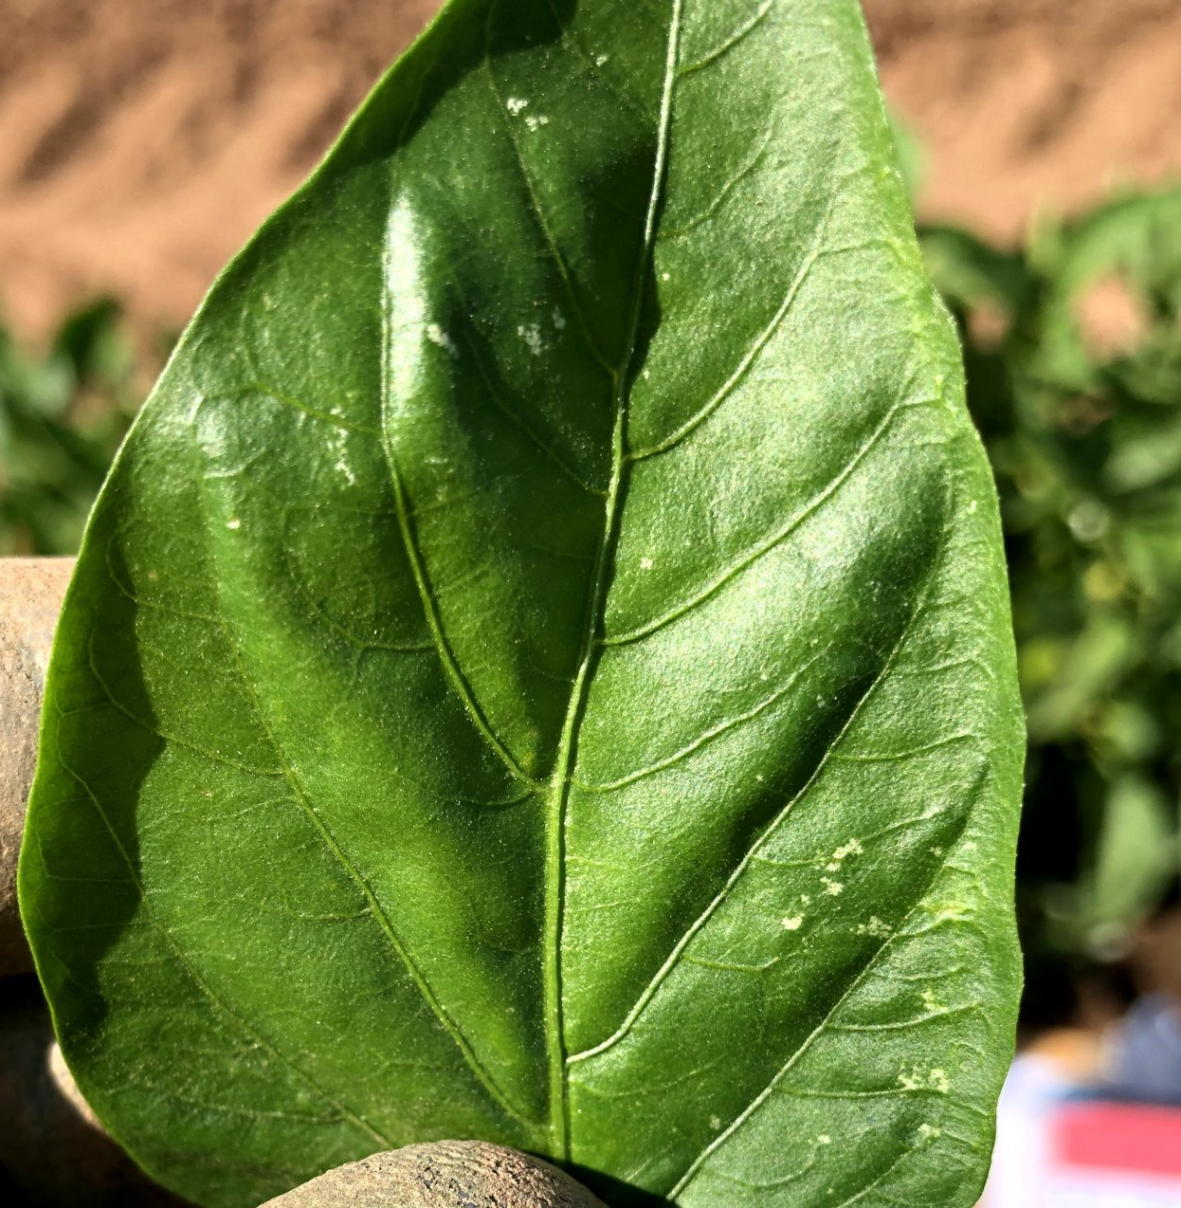
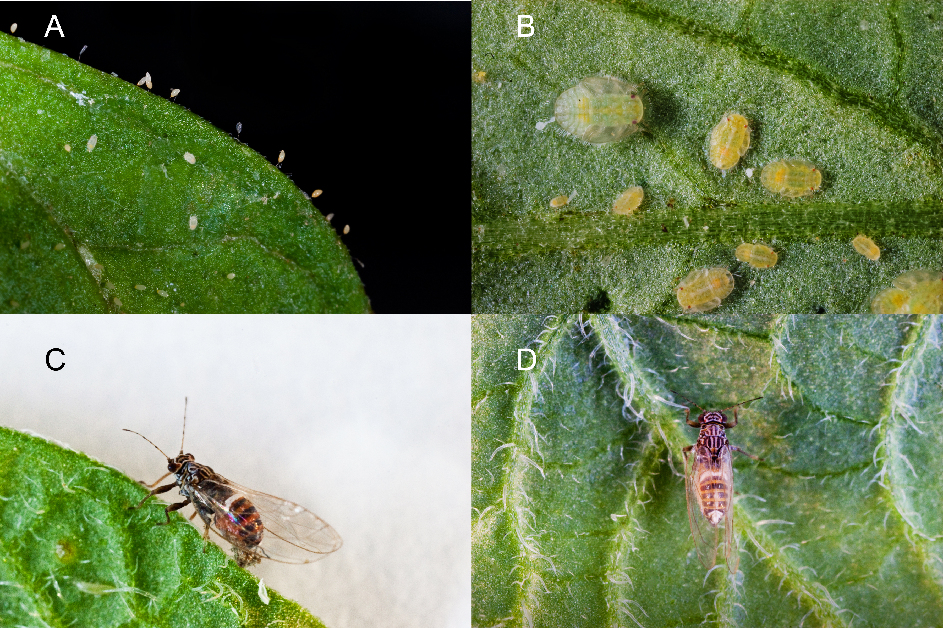
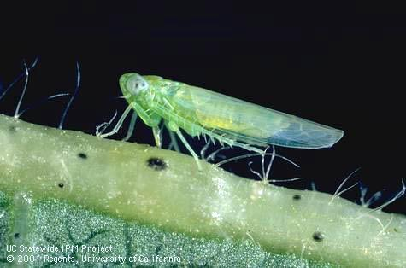
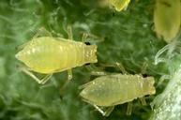
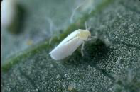
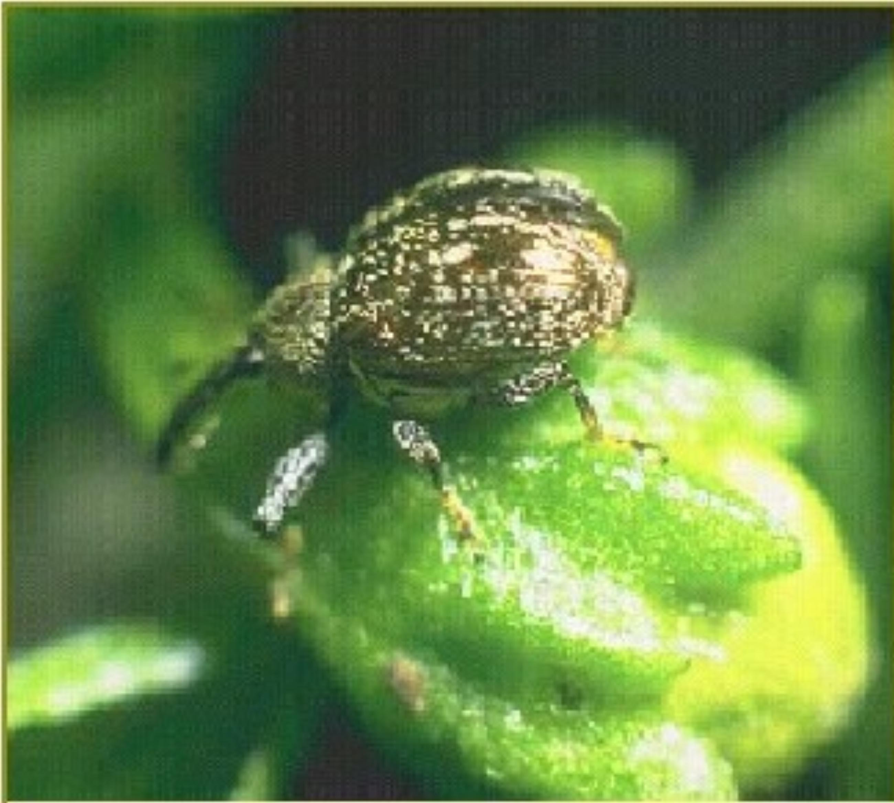
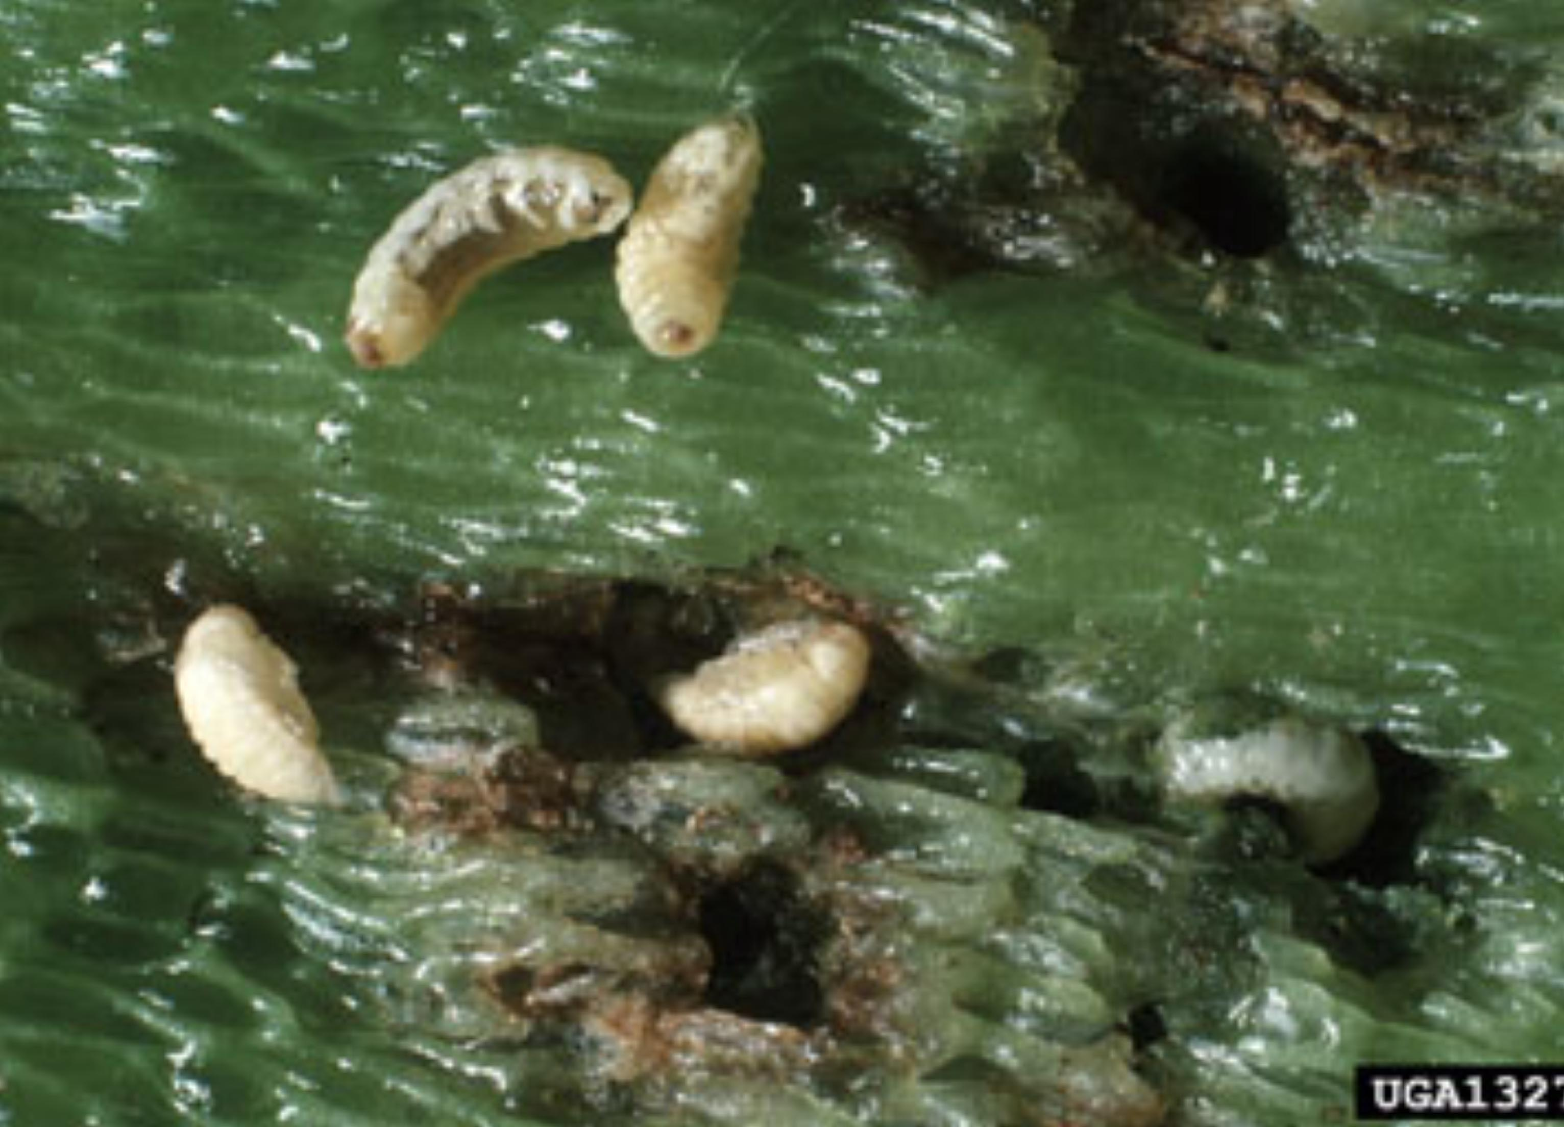
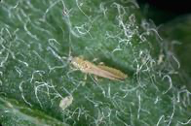
Common Pests
(Photo by Greg Kund)
(Photo by Greg Kund)
UC IPM
UC IPM
UC IPM

Slide 7
Pepper Field Insect Counts
1-Untreated Control
2-Intrepid+Sequoia, Radiant
3-Pyganic, Trilogy, Entrust
4-Sivanto Prime (Soil)
5-Sivanto Prime (Foliar)
6-Intrepid+Sequoia, Spear Lep+Leprotec
7-Spear Lep+Leprotec, Radiant
8-Asana

Slide 8
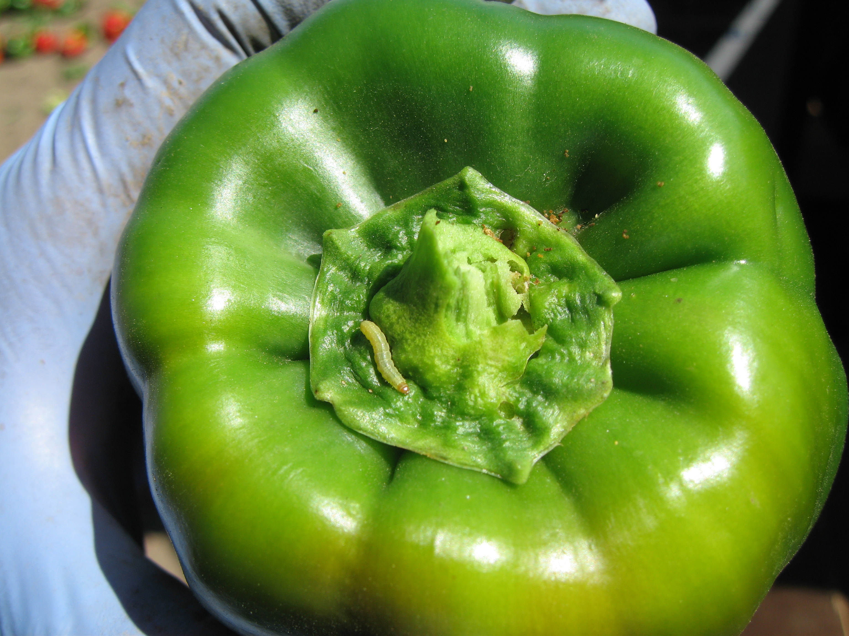
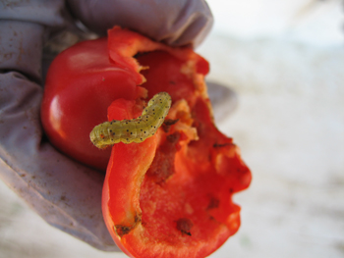
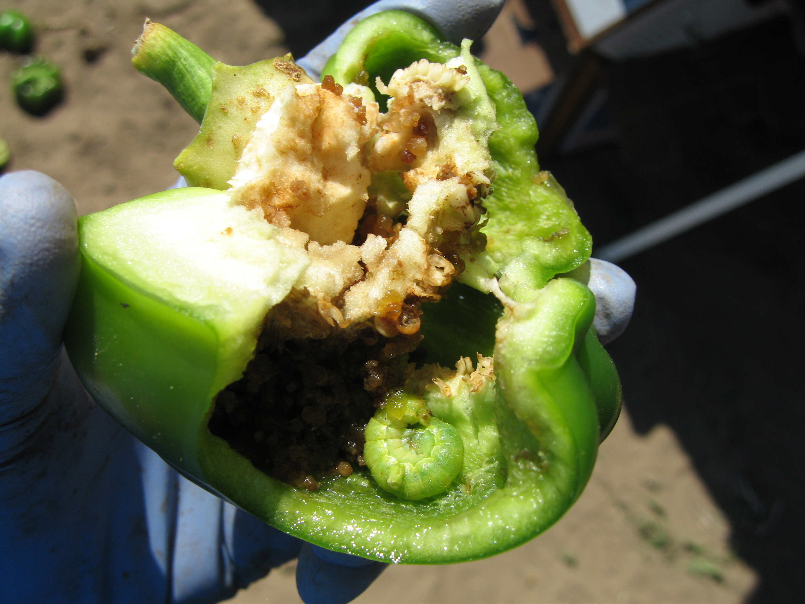
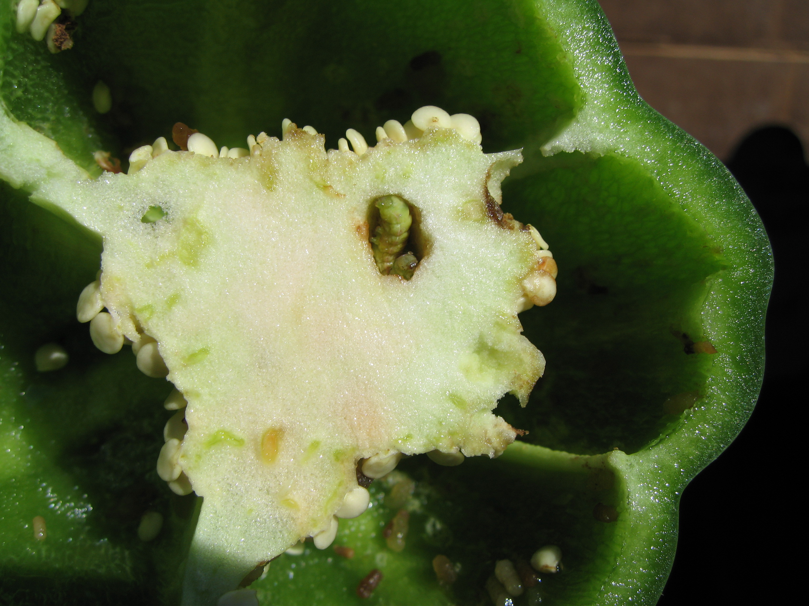
Worm Damage
(Photos by Greg Kund)

Slide 9
Beet Armyworm Damage
Spear-Lep + Leprotec ,Radiant
Intrepid+ Sequoia, Radiant
Intrepid + Sequoia, Spear-Lep + Leprotec
Pyganic , Trilogy, Entrust
Sivanto Prime (Soil)
Sivanto Prime Foliar
Untreated Control
Asana

Slide 10
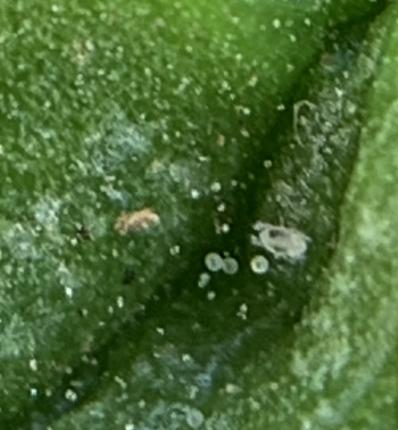
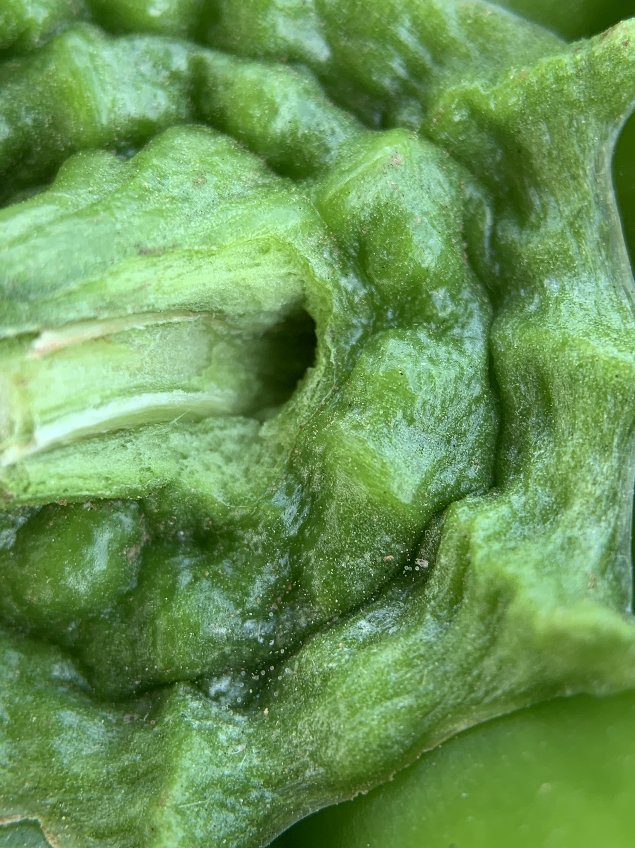
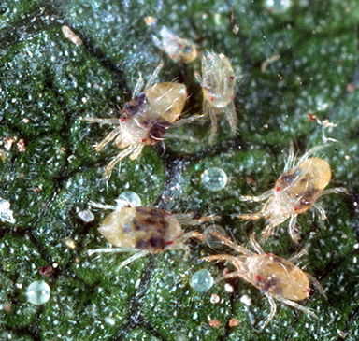
Spider Mites
(Photo by Greg Kund)
(Photo by Greg Kund)
(Photo by UC IPM)

Slide 11
Spider Mite Damage
Spear-Lep + Leprotec ,Radiant
Intrepid + Sequoia, Spear-Lep + Leprotec
Intrepid+ Sequoia, Radiant
Untreated Control
Pyganic , Trilogy, Entrust
Sivanto Prime (Soil)
Sivanto Prime Foliar
Asana

Slide 12
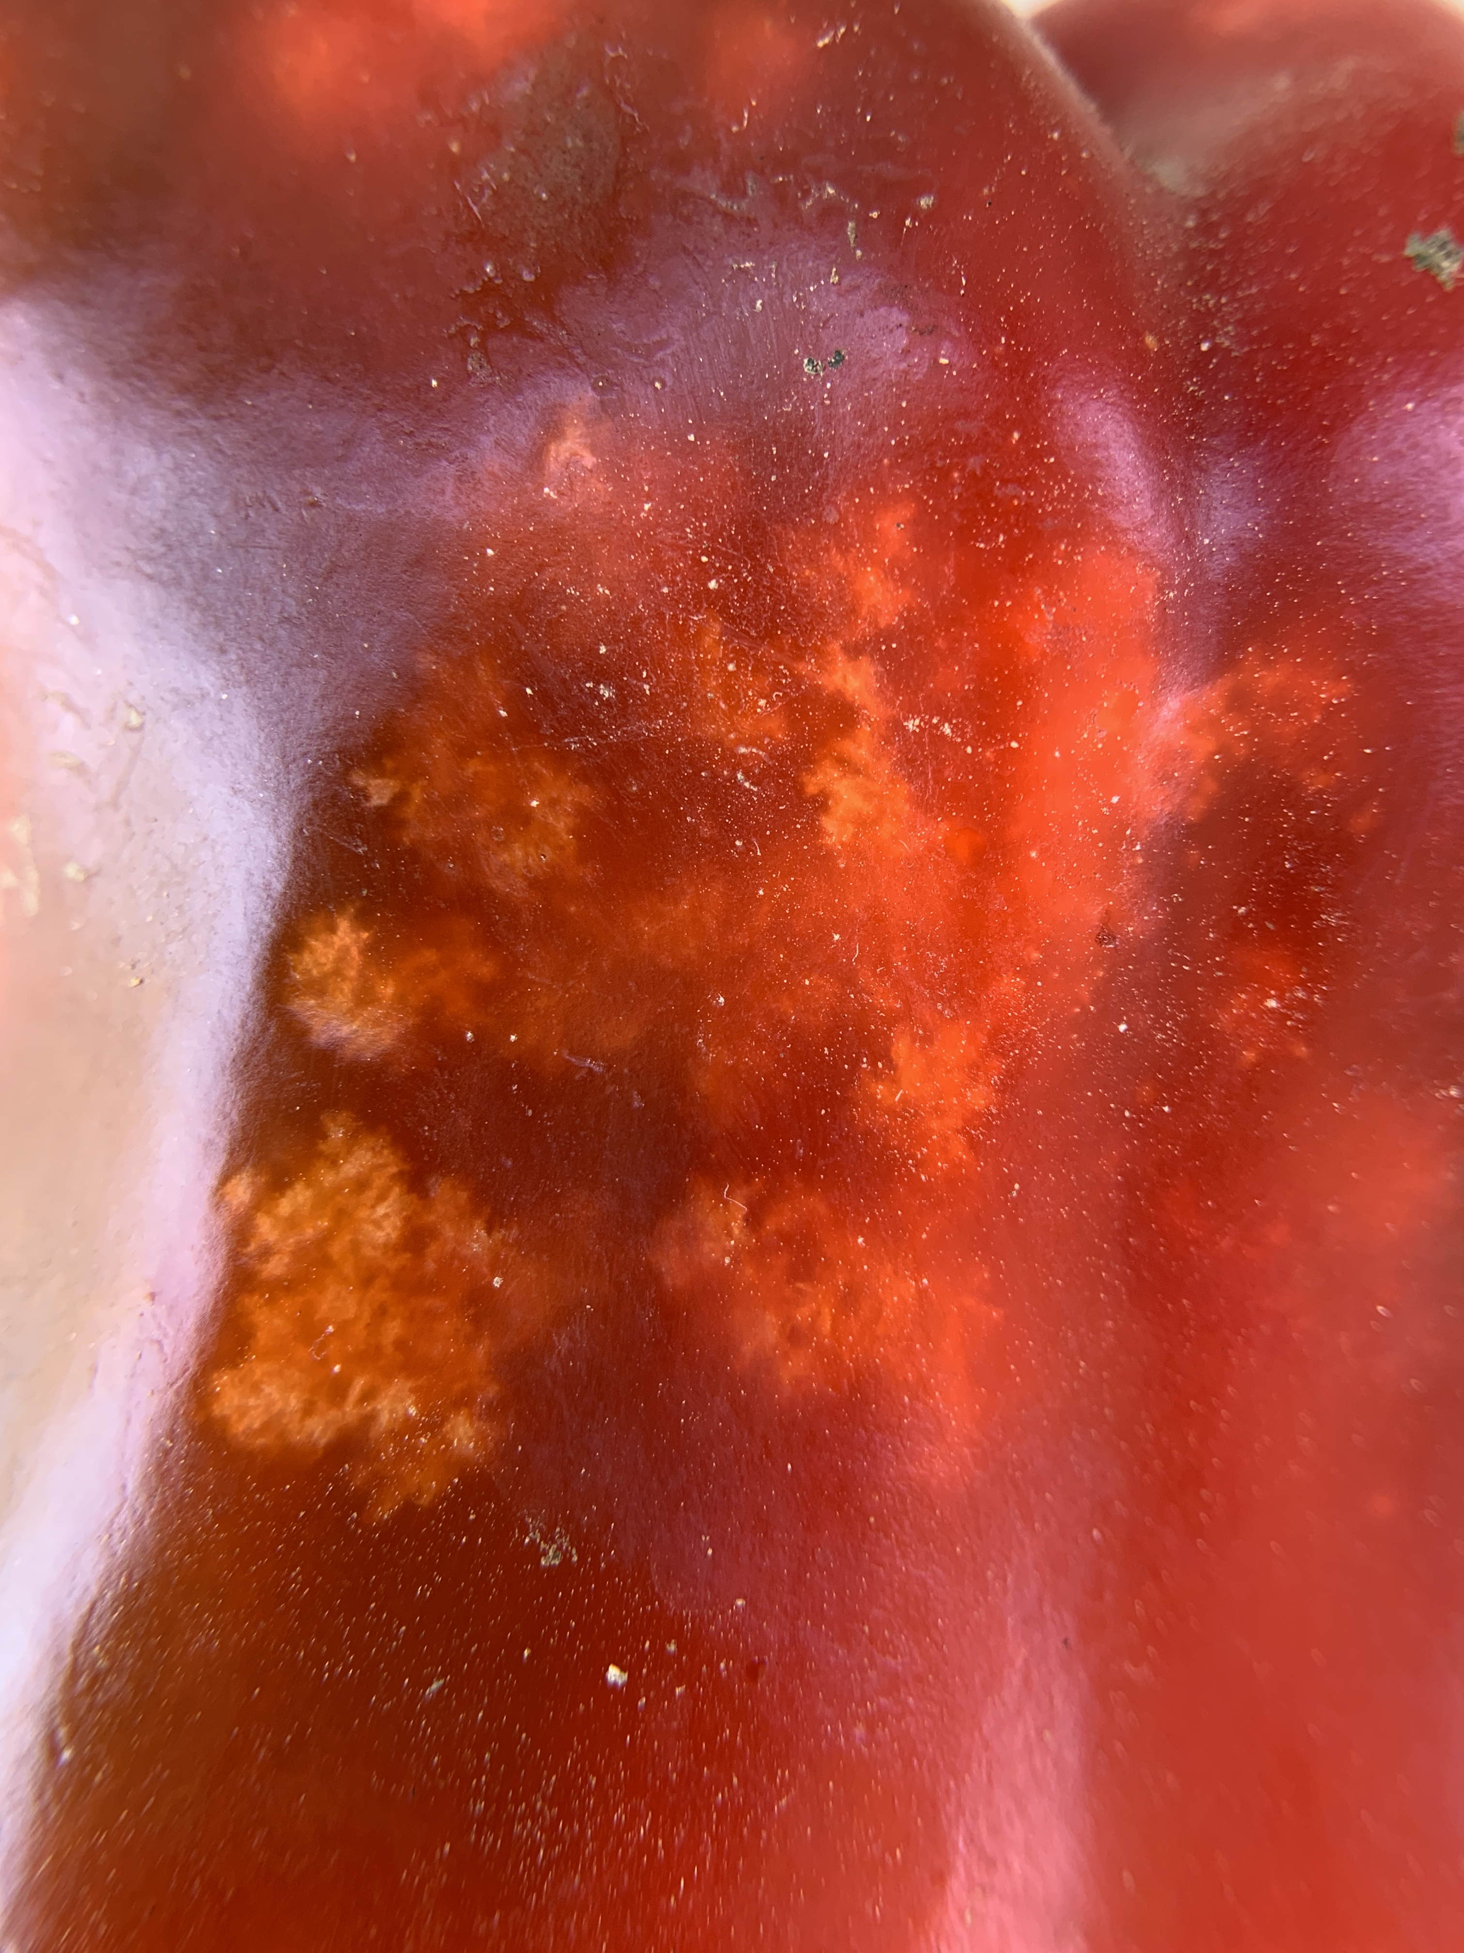
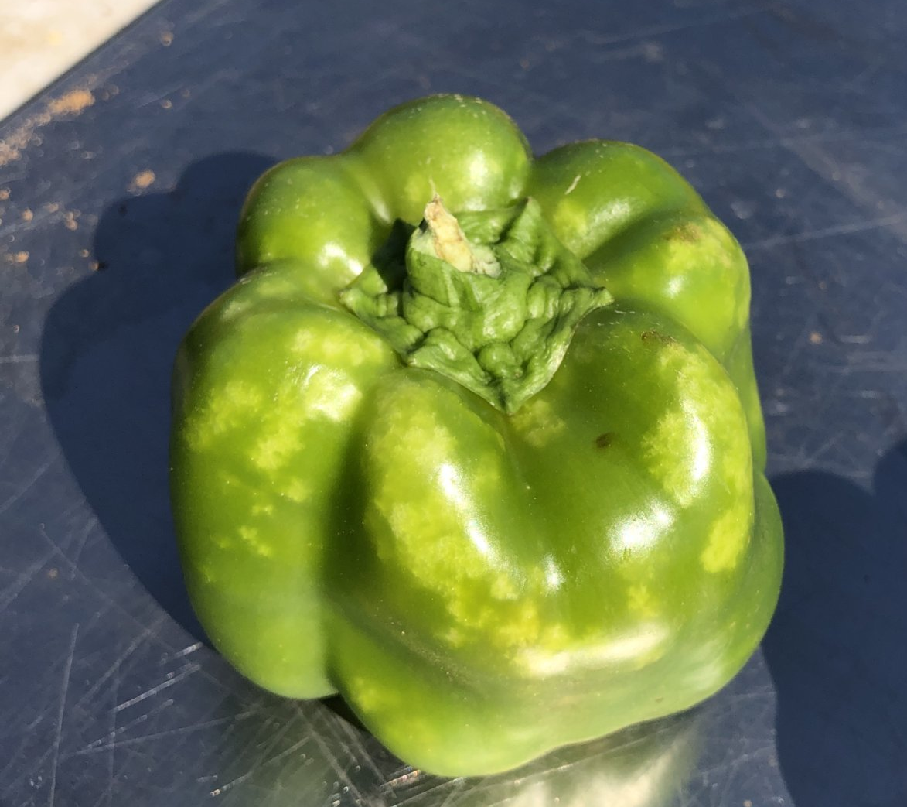
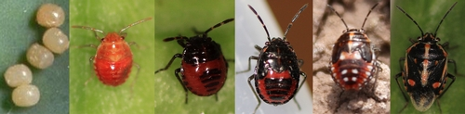
Bagrada Bug
(Photo by Greg Kund)
(Photo by Greg Kund)
(Eggs and the last instar photos by Eric Natwick and the rest by Surendra Dara)
Adult size ¼”

Slide 13
Bagrada Bug Damage
Untreated Control
Spear-Lep + Leprotec ,Radiant
Intrepid+ Sequoia, Radiant
Intrepid + Sequoia, Spear-Lep + Leprotec
Pyganic , Trilogy, Entrust
Sivanto Prime (Soil)
Sivanto Prime Foliar
Asana

Slide 14
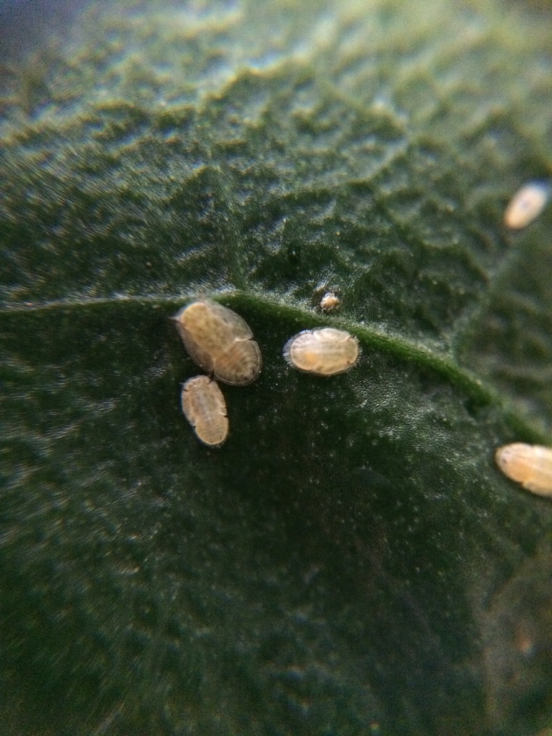
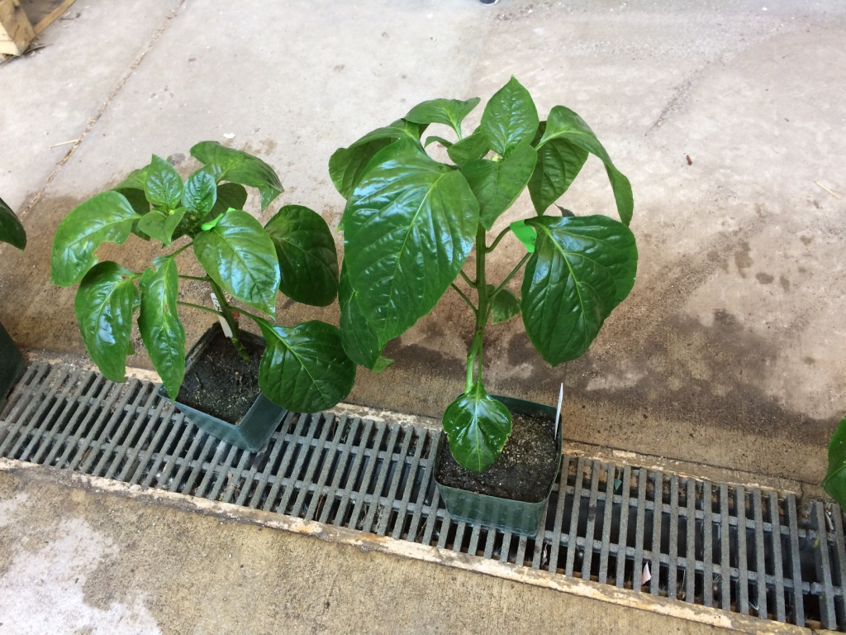
Psyllid Baseline Resistance Studies
Exirel (cyantraniliprole)
Populations
1-UC Riverside - Agricultural Operations
2-Temecula, CA

Slide 15
Exirel – Pepper Psyllids

Slide 16
Exirel – Pepper Psyllids

Slide 17
Future studies
New materials to test:
Proprietary Insecticides–(Plinazolin-Syngenta)
Replacement of neonicotinoids
OMRI organic treatments
Develop and evaluate IPM programs

Slide 18
Newer Registered Materials
Sequoia (sulfoxaflor) Corteva
Sefina (afidopyropen) BASF
Spear-T and Spear-Lep (Vestaron)
Minecto Pro (Syngenta)

Slide 19
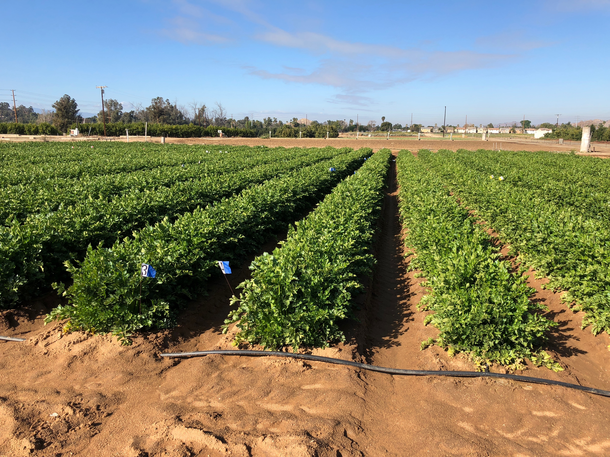
Celery IPM Research

Slide 20
Celery Field Trial
Goals and Objectives
Screen new chemicals for use in an IPM program
  Develop IPM rotations that:
    Reduce costs
    Manage insecticide resistance
    Economically viable

Slide 21
2021 Screening Trial
Material
Manufacturer
# Rates
Exirel
Radiant
Dipel
Asana
Spear-Lep
* Leprotec
Beleaf
Dupont/FMC
Dow/Corteva
Valent
Dupont/FMC
Vestaron
Vestaron
FMC
1
1
1
1
1
1
1
* (Aqueous Btk to improve the efficacy of Spear-Lep)
Notes:
21
List of materials to be used in the Celery trial. Chemical and IPM trials to be done.

Slide 22
2021 Screening Trial (Contd.)
Material
Manufacturer
# Rates
Minecto Pro
Entrust
Pyganic
Trilogy
Aza-diret
Dipel
Venerate
Grandevo
Syngenta
Corteva
MGK
Certis
Gowan
Valent
Marrone-Bio
Marrone-Bio
1
1
1
1
1
1
1
1

Slide 23
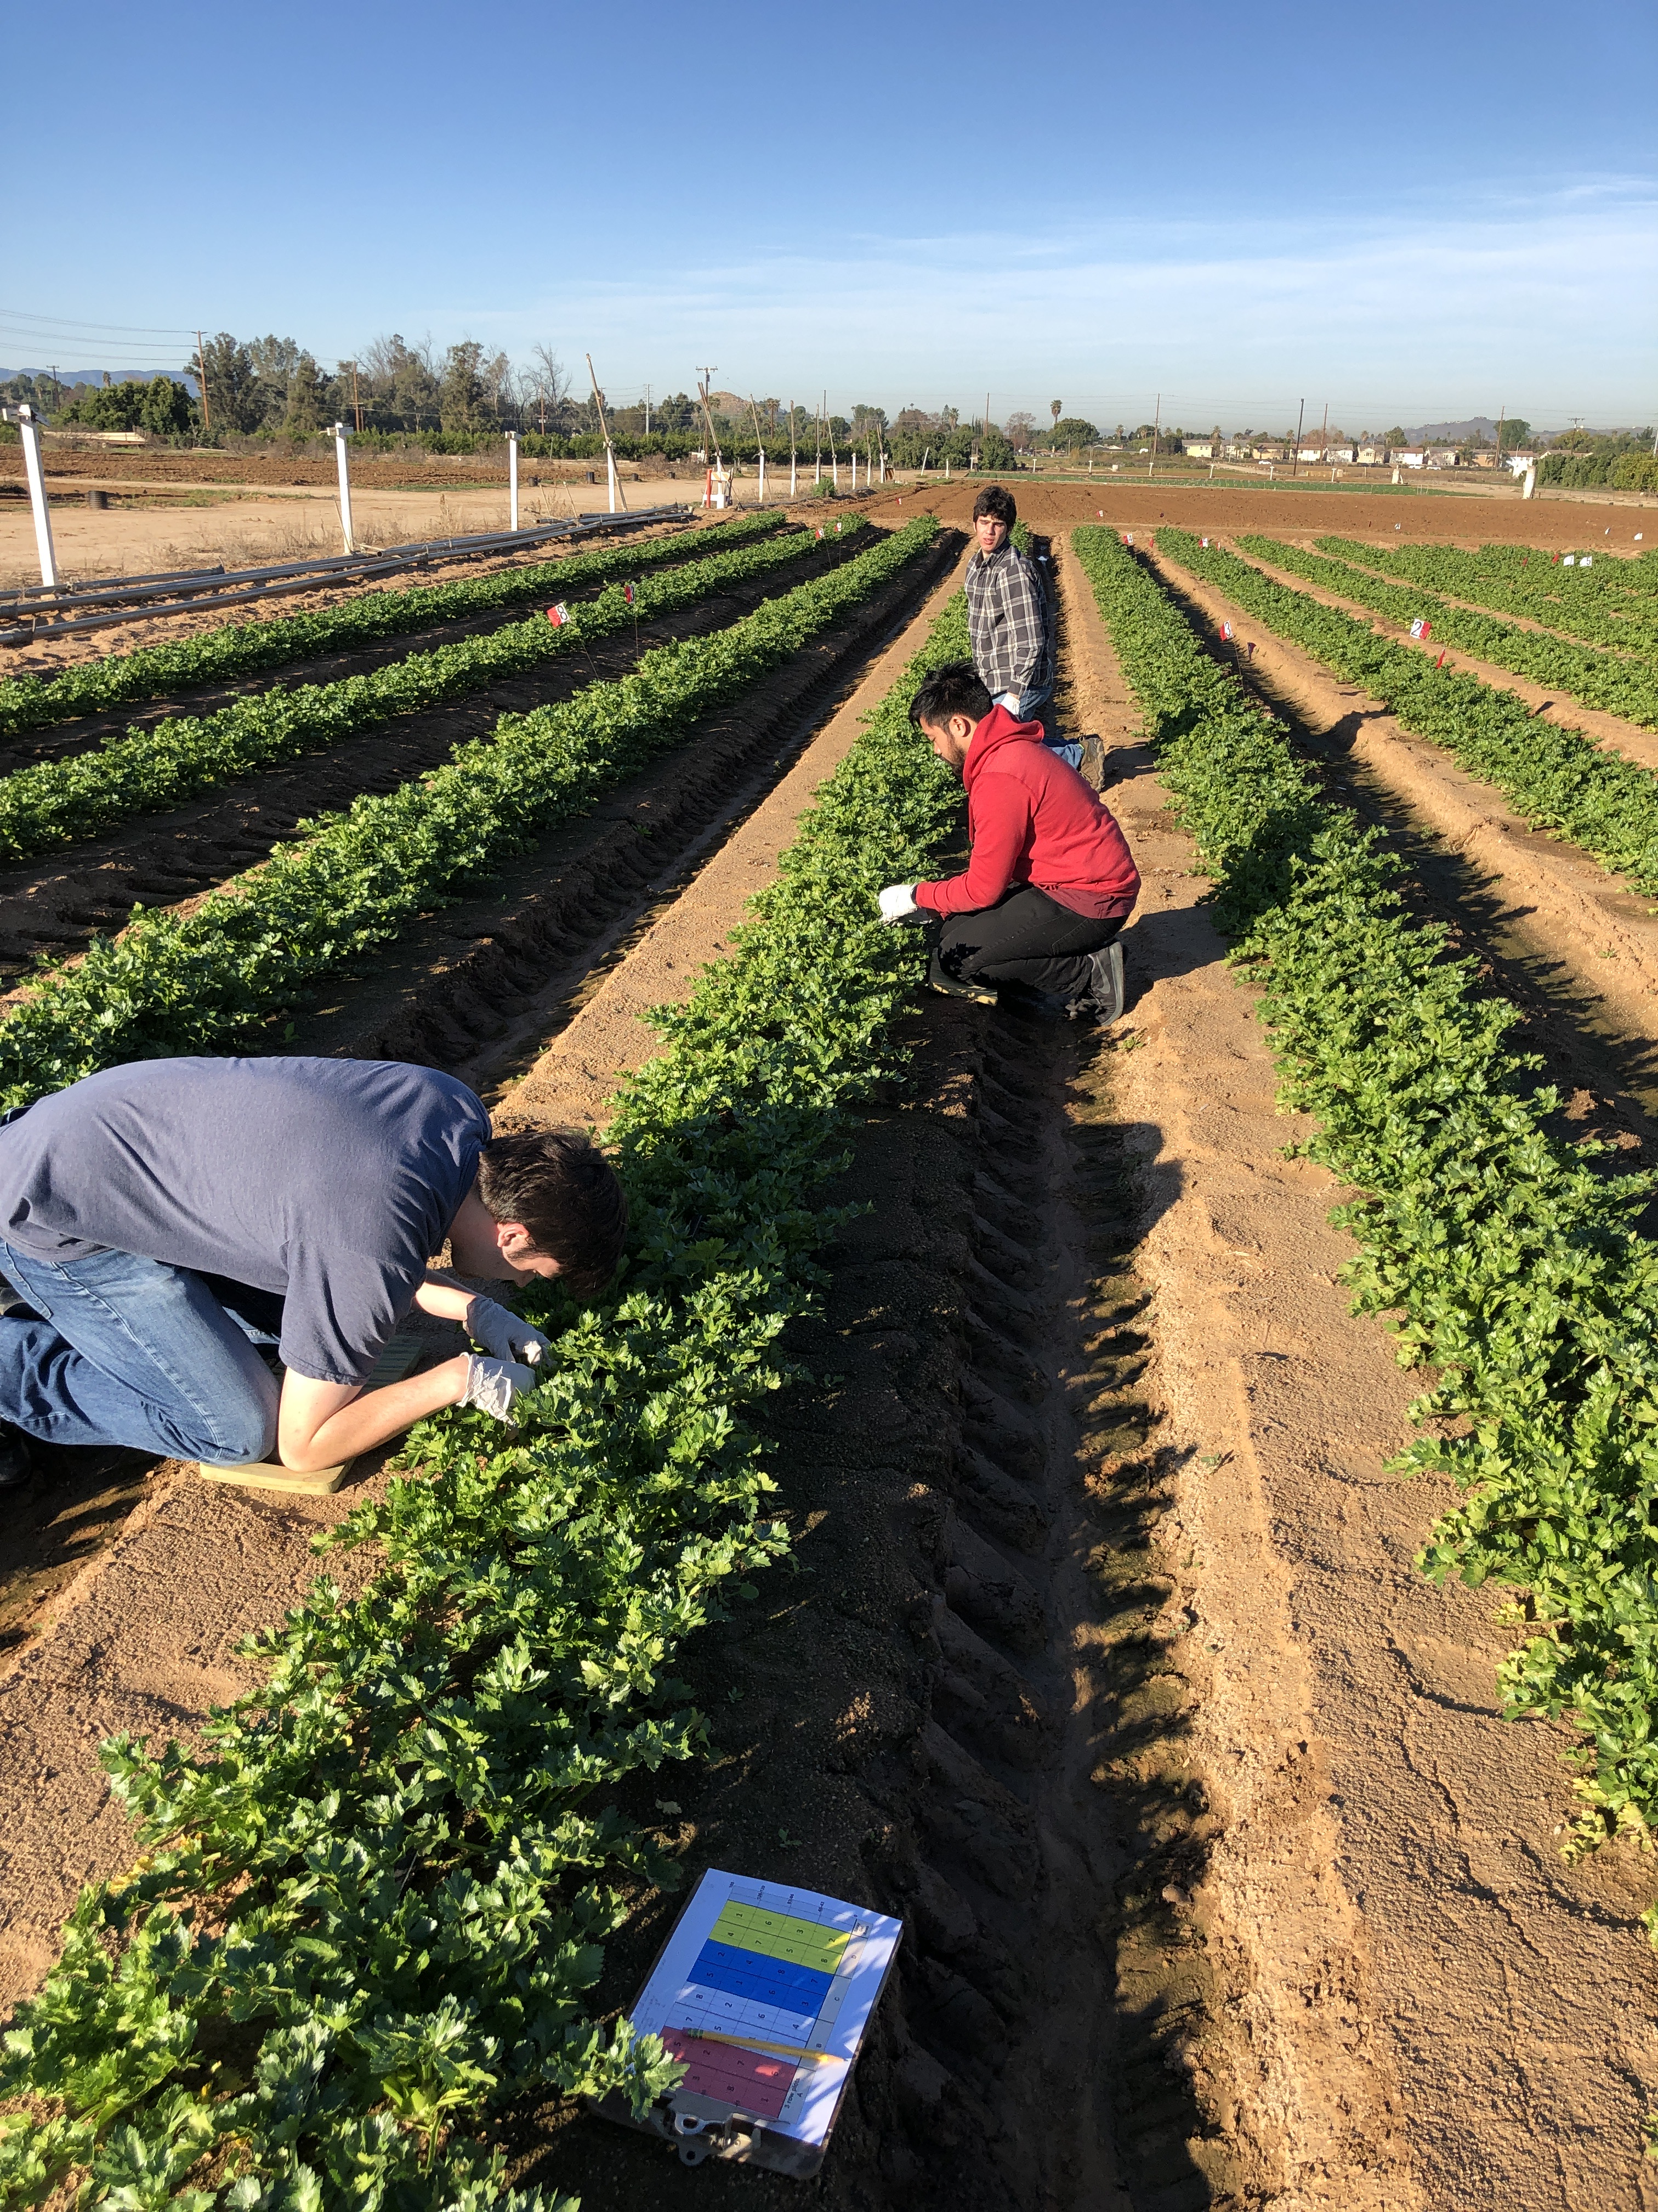

Slide 24
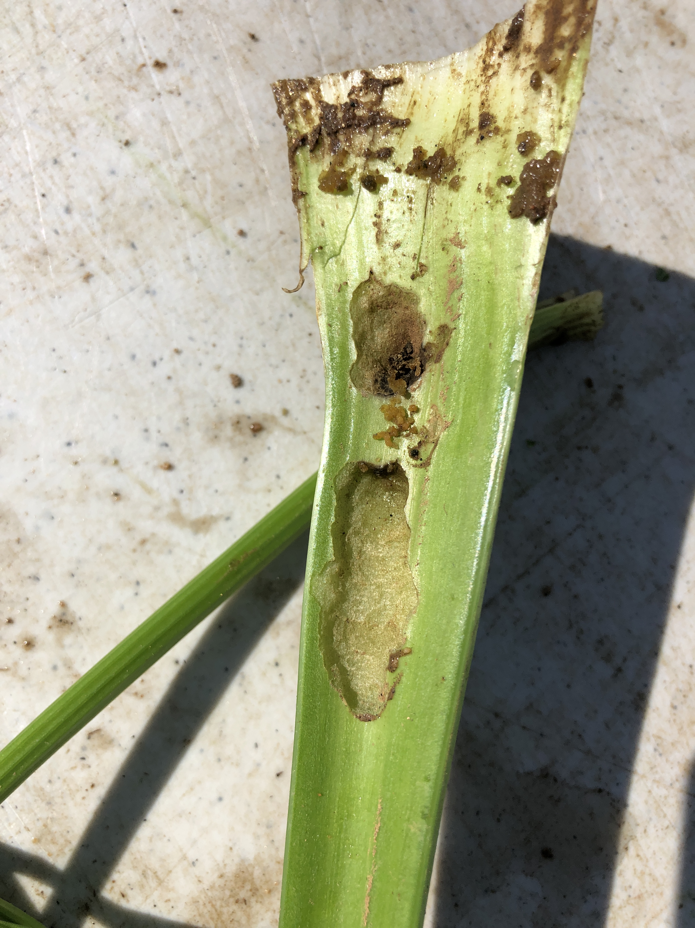
Aphids
Beet Armyworm
Carbamates and Pyrethroids increase aphid populations.
Photo by Greg Kund
Photo by Greg Kund

Slide 25
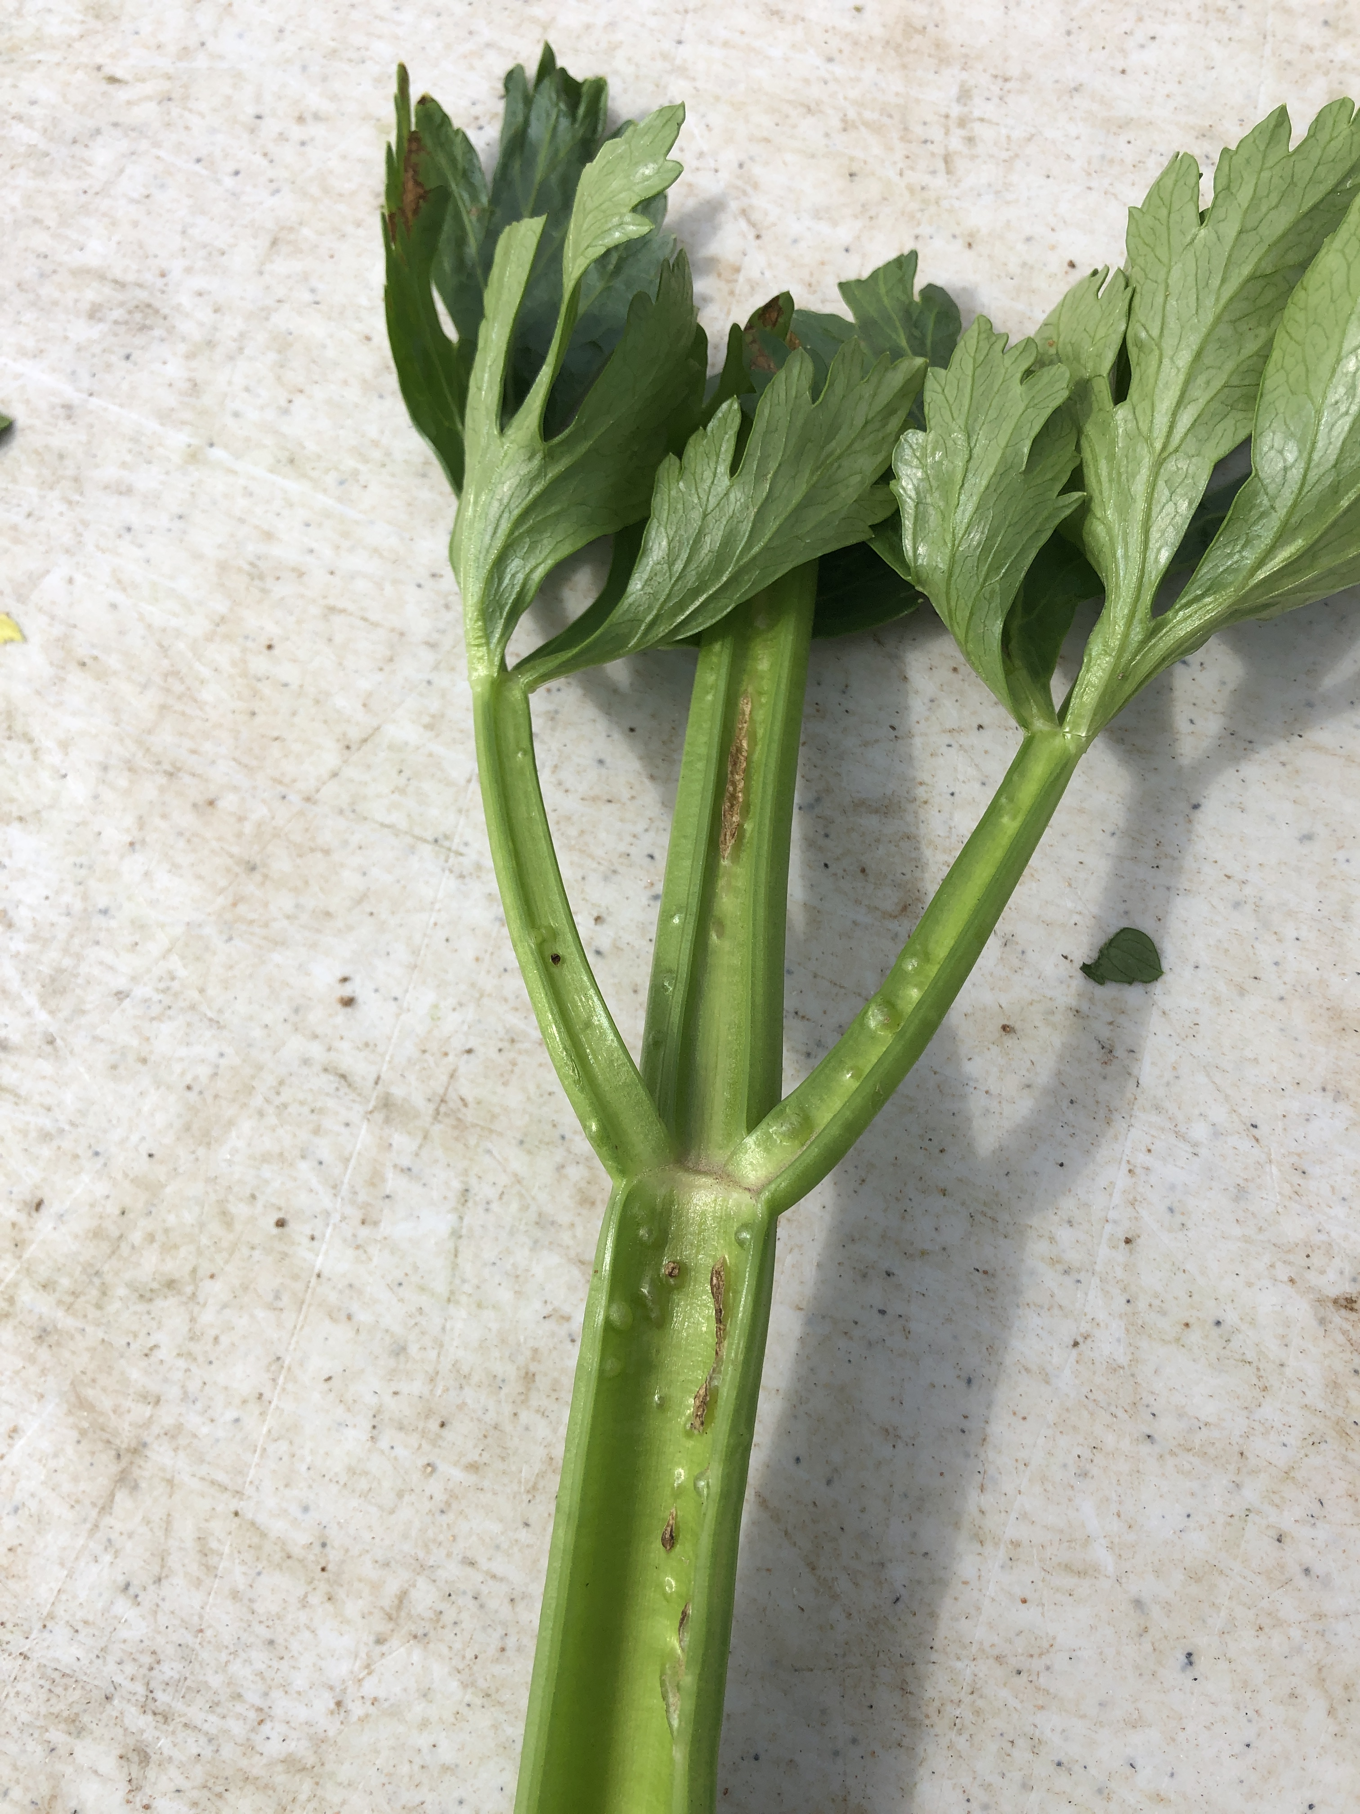
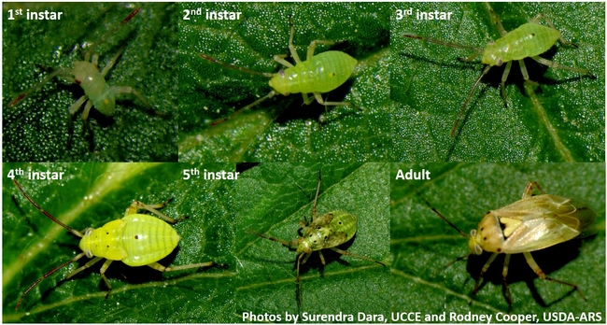
Lygus Bug Damage
Photo by Greg Kund

Slide 26
Insect Field Counts

Slide 27
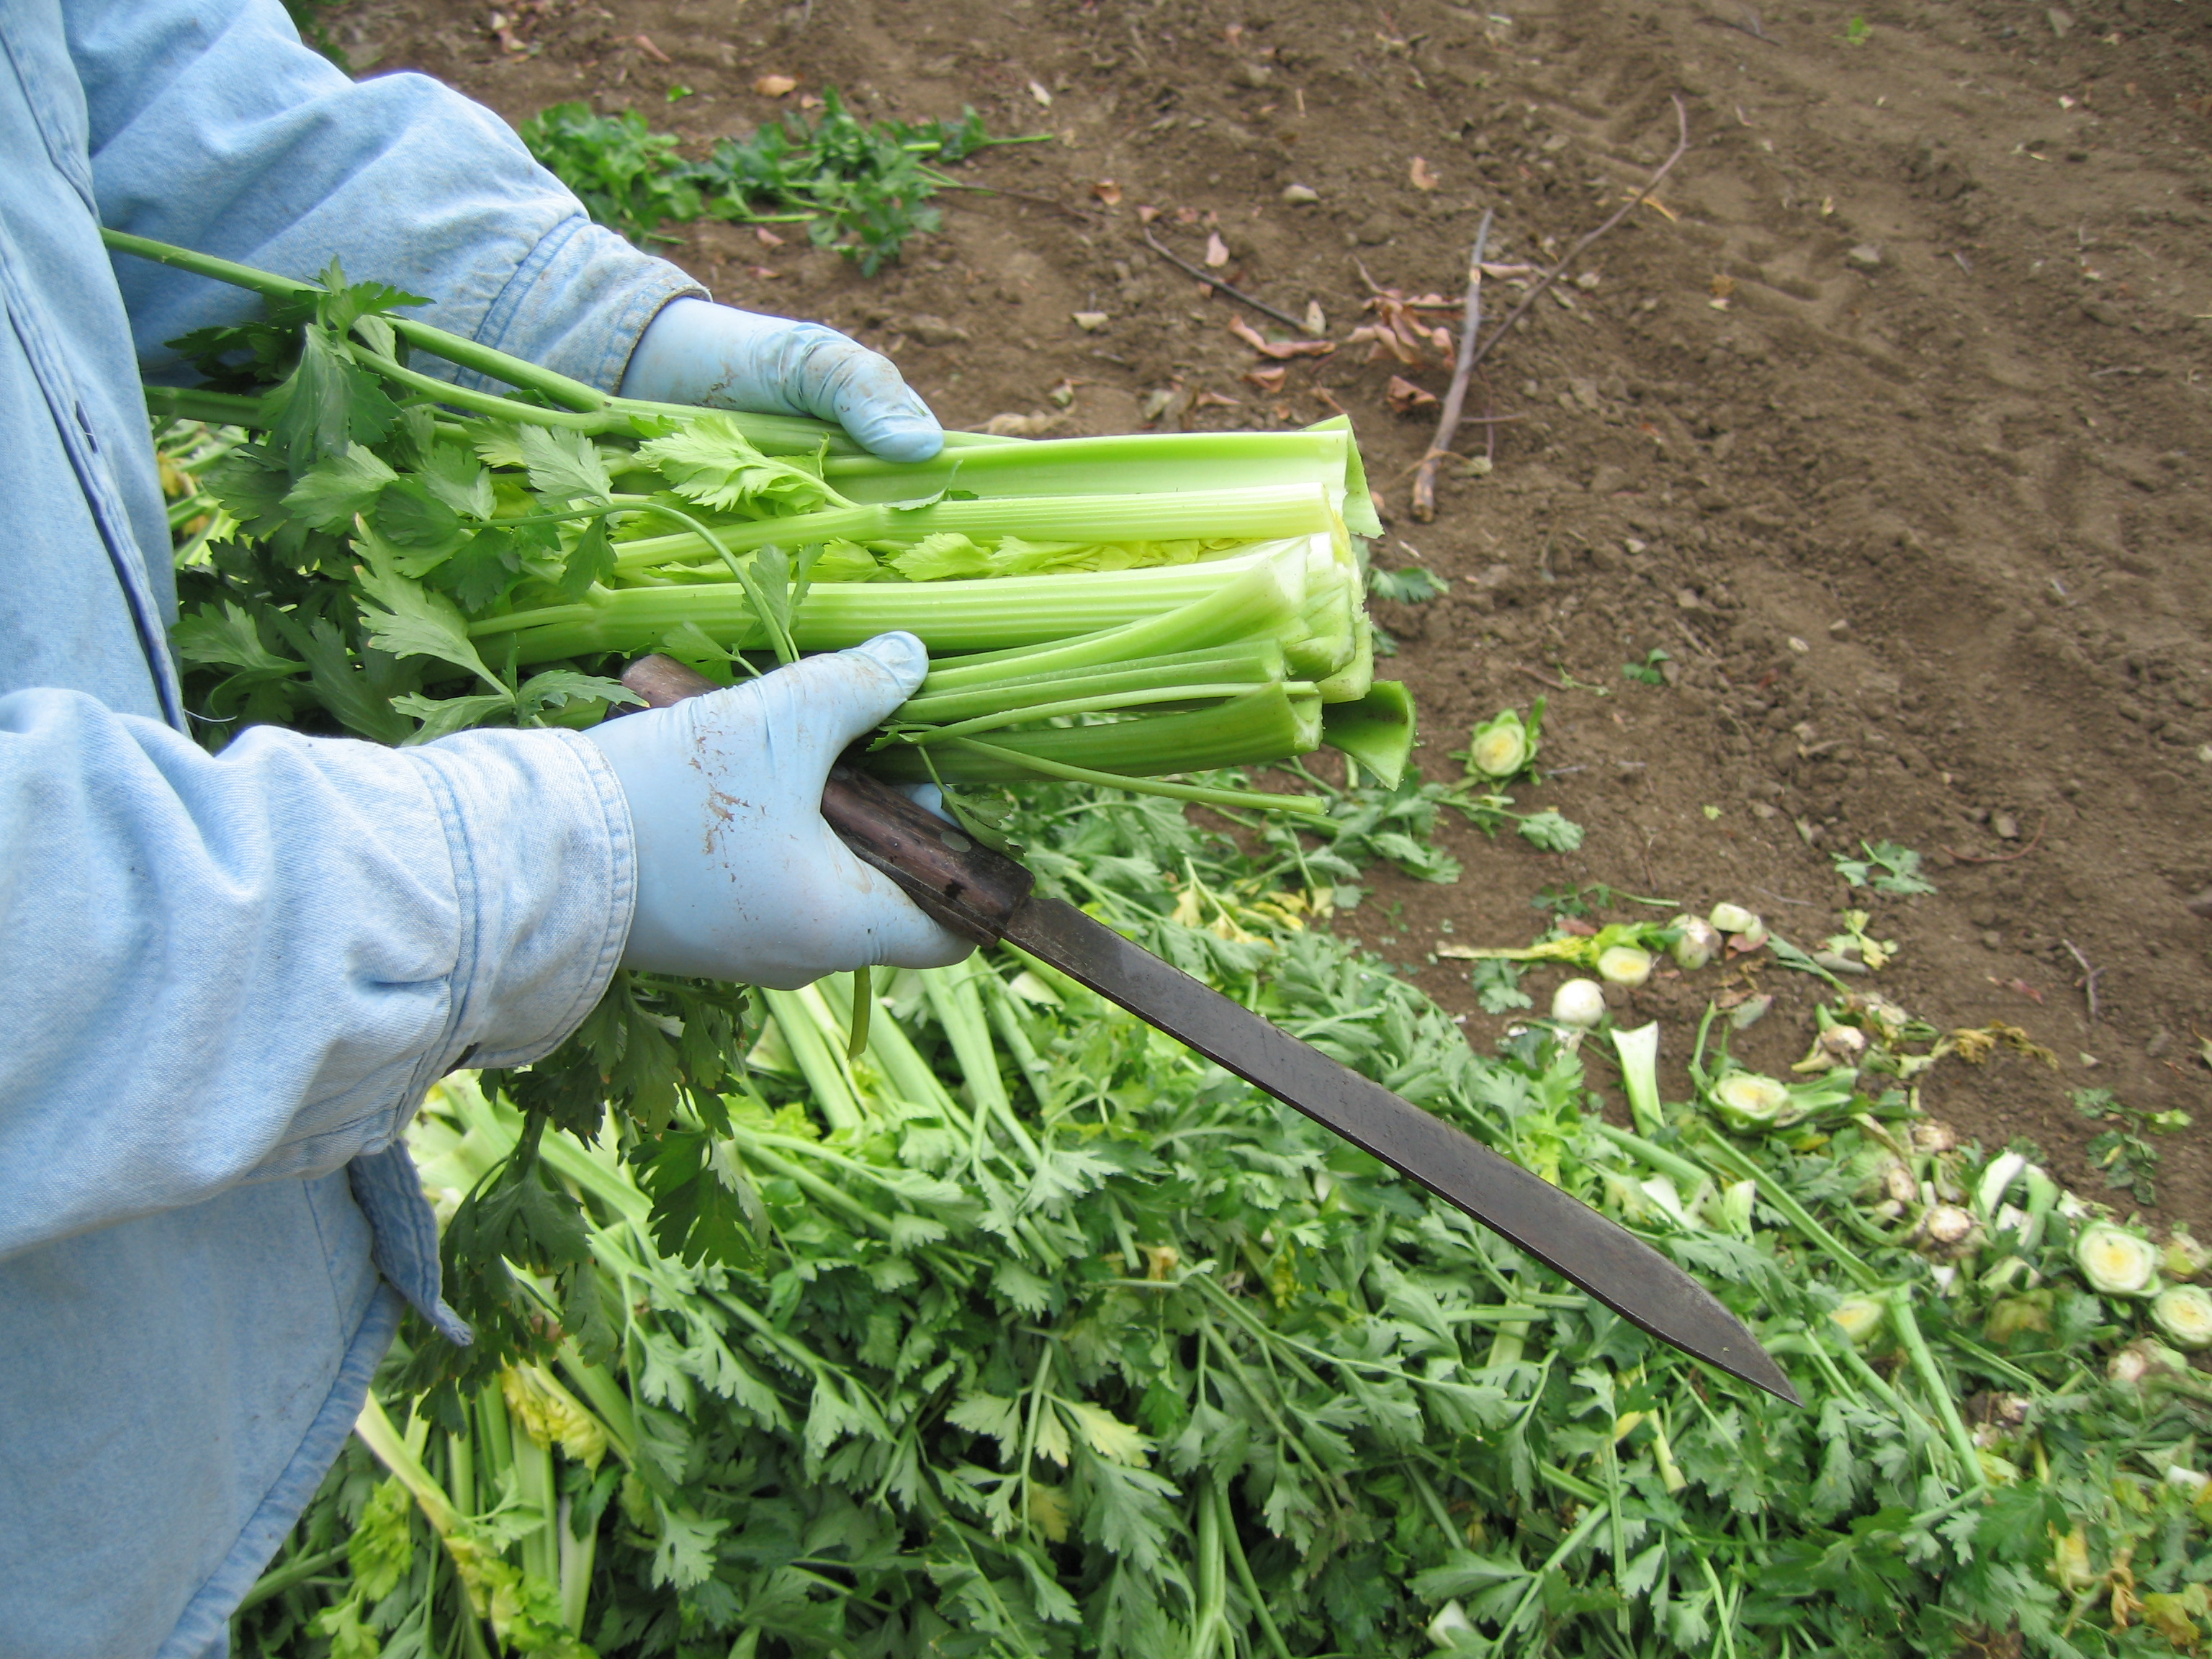

Slide 28
Worm Control

Slide 29
Lygus Control

Slide 30
Celery IPM Trial-2021 Rotations
Low Input No. App.
Exirel SE + 13.5 oz 1
  Beleaf 50SG 2.8 oz
B. Radiant SC + 8 oz 1
Beleaf 50SG 2.8 oz
C. Exirel SE 13.5 oz 1
D. Dipel DF 1 lb 1
Chem Approach No. App.
Asana XL 9.0 oz 6

Slide 31
2021 IPM Trial Economics

Slide 32
Insecticide Resistance of Celery Pests
- Lygus Bug -
Establish susceptible and resistant populations of Lygus to insecticides.
Sarah Zukoff – Cal Poly Strawberry Center
Flonicamid (Beleaf), Thiamethoxam (Platinum), Flupyradifuron (Sivanto), Malathion, Novaluron (Diamond), Bifenthrin, Dibrom
2. Develop biochemical assays to identify resistance mechanisms.
Develop PCR tests to detect resistant genes.
Develop rapid field diagnostic test.

Slide 33


Acknowledgements
California Celery Research Advisory Board
California Pepper Commission
John Fujii – Gardena Nursery
Andy White – White Seed Company
Dave Wetovick – UCR Agricultural Operations

