Slide 2
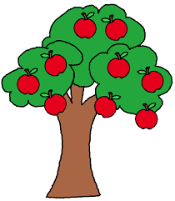
Fruit Tree Pruning and Grafting for Napa Home Gardeners
Presented by UC Master Gardeners
of
Napa County

Slide 3
Who We Are
Scientifically based research information
Volunteers
Part of the University of California Cooperative Extension system
Receive 80 hours of initial training
Train new Master Gardeners!
Notes:
The Master Gardener program is designed to provide scientifically based gardening information to home gardeners.
We are all volunteers, and are part of the University of California Cooperative Extension system. See our logo!
We receive 80 hours of initial training to become certified. We take continuing ed classes each year to remain certified.
And we train new Master Gardeners! Just ask us after the program how and when to apply!

Slide 4
What We Do
Workshops
Help Desks: UCCE, Mobile & Farmers Markets
Website, Facebook, Blog
Weekly Newspaper Column
Soon, a new Demonstration Garden
Monthly Guide to Gardening
Trees in Napa Updated Book
Tomato Sale: April
UC Master Gardeners’ Garden Tour: 2017 (Think ahead!)
Train New Master Gardeners
Notes:
And we have several services we want to make sure you know about!
First, workshops—you already know that, because you are here!
We have a Help Desk (bricks and mortar), and here (Hold up business card) is the information for that. And we have Mobile Help Desks at various nurseries in the area in the spring, and we are generally a presence at all the valley Farmers Markets. Have any of you seen us around?
Our website is just packed with help! Google Napa County Master Gardeners. One of our team today will give you a brief tour of our website towards the end of the program today.
We are also linked to the Agriculture and Natural Resources library at UC Davis.
We have a weekly column in the Napa newspaper—have you seen it? You can find an archive of our newspaper articles on our website.
We have a page at Facebook, and our website has a link to our Blog. Visit us at all those places!
We used to have a comprehensive demonstration garden in Napa at Connolly Ranch, and we will be starting work on a new one soon. Catch our progress on our website!
We have our Monthly Garden Guide specific to Napa County and have just completed an update to our book about Trees in Napa.
We want you to take advantage of all this information!
But wait, there’s more!
We train future Master Gardeners! Check our website to sign up to be notified when we begin recruiting for the 2017 class next summer! Our 2016 class just started on January 5.

Slide 5
Answer Your Questions!
Mike Quinn: Selection, Planting, Care
Cindy Pitcher: Pruning basic theory
Gayle Nelson: Tree anatomy
Helen Dake: Pruning vocabulary and guidelines
Rich Bruhns: Tools
Tom Kahl: Grafting demonstration
Notes:
Today is tfor answering your questions, based on research from our partners at the University of California.
Here’s our panel.
Meet Mike Quinn, with answers about tree selection, planting, pruning, and initial care.
Cindy Pitcher has been researching pruning basics and will answer your questions.
Gayle Nelson will help out with answers to your tree anatomy questions.
Helen Dake helps us appreciate some pruning concepts, and gives guidelines for getting started.
Rich Bruhns will answer your questions about tools, as well as have some to show you.
Finally, we have Tom Kahl with us, not a Master Gardener, but a very gracious person, to show us how to graft.

Slide 6
Selecting Fruit Trees
Selection considerations
Planting requirements
Care and cultivation
YOUR questions
Pruning

Slide 7
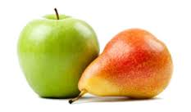
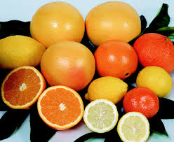
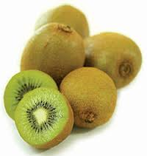
What Do You Like?
Stone
Pome
Stone
Other
Citrus

Slide 8
Rootstock: dwarf, semi-dwarf, standard

Slide 9
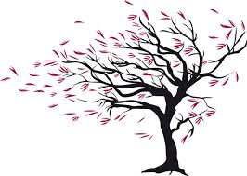
Planting Requirements
Sun, shade, exposure
Wind
Soil requirements
Drainage
Space

Slide 10
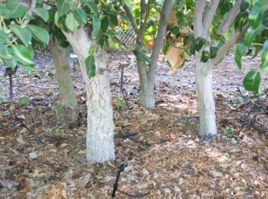
Specialties
Multi-graft
More-in-a-hole
More-in-a-hole Mature

Slide 11
Care and Cultivation
Water
Soil
Amendments
Fertilizer:N-P-K
Mulch
Notes:
Fruit trees grow best when irrigated regularly.
How much? A medium sized semi-dwarf fruit tree can use 16 gallons/day in the hot summer—in coastal conditions without fog influence. The same tree in the central valley uses 19 gallons. Home gardeners can roughly figure that a tree with two 1-gallon drip emitters would have to have those emitters on about 8 hours PER DAY.
The Home Orchard book has tables to help calculate. It all depends on tree size and climatic conditions.

Slide 13
Pruning
Shape
Growth
Fruit production
Dormant
Summer
Height
Thin fruit

Slide 14
Why are fruit trees pruned?
To be healthy and productive
Remove hazards
Control growth and development
Stimulate formation of flowers and fruit buds
Promote productivity and long-life
Makes the gardener feel good!
Notes:
Fruit trees are pruned so the tree will be as healthy and productive as possible.
The goal is good fruit production and a happy tree.
And a happy gardener.
Pruning helps the tree maximize its potential.
Controling growing and development also addresses the shape of the plant
C-a-n increase fruit production quantity (and thinning of immature fruit can increase individual fruit size)
By being familiar with the tree, by being out there touching it, you can catch potential problems earlier
Being outside and working in the garden feels good, like winter may be ready to turn into spring
Can also tie tape on branch/es to remind you to give them another look in summer or next pruning season

Slide 15
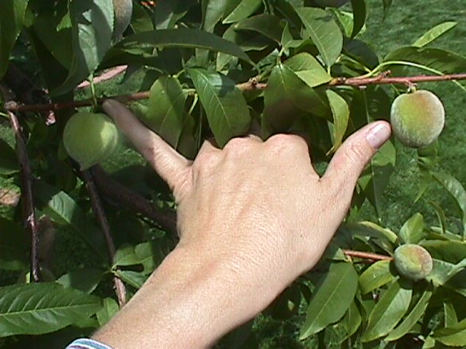
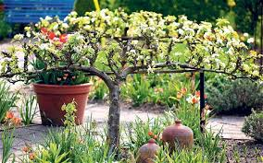
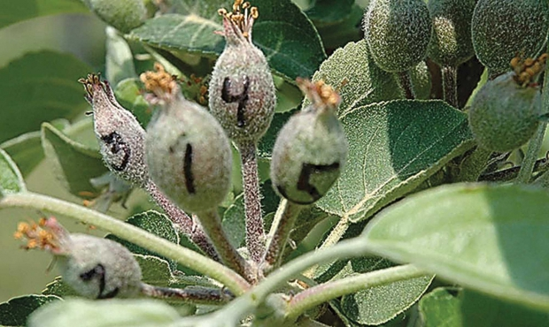
Low Height and Thin Fruit

Slide 16
When to prune
It is never too late to prune. Trees (and shrubs) can be pruned any time of year. However, plants and trees respond differently to pruning at different times of year. There are certain seasons for pruning to get certain results.
Dormant pruning: Manages fruit and tree structure
Summer pruning: Manages tree size
Notes:
And I’ll be talking about both of these pruning times in just a few minutes.
Let’s first talk about How to do it right beginning with a tree’s anatomy.

Slide 18
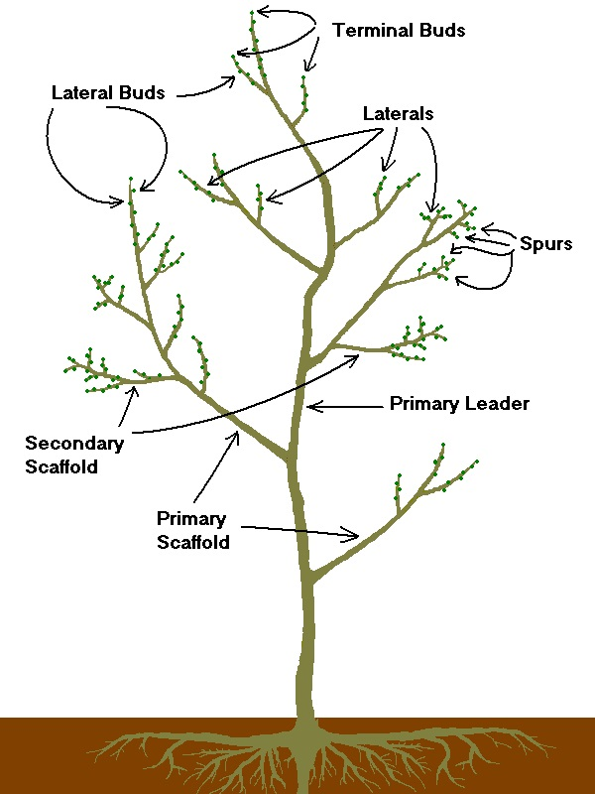

Slide 19
Tree Anatomy
We’ll stop often to examine real tree parts!
Trunk Nodes
Canopy Fruitwood
Collar Spur
Scaffold branches Scion
Lateral branches Rootstock
Shoots Graft union
Leader/Central leader Watersprouts/suckers
Notes:
See the text printout.
So that gives us some common vocabulary about a fruit tree.
Now I want to turn to a common vocabulary of Pruning terms.

Slide 21
Open Center Pruning
Notes:
Sometimes called “vase” .
Keep open from the start.
Center of tree is kept free of large branches & upright shoots to allow sunlight to reach lower fruiting wood.
Most commonly used method. Stone fruits, apricot and almonds. But can be used on Pomes.

Slide 22
Central Leader Pruning
Notes:
Think of a Christmas tree with lateral branches arranged in layers or tiers.
Remember the goal is always sunshine reaching the branches to promote blossoms and fruit.
Pome trees naturally grow this way.
Can tie or stake lateral branches outward.

Slide 23
Two Basic Pruning Cuts
Thinning cut: Remove branches at their point of origin, results in a reduced number of branches
Heading cut: Remove a portion of a shoot or branch leaving only a bud, results in increased number of branches.
Notes:
If you have this down. You have it!
Make Thinning cuts just outside the branch collar.
Don’t leave a stub.
Prevent crowding, more light.
Heading, cut just above a bud to stimulate that bud.
Where will the energy go?
Sort of a third cut Topping: Reducing a tree’s size through use of heading cuts
Transition to Tools.

Slide 25
Pruning Tools

Slide 26
Tools
Sharp
Clean
Ladder cautions
Personal protection
Lubricated
Stored safely

Slide 27
Sharp

Slide 28
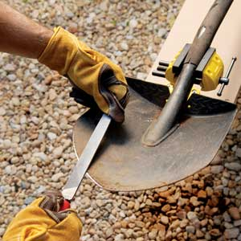
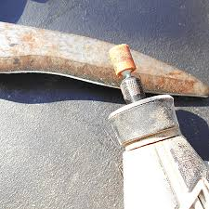
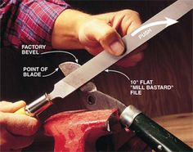
Sharpen and Restore

Slide 29
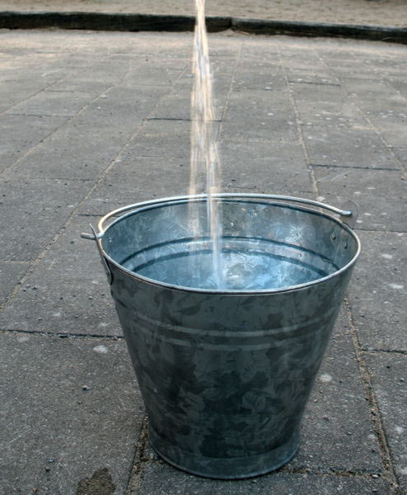
Sterilize
1 Part bleach or vinegar to . . . . . . . 9 Parts water

Slide 30
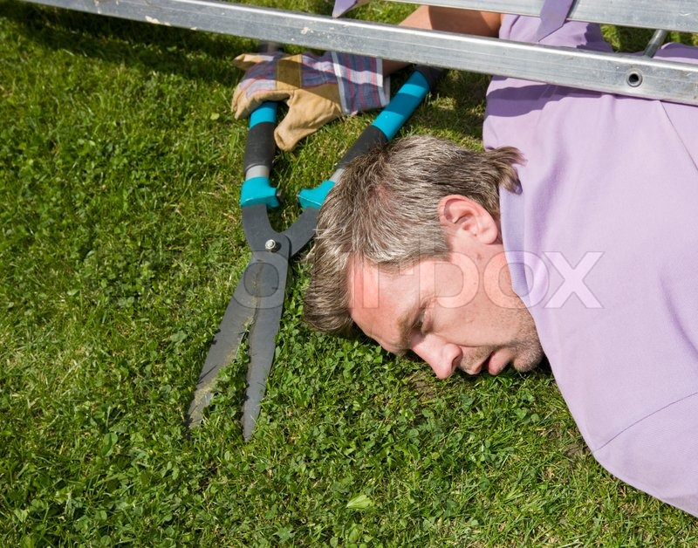
Ladder Safety

Slide 31
Orchard Ladder

Slide 32
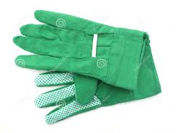
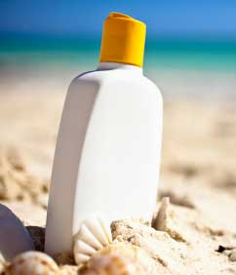
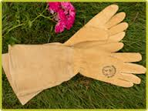
Personal Protection

Slide 33
Clean and Lubricate

Slide 34
Store Tools

Slide 36
Getting Started
Allow yourself lots of time
Assemble all your tools including disinfectants
Know what you want to do
Take your time. Make some cuts. Step back and look at the tree.

Slide 37
Where to cut?
Notes:
Here we are in front of our tree with all our tools ready to start.
In general start with thinning cuts, just outside branch collar.
One way to start is with dead, broken, diseased distorted branches,
Next easy step, remove suckers (water sprouts-- they are vertical.
Branch stubs are another easy step, as are weak narrow crotches (45 to 60 degrees).
Now for some cuts that require decisions. Rubbing or overlapping branches, which to remove.

Slide 38
Guidelines
In general, thinning cuts, then heading cuts
Start with removing dead, dying, broken, or diseased branches, and water sprouts, root suckers
Move from large branches to smaller—can be scary
Remove crossing and unwanted branches
When heading consider where bud faces
Notes:
Shaping and opening up tree.

Slide 39
Notes:
Questions?
Introduce Tom Kahl

Slide 40
Grafting, by Tom Kahl
Scion
When
Tools and materials
Protective coatings
Whip graft
Cleft graft
Side graft
Budding
Notes:
There is plenty of information about grafting from the University of California—but most of it is in words, not pictures. While there are also videos on grafting from UC, they focus on walnuts and pistachios, grapes and citrus. Today we have a live demonstration and discussion of grafting. Tom Kahl!
This information is from University of Minnesota Extension, as UC’s online resources for grafting are minimal. But The Home Orchard book discusses it in depth, with pictures.
Scion: Scions are selected from the previous season's growth, while they are dormant, but before growth begins in the spring. If the scions are left on the tree until spring, however, there is some danger that the buds will start to grow or be injured during winter.
When: It is best to graft in the spring, from the time the buds of understock trees are beginning to open, until blossom time.
Tools and Materials: Budding knife, Grafting knife, A fine-tooth saw for cleft grafting, Pruning shears, Dormant scions (cultivar labeled)
Protective coating: All grafts should be covered with a protective coating immediately after completing the graft.
Whip graft: The whip graft is used mostly on young apple and pear trees when the branches are relatively small (not more than 1/2-inch in diameter) and the understock is about the same diameter as the scion of the new cultivar.
Cleft graft: The cleft graft is used for topworking older established apple and pear trees, either on the trunk of a small tree or on the side branches of a larger tree. It is best adapted to branches 1 to 2 inches in diameter.
Side graft: Although the side graft is adapted to a wide range of branch sizes (1/4 to 3/4 inch diameter), its use is generally restricted to branches that are too large for the whip graft yet not large enough for the cleft graft. As the name suggests, the scion is inserted into the side of the stock, which is generally larger in diameter than the scion.
Budding: Budding is a form of grafting in which a single bud is used as the scion rather than a section of stem. It is the most commonly used method for fruit tree production in the nursery, but can also be used for topworking plum, cherry, apricots, and peach as well as young apple and pear trees. (Cherry, plum, apricot, and peach are not easily cleft grafted or whip grafted.)
University of Minnesota Extension for this.
Our ANR The Home Orchard book has this information, too.

Slide 41
The Almost End
Sunlight
Wrap up
Review Parking Lot
Field trip!
Silverado MS
1133 Coombsville
Noon to 1.30
Bring your pruners!

Slide 42
Need More Help?
Resource list
Computer search with UC first—
UC apples, UC peach leaf curl, UC pruning
UC has step-by-steps, videos, orchard help
Find today’s slides on our website
Our Help Desk is open M-W-F, 9-12—in person, online, on the phone

Slide 43
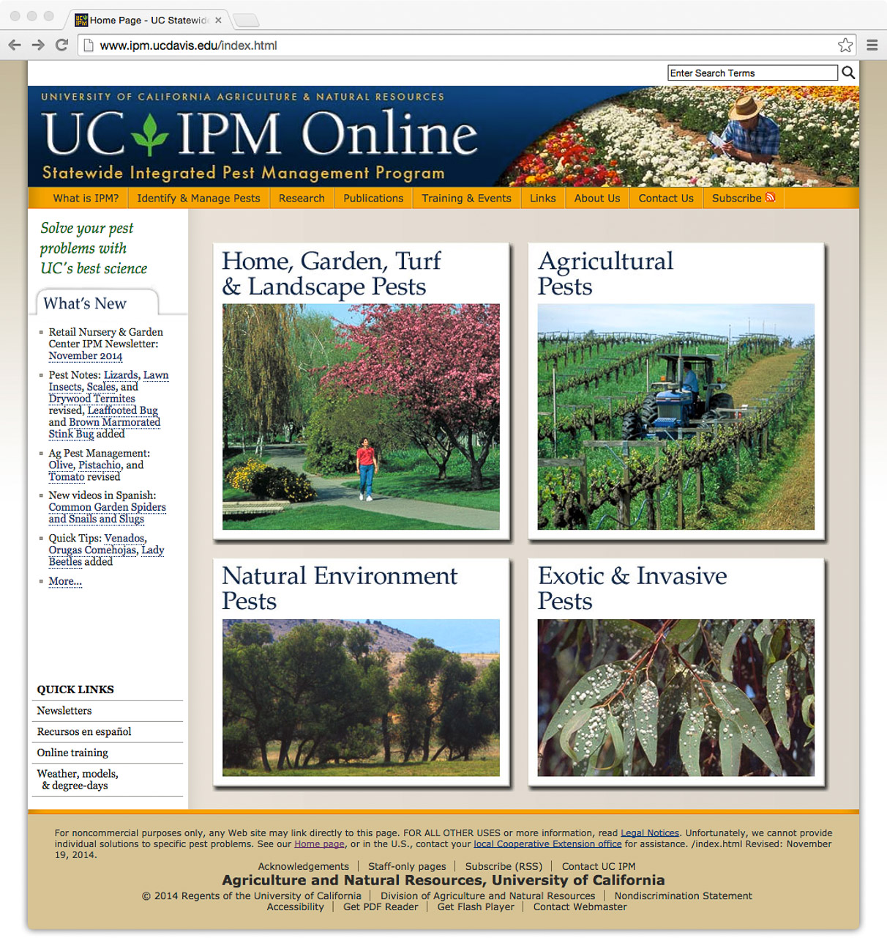
Resources
Notes:
MY single most favorite online resource.

Slide 44
Thank You!

