Slide 1
Napa Master Gardeners Online & The California Garden Web
1
Search: Napa Master Gardeners”
Or: http://ucanr.edu/sites/ucmgnapa/
2: Gardening Resources
Even More Information
Notes:
These slides were printed back-to-back on one page for the handout

Slide 2
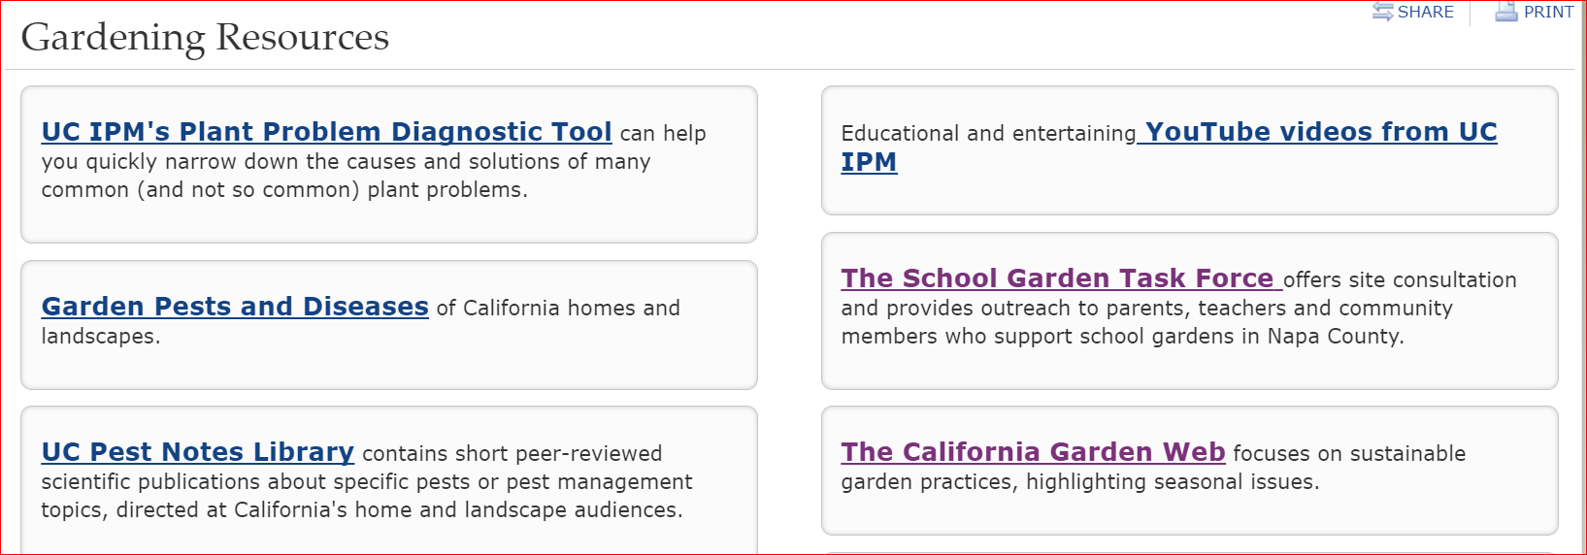
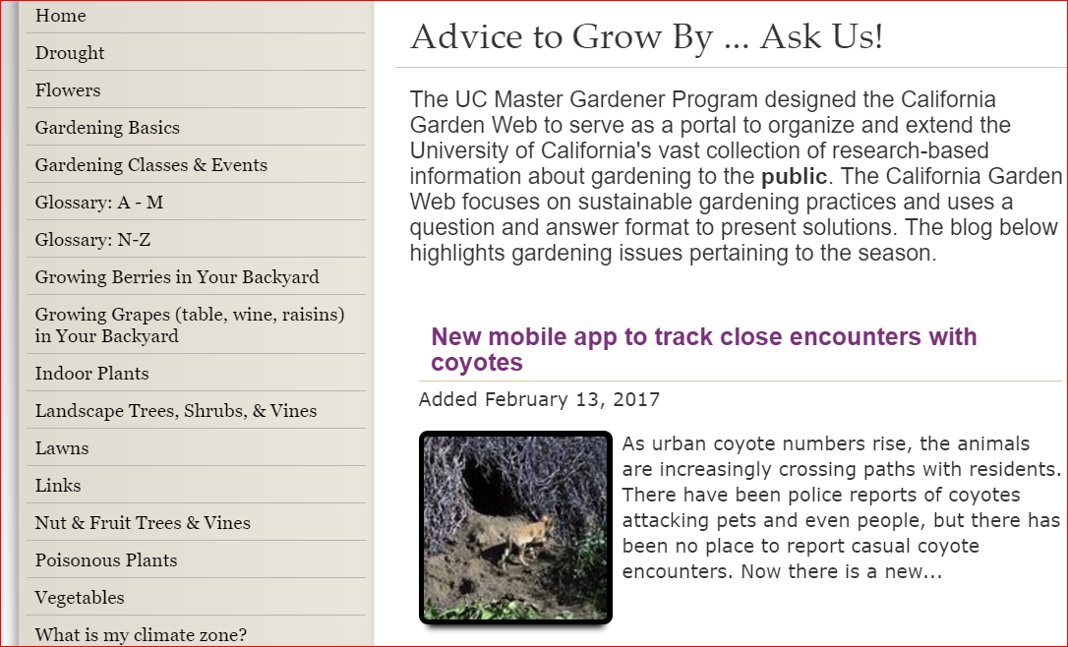
3: The California Garden Web
4: Vegetables

Slide 3
http://cagardenweb.ucanr.edu/Vegetables/
Scroll Down on this screen to get a list of Vegetables—
see reverse side of this page for the example

Slide 4
Click on an item for detailed information
You can also search for a specific plant or problem by searching: UC xxxxxxxx (In place of x’s enter what you are searching for)
Also try searching: ucvegetablegardening101 & UCvegetablegardenbasics

