Slide 1
UC Master Gardener Program University of California Cooperative Extension Napa County
Welcome to Growing Groceries (Summer Vegetables) March 2018
Notes:
Welcome and Introduction.
WORKSHOP INTRO
Who likes to garden?
Who LOVES to garden?
GREAT! Because Master Gardeners are here to share some useful gardening information with you!
Alright—then I have another question for you--
Who has told a friend about our workshops?!
OR
Who is here for a Master Gardener Workshop on Citrus care?
No one?! Good, because this workshop is about Getting Your Garden Ready for Winter!
OR
Who has been to a Master Gardener workshop before?
No corny questions, just launch into the Introduction, which follows.
Note:
Underlined, italicized words will need to be replaced to describe the workshop being presented that day.
This document is in MS Word, so changes are easily made.
WELCOME to our UC Master Gardener’s of Napa County workshop! My teammates and I have some helpful information to share with you today that your garden and the gardener in you will appreciate.
We will give you some guidelines for getting your garden ready for winter and winter planting, if you decide to do it.
We are glad you are here for this great information!
I am _____________, UC Master Gardener.
Before we get to our talk, allow me to
Tell you who Master Gardeners are,
Give you an overview of today’s workshop, and
Introduce the Master Gardeners who are here today.
First things first.
The bathrooms are ______________________________.
We will not be taking a formal break, and please feel free to get up at any time.
What are Master Gardeners all about?
The Master Gardener program is designed to provide scientifically-based gardening information to you, the home gardener.
Home gardeners such as yourselves are the reason we have this program.
We are all volunteers, and we are part of the University of California Cooperative Extension system.
We receive 80 hours of initial training to become certified. We also take continuing education classes each year.
And we have several services we want to make sure you know about!
First, workshops—you already know that, because you are here!
We have a Help Desk, and here (Hold up business card) is the information for that. And we have Mobile Help Desks at various nurseries in the area in the spring, and we are generally a presence at all the valley farmers markets. Have any of you seen us around?
(CLICK) Our website is just packed with help! Google Napa County Master Gardeners. We are also linked to the Agriculture and Natural Resources library at Davis.
We have a weekly column in the Napa newspaper—have you seen it? One of your handouts today is this week’s article on . . . Landscape Pruning!
You will find us at all the county farmers markets—Napa, St Helena, Calistoga. You can bring your questions there or to the Help Desk.
We have a comprehensive demonstration garden in Napa at Connolly Ranch, at Browns Valley and Thompson roads. Have any of you been there?
Please check our open garden schedule on our website and come have a look!
We want you to take advantage of all this information!
We have our Monthly Garden Guide specific to Napa County and are working on an updated book about Trees in Napa.
But wait, there’s more!
We train future Master Gardeners! Check our website to sign up to be notified when we begin recruiting for the 2016 class next spring! Our 2015 class is full—and FYI, the training runs from January through mid-March.
In the next couple of weeks, we will be sending you a very short online survey about this workshop. We want your feedback! We will use your replies as part of our obligation to report our effectiveness and outreach to the University of California.
Now, finally, I’m going to tell you about today!
With me today are these Master Gardeners:
Melody Kendall
JoAnn Boland
Jennifer Loebs
Rachelle Benney
Questions. (Discuss with your team how you/they would like questions handled.)
Even though our time is limited and we have a lot of workshop material to cover, we will all be here to answer questions individually afterwards if you have a question about your own garden.

Slide 2
Today’s MG Team
Pat Woodridge
Pat Hitchcock
Julie Pramuk
John Durham
, Greeter
Barb Whitmill, Cashier
Notes:
Provide class years—Jennifer-2014; Priscilla 2009

Slide 3
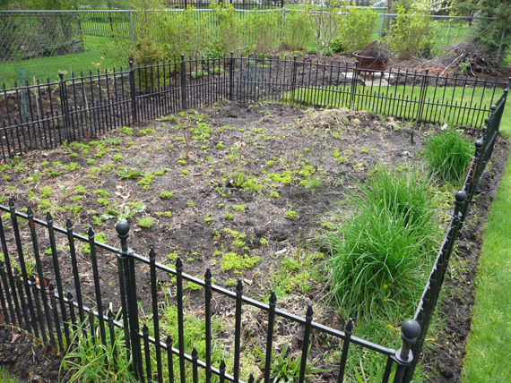
Preparing Your Garden Site

Slide 4
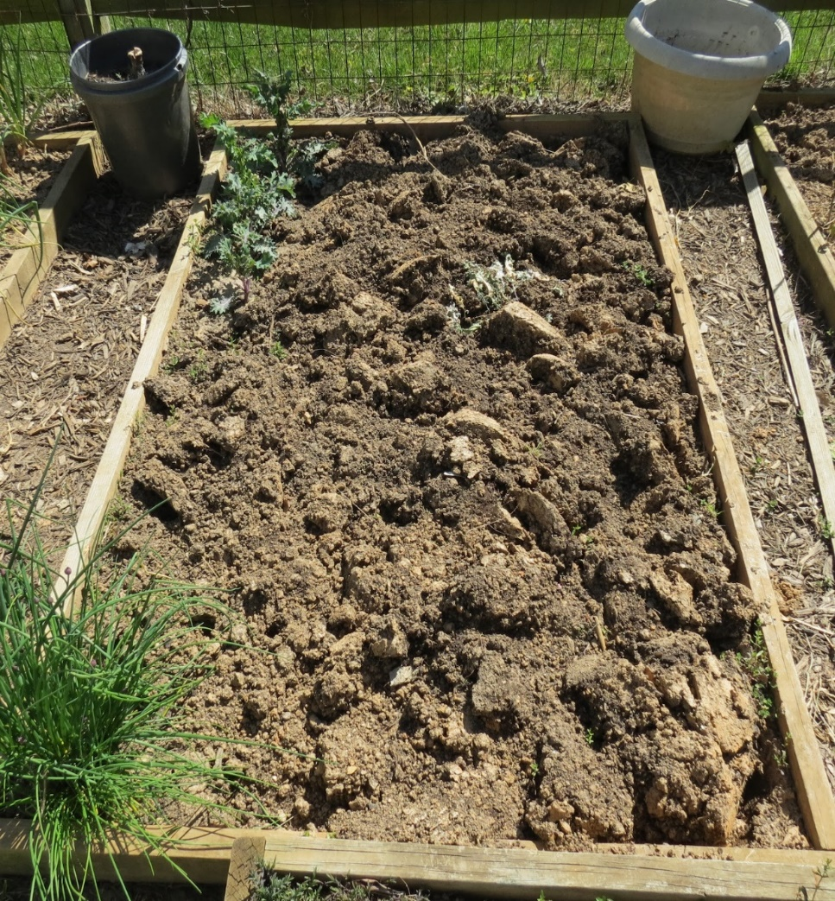
1st Rule of Garden Soil Preparation: DO NO HARM!
Avoid compaction. Never try to work wet soil.
Avoid excessive soil disturbance.
Worms and microbes can be destroyed by a rototiller.
Can bring up weed seeds.
Avoid overuse of chemical and synthetic fertilizers, herbicides and pesticides, over-fertilizing, over-watering, severe under- watering. Moderation is key.

Slide 5
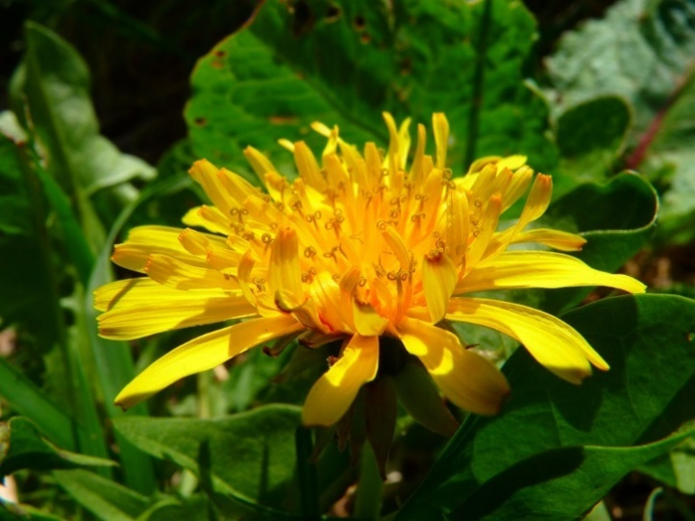
2nd Rule of Garden Soil Preparation: REMOVE ALL WEEDS!
To hoe or not to hoe…..that is the question!
PULL THEM – CUT THEM – ROTOTILL

Slide 6
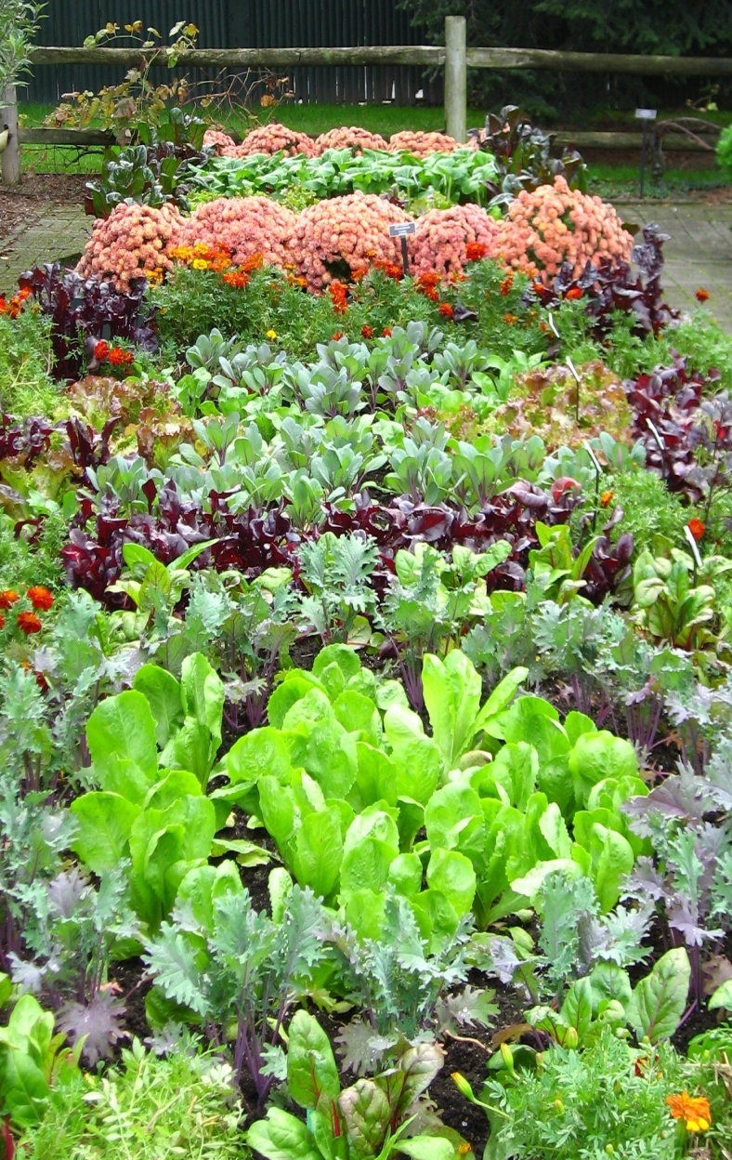
3rd Rule of Garden Soil Preparation: Know What You’re Doing Before You Do It!
Good Soil – Our native soil is often clay-based. Incorporate organic soil amendments to improve poor soil and increase yield.
Level Ground – Level ground is easier to prepare, plant and irrigate.
Water Supply – Locate your garden near a water supply easily reached with a hose.
Adequate Light - Vegetables need at least 6-8 hours of sunlight each day.
Close to Home – Plant your garden near your home, making it easier to work in and carry tools back and forth.

Slide 7
Plan ahead
Plant vegetables that your family likes and in quantities that you will use.
Plant only as large a garden as you can maintain easily.
Plant disease-resistant varieties that are adapted to your area.
Think about sharing produce.
Use mulch to help conserve soil moisture, reduce frequency of irrigation, and control weeds.
Check irrigation system periodically for leaks or clogs.

Slide 8
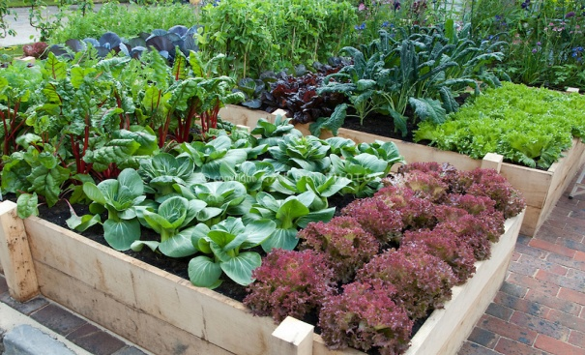
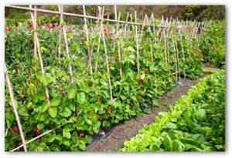
When you plan your garden….
Set up your garden in blocks rather than rows
Provide windbreaks as needed
Keep tall plants from creating unwanted shade
Plant some crops now that take advantage of cool weather

Slide 9
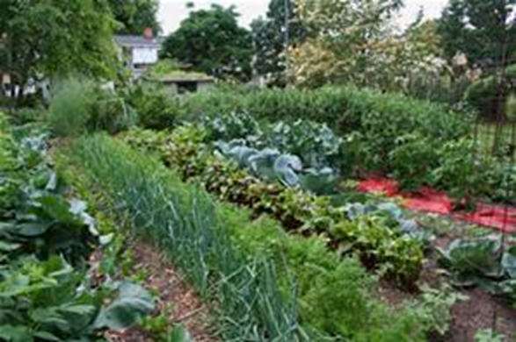
Plants grow well in soil that …
Has a healthy physical structure
Contains essential micronutrients
Notes:
First thing to know is….

Slide 10
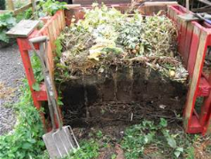
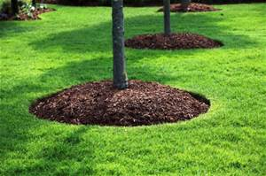
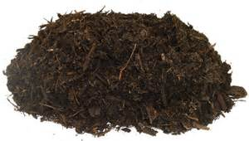
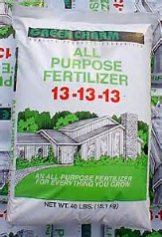
Some essential garden terms that people sometimes mix up
Compost
Mulch
Amendments
Fertilizer
Notes:
Before we proceed ……want to clarify…understandably so, Because they are related and sometimes overlap. I know I used to mix them up.

Slide 11
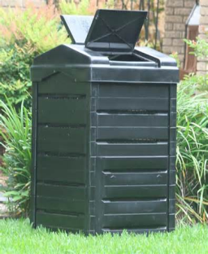
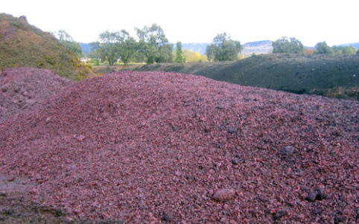
Compost: A mixture of organic matter that is decomposed, i.e., been digested by organisms
Make it at home
Buy it from recycling plants
Buy it in bags from stores (expensive option)
Notes:
Compost: A whole another workshop, You already know it is good stuff

Slide 12
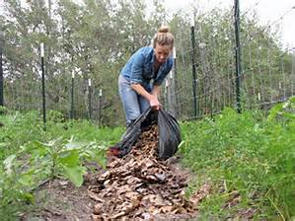
Mulch: Material layered on top of the soil to cover and protect it.
Mulch serves many purposes: preserves moisture, reduces weeds, prevents erosion, also can slowly add some micronutrients.
Mulch is usually organic (leaves, grass clippings, compost, straw, etc.) but can be inorganic (e.g. plastic).
One of the best mulches is compost
Notes:
Woman spreading leaves as a mulch

Slide 13
Amendments: Material mixed into the soil to improve the texture or physical condition of the soil to support healthy plant growth (tilth).
Some examples of amendments include:
Barnyard manure
Green Manure and Cover Crops
(E.g. Fava Beans, Mustard, Vetches)
Packaged mixes

Slide 14
One of the best amendments is compost
Compost develops into humus to improve soil structure
Improves drainage and aeration
Conserves soil moisture
“Finished” compost can be mixed into the soil right before planting
Notes:
And guess what…one of the best amendments is compost.

Slide 15
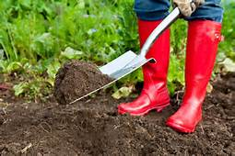
Distinguish between amendments that can be added right before planting and those that can’t
Some amendments (animal manure, green manure) should be added early enough that organic materials can break down.
Notes:
If materials are added before they break down, they can take nitrogen that the plants need

Slide 16
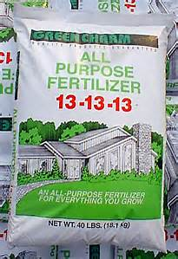
Fertilizers: Substances added to soil to provide plants with essential micronutrients
Nitrogen–Phosphorous--Potassium
X-X-X
The three numbers on fertilizer bags and boxes sold in stores show how much of the three most essential micronutrients the product will provide
Notes:
Our 4th garden term

Slide 17
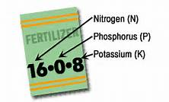
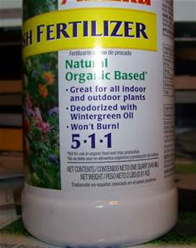
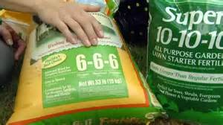
5-X-X Nitrogen (N) promotes green leafy growth
X-5-X Phosphorus (P) assists in flower, seed, and fruit production
X-X-5 Potassium (K) helps develop root and tubers
Notes:
Especially nitrogen does not last in soil, and needs to be replenished

Slide 18
Organic Fertilizers
Include variety of nutrients.
Can amend and improve soil.
Encourages micro-organisms in soil
Slow release.
Less likely to “burn” plants
Notes:
Two kinds of fertilizers

Slide 19
Organic Fertilizer Examples
Commercial organic fertilizers
Animal manures
Seaweed (kelp)
Fish meal or emulsion
Soybean meal
Alfalfa pellets
Bone and blood meal

Slide 20
Synthetic Fertilizers
Fast-acting
Often less expensive
Can be hazardous to plants or soil if used incorrectly or too much
Key: Use according to the direction on the bag/box and in moderation to avoid environmental pollution due to overuse.

Slide 21
Ways to Fertilize
Add to soil before planting (slow release forms are an option)
Foliar feed: spray a mist solution to be absorbed by osmosis.
Liquid solutions: Watering can
“Side-dress” by working a granular fertilizer into top inch of soil near plant roots and water in well.

Slide 22
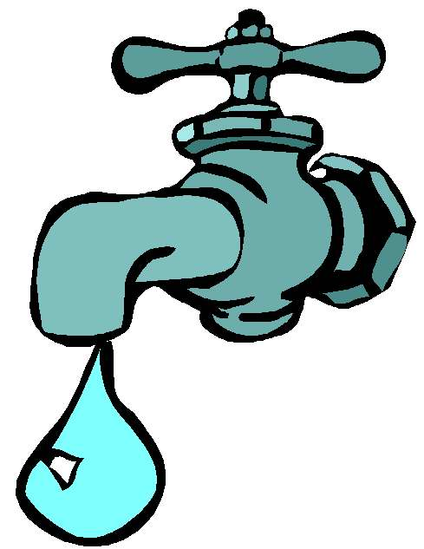
IRRIGATION, VEGGIES & YOU
Water needs depend on many factors
Soil Condition (sandy, clay, loam)
Weather and wind
Ambient temperature
Type of vegetable
Notes:
What is your current method, or plan to irrigate your veggies? This section will cover three main methods--

Slide 23
More Rain Coming?
Don’t count on it: Plan your garden and watering methods accordingly

Slide 24
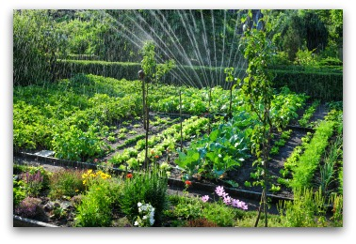
Over Head Sprinklers?
Low labor time, BUT need to water a long time to get deep into roots; water loss to evaporation
Notes:
Takes great deal of water to get the same effect of a long, steady rain

Slide 25
Hand Water?
Labor intensive; Unlikely to get to roots. Need to get down to base of plant. Water evaporation
Notes:
Maybe as an additional soaking--but at the base of the plant if drip system isn’t doing the job. Much time to replicate a 1-2” rainfall.

Slide 26
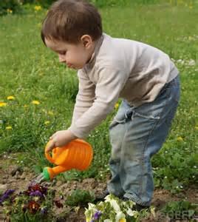
Here’s the Right Way!
Get to the root of the issue
Notes:
Just seeing the top of the soil wet isn’t enough. Check to see if you are getting deep enough.

Slide 27
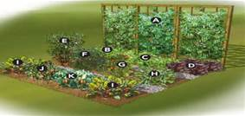
Plan Before Planting
Lay out: Blocks vs. long rows
Group plants by water needs
Install drip systems with built in emitters before planting
Notes:
Options: Built in emitters vs manually installed emitters. Avoid planting tall plants so they shade smaller ones.

Slide 28
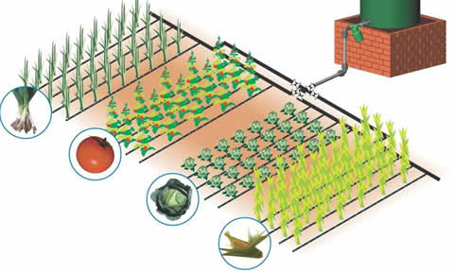
DRIP System By Zones
MG OK
Provides deep watering at roots
Notes:
Provides deep watering at roots; no waste; minimal labor (after one-time installation); needs monitoring for leaks, plugged emitters and if need different emitter

Slide 29
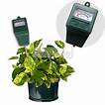
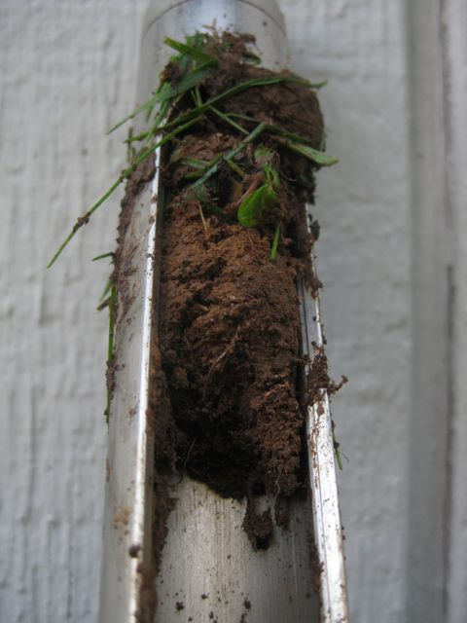
When to Water
Test: Water if dry at 3-4 inches
Monitor Regularly Avoid over watering.
NOTE: Drooping leaves does NOT always mean the need for watering. Check the soil. Avoid overwatering. Roots can drown.
Notes:
As we will see in the next set of slides

Slide 30
Critical Periods for Adequate Watering:
Vegetable | Period
Pea | Flowering & seed enlargement
Pepper | Flowering through harvest
Pumpkin | Fruit forms
Squash | Bud forming & flowering
Swiss Chard | When true leaves form
Tomato | Flowering through harvest
Lettuce | When true leaves form
Notes:
What part of the plant do you eat?

Slide 31
Critical Periods for Adequate Watering:
Vegetable | Period
Bean | Flowering/forming pods
Broccoli | Forming heads
Corn | Silking, tasseling, forming ears
Cucumber | Flowering; fruit forming
Eggplant | Flowering through harvest
Melon | Fruit set & early development
Onion | Bulb enlargement

Slide 32
Warm Season Crops
Grow best 65 to 95 Degrees
Are injured or killed by frost
Cool Season Crops
Grow best 55 to 75 Degrees
Tolerate some amount of short-term freezing (frost tolerant)
Notes:
Cool Season workshop August 26th

Slide 33
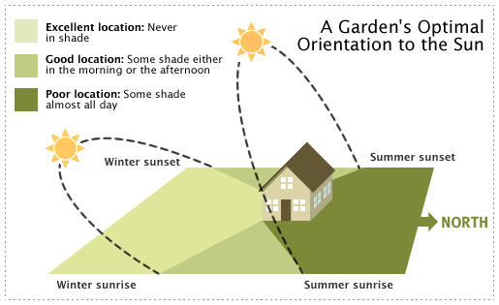
SUNLIGHT 6-8 Hours Daily
West
South
East
Notes:
Requirement for summer vegetables—need to survey your area

Slide 34
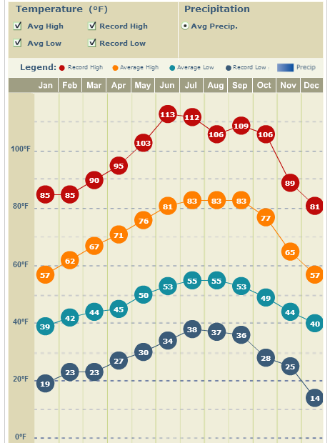

Slide 37
Integrated Pest Management
Prevention
Diagnose First!
Cultivation or pest/disease?
Non-chemical control
Limit use of pesticides (least toxic first)
Notes:
Reference Handouts

Slide 38
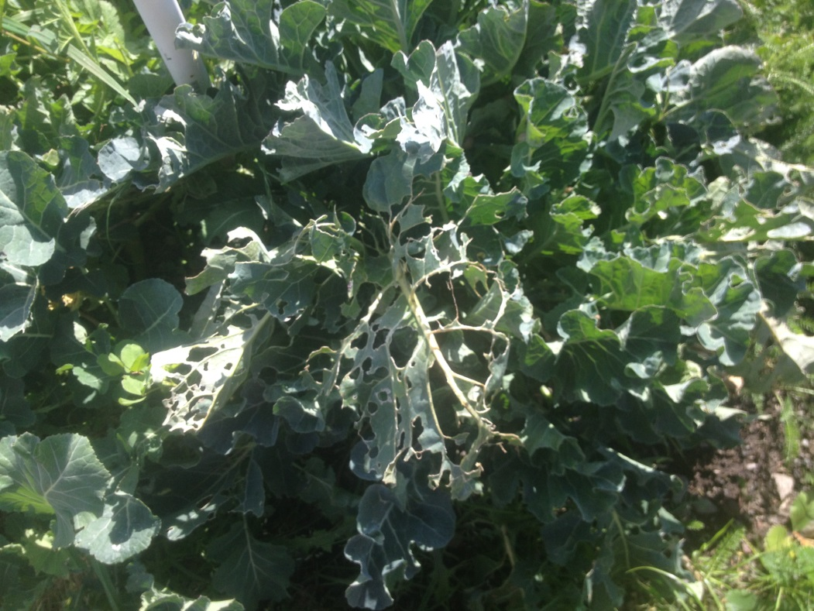
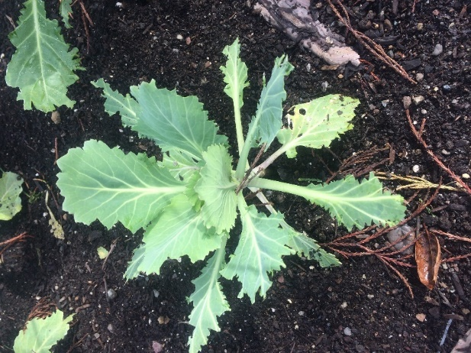
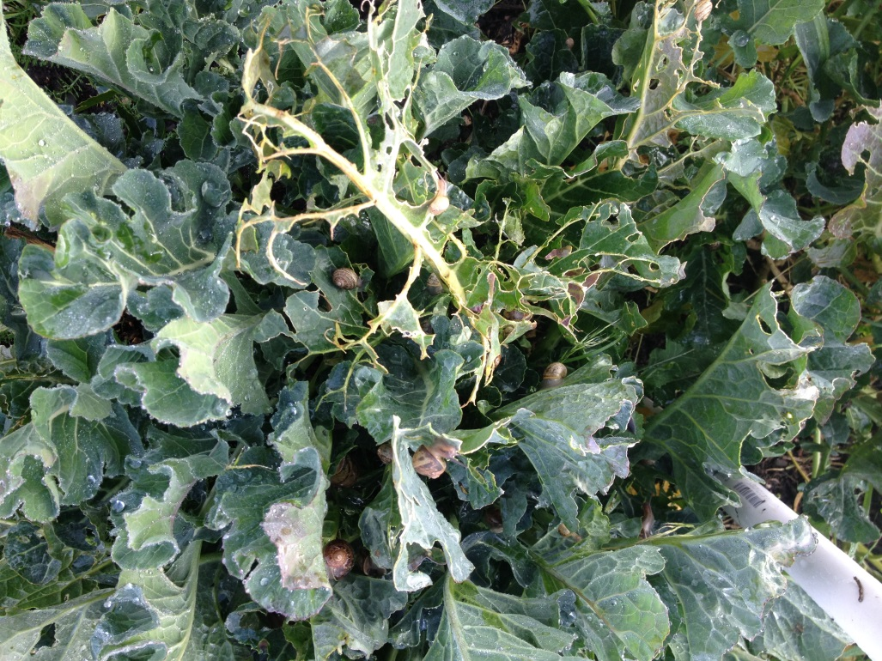
What Happened Here?

Slide 39
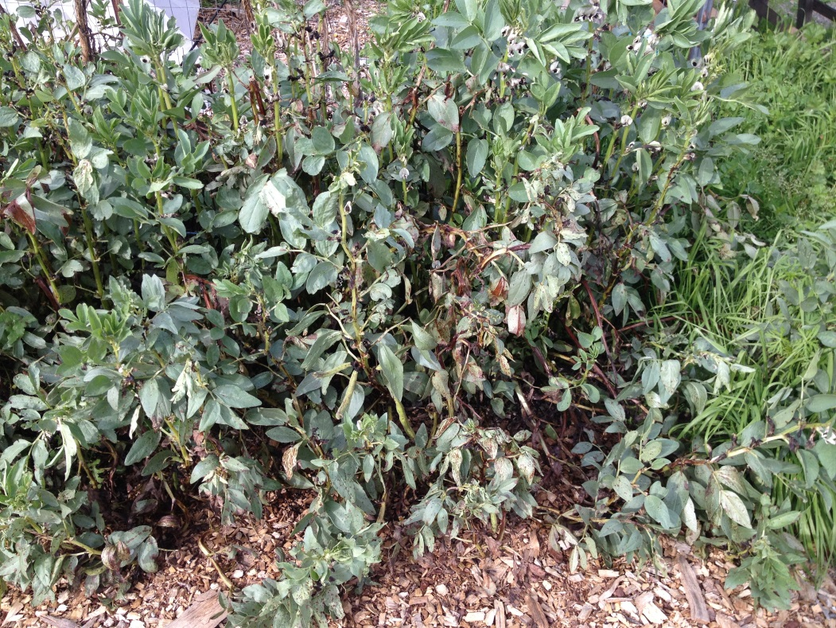
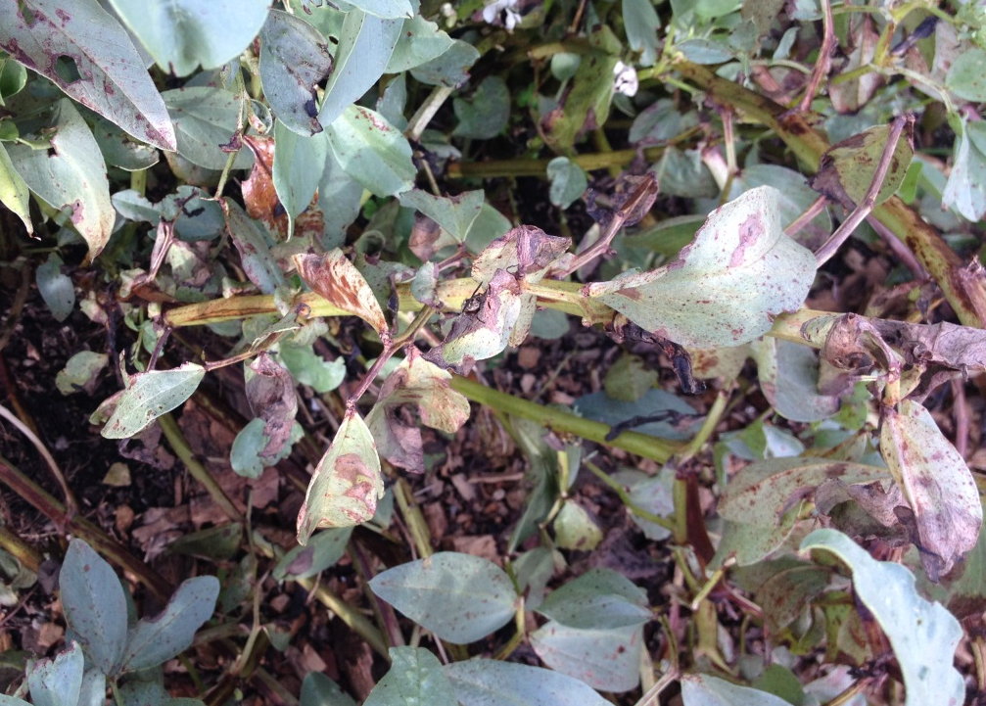
What Happened Here?

Slide 40
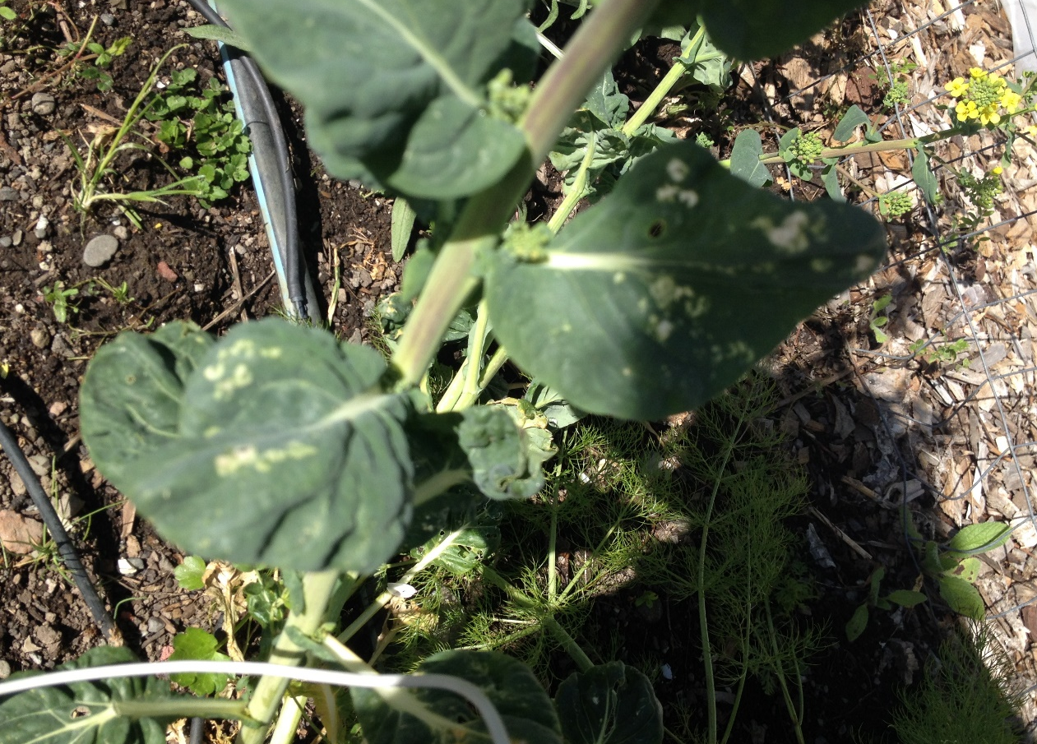
What Happened Here?

Slide 41
Prevention
Healthy soil
Healthy plant
Right plant in the right place
Proper care: water, fertilizer, light, temperature
Sanitation/crop rotation

Slide 42
Addressing Diseases
Proper cultivation
Resistant varieties
Cut out affected parts if isolated issue (and not soil-borne)
“Shovel-prune”

Slide 43
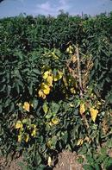
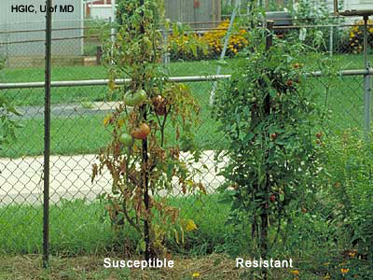
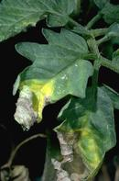
Wilt on Tomato

Slide 44
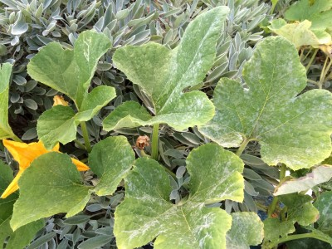
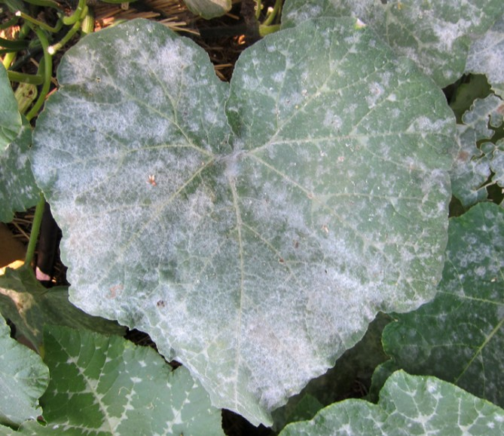
Powdery Mildew

Slide 45
Insect Pests
Know your “good guys”
Tolerate some damage
Wait for beneficials
Non-chemical controls first
Barriers/exclusion
Water Sprays (aphids)
Physical removal – multiple options
Pheromone traps

Slide 46
Insect Pests
Pesticides are a last resort
Least toxic first (e.g., soap spray, iron phosphate for snails and slugs, Bt)
Apply pesticides in accordance with manufacturer’s specifications
Prevent overspray/run-off

Slide 47
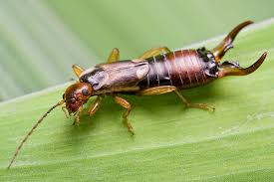
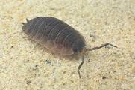
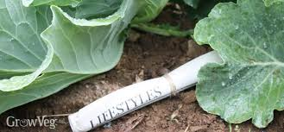
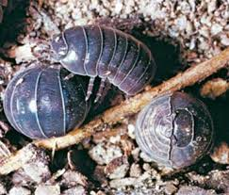
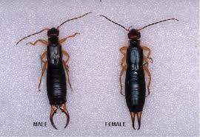
GOOD OR BAD?
Earwig
Sow Bug and Pill Bug (“Roly-Poly”)

Slide 48
Vertebrate Pests
Types of pests:
Deer
Gophers, moles, voles, ground squirrels
Squirrels
Raccoons, opossums
Rabbits
Birds
Two primary options for control:
Barriers/Exclusion
Killing (as allowed)

Slide 50
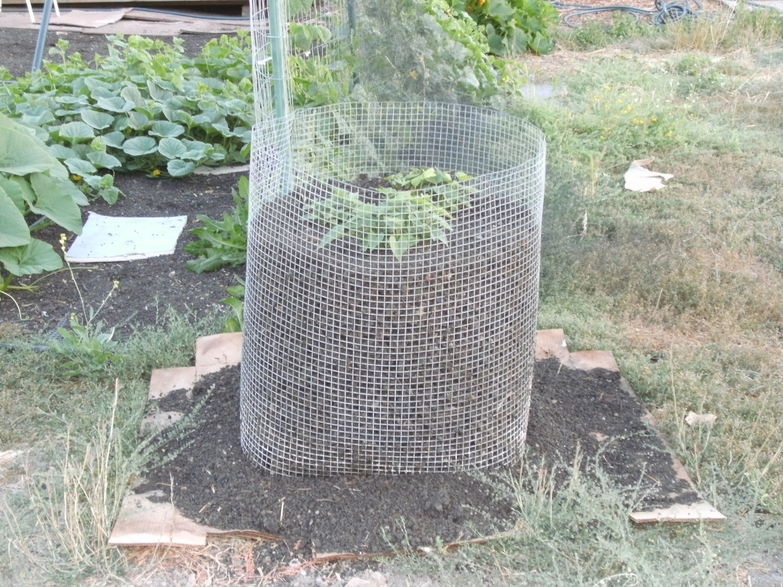

Slide 51
Frost and Cold Temperatures
Plant summer veggies when soil AND nights are warm
Cold temps slow plant growth and reduce nutrient absorption
Many options for frost protection
Frost protection cloth
Plastic jugs
Wall-o-water
Newspaper, sheets, plastic sheeting

Slide 52
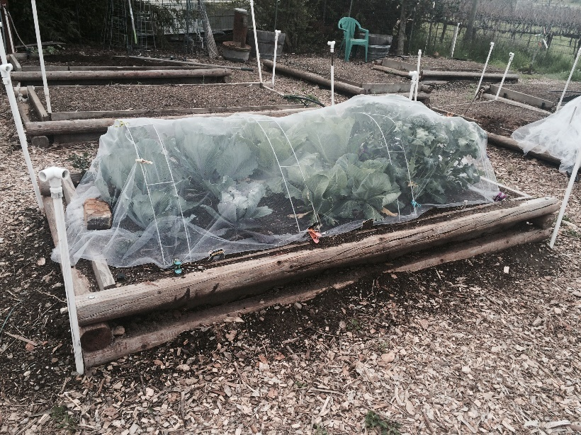
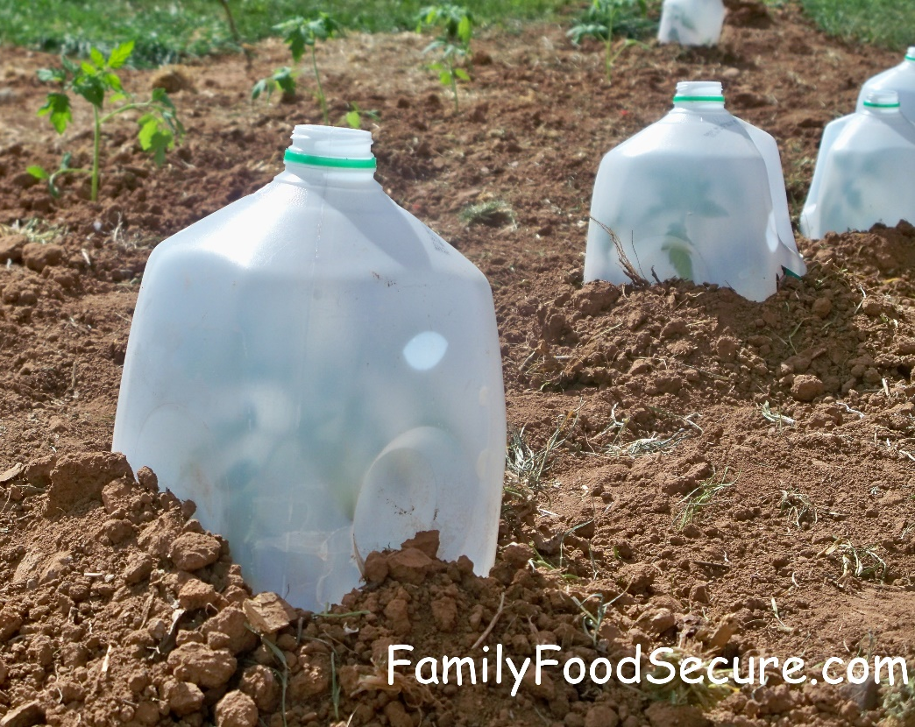
Frost and Cold Temperatures

Slide 53
What About Weeds?
What is a weed?
“A plant growing in a place that you don’t want it to.”
Weeds can compete with desired plants
Prevention
Mulch
Prevent re-seeding
Don’t bring home weeds
Collateral Damage
Reuse: Mulch, home-compost, or yard waste
Notes:
Don’t dig up the soil
Mulch
Perennial weeds vs. annual weeds
Advantage of sheet mulching

Slide 54
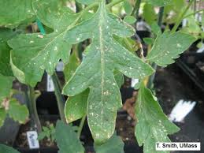
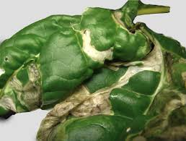
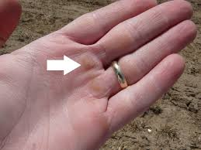
BAD BUGS
Thrips
Leafminers

Slide 56
Aphids

Slide 57
BAD BUGS
Squash Bugs
Harlequin Bugs

Slide 58
BAD BUGS
Corn Earworm
Cabbage Loopers
Tomato Hornworm

Slide 59
GOOD BUGS
Lace Wing
Parasitic Wasps

Slide 60
GOOD BUGS
Soldier Beetle
Hoverfly

Slide 61
GOOD BUGS – SOME OTHERS
Praying Mantis
Ground Beetles
Braconid Wasps
Tachinid Flies
Predatory Mites
Aphid Midges
Damsel Bugs
Minute Pirate Bugs
Mealybug Destroyer

Slide 62
Rust on Beans, Corn Smut

Slide 63
Tips on Buying Seedlings
Would you buy any of these examples?
Beet
Radish
Why?
Broccoli
Cabbage
Broccoli Red Cabbage
Modified slide # 8

Slide 64
So many veggies—so hard to choose
Notes:
So we are focusing on establishing a healthy garden whatever you choose. We will show you and with a handout how to get very specific information on all vegetables.

Slide 65
Preparation
Terrain: Level Ground: Easier to prepare, plant and irrigate.
Easy Access
Water Supply – Locate nearby
Windbreaks—as needed

Slide 66
Starting Indoors
Seeds: Small vs Large
Kits
Soils
Grow Light
Watering

Slide 67
Into the Garden

Slide 68
Enjoy!
“Afternoon
Harvest”

Slide 69
Management and Prevention
Fertilizer
Irrigation
Timing
Quantity
Mulch
Threats
Notes:
Reference Handouts

Slide 70
FERTILIZER
Vegetable gardens are unnatural systems
Regular fertilizer application required
Before planting
Possibly during growth period
Organic preferred
Follow package directions
Notes:
Reference Handouts

Slide 71
RAIN
More Rain Coming?
Can’t count on it… Plan your garden and watering methods accordingly
Plant Now?
Maybe…wait till soil is workable
Notes:
Ask audience about what it means for soil to be workable

Slide 72
Water Needs Depend on Many Factors
Soil Type (sandy, clay, loam) and organic content/mulch
Weather (sun, temperature, humidity, wind)
Time of year (day length)
Type of vegetable
Growth cycle of the plant
Notes:
What is your current method, or plan to irrigate your veggies? This section will cover three main methods--

Slide 73
When to Water
Test: Water if dry at 2-3 inches
Monitor Regularly
NOTE: Drooping leaves do NOT always mean you need to water. Check the soil. Avoid overwatering. Roots can drown.
Notes:
As we will see in the next set of slides

Slide 74
RELATIVE WATER NEEDS BY TIME OF YEAR
Notes:
If July 4 is 100%, then April 1 is 50%, Memorial Day is 75% percent, mid-August is 50% percent, and mid-September is 30%
Of course, your plants are smaller in the early spring and there may still be moisture in the soil, so you need to adjust accordingly
The main thing to remember is that most of us overwater in August and September.
When should you stop watering your tomatoes?
We have a great handout on critical watering periods for a variety of vegetables.

Slide 75
What About Weeds?
What is a weed?
“A plant growing in a place that you don’t want it to.”
Weeds can compete with desired plants
Prevention
Mulch
Prevent re-seeding
Don’t bring home weeds
Collateral Damage
Reuse: Mulch, home-compost, or yard waste
Notes:
Don’t dig up the soil
Mulch
Perennial weeds vs. annual weeds
Advantage of sheet mulching

Slide 76
BAD BUGS
Thrips
Leafminers

Slide 77
Master Gardeners Online
Search: “Napa Master Gardeners”
Or: http://napamg.org

Slide 78
Master Gardeners Online

Slide 79
Master Gardeners Online

Slide 80
Master Gardeners Online

Slide 81
Master Gardeners Online

Slide 82
Master Gardeners Online

Slide 83
Master Gardeners Online

Slide 84
Master Gardeners Online

Slide 85
Program Evaluation Quick Guide
STEP 1: Collect participant name and email address via online registration or sign-in sheet for all public education events (sign-in template available in evaluation toolkit).
STEP 2: Socialize the survey at the end of each event. Marketing material and tips are provided in the Evaluation Toolkit to help tell participants about the survey.
STEP 3: Submit completed Contact Sheet (available in the evaluation toolkit). within one week of event, e-mail to Tamekia Wilkins, mgevaluation@ucanr.edu.
See the “Program Evaluation Quick Guide & FAQs” for more detailed insructions. Located in the Evaluation Toolkit, mgcoord.ucanr.edu/ProgramEvaluation.

Slide 86
Thanks!
Be sure to complete the evaluations before leaving

