Slide 1
The Art of Bonsai
Penny Pawl, UC Master Gardener
September 3, 2020
Napa County Library www.napalibrary.org
UC Master Gardeners Napa County napamg.ucanr.edu

Slide 2
UC Master Gardeners of Napa County
Our mission: “To extend research-based knowledge and information on home horticulture, pest management, and sustainable landscape practices to the residents of California and be guided by our core values and strategic initiatives."
napamg.ucanr.edu

Slide 3
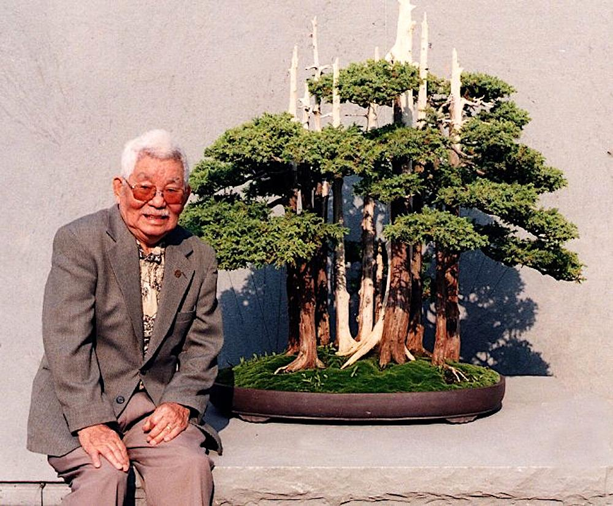
The Father of American Bonsai
JOHN NAKA
Bonsai Group Goshin
At the American Bonsai Collection, Washington D C

Slide 4
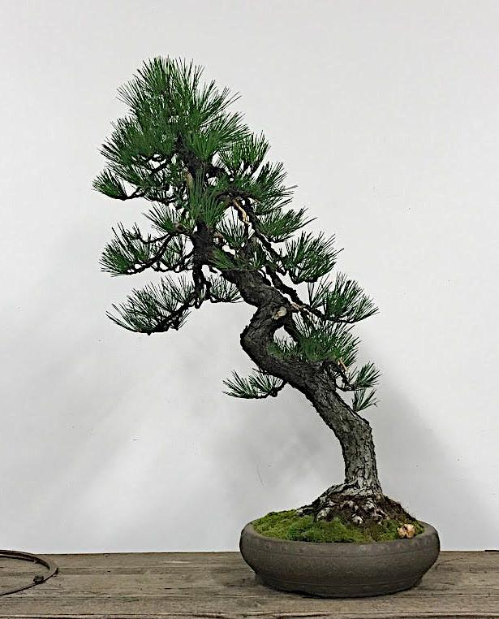
This pine is in the collection of Pacific Bonsai Collection
It was started as a bonsai in a Japanese Internment Camp

Slide 5
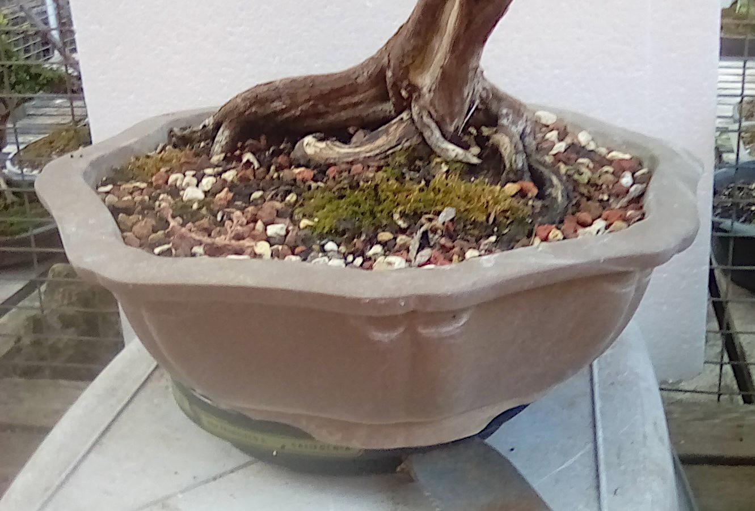
Roots give the look of age

Slide 6
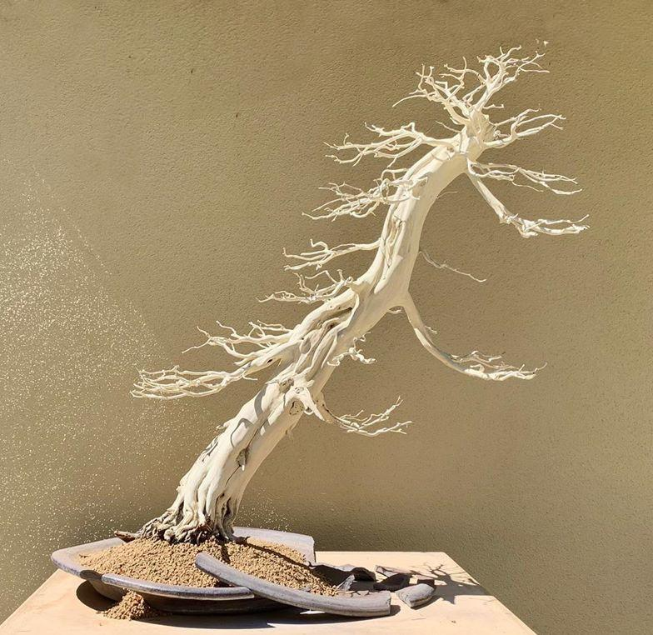
A TRULY FINISHED BONSAI
PACIFIC BONSAI MUSEUM

Slide 7
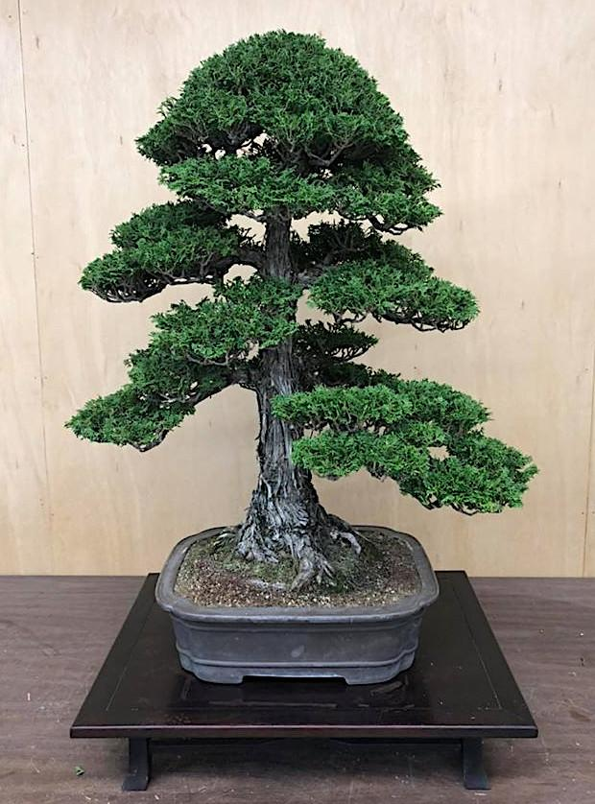
Formal upright
Chokkan
Peter Tea bonsai

Slide 8
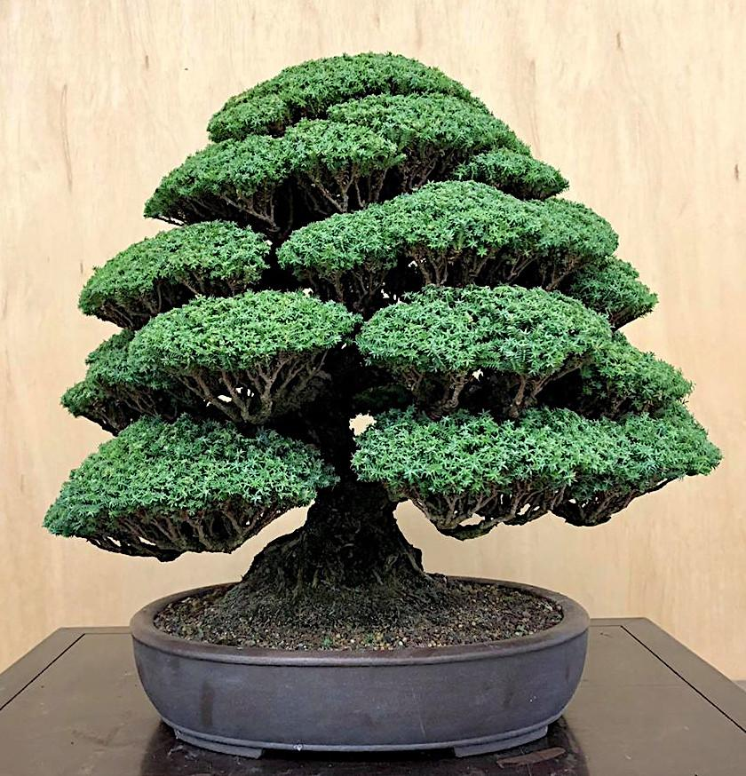
Moss Cypress
Informal upright
Moyogi
Peter Tea Bonsai

Slide 9
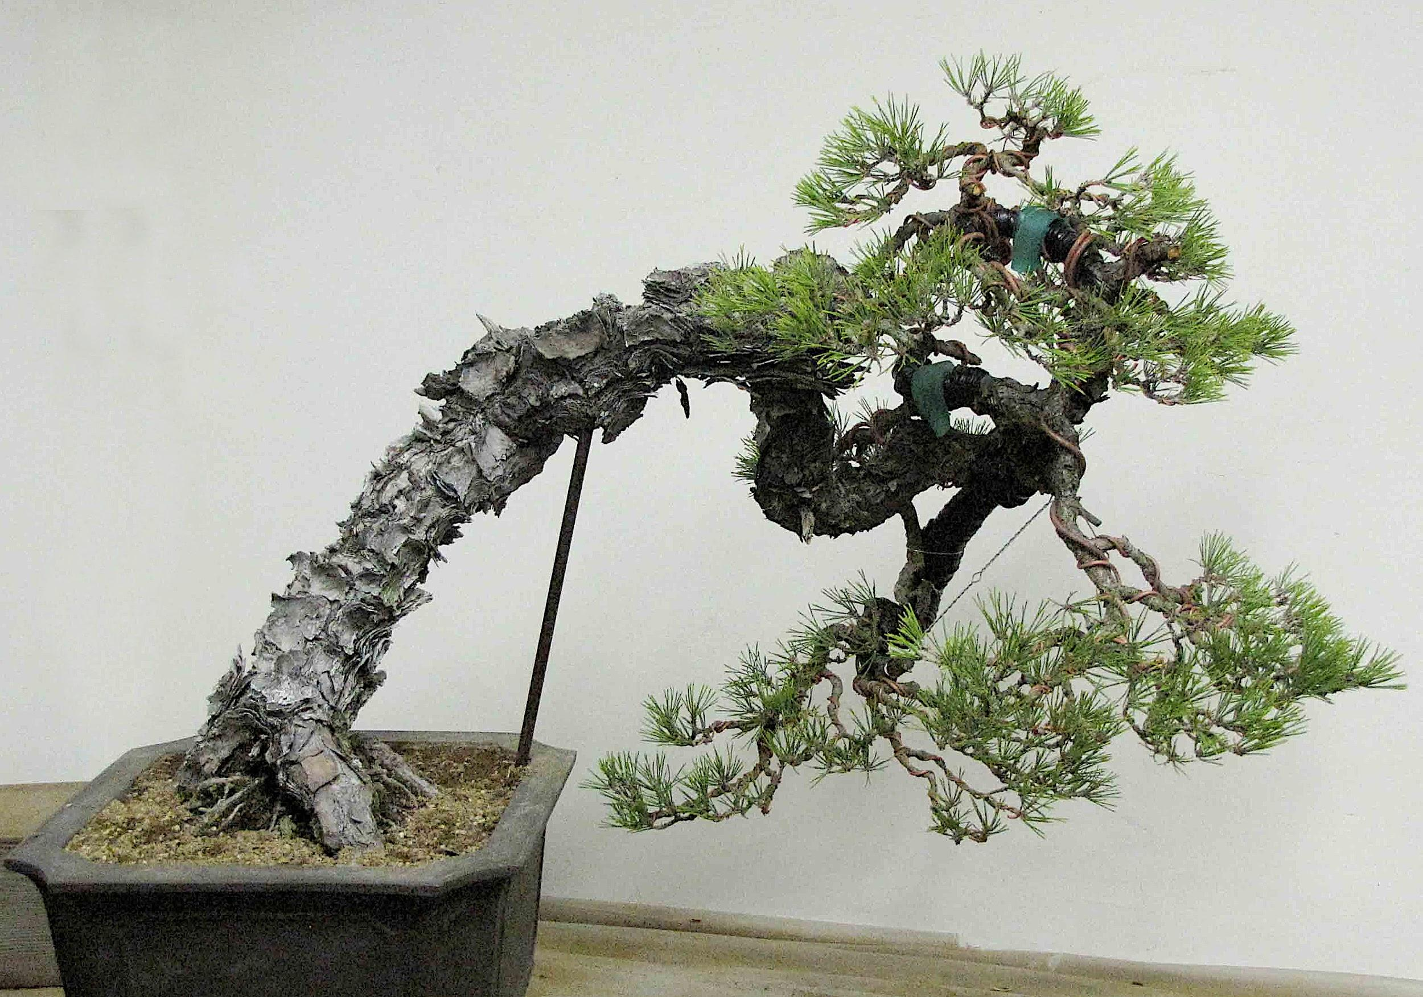
Slant Style
Japanese Black Pine
Shakan
Peter Tea Bonsai

Slide 10
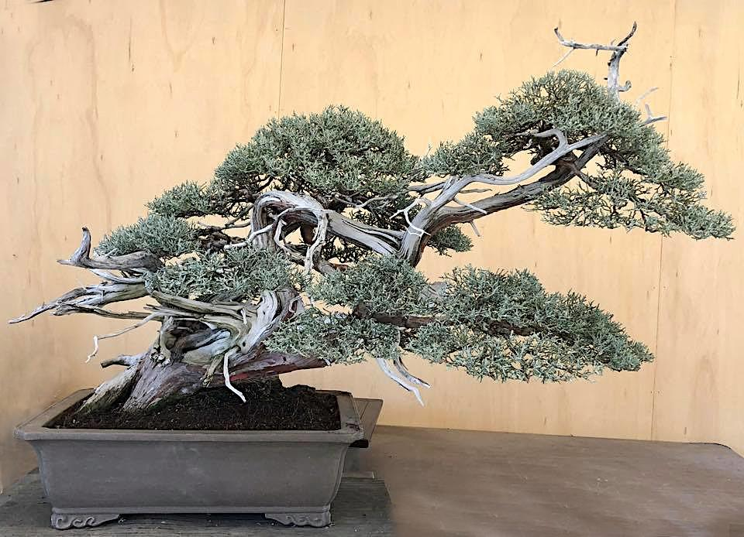
Windswept
Western Juniper
Fukinagashi
Peter Tea Bonsai

Slide 11
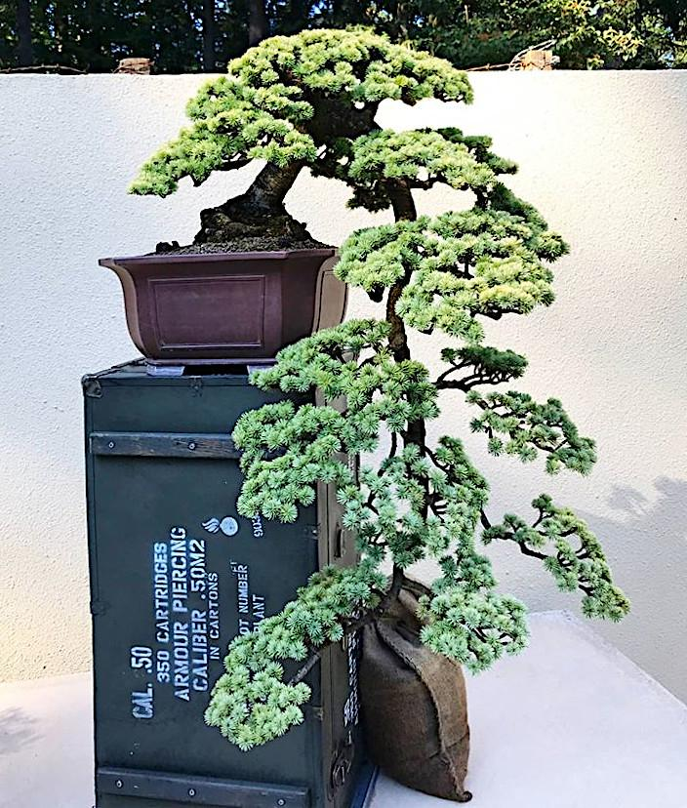
Cascade Bonsai
Atlas Cedar
Kengai
Pacific Bonsai Collection

Slide 12
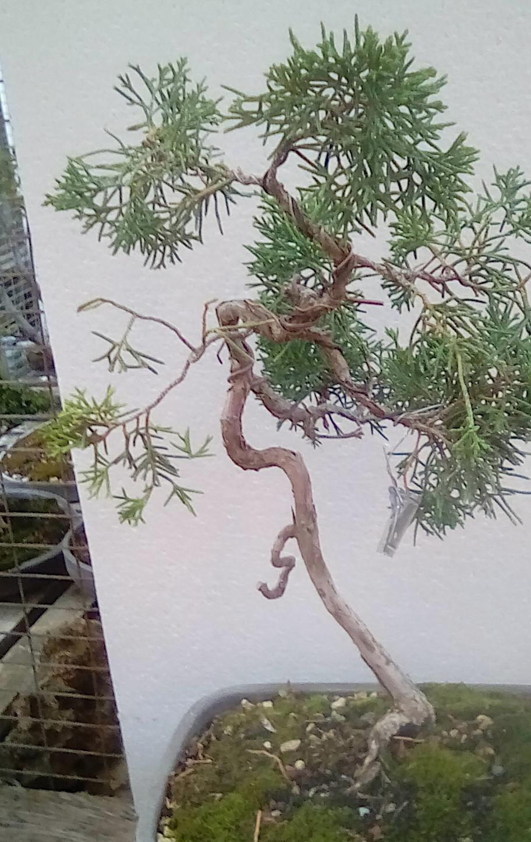
SCHIMPAKU FREE FORM FROM CUTTING
IN TRAINING 5+ YEARS

Slide 13
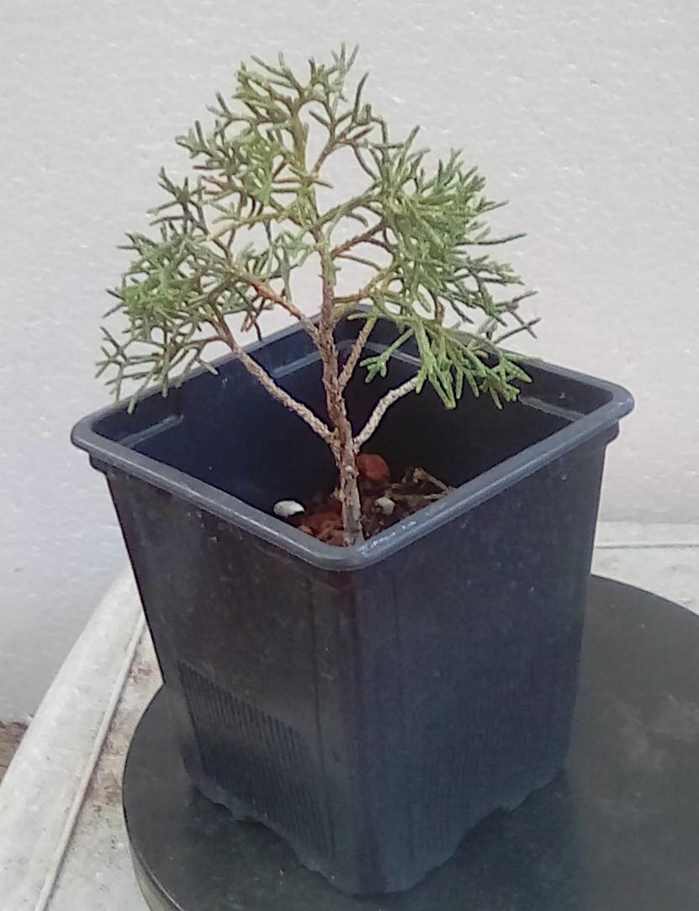
SCHIMPAKU
CUTTING 1 YEAR OLD

Slide 14
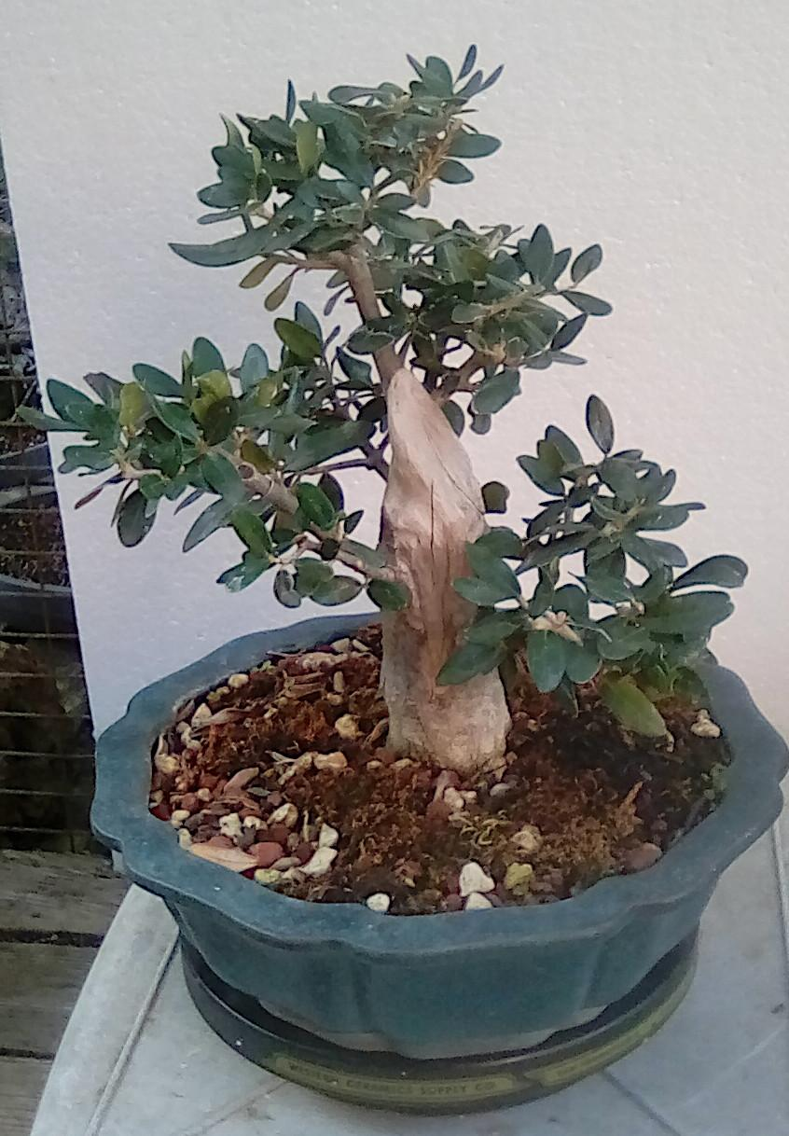
CARVED OLIVE FROM LARGE CUTTING
AGE ABOUT 3 YEARS

Slide 15
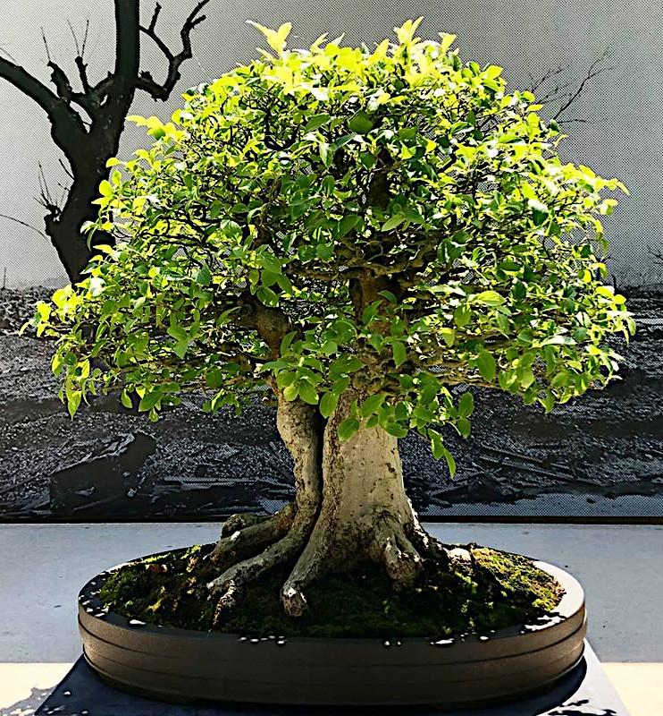
Chinese Hackberry, Celtissinensis
Ben Oki bonsai

Slide 16
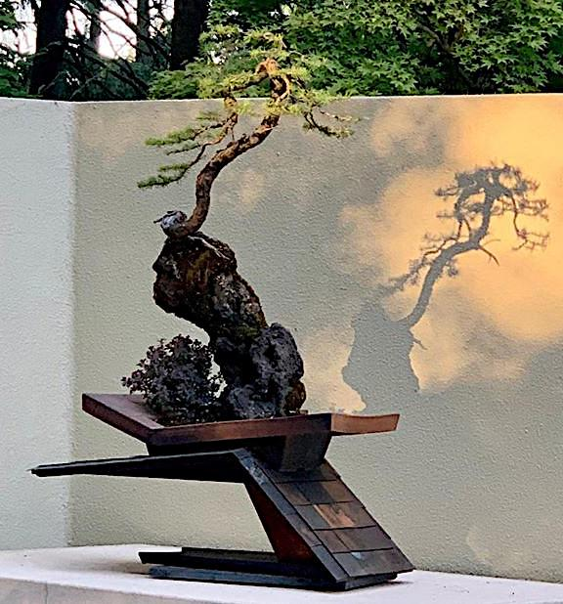
Douglas Fir
A very modern Bonsai
At the Pacific Bonsai Collection

Slide 17
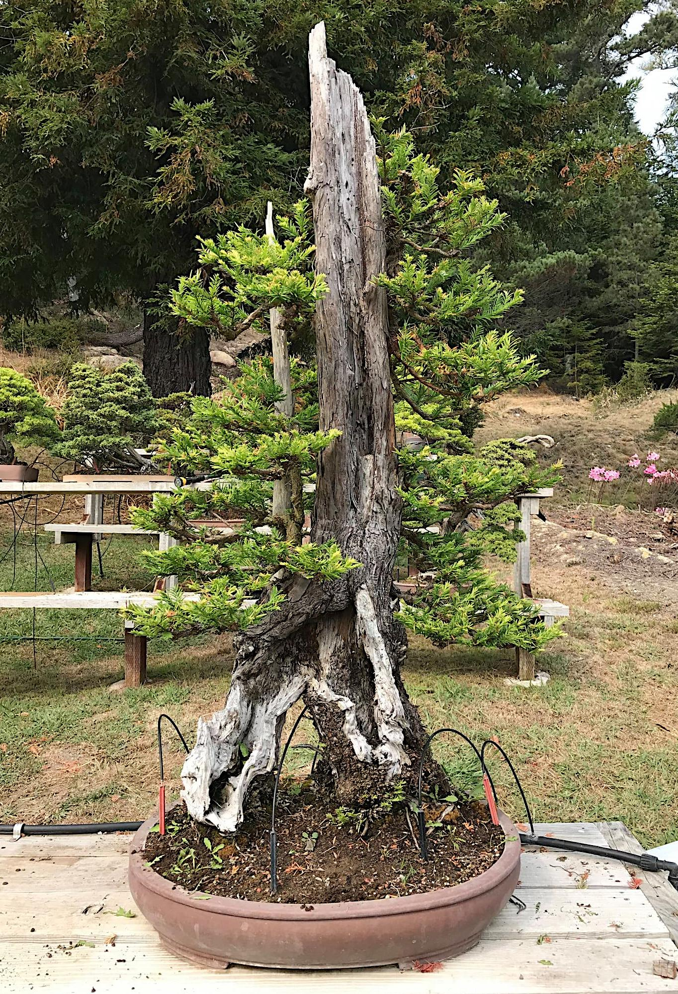
Collected Redwood in training 14 years
Bob Shimon Bonsai

Slide 18
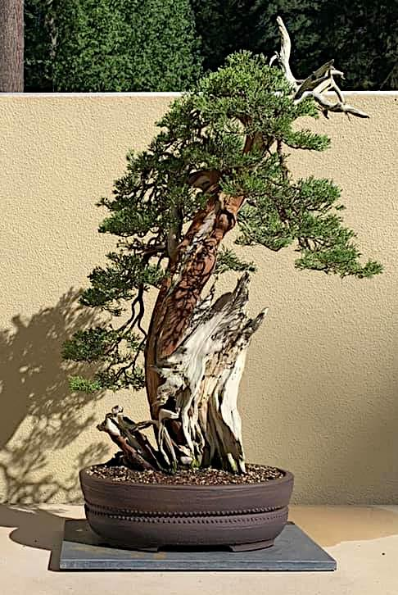
California Juniper
Pacific Bonsai Collection
By Mas Imazumi

Slide 19
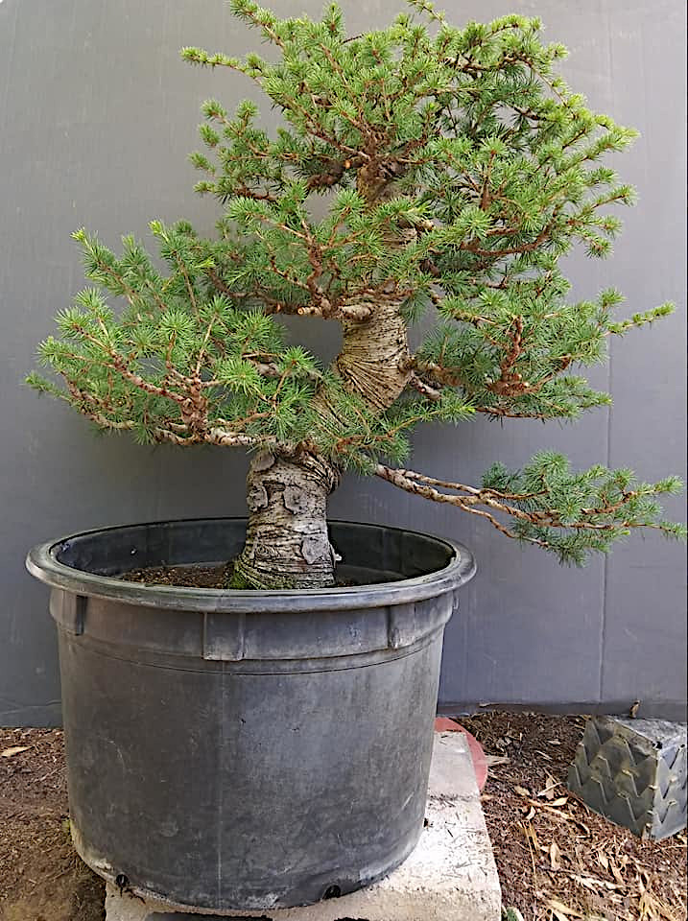
BEFORE
Atlantic Cedar
(CedrusAtlantica)

Slide 20
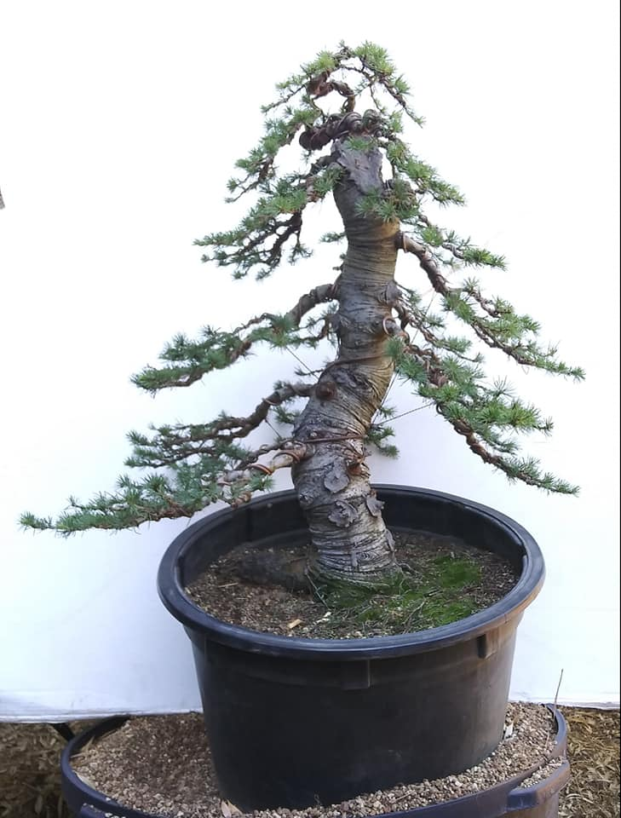
AFTER
Atlantic Cedar
(CedrusAtlantica)

Slide 21
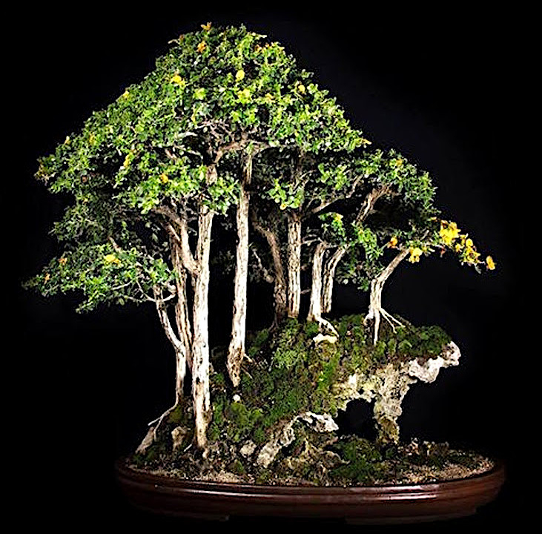
A mixed forest on a rock
Created by an bonsai
artist in Vietnam
Quoc Viet Tran

Slide 22
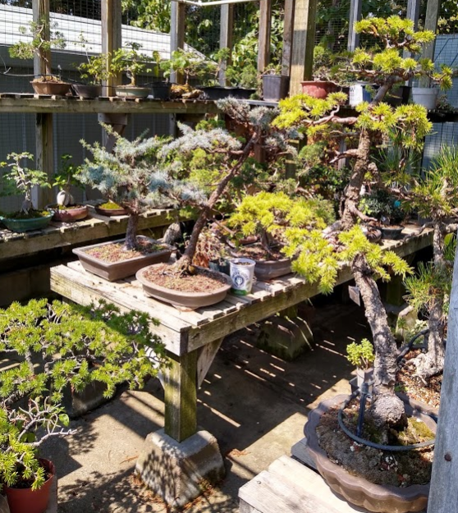
Penny’s extensive personal collection

Slide 23
Resources (
Napa Valley Bonsai Club – meets 2nd Sat. of each month 10-2 pm * Napa Senior Center annex. 1500 Jefferson Napa, Ca. (*note: not currently meeting due to COVID) contact Brent@bpjihlis
Displays / Collections:
Pacific Bonsai Museum 2515 335 St Federal Way Seattle, Washington
Huntington Collection 1151 Oxford Rd., San Marino, Ca.
Golden State Bonsai Collection 650 Bellevue, Lake Merritt, Oakland, Ca.
FREE - Open Tuesday to Sunday; Tue-Fri 11-3; Sat 10-3; Sun 12-3
Nurseries:
Lone Pine Gardens 6450 Lone Pine Road, Sebastopol , Ca.
Open - Thursday, Friday and Saturday 10 to 5
Dirty Lotus Garden Center Citrus Heights, Ca. by appointment only, call 877-610- 9038; Bonsai materials and classes
East Bay Nursery 2332 San Pablo Berkeley, Ca.
Deer Meadow Bonsai Occidental, Ca Pots and bonsai 707-874-1679

Slide 24
Demonstration

Slide 25
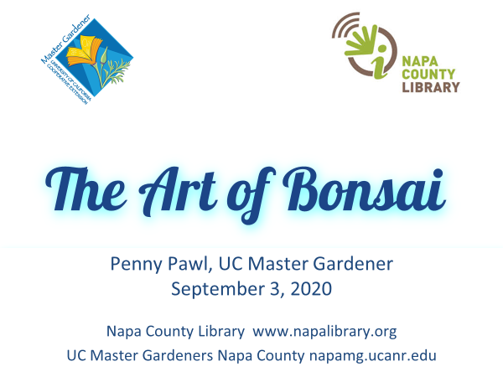
Creating a
Wildlife Habitat

