Slide 1
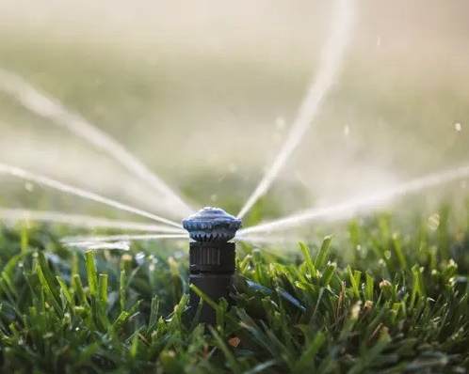
Irrigation Workshop
Basics, Tips and Tricks
for the Home Gardener
Notes:
Created:
Created by: Stephen Boals
Audience: Those who want to learn more about irrigation and best practices for implementing systems
Publicity: Learn the basics about irrigation systems, components, planning and assembly.
Update History: v1 Draft on 25 August 2022
Hello all and welcome to another gardening workshop brought to you by the UC Master Gardener Program. My name is Steve Boals, and I’ll be discussing one of my favorite, and some times painful topics – irrigation. We’ll discuss the basics, and some tips and tricks learned through the years to help make your project a success and hopefully save you heartache, time and cost.

Slide 2
Who Are Master Gardeners?
Master Gardeners of Placer County
  Extend research-based, sustainable gardening and composting information
  Present accurate, impartial information to home gardeners
  Encourage public to make informed gardening decisions

Slide 3
Who Are Master Gardeners?
Where to find us…
Online, in the Media, and Special Publications
  Hotline: Call (530) 889-7388 or submit your questions online
  Website: pcmg.ucanr.org
  Facebook, Twitter, Instagram
  Gold Country Media monthly column
  Curious Gardener quarterly newsletter on our website
  Gardening Guide and Calendar

Slide 4
Who Are Master Gardeners?
Where to find us…
Workshops, Fairs and Festivals, and Special Events
  Speakers by Request
  Workshops (various venues, check website)
  Farmers’ Markets (seasonal: Auburn, Roseville)
  Fairs and Festivals Booths (varies)
  Garden Faire (April)
  Mother’s Day Garden Tour (May)

Slide 5
The Definition
irrigation
noun
ir·​ri·​ga·​tion | \ ˌir-ə-ˈgā-shən \
Definition of irrigation
1: the watering of land by artificial means to foster plant growth
Source: https://www.merriam-webster.com/dictionary/irrigation
Notes:
I always like to start my sessions with a definition of the topic, and here I present the Merriam Webster definition of irrigation. I think the most important word here is “artificial”. Here in California we are blessed with consistent summer thunderstorm and high humidity, both which come with their own problems. But for us, artificially augmenting our plant’s water intake is critical for growing most plants and trees. Irrigation is critical, and so is the efficient delivery of water during our hottest months.

Slide 6
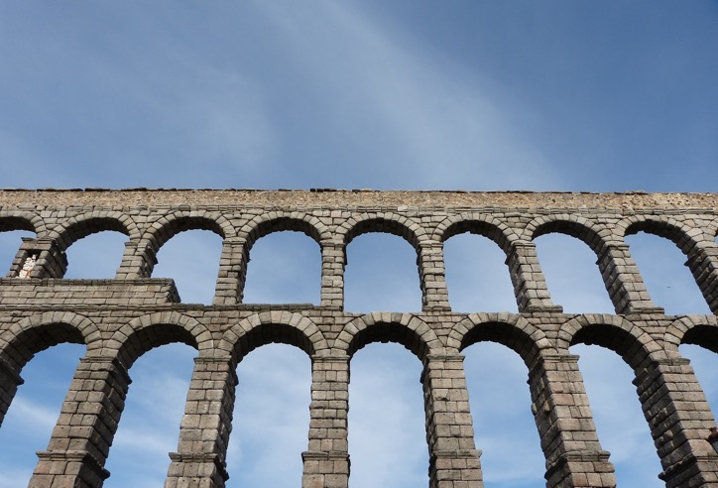
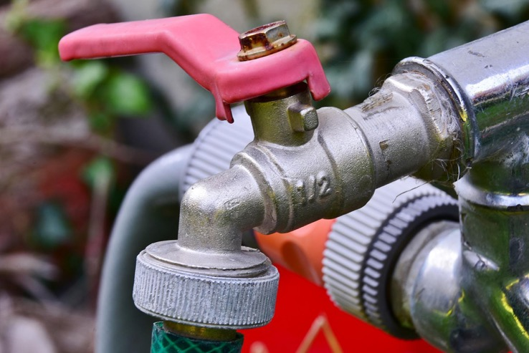
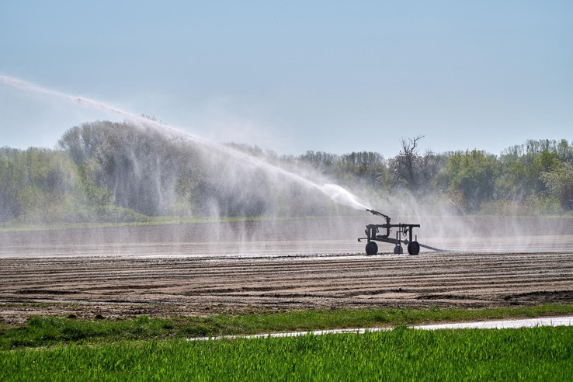
History
Photo credit: Pixabay
Notes:
Throughout history, we have been focused on moving water for not only consumption and survival, but for the growth of plants for consumption. Now I probably wouldn’t use an aqueduct today…although we have a modern aqueduct system here in placer….but as home owners, we have a myriad of great choices, some time too many, to water our gardens and landscape. We will talk about those options today, and cover the following (next)

Slide 7
Workshop Purpose
Familiarize the attendee with irrigation terms and concepts
Provide basic planning and assembly guidance
Provides lessons learned and focus areas for success
Notes:
Irrigation is a massive subject, and in the short time we have today, I couldn't hope to touch everything you may want to know. My guess is that today’s presentation will have parts that are familiar, and some that are hopefully new and helpful, but here are my goals:
We’ll cover basic terms and concepts, and explore the components available for irrigation systems. I’ll provide some simplified slides to help plan a new system, help you upgrade your current system or expand.
And throughout, I have woven in 20 years of success and failure, mine that is, on irrigating our 2 acre parcel, and hopefully help you avoid pitfalls and problems I have experienced.
So, let’s get started.

Slide 8
Irrigation Components
Understanding & Terminology
Notes:
First off, let’s talk about the components of an irrigation system and some terminology. These slides are not all inclusive, but I've focused on providing those that are critical and most commonly used. Note: not every system will have all of these, but hopefully the list will raise awareness for your of what is out there and available.

Slide 9
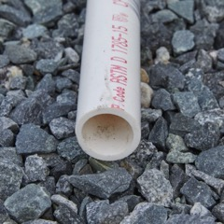
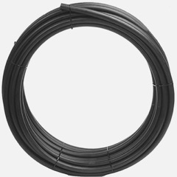
Pipes and Tubing
PVC
Poly
Polyvinyl Chloride
What does schedule mean?
  40 vs 80 (Thickness)
Class 200 (Thinner)
Identifying pipe
Common sizes used in irrigation
  1 ¼, 1, ¾, ½ inch
Special glue for assembly
Polyethylene (black tubing)
Flexible and easy to work with
No special tools required (but they help)
Common tube sizes
  ¾, ½, ¼
Legos for gardeners ;)
What do I pick?
Environment, Pressure, Location, Purpose
Reference: Sprinkler school
Notes:
Irrigation, at the most basic level, is moving water from point A to point B. In most of your home environments, there is probably a point C, D, E, F and on and on. To move that water, we need to choose the highway, and most systems will utilize two types of pipe: PVC and/or Polyethylene pipe. Easy to distinguish: one is white and rigid, the other black and flexible. Both come in a variety of sizes and lengths, and typically larger sizes are utilized for runs from the source to the start of delivery. Most on that in a minute. A few details to understand. First, white PVC pipe comes in a number of thicknesses, and the term typically used is ”schedule”. The higher the schedule, the thicker the pipe wall. Typically schedule 80 pipe is used for longer supply runs and the thinner schedule 40 is used for your zones. You can easily identify pipe by the printed text on the outer shell. You can see it up here in the pvc photo. Most gardeners are mostly familiar with the above ground use of black poly drip pipe. It typically is not used underground because its very flexible, but note you can buy thick poly for underground runs through tricky areas with existing underground structures (rocks, stumps, etc). Poly is easy to work with, and your local stores will carry all of the right sizes for your projects.

Slide 10
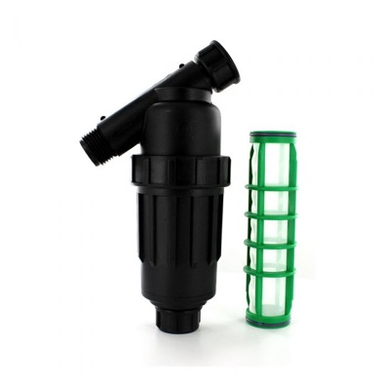
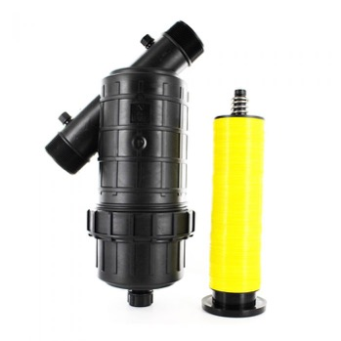
Filters
Filters will save money, time and plants!
Types: Mesh and Disc
Use one on every irrigation system
Most home irrigation systems can use a mesh filter (see table)
Ditch water or fine sand from well
  Use a disc filter
Insurance Policy
Irrigation Product Type | Minimum Filtration Needed
Rotors, Sprinkler Spray Nozzles | 80 Mesh
Drip Emitters, Sprayers, Spray Jets | 120 Mesh
Drip Tape | 155 Mesh
Filter Buying Guide
Notes:
Filters are often overlooked when using a domestic water supply, as it is assumed that it is contaminant free. I recommend always using a filter of some type as calcium or rust build up or particles of any size can cause major issues with a drip system. There are two main types of irrigation filters: mesh and disc. Most home systems can use a mesh filter, they are cheaper and widely available. The table on the slide shows the proper mesh size for the sprinkler of delivery type. Disc filters are preferred for dirty water that has biological elements. So if you have ditch water or a shallow old well or cistern, this might be your best option. Filters should be cleaned on a regular schedule or you can have blockages occur, typically on the hottest days.

Slide 11
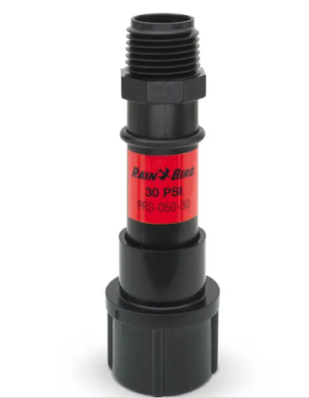
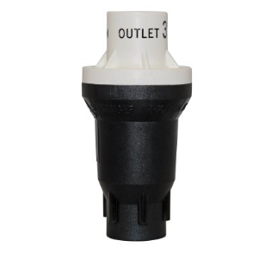
Pressure Regulator
Reduces inbound pressure
Required for drip*****
  Residential 50-60 PSI
  Well 40-55 PSI
  Ditch 10-30 PSI
  Drip System Operation 7-30 PSI
30 PSI for most drips, 10 for drip tape
Non-regulated household pressure will blow your tubing and fittings…maybe not initially
Photo credit: Pixabay
Notes:
Another important component that is overlooked quite often is the pressure regulator. If you have a drip system, this is absolutely required, and without one, you could have a system blowout or rupture or drip tubing and components. Typical water supplies from the home are in the 40-60psi range which is 2-6 times the rated max pressure for drip irrigation. Understand that the system may not pop initially, but over time, with expansion and contraction due to heat and cold, weak points will eventually fail, and it usually happens when you are on vacations or gone for the day. Always, always use one of these in your zones for drip. They are easy to install, and some of the filters you buy have them internally to make it simple. You can buy them threaded for a hose setup, or like the one on the right for addition to your pvc.

Slide 12
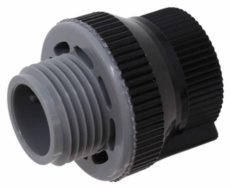
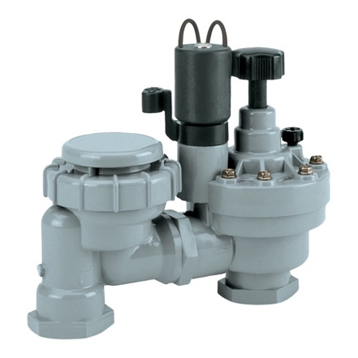
Anti-siphon
Prevents backflow of water into domestic supply
Use on hose bibs and all irrigation lines.
Compost tea & fertilizer do not taste good
Photo credit: Pixabay
Notes:
An anti-siphon, or backflow preventer, can prevent the movement of pipe, hose and tube water back into your domestic water supply. Think about that soaker host in the garden where you just applied your special, almost patented mix of compost tea and fish emulsion flowing into your icemaker on a hot day, not fun. Although there might be some health benefits….
You should have these on all your hose bibs and irrigation lines. Sprinkler valves have this function built in.

Slide 13
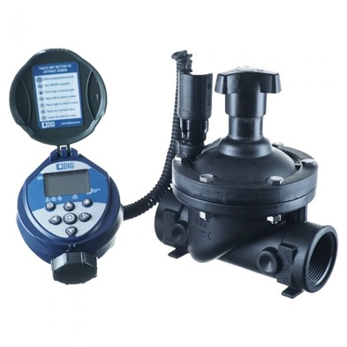
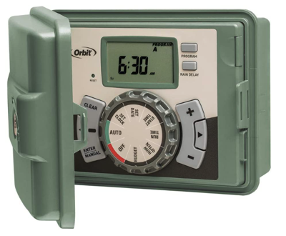
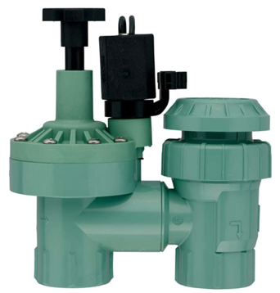
Valves and Timers
Why have valves?
  Divide up your irrigation
  Zones
  Different plant needs
In-line vs Anti-siphon
Electrically controlled (Solenoid)
Controller/timers
  Sequencing
  All-in-one
  Neat stuff (Rain detector, wireless, adaptive)
Photo credit: Rainbird
Notes:
For the simplest drip setup, your valve is your hose bib and the timer is you.
If you want to automate your irrigation, timers and valves can chop up your yard into watering zones that let you control the delivery of water, and automate the task. They can be separate components, such as valves controlled by an electric timer system, or they can be combined like the on up top. These combined units are great for areas away from an electrical source. I use them in remote garden areas where its cost prohibitive to run pipe and electrical lines

Slide 14
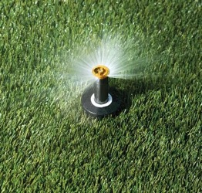
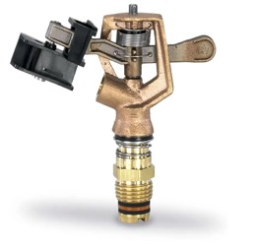
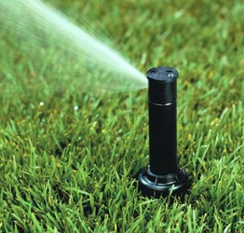

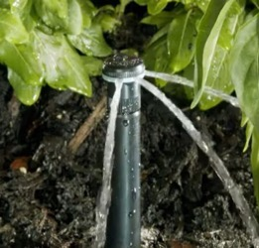
Sprinklers
Spray Head (Fixed Nozzle)
Rotating Head (Single Stream)
Impact or Gear Drive
Rotary Nozzle (Multi-stream)
Bubbler
Great for small yards
Short distances
Adjustable distance
Great for large area coverage
Adjustable distance, arc and patterns
water conservation
Adjustable arc and distance
Specialty heads for large, small and unique shapes
great for shrubs/borders
Like an open flow hose (zone isolation)
Great for small yards
Short distances
Adjustable distance
Impact
Long distance
Lawns and acreage
Durable
Photo credit: Rainbird
Notes:
Sprinklers have come a long way since I was a kid. I remember the days of brass sprinklers and you had 2 choices: a rainbird impact sprinkler or a fixed spray head for your lawn. Today, there are specialized sprinklers for just about any need, pattern or area. I think we are all familiar with most. I will focus on one type, and that is the relatively new rotary multi-stream. These are fantastic for water conservation, and really water just about any shaped area well. They are highly adjustable, and even have square pattern heads you can purchase for square and rectangle beds. The newer ones reduce water flow by 60% and efficiency is improved by 30%, so you can save some serious $$ on your water bill. They can just slip into your existing popup sprinkler bodies as well.

Slide 15
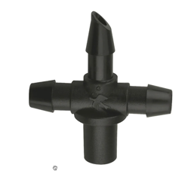
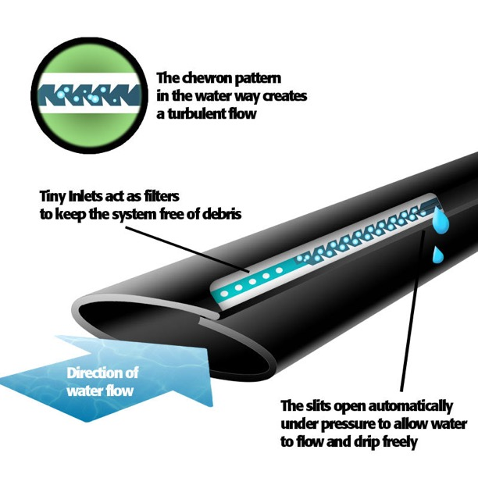
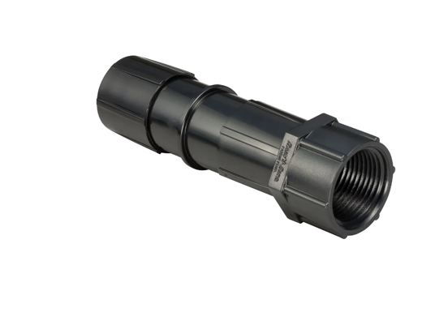
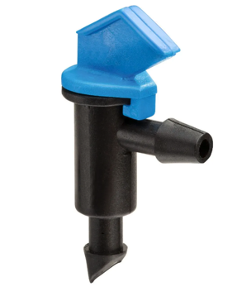
Drip Components and Emitters
Connectors
Transitions
Emitters
  Dripper
  Bubbler
  Sprayer
  Soaker
  Drip line
  Emitter Tubing
  1 million options!!
Photo: Sprinkler school
Notes:
If you are like me and love to go to the big home improvement stores, you are probably overwhelmed in the drip irrigation section. Essentially if you can imagine it, it exists. Just a little terminology here, starting with connectors. These are essentially components that let you link different tubing and pipe types, they come in different configurations, two prong, three prong, crosses, etc. Transitions are components that let you go from different pipe types, different thread types and different size tubing. This one here is pipe thread to 5/8 tubing. And finally, emitters are things that deliver water. On the screen is the one I use most, the flag dripper. These can be pressure regulating, which insure equal delivery in your drip zone, and can also be cleaned by twisting the flag and pulling. One other mention here is an emitter type that has made my watering extremely efficient: drip tape. Drip tape is thin tubing that has emitters spread evenly along the line. The emitters are built in, and this type of setup is great for growing crops or flowers in long lines or beds.

Slide 16
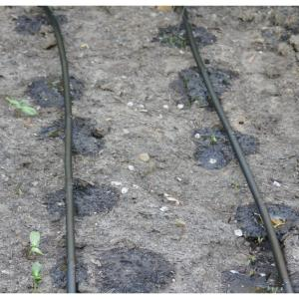
Choosing the Right Delivery
Understand soil type and true drip pattern
Choose emitter type for specific plant
  Ground cover example
  Flow & time
Sand
Loam
Clay
Notes:
Many gardeners assume that what you see is what you get with drip irrigation. What you see on the surface is not exactly what you get over time, it’s kind of like an iceberg where there is more underground. The first challenge is to determine your soil type.. Most of place county is somewhere between loam and clay. If you look at this simplified graphic, you can see a close approximation to the effect of gravity and resistance in the soil as water drips and seeps overtime. You can see there is a definite expansion pattern, which in reality is more like an onion shape. Why is this important? Well, it will help you with spacing your emitters and lines, but more importantly, how to space for different stages of plantings. Think about seedlings and how close emitters will have to be initially, and then at maturity. Just food for thought. If you grow seedling you will need closer emitter spacing than if you have mature plants.

Slide 17
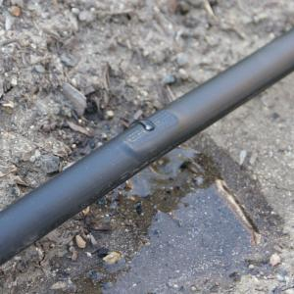
Component Tips and Tricks
You get what you pay for!
Always use a filter
Always use a pressure reducer
For elevation changes – pressure compensating
Drip tape rocks!!
Notes:
So that’s the end of our components section. Some quick tips.
First off, the web is great for finding just about any type of irrigation component you want, but beware. There are a ton of cheapo components on Amazon and places like AliExpress. Most of these components are shoddy quality, and will get you in trouble or worse, kill your plants. I always recommend buying name brand components. They are tested and have some quality process associated.
The next two items bear repeating, but it is recommended to always use a filter and a pressure regulator to prevent failure of your system and a massive water bill.
If you have fluctuating elevation, like a rolling field or stairs in your garden you want to use pressure compensating emitters, which will help insure equal delivery and pressure of water.
Finally, as I mentioned, drip tape is a great option, especially for those of you who have larger areas or row crops. It can be a low cost way to deliver drip irrigation to your crops.

Slide 18
Irrigation Planning
Roadmap for Success
Notes:
Let’s move onto the planning stage. One of my favorite planning quotes is from Benjamin franklin “By failing to prepare, you are preparing to fail.” Like any other project, irrigation planning and preparation is critical. Over the next few slides well discus some planning guidelines that can help on any watering project.

Slide 19
Basic Considerations
Know when to hire a professional
Cost
Time saved vs time spent
Savings on bill
Notes:
To start, there are some basic limitations. I would always suggest you draw that line you just wont cross, and know when to hire a professional. Mine is typically 220 wiring and pump work, I am not an electrician, and I would rather pay someone who knows what they are doing than short. Out my electrical or get a wicked shock that could stop my heart…common sense, right? But with irrigation, maybe you sub out the stuff you don’t want to do. I for one, don’t want to dig a 100’ trench. So pick and choose what you can sub out. Second is cost…irrigation project costs can add up quickly, so run some quick numbers to calculate what it will cost. It stink to run out of funds halfway through a project. You can also sequence your project over a few months to stay on budget. What is your goal for your project? To stop the hand watering craziness and save some time in your day? I have a saying I always repeat with my wife when we leave nursery with another 5 plants – In the Sacramento area, if its not on automated water, its destined to die in the heat. Lastly, most of the new irrigation techniques and sprinklers can save you a ton of money as mentioned. Likewise, planning your zones can keep you from over or underwatering, saving on water costs and plants.

Slide 20
Determine Soil Type
  Soil types will determine irrigation requirements
  Sandy, loamy, or clay
Notes:
We talked a little bit about this in the previous section, but knowing your soil type is critical when planning and helps determine emitter spacing and drip rates. Most of you will fall into loamy-clay soil types, and a good bet is a 1 gph flow rate to prevent runoff and get max penetration in the soil. There are some great references on your resource sheet that go a little more in depth. Just know that its better to water slow for long periods than to water fast for short periods in most cases.

Slide 21
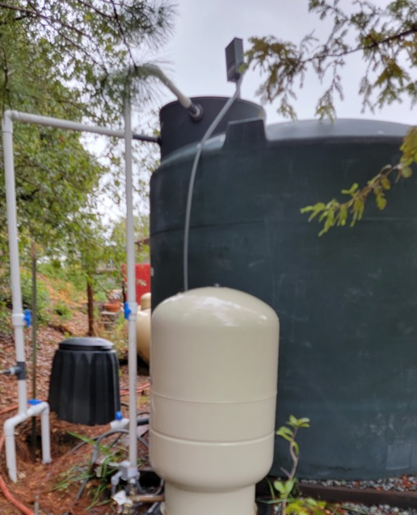
Identify Water Source
  Source
    Municipal water system
    Well
    Irrigation ditch/canal
  Know water pressure (Pounds per Square Inch – PSI)
    Municipal water – 30 to 60 PSI
    Well – 30 to 50 PSI adjustable pressure switch
    Irrigation ditch/canal – varies widely, requires testing
    Elevation changes within your yard affects pressure
Notes:
Moving on to water sources, many of us here in Placer County have multiple sources. I know for my property, I have a domestic well, and old hand dug irrigation well and ditch water access. These 3 different sources have different flow rates, different water characteristics and overall storage limitations, so I typically have to choose. The pressures are also different, and the fouling or filter requirements are all different as well. You may not have these problems if you are on city water, but where your water comes from will determine specific design elements we will discuss.

Slide 22
Determining Gallons per Minute
Get a 5 gallon bucket and a stopwatch
Turn hose bib on and start watch
Stop it when bucket is full
Most homes – 6-12 gpm
5 gallons
60 s
Flow Rate(gpm) =
X
Time to Fill (s)
minute
<Your> gallons
60 m
Flow Rate(gph) =
X
minute
hour
Notes:
Flow rate is a key characteristic of your source that will help you understand how much water you have at your disposal, how many emitters you can place on a line and how many sprinklers you can drive. This ties directly into your zone design. To figure your out, there is a simple test using a 5 gallon bucket and a stopwatch. Essentially, you time how long it takes to fill a bucket. Use the first equation to figure out you gallons per minute and gallons per hour. Most homes will be in the 6-12 gpm, if you have a low flow well, you may be under 5. So how do you use this info?

Slide 23

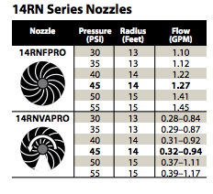
Example
Example:
My bucket takes 60 seconds to fill, so the flow rate is 5 gpm. Converted, that’s 300 gallons per hour. How many impact or rotary sprinklers can I use per zone if my pipe pressure is 40 psi?
1
4
Notes:
So here is a quick example of how we can use that info. I grabbed the technical specifications off rainbird’s site for an impact and rotary just for illustration purposes.

Slide 24
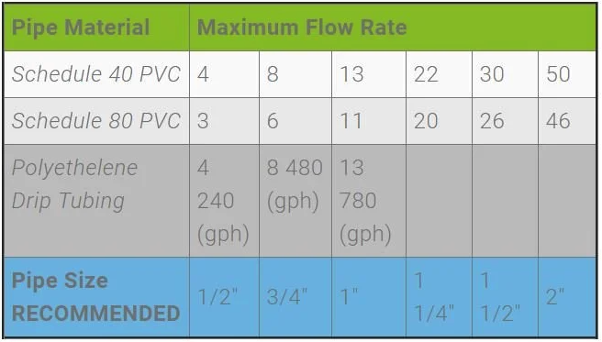
What Type & Size of Pipe?
Sprinkler School
Notes:
The size of your pipe also restricts your flow rate. So if we stick with our example and know that our water source feeds at 5 gpm. What happens if I use Schedule 80 ½ inch pvc as my mainline to 5 zones? You can see on the chart, it will be limited to 3 gpm. So using this chart I can figure out what type of pipe to use. Typically, a irrigation system will use ¾ or 1 inch pipe.

Slide 25
Tubing rules of thumb
For 1/2″ Tubing: 200/200 Rule – don’t exceed 200′ or 200 gph.
For 1/4″ Tubing: 30/30 Rule – Don’t exceed 30′ or 30 gph.
Keep the overall length of all tubing on one zone to 400′.
Notes:
Now if you hate math, and just want some basic rules of thumb, and just want to low down on drip irrigation, this is my favorite slide. The 200/200 and 30/30 rule will be adequate for any drip system you put in. Most drip emitters will be tagged with their gph usage. So in this example, you can do a 30 ft ¼ drip and have no problems having 30 1gph flag drippers. Or 15 2 gph or 7 4 gph.

Slide 26
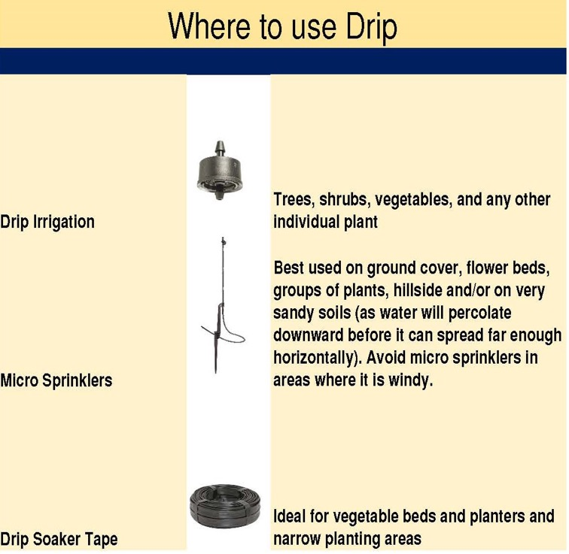
Watering Frequency & Emitter Types
Watering Frequency
  All about timing
  Varies by plant type
  Dripper water schedule
Micro sprinklers reduce watering times and frequency for medium and large trees and shrubs
Notes:
Drip is all about getting the right amount of water to the necessary location and focusing your systems efforts. Drip emitters are perfect for individual plants where you can focus water at the roto system. Micro sprinklers can be a great option for groundcovers and high density landscape plants where there are many root systems that are tightly planted. Example: a tulip bed or phlox…essentially ornamentals. Finally, I've talked about the advantages of drip tape already quite a bit

Slide 27
Draw a Diagram of the Area to be Included the Drip System
  Make sketch to scale using graph paper
  Include location of house, retaining walls, paved areas, sidewalks, and water sources accurately
  Use measuring tape
  Identify zones & plants in zones
  Flow to zones
Notes:
So now to put it all together, you can start to sketch out your plan. Graph paper is great, and there are a number of free sketch tools online offered by orbit , rainbird and other irrigation providers.
Take measurements and begin to layout your system. This will help give you an idea of how much material you will need, the number of sprinklers and emitters, etc.
The most important aspect here is laying out your zones and how much flow you will need to provide the water to your plants.

Slide 28
Planning Tips and Tricks
Use the biggest supply pipe you can
Don’t mix emitter types in zones
Plan for expansion (cause that’s what gardeners do ;) )
Figure out max water usage & timing
Notes:
To wrap up, here are a few tips for planning out your system. If your watering zones are any type of distance, you want to use the largest supply pipe that fits your flow rate.
Mixing emitter types is setting yourself up for problems. Water tends to flow to the highest flow rate emitters, the path of least resistance, and inevitably, you will leave plants thirsty.
Always leave a stub of pipe for any future expansion or plans to make it easy to add on. If you are like me, there is always a vision for that future project, plan ahead.
Finally, use the charts and references to plan out your flow and required drip rates.

Slide 29
Irrigation System Assembly
Putting it all together
Notes:
So now the fun part, how do we put it all together and make it last

Slide 30
Basic Plumbing Rules
Pipe should be 8-12” underground (code)
All anti-siphon valves 6” high than the highest emitter/sprinkler
Notes:
Two rules you should be aware of as you start your installation. You are going to spend a ton of time and effort putting in this system and you want to protect it. You need to bury your pipe runs between 8 and 12 inches. This does a few things. First, it gives you some space to work the soil above the pipe. Second, in areas of freeze it protects the pipes below from the threat of frozen water.
A second big one I learned the hard way if that antisiphon valves need a pressure differential to work and it the valves are below a sprinkler head you will have trouble with the siphon and valve operation..

Slide 31
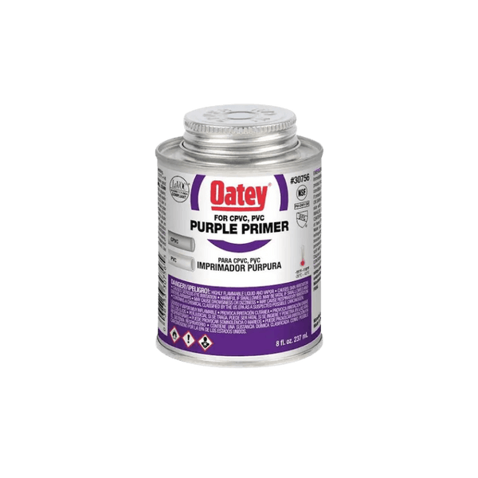
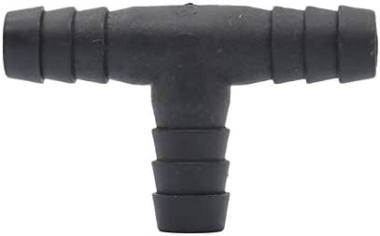

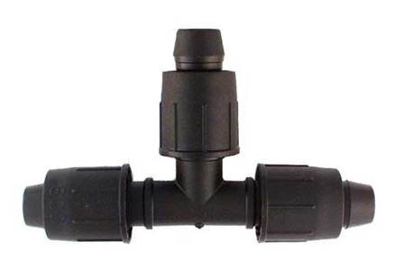

Making Connections
Use primer on all contact surfaces
Coat all contact surfaces
Fully seat connections
Twist as you assemble
Use plumber’s tape on all threaded connections
PVC
Poly
Use the right size connectors
Make clean perpendicular cuts
Push tubing ALL the way onto the barbs or into compressions fitting
Use plumber’s tape on all threaded connections
Reference: Sprinkler school
Notes:
Pipe and tubing are really erector sets or tinker toys for adults, and assembling them is simple if you follow a few rules. First, with PVC pipe, you use a 2 step process to prep the PVC with primer. The primer sets the stage for a chemical change in the PVC and preps it for bonding. It softens the pipe and as you apply the blue cement, it will fuse the two parts together in a chemical bonding process. When you put the pipes together, insure an even application of primer and cement, push the parts together and twist as you go until it is fully seated. It takes 15 minutes for initial bonding where the joint can with stand pressure and 2 hours to cure.
Poly tubing is simple if you follow some basics. Always cut the tubing at a perpendicular angle. Always put the tubing on completely past the last set of barbs to prevent leaks and failure.
For any pipe threads or screwed ends, always use a few wraps of pipe thread tape to provide. Clean seal, and screw all the way.

Slide 32
Insuring a Leak Proof System
Make sure surfaces are always clean and dry
Always use several full wraps of pipe thread tape on threads
Tighten threaded fittings all the way
Apply glue liberally
Clean off excess glue
Pressure test
Inspect
Perform ALL tests before burying ☺
Notes:
To prevent leaks, make sure all your pipe joints and threads are completely free of dirt and dry. As mentioned, use pipe tape and screw down joints all the way to the stops. Don’t go cheap on glue, but make sure and wipe excess glue and primer as it can weaken the pipe outside of a joint. Inspect your work,, and after 15 minutes, pressure test and check for leaks. Obviously, test before you bury or you’ll have an unintended drip system

Slide 33
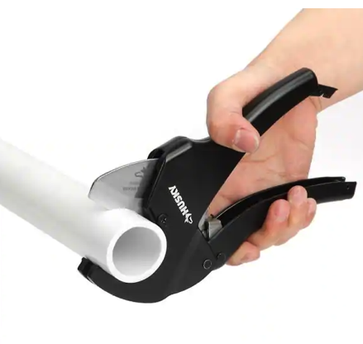
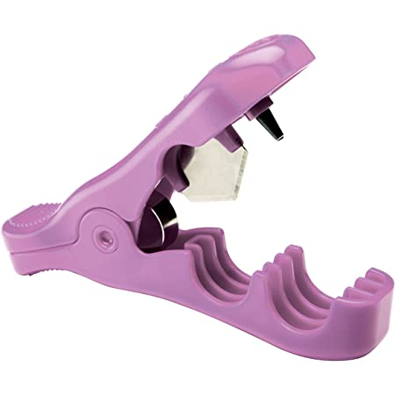
Tips and Tricks
Flat piece of cardboard is a great working surface
Wear gloves when using PVC cement
Proper tools are a huge time saver
  Pipe cutter
  Punch
Take Your Time
Think expansion
Always flush the system before sealing
Notes:
If you are doing PVC work, I always find it nice to have a flat clean working surface. A square of cardboard is great for slipping under pipe while doing joint work. Wear gloves. No matter how careful you are you will get PVC primer and cement on your hands and its tough to get off and can irritate your skin. Two tools I recommend for both types of pipe are these cutters pictured here. The PVC cutter is great and simple to use and guarantees a 90 degree clean surface. The poly cutter and punch makes easy work for big drip projects.
If you plan well and take your time, the end result will be success.
Finally, no matter how careful, some dirt or debris will get into your system. I typically leave the last emitter or end of pipe off until I do a system flush to prevent clogging.

Slide 34
Troubleshooting
Check the source
Debris is a top culprit
  Clean main filter
  Clean screens on heads
Any changes?
Moisture meter
Solenoids
Test mode on most controllers (cycles through zones)
Phone a friend or a contractor
Notes:
So once the system is in place, I always use a test or cycle mode on the sprinkler to go through my zones and make sure they are working as intended and there are no clogs. If they aren’t, start at the filter and emitters. You can be proactive, especially with drip emitters by testing your yard with a moisture meter. This can give you a heads up if your system isn’t working as planned before your plants die off. As with everything else, you always have the phone a friend option if you just cant figure it our. Or a contractor.

Slide 35
Maintenance
Filter cleaning
  Depending on water source
  Monthly during growing season
Flag dripper cleaning
Run zone test
Flush system
Clean heads (if on PCWA) of algae
Notes:
Think of the irrigation system as a friendship or relationship you get out of it what you put into it. If you ignored overtime the relationship will go sour. Periodic maintenance will help prevent serious headaches clean your filter Weekly or monthly clean your trippers test your system and flush it at least once a season for sprinklers clean the heads in the filter baskets periodically. These types of maintenance functions we’ll pay huge dividends keep your system running well

Slide 36
References
UCANR Irrigation and Soils Homepage
https://ucanr.edu/sites/Irrigation_and_Soils_/
UCANR Sacramento MG Irrigation Links
https://sacmg.ucanr.edu/Irrigation/
Rainbird Irrigation Design Manual
https://www.rainbird.com/sites/default/files/media/documents/2018-02/IrrigationDesignManual.pdf
Sprinkler School Resources
https://school.sprinklerwarehouse.com/
University of Florida – Basic Tips for Designing Irrigation Systems
https://edis.ifas.ufl.edu/publication/AE539

Slide 37
Additional Resources
https://mg.ucanr.edu/Resources/Gardening_Resources/
Resource Sheet
Notes:
Well as we end up here hopefully you got something out of this webinar and there’s a slider to you can leverage for future projects. You can always go to the Master Gardener website and I’ve also included some great links on your resource sheet to help in areas we may not covered and continue your irrigation education thank you so much for your time and happy irrigating!

Slide 38
Thank You!
Any Questions?
Master Gardener Hotline: (530) 889-7388
Rot Line: (530) 889-7399
Master Gardener Website: pcmg.ucanr.org
Evaluations, please!

