Slide 1
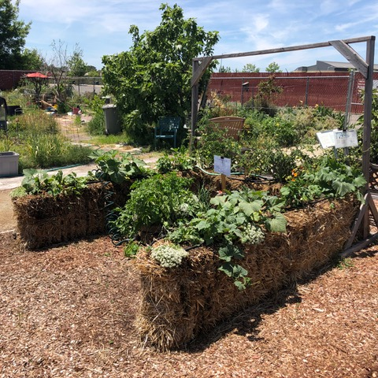
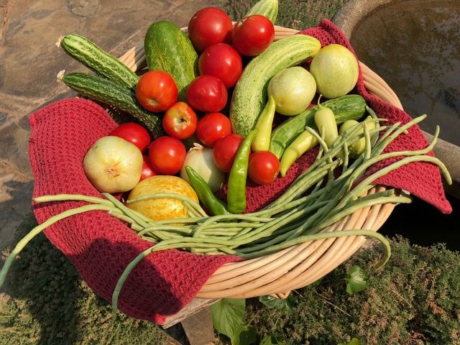
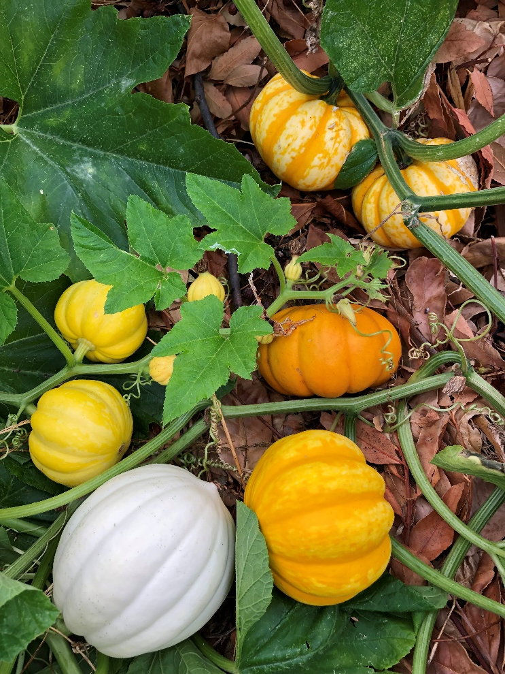
Straw into Gold: Gardening with Straw Bales
Notes:
Created:
Created by: Jan White & Diane Arnold
Audience: Garden Faire 2020,
Publicity: As listed for the Sun City Lincoln Hills Garden Club.
"The amazing diversity and versatility of succulents will be discussed by examining the “Who, What, Why, When and How” of growing succulents. You will learn what succulents “really are”, why you’ll love to grow them, which succulent varieties do well in our area, how to grow and propagate succulents and when to plant and propagate succulents.”
Update History: for each update to the presentation include date, name of updater, explanation of update
(were additional slides added, were web links updated, etc.)

Slide 2
AGENDA
Welcome!
Today’s Agenda
Who are Master Gardeners?
Why garden with straw bales?
Planning and preparation
Conditioning of bales
Planting of bales
Watering bales
Harvest
Compost
Questions and Answers

Slide 3
Who Are Master Gardeners?
Master Gardeners of Placer County
Extend research-based, sustainable gardening and composting information
Present accurate, impartial information to home gardeners
Encourage public to make informed gardening decisions

Slide 4
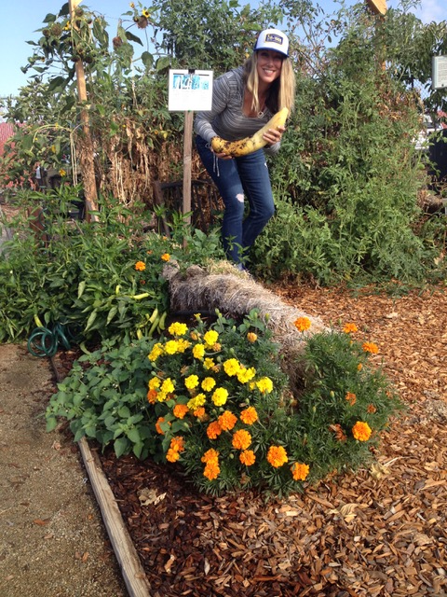
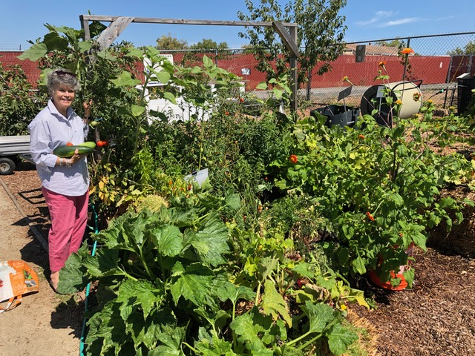
Why Garden with Straw Bales?
Advantages
No soil/No weeds
Raised bed height
Plant earlier
No tools/Just a trowel
Plant all sides of bale
Impossible to overwater
Creates super compost

Slide 5
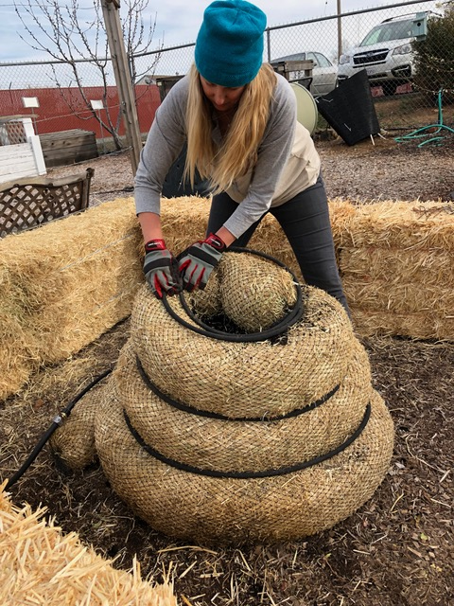
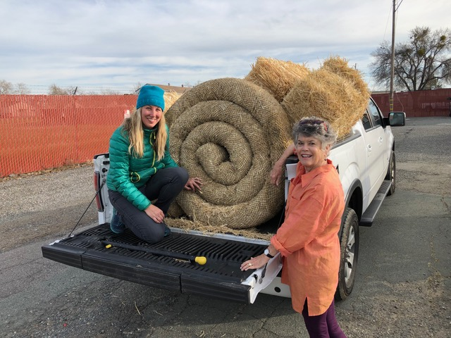
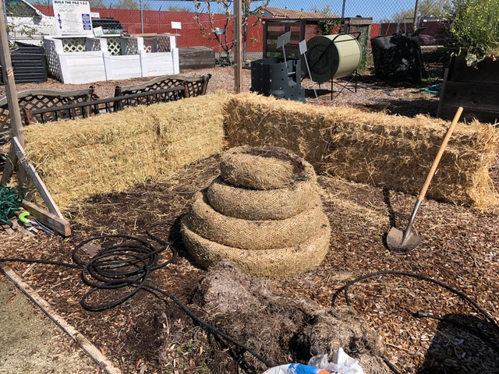
Planning
Design layout of bales
Create planting chart
Purchase materials:
Straw bales, soaker hoses and hose timer

Slide 6
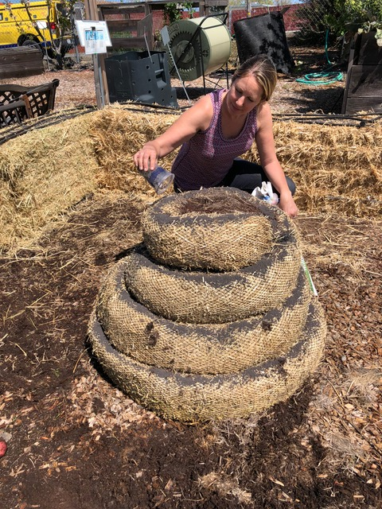
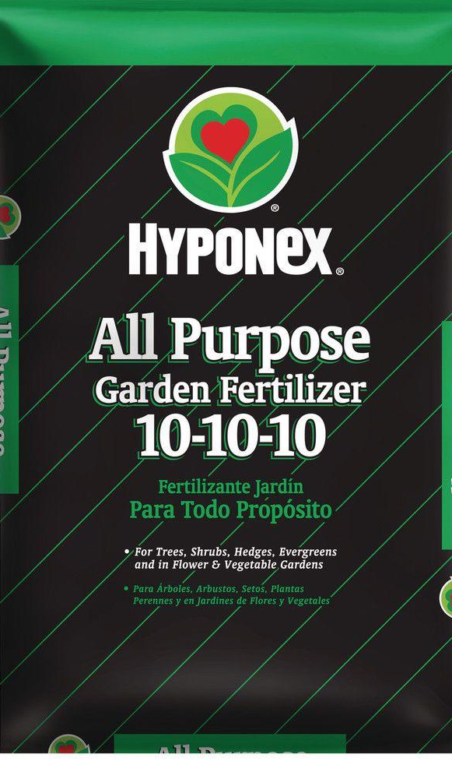
Conditioning of Bales
Various sources to guide you
Two week process applying (handout):
Fertilize
Alternate watering days
Use regular lawn fertilizer (all nitrogen
i.e. NPK 20-0-0)
1 pound/bale
Not “slow release”
No herbicides
End of two weeks:
Apply balanced fertilizer (i.e. NPK 10-10-10)

Slide 7
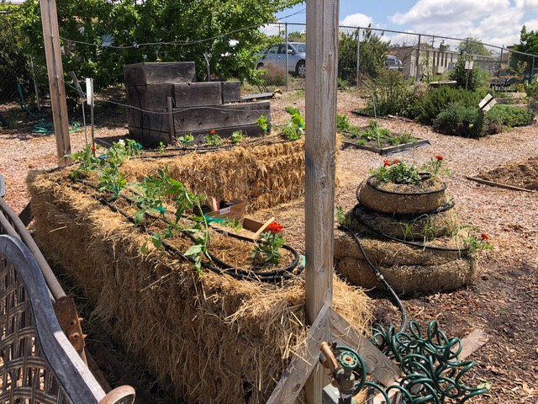
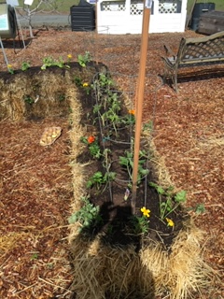
Planting of Bales
Nursery Starts
Use trowel to dig hole in bale
Add handful of sterile planting mix (not garden soil)
Sowing Seeds
2” layer of planting mix on top (not garden soil)
Trellis for tomatoes, beans, sunflowers

Slide 8
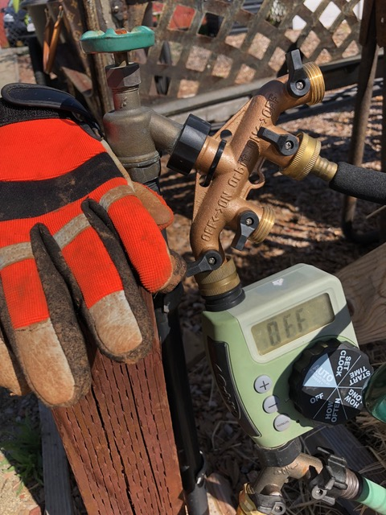
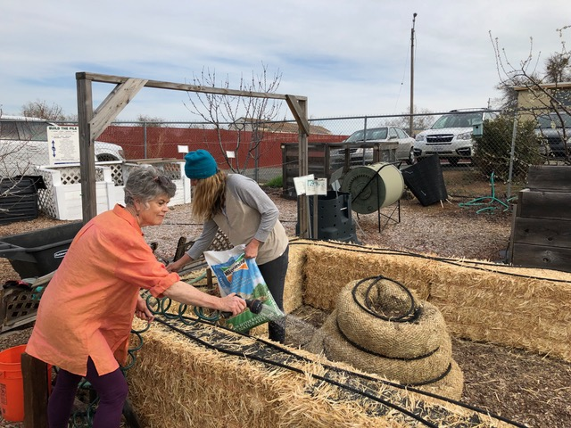
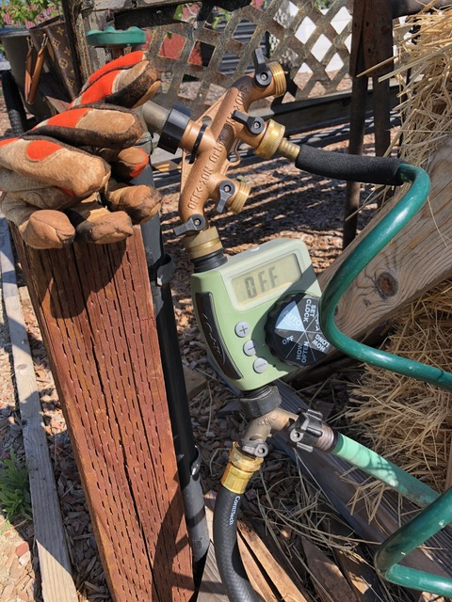
Watering
Soaker hoses allow even and gentle water distribution
Set timer according to weather
Notes:
[Sources: Sunset, USDA, Placer Herald/Elaine Applebaum-2009, CA Garden Web]

Slide 9
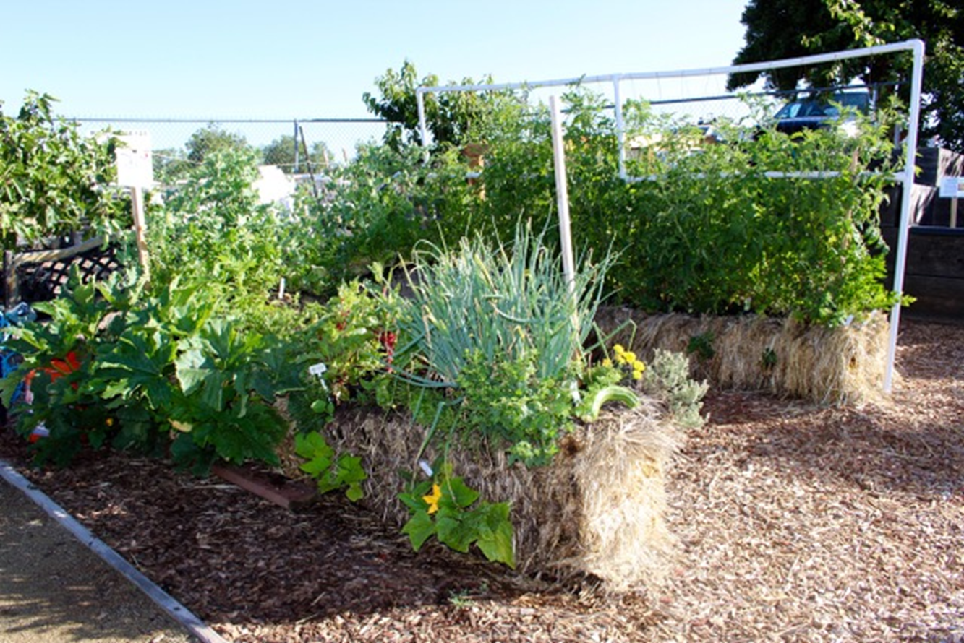
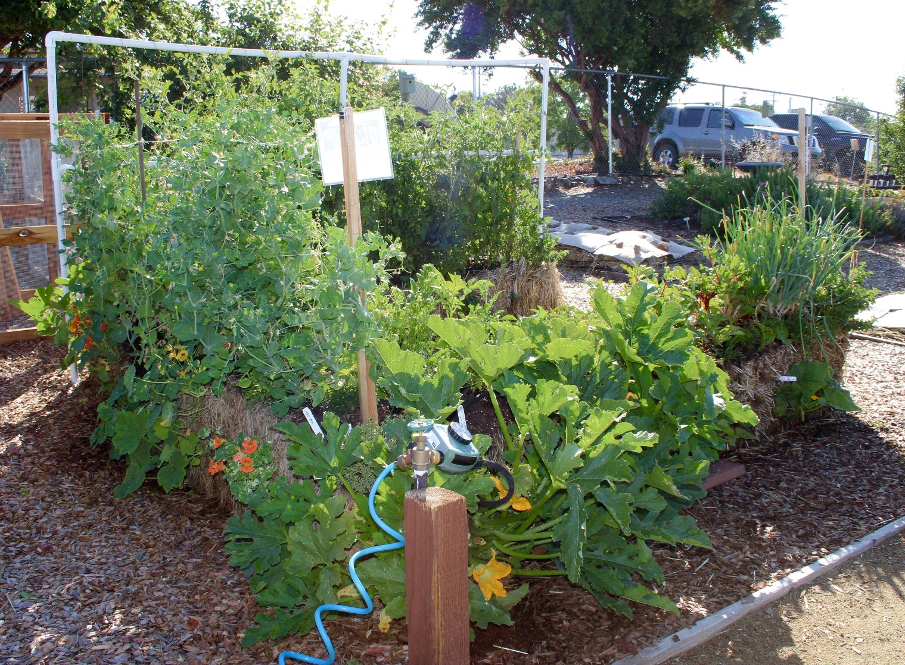
Two Months Later…

Slide 10
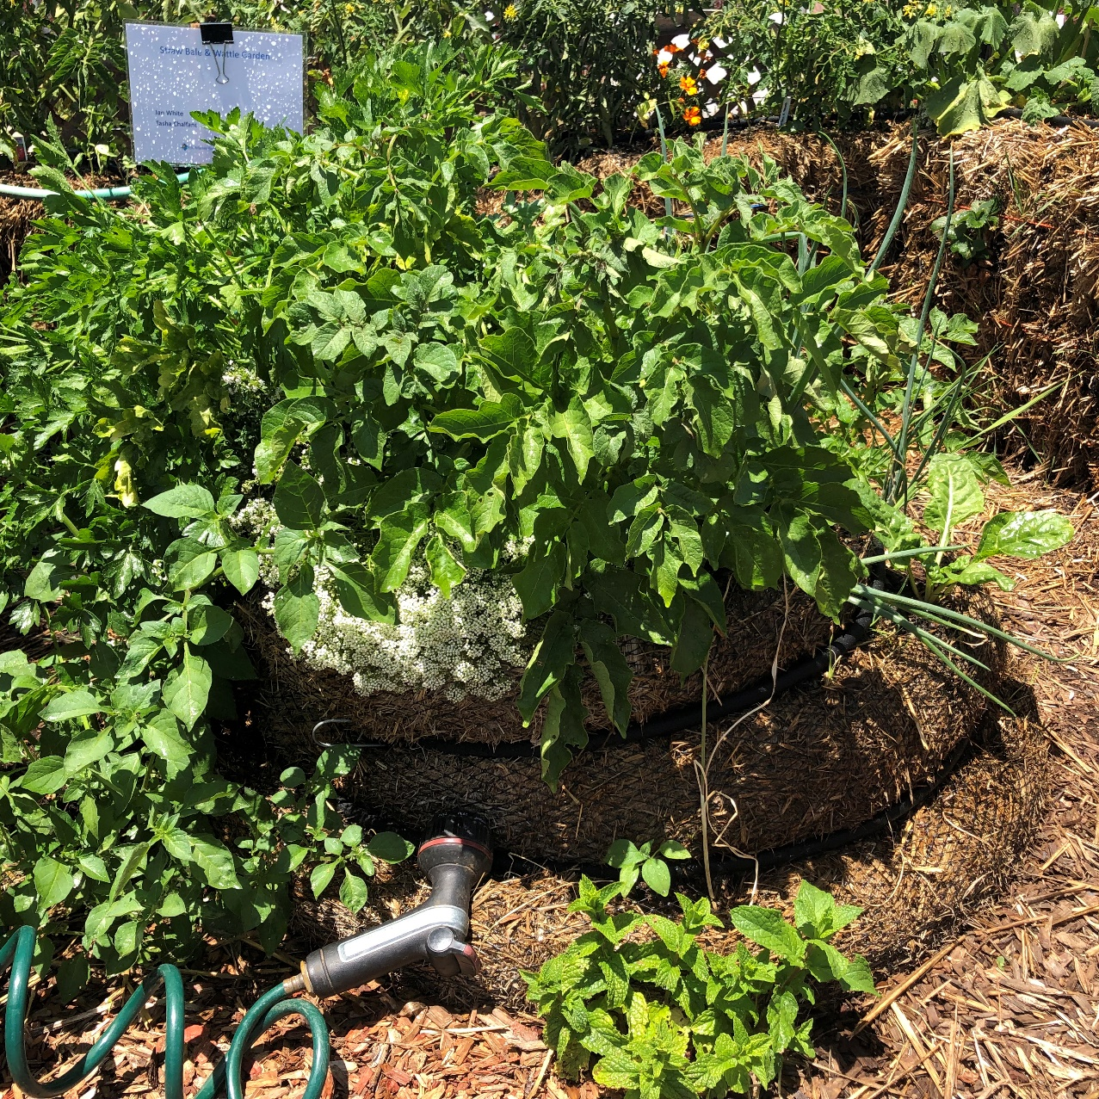
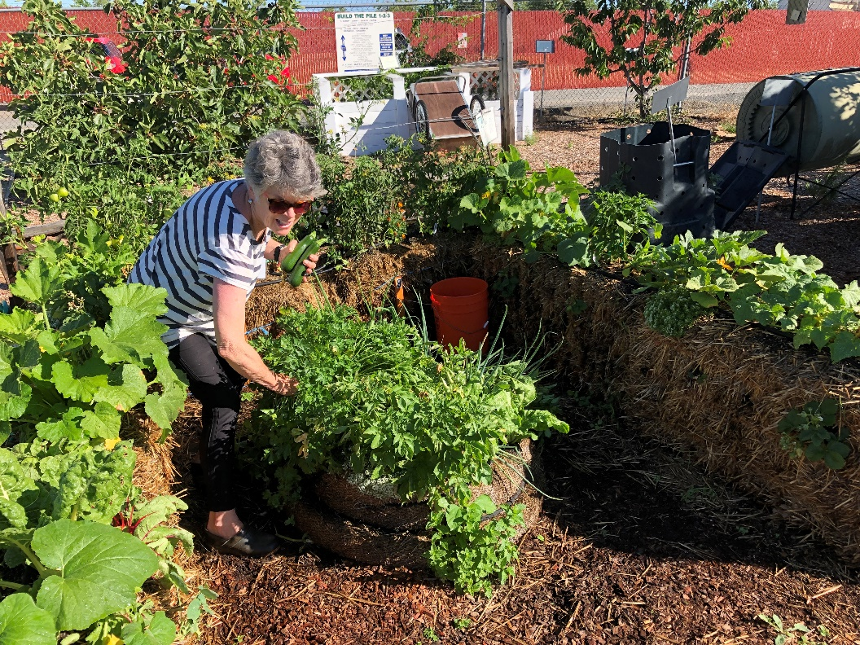
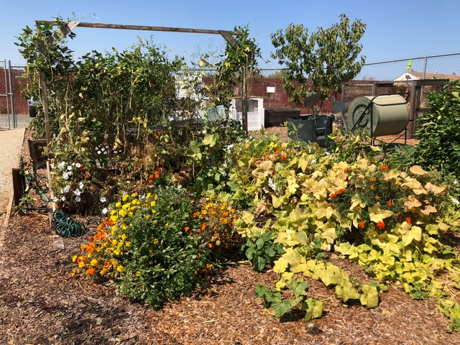
Summer Harvest
Picking parsley
Spuds sprouting in wattle
Pounds of cucumbers
Notes:
[Sources: Sunset, USDA, Placer Herald/Elaine Applebaum-2009, CA Garden Web]

Slide 11
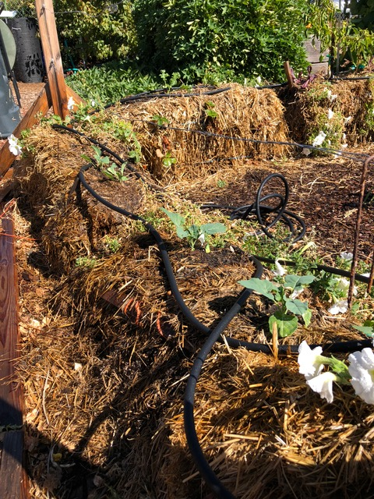
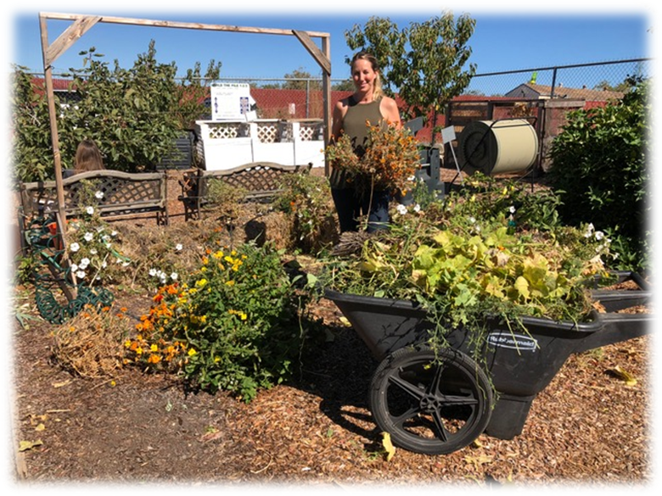
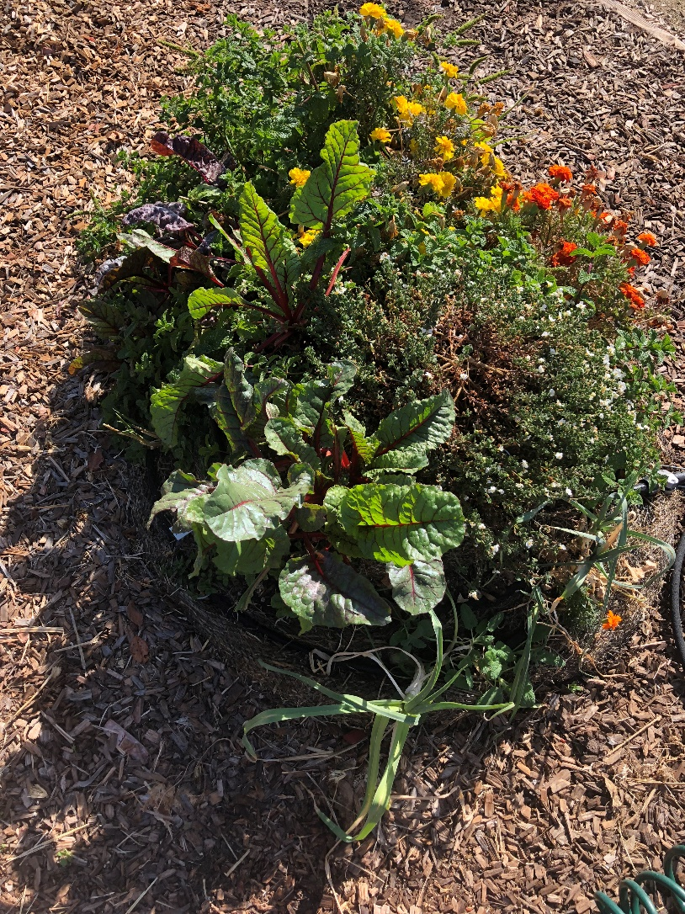
Fall Planting for Winter Harvest
Notes:
[Sources: Sunset, USDA, Placer Herald/Elaine Applebaum-2009, CA Garden Web]

Slide 12
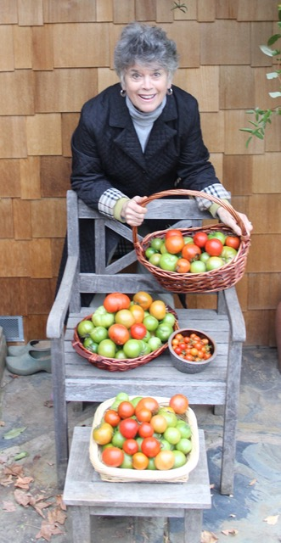
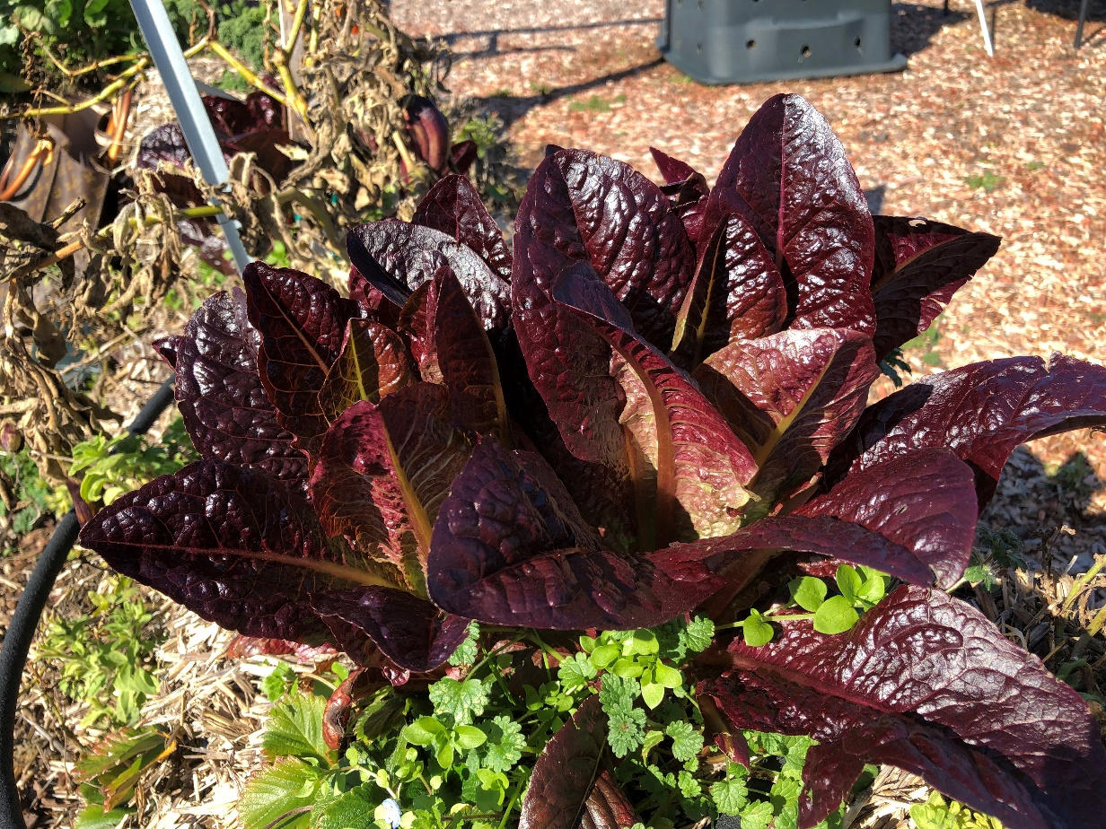
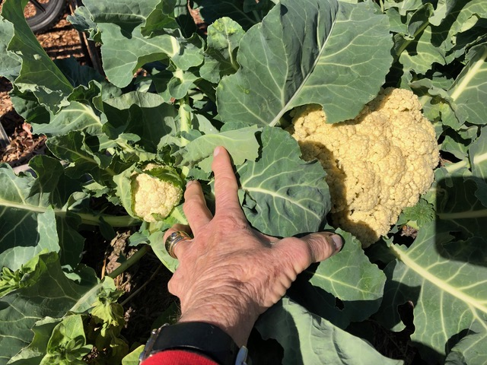
Winter Harvest
Notes:
[Sources: Sunset, USDA, Placer Herald/Elaine Applebaum-2009, CA Garden Web]

Slide 13
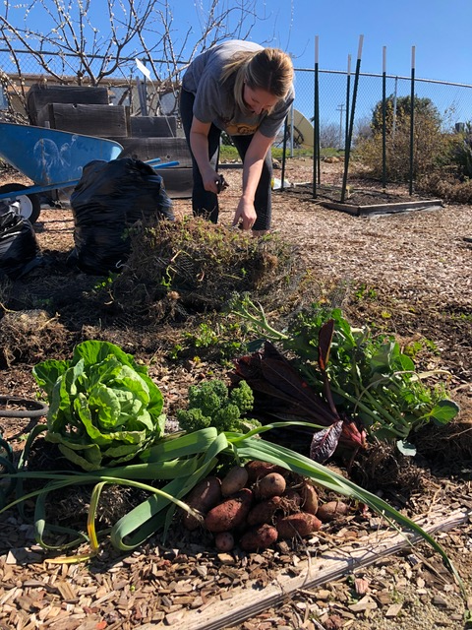
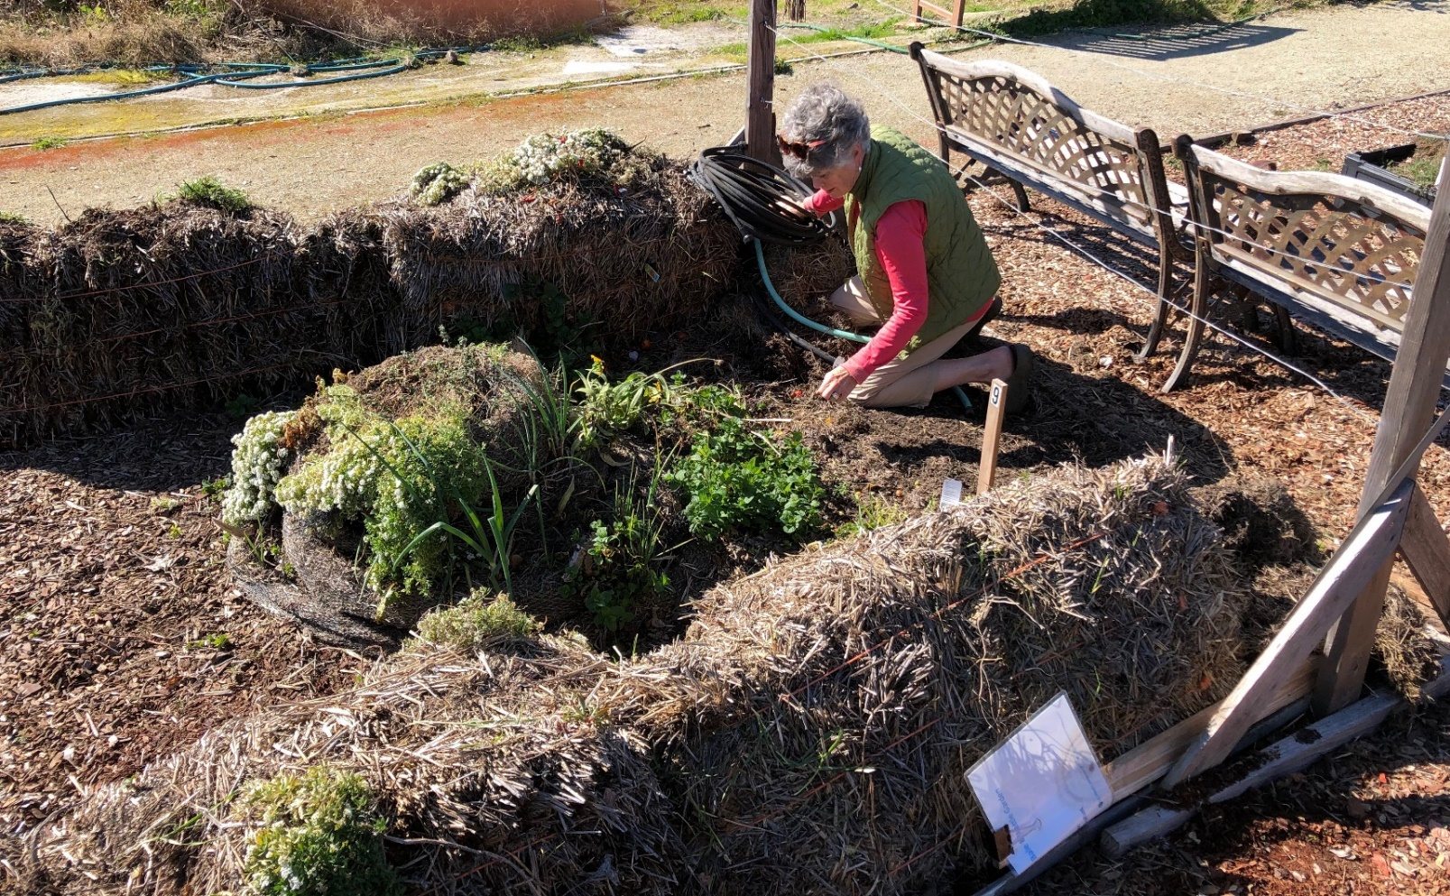
Compost
At end of year
Collapsed bales make excellent compost (rice bale = best)
Potatoes come rolling out!
Notes:
[Sources: Sunset, USDA, Placer Herald/Elaine Applebaum-2009, CA Garden Web]

Slide 14
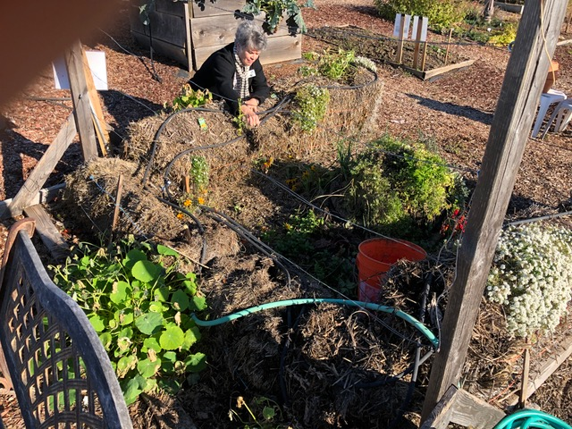
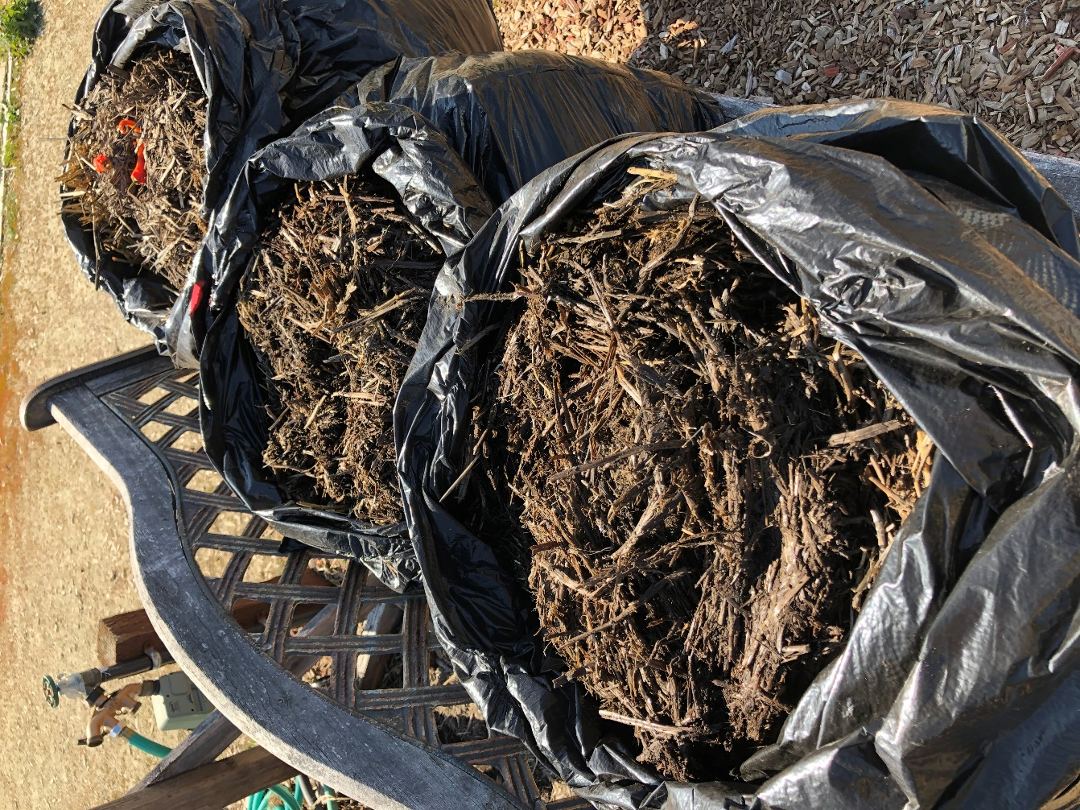
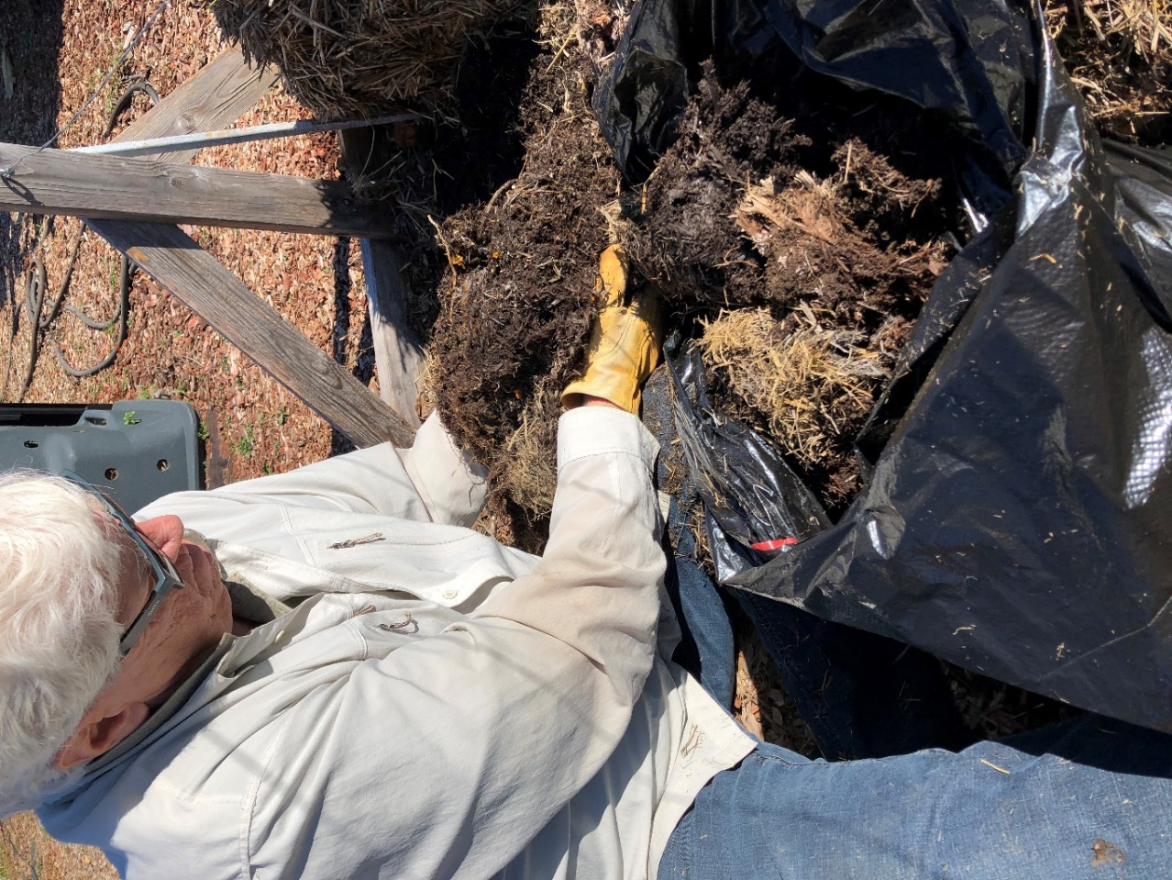
Compost
Notes:
[Sources: Sunset, USDA, Placer Herald/Elaine Applebaum-2009, CA Garden Web]

Slide 15
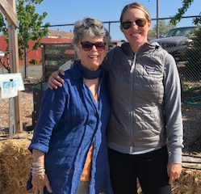
Wrap-Up
Straw Bale Gardening
So easy
Raised bed heights
No soil
No weeding
No tools except a trowel
Extends growing season
Makes super compost
Notes:
[Aloe polyphylla]

Slide 16
Thank You!
Any Questions?
Master Gardener Hotline: (530) 889-7388
Rotline: (530) 889-7399
Master Gardener Website: pcmg.ucanr.org
Evaluations, please!

