Slide 1
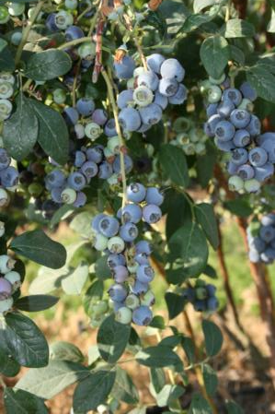
Sweet, Nutritious and Wildly Popular—Grow Your Own Blueberries
Notes:
Created: December 31 2024, Approved by Kathy Gee on January 3, 2024
Created by: Michelle Marquard-Lakhani of Placer County Master Gardener
Audience: Anyone wanting to grow and care for/optimize growth of their blueberries
Publicity: Sweet, Nutritious and Wildly Popular, learn how to purchase, care for, and harvest blueberries in your garden. Growing blueberries can be done easily in a container garden. Come learn how!
Update History: Revision 1.0 Date: , Revision 2.0 Date: , Revision 3.0 Date: , presentation copy January 4, 2024. Michelle Marquard-Lakhani
1.0 through 3.0 were release for review and updated based on feedback prior to final presentation copy release.

Slide 2
Who Are Master Gardeners?
Master Gardeners of Placer County
  Extend research-based, sustainable gardening and composting information
  Present accurate, impartial information to home gardeners
  Encourage public to make informed gardening decisions

Slide 3
Who Are Master Gardeners?
Where to find us…
Online, in the Media, and Special Publications
  Hotline: Call (530) 889-7388 or submit your questions online
  Website: pcmg.ucanr.edu
  Facebook, Instagram, X, You Tube
  Gold Country Media monthly column
  Curious Gardener quarterly newsletter on our website
  Gardening Guide and Calendar

Slide 4
Who Are Master Gardeners?
Where to find us…
Presentations, Fairs and Festivals, and Special Events
  Speakers by Request
  Workshops (various venues, check website)
  Farmers’ Markets (seasonal: Auburn, Lincoln, and Roseville)
  Fairs and Festivals Booths (varies)
  Garden Faire (April 13, 2024)
  Mother’s Day Garden Tour (May 12, 2024)
Notes:
24

Slide 5
Growing Your Own Blueberries
Imagine waking up during spring and summer and walking out to your garden to pick fresh blueberries.
Now let’s get started!
Notes:
Presenter Notes
Not to be overly romantic but…imagine having fresh blueberries available to you right from your very own plant(s)! The objective of today’s presentation is to equip you to do just that, let’s get started.

Slide 6
Agenda
An Introduction to Blueberries
Planting Considerations
Buying Blueberry Plants
Planting
Caring for Blueberries
Notes:
Presenter Notes
We’ll start with an introduction to blueberries, things you need to think about when planting them, guidance on how to approach buying blueberries including varieties that are best for your garden based on size, plant structure, and harvest. Then we’ll cover planting and finally how to care for your blueberry plants.

Slide 7
An Introduction to Blueberries

Slide 8
Growing Blueberries
  Your blueberry plant will need ~3 years to produce a good harvest.
  Southern highbush varieties are best suited to our mild winters, they are low-chill cultivars requiring only 150 to 600 chill hours for bud-break.
Notes:
Reference: Information from this page was obtained from the UCANR California Agriculture—Blueberry research launches exciting new California specialty crop at: https://calag.ucanr.edu/Archive/?article=ca.v059n02p65. Section: Full Text, author sites Gough 1991.
Presenter Notes
Your blueberry plant will need roughly 3 years to produce a good harvest but allow 6 to 8 years before they are likely to reach their full production. If your plants are healthy they should remain productive for 20 years or more. Like many fruiting plants, blueberries may produce some fruit the first few years. It is recommended you pluck the blueberries off the plant in the first few years to all the energy the plant produces to go toward root and plant growth.
Blueberries have chilling requirements. Southern highbush are best suited for our area and I’ll go through some of the details associated with this in a few slides. You’ll want to make sure to choose the type of plant best suited to your area.
Best to buy local and if you’re purchasing plants online make doubly sure you are getting a plant well suited to the climate in your area. Now on to planting considerations.

Slide 9
Planting Considerations

Slide 10
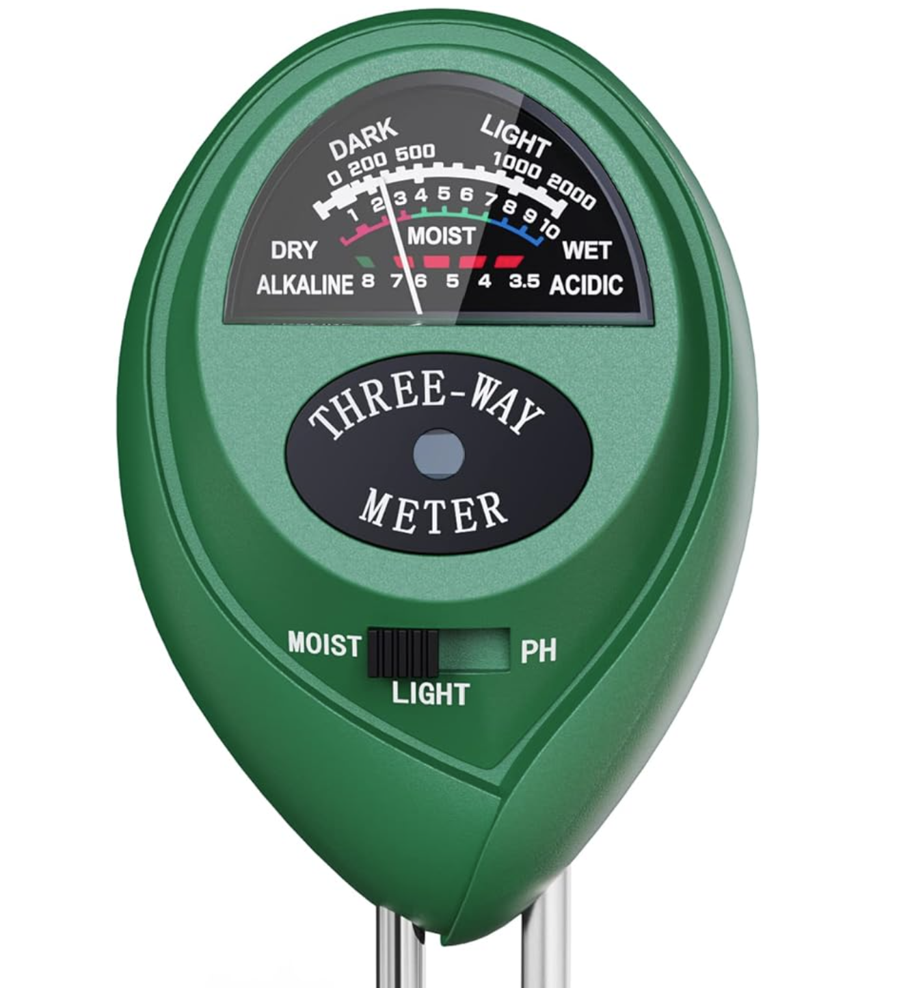
Planting Considerations
  Blueberries are acid-loving plants; therefore, most California soils must be acidified for successful plant establishment. The optimum soil pH for blueberry culture is 4.0 to 5.2.
Notes:
Reference: Information from this page was obtained from the UCANR California Agriculture—Blueberry research launches exciting new California specialty crop at: https://calag.ucanr.edu/Archive/?article=ca.v059n02p65. Section: Planting Considerations, author sites Strik et al. 1993
Presenter Notes:
Soil acidification is most often achieved using sulfuric acid, which is broadcast over the surface of the soil and then flood irrigated with sufficient water to incorporate it to a depth of 12 inches. Soil sulfur can be applied but may require several months to convert to sulfate and change the soil pH. Sulfur is not as predictable as sulfuric acid for changing soil pH. Therefore, when applying sulfur, additional attention must be given to monitoring soil pH and making appropriate adjustments. Citric acid and other acidic compounds may be used to lower soil pH, but they are more costly. A basic 3:1 or 3 way soil meter can be used to test the acidity of your soil to make any needed adjustments. I purchased this one from Amazon for $9.99.

Slide 11
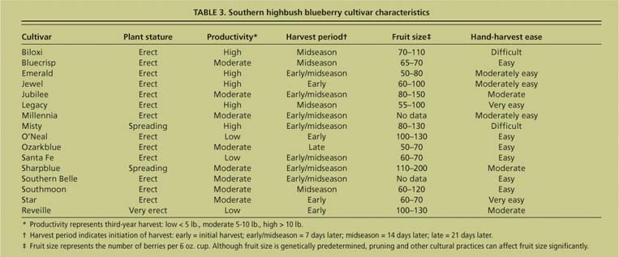
Southern Highbush Cultivars
It’s a good idea to plant at least two cultivars. When choosing you might consider choices extend your harvest period.
California Agriculture 59(2):65-69. https://doi.org/10.3733/ca.v059n02p65 TABLE 3. Southern highbush blueberry cultivar characteristics
Notes:
Reference: Information from this page was obtained from the UCANR California Agriculture 59(2):65-69. https://doi.org/10.3733/ca.v059n02p65 TABLE 3. Southern highbush blueberry cultivar characteristics
Presenter Notes:
Don’t worry about writing these down, I’ve included the link to the site on the resource sheet.
There are many varieties of southern highbush cultivars. Let’s take a few minutes to review the table. Just a note, you may have noticed that I’ve limited the information to Southern Highbush blueberry cultivars, I’ve done this as these are best suited to our mild winters. You won’t starved for choice in any case. Depending on your area you will want to decided on which plant or plants will be best suited to your situation. Some blueberries are erect or very erect while others are the spreading varieties. Additionally, as I noted earlier, if you want to extend your fruiting or harvest window you’ll want to pick varieties that differ. An example would be Jewel that fruit early and Southmoon that fruit midseason. Or Southmoon that fruits midseason and Ozarkblue that fruits late season. Finally, you may have preferences associated with fruit size and ease of harvest.

Slide 12
Buying Blueberry Plants

Slide 13
Buying Blueberry Plants
Ideally buy locally
Plant Stature
Soil Requirements
Ease of harvest
Harvest Period
Notes:
Reference: Information from this page was obtained from the UCANR California Agriculture 59(2):65-69. https://doi.org/10.3733/ca.v059n02p65 TABLE 3. Southern highbush blueberry cultivar characteristics
Presenter Notes:
We won’t spend a great deal of time talking about buying as the information provided in planting considerations should be a good guide. Again, you’ll wanting to be thinking a few steps ahead…what you’d like to get based on planting considerations and your space and objectives. Have a couple of options for varieties and then search locally for them. Now on to planting

Slide 14
Planting

Slide 15
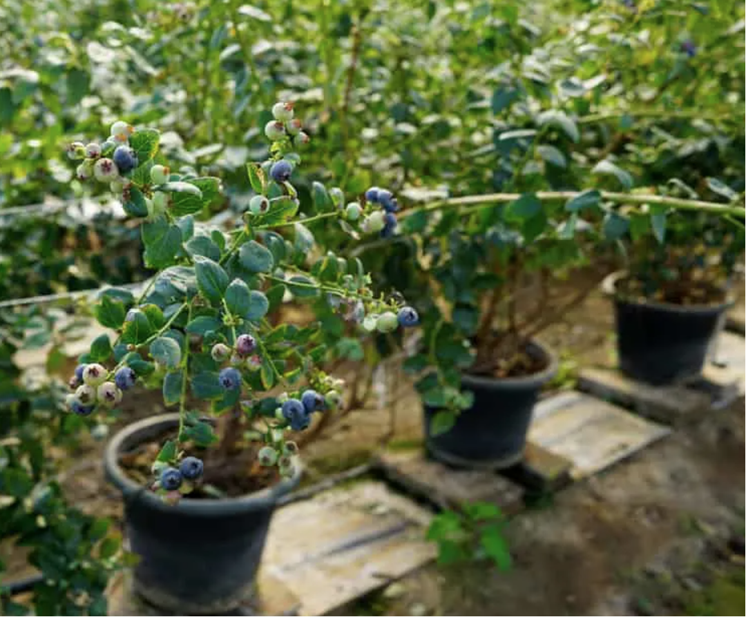
Planting Blueberries
Location:
  Heat tolerance
  Cold tolerance
  Sun Exposure: Morning sun and afternoon shade
Pollination: Blueberries are self-pollinating but are better producers when more than one variety is present for cross-pollination.
Notes:
Reference: Information from this page was obtained from the University of Maryland Extension, University of Maryland in an article titled Growing Blueberries in Containers. Link: Growing Blueberries in Containers | University of Maryland Extension (umd.edu)
Presenter Notes:
When planting blueberries you’ll want to consider the areas sun and shade patterns. Blueberries enjoy full sun in the morning but direct sun in the afternoon can stress the plant(s), so shady and dappled light in the afternoon is a perfect location solution. You don’t need to be concerned about freezing weather unless the plants are not dormant. If the plant has broken dormancy and the temperatures drop below freezing it would be a good idea to cover the plant to prevent burn. Planting one variety is absolutely fine as blueberries are self-pollinating. That said, you might consider planting two to extend your fruiting cycle.

Slide 16
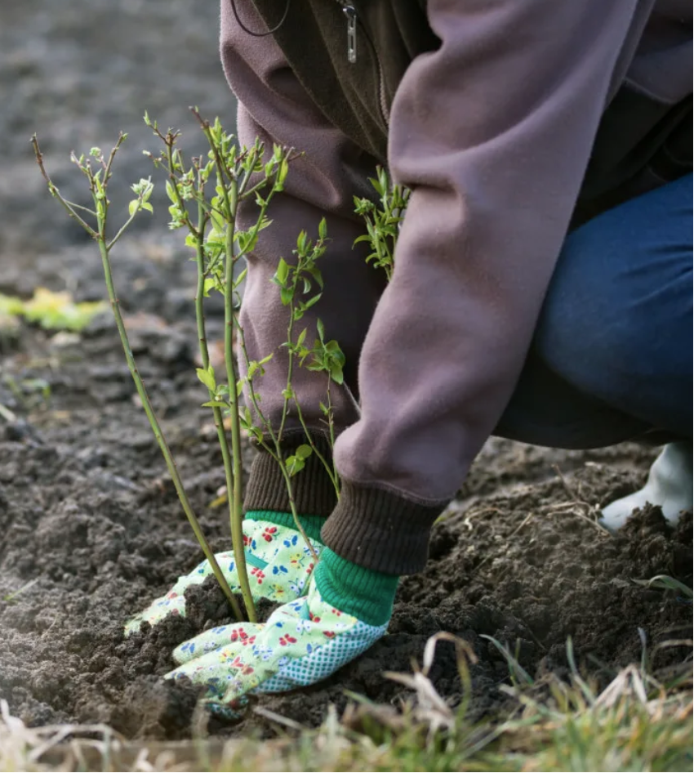
Planting Blueberries
Soil Requirements
  Acidic pH (4.0-5.2)
  Well-draining
  High in organic matter
Notes:
Reference: Information from this page was obtained from the UCANR site in an article titled: Blueberry research launches exciting new California specialty crop. Link: All Issues - California Agriculture (ucanr.edu)
Presenter Notes:
Planting considerations
Blueberries are acid-loving plants; therefore, most California soils must be acidified for successful plant establishment. The optimum soil pH for blueberry culture is 4.0 to 5.2 (
You can test for acidity in the soil using a soil meter. First test the soil and then add soil sulfur, if needed, to obtain acidity level in optimal range.
You’ll want to be sure your soil is moist but not saturated and lastly, high in organic matter. You can add well-composted materials if needed.

Slide 17
Planting Blueberries
Decisions include one or more plants. Ideally, choose at least 2 varieties and In ground or potted?
Timing: Spring
Soil:
  Prepare the soil/ choose the right planting medium
  Test for acidity and further acidify soil regularly
Gently shake away dirt after removing from container to ensure roots are not tangled or wrapped around one another. Plant in container allowing 3x width of ready soil for roots system growth.
Water well
Notes:
Reference: Information from this page was obtained from the UCANR site in an article titled: Blueberries in the Home Garden. Link: 171602.pdf (ucanr.edu).
Presenter Notes:
Once you’ve decided on how many and what kind you’ll need to think about timing. Planting Blueberries Plants are available bare root and in containers. The ideal time to plant is generally in the spring. Position the plants so the crown is no greater than 1⁄2 inch below the ground. There is no need to fertilize the plants at this time as blueberries do not require large amounts of fertilizer and are sensitive to being over-fertilized. Once you have planted your blueberries, mulch them with a 3-4 inch layer of pine bark or pine needles. A pine-based mulch helps maintain the acid soil condition.
Water well and finally it’s worth mentioning that over fertilizing can also cause problems. You best choice is a “sparse” application of a fertilizer specifically labeled for use on azaleas and rhododendrons

Slide 18
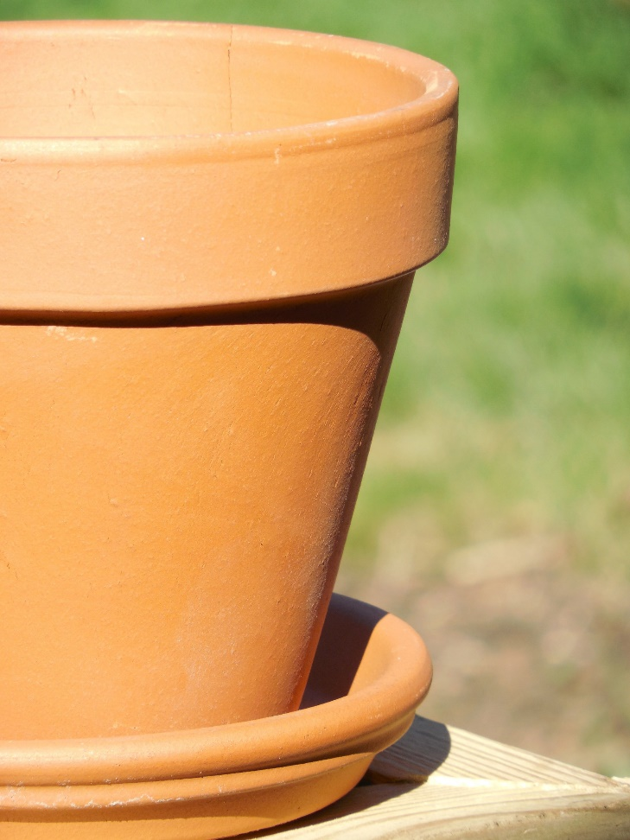
Container Planting
Container Size
  Blueberries have a shallow broad root system
Soil Mix for Potted Plants
  Use a high acidity mix
Retain moisture
  Add mulch
  Raise and move container
  Group together
Repot every 3-4 years as the plant grows
Notes:
Reference: Information from this page was obtained from the UCANR site article on Container Gardening Basics Link: https://mgsantaclara.ucanr.edu/garden-help/container-gardening/. Additional information was obtained from the University of Maryland Extension, University of Maryland in an article tiitled Growing Blueberries in Containers. Link: Growing Blueberries in Containers | University of Maryland Extension (umd.edu)
Presenter Notes:
A topline view of container gardening includes, review slide. Now on to some specifics.

Slide 19
Container Planting Cont.
All containers should have drainage holes.
What kind of container is best suited to blueberries?
Container Size and repotting
Potting Soil
Take care to avoid problems with either underwatering, overwatering, or inconsistent watering.
Notes:
Reference: Information from this page was obtained from the UCANR site article on Container Gardening Basics Link: https://mgsantaclara.ucanr.edu/garden-help/container-gardening/. Additional information was obtained from the University of Maryland Extension, University of Maryland in an article titled Growing Blueberries in Containers. Link: Growing Blueberries in Containers | University of Maryland Extension (umd.edu)
Presenter Notes:
All containers should have drainage holes. If a drainage hole is not there it can usually be added using a household drill. Use a concrete or masonry bit for glazed or unglazed pots.
Material options benefits/drawbacks
Clay or terra cotta pots are porous. They allow for aeration but if you are using potting soil with peat moss your plant is unlikely to suffer from lack of aeration.
Plastic, glazed and cement pots are non-porous and maintain temperature and water at a more constant level.
Wood planters made of cedar or redwood are naturally resistant to decay. Repurposed wood can be used for gardens, but it is advisable to avoid using wood previously treated with arsenic-based preservatives for vegetables and other edibles.
Metal planters can get hot and need more watering.
Container Size: Consider mature root depth (vertical) and spread (horizontal) when sizing a container for a particular plant. Select a well-draining, large weather-proof container… Mature blueberries need a container at least 24 inches deep and about 24-30 inches wide. When planting smaller shrubs, start with a smaller container and repot as it grows. Repot in late summer or early fall so roots have enough time to grow before winter.
Potting Soil: Use a 50-50 mix of potting soil and peat moss as your planting media. Wet it thoroughly before placing it in the container. If the shrub is pot bound gently tease the roots to encourage root expansion into the potting media. Place the blueberry into the potting media and plant it the same depth as it was in its container.
Lastly, Take care to avoid problems with either underwatering, overwatering, or inconsistent watering.

Slide 20
Caring for Blueberries

Slide 21
Caring for your Blueberries
Annual care:
Blueberries need annual pruning to maintain the right balance of new & previous season growth.
Adding sulfur during our wet season helps maintain acid soil conditions. Monitor and add additional sulfur to acidify soil as needed to maintain desired acidity.
Mulch in hot summer / early fall weather so roots remain cool and moist.
Notes:
Reference: Information from this page was obtained from the publication titled The Rural Sprout.in an article titled How & When to Prune Blueberry Bushes for Bountiful Berries Every Year. By: Author Tracey Besemer. Link: How & When to Prune Blueberry Bushes for Bountiful Berries Every Year (ruralsprout.com).
Presenter Notes:
Blueberries begin blooming in late January through March. The plants are dormant December. Pruning can be done in late January and should include a mix of previous years growth as well as new growth. We’ll covering how to approach pruning in just a minute.
Remember to monitor the acidity of the soil through the wet season and add sulfur or other amendments as needed, especially during the wet season.
Mulching can be done during the summer and fall to maintain moisture in the soil and help the soil to keep cool.
Now, on to pruning your blueberries.

Slide 22
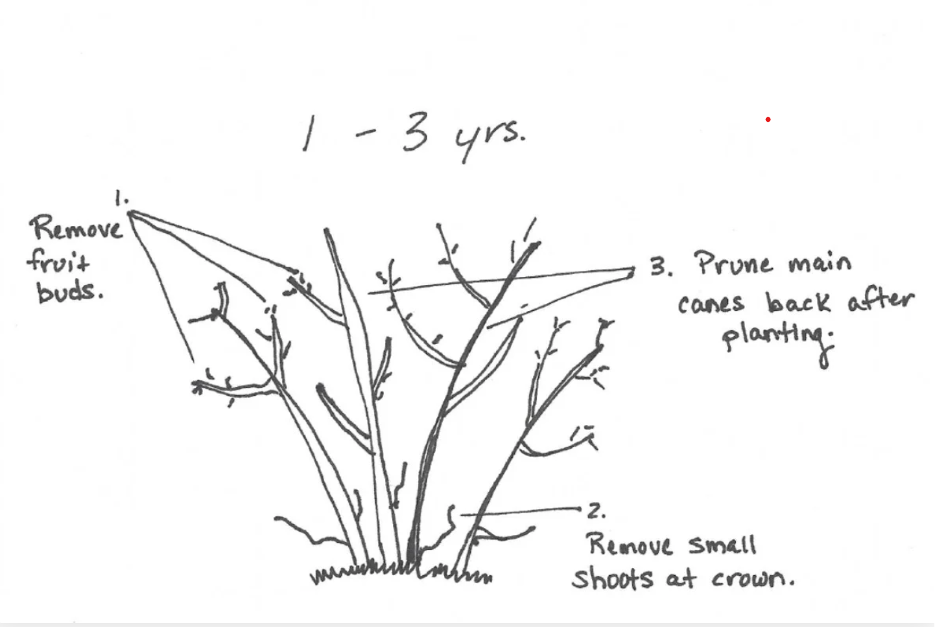
CARING FOR BLUEBERRIES:
Pruning
  Remove all blossoms first two years
  Remove diseased and damaged branches
  After second year, annually prune out all but 6-8 branches, suckers & weak wood in December-early January
Notes:
Reference: Information from this page, including graphics, was obtained from the publication titled The Rural Sprout.in an article titled How & When to Prune Blueberry Bushes for Bountiful Berries Every Year. By: AuthorTracey Besemer. Link: How & When to Prune Blueberry Bushes for Bountiful Berries Every Year (ruralsprout.com).
Presenter Notes:
I thought it would be helpful to share a visual guide for pruning. First I’ll cover young plants and then established plants 4+ years. Let’s walk through this and then we can look at how this changes as the plant matures.

Slide 23
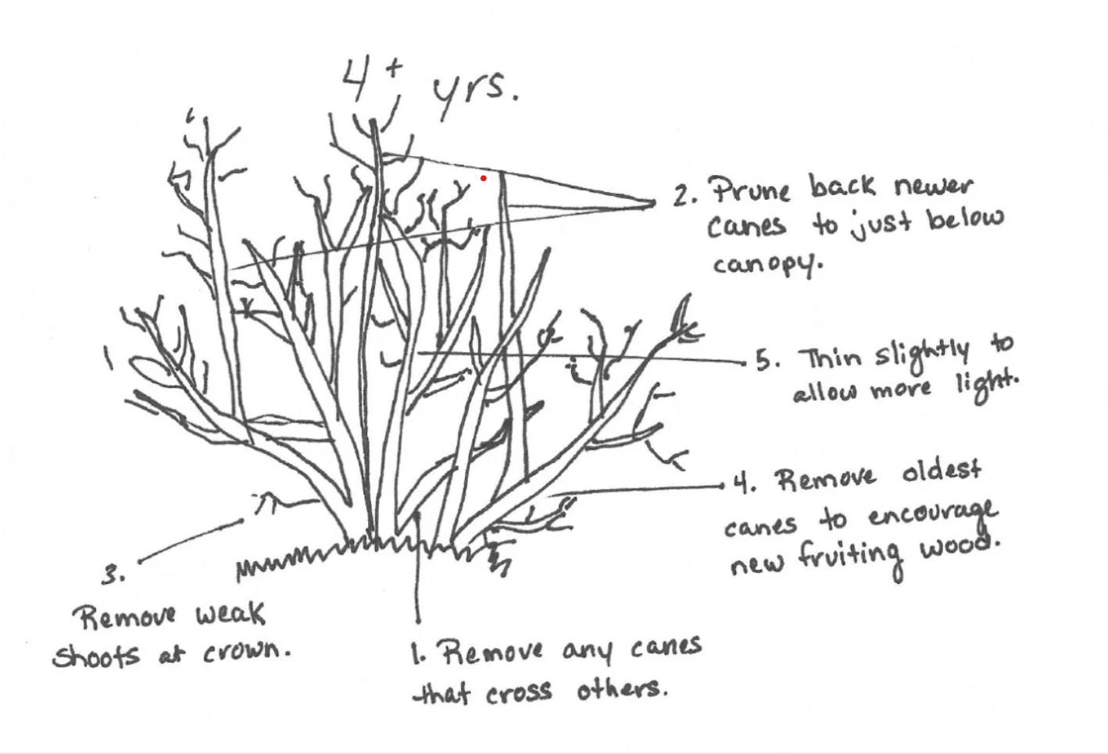
Caring for Blueberries: Year 4+
Notes:
Reference: Information from this page, including graphics, was obtained from the publication titled The Rural Sprout.in an article titled How & When to Prune Blueberry Bushes for Bountiful Berries Every Year. By: AuthorTracey Besemer. Link: How & When to Prune Blueberry Bushes for Bountiful Berries Every Year (ruralsprout.com).
Presenter Notes:
So, we’ve made it through the first few years. Let’s look at how the pruning process changes. Let’s look at pruning up close, I’d like to be sure you identify leaf buds and fruit buds when you begin pruning.

Slide 24
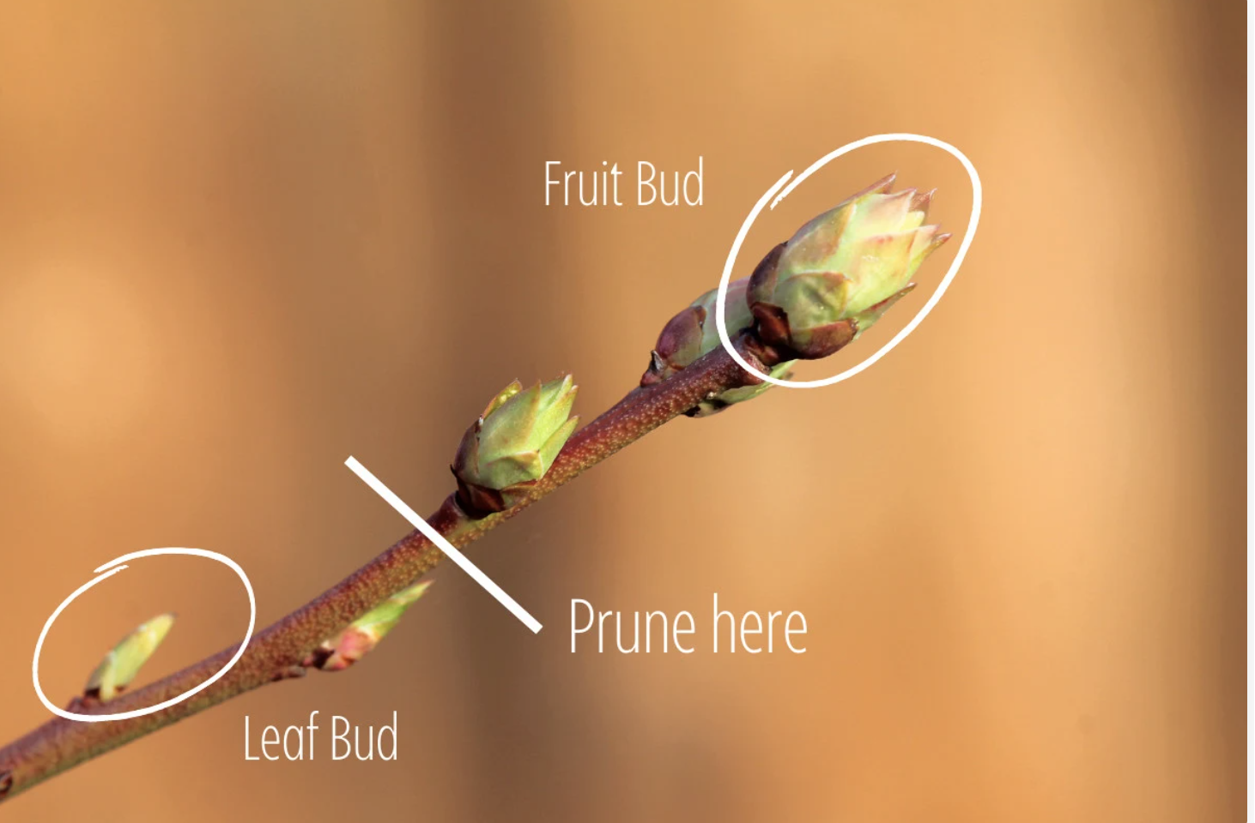
Caring for Blueberries: Example
Notes:
Reference: Information from this page, including graphics, was obtained from the publication titled The Rural Sprout.in an article titled How & When to Prune Blueberry Bushes for Bountiful Berries Every Year. By: AuthorTracey Besemer. Link: How & When to Prune Blueberry Bushes for Bountiful Berries Every Year (ruralsprout.com).
Presenter Notes:
I thought it would be helpful to share a visual guide for pruning, especially during the first few years. Let’s walk through this and then we can look at how this changes as the plant matures.

Slide 25
CARING FOR BLUEBERRIES:
Fertilizing
  No fertilizer is required when you’re planting. However, it is a good idea to add a slow-release formula ~3 to 4 months post planting.
  Adding sulfur during our wet season helps maintain acid soil conditions. Monitor and add additional sulfur to acidify soil as needed to maintain desired acidity.
Irrigation
  Drip
  Mini-sprinklers
Notes:
Reference: Information from this page was obtained from the UCANR site in an article titled: Blueberries in the Home Garden. Link: 171602.pdf (ucanr.edu). Additional information was obtained from the UCANR site article on Container Gardening Basics Link: https://mgsantaclara.ucanr.edu/garden-help/container-gardening/. And, the University of Maryland Extension, University of Maryland in an article titled Growing Blueberries in Containers. Link: Growing Blueberries in Containers | University of Maryland Extension (umd.edu)
Presenter Notes:
There is no need to fertilize the plants at this time as blueberries do not require large amounts of fertilizer and are sensitive to being over-fertilized. Once you have planted your blueberries, mulch them with a 3-4 inch layer of pine bark or pine needles. The pine-based mulch helps maintain the acid soil condition. Alternatively, add sulfur to help maintain desired acidity levels.
A reminder that Blueberries are sensitive to over/under watering so you’ll want to be consistent and aware as the weather changes. Drip or mini-sprinklers on a timer can be helpful in maintaining consistency.

Slide 26
Caring for Blueberries
Harvest when mature:
  Extended harvest period by using more than one variety
  Check acidity levels if you experience uneven ripening of cluster or small fruit size
  Store at 32-40 degrees F to maintain quality / optimal longevity
Notes:
Reference: Summary of prior material covered.
Presenter Notes:
I’ll wrap up today’s presentation with a quick summary about harvesting. A reminder you can extend your fruiting period by selecting more than one blueberry bush and variety.
Be sure to maintain acidity levels and if you experience uneven ripening or small fruit it may be due to acidity being outside the range.
Lastly, you can store your blueberries in your fridge or a cold box to extend the useful life if this fun and nutritious fruit.

Slide 27
My Blueberries
January 15, 2024

Slide 28
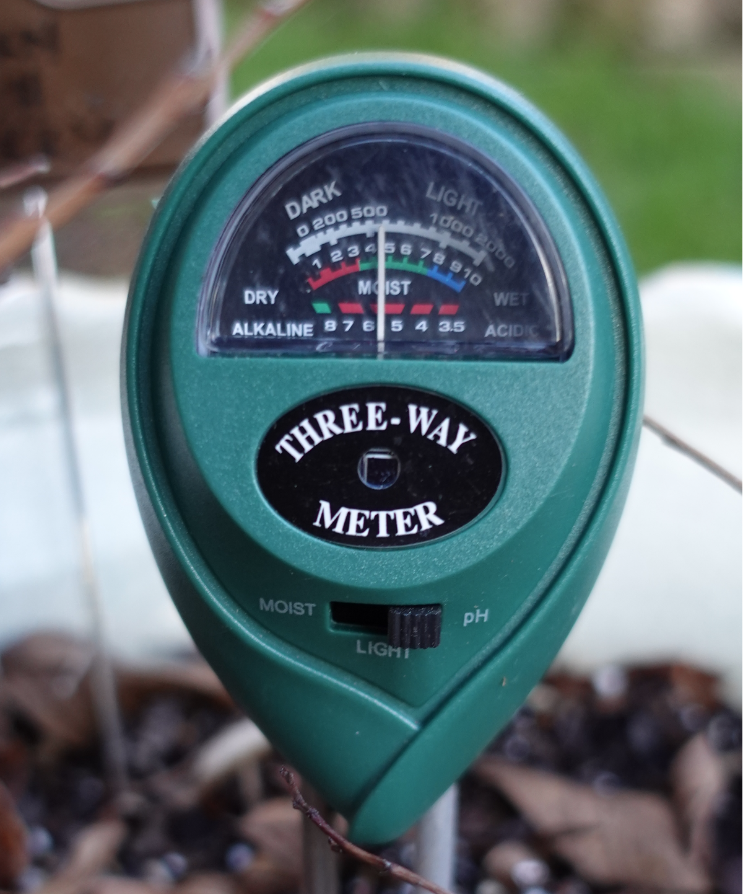
The target range is 4.0 to 5.2
Photo by Michelle Marquard-Lakhani

Slide 29
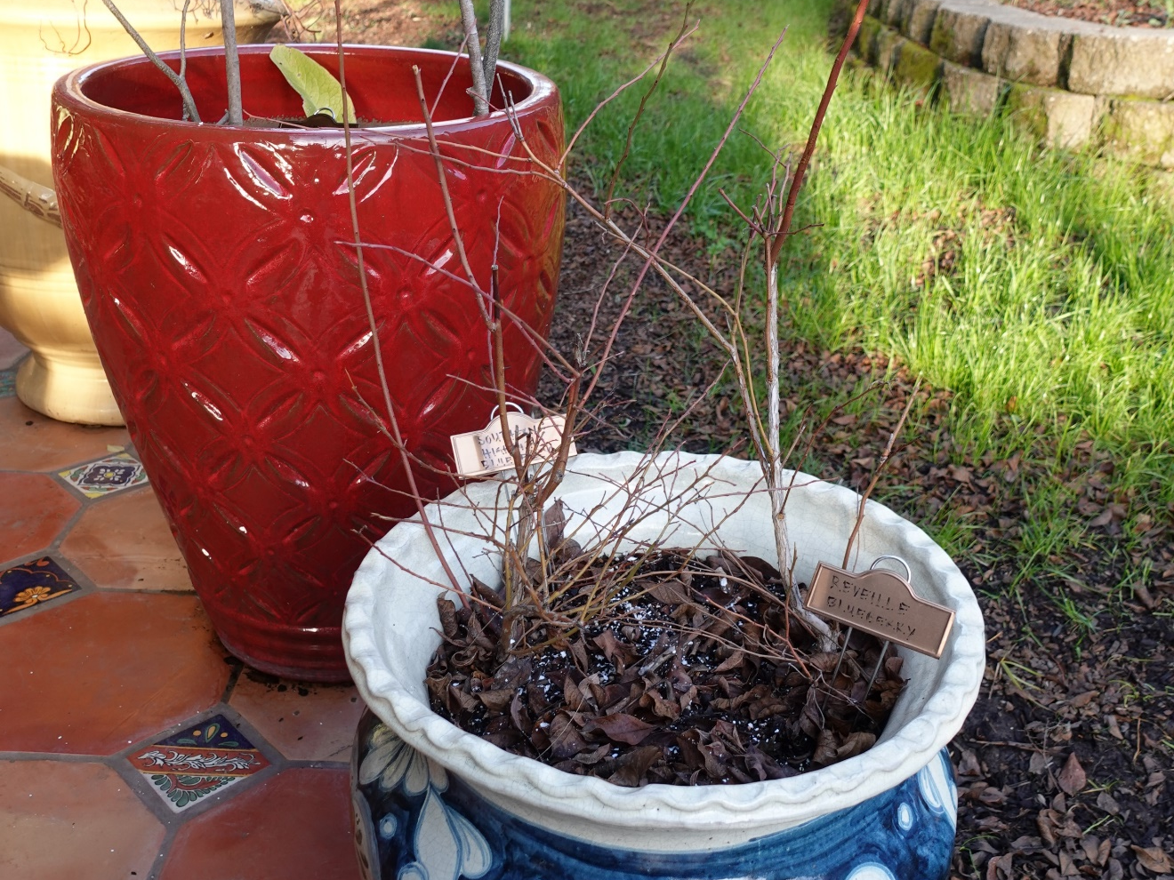
View of blueberries prior to pruning
Photo by Michelle Marquard-Lakhani

Slide 30
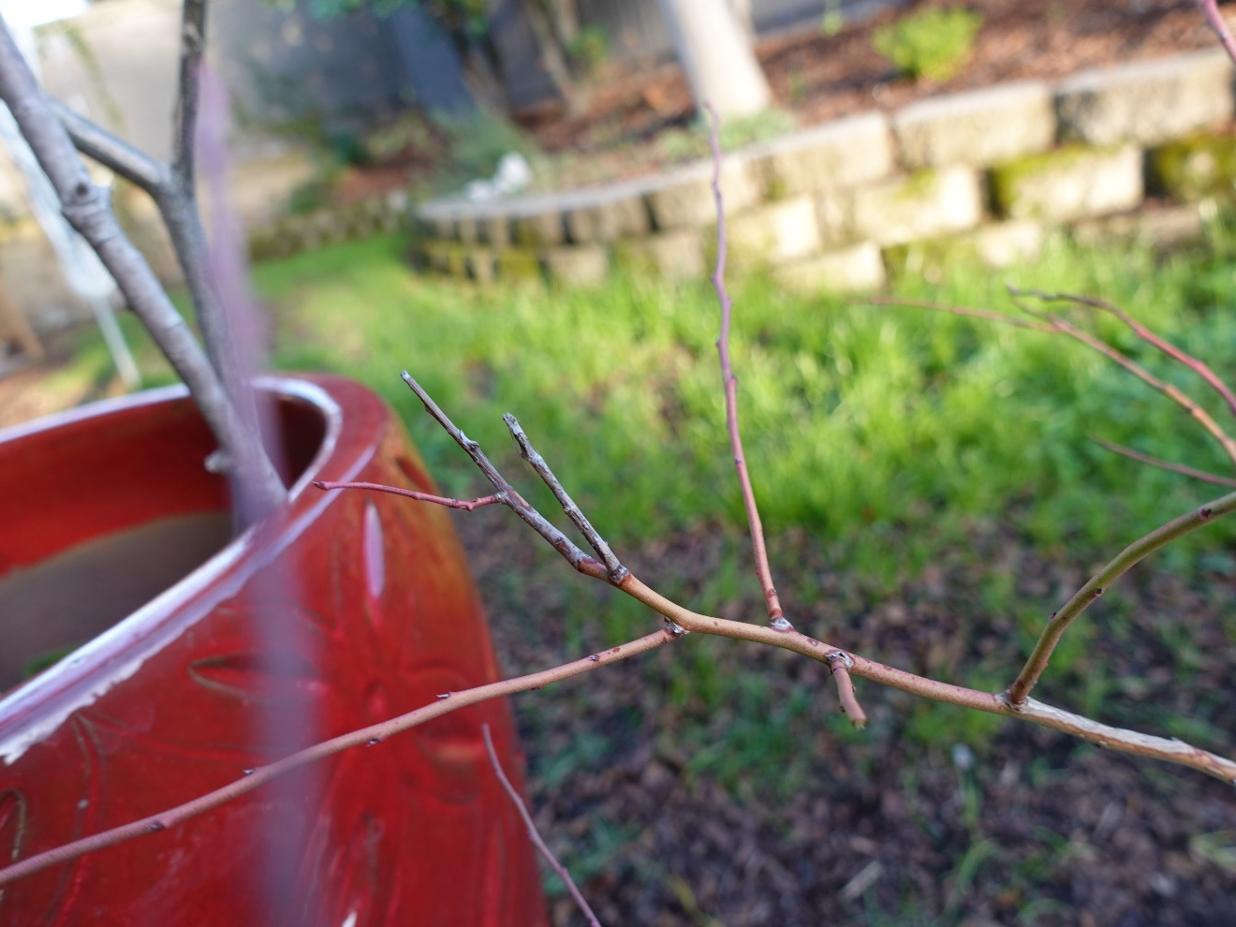
Dead wood needs to be trimmed away
Photo by Michelle Marquard-Lakhani

Slide 31
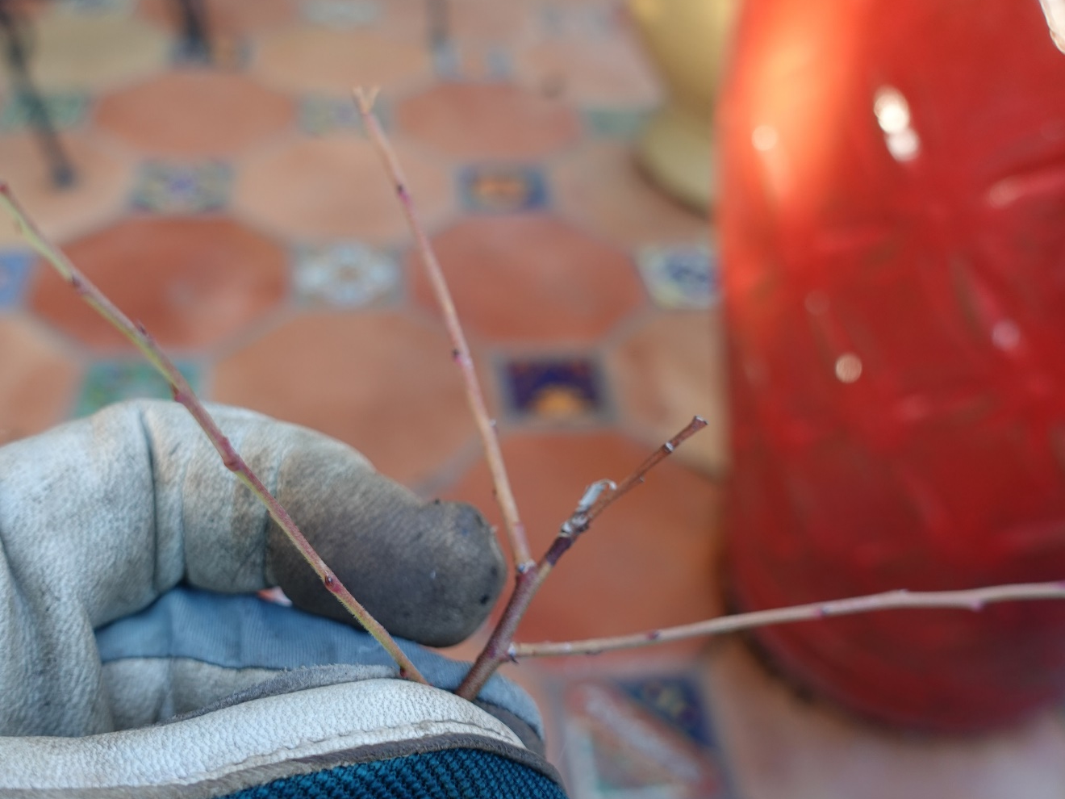
Dead wood needs to be trimmed away
Photo by Michelle Marquard-Lakhani

Slide 32
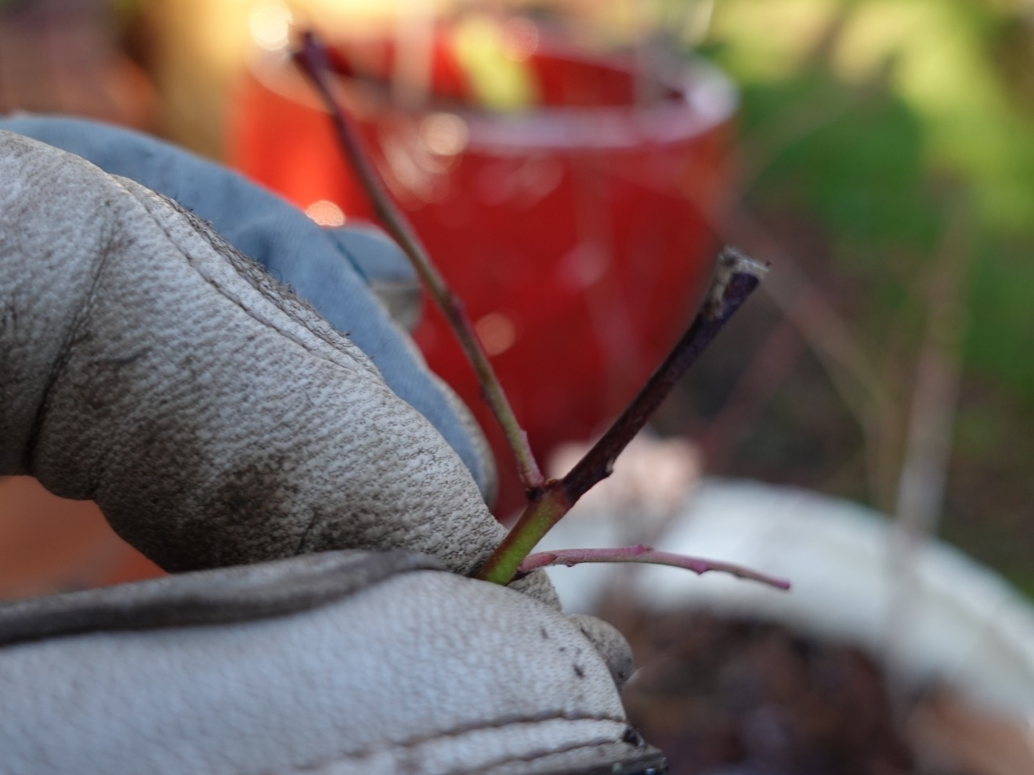
Dead wood needs to be trimmed away
Photo by Michelle Marquard-Lakhani

Slide 33
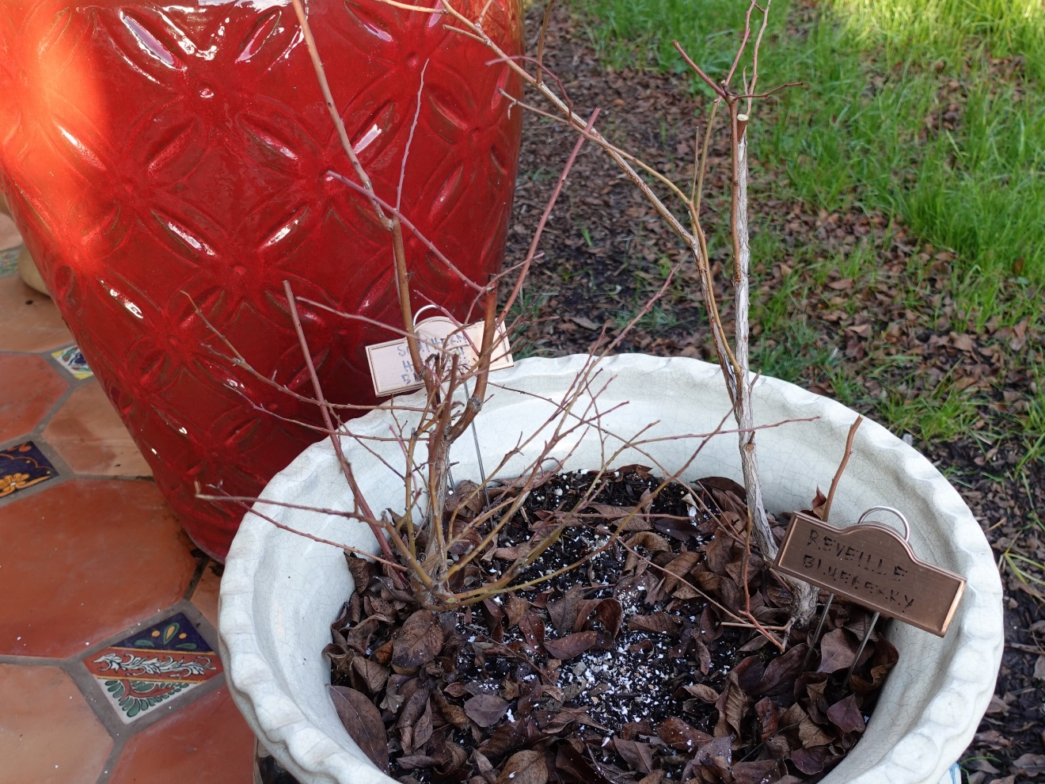
View of blueberries after pruning
Photo by Michelle Marquard-Lakhani

Slide 34
Thank You!
Any Questions?
Master Gardener Hotline: (530) 889-7388
Master Gardener Website: pcmg.ucanr.edu
Evaluations, please!

Slide 35
References
http://ucanr.org/sites/gardenweb/Berries/?uid=25&ds=466
https://ucanr.edu/sites/gardenweb/files/141264.pdf
http://ucanr.edu/datastoreFiles/391-211.pdf
California Master Gardener Handbook, 2002,
ANR Publication 3382, anrcatalog.ucdavis.edu/
Sunset Western Garden Book, Sunset Publ. Co.
California Blueberry Commission: http://www.calblueberry.org/annual-reports.htmlCouncil
U.S. Highbush Blueberry Council: https://ushbc.blueberry.org/

Slide 36
All blueberry photo(s) used in this presentation are from the picture below. This picture was retrieved from the ANR Repository https://ucanr.edu/repository/view.cfm?article=73456%20&search=blueberry

