Slide 1
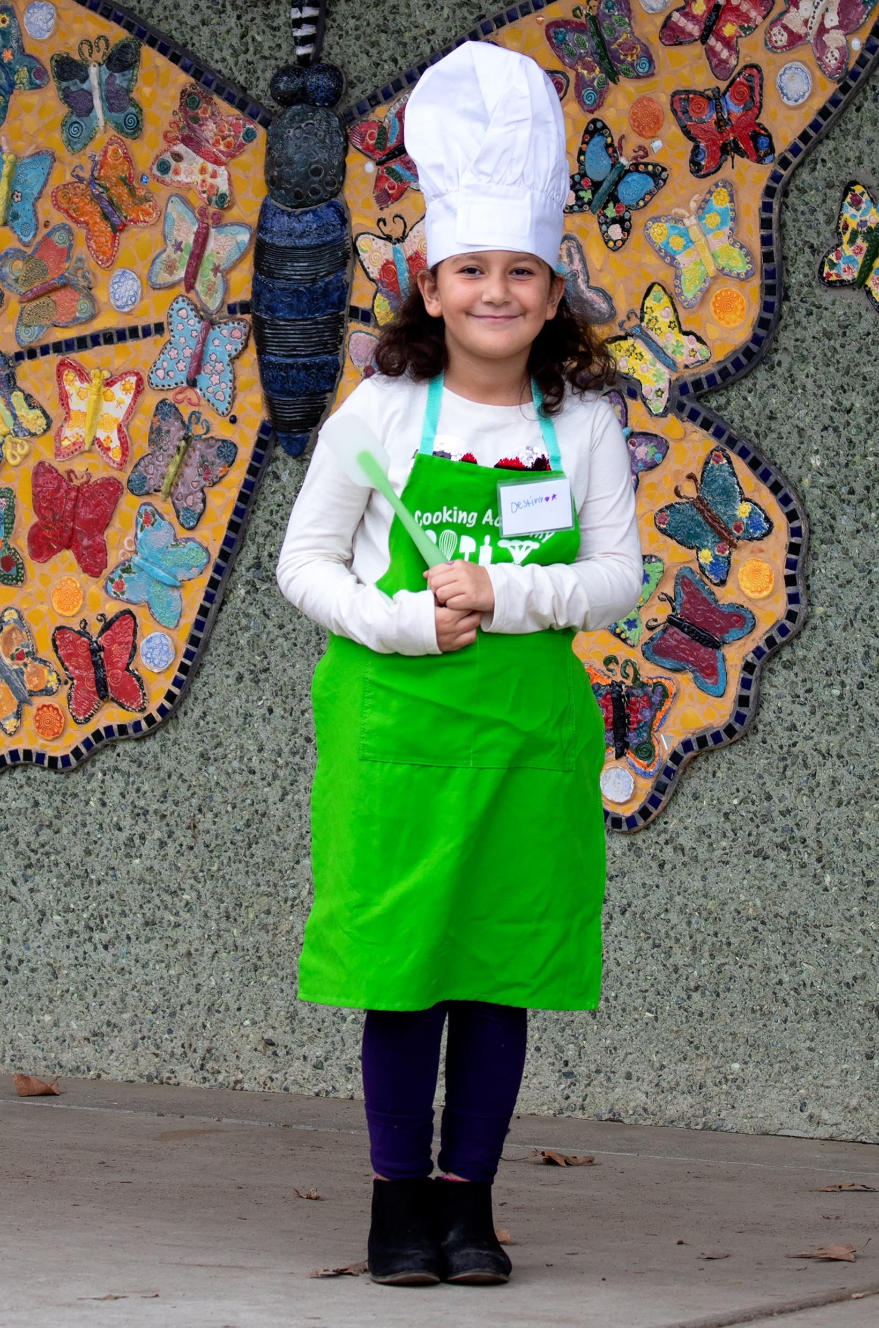
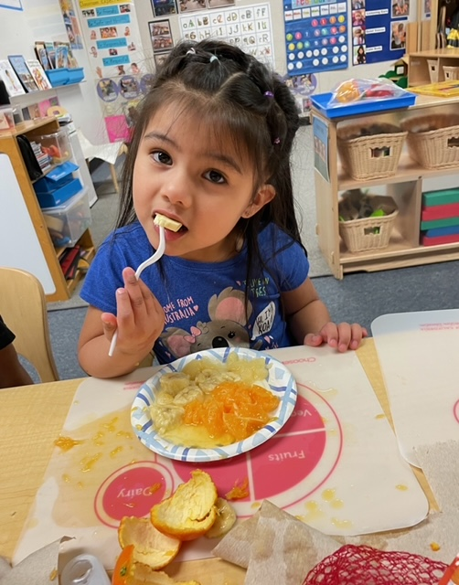
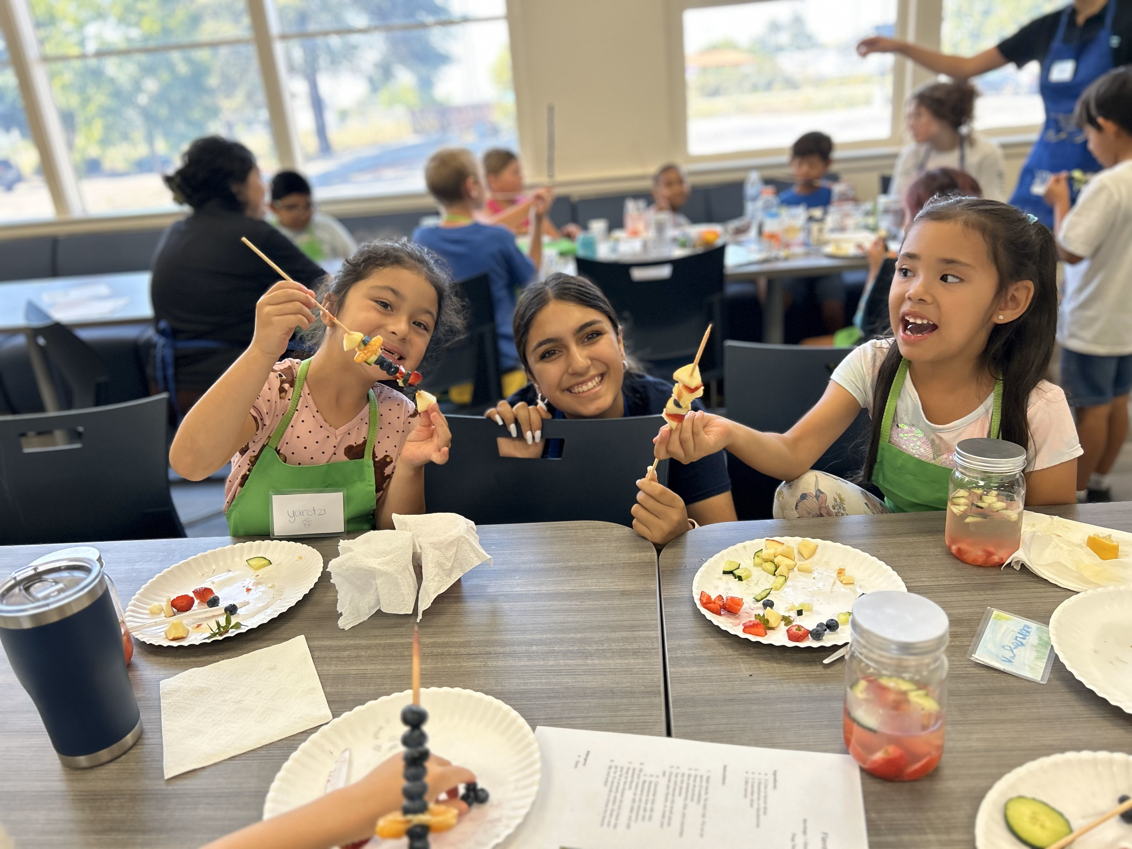
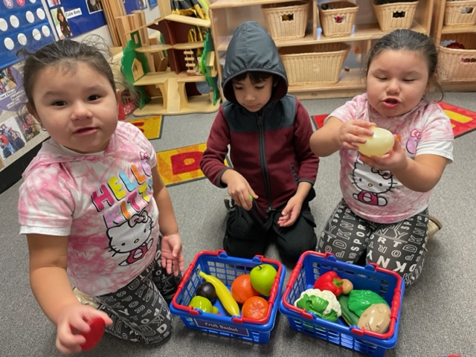
FFY2023
UCCE Yolo County
Successes
Over 90% of the student body at Esparto Elementary School participated in SNAP-Ed programming.
The partnership with EUSD expanded to include Cooking Academy in the after-school and summer programs.
Preschool teachers from 26 classrooms reached 432 early-learners and taught 155 hours of nutrition education.
Results
Early Childhood
Preschool students who participated in GGG were more likely to wash hands, identify healthy food, try new foods, and choose fruits and vegetables in the classroom.
Youth
4th grade students at Esparto Elementary were more likely to drink water, eat fruits, and participate in 60+ minutes of MVPA after completing seven UP4it lessons.
Adult
Partnership with RISE Inc., a family resource center in Esparto expanded to include parents and seniors.
Organizational
The WJUSD after-school program continued to implement CATCH PE at the organizational level. Programming reached 650 students and increased physical activity.
CFHL educators trained 34 teachers from 15 sites in Go, Glow, Grow at the Yolo County Office of Education Head Start annual training.
County Statement: The CalFresh Healthy Living, UCCE Yolo County Program commits to helping residents lead healthier and happier lives through multi-sector collaboration and partnerships integrating policy, system and environmental change efforts.
Serving Individuals and Communities
Trained extenders delivered 840 hours of nutrition education and physical activity curricula interventions to 1,728 individuals.
101 enrolled volunteers were trained to deliver evidence-based interventions through nutrition education and physical activity curricula.
Programming was delivered in 70 classrooms at 32 sites to promote healthy and active lifestyles.
Providing Education
After-school extenders were trained and received technical assistance on CATCH physical activity curriculum. Loaning equipment to the after-school sites ensures curriculum fidelity and regular delivery.
Teachers and early childhood education professionals received technical assistance on utilizing University of California classroom curricula. CFHL educators provide lesson demonstrations for enrolled extenders.
Experiential food preparation and taste-testings, along with parent food resource management classes, ensure Yolo County residents are ready and able to prepare nutritious foods.
Helping to Make Organizational and Environmental Changes
Joint 4-H and CalFresh Healthy Living, UCCE programming through after-school and summer Cooking 101 lessons. Youth engagement strategies are integrated into lesson design and delivery.
Coordination of nutrition, chronic disease prevention, and physical activity goals at county, state, and national levels through partnerships and collaborations.
Serving California Agriculture
Collaborations with the Food Bank, Health Department, Yolo Farm to Fork, and school garden coordinators promoting locally-grown seasonal produce and increasing consumption of these foods at home.
Building Partnerships
Esparto RISE: Collaborating with multiple programs to improve health outcomes of Esparto residents.
Local K-12 schools and districts: implementing nutrition and physical activity curricula.
4-H: Joint after-school programming through Cooking Academy.
After-School Programs: Integrating skills-based nutrition education and physical activity.
Yolo County Office of Education Head Start: Institutional implementation of Go, Glow, Grow preschool curriculum into program lesson plans.
70 Cottonwood Street, Woodland, CA 95695

